Slide 1
Obliquity pacing of Antarctic glaciations during the Quaternary
Christian Ohneiser, Catherine Beltran, Christina Hulbe, Chris Moy, Christina Riesselman, Rachel Worthington, and Donna Condon

Slide 2
The frequency of Antarctic glaciations during the Quaternary are not well understood
D18O and ice core records provide evidence for eccentricity paced global ice volume changes since c. 800 000 years.
However, the D18O records are a global average – not an Antarctic record.
Quaternary, sedimentary records proximal to the ice margin are needed to understand better the recent glacial history of Antarctica.

Slide 3
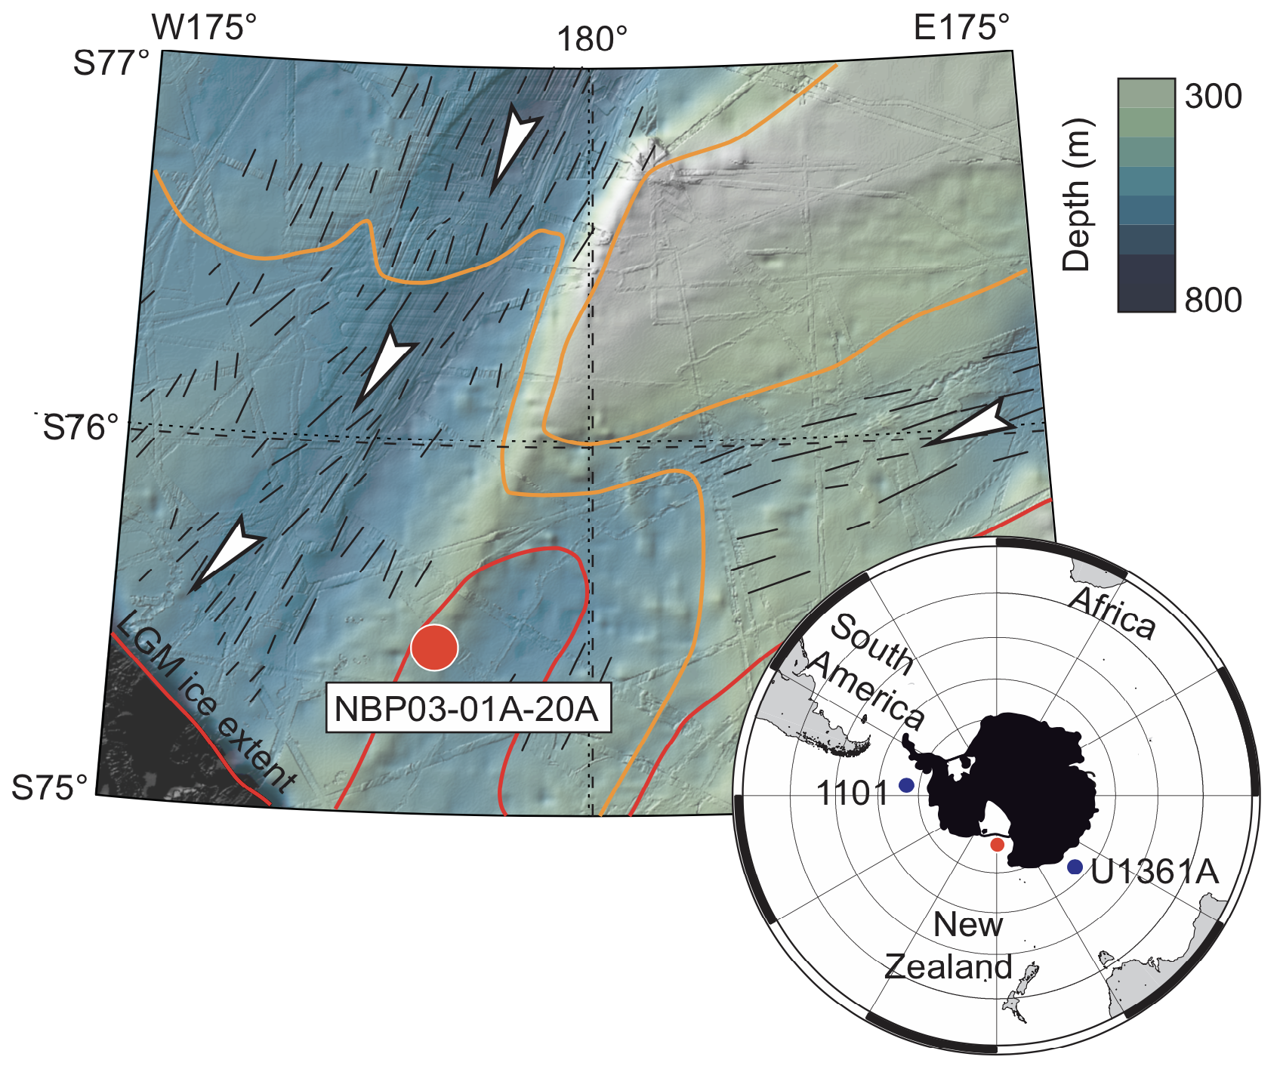
An old core revisited - NBP03-01A-20PCA
Collected in 2003 from the RV Nathanial Palmer
6.21 m long with a record of calving/grounding zone advance/retreat.
Arrows indicate ice flow direction – dashes indicate seafloor lineations

Slide 4
Paleomagnetism
Sediments comprise mud with numerous clasts.
Paleomagnetic analyses revealed magnetic a reliable magnetization with normal and reversed polarity

Slide 5
Paleomagnetism
Magnetic mineralogy is detrital magnetite dominated by pseudosingle domain grains with a contribution of Super paramagnetic grains
No evidence of alteration since deposition

Slide 6
A 1 Myr record of RIS advance and retreat
We have generated magnetic mineral concentration, XRF Ti and IBRD records.
XRF Ti and magnetic mineral concentration are controlled by terrigenous vs biogenic variations
IBRD tracks ice proximity (calving or grounding zone)
We suggest that together these are a record of Ross Ice Shelf advance and retreat

Slide 7
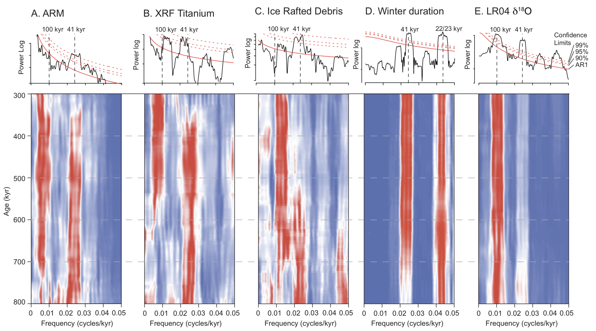
Pacing of RIS advance and retreat
Time series analyses reveals obliquity cycles in all data
Obliquity persists to at least 400 ka (red region at c. 0.024 cycles/kyr)
Eccentricity is also present in all data but MTM indicates statistically less significant

Slide 8
Pacing of RIS advance and retreat
Different from ice sheet histories derived from D18O records and ice cores
Indicates that the Antarctic ice sheets behaved independently of the Northern Hemisphere ice sheets.

Slide 9
Drivers of RIS obliquity fluctuations
The obliquity filtered ARM data, which is the most well resolved proxy, show a clear out of phase relationship with the orbital obliquity, where high obliquity (warmer periods) resulted in low ARM (a distal grounding zone or calving line) and vice versa.
Insolation is the principal controller of season length (short winters and long summer reduce sea-ice extent) sea-ice extent may have controlled RIS¹.
Sea-ice is suggested to be a stabilizer of ice-shelves in Antarctica²
Obliquity exerts a major influence on insolation at high latitudes therefore sea-ice fluctuations may have paced with obliquity and may have controlled Ross Ice Shelf advance and retreat.

Slide 10
MIS-12, 41kyr-100 kyr transition
Eccentricity pacing may have strengthened after MIS-12
Eccentricity pacing of the EAIS was demonstrated from sedimentary records after 400 ka².
At minima in insolation at 400 Ka led to regional cooling (MIS-12) and perhaps establishment of more persistent sea-ice in Ross Sea³.
Supporting evidence of a regional cooling comes from ODP Sites 1093 and 1094 with ocean cooling/sea-ice expansion^{4,5} and Dome Fuji and Dome C ice cores which record the coldest temperatures during MIS-12^{6,7} .

Slide 11
Conclusions
Ross Ice Shelf and by extension the WAIS may have been paced by Obliquity much later into the Quaternary than previously thought.
We need more well dated sediment cores from around the Antarctica and in particular near the ice margins which track advance and retreat of the ice front.
References
1. Huybers, P. & Denton, G. Antarctic temperature at orbital timescales controlled by local summer duration. Nat. Geosci. 1, 787–792 (2008).
2. Massom, R. A. et al. Antarctic ice shelf disintegration triggered by sea ice loss and ocean swell. Nature 558, 383–389 (2018).
3. Wilson, D. J. et al. Ice loss from the East Antarctic Ice Sheet during late Pleistocene interglacials. Nature 561, 383–386 (2018)
4. Beltran, C. et al. Southern Ocean temperature records and ice-sheet models demonstrate rapid Antarctic ice sheet retreat under low atmospheric CO2 during Marine Isotope Stage 31. Quat. Sci. Rev. 228, 106069 (2020).
5. Kunz-Pirrung, M., Gersonde, R. & Hodell, D. A. Mid-Brunhes century-scale diatom sea surface temperature and sea ice records from the Atlantic sector of the Southern Ocean (ODP Leg 177, sites 1093, 1094 and core PS2089-2). Palaeogeogr. Palaeoclimatol. Palaeoecol. 182, 305–328 (2002).
6. Jouzel, J. et al. Orbital and millennial antarctic climate variability over the past 800,000 years. Science 317, 793–796 (2007).
7. Uemura, R. et al. Asynchrony between Antarctic temperature and CO2 associated with obliquity over the past 720,000 years. Nat. Commun. 9, 961 (2018).

Slide 12
Acknowledgments
Funding for research was provided by New Zealand Antarctic Research Institute, The University of Otago, and The Antarctic Science Platform

