Slide 1
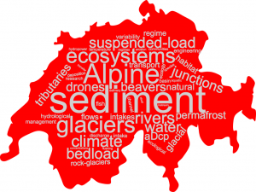
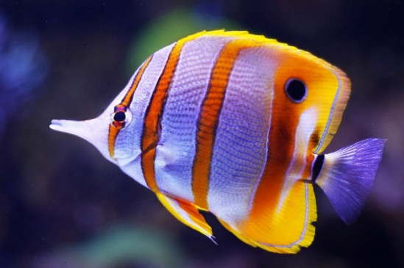
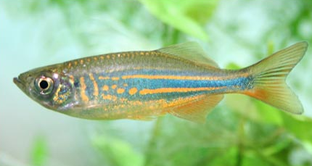
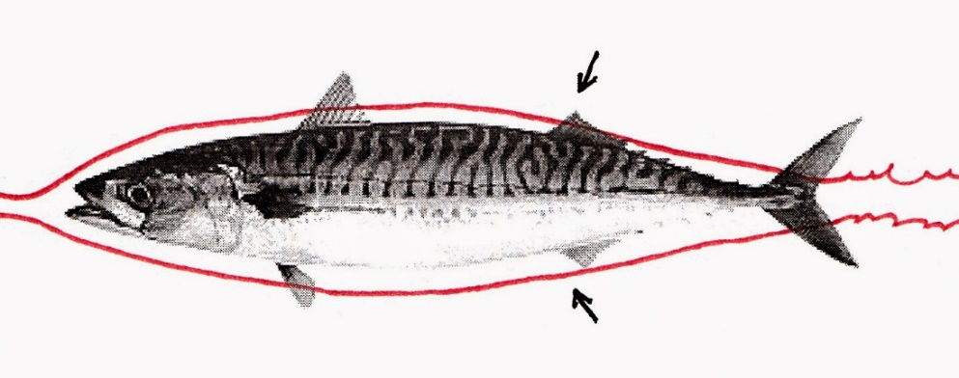
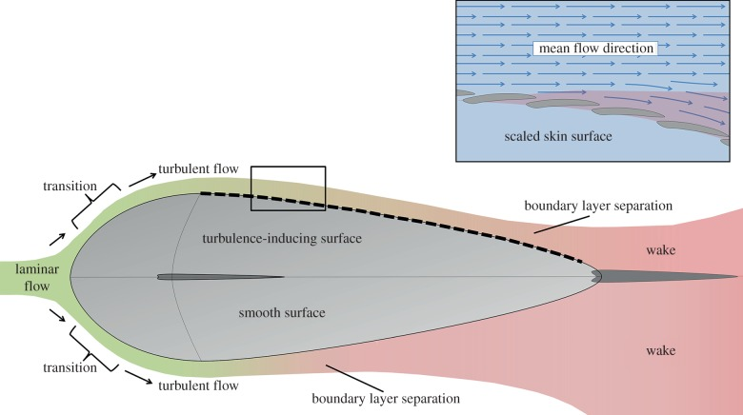
Hydraulic modelling of fish-flow interactions
Yufang Ni^{1,2} and Stuart N. Lane²
¹ State Key Laboratory of Water Resources and Hydropower Engineering Science, Wuhan University, Wuhan, China
² Institute of Earth Surface Dynamics, Faculté des géosciences et de l'environnement, Université de Lausanne, Lausanne, Switzerland

Slide 2
Methodological model
Preprocessing
(Mesh size, grid, model parameters)
Run RANS model
(A steady state solution to hot start using the DDES)
Run with DDES
(Detailed description of turbulence; flow separation)
Post processing
(Paraview; Matlab; Tecplot)
Evaluate results
(Trial and error)
OpenFoam
HPC clusters of UNIL
wally
DDES: Delayed detached-eddy simulation

Slide 3
Fish case descriptions
Computational Domain 1.28 m wide, 20.48 m long, 2.56 m high
Cuboid fish 4 cuboids (16 cm, 32 cm, 64 cm, 16 cm) Width: 16 cm
Discharge 2.6 m³/s
Head
Tail
Size (cm) | Number of grid | Run speed | Estimated runtime
4 | 331904 | Fast | 1
2 | 2655232 | Slow | 16 (= 2³*2)
1 | 21192704 | Very slow | 256 (= 16*2³*2)

Slide 4
Results with DDES-Velocity
0.7 m downstream of the fish
Vorticity z
(planform)
Flow
(side view)
(side view)
(planform)
Streamlined shape (relatively)
Non streamlined shape

Slide 5
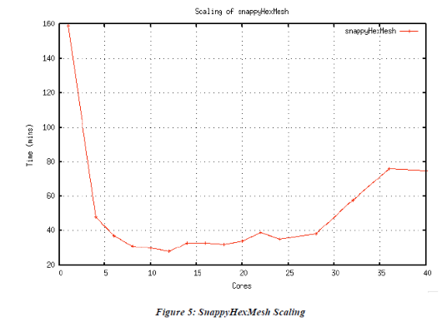
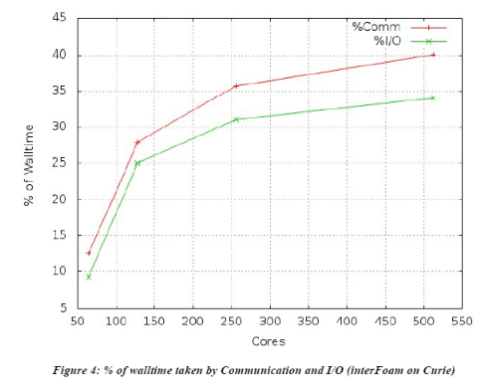
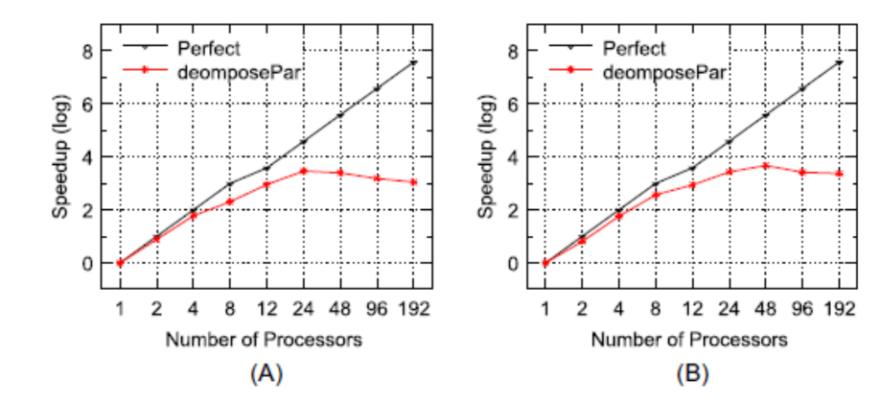
Speed test with HPC clusters wally
Faster with more nodes/cores
MPI communication time (limits)
Case-dependent (case setup/clusters)
Resources-sharing with others (real speed)
Moylesa et al., 2012, PACE
Xu et al., 2017, Concurrency Computat Pract Exper

Slide 6
Thank you for your attention!

