Slide 1
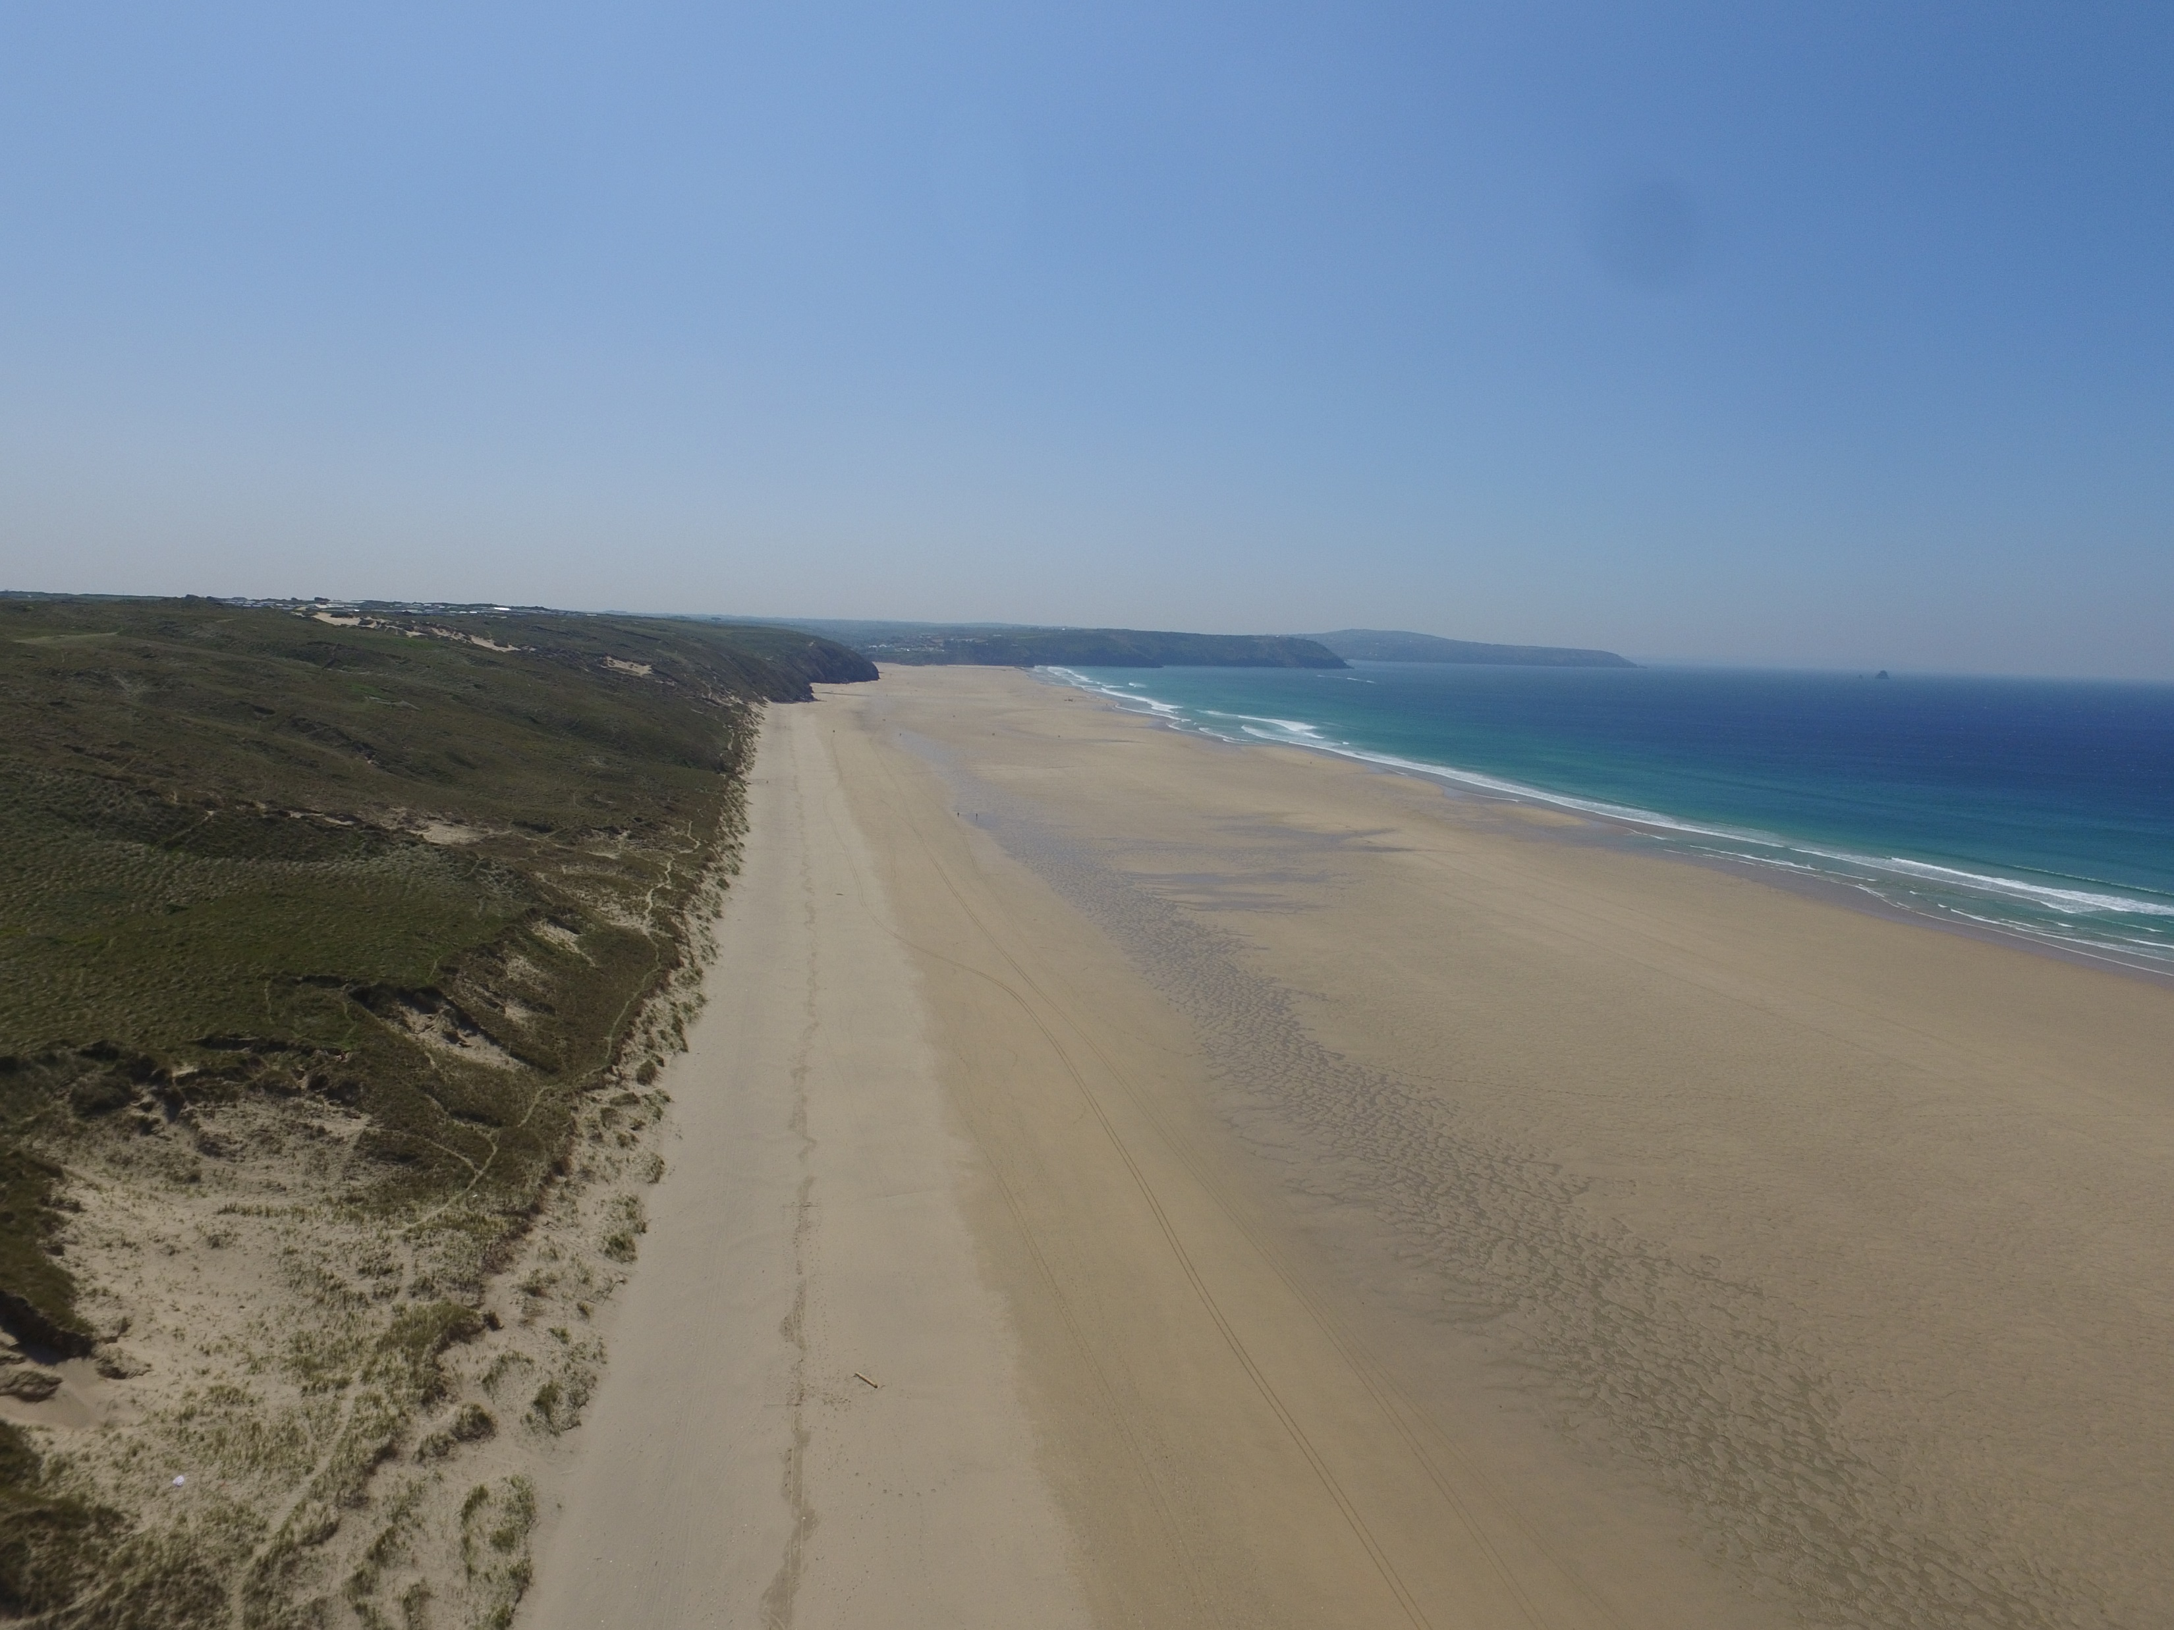
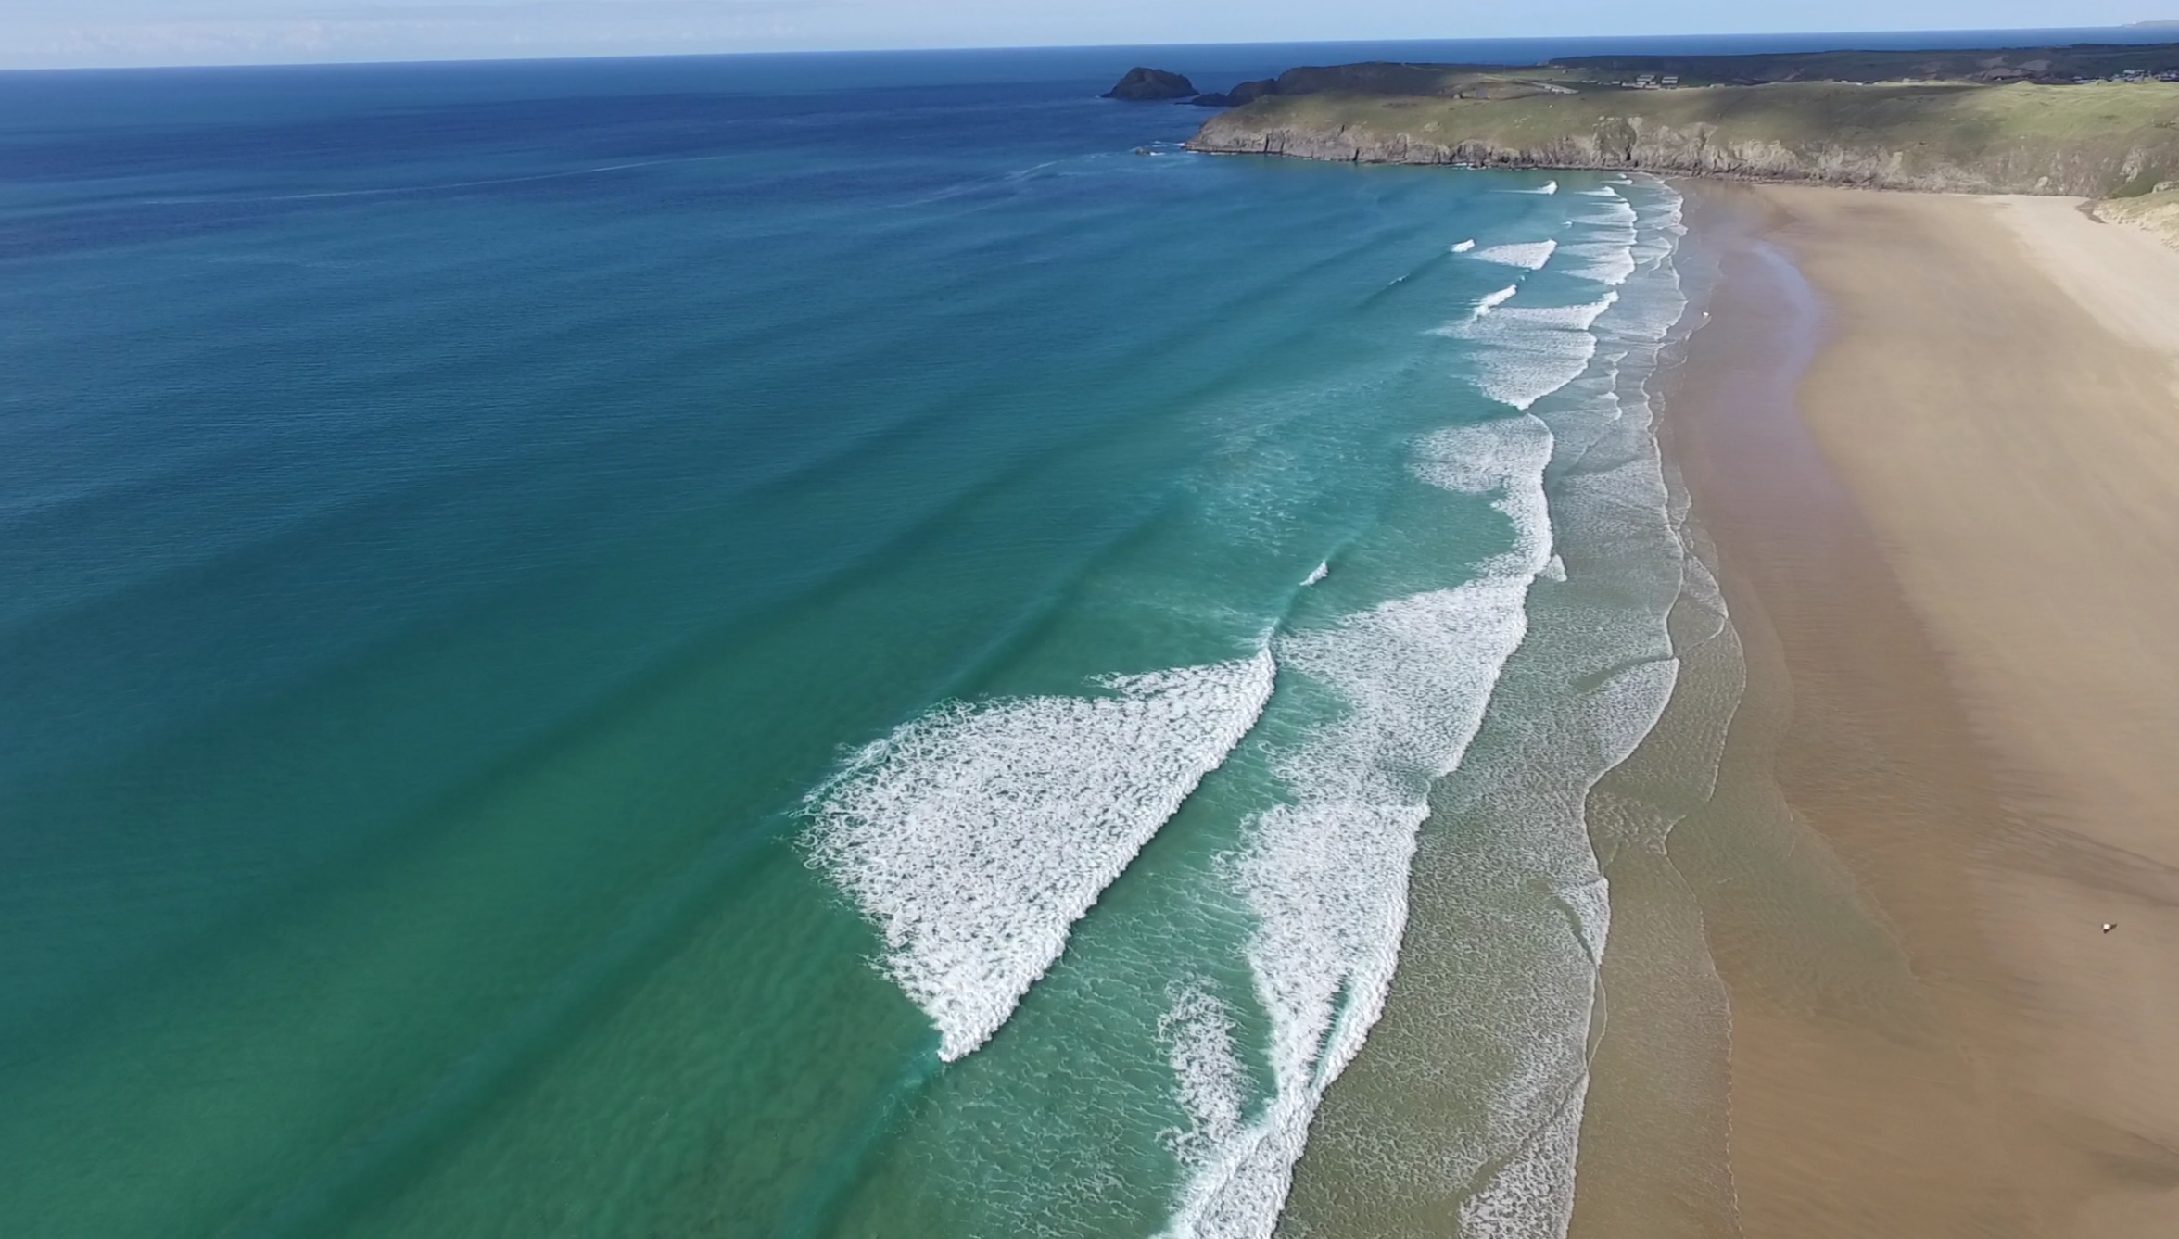
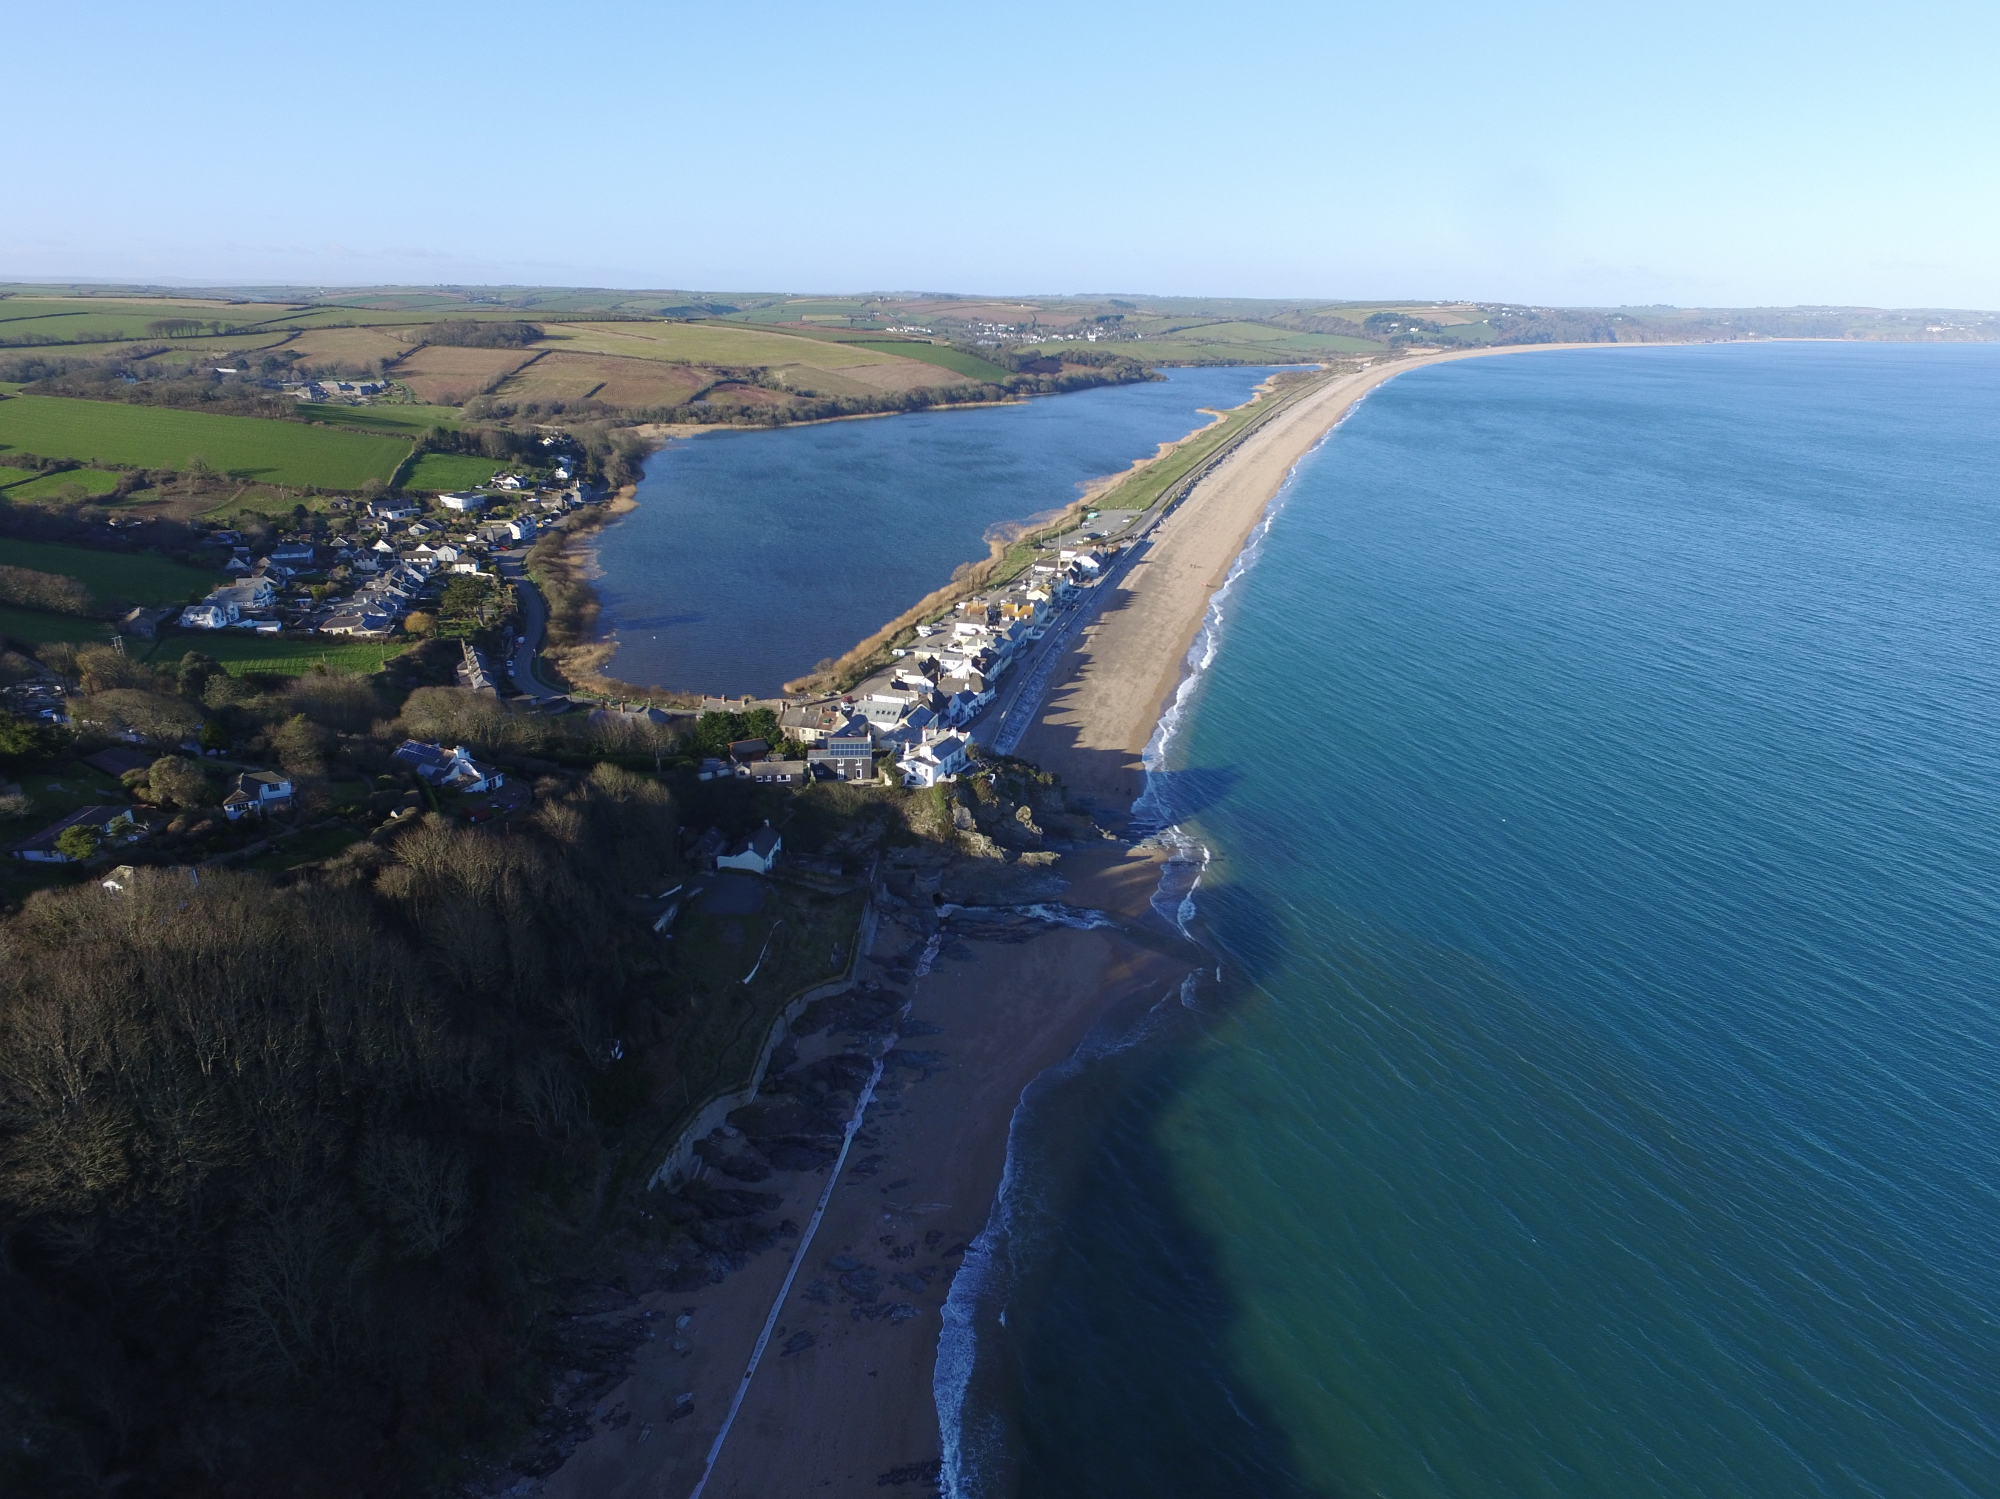
A novel, rules-based shoreface translation model
for predicting future coastal change to realistic coastlines
(ShoreTrans)
Perranporth, UK
Start Bay, UK
Jak McCarroll, Gerd Masselink, Nieves Valiente, Tim Scott, Mark Wiggins, Josie-Alice Kirby, Mark Davidson

Slide 2
Motivation: How Will Beaches Look in 100 years?
It’s unsatisfying to simply apply Bruun and get a recession rate.
Rather, our concern is: “How will real profiles, with real-world complexity (irregular dunes, walls, rocks, open sediment budgets), translate under SLR?”

Slide 3
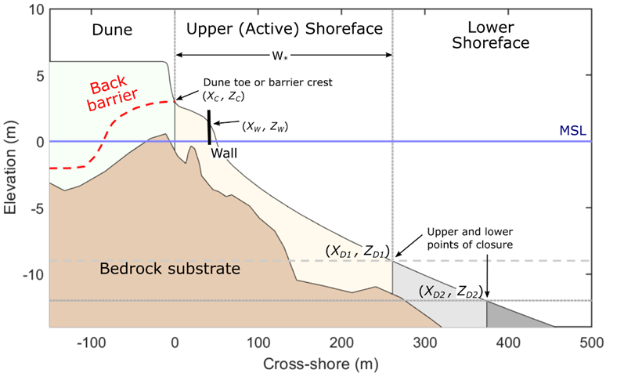
Total Sediment Budget
The profile volume ($\text{V}$) or shoreline position ($\text{X}$) is a function of cross- and longshore gains/losses, including trend and fluctuating components.
$$\text{Δ}\text{V} \text{or} \text{Δ}\text{X}=f_{cross−shore}+f_{longshore}+f_{SLR}$$
$$\text{Δ}\text{V} \text{or} \text{Δ}\text{X}=Trend+Variability$$
Cross-shore fluxes:
Fluctuating storm erosion/accretion
Barrier rollover / dune accretion
Trend onshore transport from the lower shoreface (or megarip transport to lower shoreface)
longshore
x-shore
Longshore fluxes:
Longshore transport gradients
Headland bypassing
Estuarine exchange
Other inputs (treated as per longshore inputs):
Nourishment
Biogenic production

Slide 4
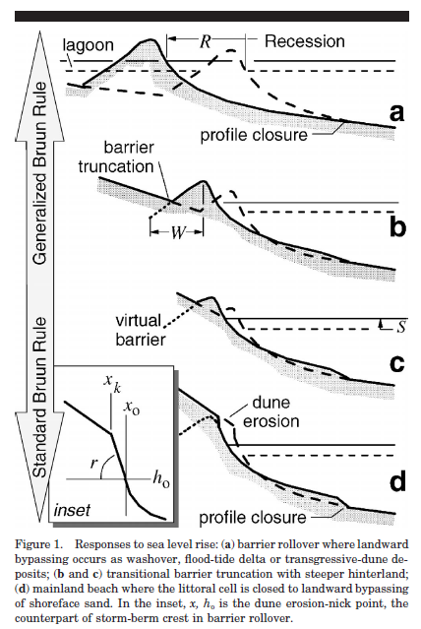
Shoreface Translation due to SLR
Low substrate
gradient
Onshore
transport
$$\text{Δ}\text{V} \text{or} \text{Δ}\text{X}=f_{cross−shore}+f_{longshore}+f_{SLR}$$
Inspiration from original Shoreface Translation Model (STM; Cowell et al., 1995, 2006 etc) and others (e.g., Kinsela et al., 2017)
Recent lab models (Atkinson et al., 2018; Beuzen et al., 2018) provide basis for translating real surveyed profiles and adjust erosion for presence of sea-walls
Steep substrate
gradient
Offshore
transport
Modified from: Cowell, P. J., Thom, B. G., Jones, R. A., Everts, C. H., & Simanovic, D. (2006). Management of uncertainty in predicting climate-change impacts on beaches. Journal of Coastal Research, 232-245.

Slide 5
Aims
Introduce the translation model (ShoreTrans), that:
Uses the real (unparameterized), surveyed profile, including unerodable surfaces.
Includes previously established morphodynamic rules.
Incorporates all components of the sediment budget.
Is suited to 10-100 year timescales.
Can determine change in BEACH WIDTH as well as SHORELINE RECESSION.
Apply the model to two extensively researched, macrotidal UK sites:
Perranporth (sandy, dissipative, large dunes)
Start Bay (low and steep gravel barrier, moderate energy)
Use the model to provide a conceptual framework for the relative importance of the primary controls on coastal change.

Slide 6
Model Description
Basic translation mechanism
Walls and rocks
Translation modes: ‘Rollover’ and ‘Encroachment’
Sediment budget
Cross-shore variability (storm demand)
Probabilistic uncertainty

Slide 7
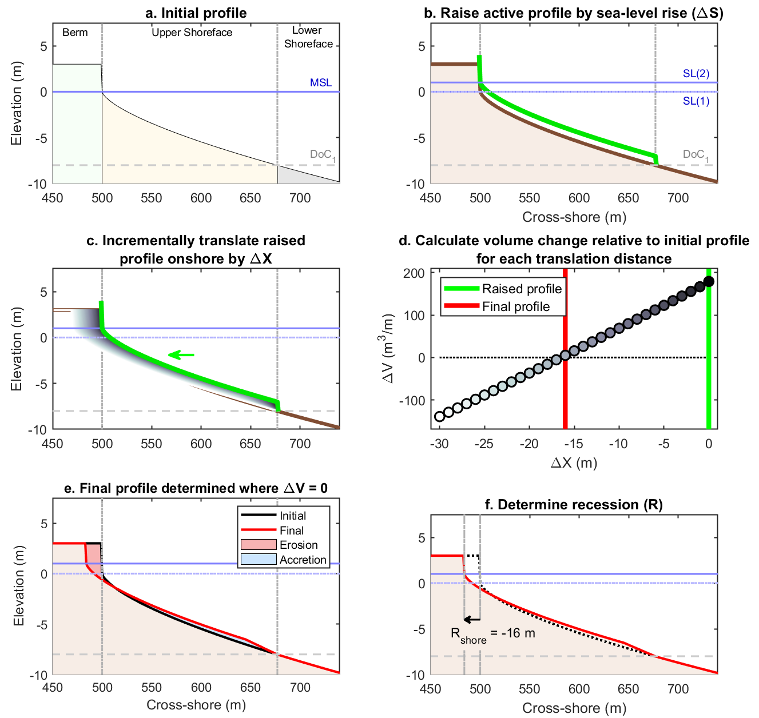
1. Basic Translation Mechanism
The basic mechanism is as per Bruun (and Atkinson et al., 2018). The profile is raised by the change in sea-level and is shifted onshore until the volume balances.

Slide 8
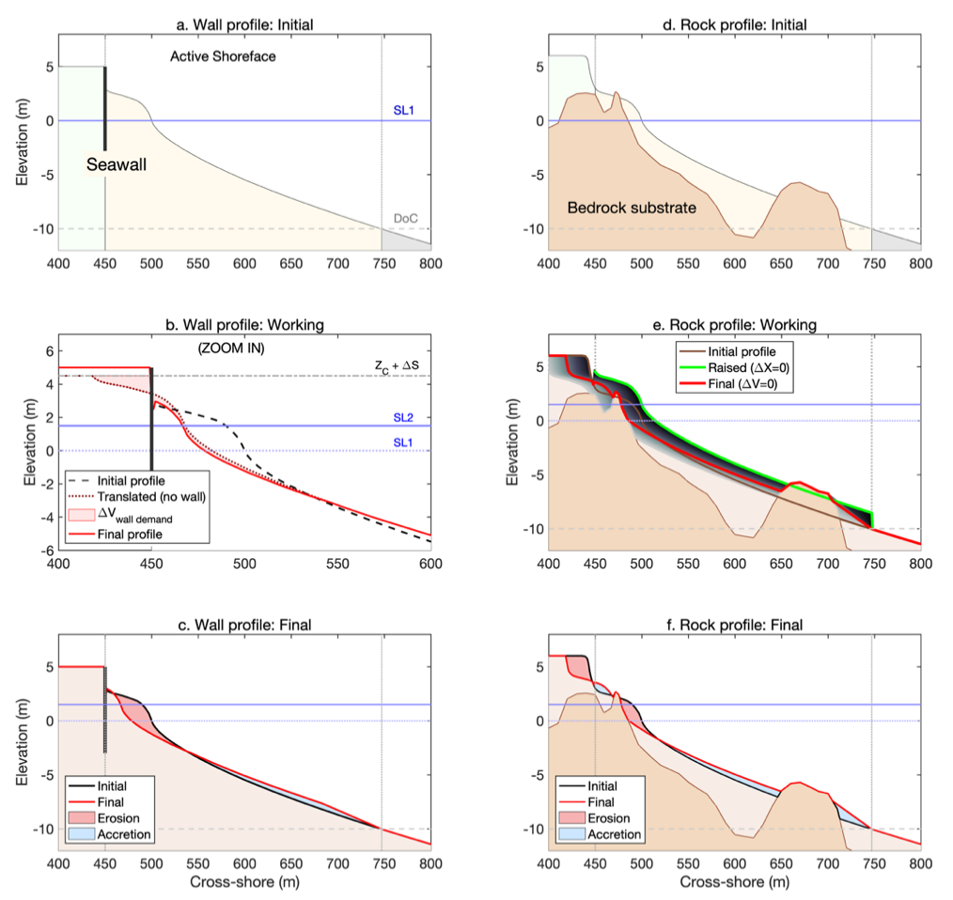
2. Walls and Rocks
Walls are dealt with as per Beuzen et al. (2018). The translation is initially calculated as if the wall were not present, then the wall is inserted and the potential erosion behind the wall (wall demand volume), is transferred in front of the wall.
Unerodible sub-horizontal surfaces (e.g., rocks) are dealt similarly to Cowell’s STM and Kinsela et al. (2017). Rocks act to fill potential accommodation space. Offshore reefs may therefore reduce potential recession.

Slide 9
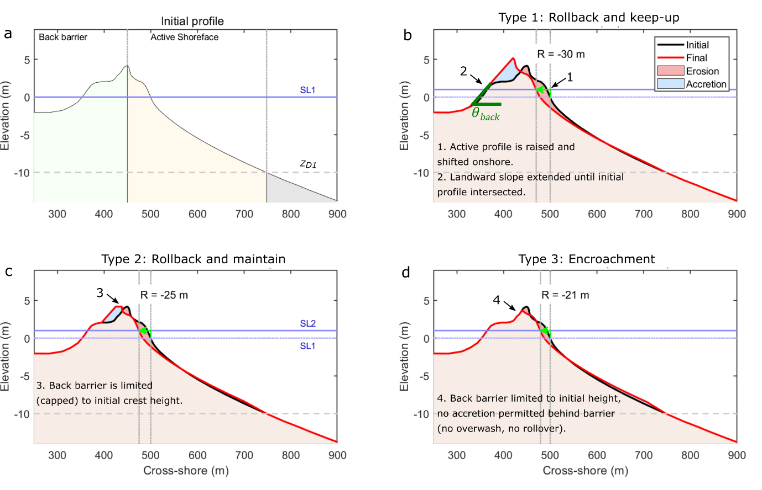
3. Translation Modes: ‘Rollover’ and ‘Encroachment’
This basis of this approach is similar to Cowell’s STM. Using the surveyed (unparameterized) profile. The mode is set manually
Type 1: Rollover => typical for low barriers (low substrate gradient), where overwash generates onshore transport. Increased recession rate relative to standard Bruun-rule.
Type 2: Intermediate mode, barrier height capped to initial height.
Type 3: Encroachment => typical for dune-backed profiles (high substrate gradient), where eroded dunes generate offshore transport. Equivalent to standard Bruun-rule.
Dune accretion and slumping can be applied when in Encroachment mode.

Slide 10
4. Sediment Budget Components
$$\text{Δ}\text{V} \text{or} \text{Δ}\text{X}=f_{cross−shore}+f_{longshore}+f_{SLR}$$
$$\text{Δ}\text{V} \text{or} \text{Δ}\text{X}=Trend+Variability$$
The following functions are available in the model
Component | Method | Processes represented
Cross-shore trend | Volume transferred between lower and upper shoreface at each timestep | Gradual onshore transport / mega-rip offshore transport
Cross-shore variability | (see next slide) | Storm erosion / accretion
Longshore trends (and other sources) | Volume added/subtracted from profile at each timestep | Longshore gradients, bypassing, estuarine exchange, biogenic production, nourishment
Longshore variability | Envelope of min/max change added to trend projection | Short-term beach rotation
Example of adding/removing volume from profile (no SLR)

Slide 11
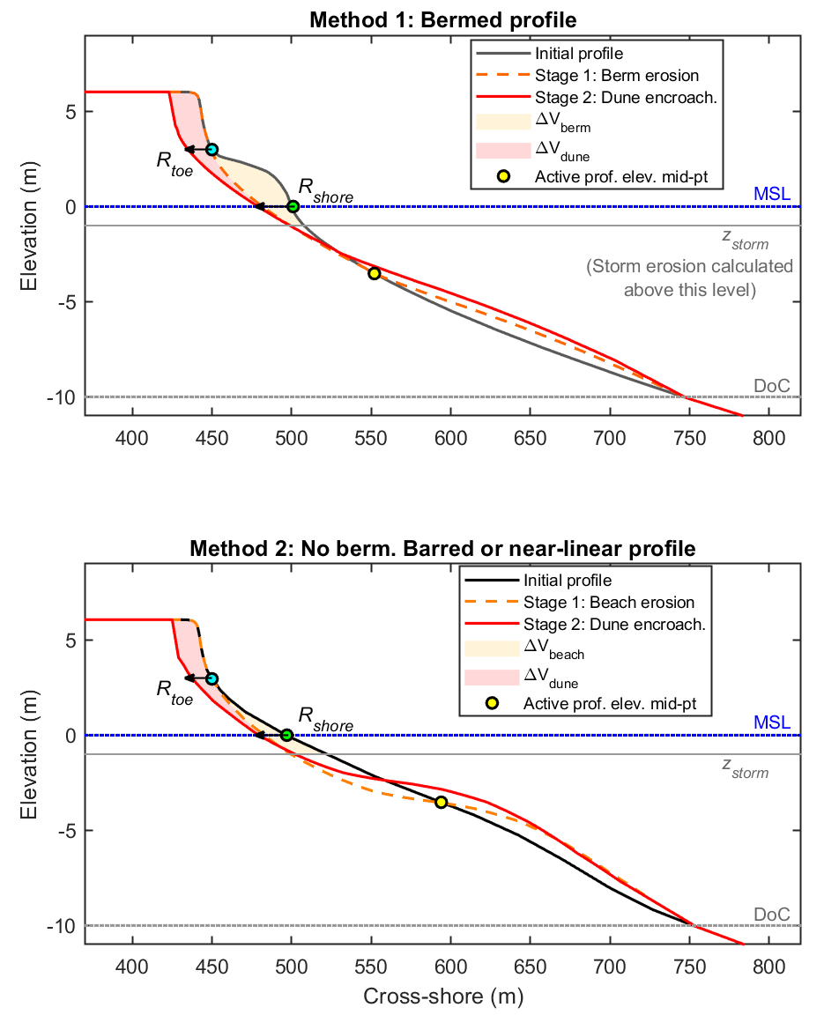
5. Cross-shore Variability (Storm Demand)
Method 1: For bermed profiles
Fit a curve ($z = Axm$) to remove the berm.
Use Kriebel and Dean (1993) approach to translate profile up and onshore until required volume loss is reached (storm erosion is treated as per SLR translation).
Method 2: For barred or near-linear profiles
Apply a sediment loss-gain as a simple Sine-curve wavelength from the dune toe to depth of closure.
Use Kriebel and Dean (1993) approach to translate profile (as per Method 1).

Slide 12
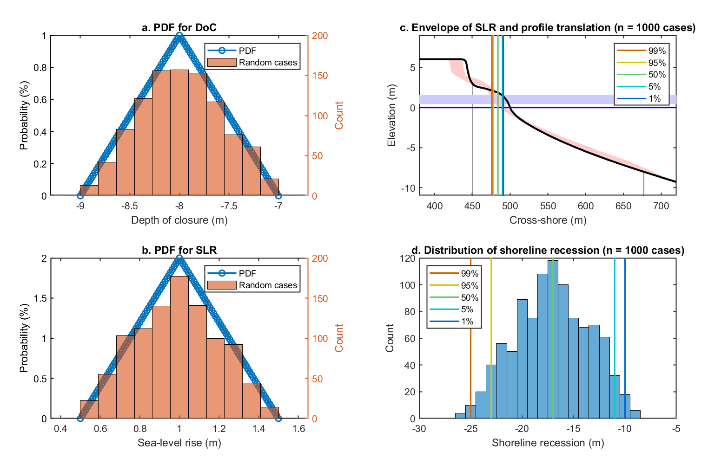
6. Probabilistic Uncertainty
Uncertainty is dealt with as per Cowell’s STM and Kinsela et al. (2017).
A triangular PDF is used for inputs to the model (e.g., DoC, SLR) to generate a random sample (e.g., n = 1000 cases).
The random cases are run with ShoreTrans to generate a distribution of outputs, including an envelope of profiles and shoreline recession predictions.
DoC = depth of closure

Slide 13
Results: Application to test sites
1. Perranporth, Cornwall, UK: Sandy, high-energy, dissipative, high dunes, cross-shore dominant (using encroachment mode).
2. Start Bay, Devon, UK: Low gravel barrier, moderate-energy, reflective, alongshore dominant (using rollover mode).
Most of the examples apply 1-m SLR over 100-years, which is approx. equivalent to extrapolating RCP8.5 out to 2120.

Slide 14
Site 1: Perranporth, UK
P3, S Dunes
View angle
P2, Mid Cliffs
P1, N Dunes (perched on bedrock)
Cornwall, UK. High-energy, macrotidal.
Dissipative, low-tide and subtidal bars.
3.5-km embayment with large headlands.
Variously backed by dunes, cliffs.
Open budget (headland bypassing, cross-shore beyond DoC), but dune vegetation line has been relatively stable for 35-years
Looking south, photo by Peter Ganderton.

Slide 15
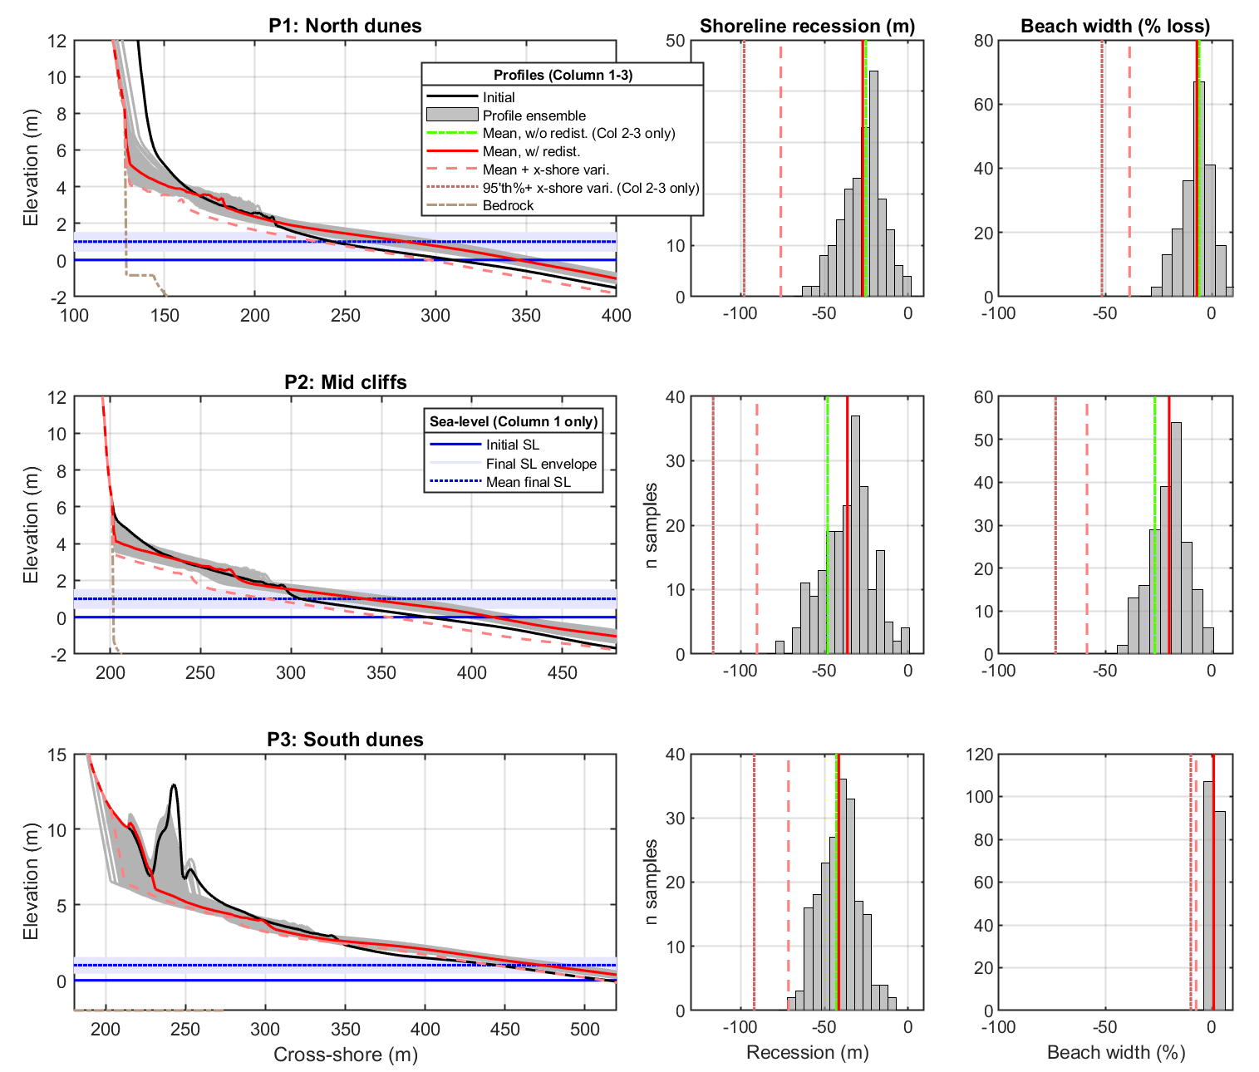
Site 1: Perranporth, UK
P3, S Dunes
For 1-m SLR over 100-years
Profile evolution
Shoreline recession
Beach Width Change (%)
P2, Mid Cliffs
P1, N Dunes (perched on bedrock)
Looking south, photo by Peter Ganderton.

Slide 16
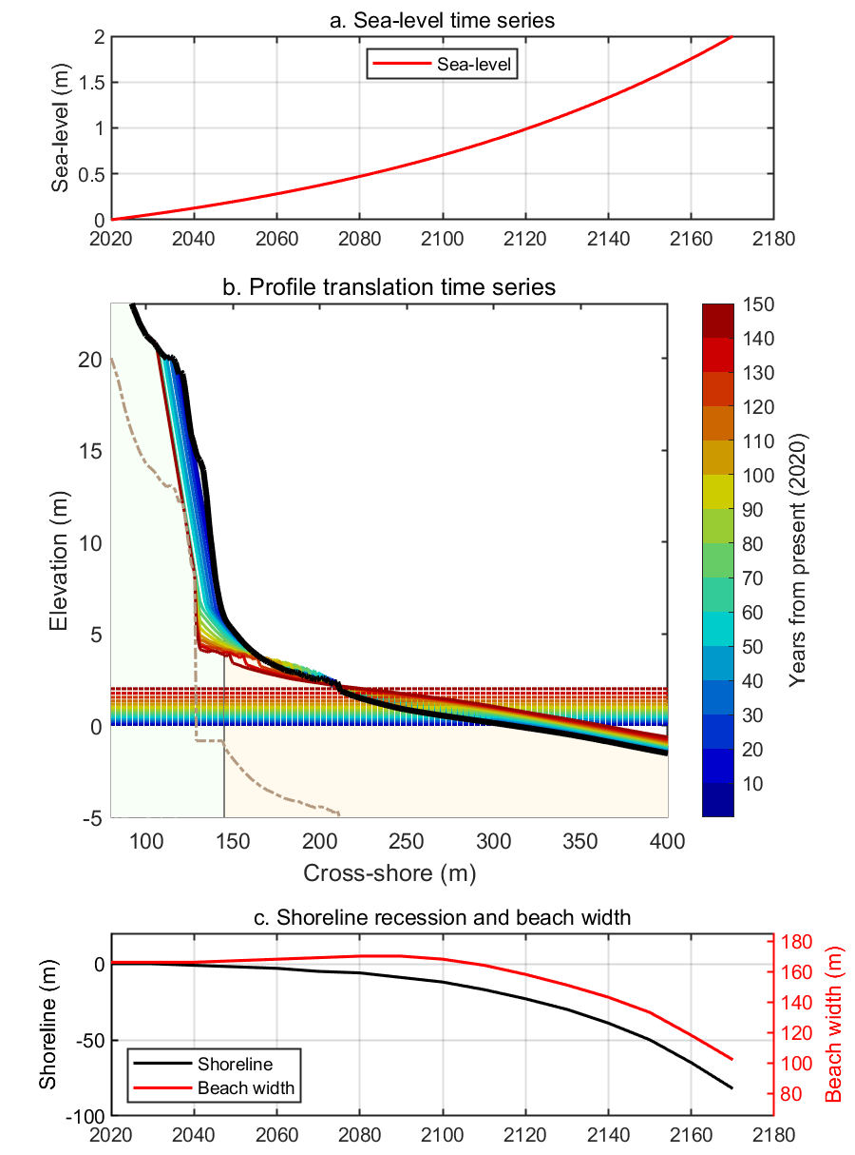
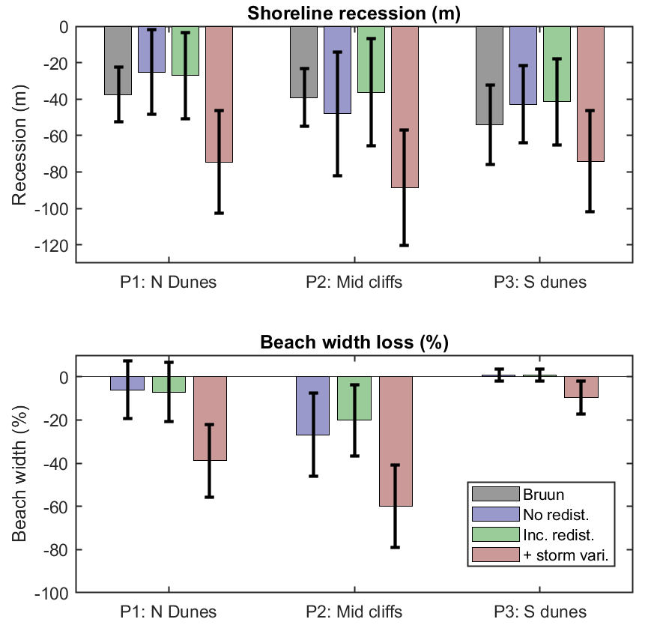
Site 1: Perranporth, UK
Time series for evolution of P1, North Dunes, for 2-m SLR over 150-years
Summary of shoreline recession
and beach width change, for 1-m SLR over 100-years
Predicted recession rates are compared against the standard Bruun-rule. Green bars include redistribution of eroded dune volume across the full embayment. Pink bars add maximum storm demand (short-term variability) to the long-term trend.
Looking south, photo by Peter Ganderton.

Slide 17
Site 2: Start Bay, UK
P18
P1
Multi-decadal
longshore
transport
trend
P0
Devon, UK. Moderate energy, reflective, macrotidal.
Multiple gravel barriers, separated by small headlands.
Slapton Sands (pictured) is the longest at 4-km.
Variously backed by lagoons, cliffs, sea-walls.
Multidecadal trend of clockwise rotation (northward transport).
Short-term variable rotation (bi-directional storms).
Looking north, photo by Peter Ganderton.

Slide 18
Site 2: Start Bay, UK
For 1-m SLR over 100-years
P18
Profile evolution
Shoreline recession
P1
P18
P1
P1
Lagoon-backed receding barrier
Rollover mode (onshore transport)
-0.7 m³/m/yr trend
SLR only = 30 m recession
SLR + TREND > 100 m recession
P0
P0
P18
Cliffed-backed prograding barrier
Rollover mode
+1 m³/m/yr trend
SLR only = 20 m recession (50% less than lagoon-backed prof.)
SLR + TREND = 90 m progradation
P0
Sea-wall backed
-0.2 m³/m/yr trend
Beach is predicted to erode entirely
*** Extreme scouring in front of wall is unrealistic, this will be capped at MLWS

Slide 19
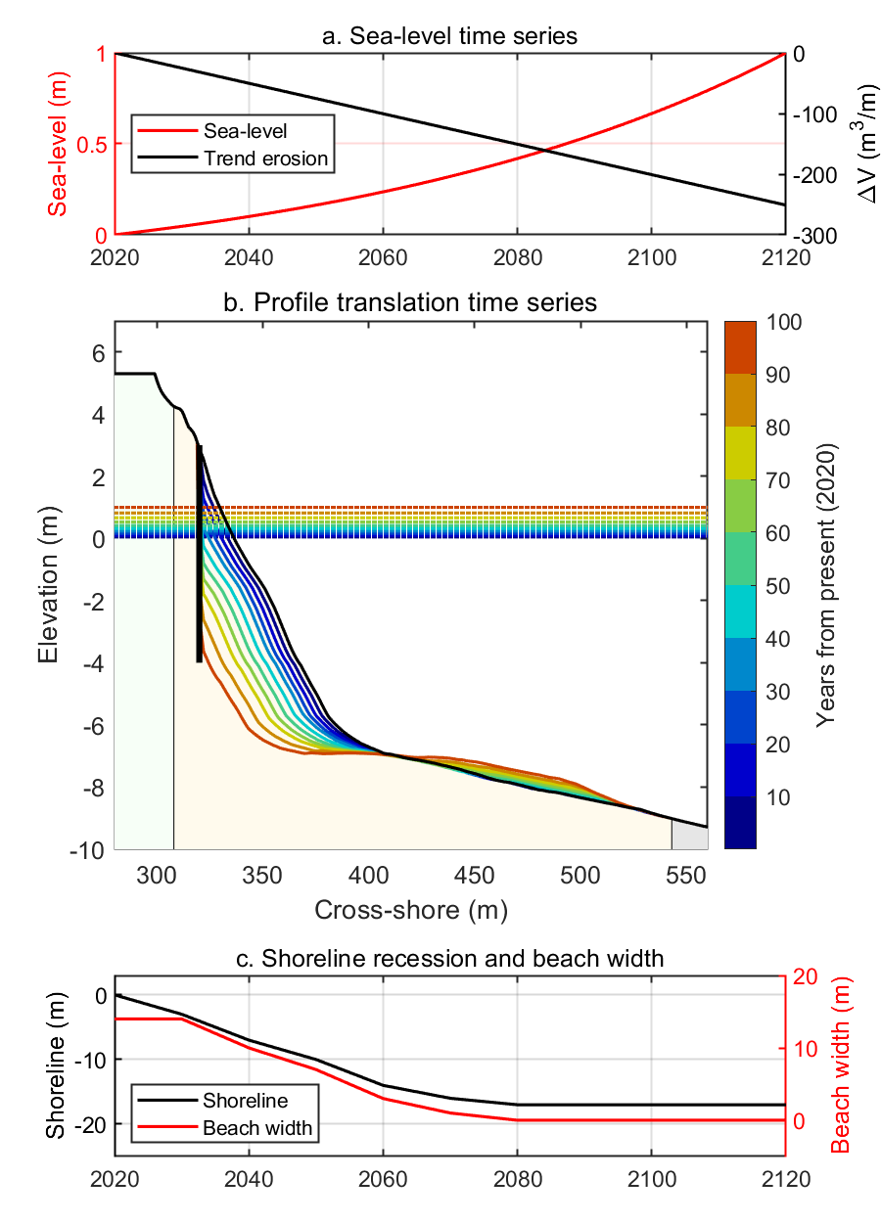
Site 2: Start Bay, UK
Time series of profile change for 1-m SLR over 100-years, for a sea-wall backed profile (P0)
Annual longshore sediment budget (1985-2020 trend), no SLR
south
north
Shoreline recession due to SLR ONLY (ΔS = 1 m, trend = 0)

Slide 20
Discussion: Conceptual Models
ShoreTrans is applied to idealised profiles to investigate the relative impact of varying inputs on shoreline recession and beach width reduction rates.
Inputs to be tested: profile shape, translation type, sediment budget, wall location, storm demand.

Slide 21
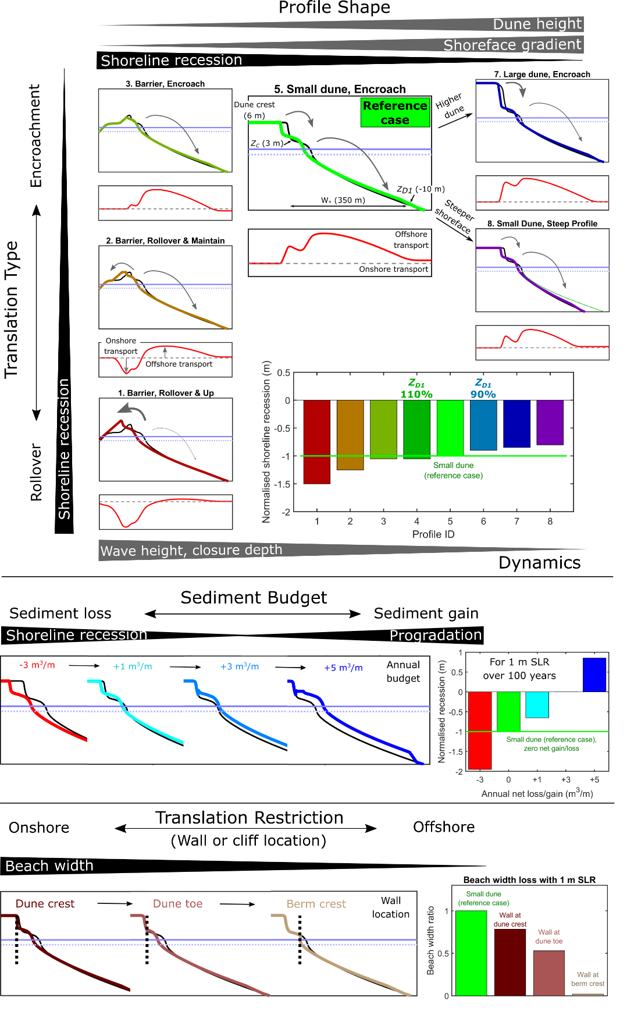
What are the relative impacts to shoreline recession, for 1-m SLR over 100-yrs, of changes to the profile shape and translation type?
Conceptual Model (1)
dune = 10 m
Max increase in recession: Full barrier rollover increases recession by ~50%.
Max decrease in recession: 20% increase in steepness produces ~20% decrease in recession ($z= A x^{m};A:0.25 →0.3)$.
Depth of Closure (DoC) estimates vary widely and may be a large component of uncertainty (This example uses DoC = -10 m. The bars marked “110%” and “90%” in the histogram represent changes to DoC).
$$W_{∗} (300 m)$$
A = 0.3
$$Reference case: z=50 m berm+ A x^{m}$$
(A = 0.25, m = 0.67)

Slide 22
Conceptual Model (2)
What are the relative impacts to shoreline recession, for 1-m SLR over 100-yrs….
For changes to sediment budget?
Positive budget to fully offset SLR:
${ΔV}_{SLR offset}= \frac{ΔS}{Δt}W_{∗}=\frac{1}{100} 300=3$ m³/m/yr
(For a 300 m wide active shoreface)
$$W_{∗} (300 m)$$
$$ΔS=sea−level; Δt=years;W_{∗}=active shoreface width$$
For presence and location of a sea-wall?
50% beach width loss for wall at dune toe
100% beach loss for wall at berm crest
$$Reference case: z=50 m berm+ A x^{m}$$
(A = 0.25, m = 0.67)

Slide 23
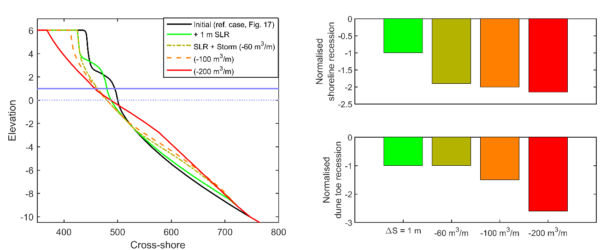
Conceptual Model (3)
How large is the impact of short term x-shore variability (storm cut),
relative to SLR translation?
$$z=50 m berm+ A x^{m}$$
A = 0.25, m = 0.67
For this example profile, a 200 m³/m storm cut generates the same amount of shoreline recession as 1-m SLR.

Slide 24
Discussion
Bruun-rule may be suitable for a first-pass assessment for some coastlines, if….
The fundamental assumption of profile translation is accepted (probably OK over ≤ 100 year time frames; e.g., Dean and Houston, 2016; Wolinsky and Murray, 2009).
Rollover (overwash) is accounted for with low barriers (‘modified Bruun rule’, Dean and Maurmeyer, 1983; Rosati et al., 2013)
Other budget components are accounted for (longshore and cross-shore).
The profile has onshore accommodation space and minimal unerodable sections (walls, cliffs, exposed rocky substrate, etc).
But… on it’s own, basic Bruun gives no sense of uncertainty and relative importance of different inputs (e.g., “I don’t trust Bruun, because of the size of that dune”).
The method shown here is not necessarily right (in a deterministic sense). Instead, it gives an easy method to compare the relative importance of different morphological features, processes and assumptions. This has the potential to give greater confidence in future shoreface predictions.

Slide 25
Conclusions
The novel translation model (ShoreTrans) is based on existing models (e.g. Cowell’s STM), but is tailored to addressing realistic, complex profile translation, and sediment budgeting, across embayments (or open coasts), over 10-100 year time-frames, including short-term variability, and long-term trends.
Application to 2 field sites (Perranporth and Start Bay, UK), and a conceptual model demonstrate:
Recession rates vary by ±50% (relative to the standard Bruun rule), based on changes in to profile shape and translation type.
Inputs/outputs to sediment budgets and short term variability may equal/exceed SLR effects; the model can be used to explore these effects.
ShoreTrans projects loss of BEACH WIDTH as well as shoreline recession.
Projections indicate wall and hard-rock cliff-backed profiles are at imminent risk of disappearing under projected SLR.

Slide 26
That’s it,
thank you!
A publication based on the content of this presentation will be made available on a preprint server by end of May 2020. The Matlab code will be made freely available soon (maybe June 2020).
Please contact me if you are interested in using ShoreTrans (jak.mccarroll@Plymouth.ac.uk).

