Slide 1


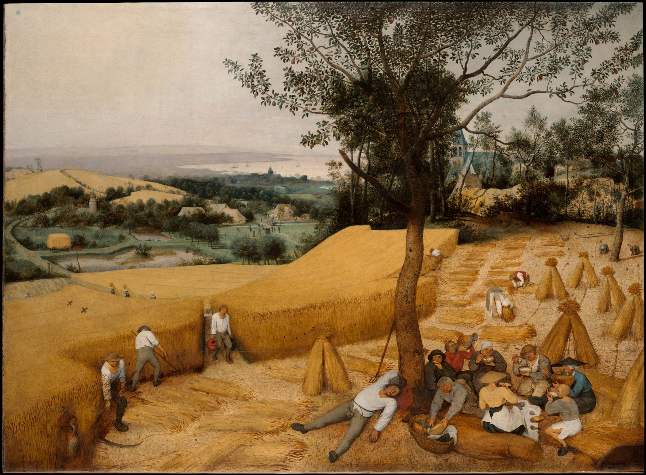
The significance of climate variability on early modern European grain prices
Fredrik Charpentier Ljungqvist ^{1,2,3}, Peter Thejll ⁴,
Bo Christiansen ⁴, Andrea Seim ⁵,
Claudia Hartl ⁶, Jan Esper ⁶
¹ Department of History, Stockholm University, Sweden
² Bolin Centre for Climate Research, Stockholm University, Sweden
³ Swedish Collegium for Advanced Study, Uppsala, Sweden
⁴ Danish Meteorological Institute, Copenhagen, Denmark
⁵ Institute of Forest Sciences, Albert Ludwig University of Freiburg, Germany
⁶ Department of Geography, Johannes Gutenberg University, Mainz, Germany
¹

Slide 2
Motivation for the study
Grain was the most important food source in early modern Europe, representing 70–80 % of the caloric intake.
The availability, and price, of grain affected average standard of living, including fertility, mortality, and even determined real income.
Grain trade was one of the largest, most important, and best monitored fields of economic activity.
Recent advances in high-resolution palaeoclimatology have made it possible to reassess the grain price–climate relationship with an unprecedented detail and statistical rigour.
The influence of climate variability on grain yields and prices in early modern Europe has for a long time been a matter of contrasting views.
The low-frequency (multi-decadal) climate–price relationship is very understudied as almost all studies have only addressed high-frequency relationships.

Slide 3
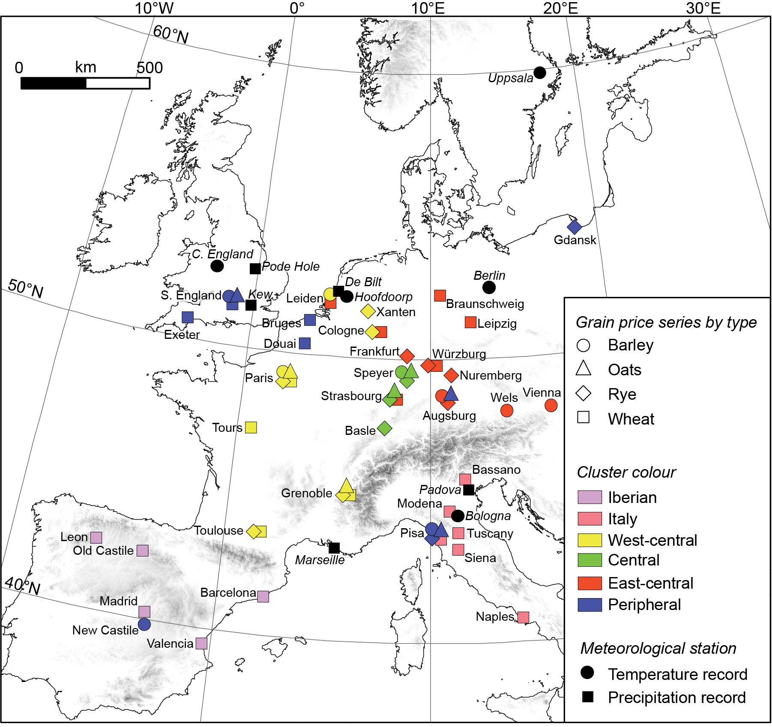
Location of the included grain price data (coded after grain type and cluster assignment) as well as the location of the instrumental temperature and precipitation station records.
In total 56 grain price series covering all or much of the period 1500–1800:
Barley: 10 series.
Oats: 7 series.
Rye: 14 series.
Wheat: 25 series.

Slide 4
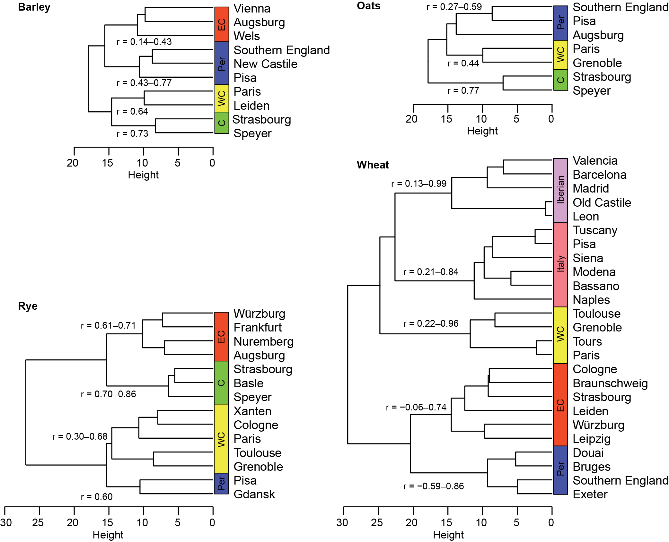




Grouping the grain price series into
regional clusters after their covariance
Hierarchical cluster analysis of the price series for barley, oats, rye and wheat.
No included grain price series was allowed to have more than 20% missing annual values over the common standardisation period 1546–1650.

Slide 5
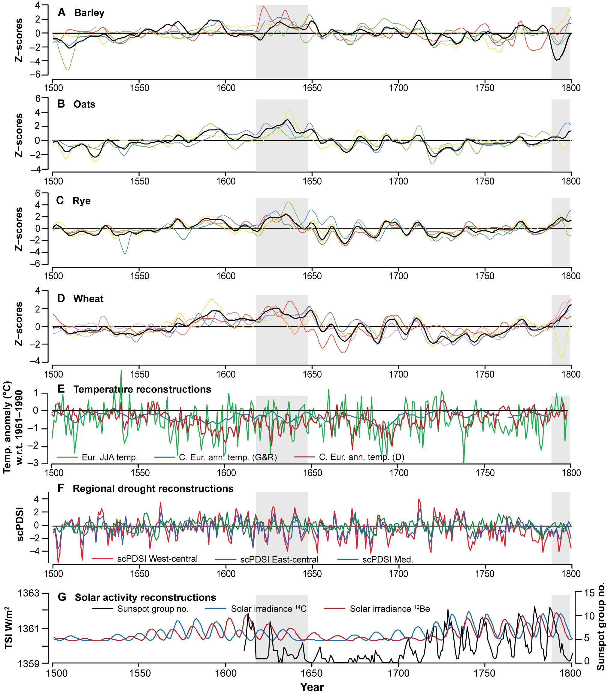
Key data series used
A Price series of barley (10-year smoothed).
B Price series of oats (10-year smoothed).
C Price series of rye (10-year smoothed).
D Price series of wheat (10-year smoothed).
E Temperature reconstructions.
F Regional drought reconstructions.
G Solar activity reconstructions.
The Thirty Years' War and the period following the French Revolution are shaded in grey.

Slide 6
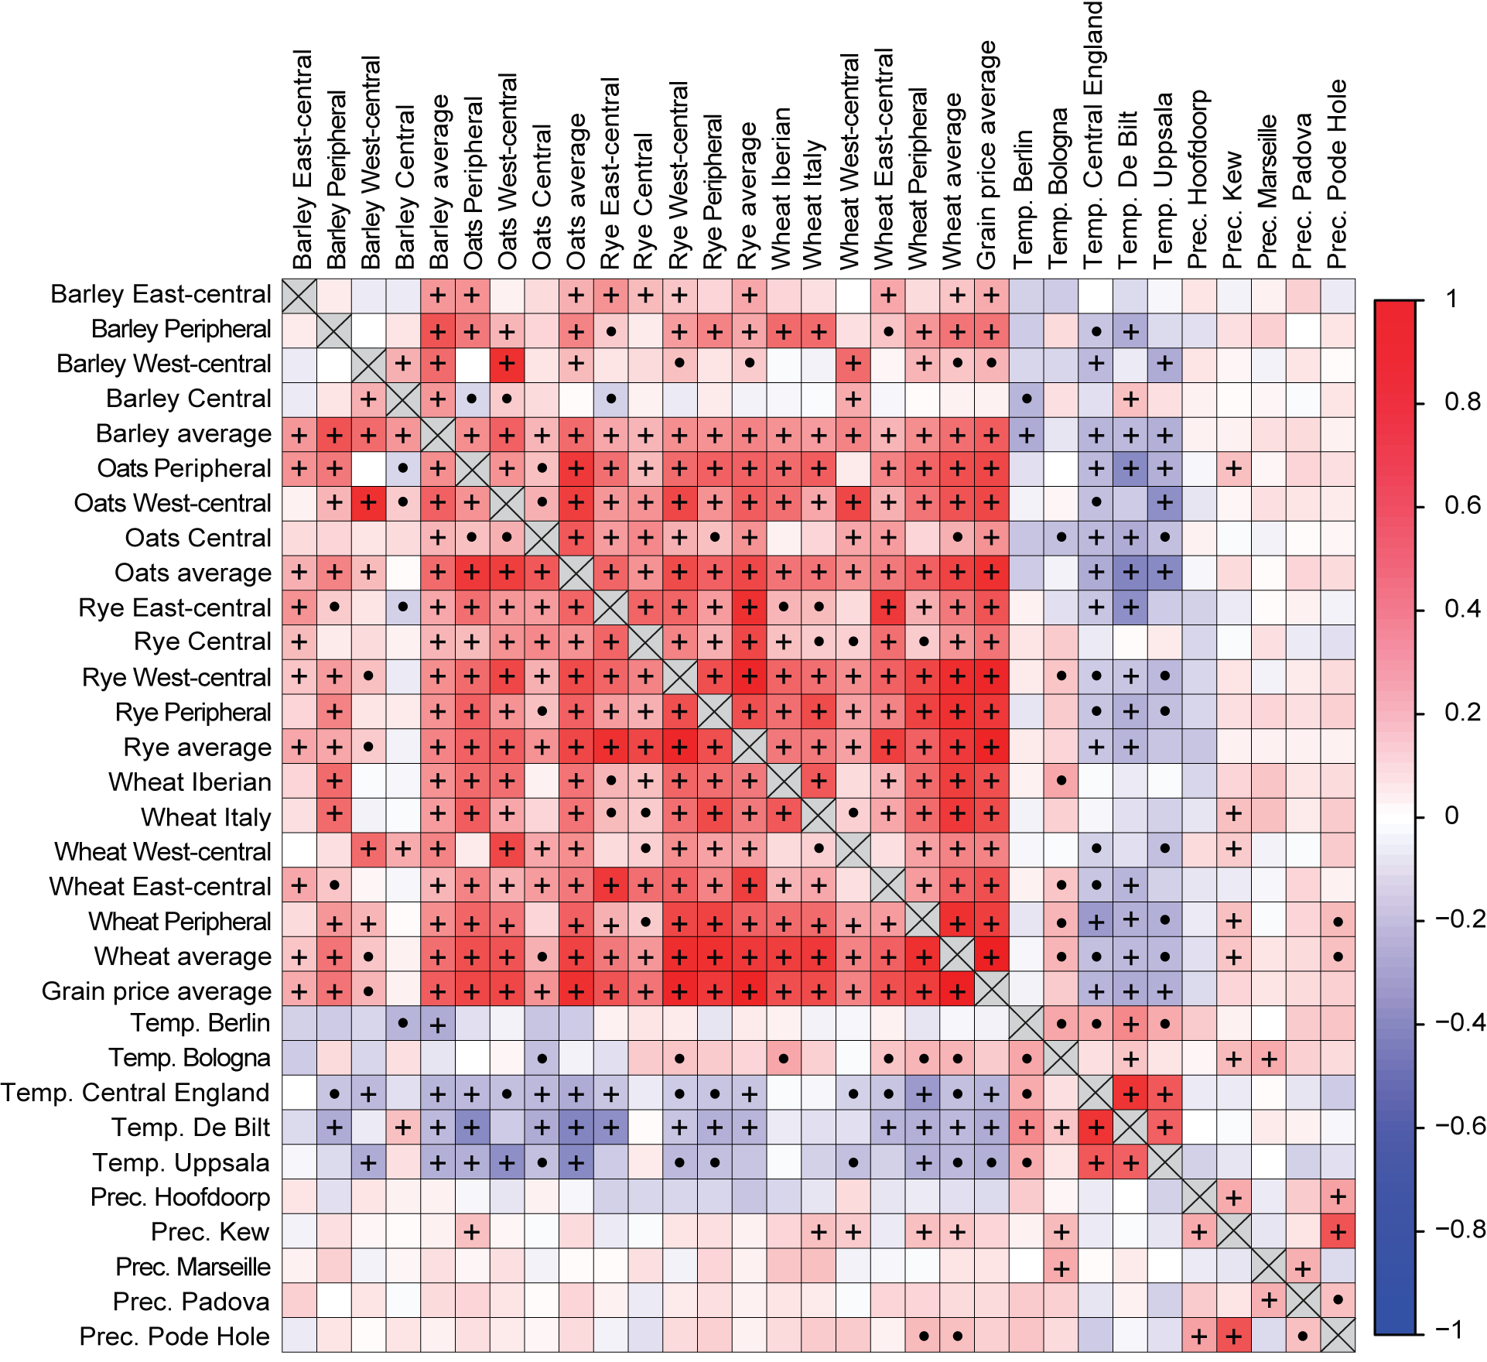
Correlation between grain price clusters and instrumental annual mean temperature and precipitation station data
Pearson correlation values from the start of each instrumental series until 1800.
Correlations significant at p=0.05 with a t-test marked with a dot (•). Those also significant with a more conservative phase-scrambling based significance test are marked with a plus sign (+).
Blue colours correspond to negative correlations and red colours to positive correlations.
Correlation

Slide 7
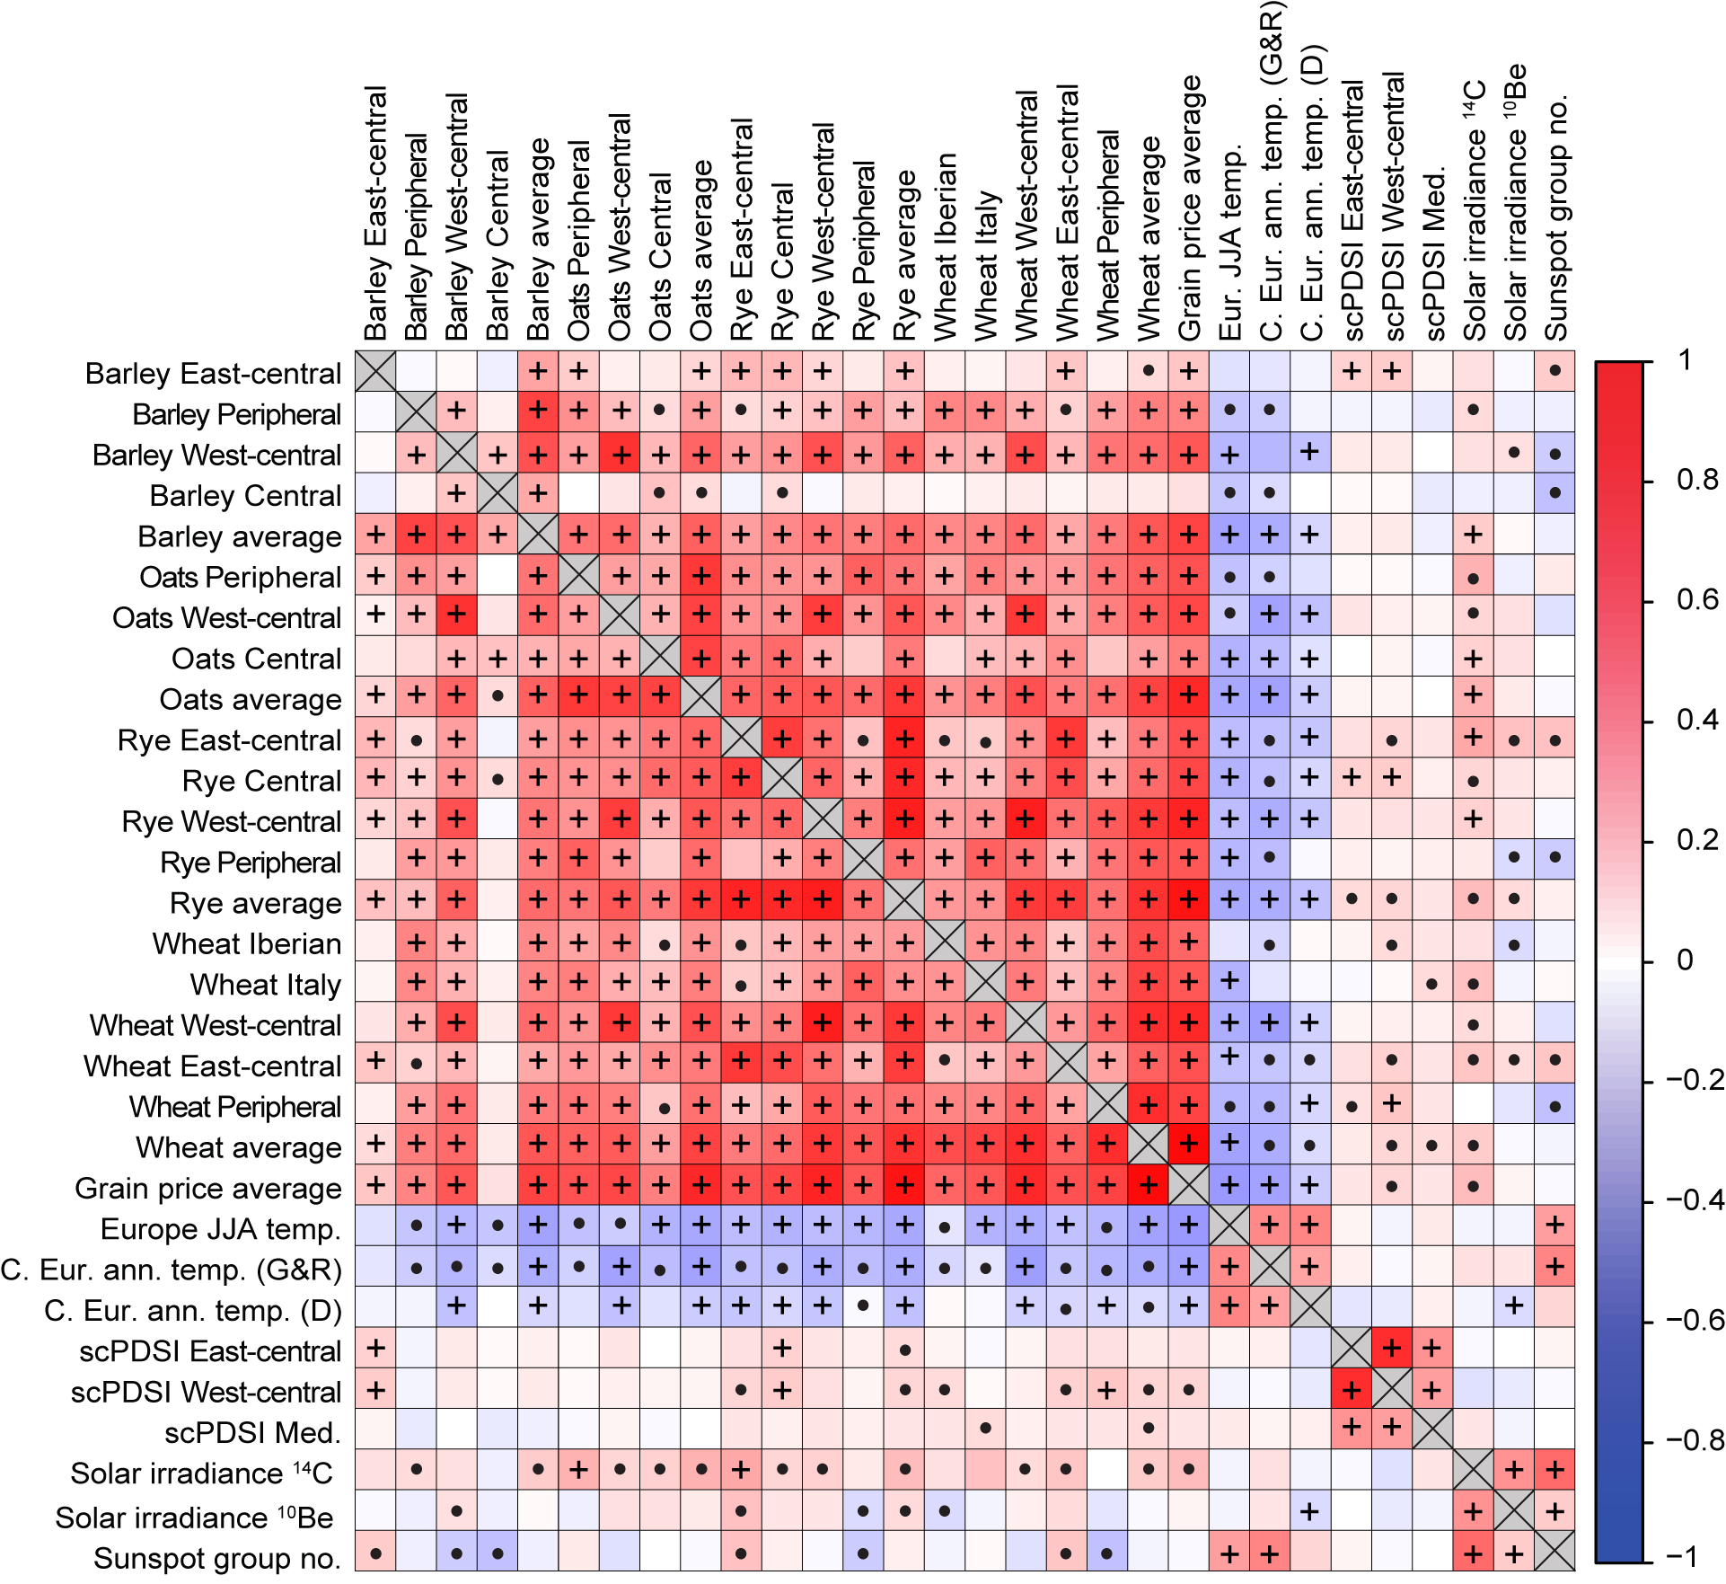
Correlation between grain price clusters, reconstructed temperature, drought estimates, and solar activity series
Grain prices lagged one year
Pearson correlation values over the period 1500–1788, but excluding the Thirty Years’ War (1618–1648).
Correlations significant at p=0.05 with a t-test marked with a dot (•). Those also significant with a more conservative phase-scrambling based significance test are marked with a plus sign (+).
Blue colours correspond to negative correlations and red colours to positive correlations.
Correlation

Slide 8
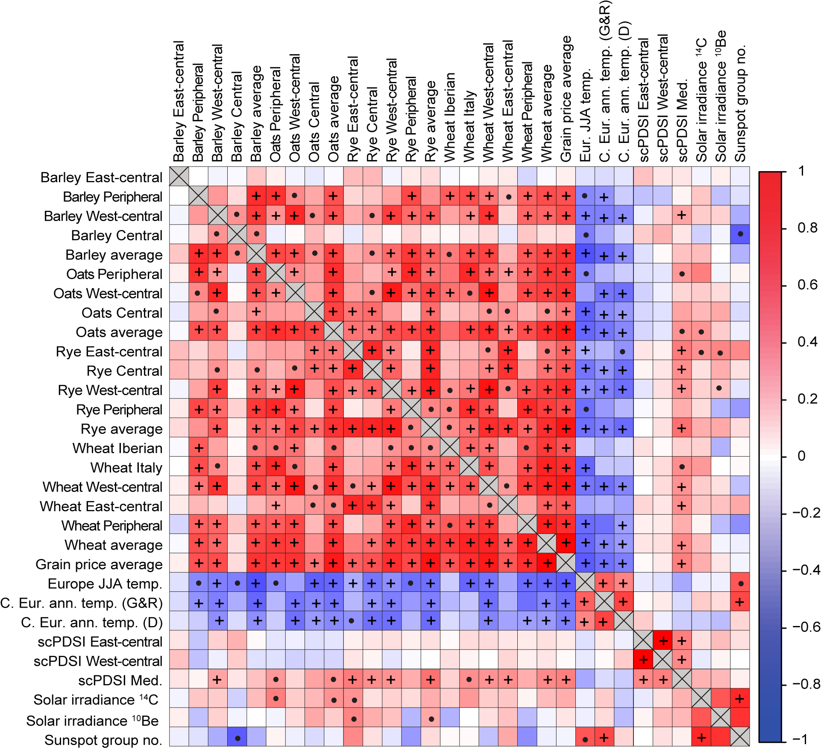
Correlation between grain price clusters, reconstructed temperature, drought estimates, and solar activity series
Decadal box-car filtered values
Pearson correlation values over the period 1500–1788, but excluding the Thirty Years’ War (1618–1648).
Correlations significant at p=0.05 with a t-test marked with a dot (•). Those also significant with a more conservative phase-scrambling based significance test are marked with a plus sign (+).
Blue colours correspond to negative correlations and red colours to positive correlations.
Correlation

Slide 9
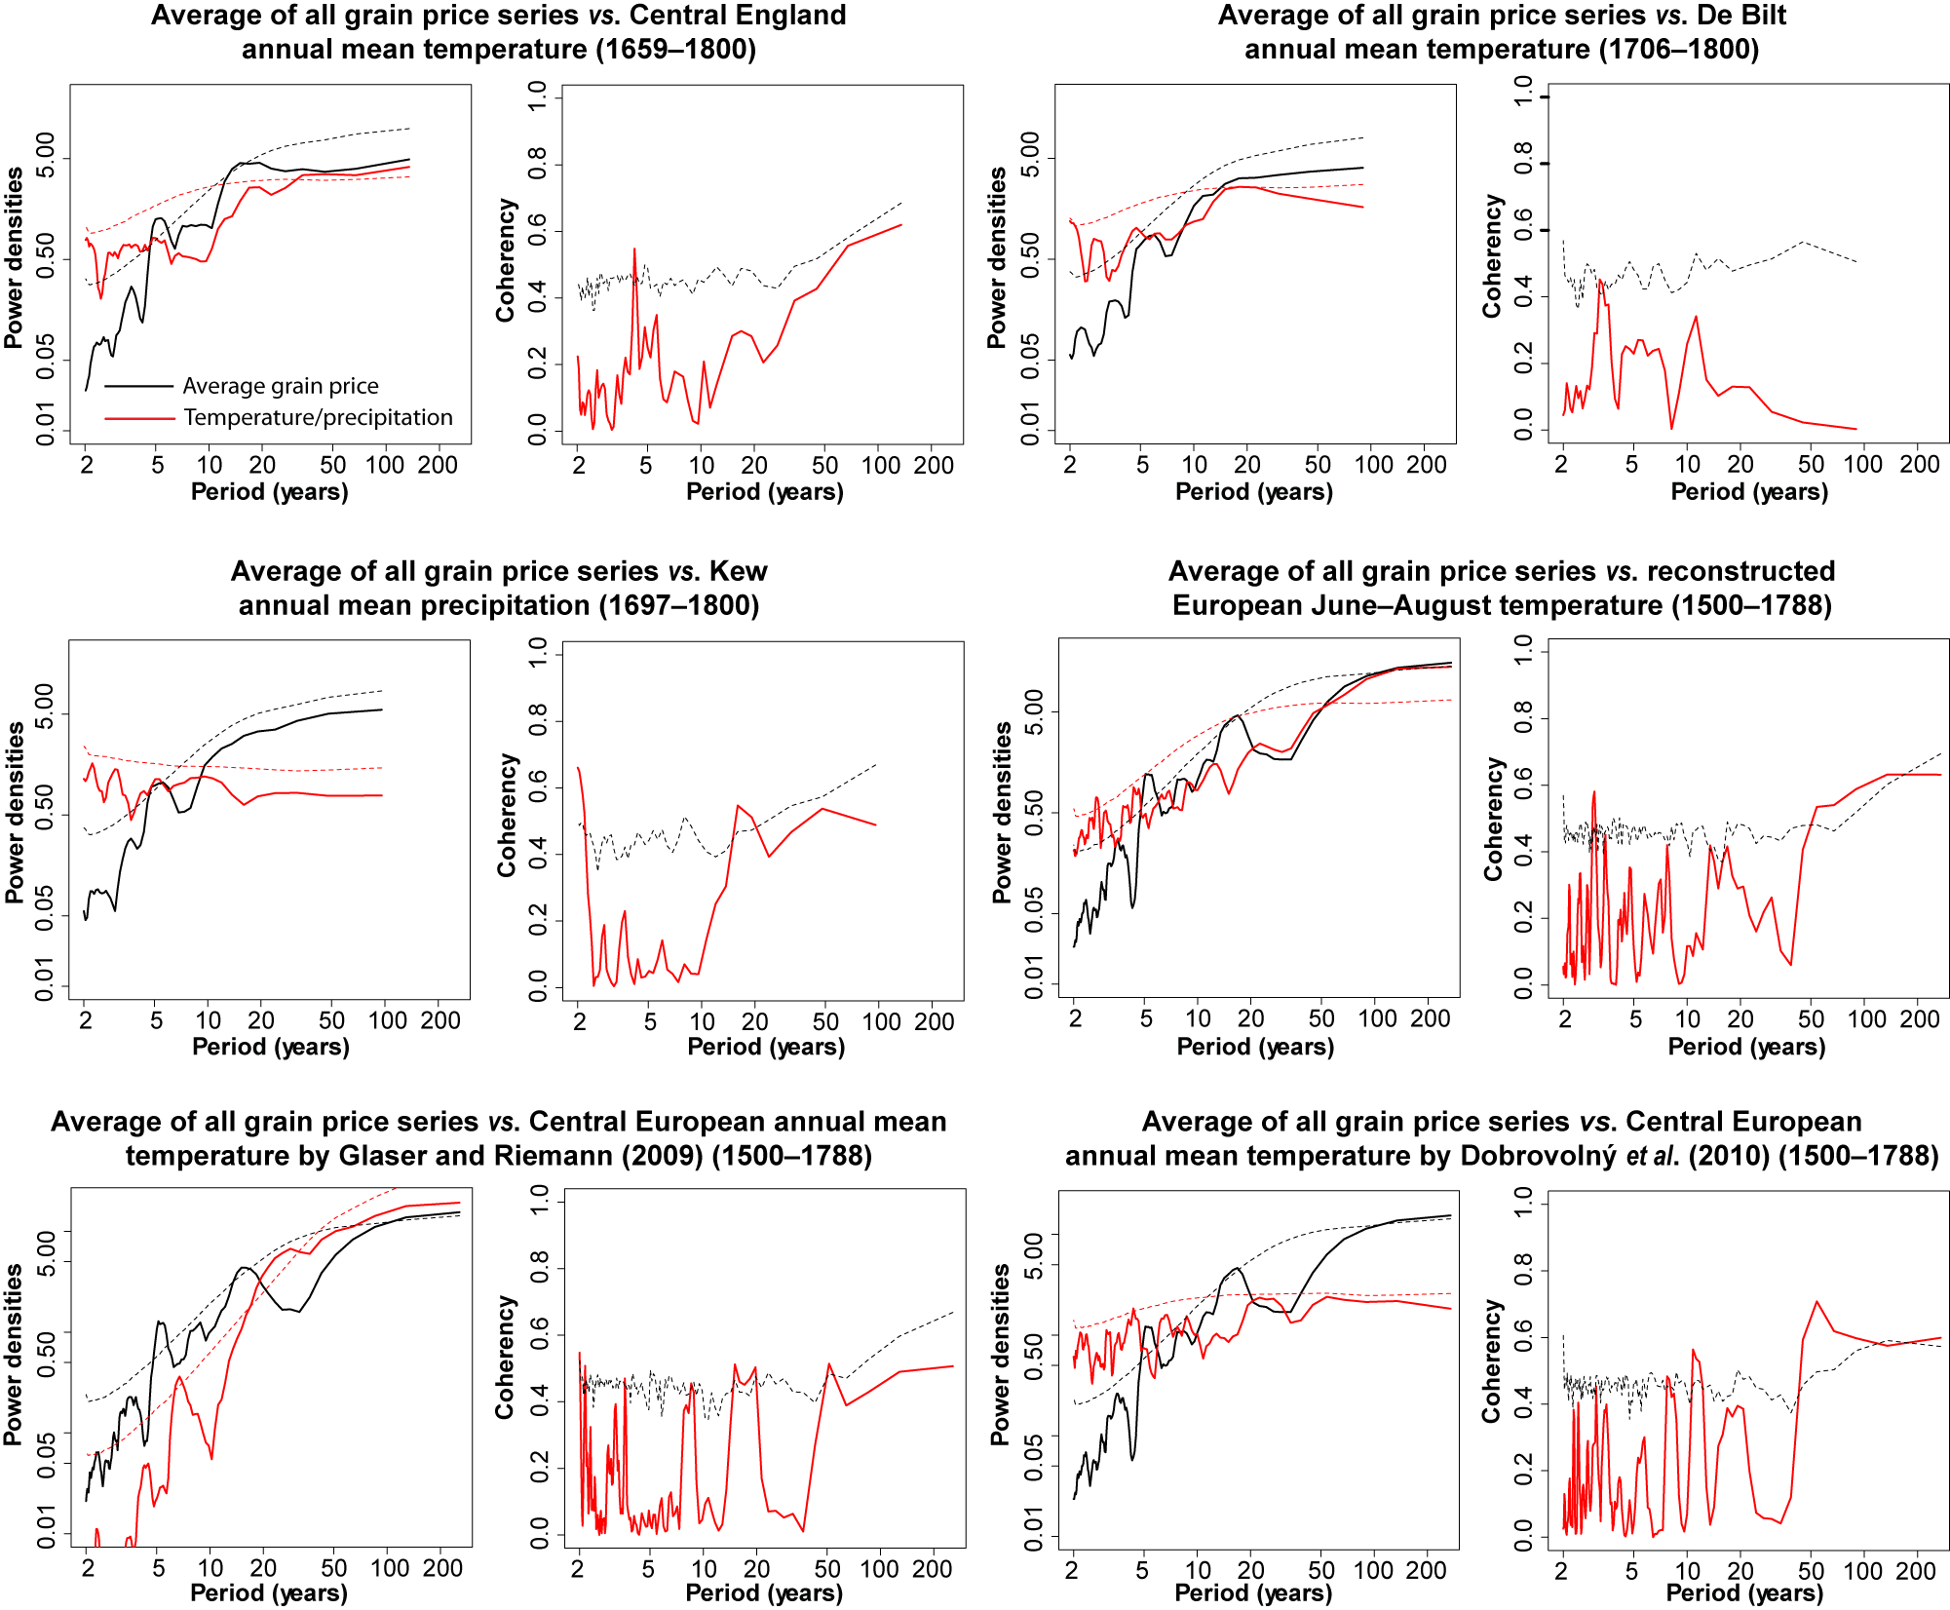
Detection of periodicities between grain prices and climate
Spectral power density and coherency analyses between average grain prices and climate data over the 1500–1788 period with the Thirty Years' War (1618–1648) period excluded. Stippled lines indicate the 95% significance levels determined by surrogate-data methods based on generating unrelated series with the same autocorrelation at lag 1 as the original series. 10,000 surrogate data trials were performed.

Slide 10
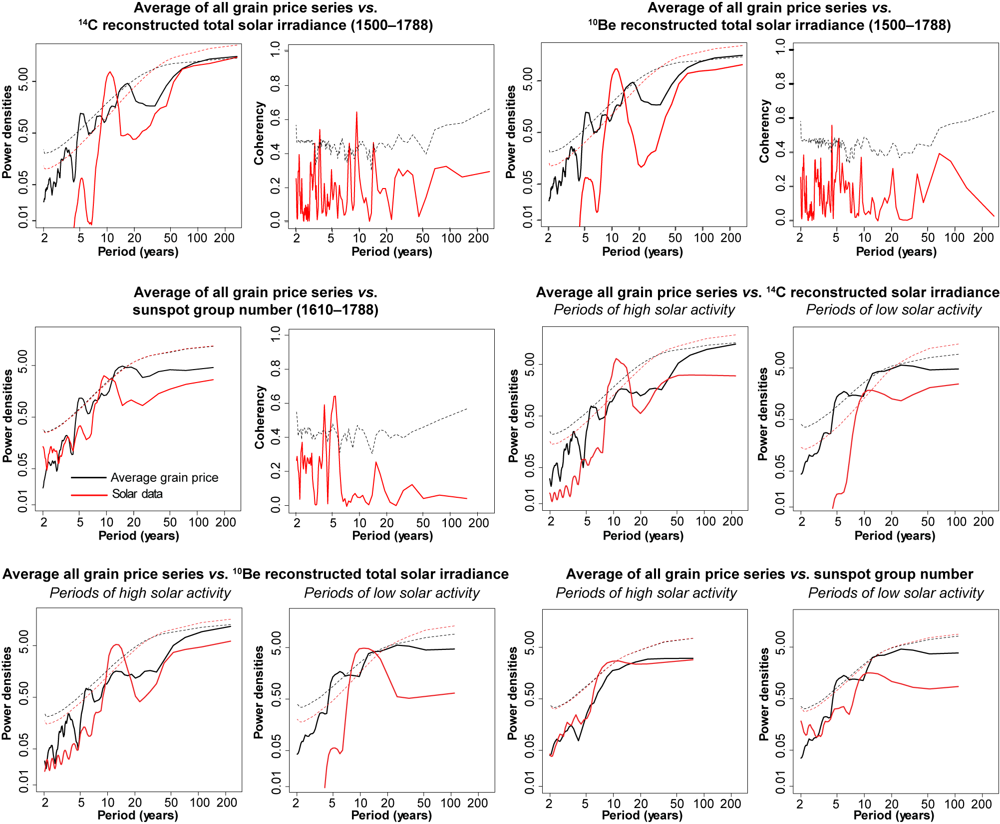
Detection of periodicities between grain prices and solar variability
Spectral power density and coherency analyses between average grain prices and solar variability series. The Thirty Years' War (1618 – 1648) period is removed. From the middle of the middle row we show a separate analysis, namely the power-spectra for the average grain price series and three solar activity series during periods of high and low solar activity. The grain price average series is divided into intervals corresponding to the solar activity series in the power spectra.

Slide 11
Grain prices and grain yields
The strong temperature–grain price relationship is noteworthy as grain price variability only partly reflects harvest yield variations.
Grain prices were also determined by market organisation, economic conditions, political and institutional setting, efficiency and cost of transportation, and levels of demand.
A lack of accurate harvest yield data makes it challenging to quantify how strong the relationship was between grain price variability and actual harvest yield variations.

Slide 12
The insignificance of precipitation and drought
Very weak hydroclimate (precipitation and drought) signals in the grain prices even for the Italian and Iberian grain price clusters.
The weak hydroclimate signal – that also generally is positive (i.e., wet = high prices) – may come as a surprise to some, but this tendency was already noted by Brückner (1895).
The significance of temperature, and insignificance of hydroclimate, is likely related to spatial scale: temperature shows large spatial homogeneity whereas hydroclimate shows high spatial heterogeneity.
Drought is unlikely to influence harvests over wide regions of Europe during the same year except during exceptionally dry years.

Slide 13
Summary and conclusion
We have demonstrated that a negative temperature–grain price relationship holds true for: (1) the entire Europe, and (2) for the prices of barley, oats, rye as well as wheat.
The negative correlations between temperature and grain price increase with spatial scale, and number of grain price series, and are strongest for reconstructed June–August temperature.
Apparently the temperature–grain price relationship was especially strong during the coldest phases of the Little Ice Age.
The temperature–grain price relationship broke down during the Thirty Years’ War (1618–1648) and following the French Revolution (1789).

Slide 14
Implications and outlook
All the 10 % coldest summers 1500–1800 occurred during the time-interval 1574–1704, disproving earlier notions that climate “shocks” on early modern agriculture can be considered random events.
The stronger than hitherto reported evidence for long-term temperature impacts on grain prices implies that temperature variability has been a more important factor in European economic history than commonly acknowledged.
Summer temperature, at decadal time-scales, explain as much as 40% of the average early modern European grain prices. Is this not an argument to give climate “agency” when considering that grain prices, in turn, played a decisive role in early modern economy and society?

