Slide 1
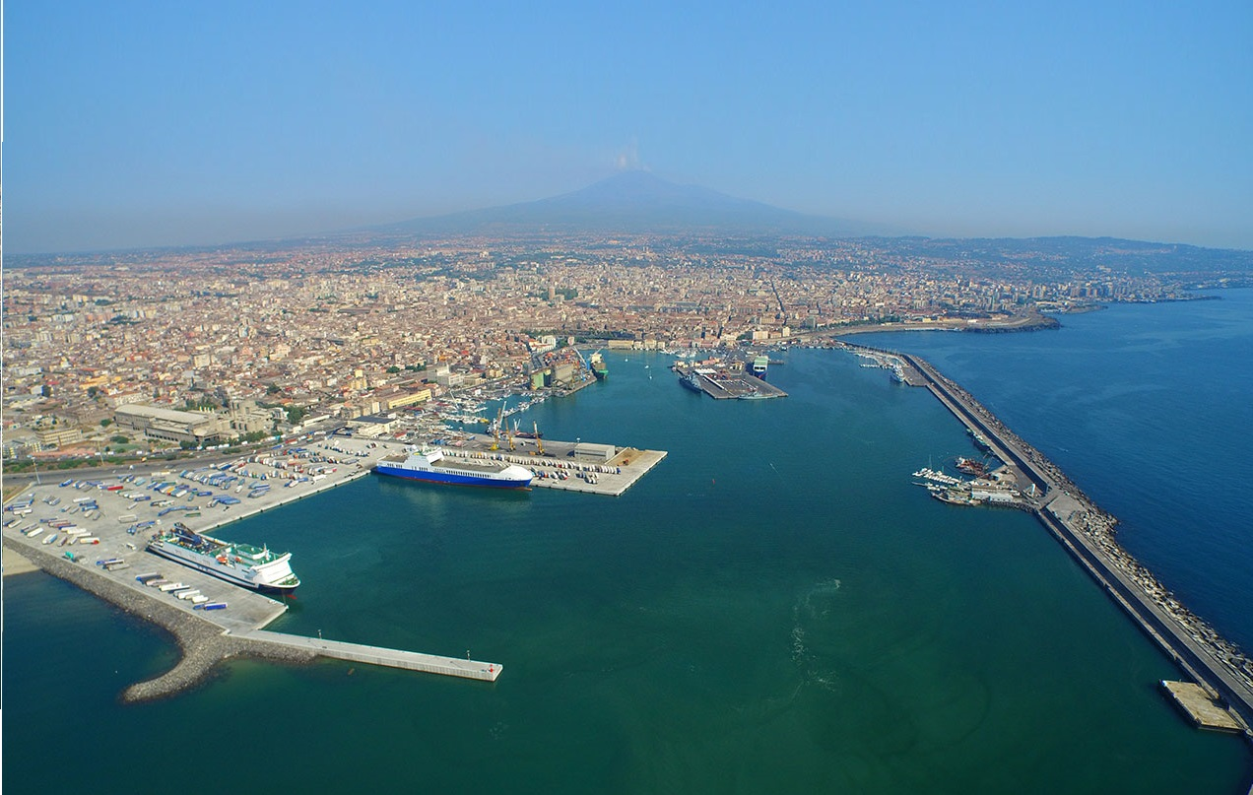


Advanced modelling of wave penetration in ports
Konstantina Aikaterini MAROUDI, Delft University of Technology MSc graduate, The Netherlands
Sebastiaan P. REIJMERINK, Deltares, The Netherlands
Picture: Porto di Catania, Sicily, Italy, Downloaded from https://siciliammare.it/porti-tirrenia-traffico-merci-catania-cresciuto-del-46_1490/

Slide 2



Content Overview
Introduction
Methodology
Results
Conclusions & Recommendations

Slide 3
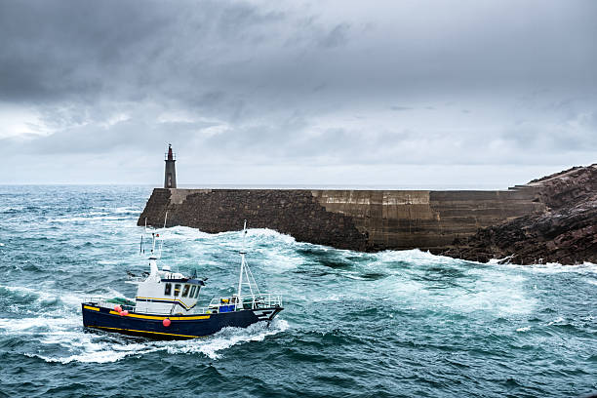
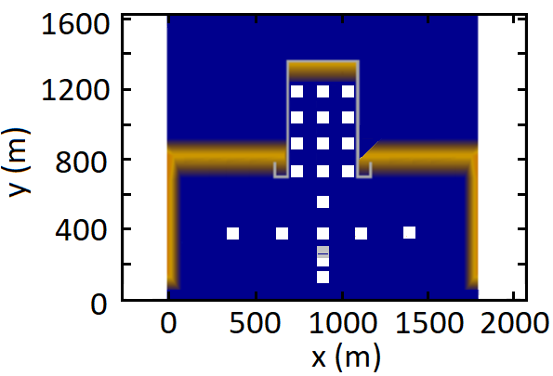
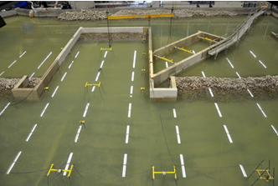
Introduction-Wave penetration
Why studying wave penetration?
Safe sailing and mooring
Port downtime, when port
operations can/ cannot take place
How to study wave penetration ?
Physcial model VS Numerical model
Accurate Less accurate but cheap & fast but expensive, time consuming to check alternative designs
Introduction
Methodology
Results
Conclusions &
Recommendations

Slide 4
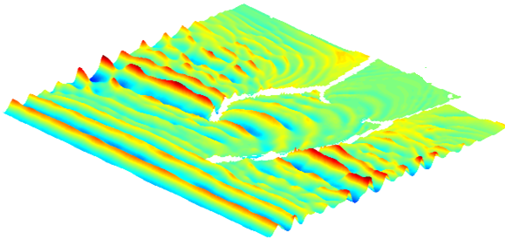
Introduction-SWASH
Simulation of wave penetration with the non-hydrostatic model SWASH
Time resolving model
Hydrostatic & non-hydrostatic water pressure
Horizontal & Vertical Discretisation ( e.g. 1D model 35-250 cells per L,
2D model 10-75 cells per L, 2 vertical layers)
Validation: an open benchmark dataset, consisting of physical scale model tests of schematic port layouts (Deltares, 2016) (See next slide)
Water surface
Port
Introduction
Methodology
Results
Conclusions &
Recommendations
Layer 1
Layer 2
Δx
bottom
4

Slide 5
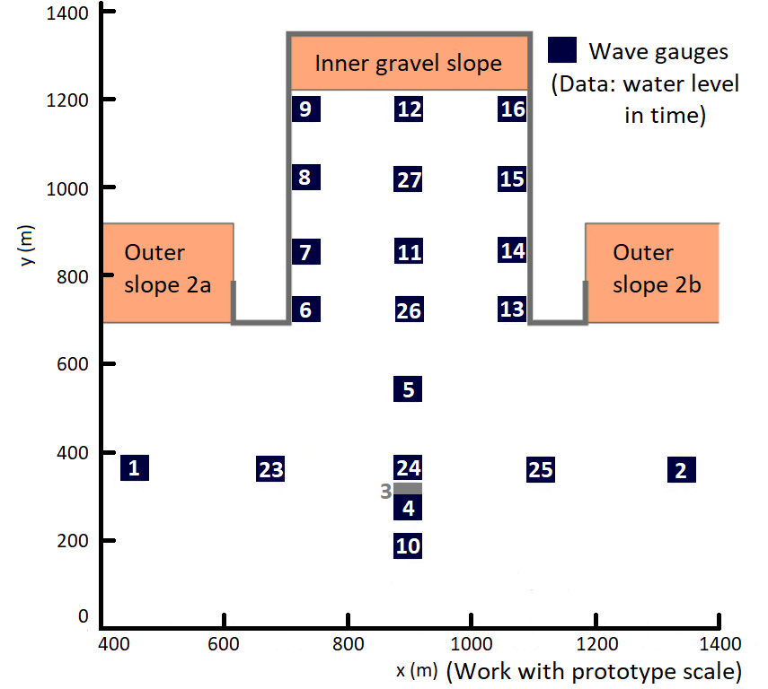

Introduction-The physical scale model
Time resolving model
The physical scale model of a simple port layout (Deltares,2016)
Previous work: Simulations of the most complex harbour layout showed that SWASH can model primary waves resulting from a JONSWAP spectrum with an ${\overline{H}}_{error, primary waves }$=15%. This can be attributed to a group of wave processes (Van Mierlo, 2014).
To identify the role of each wave process on the model accuracy, this research addresses regular waves conditions and a simple layout of a harbour basin.
Introduction
Methodology
Results
Conclusions &
Recommendations
bottom
5

Slide 6
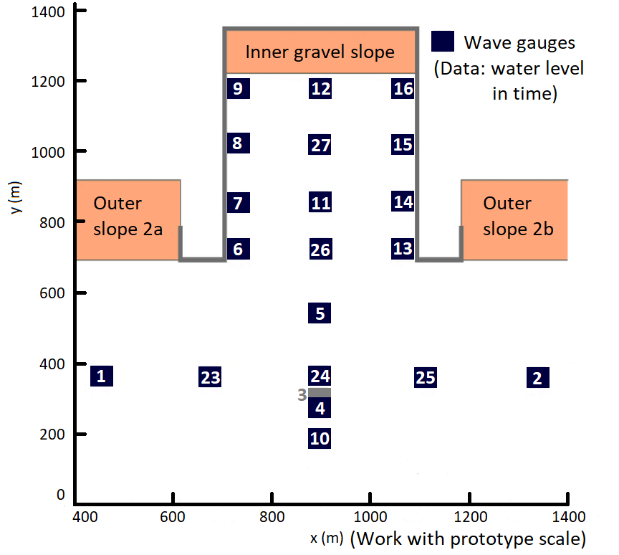
Introduction-Wave processes
Objective: How SWASH models wave penetration per wave process, separately (simplified models) and combined (full harbour layout)
Introduction
Methodology
Results
Conclusions &
Recommendations
Inside the
harbour basin
Outside the
harbour basin
bottom
6

Slide 7
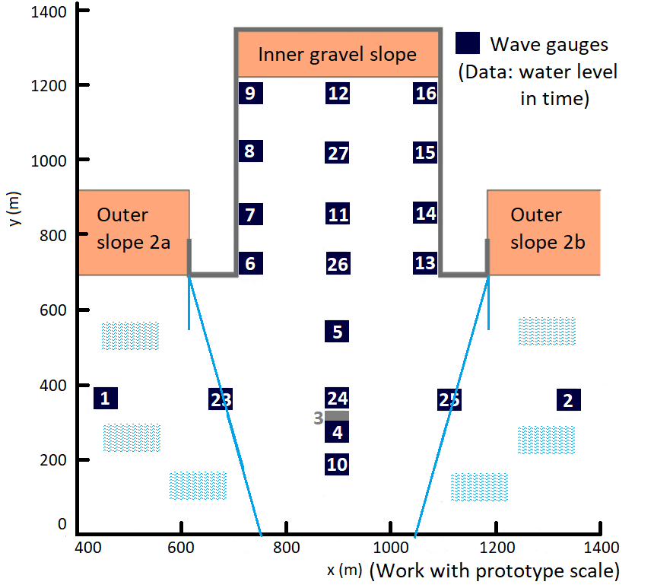
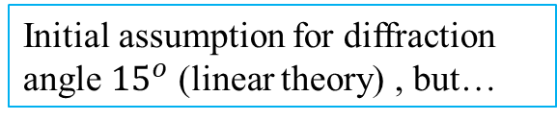
Introduction-Wave processes
Objective: How SWASH models wave penetration per wave process, separately (simplified models) and combined (full harbour layout)
Reflection off the outer gravel slope
Reflection off the concrete harbor wall
Reflection off the harbor end
Diffraction
Introduction
Methodology
Results
Conclusions &
Recommendations
Inside the
harbour basin
Outside the
harbour basin
Initial assumption for diffraction angle ${15}^{o}$ (linear theory) , but…
bottom
7

Slide 8
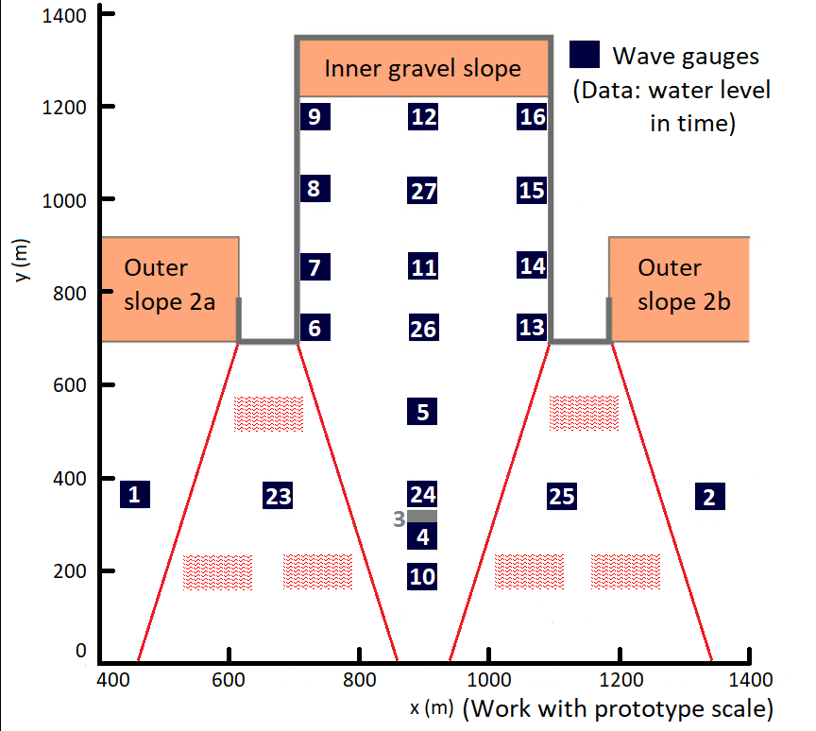
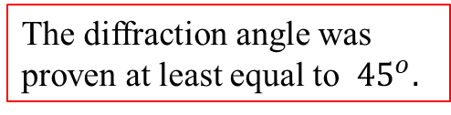
Introduction-Wave processes
Objective: How SWASH models wave penetration per wave process, separately (simplified models) and combined (full harbour layout)
Reflection off the outer gravel slope
Reflection off the concrete harbour wall
Reflection off the harbor end
Diffraction
Introduction
Methodology
Results
Conclusions &
Recommendations
Inside the
harbour basin
Outside the
harbour basin
The diffraction angle was proven at least equal to ${45}^{o}.$
bottom
8

Slide 9
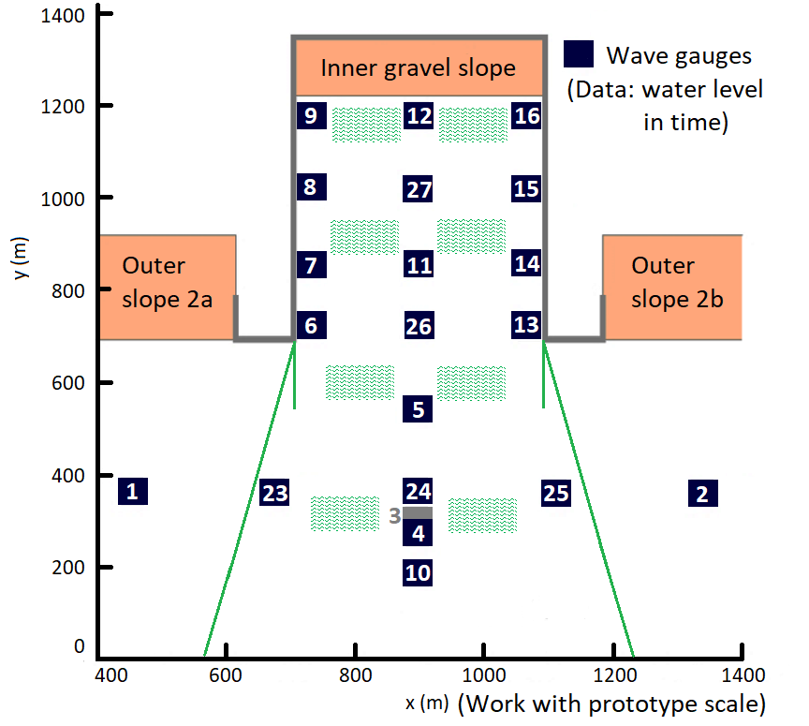
Introduction-Wave processes
Objective: How SWASH models wave penetration per wave process, separately (simplified models) and combined (full harbour layout)
Reflection off the outer gravel slope
Reflection off the concrete harbour wall
Reflection off the harbour end
Diffraction
Introduction
Methodology
Results
Conclusions &
Recommendations
Inside the
harbour basin
Outside the
harbour basin
bottom
9

Slide 10
Introduction-Wave processes
Objective: How SWASH models wave penetration per wave process, separately (simplified models) and combined (full harbour layout)
Reflection off the outer gravel slope
Reflection off the concrete harbour wall
Reflection off the harbour end
Diffraction
Introduction
Methodology
Results
Conclusions &
Recommendations
Inside the
harbour basin
Outside the
harbour basin
bottom
10

Slide 11
Introduction-The selected dataset
Test | L [m] | kd | Wave conditions | H/L | Wave breaking
T003 | 225.59 | 0.55 | Intermediate/shallow water | 0.011 | -
T012 | 197.05 | 0.63 | Intermediate/shallow water | 0.014 | -
T001 | 80.48 | 1.55 | Intermediate water | 0.001 | -
T002 | 120.74 | 1.03 | Intermediate water | 0.012 | -
T011 | 104.71 | 1.19 | Intermediate water | 0.029 | -
T010 | 39.38 | 3.16 | Deep/Intermediate water | 0.075 | yes
T013 | 31.52 | 3.95 | Deep water | 0.061 | close to the breaking limit
Introduction
Methodology
Results
Conclusions &
Recommendations
1st group
Low kd
2nd group
Average kd
3rd group
High kd
! For consistency reasons, the graphs in the next slides are those of the representative test T002 !
11

Slide 12
Methodology-4 SWASH Models
Physical scale model: Cross section A → Model A, Cross section B→ Model B
1D Model A:
Reflection off a gravel slope
Introduction
Methodology
Results
Conclusions &
Recommendations
1D Model B: Reflection off
the harbour end
2D Simplified Model C:
Reflection off the concrete wall
Diffraction
2D Final Model D:
Full wave penetration
12

Slide 13
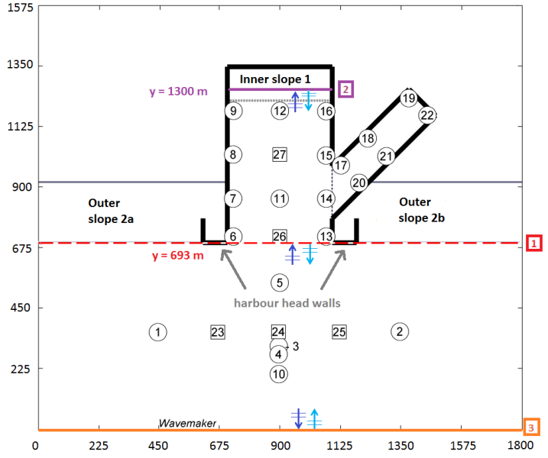
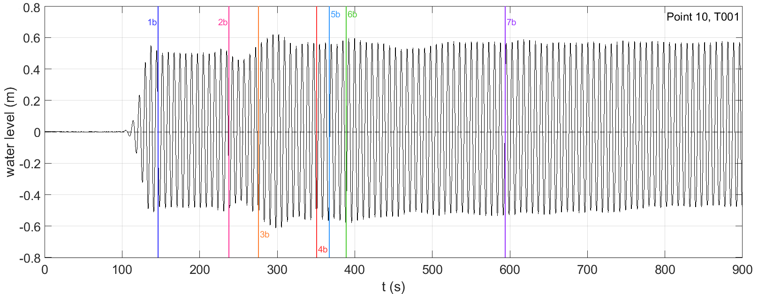
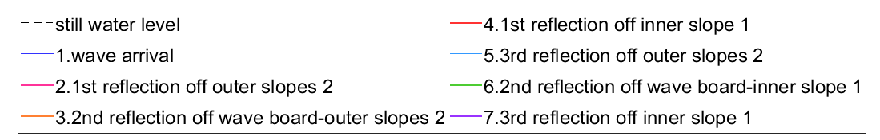
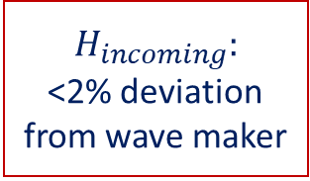
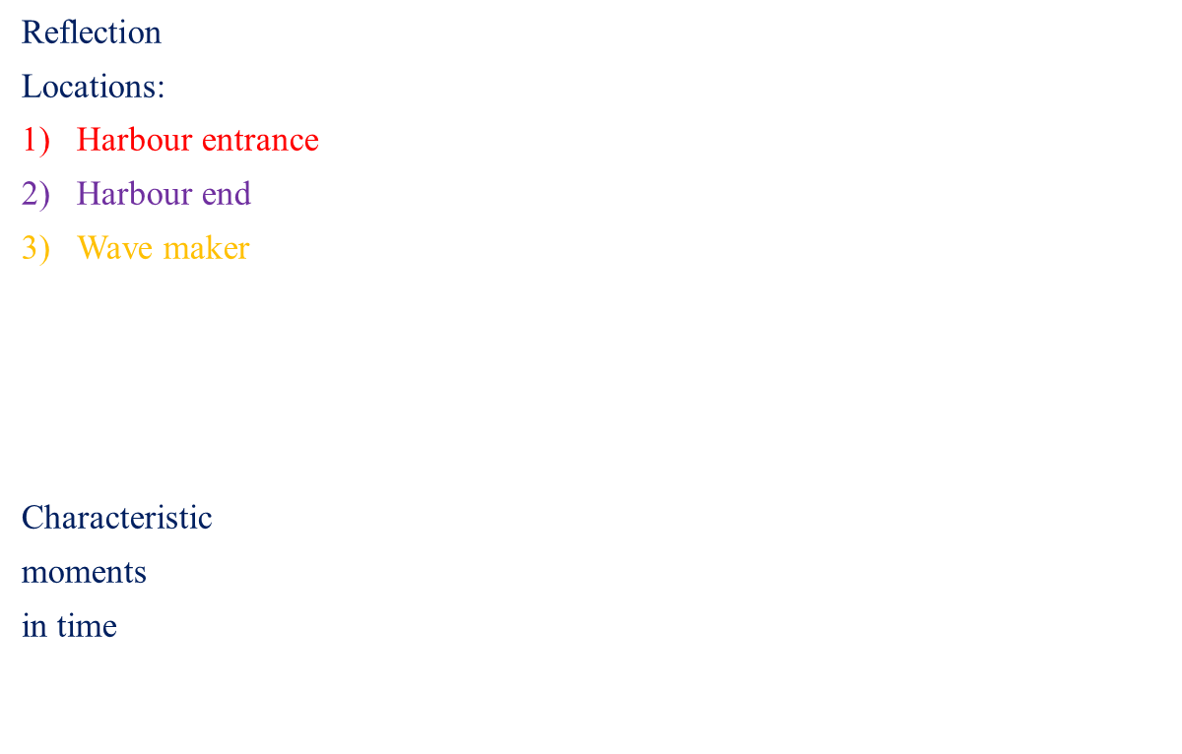
Methodology
Assume linear wave celerity,
calculate when the reflected waves arrive at a each point, draw vertical lines
Reflection
Locations:
Harbour entrance
Harbour end
Wave maker
Characteristic
moments
in time
Introduction
Methodology
Results
Conclusions &
Recommendations
$$H_{incoming}:$$
<2% deviation
from wave maker
13

Slide 14
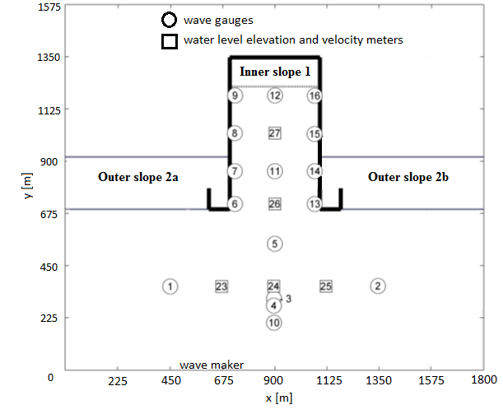
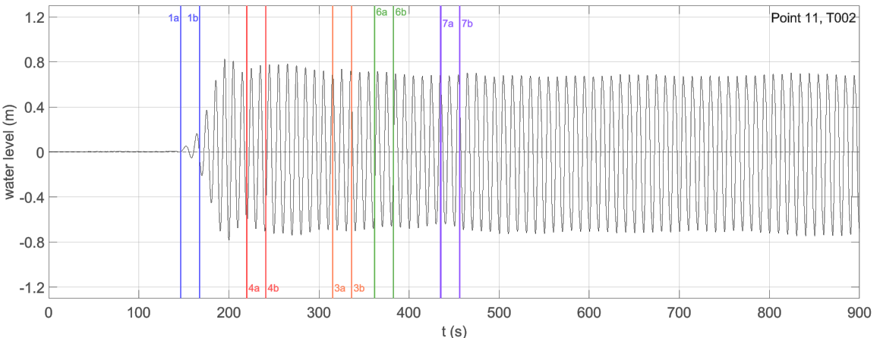
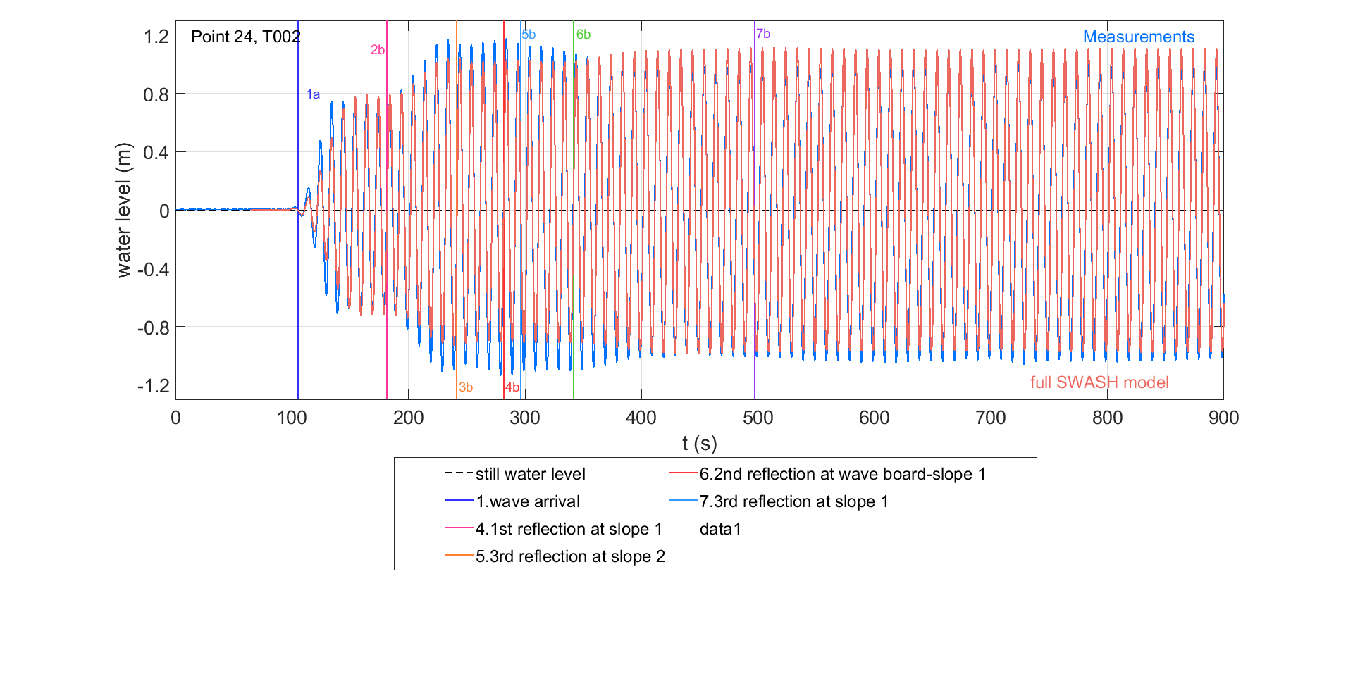
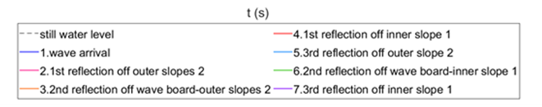

Methodology
Initial diffraction trends
Time interval influenced only by diffraction
Temporal trends: Synchronize measured and SWASH water level time series
Introduction
Methodology
Results
Conclusions &
Recommendations
Steady state:
$$Spatial trends:$$
$$Diff=\frac{\overline{H_{SWASH}}−\overline{H_{measured}}}{\overline{H_{measured}}}$$
14

Slide 15
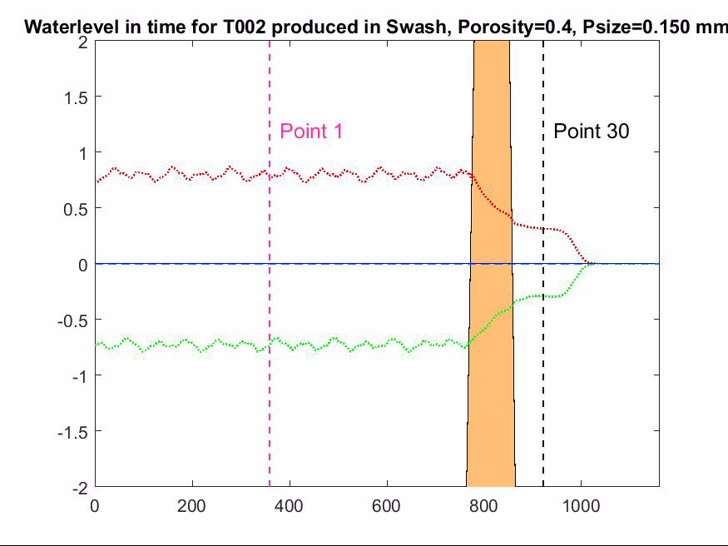
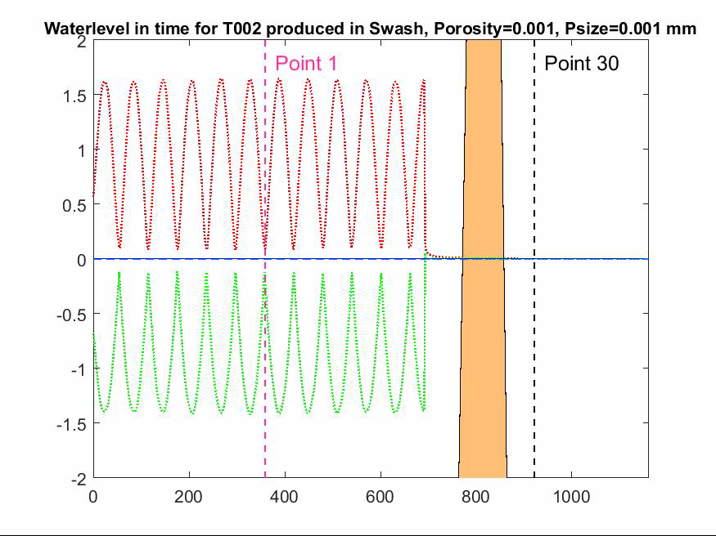
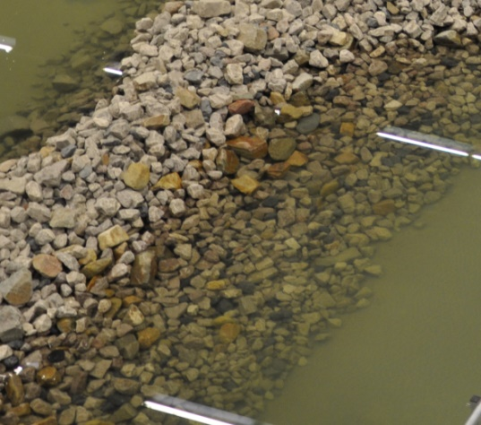
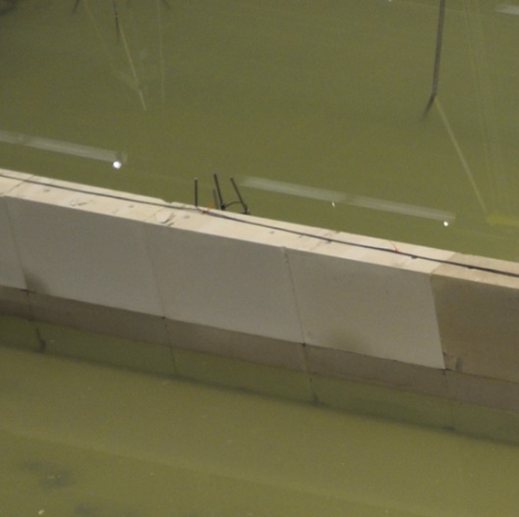
Results-Model A
Design the envelope of water level in time →Representation of the standing waves pattern
Gravel slope -10%Reflection Concrete wall-100%reflection
Introduction
Methodology
Results
Conclusions &
Recommendations
15

Slide 16
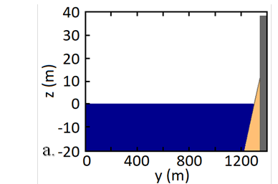
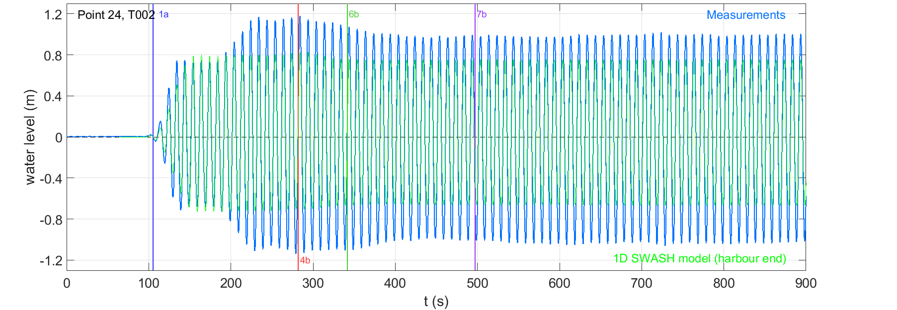
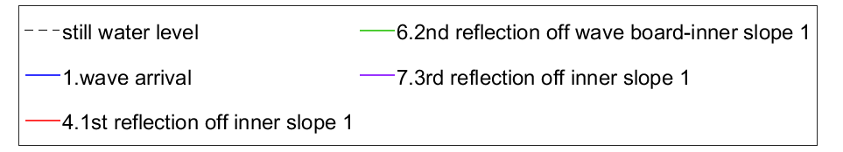
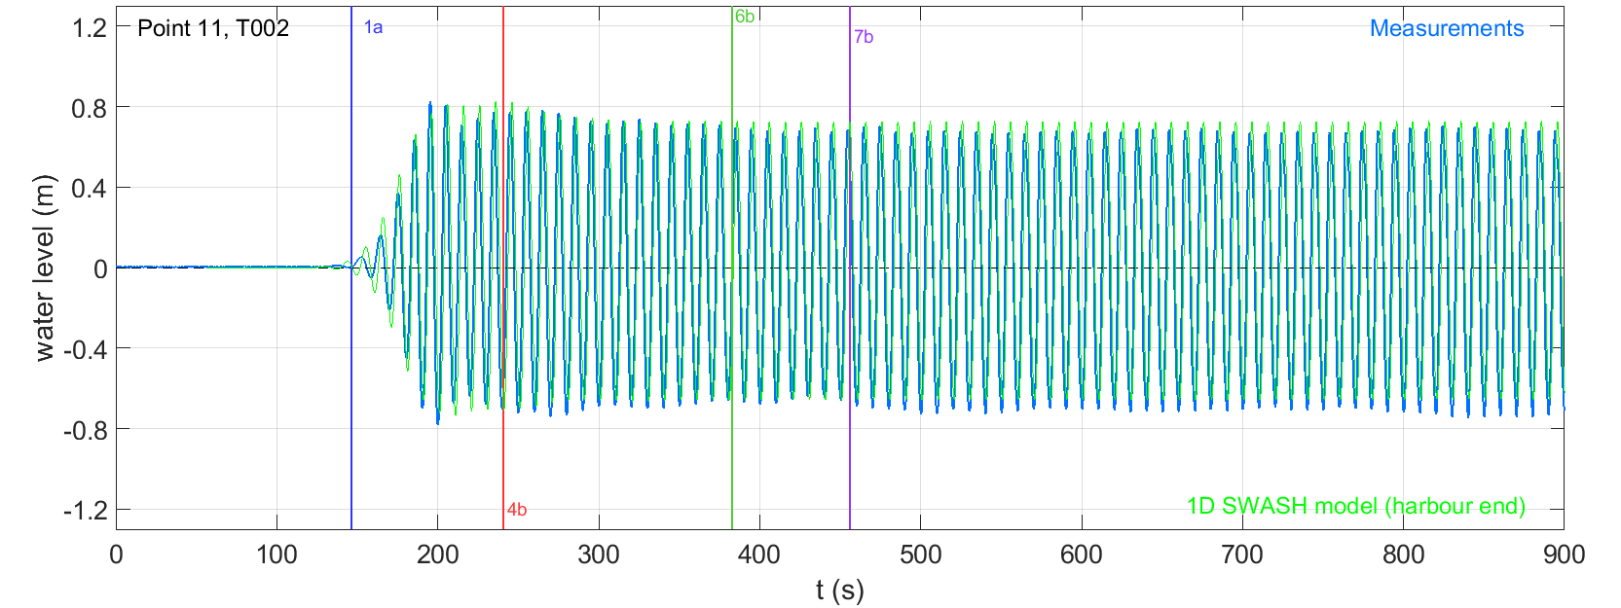


Results-Model B
Out In
Outside the basin
Inside the basin
Basin entrance
Introduction
Methodology
Results
Conclusions &
Recommendations
$$H_{steady state}$$
High deviations!
Max Differences from 13 to 90% !
Low
Influence of reflection off the harbour end
High
$$H_{steady state}$$
Smaller deviations!
Max Differences from 12 to 40%
16

Slide 17
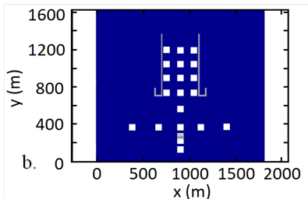
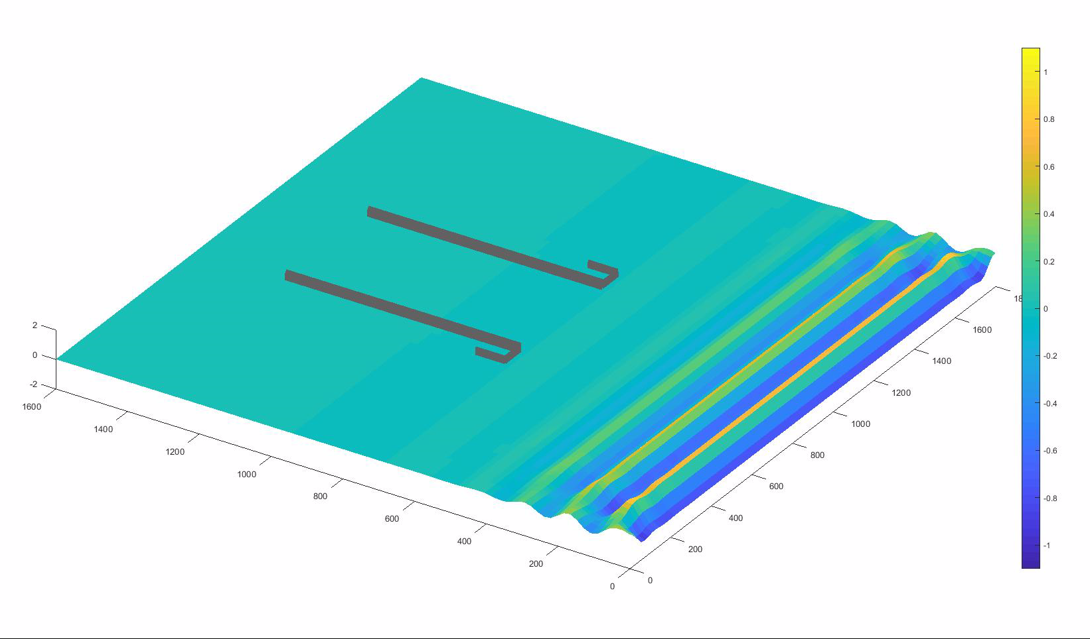
Results-Model C
Reflection outside-Diffraction inside the harbour
Introduction
Methodology
Results
Conclusions &
Recommendations
17

Slide 18
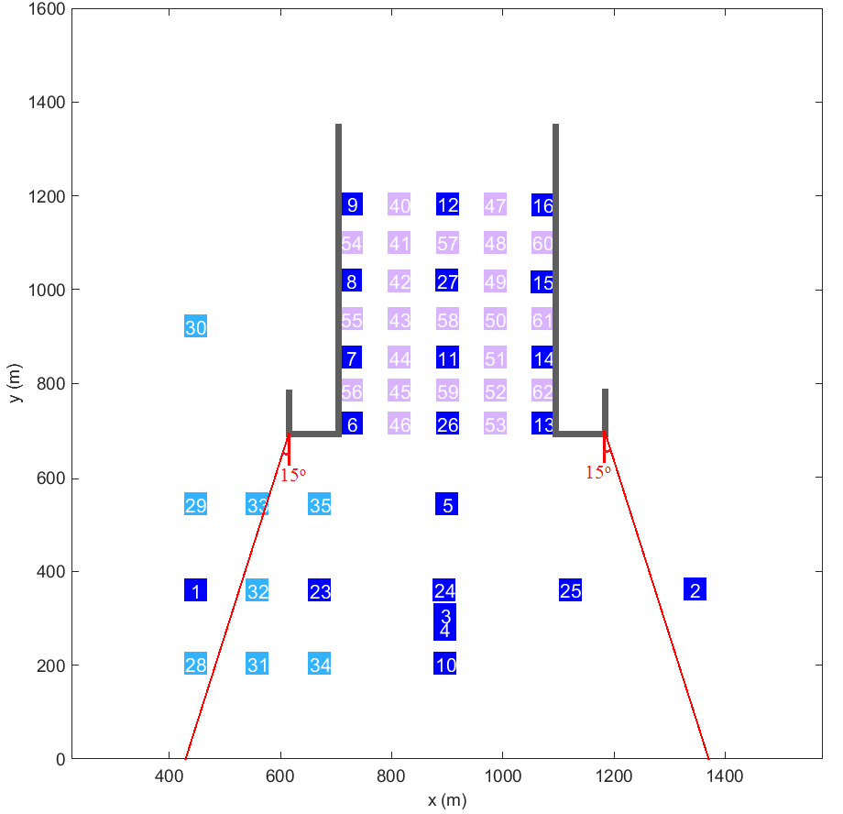
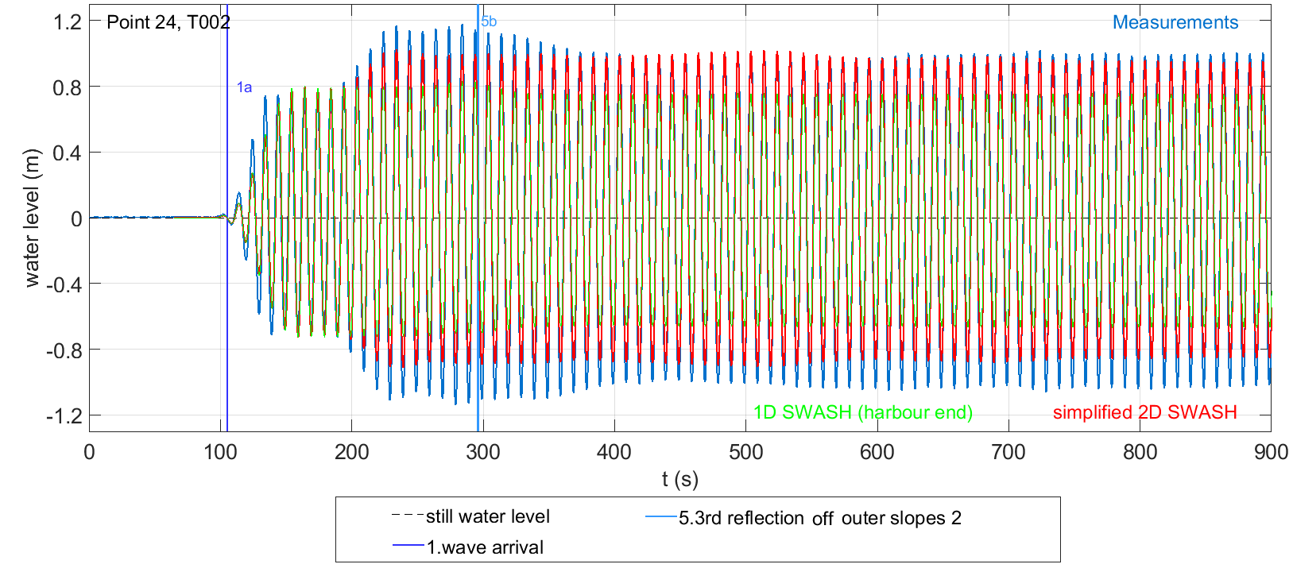
Results-Model C
Outside the harbour basin,
reflection off the concrete head walls
is the dominant process!
Introduction
Methodology
Results
Conclusions &
Recommendations
Green: reflection off
harbour end
Red: reflection off
concrete head walls
18

Slide 19
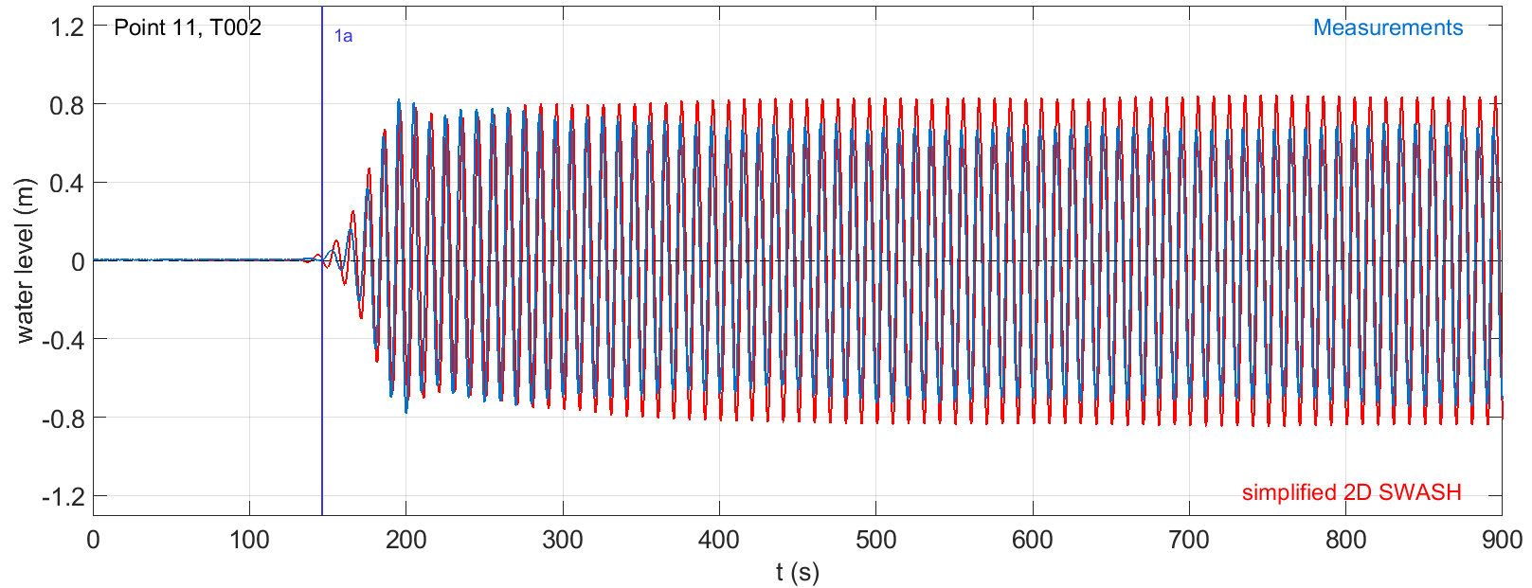
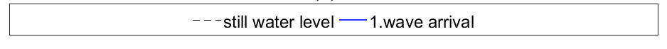

Results-Model C
Diffraction inside the harbour
Measurements: Limited information
SWASH :
Initial measured trends identified
$H_{steady state}$is comparable $H_{measured}$one→
→significant role of diffraction
Interval influenced
by diffraction
Initial measured
diffraction trends
Introduction
Methodology
Results
Conclusions &
Recommendations
19

Slide 20
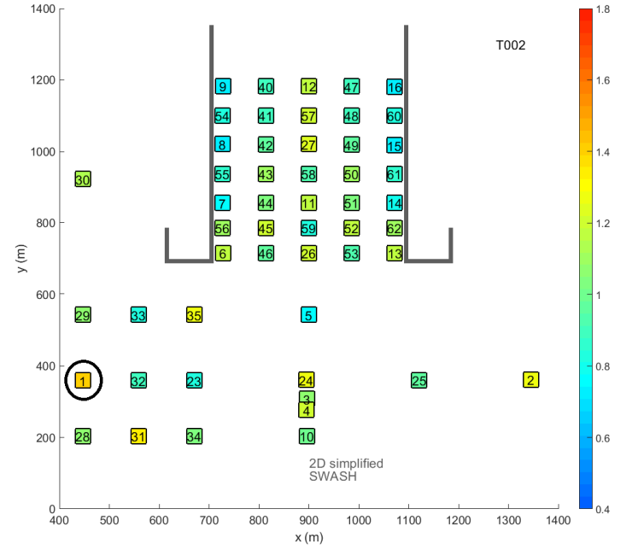

Results-Model C
Test | Min | Max
T001 | 0.43 | 1.29
T002 | 0.72 | 1.23
T003 | 0.83 | 1.18
T011 | 0.58 | 1.28
T012 | 0.72 | 1.34
Top view-Ratio ${\overline{H}}_{steady state, model }$/$H_{incoming}$
Diffraction’s influence on H
Introduction
Methodology
Results
Conclusions &
Recommendations
Test | Outside the basin
 | Min | Max
T001 | 0.67 | 1.45
T002 | 0.77 | 1.41
T003 | 0.51 | 1.23
T011 | 0.78 | 1.36
T012 | 0.60 | 1.34
Influence of Reflection off concrete walls on H
20

Slide 21
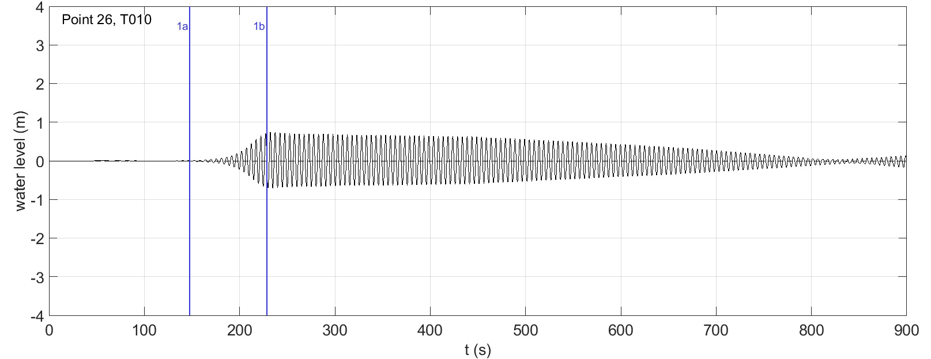
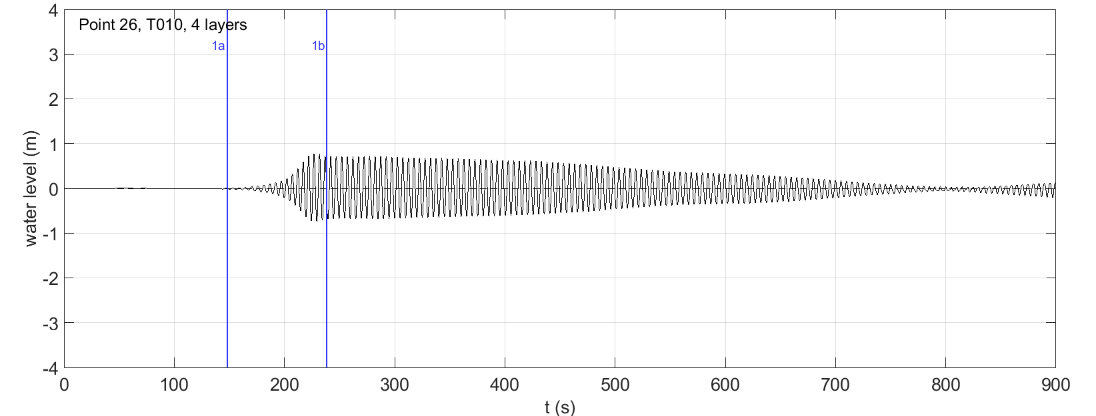

Results-2D models
Numerical instabilities : For relatively high waves (H/d>0.2) and/or breaking waves
Increase of vertical resolution →no improvement
Introduction
Methodology
Results
Conclusions &
Recommendations
$$Proposal:$$
Increase
Horizontal Resolution
(number of cells per L)
21

Slide 22

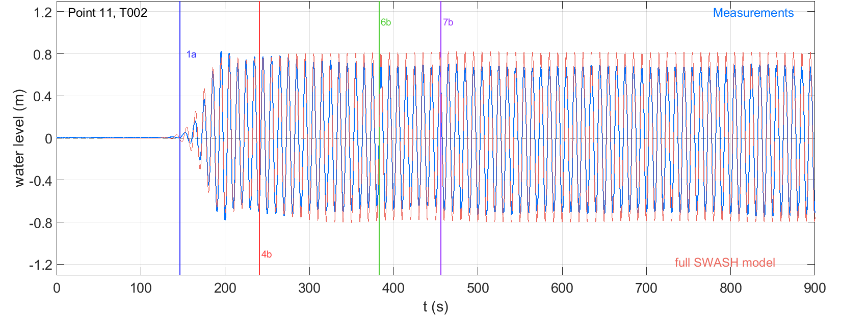

Results-Final Model D
Outside the basin
Inside the basin
Increase due to reflection
Introduction
Methodology
Results
Conclusions &
Recommendations
Temporal trends:
${\overline{H}}_{incoming}$: error 4-6%
Wave height changes/trends due to reflection & diffraction identified
Steady state reached
Good match for diffraction
22

Slide 23

Final 2D SWASH model for Layout 1(2)
Ratio ${\overline{H}}_{steady state }$/$H_{incoming}$ Difference (%) = $\frac{\overline{H_{SWASH}}−\overline{H_{measured}}}{\overline{H_{measured}}}$
Steady state wave height -Spatial trends:
Overall Agreement sufficiently well (trends, colours)
Good agreement(<10%): Close to the wave maker & When waves enter the harbour
Insufficient agreement (>31%) near the harbour entrance , in front of the concrete walls. Explanation: Strong standing wave pattern, the wave height changes fast close to a specific output point
Introduction
Methodology
Results
Conclusions &
Recommendations
23

Slide 24
Conclusions & Recommendations
Modelling reflection and diffraction in SWASH: sufficiently well for engineering purposes.
Relative importance of wave processes contributing to wave penetration
Outside the harbour basin:
  reflection off the harbour head walls
  reflection off gravel slope
  reflection off the harbour end
Inside the harbour basin:
  reflection off the harbour end
  diffraction
Tackle numerical instabilities
Examine the area close to the output point and not only the specific coordinates
Wave celerity: Linearity Assumption VS high order Stoke theory
Apply the research approach on:
more tests (different angle of incoming waves, complex layouts)
Introduction
Methodology
Results
Conclusions &
Recommendations
Head walls
24

Slide 25
Thank you for your attention!
I will be happy to answer your questions in the discussion or the chat or by email: marouditeni@gmail.com

