Slide 1
Simulating crop yields in Morocco using the CARAIB dynamic vegetation model driven by WorldClim and interpolated anomalies from Climate Research Unit
I. Loudiyi ¹, I. Jacquemin ², B. Tychon ², L. Francois ², M. Lahlou ³, J. Wellens ², and R. Balaghi ⁴
¹Institute of Astrophysics and Geophysics, University of Liège, Belgium
²Research Unit : SPHERES, University of Liège, Belgium
³The Agronomic and Veterinary Institute Hassan 2, Morocco
⁴National Institute of Agronomic Research, Morocco
Iliass.loudiyi@uliege.be

Slide 2
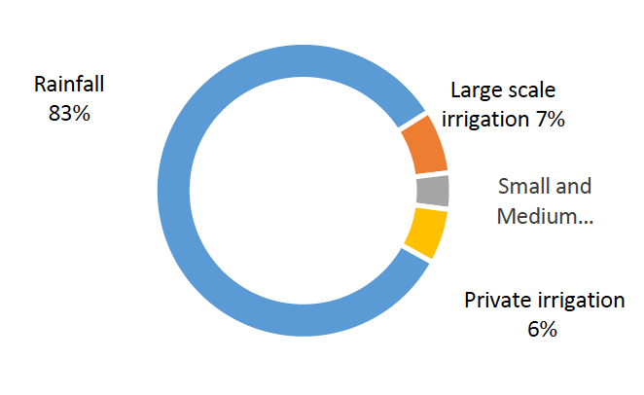
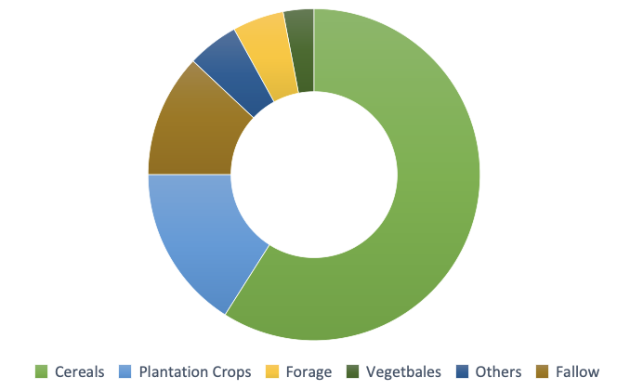
Overview :
Morocco, by its geographical position and its climate, is strongly affected by climate change and presents an ever-increasing vulnerability. In fact, the country's economy, being very dependent on agriculture, would be greatly affected. It is therefore necessary to further simulate and analyse past crop yields in order to develop knowledge about climate change and strengthen forecasting systems to predict it impacts on agriculture.
Moroccan Agriculture :
Cereal crops are the most dominant agricultural activities in Morocco, particularly in rainfed regions, since it occupies more than half of the area. Graph 1 shows about 59% of arable land is devoted to cereals, 16% to plantation crops (olives, almonds, citrus, grapes, dates), 5% to forage, 3% to vegetables, 5% to other crops (sugar beets, sugar cane, cotton and oilseeds), and 12% is fallow.
Graph 1 : Distribution of agricultural area in Morocco
Graph 2 : Distribution of agricultural area by water sources in Morocco

Slide 3
Dynamic Vegetation Model CARAIB (CARbon Assimilation In the Biosphere) :
This spatial model developed within the Unit for Modelling of Climate and Biogeochemical Cycles (UMCCB) of the University of Liège, includes crops and natural vegetation and may react dynamically to land use changes. Originally constructed to study vegetation dynamics and carbon cycle, it includes coupled hydrological, biogeochemical, biogeographical and fire modules. For crops, a specific module describes basic management (sowing, harvest, rotation) and phenological phases.
Main Inputs | Main Outputs
Meteorological variables Soil parameter Elevation Morpho-physiological parameter Phenological phases Basic crops management (sowing, harvest, rotation) | Soil hydrology Surface energy budget Yield, gross and net primary productivity Cover fraction for simulated species Biome distribution Soil heterotrophic respiration Carbon sequestration

Slide 4
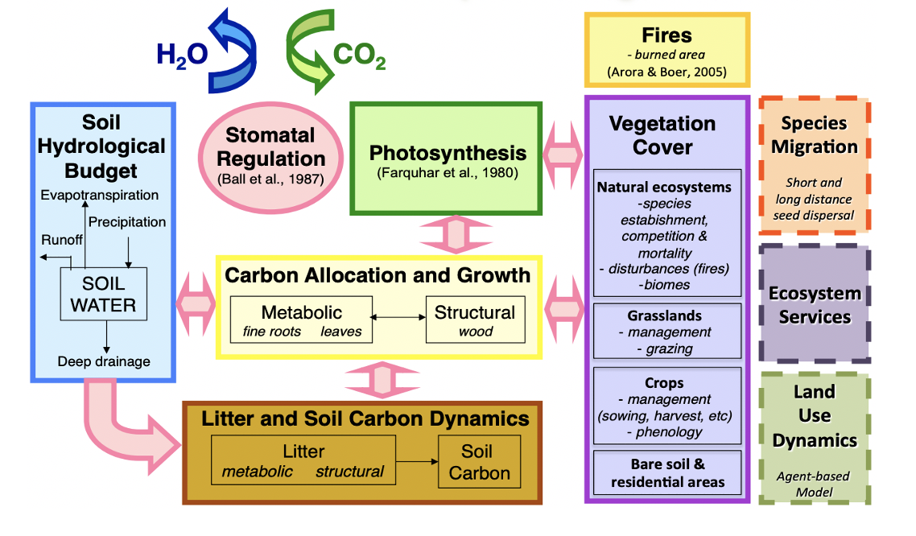
Dynamic Vegetation Model CARAIB (CARbon Assimilation In the Biosphere) :

Slide 5
Simulation protocol :
The simulations are performed across all Morocco, by using different input data. The timeline of simulations is divided in two periods (Graph 3) : past (from 1901 to 2018) and future (from 2019 to 2100). For the past period, we are using high resolution (30 arc sec) gridded climate data derived and interpolated anomalies from WorldClim (climatology) and Climate Research Unit CRU (trend and variability). For the future period, we use interpolated and bias-corrected fields from using the climate model HadGEM2-AO for three different Representative Concentration Pathway scenarios (RCP2.6, RCP4.5 and RCP8.5)
Regarding the crops, we are going to focus on cereals (soft wheat, drum wheat, barley), maize, olives, potatoes and sugar beets.
HadGEM2-AO
WorldClim + CRU
RCP2.6, RCP4.5 and RCP8.5
1860
1901
2018
2100
Graph 3 : Timeline of simulations

Slide 6
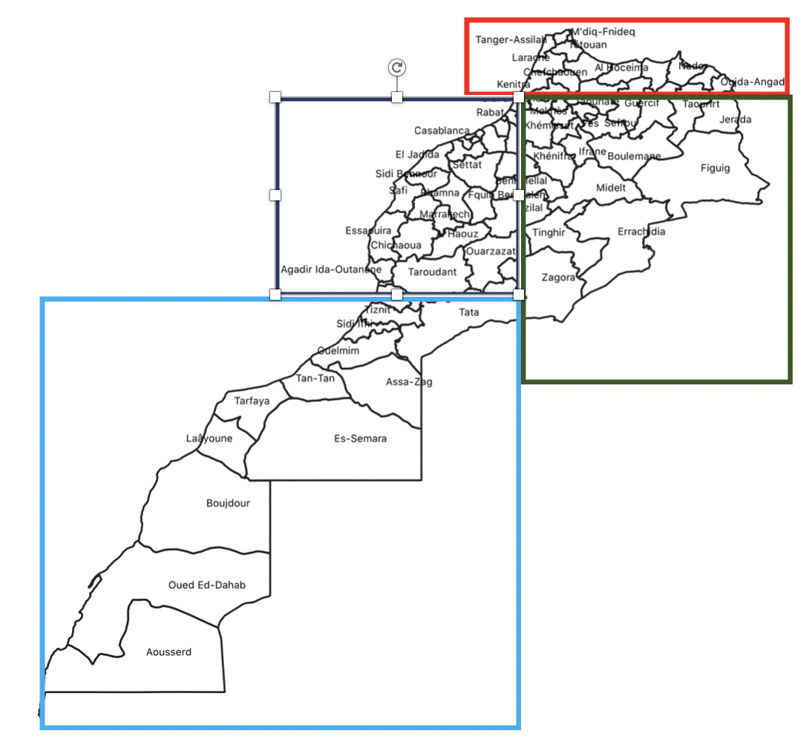
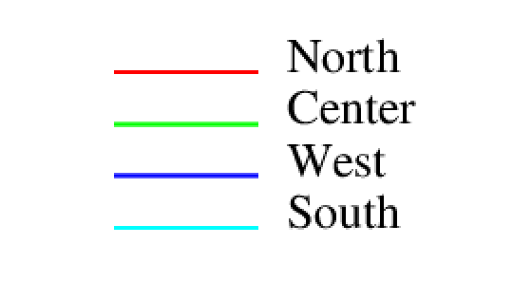
Preliminary results : Past period
In order to analyse the variation of crop yields, we divided Morocco into 4 zones : North, centre, west and south :
The following results present the mean crops yield for each zone.

Slide 7
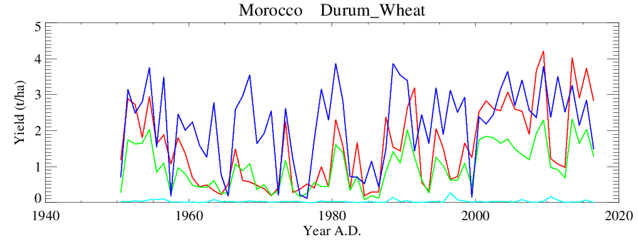
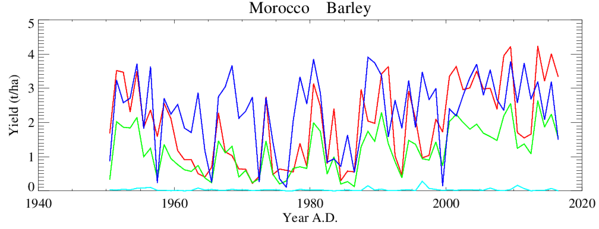
Preliminary results : Past period
Cereal productivity of soft Wheat, durum wheat and barley is strongly influenced by rainfall, varying in space and time:
In space the northern and western regions are more productive than the south and centre
In time, the yields varies from about 0,1 t/ha recorded during the dry crop season of 1999 to 4,5 t/ha during the wet season of 2009

Slide 8
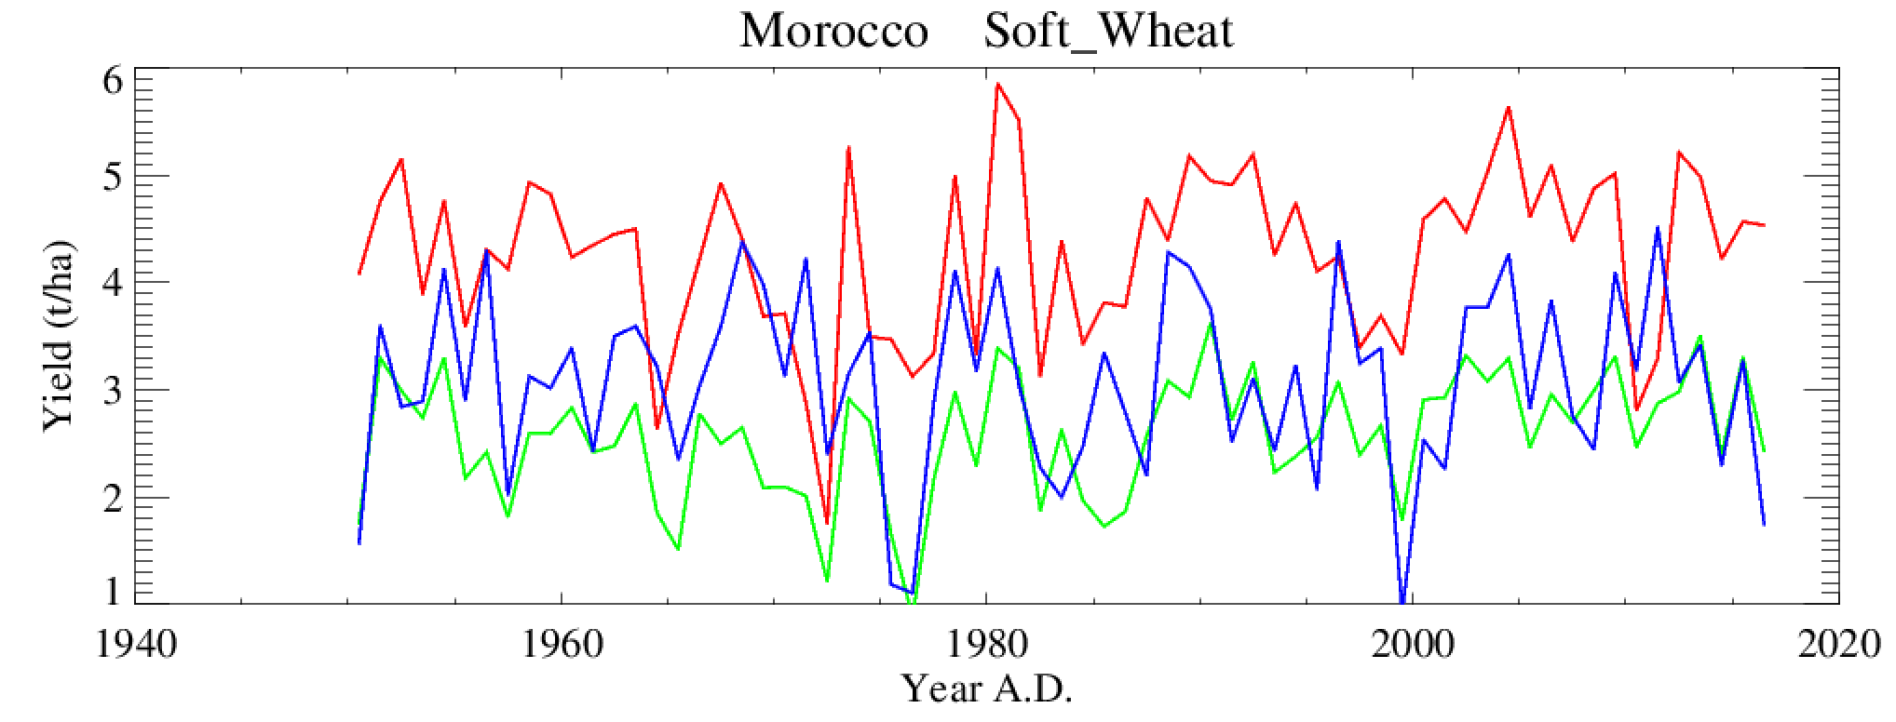
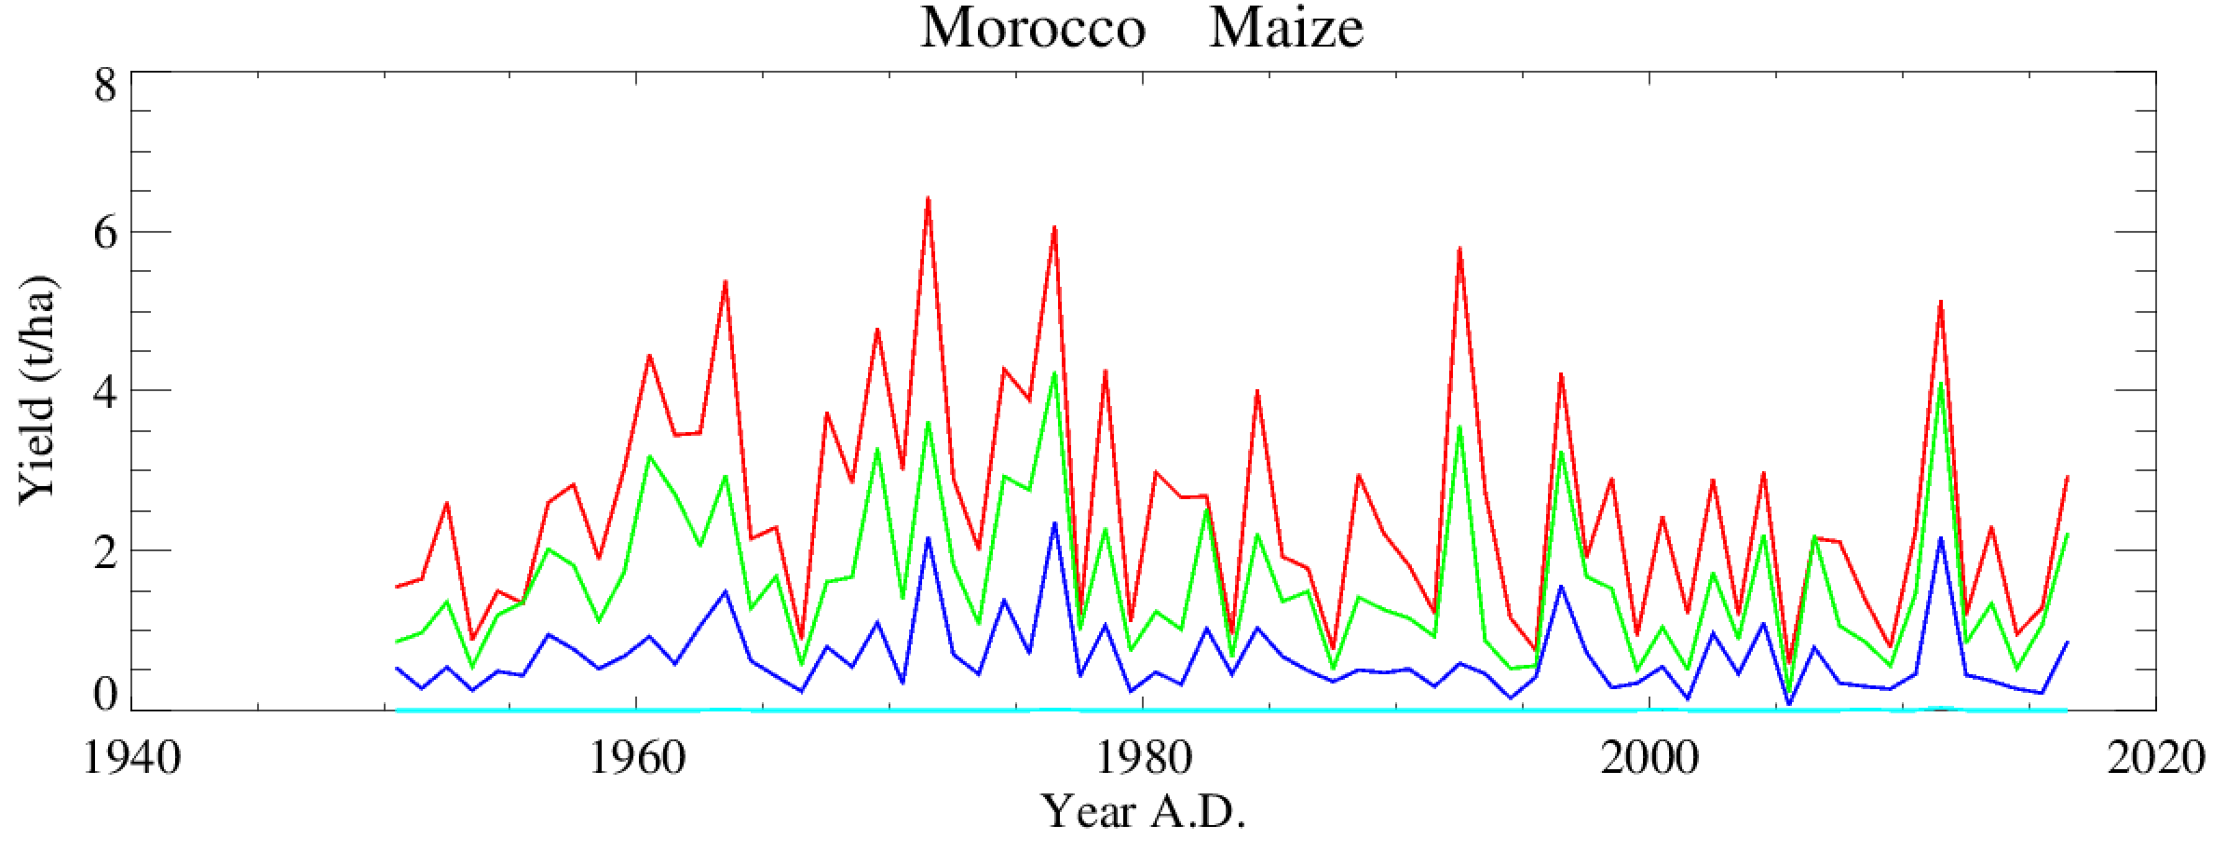
Preliminary results : Past period
Maize production is concentrated in the northern and centre regions more than the west, in other hand there is no maize production in south due to Saharan agro-ecological zone.
In fact, the inter-annual variability of yield is quite important, for example it variate from 6 to 1 t/ha

Slide 9
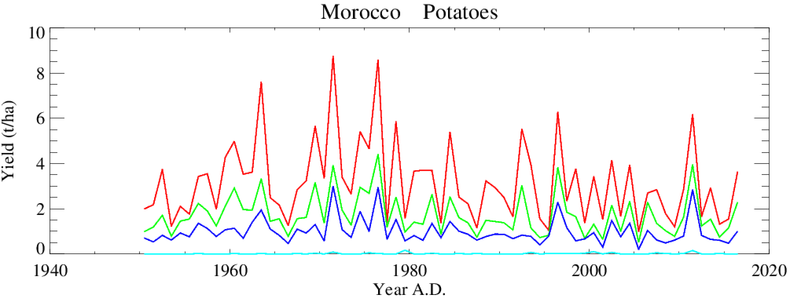
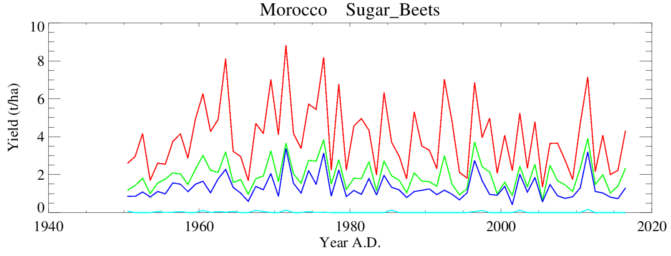
Preliminary results : Past period
Regarding potatoes and sugar beets, they follow the same pattern of maize

Slide 10
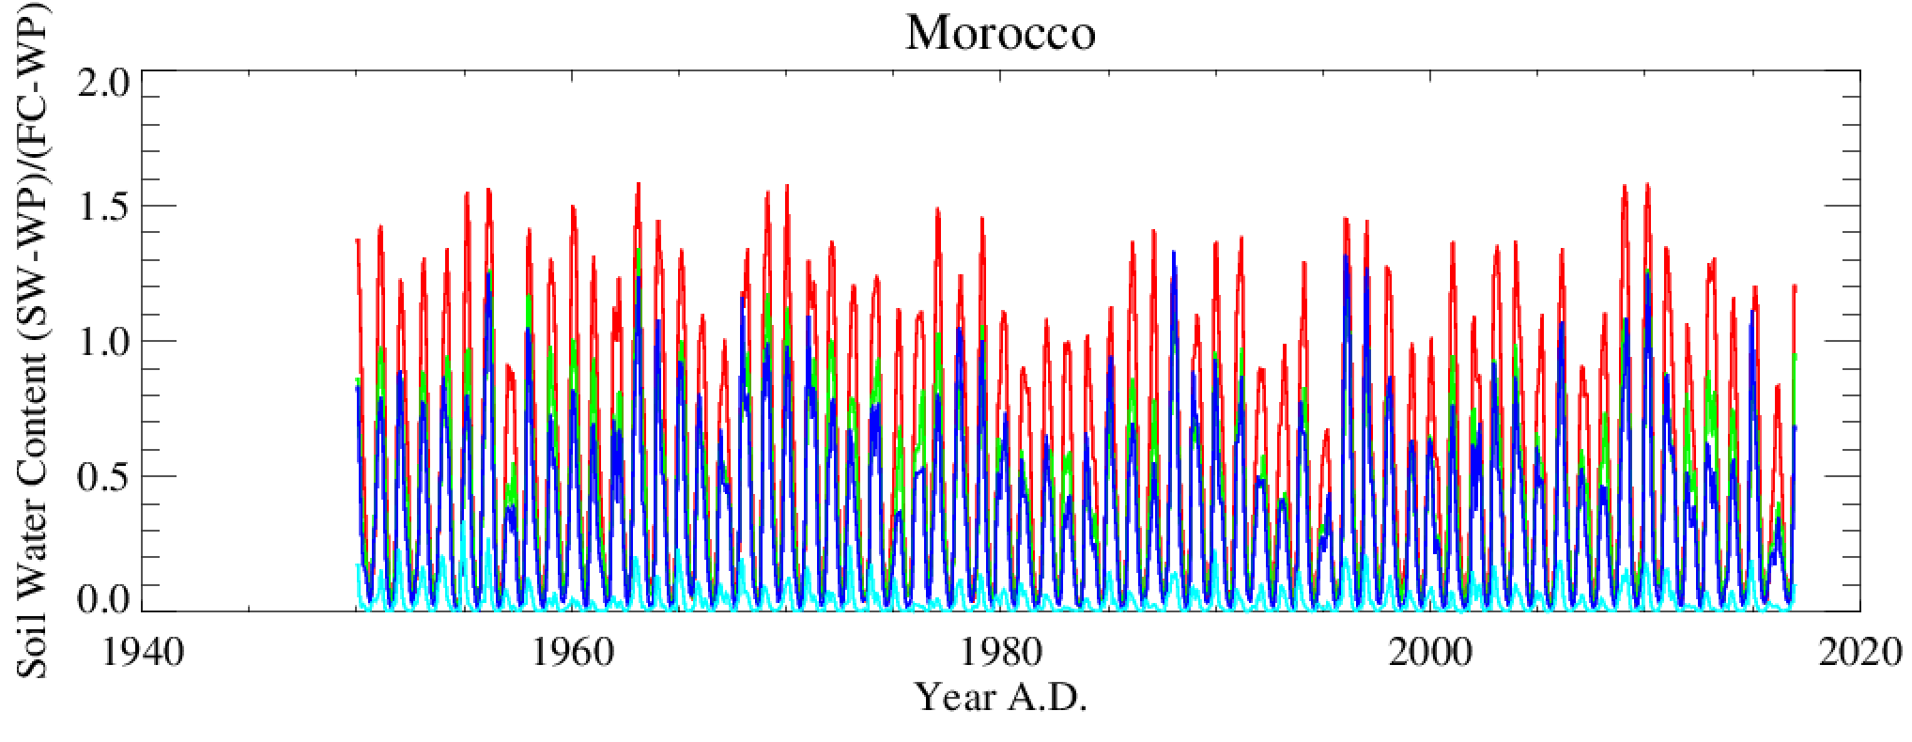
Preliminary results of soil water content : Past period
The soil water (SW) is allowed to vary between the wilting point (WP) and the saturation. Below, the soil water content will be expressed in relative units, as the fraction of the water available for plant growth (ASW) at field capacity (FC) : ASW = (SW-WP)/(FC WP). In the literature, it is also called relative extractable water
Precipitations are the only prescribed water flux in CARAIB. Indeed, this graph illustrate the soil water content for the four zones in Morocco, the amplitude of the north zone is important rather than the south , for the west and center the amplitude varies modestly. If we take the difference between the soil water content of dry year 1999 and the wet year 2009 for example, we can see there is a significative difference.

Slide 11
Comparison between observed yields and model results :
Observed yields

Slide 12
Comparison between observed yields and model results :
The values of yield results obtained using CARAIB are much higher than the observed ones, in order to bridge the gap between the two yields, some input parameter related to the hydrological module and stomatal regulation must be adjusted.
In fact, we going to use soil texture parameters (clay, silt and sand) at the depth 30-60 cm instead of 15-30 cm to increase the hydrological stress and automatically decrease the yields.

Slide 13
Conclusion :
These preliminary results appear to be encouraging. In fact after adjusting the inputs, and validating the results of the past period, we are going to simulate the future period by using the coupled climate model HadGEM2-AO for the Coupled Model Intercomparison Project phase 5 (CMIP5). The RCPs (RCP 2,6, RCP 4,5 and RCP 8,5) are selected as standard scenarios for the IPCC Fifth Assessment Report and these scenarios include time paths for emissions and concentrations of greenhouse gas and aerosols and land-use/land cover.

