Slide 1
Real-Time Detection of Water Stress in Corn Using Image Processing and Deep Learning
Mor soffer
Instructors: prof. Naftali Lazarovitch, prof. Ofer Hadar

Slide 2

Schedule
Introduction and motivation
Our method
  Data collection
  Data description
  Proposed method
Results and conclusions
Innovations
Future work

Slide 3
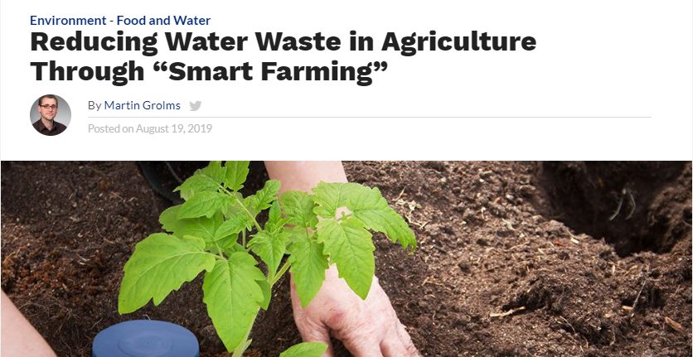
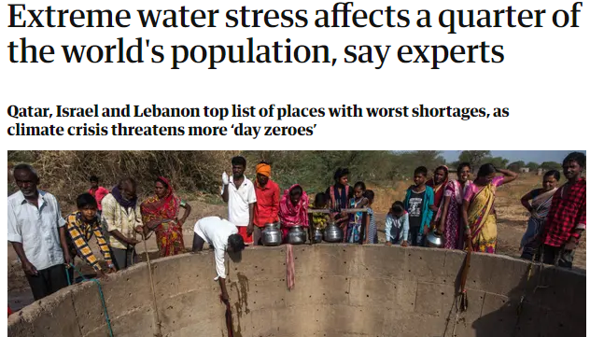
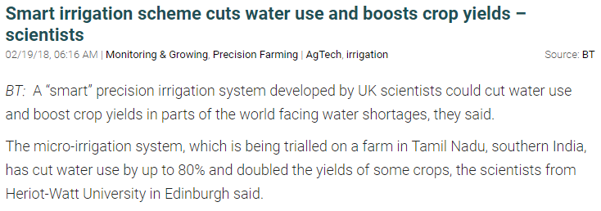
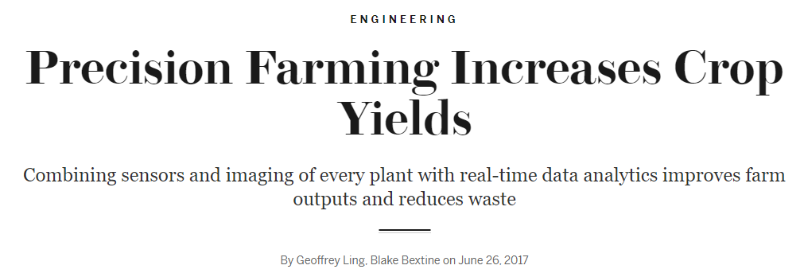
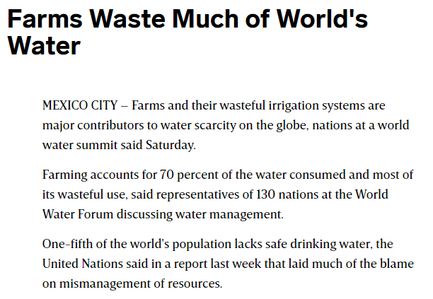
Introduction and motivation
Water limitation is one of the main environmental constraints that adversely aﬀects agricultural crop production around the world.
Precise and rapid detection of plant water stress is critical for increasing agricultural productivity and water use efficiency.

Slide 4
Introduction and motivation
What are the problems with the current methods?
  Cost – currently used tools for water stress detection are very expensive.
  Effectiveness – these tools are often very slow and cumbersome.
  Destructive methods.
Image processing is an alternative way to visually recognize water stress levels.
Such analysis is non-destructive, inexpensive and allows to examine the spatial variability of stress level under ﬁeld conditions.

Slide 5
Our method
We propose a new method for detecting water stress in corn using image processing and deep learning.
Given an image of a plant, we apply image processing techniques in order to extract main features of the image.
In addition, we represent the date when the image was taken with an embedding vector, which we convert into a grayscale image and concatenate to the filtered image.
Then, we insert these features into a Convolutional Neural Network, which outputs the plant’s level of water stress.
Notes:
In general!

Slide 6
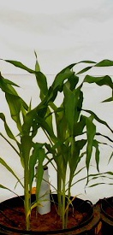
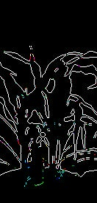
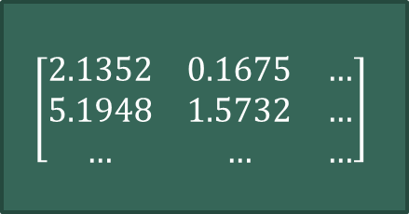
Our method
R
Image Processing (Edge Detector)
R
G
G
B
B
1
CNN
(VGG16)
2
3
4
$$\left[\begin{matrix}2.1352 & 0.1675 & … \\ 5.1948 & 1.5732 & … \\ … & … & …\end{matrix}\right]$$
5
16.11.2019

Slide 7
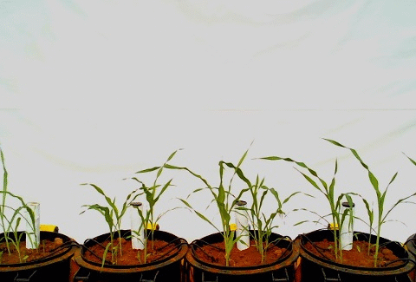
our method data collection
For the purpose of collecting the images, we performed a three-months experiment in Sede Boqer.
During the experiment we took images of ﬁve diﬀerent groups of corn, every 5 minutes.
Each group had a diﬀerent irrigation treatment, which led to ﬁve diﬀerent levels of water stress.
The images were collected using a web camera located approximately 2m from the plants.
Validation set was collected by another camera, which was located in a different position.

Slide 8
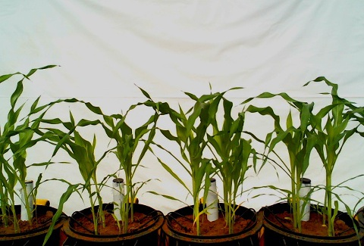
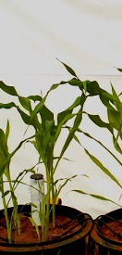
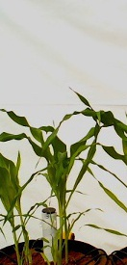
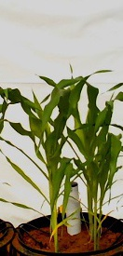
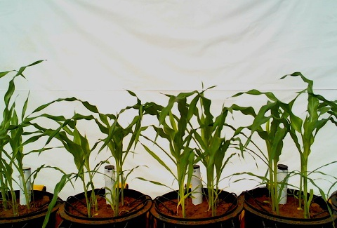
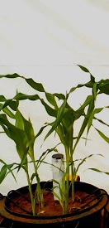
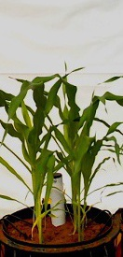
our method
Data description
During the experiment, 5066 images were collected from 5 different cameras.
After selecting images taken every 2 hours, about a quarter of the images were used as our dataset.
Traditionally, the dataset was divided into train, test and validation sets (in a ratio of 80:10:10).
In order to enlarge and diverse the dataset, we’ve applied several methods:
  Train set – random cropping with a “sliding window” which produced ten 225X132 images from every single image.
  Test set & validation set – splitting every image into two 225X132 images, that contain a single container.
These methods, together with the images collected from the sixth camera, produced 5273 images
TRAIN
TEST

Slide 9
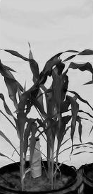
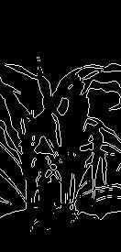
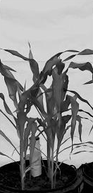
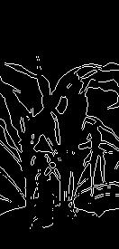
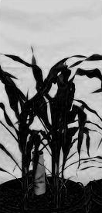
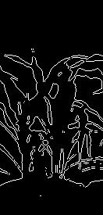
Our method proposed method
First step: Edge Detection
Every image from the train set was divided into its R,G,B channels.
Every channel was filtered with an edge detector (Sobel Filter or using Wavelet Transform).
All three channels were combined into a single RGB image.
Image Processing
(Edge Detector)

Slide 10
Our method proposed method
Second step: Date Representation
The dates of the images were represented by serial numbers.
Each number was converted into an embedded vector, and the vector was reshaped into a 225x132x1 image.
The output was concatenated with the filtered image, as the 4th dimension of the image.
In order to adjust the image dimensions to the network’s input size, a convolution layer with three filters was applied.

Slide 11
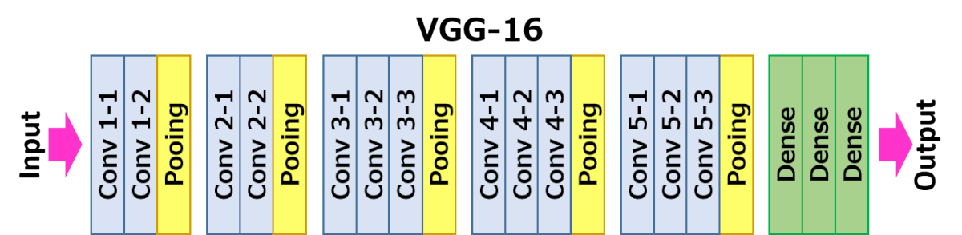
Our method proposed method
Third step: Convolutional Neural Network
Stress classiﬁcation was done by inserting processed images into a CNN.
Training the network was done using transfer-learning techniques in order to exploit the performance of an already trained CNN, for a fast and efficient training over the dataset.
We have used VGG16 as a feature extractor.
Several augmentation techniques were applied (i.e. horizontal flip and zoom).

Slide 12
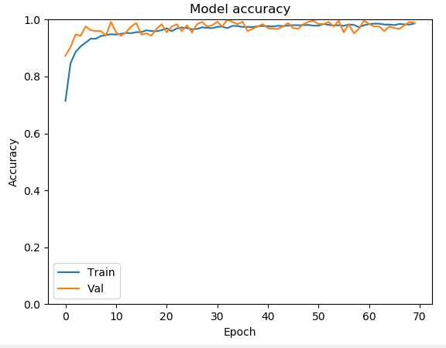
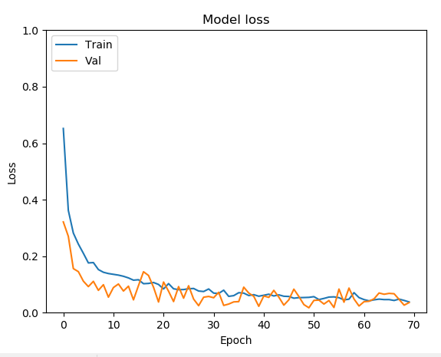
results
Results – three classes:
98% accuracy in classiﬁcation into three types of treatments (well-watered, reduced-watered and draught stressed treatments).
categorical cross-entropy

Slide 13
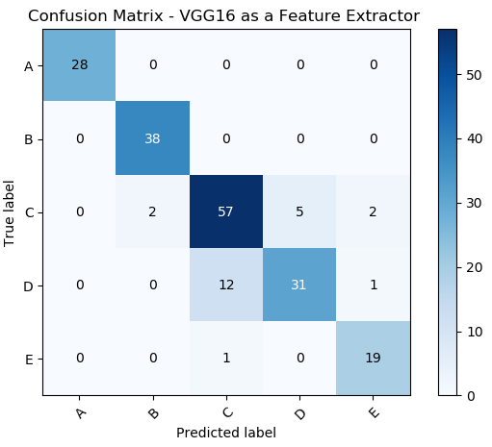
results
Results – five classes:
89% accuracy in classiﬁcation into five types of treatments.
Most errors were misclassification of neighboring groups C and D.
Better and more stable results than classification of raw RGB images.

Slide 14
Innovations or – how our work differs from previous works?
Previous studies used images taken from the same location of the same plant, for both training and validation sets. This might lead to information leakage. We use cropped images and images taken from a differently-positioned camera, in order to prevent the network from “memorizing” the images.
None of the previous studies (at least not the ones I saw) used the date the image was taken as a feature.
Some studies performed an open-field experiment which drew images with specific backgrounds, that could be mistakenly learned as a feature. We have used a white background, identical in all images.
Many previous studies have examined their work on a three different treatments case only, which is easier to classify. We have tested our work on both three and five treatments cases.

