Slide 1
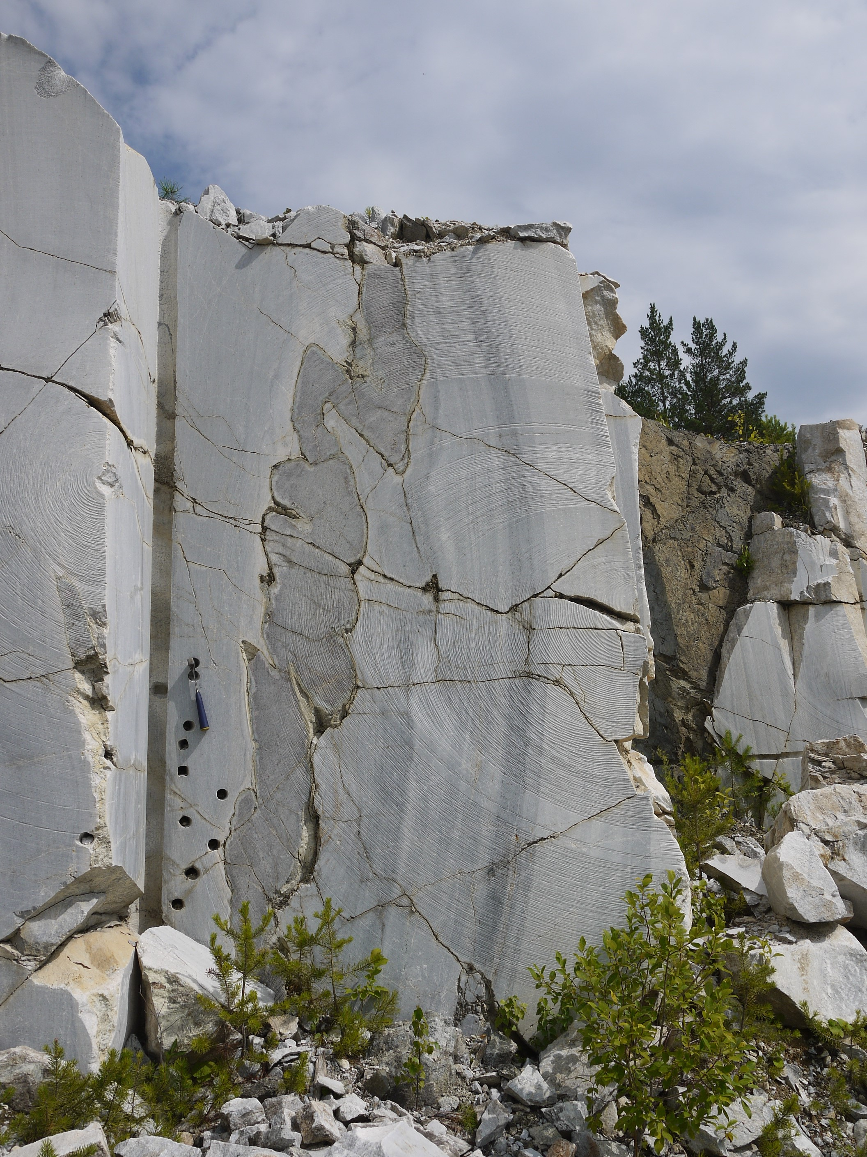
Prospects of paleomagnetic studies of the Riphean intrusive bodies of the Bashkirian megazone (Southern Urals)
Anton Latyshev (1,2), Maiia Anosova (2), and Alexey Khotylev (2)
(1) Institute of Physics of the Earth RAS, Moscow, Russian Federation
(2) Lomonosov Moscow State University, Geological Faculty, Moscow, Russian Federation

Slide 2
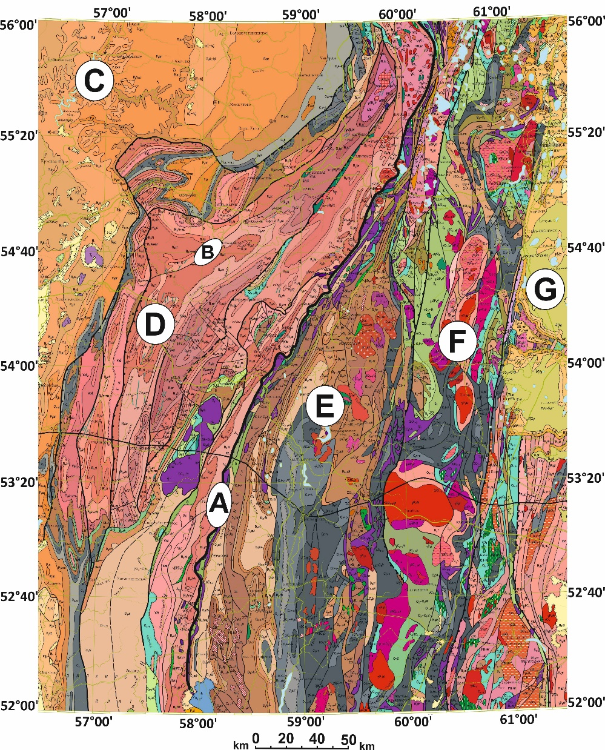
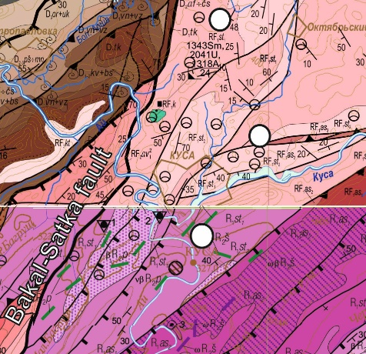
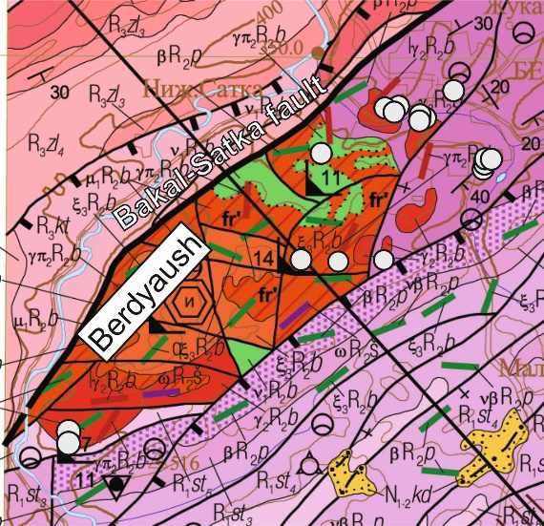
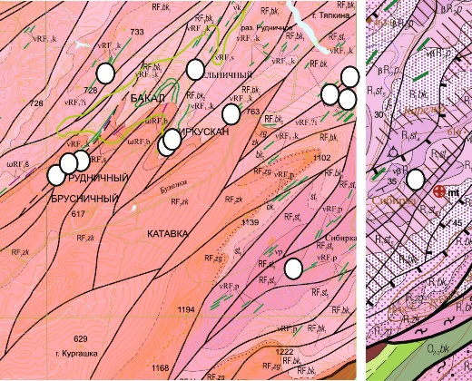
Study area
Southern Urals
А
- Main Ural fault
B
- Bakal-Satka fault
C
- East-European craton
D
- Bashkirian megazone
E
- Magnitogorsk megazone
F
- East-Ural megazone
G
- West Siberian basin
Sampling locations(large-scale maps for locations with more than 2 sites)
-
The studied objects are located in the core of the Bashkirian megazone and related to the Riphean stage of rift magmatism of the East European craton. At this moment, 42 thin basic intrusions and the Main Bakal dyke were investigated.
Slide 2

Slide 3
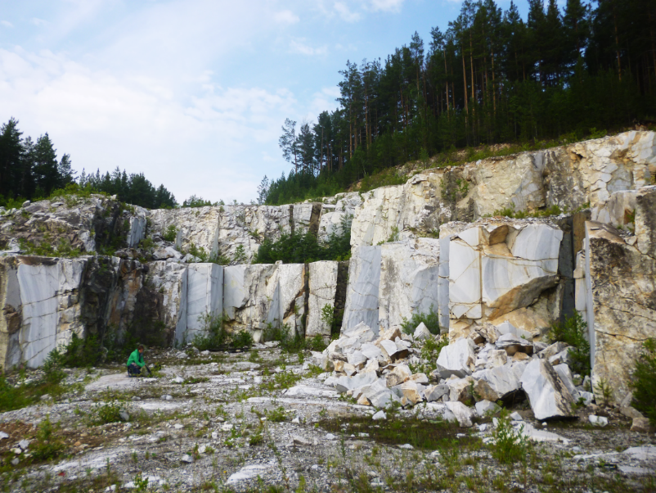
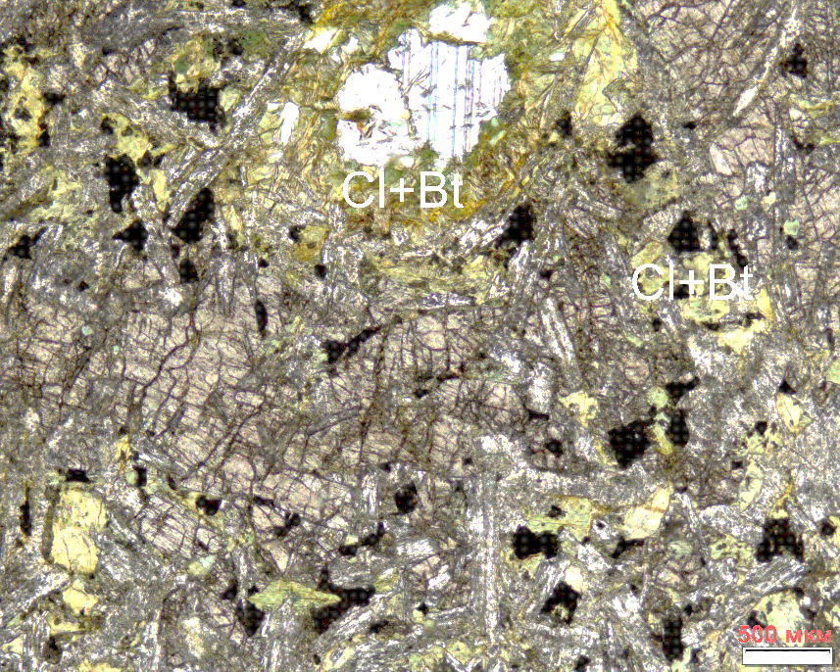
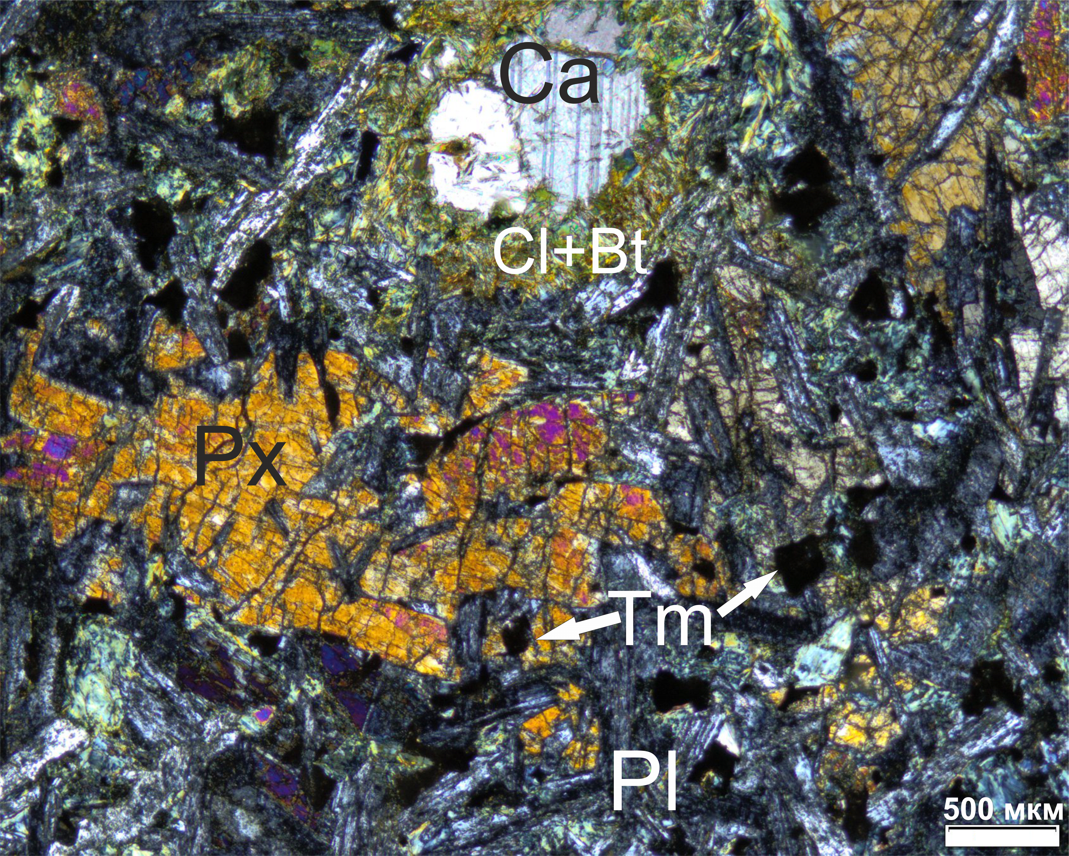
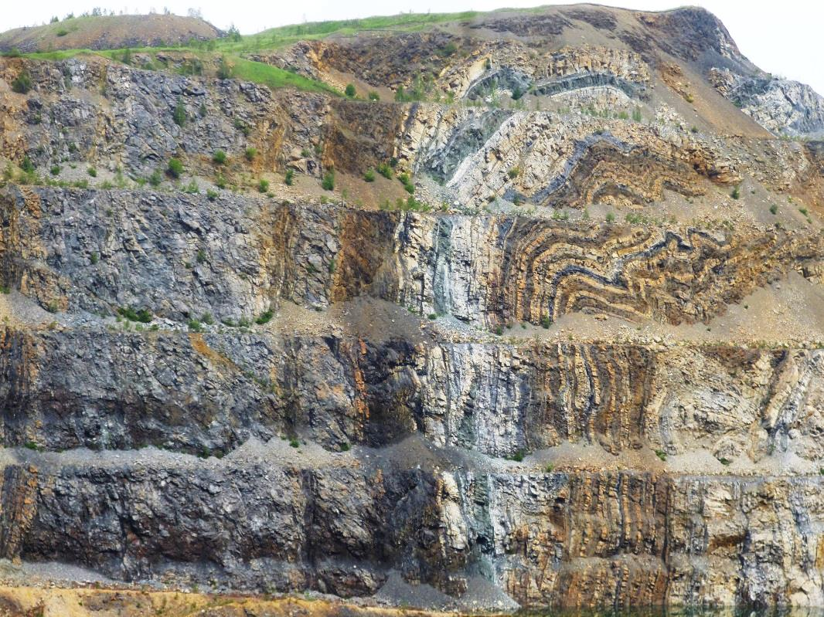
Study objects
Parallel dykes cutting Berdyaush pluton and its host rocks.
Point 16, 2018
The studied objects are mainly thin bodies of dolerite and gabbro-dolerite
Deformed sill and host rocks. Irkuskan quarry. Points 3 and 4,
2018
Paleomagnetic studies of the Bashkirian megazone intrusive bodies can be a source of new information on the East European platform position in the Riphean, as well as on the process of remagnetization during the Late Paleozoic folding on the Southern Urals.
Here we present a brief review of the remanence components identified in the Middle Riphean intrusions of the Bashkirian megazone
Slide 3

Slide 4
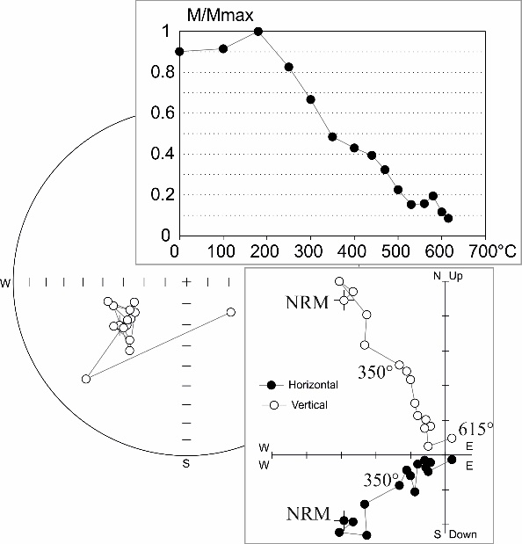
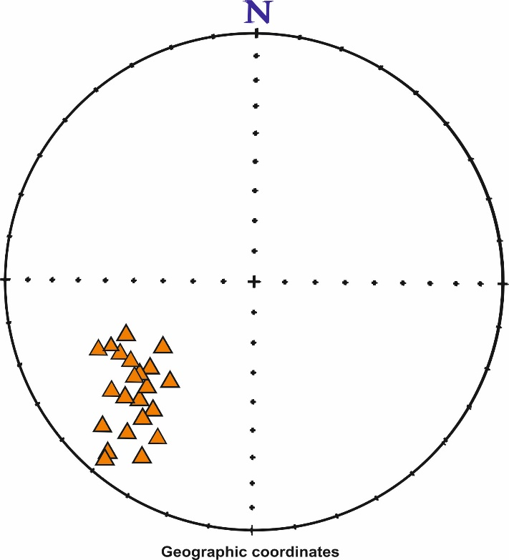
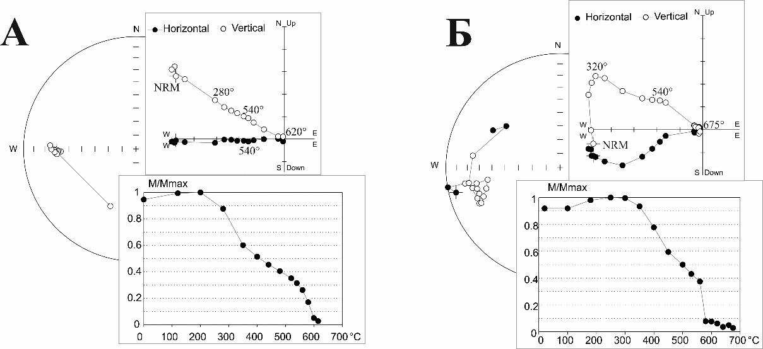
PZ2 component
Directions of the
remanence
(site mean)
Sample 338, site 19-17, Kusa.
Stereograms and Zijderveld diagrams
This high-temperature component was isolated in every study district. It has reverse polarity. Probably it is the secondary component and it has Late Paleozoic age.
This component is widespread on the Southern Urals and has been repeatedly identified by other researchers earlier.
Sample 136,
site 8-1-18
Slide 4

Slide 5
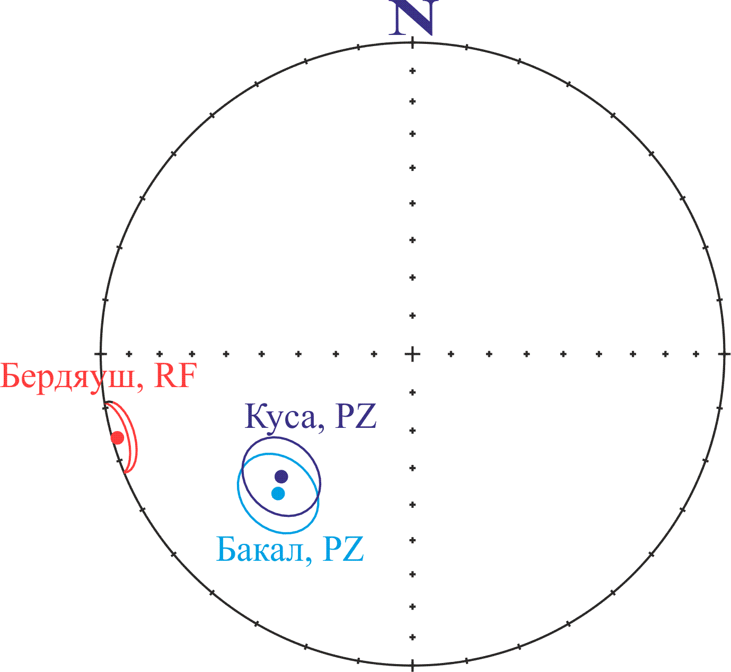
Kusa
Bakal
Kusa
The Late Paleozoic directions from different parts of the Bashkirian megazone coincide.
Bakal
Slide 5

Slide 6
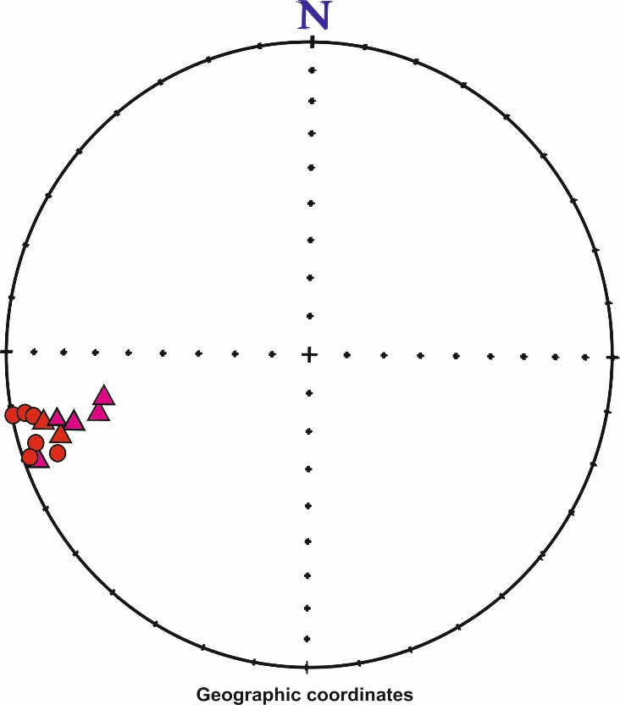
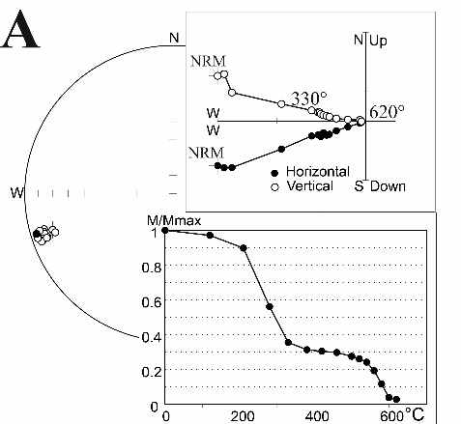
R1/R2 boundary component(~1349 Ма)
High-temperature component in a dikes of the East Berdyaush frame was isolated.
This component has a good signal.
Pole for the boundary of the Early and Middle Riphean of the East European Craton was calculated from this component of remanence of 8 sheet intrusions.
Directions of the
remanence
(site mean)
11-17
16-17
Stereograms and Zijderveld diagrams
Sample 217, site 16-1-17.
Slide 6

Slide 7

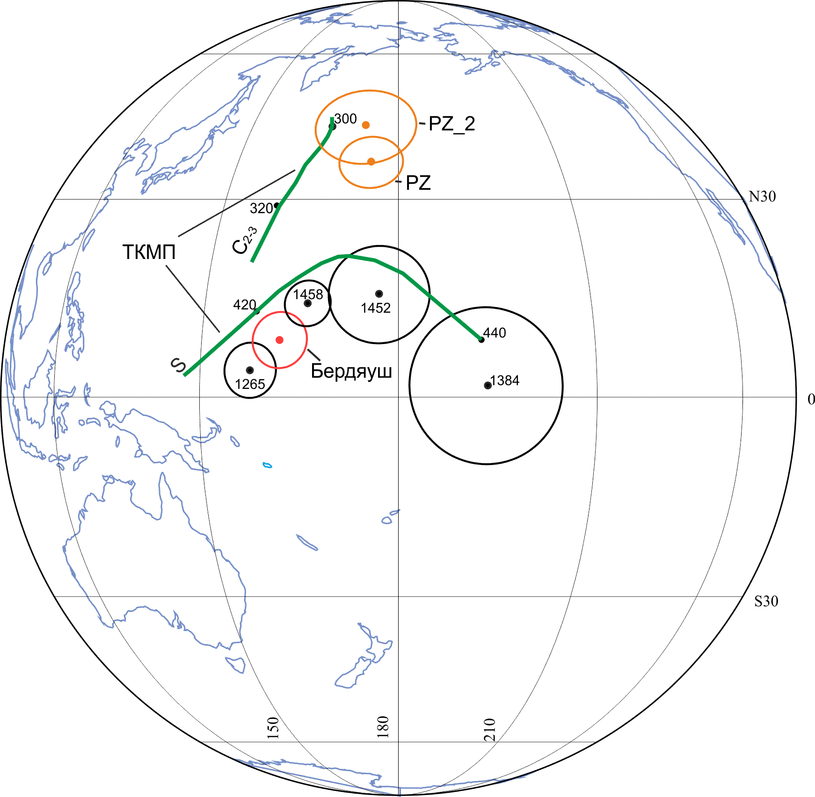
The location of the paleomagnetic poles for the East-European craton in Riphean
Directions
of the
remanence
(site mean)
The calculated pole for the East-European craton from dikes in the Berdyaush area:
APWP
N=8 Plong=162.4, Plat=8.4, A95=4.1
This pole is close to the known paleomagnetic poles of East European craton for close ages and agrees with U-Pb age of one of the studied bodies (1349 ± 11 Ma)
Also pole was calculated for the Late Paleozoic component(PZ_2 and PZ). It close to C1-2 part of APWP.
Berdyaush
Part of the APWP for the Baltic in Silurian and Carboniferous (Torsvik et al., 2012)
1458 – Valaam sill (Salmonen,Pesonen,2007)
1452 – Dikes of dolerites, Northern Ladoga area
(Lubnina,2009)
1384 – Southern Urals (Lubnina,2009)
Slide 7
1265 - Iotnic dolerites (Buchan et al.,2000)

Slide 8

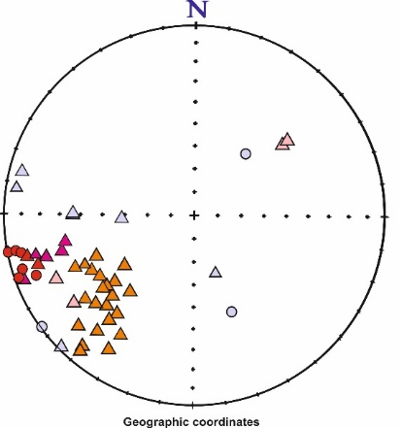
Other arguments in favor for the primary origin of the high-temperature component and the absence of later deformations:
1. Directions calculated by the high-temperature component significantly differ from the direction obtained by the older dyke of the same site.
Site 16 too
Site 16
2. Some samples from this site(16) have middle temperature Late Paleozoic component.
3. The Late Paleozoic directions from different parts of the Bashkirian megazone coincide, as explained earlier
4. Host rocks distant from the contact of the Berdyaush massif are not strongly dislocated
Slide 8

Slide 9
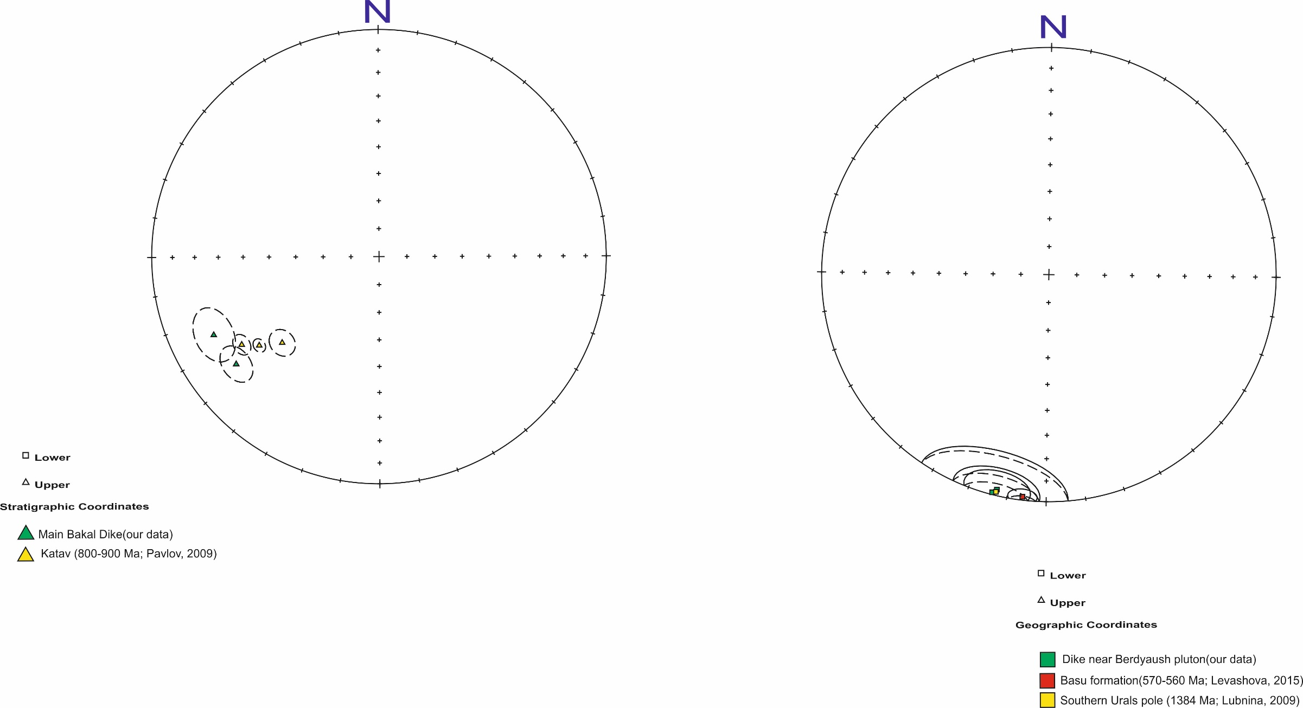
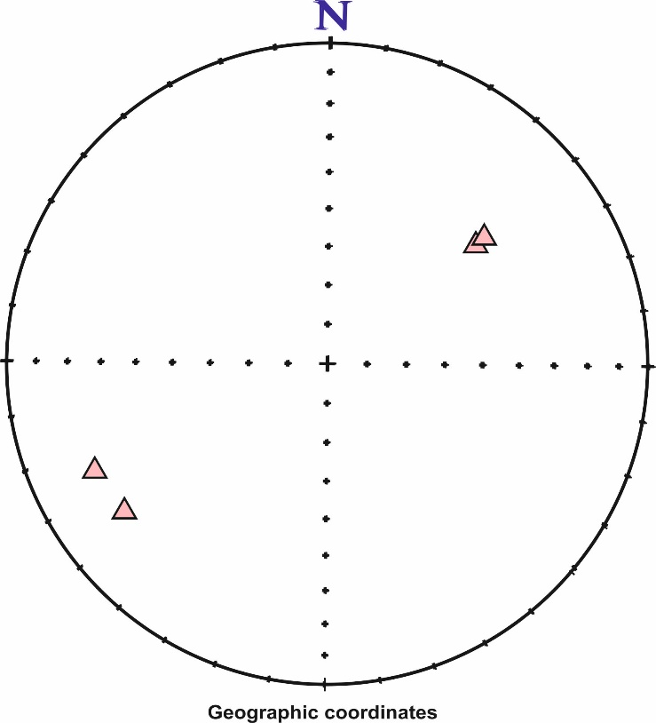

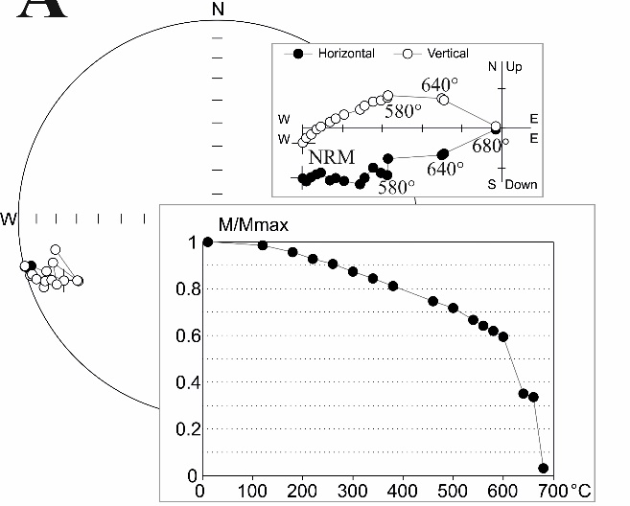

R3(?),V(?) component
.
Its have reverse polarity and normal signal.
Direction from Main Bakal dike close to direction from katav formation(Pavlov, 2009)
Directions of the
remanence
(site mean)
Directions of the
remanence
(site mean)
VGP for 2 dikes wich cut Berdyaush host rock close to pole Basu formation(Levashova,2015) and pole for East-Europian craton for 1384 Ma(Lubnina, 2009)
Poles
Stereograms and Zijderveld diagrams
But the origin of the component in these intrusive bodies is a very discussion issue.
Sample 52, site 2-5-18, Main Bakal dyke.
Slide 9

Slide 10
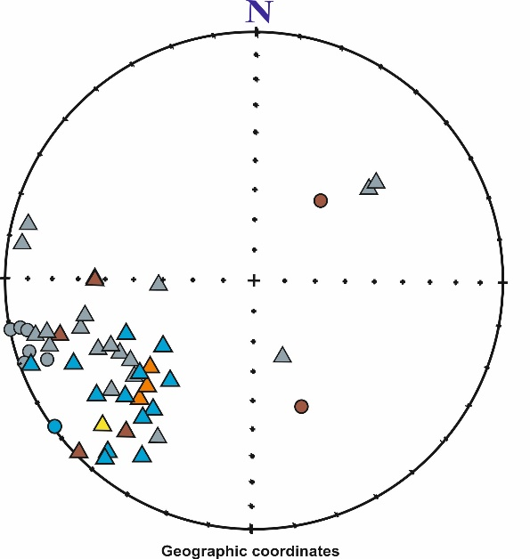
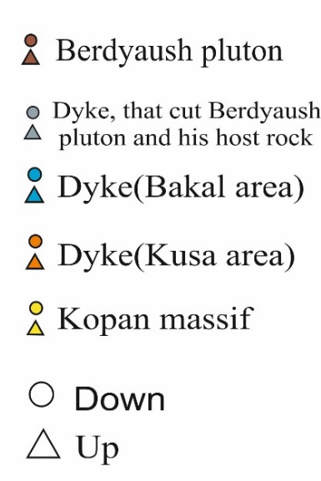

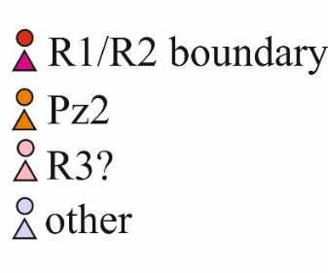
Сonclusion
Kusa
Berdyaush
Bakal
Kopan
1. Paleomagnetic data Western Urals Riphean intrusive bodies can be a source of information for reconstruction of the East-European craton positions in Rifey.
2. Was obtained the new paleomagnetic pole for the high-temperature component of remanence: N=8, Plong=163.0, Plat=8.1, A95=4.3 for 1349 ± 11 Ma. This pole substantially supplement the APWP
3. The Late Paleozoic component is widespread. On the studied part of Bashkirian megazone this component was formed in the same age interval. Afterwards there were no significant horizontal movements relative East-Europian craton. It is important fact for the reconstruction of collision deformation details
4. There is a component with a possible late Riphean age in the intrusive bodies of the Bashkirian megazone. However, its origin and age requires further study.
Slide 10

