Slide 1
For a flyover video version of this presentation, use the following link:
https://youtu.be/VWIUtZTXadM
Recommended if possible (same content, more fun)

Slide 2
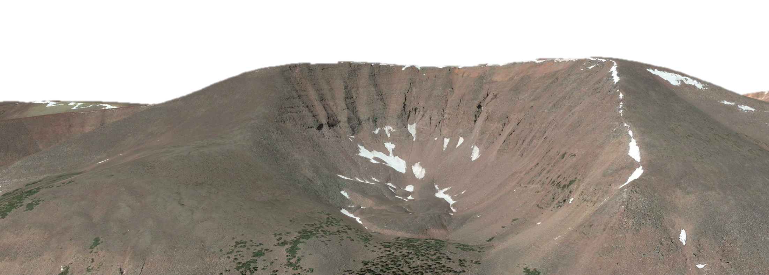
Using InSAR to characterize rock glacier movement in the Uinta Mountains, Utah
George Brencher¹, Alexander Handwerger^{2,3}, Jeffrey Munroe¹,
(1) Geology Department, Middlebury College, Middlebury, VT 05753,
(2) Joint Institute for Regional Earth System Science and Engineering, University of California, Los Angeles, USA,
(3) Jet Propulsion Laboratory, California Institute of Technology, USA

Slide 3
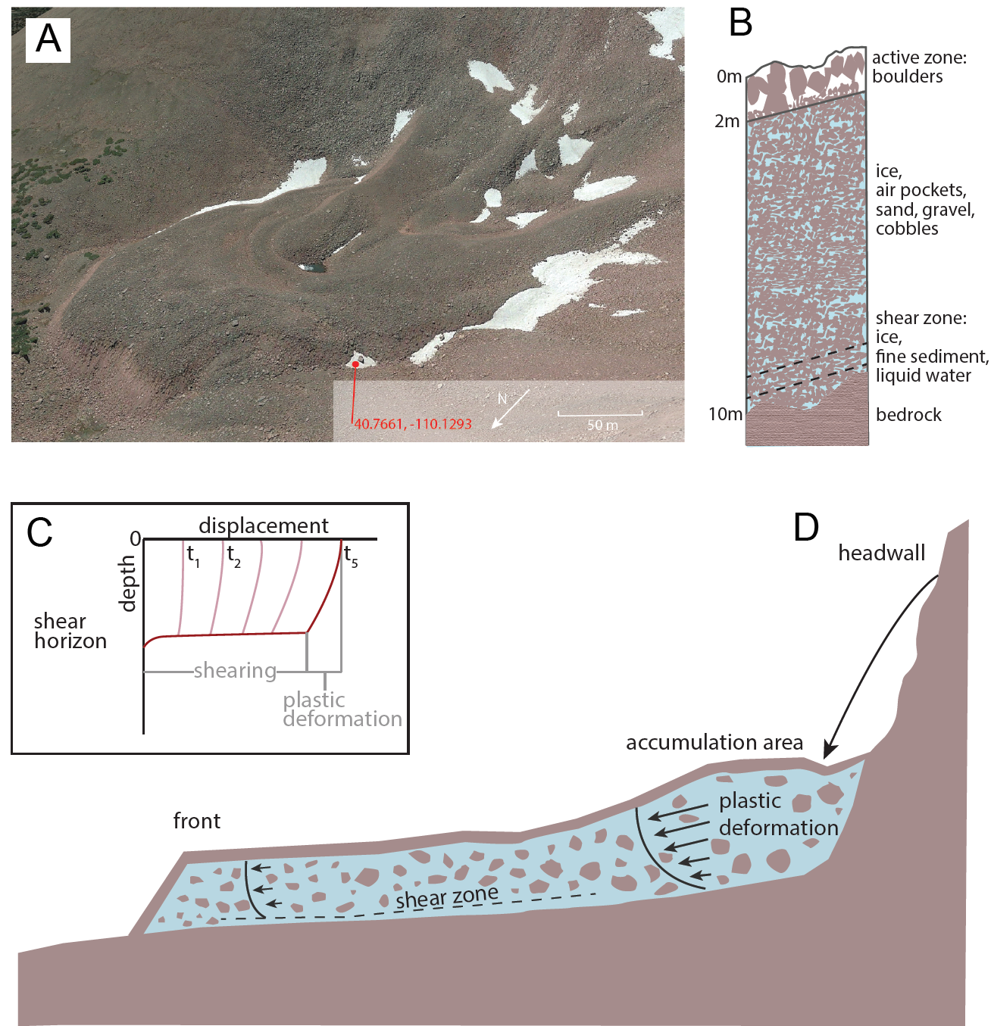
Rock glaciers
Common cold mountain landform
rock glacier classes:
active - contain ice, deform
inactive – contain ice, stationary
relict – contain no ice, stationary
Importance:
Water resource
Coarse debris transport
Permafrost indicator
After Kenner et al., 2017

Slide 4
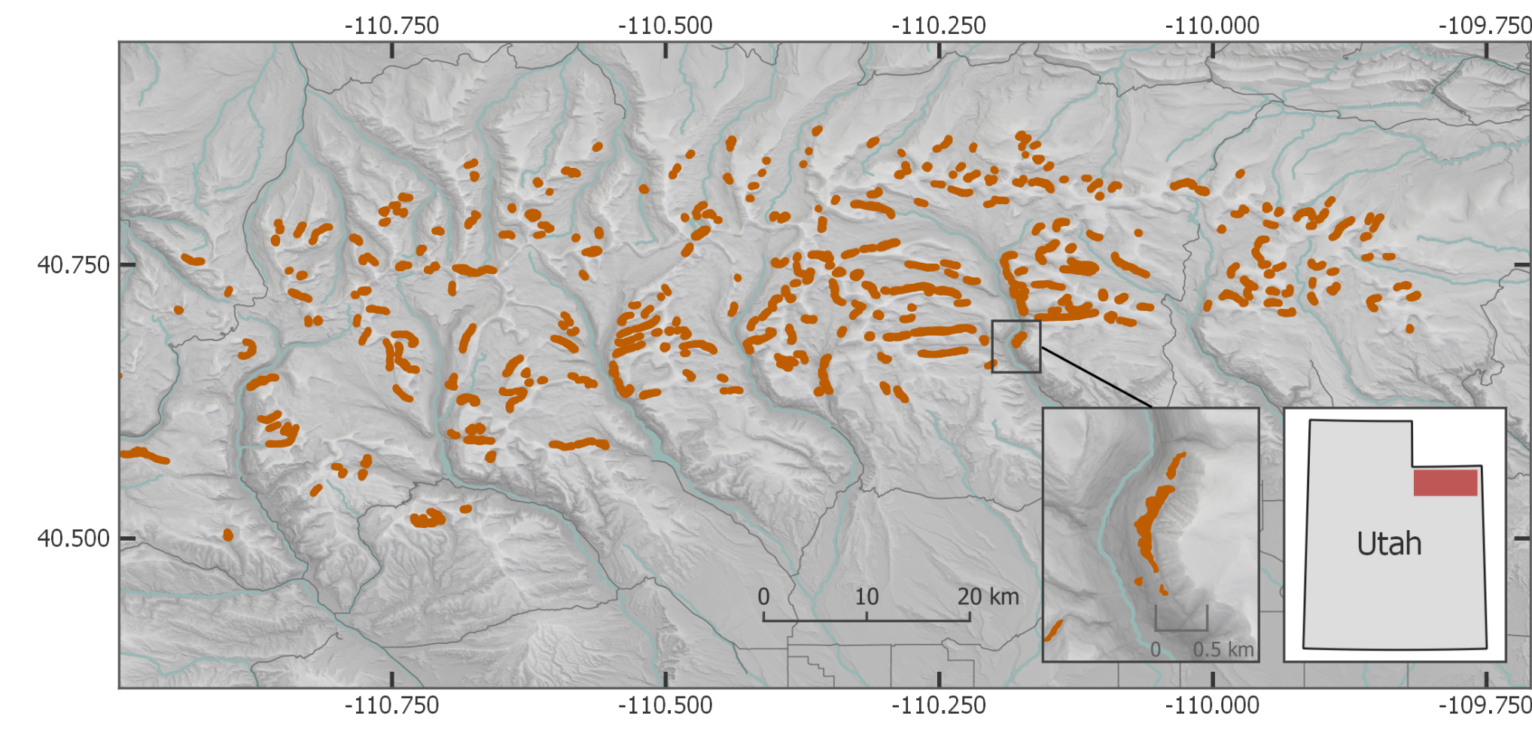
Rock glaciers in the Uintas
east-west trending mountain range covering ~10,000 km²
395 rock glaciers, unknown ice content (Munroe, 2018)
Question: what is the kinematic behavior of these rock glaciers?

Slide 5
Methods
Sentinel 1 data
generated 110 interferograms for entire Uinta range in JPL InSAR Scientific Computing Environment (ISCE)
shortest is 6 days, average is 72
generate rock glacier inventory in QGIS from:
interferograms
Google Earth
prior Uinta rock glacier inventory (Munroe, 2018)
climate data from SNOTEL stations
https://www.airbusdefenceandspacenetherlands.nl/project/sentinel-1-2/

Slide 6
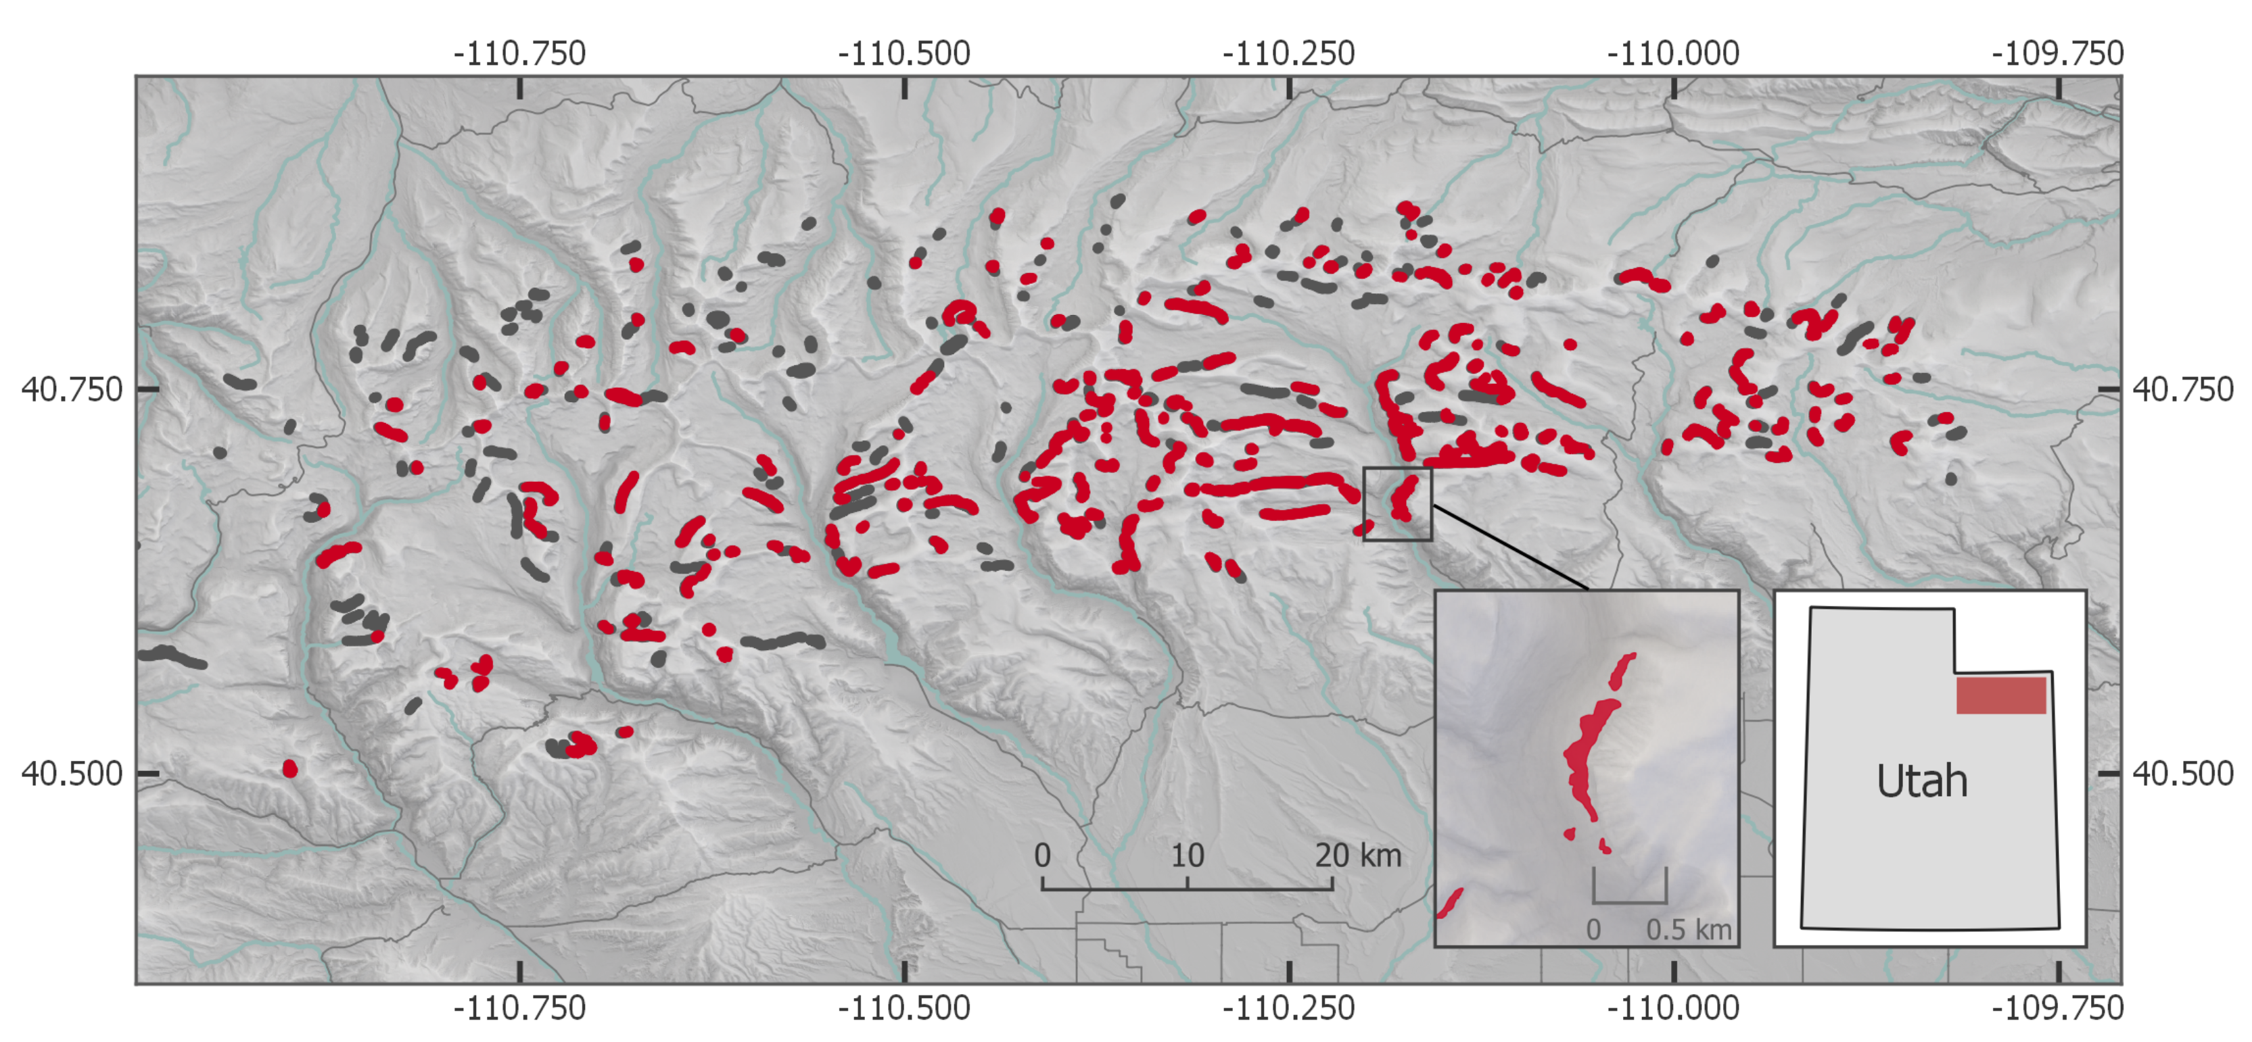
Rock glacier inventory
255 active rock glaciers, 27.6 km² area

Slide 7
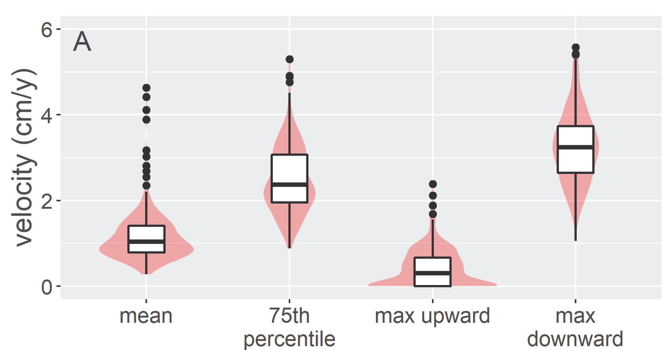
Characterizing rock glacier velocity
Mean 75th percentile LOS velocity: 2.52 cm/y

Slide 8
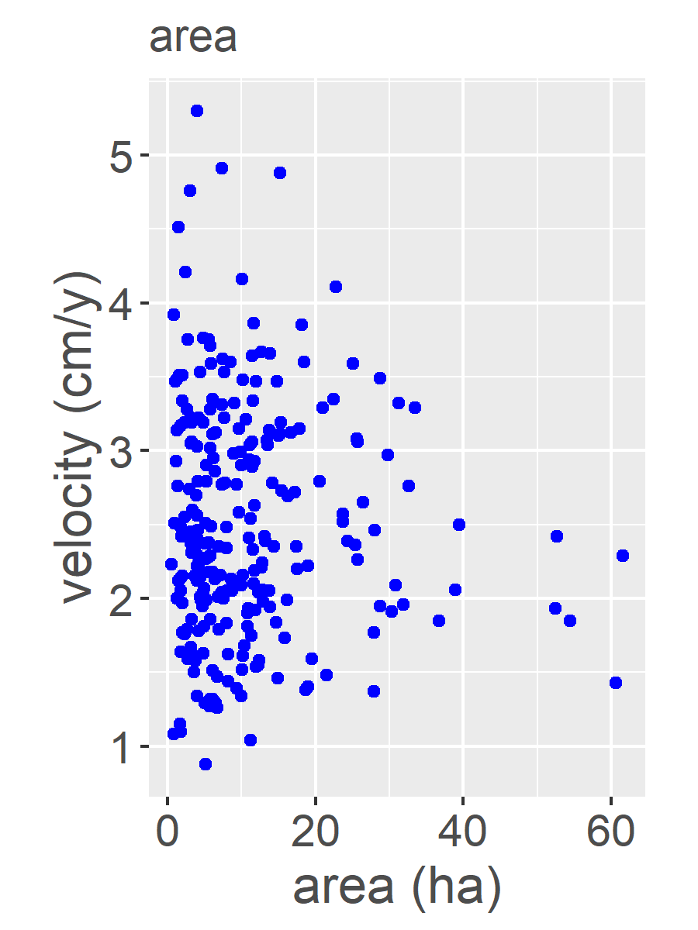
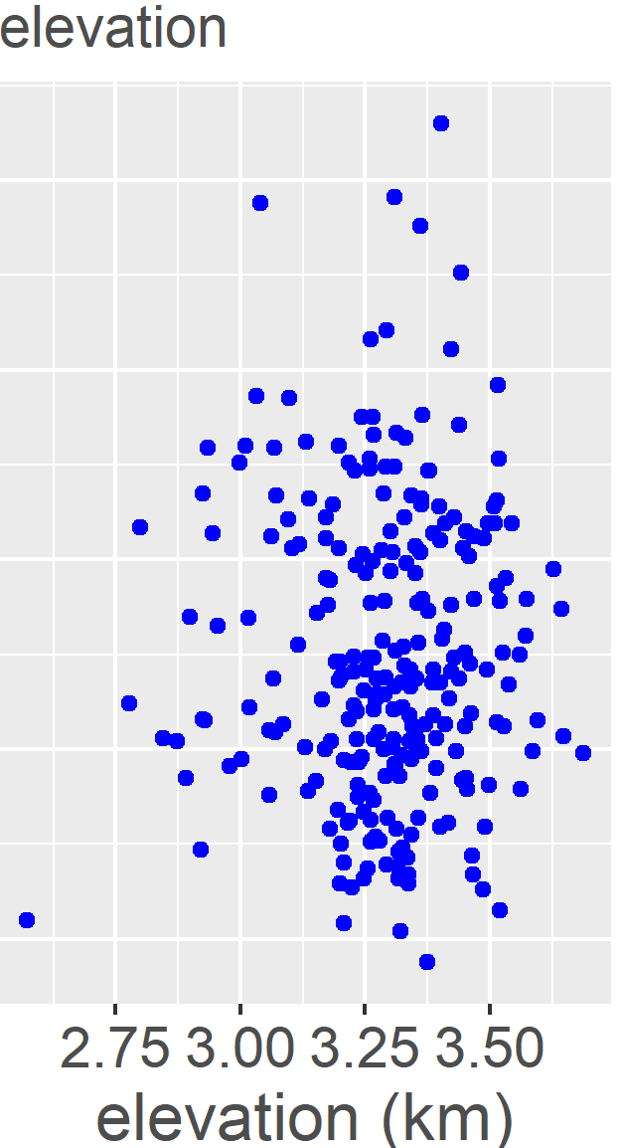
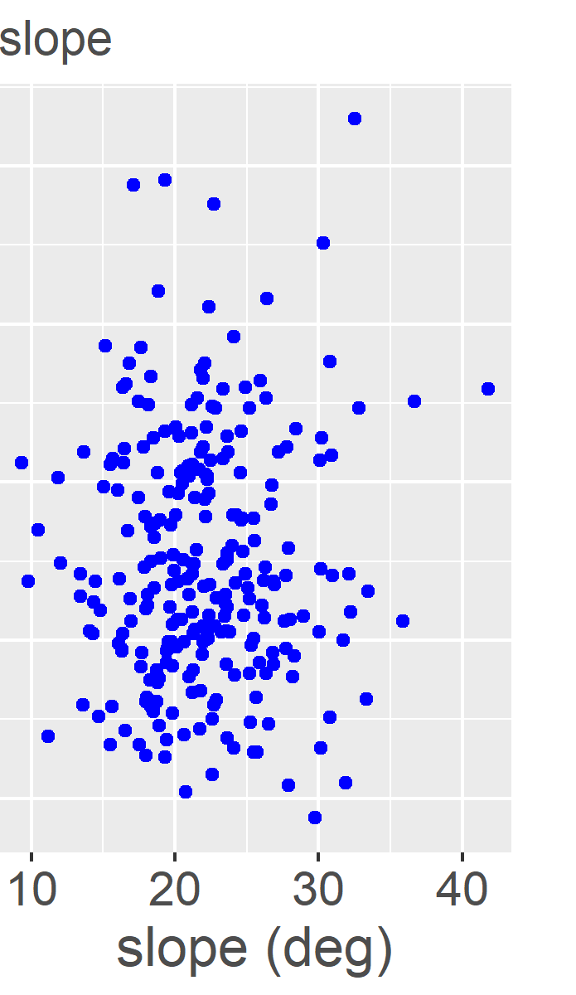
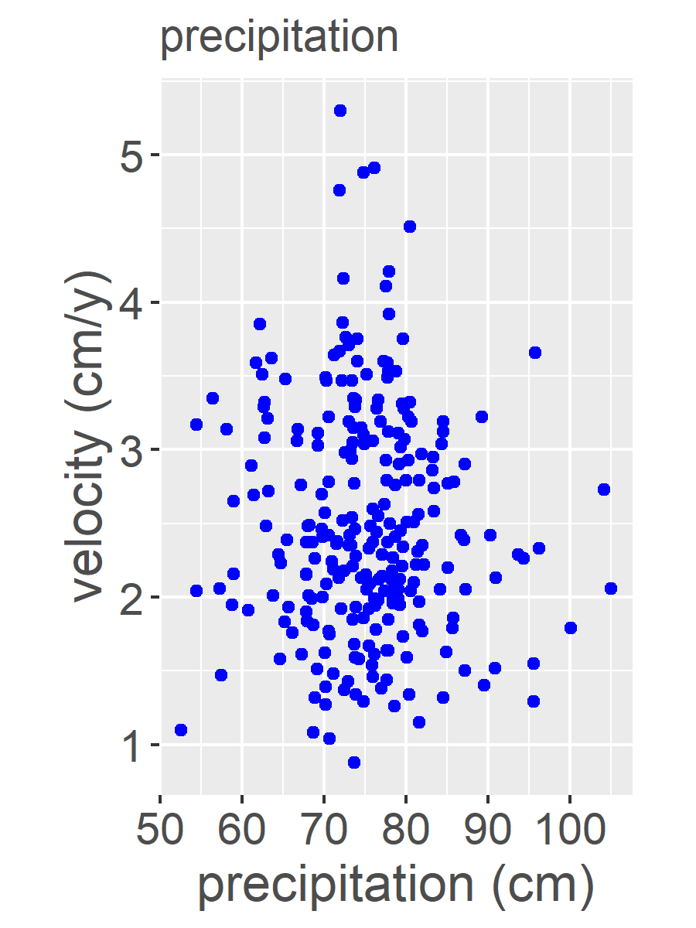
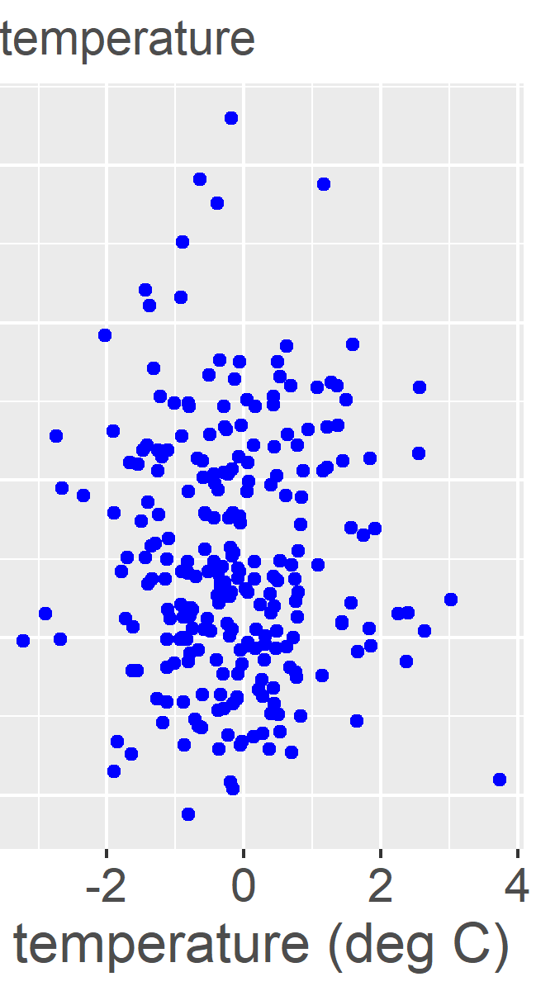
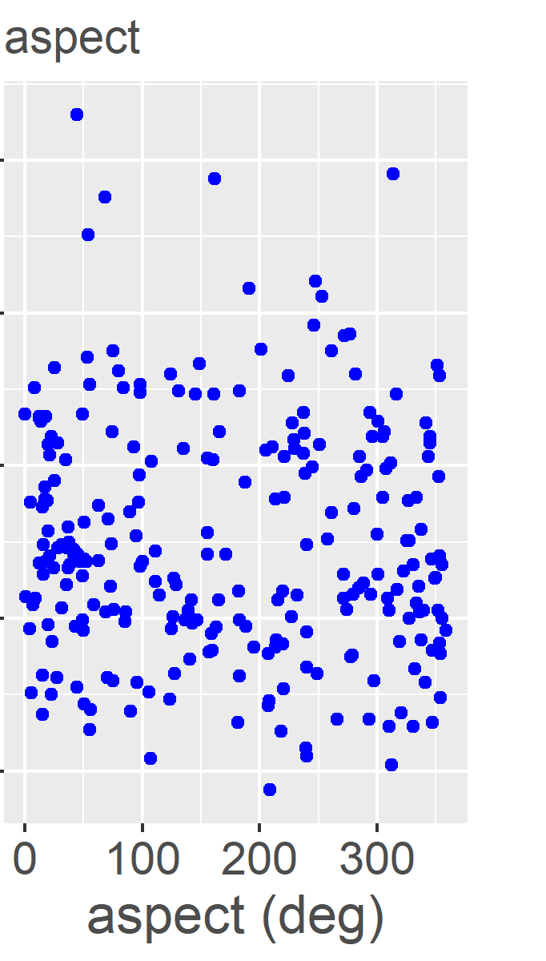
Rock glacier velocity
Large range of velocities between rock glaciers
Rock glacier velocity unrelated to physical characteristics or climate envelope
Rock glacier kinematics are complex

Slide 9
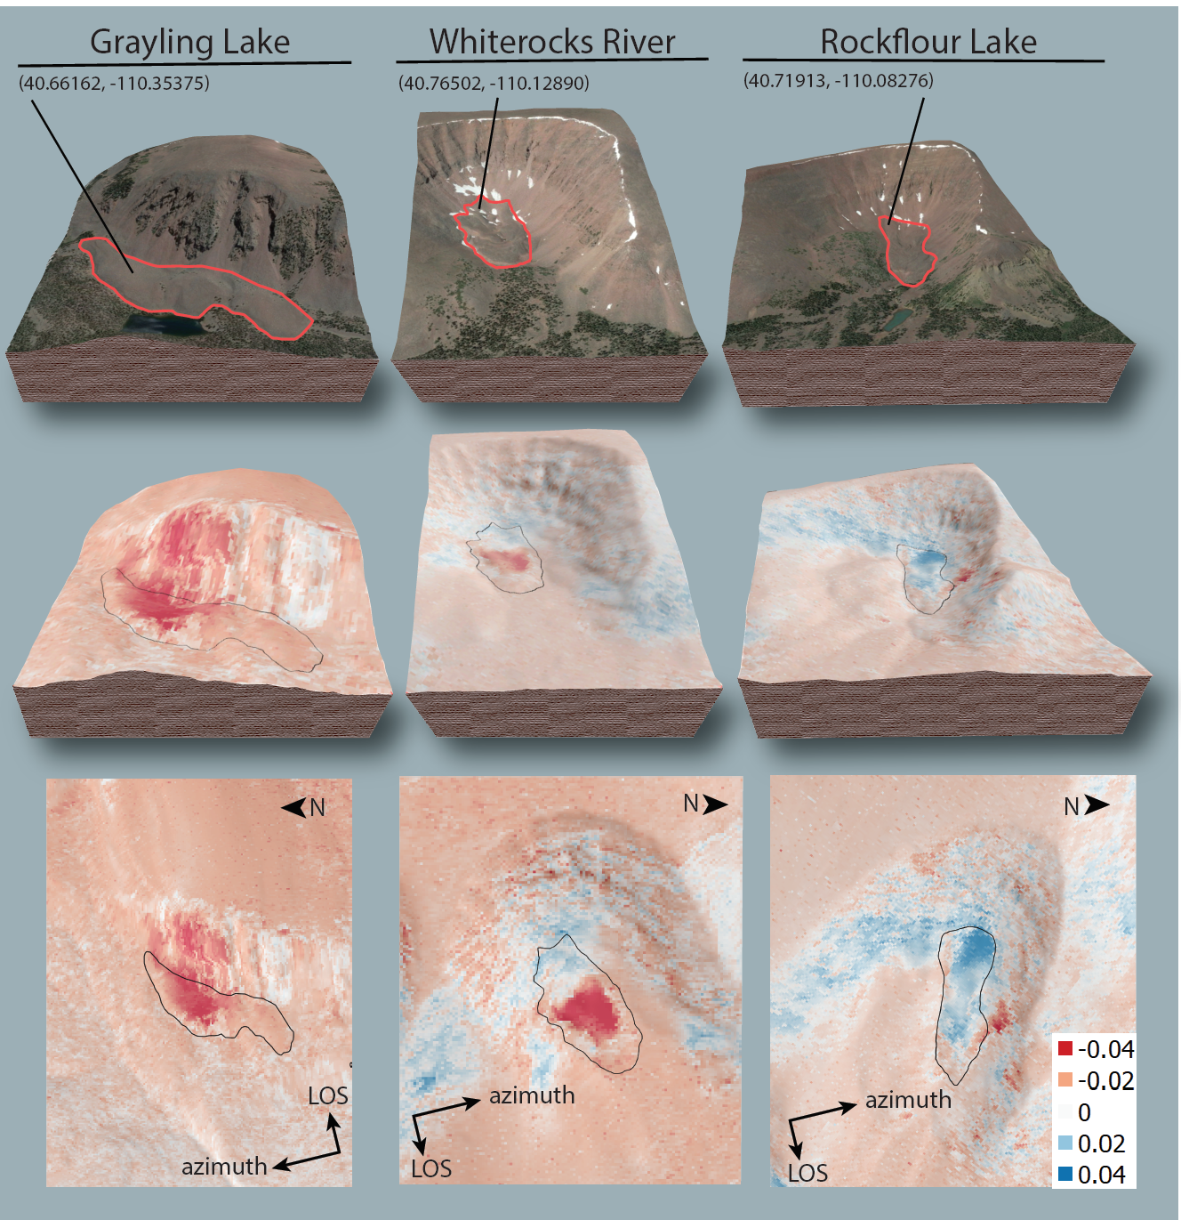
Time-dependent rock glacier kinematics
Three rock glaciers selected based on clear signal
Time-series provides time-dependent displacement measurements
Displacement compared with SNOTEL data

Slide 10
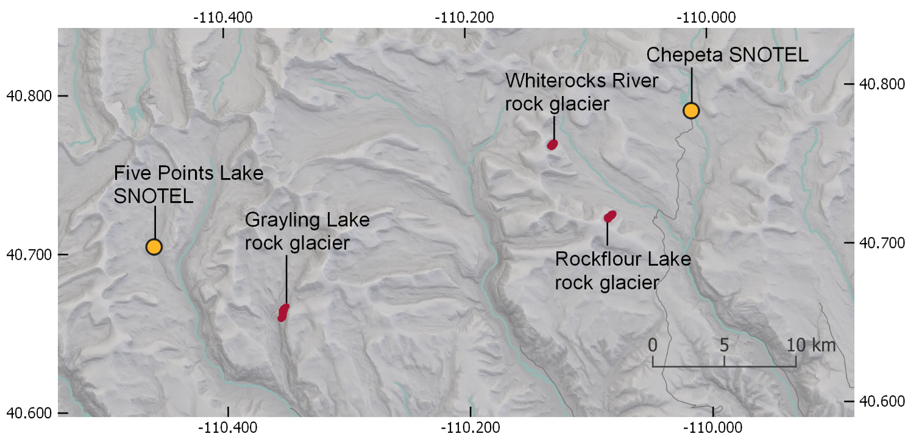
Time-dependent rock glacier kinematics

Slide 11
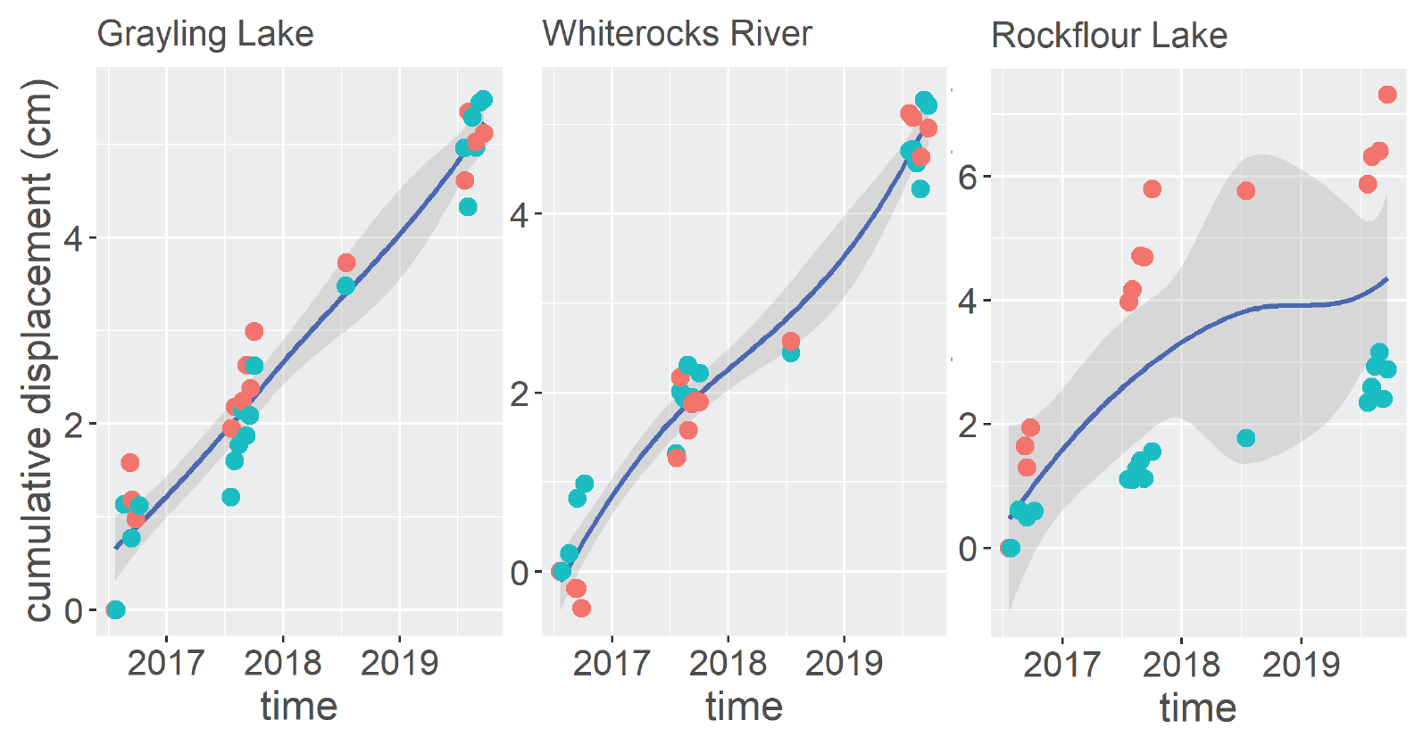
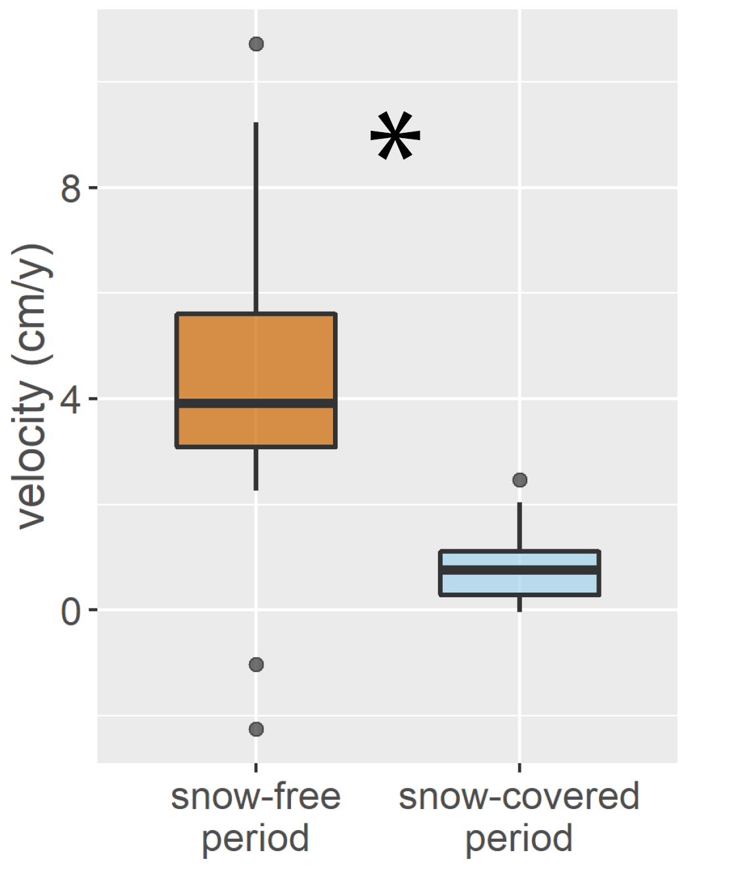
Trends in rock glacier velocity
Rock glaciers velocity is higher during the snow-free summer period than the rest of the year

Slide 12
Trends in rock glacier velocity
Winter 2017/18: low displacement

Slide 13
Trends in rock glacier velocity
Winter 2017/18: low displacement
Summer 2017-Summer 2019: low displacement

Slide 14
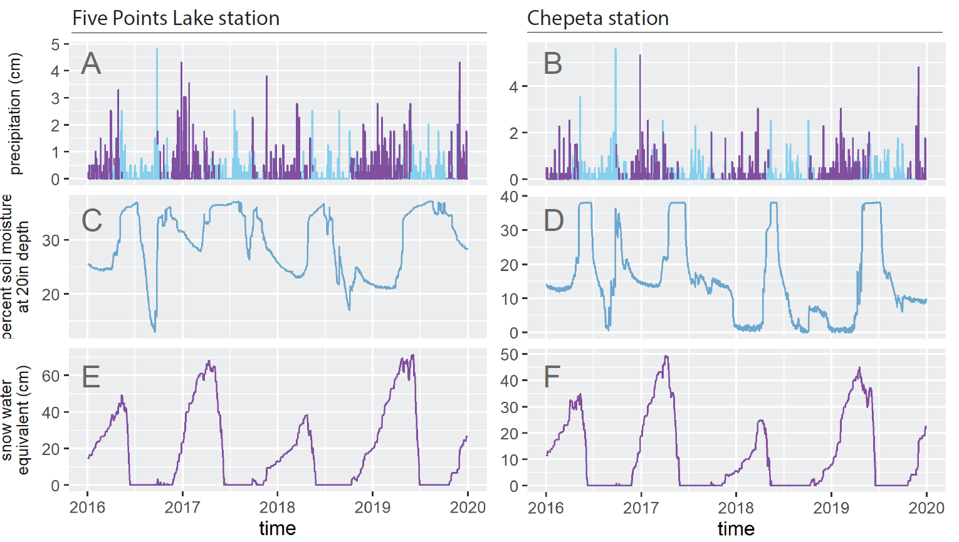
Climate variation and rock glacier kinematics
Winter 2017/18
- reduced snowfall
- reduced snowpack
- reduced soil moisture
decreased insultation
Five Points Lake SNOTEL
Chepeta SNOTEL
Spring/summer 2018
- reduced spring melt
- no large precipitation
- reduced soil moisture

Slide 15
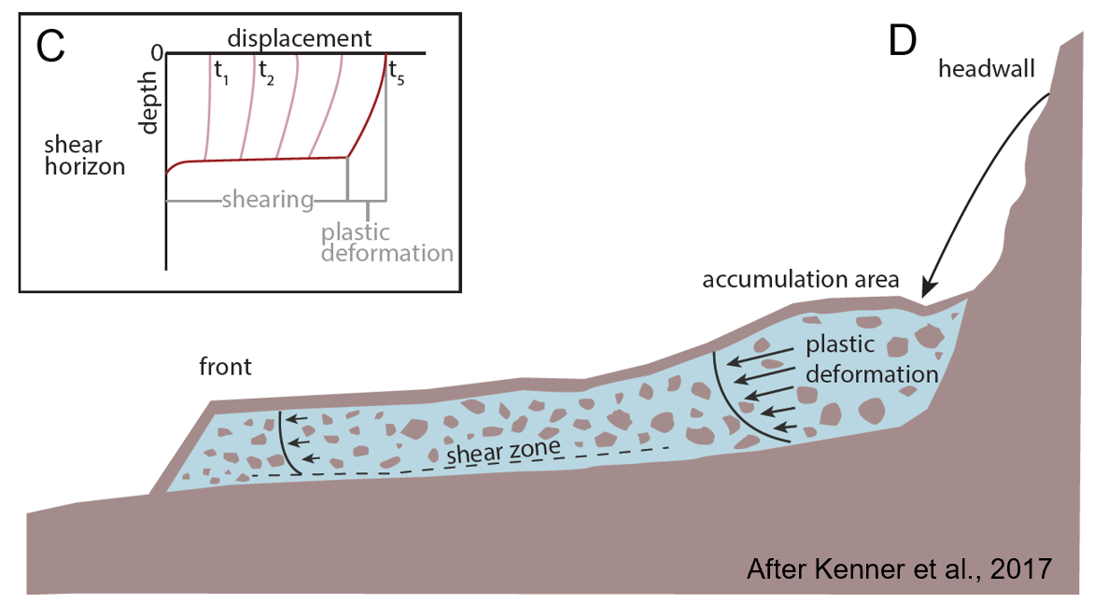
Precipitation and velocity
Rock glaciers deform along a shear zone
Shearing increases with water in the shear zone
lubricates ice-particle and particle-particle interactions
Reduces effective normal stress
Low soil moisture at 20in may indicate lack of deeper water
Low 2017/18 velocities likely explained by reduced precipitation

Slide 16
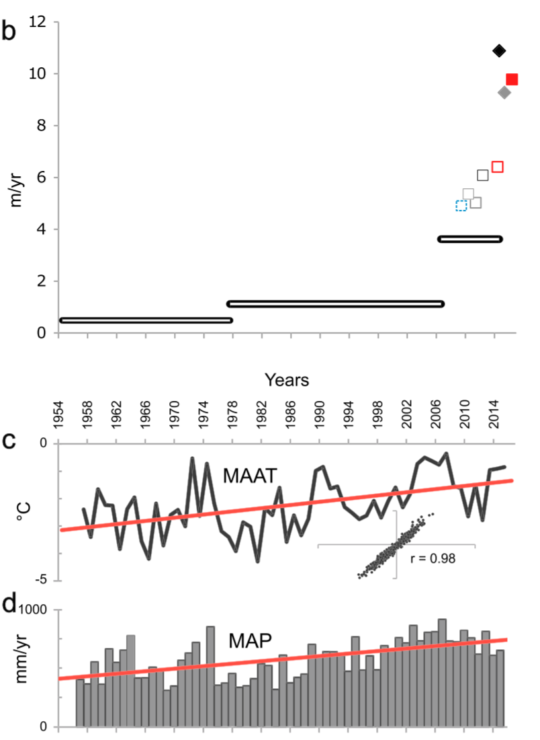
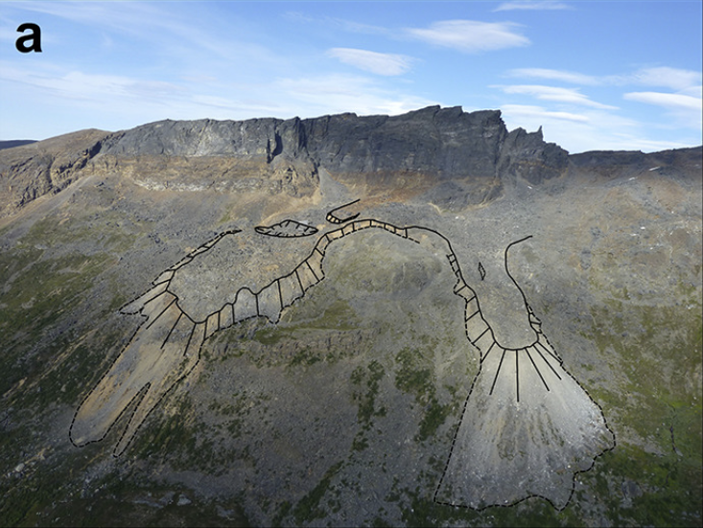
Precipitation and velocity
Rock glaciers deform along a shear zone
Shearing increases with free water in the shear zone
lubricates ice-particle and particle-particle interactions
Reduces effective normal stress
Low soil moisture at 20in may indicate lack of deeper water
Low 2017/18 velocities likely explained by reduced precipitation
Eriksen et al., 2018

Slide 17
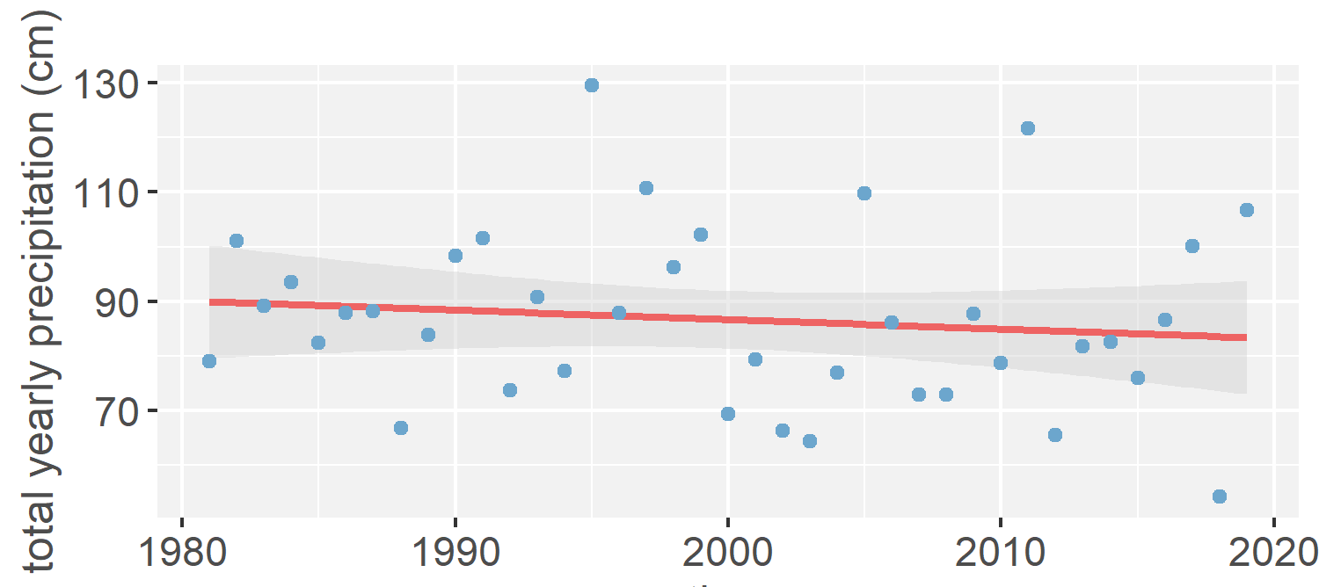
Rock glacier velocity and climate change in the Uintas
At Five Points Lake SNOTEL:
temperature increasing at 0.05 ˚C/y
precipitation decreasing at 0.11 cm/y
decreased precipitation could lead to reduced rock glacier velocities

Slide 18
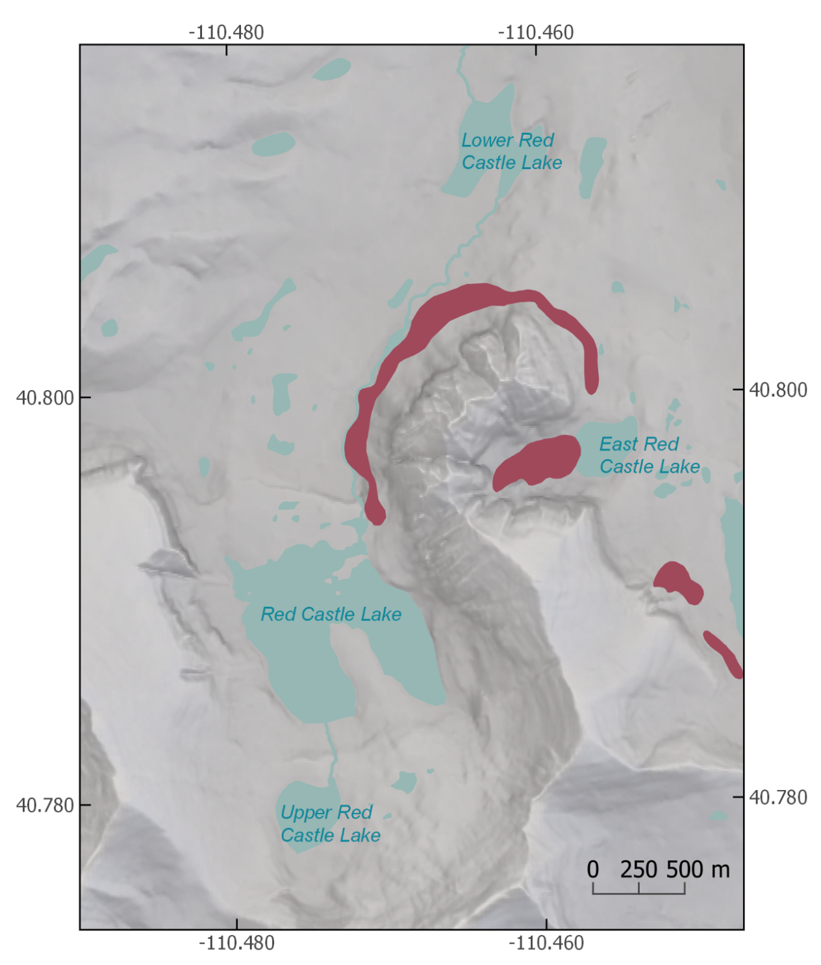
Summary
identified 255 active rock glaciers in the Uinta Mountains using InSAR
average velocity is complex
rock glaciers move more quickly in the summer than the winter
reduced precipitation decreased rock glacier velocities in 2017/18
rock glaciers may exhibit reduced velocities as precipitation decreases

Slide 19
Acknowledgments
Middlebury College geology
Middlebury URO
European Space Agency
NASA/JPL
ASF
USGS
Kristina Walowski

