Slide 1
Identifying past rockfall trajectories and runout distances from detailed 3D terrain model: The case of the Mel de la Niva mountain, Switzerland
François Noël (1), Synnøve Flugekvam Nordang (2), Michel Jaboyedoff (1) and Marc-Henri Derron (1)
(1) Risk Analysis Group, ISTE, Université de Lausanne, Switzerland
(2) Ramboll Norge AS

Slide 2
Rockfall hazard preliminary mapping
From orthophotos
From geomorphology interpretation with hillshade
From historical records
From field inspection trying to find deposited rockfall boulders and signs of activity
Photo: Canton Valais

Slide 3
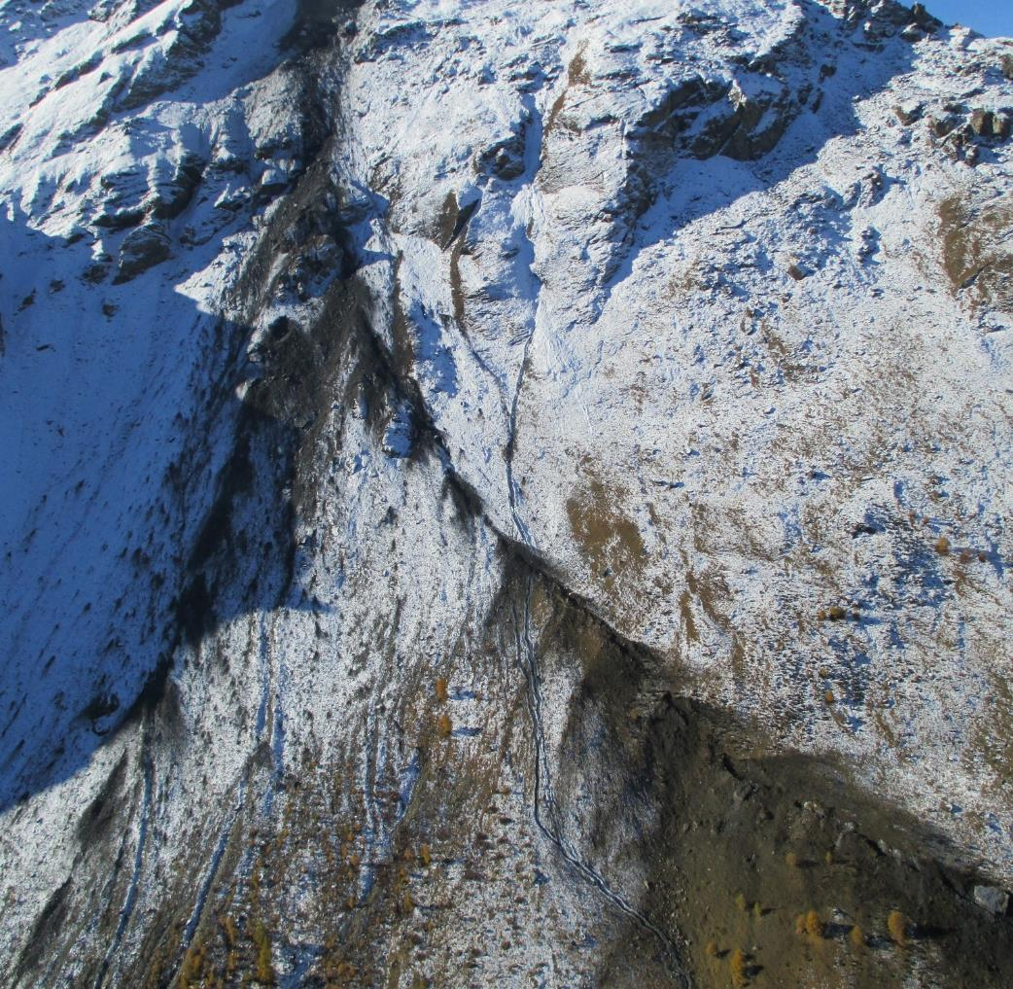
What to look for?
Impact marks
Linear features following likely rockfall paths, i.e. perpendicular(-ish) to the topographic contours (e.g. line of missing trees, aligned elongated depressions => impact marks)
Scars on the cliff faces and change in color/brightness of the materials at the foot
Combining observations: e.g. a boulder alone = glacial erratic block or from a rockfall? A boulder + a path downslope = very likely to be a rockfall deposited block.
Photo: Canton Valais

Slide 4
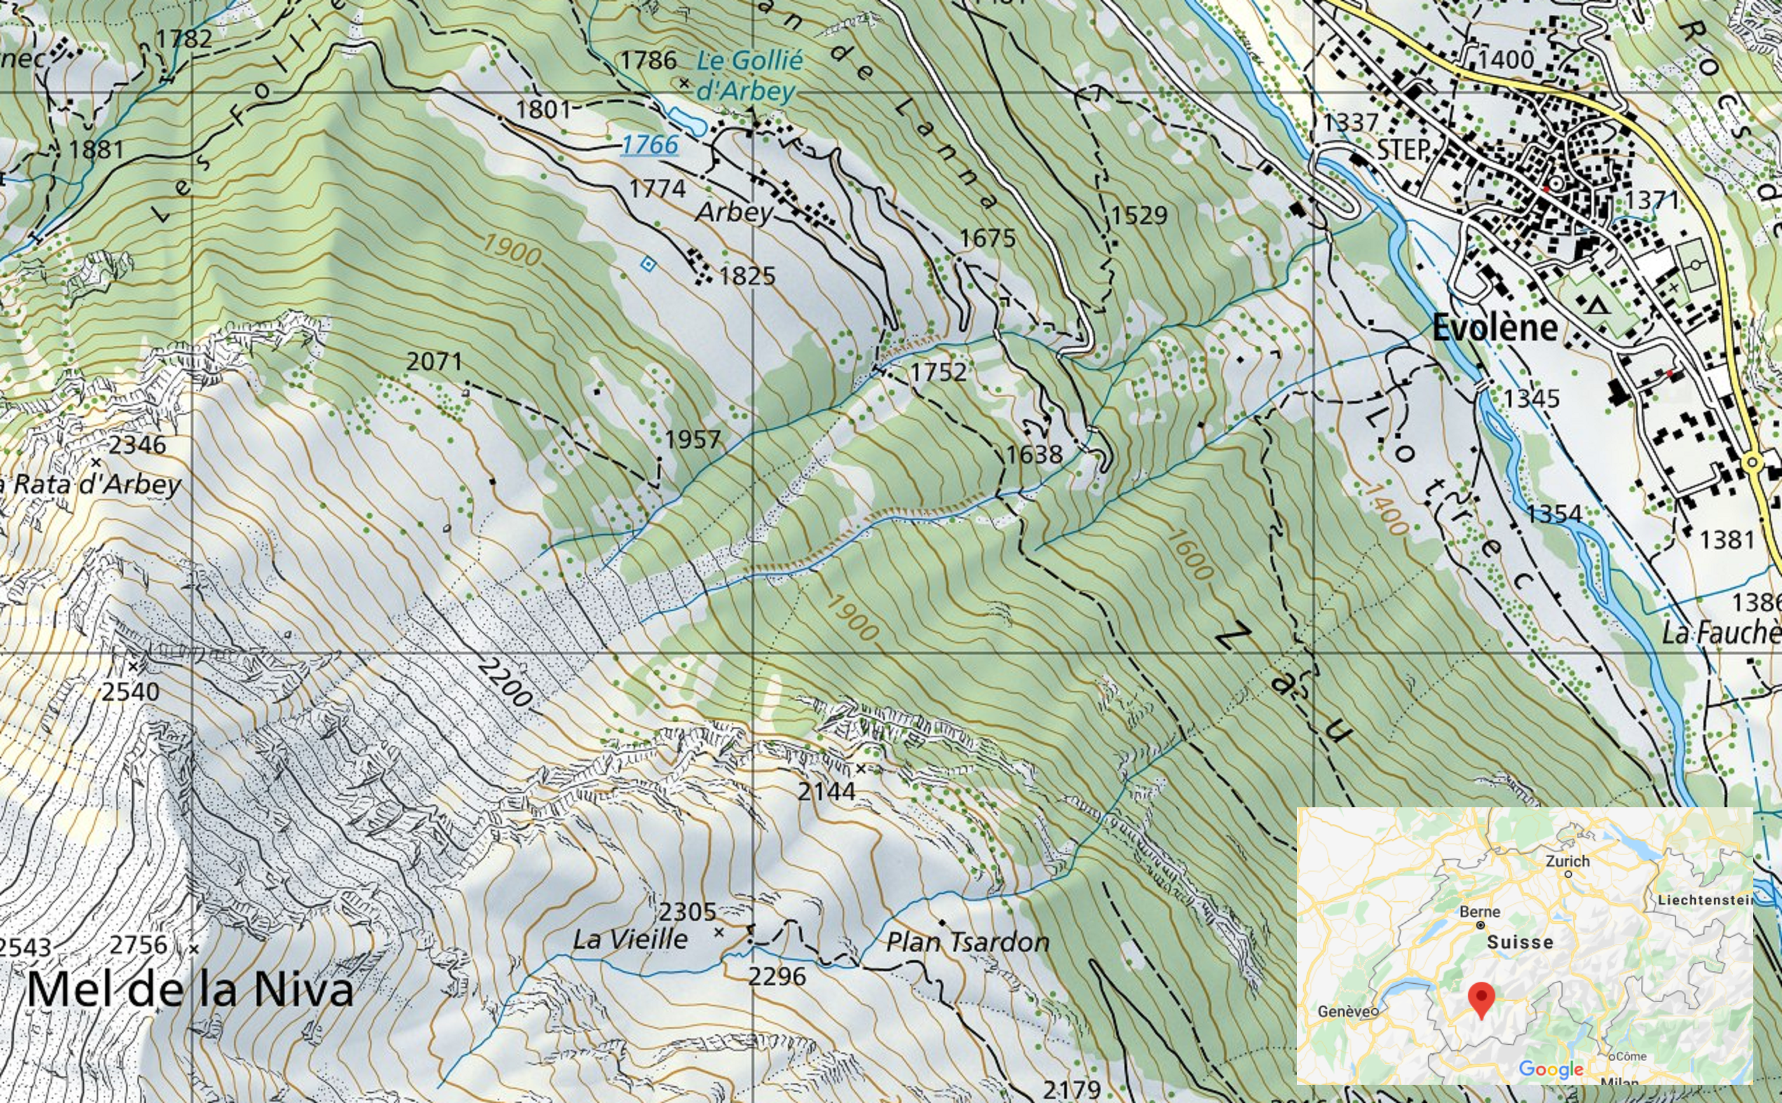
The case of the Mel de la Niva mountain
SWISSTOPO website
Google map

Slide 5
Montages of videos of the 2015 event captured by the Valais Canton and BEG SA - Géologie et Environnement
(Online content must be activated to see the videos, given the 50Mb limit for the content of this edition of EGU)

Slide 6
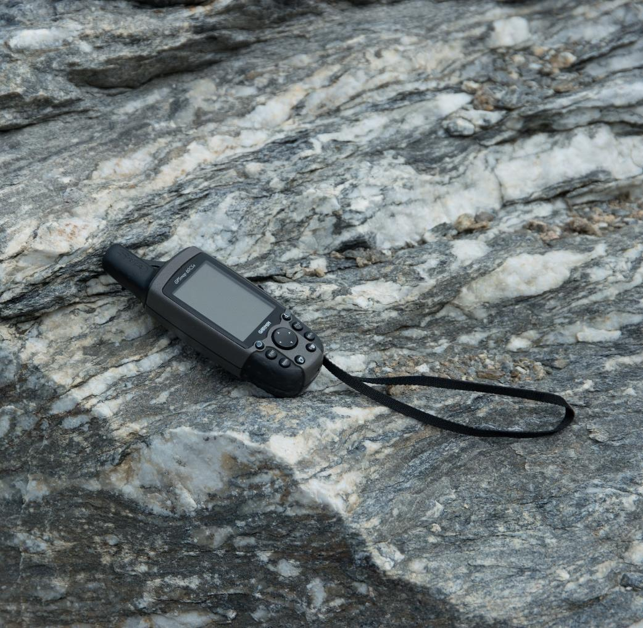
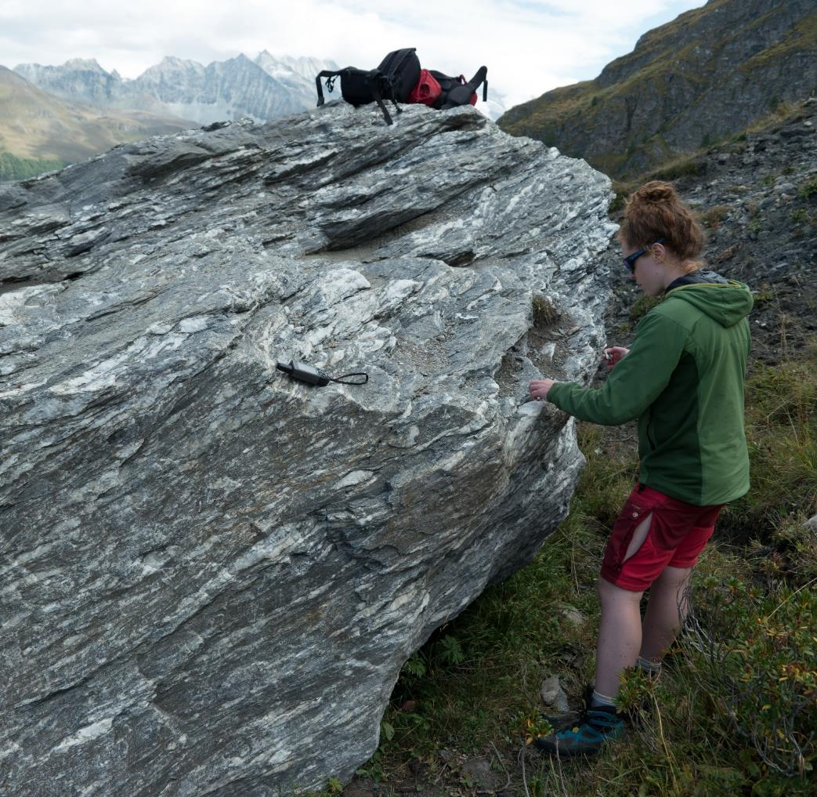
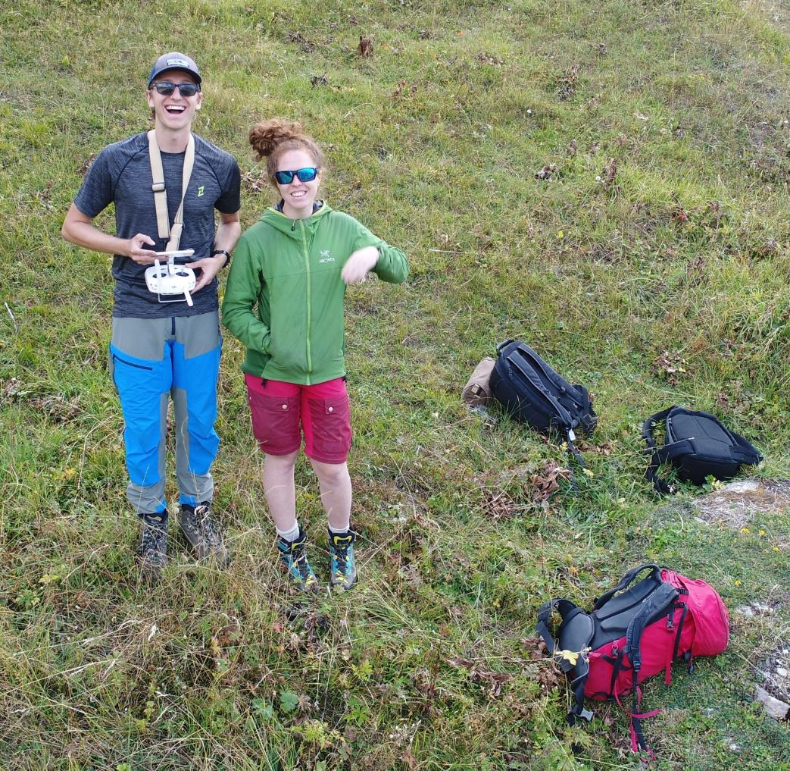
Field work
Aerial photos and videos from drone for quick on-field orientation (to quickly find the blocks and walk toward them), inspection and creation of 3D models
Qualitative & quantitative mapping of the terrain, materials, surface roughness and deposited boulders
Measurements of the main blocks with GPS and handheld mobile terrestrial laser scanner and sampling for the mass density

Slide 7
Handheld mobile TLS scan of the blocks

Slide 8
3D model of the block 1 from the 2015 event
The block is scaled based on the TLS data and textured from the UAV SfM model
The base is interpolated following the block’s schistosity
Dimensions are given with the block aligned on its main inertia axes
3D model has been shared to the RAMMS team

Slide 9
3D model of the block 2 from the 2015 event
The block is scaled based on the TLS data
The base is interpolated from the visible sides of the block, but limited by the shape of the gully
Dimensions are given with the block aligned on its main inertia axes
3D model has been shared to the RAMMS team

Slide 10
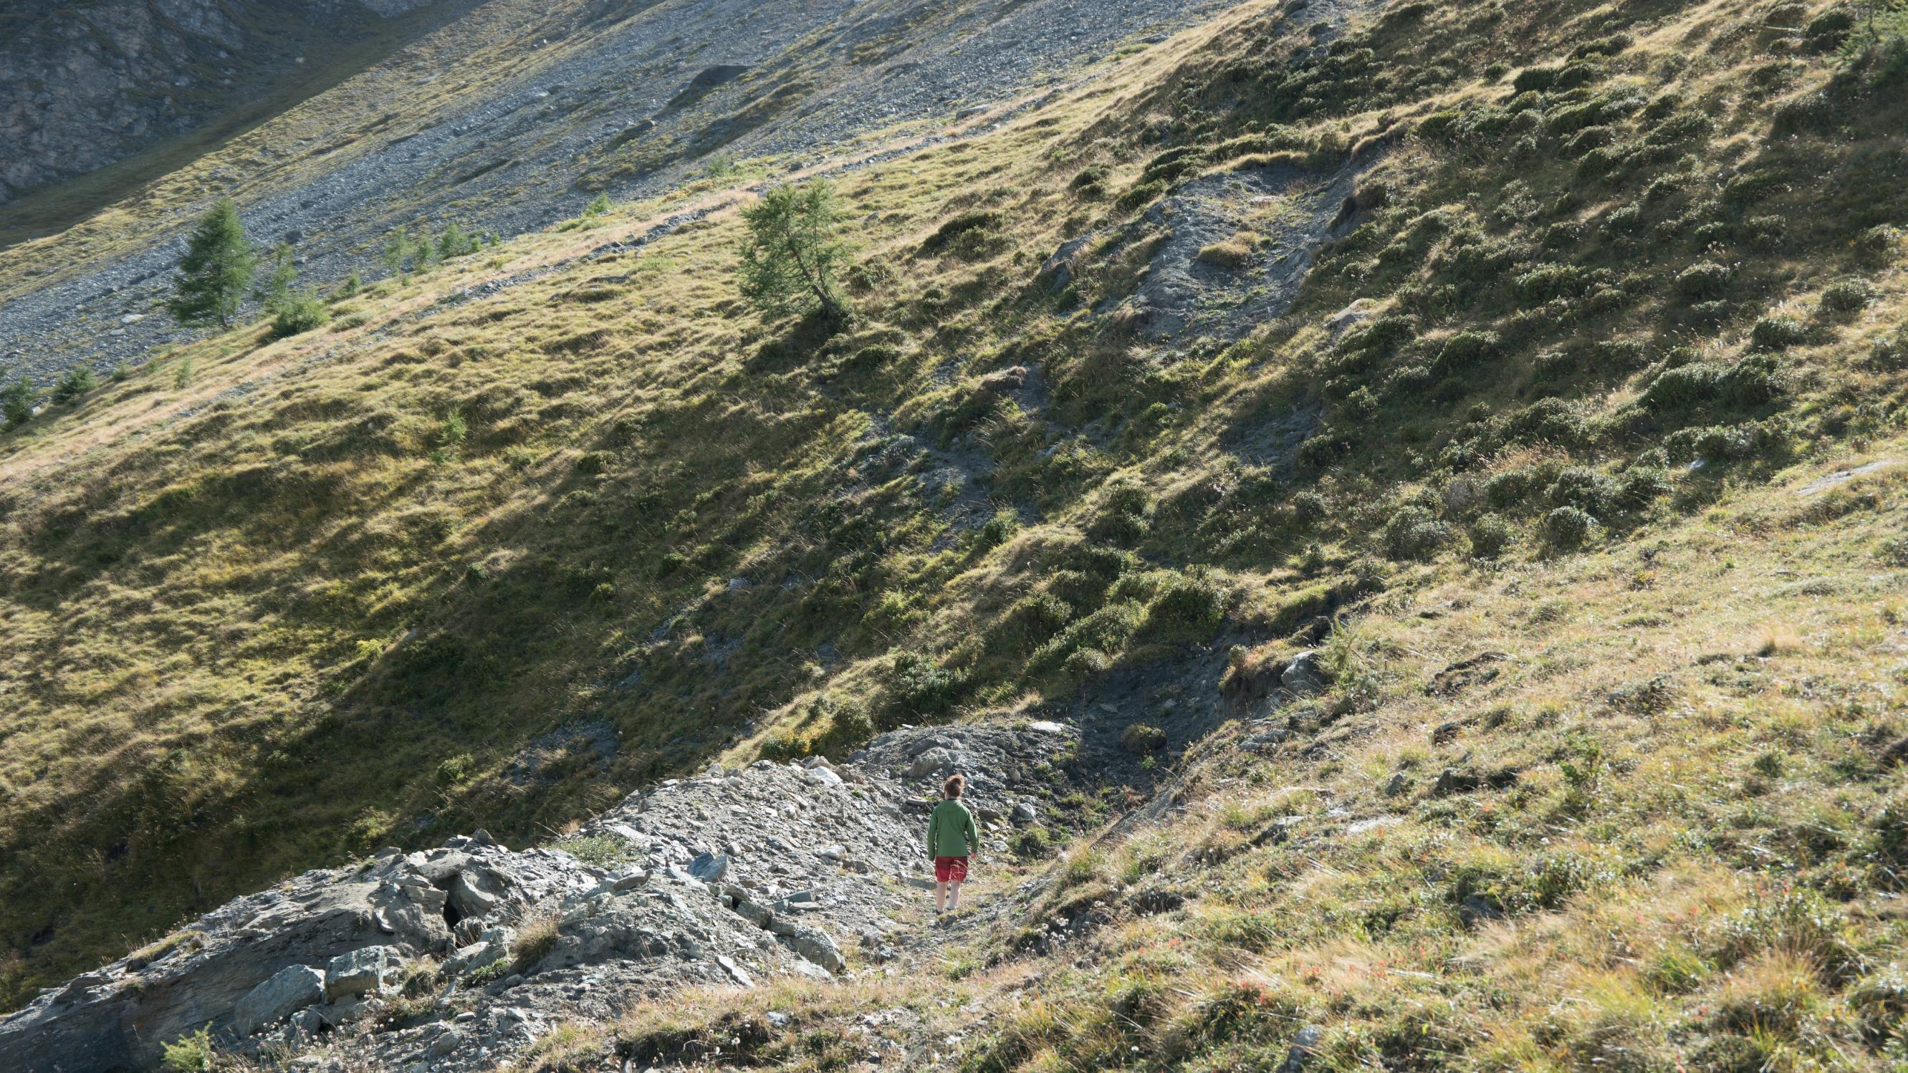
Scars left by the block 1… It should show on the 3D terrain model!

Slide 11
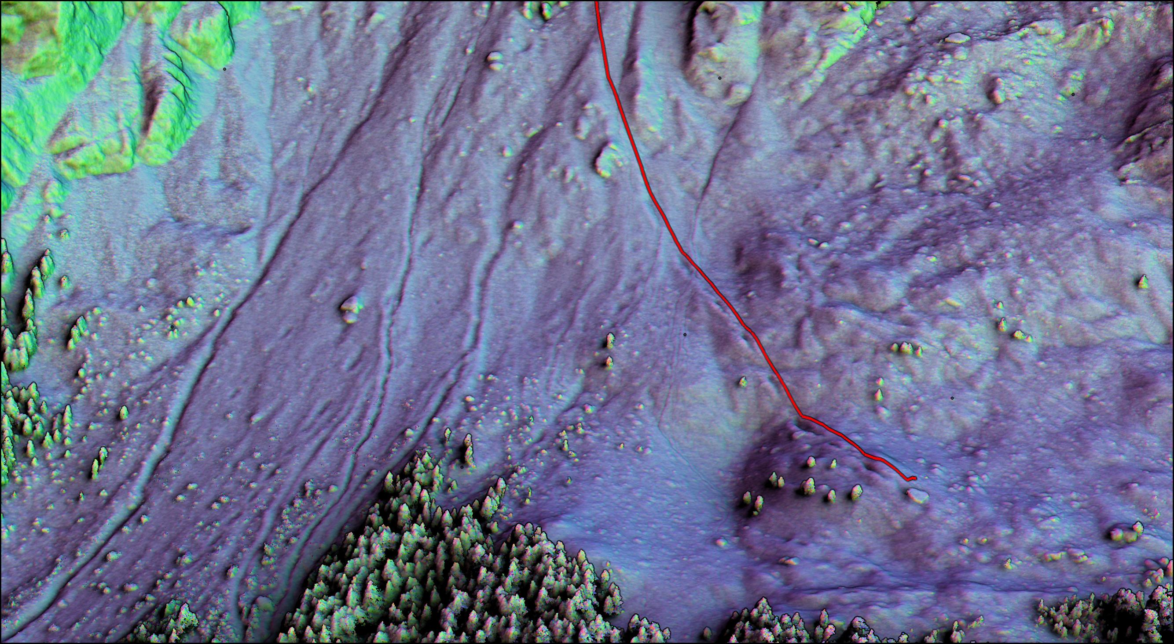
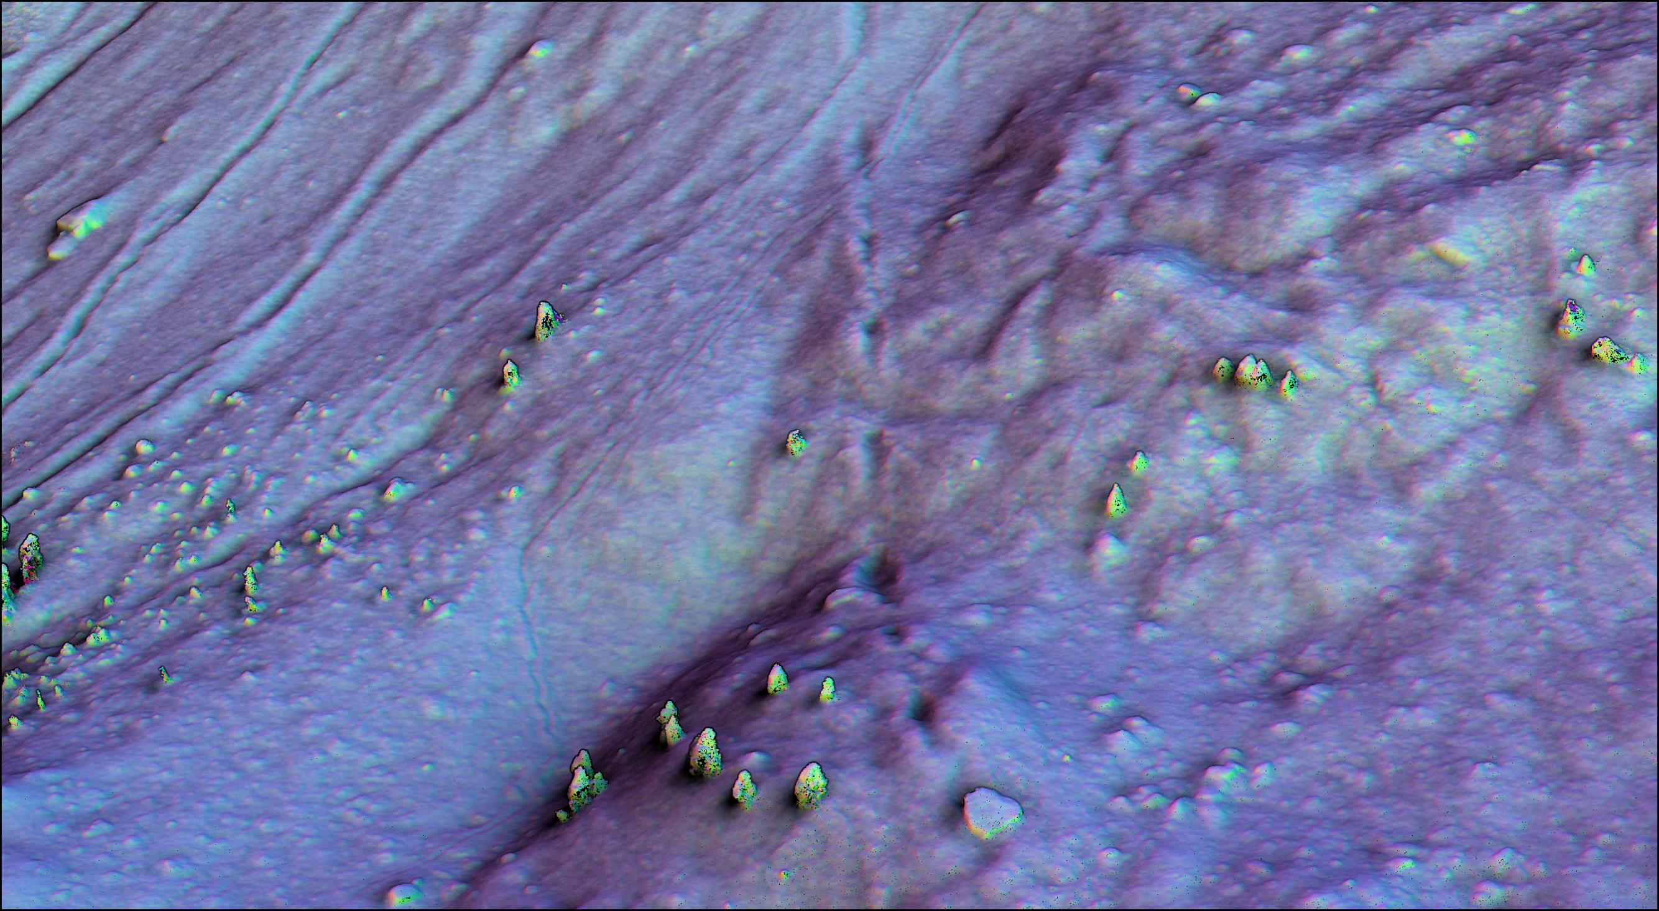
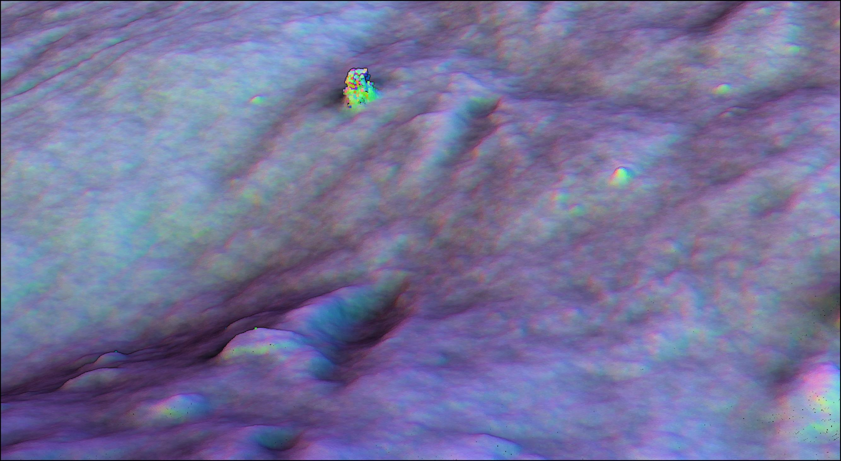
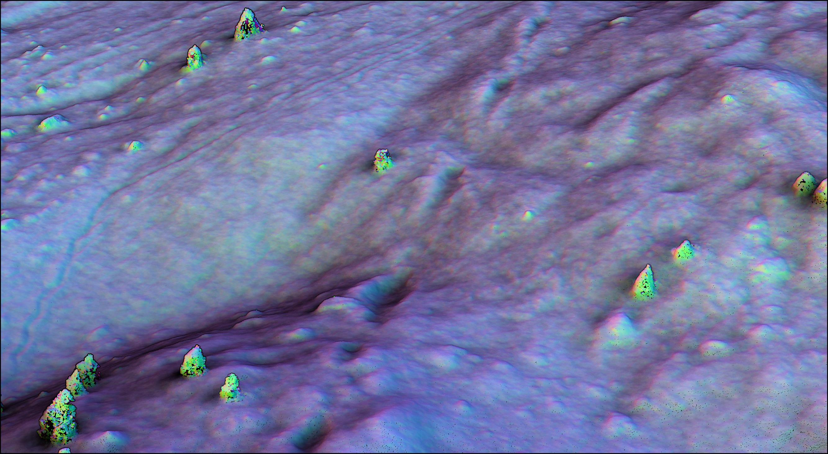
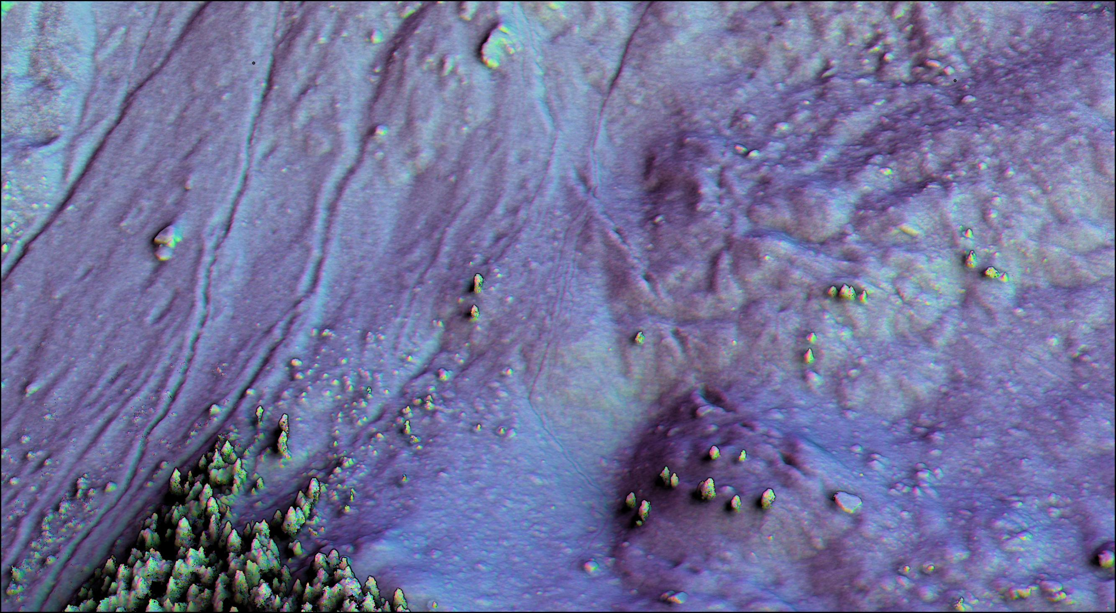
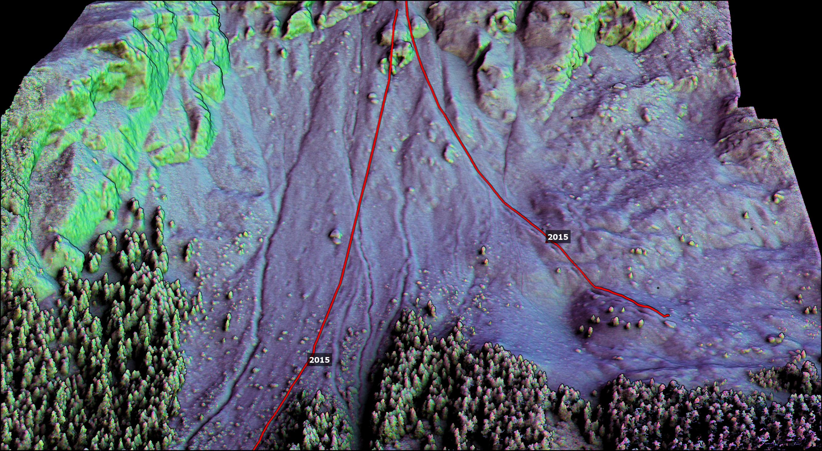
It does!
Here, the terrain is colored and shaded based on its orientation

Slide 12
…And there seems to be more than two paths!
…When did they happen?

Slide 13
Lets find out by looking at the orthophotos from the past!

Slide 14
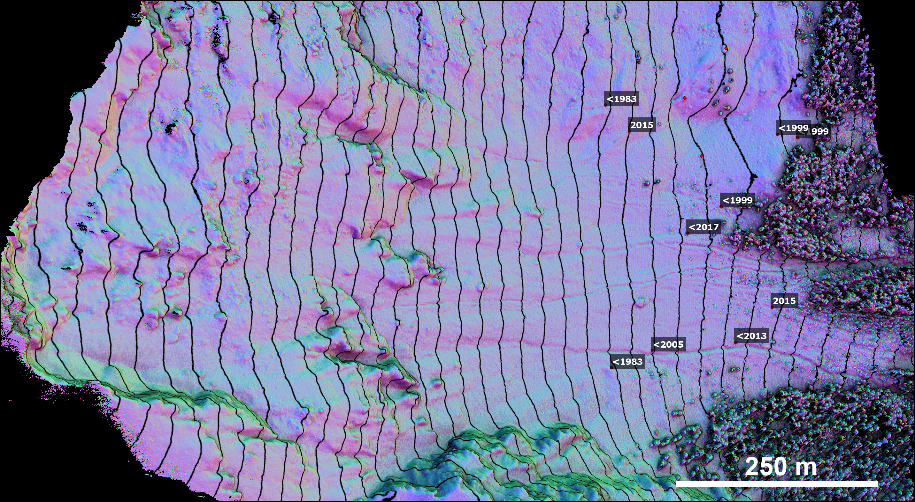
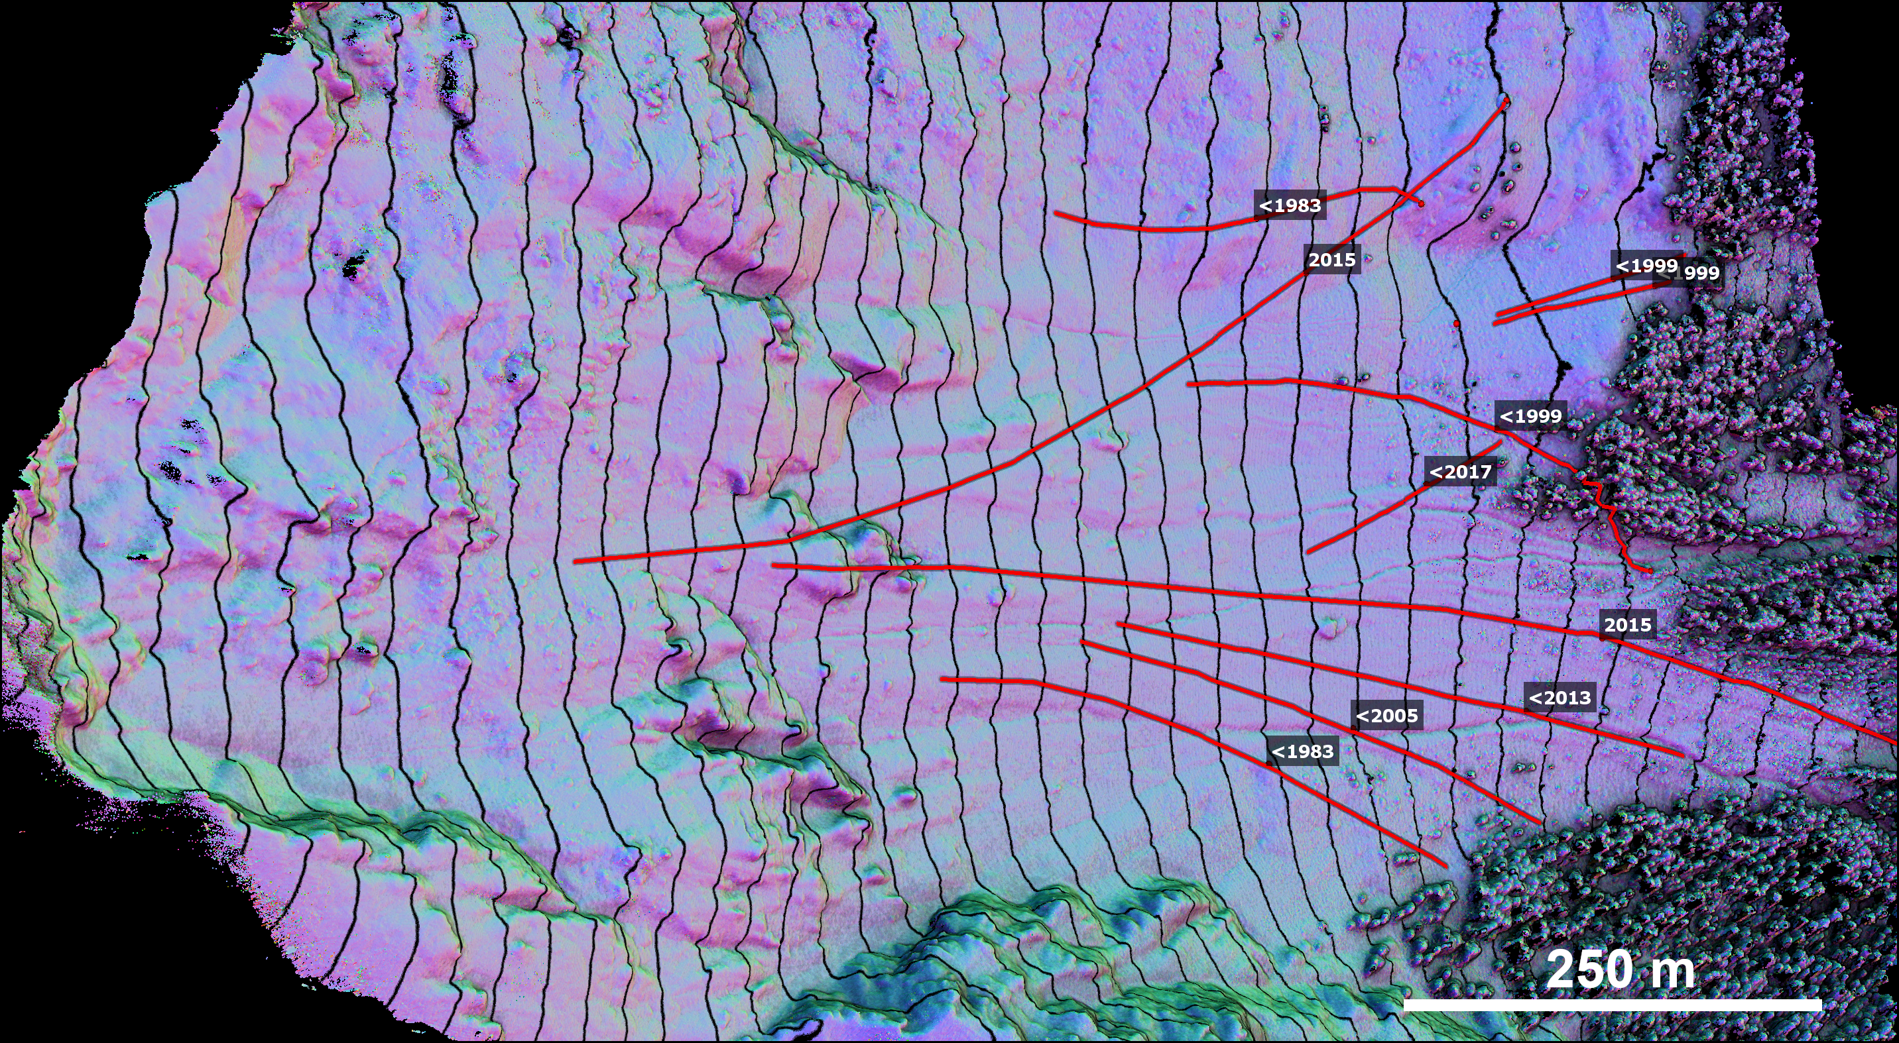
Most paths seem to deviate from the main slope aspect.
This seems corelated with the shape of the blocks.
It shows the importance of 3D rockfall simulations…
…As long as the impact models consider this effect.

Slide 15
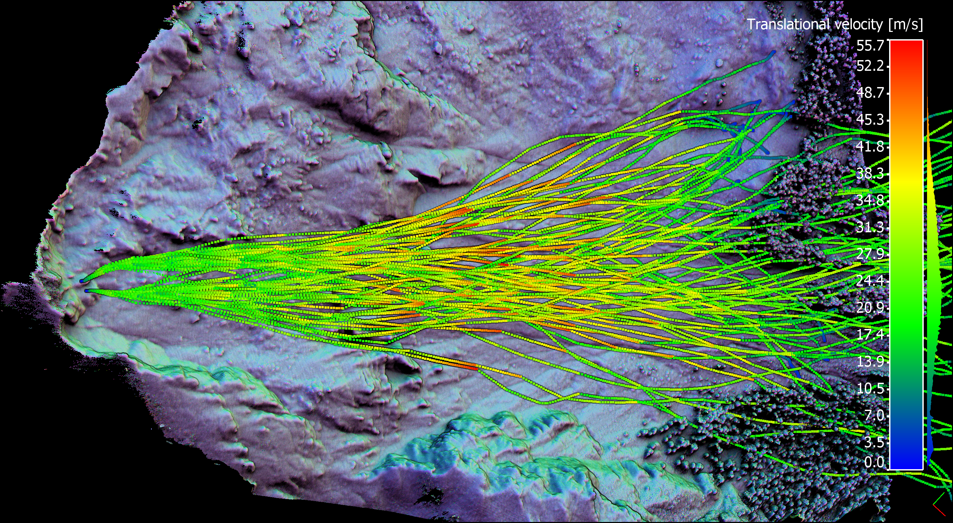
Example of 3D rockfall simulations

Slide 16
Concluding remarks
The use of detailed 3D terrain models combined with the previous existing methods for mapping rockfall features can be quite helpful.
Historical large independent rockfalls can be identified from the scars left in the terrain, visible on detailed 3D terrain models.
It brings a new method that can be useful, especially when available information for a site is limited.

Slide 17
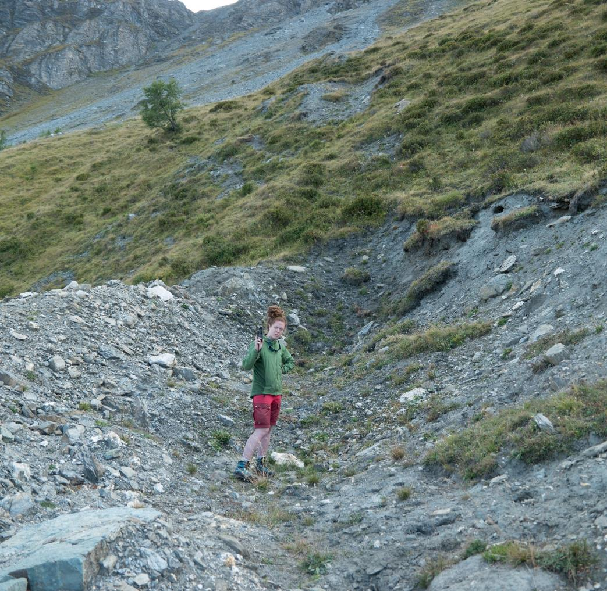
Concluding remarks
The observed rockfall paths seems to deviate slightly from the steepest down slope direction.
The scarring of the terrain related to the size and the shape of the blocks might play an important role in the observed deviations.
These observed rockfall paths show the importance of performing 3D rockfall simulations when assessing the rockfall hazard of a site.

Slide 18
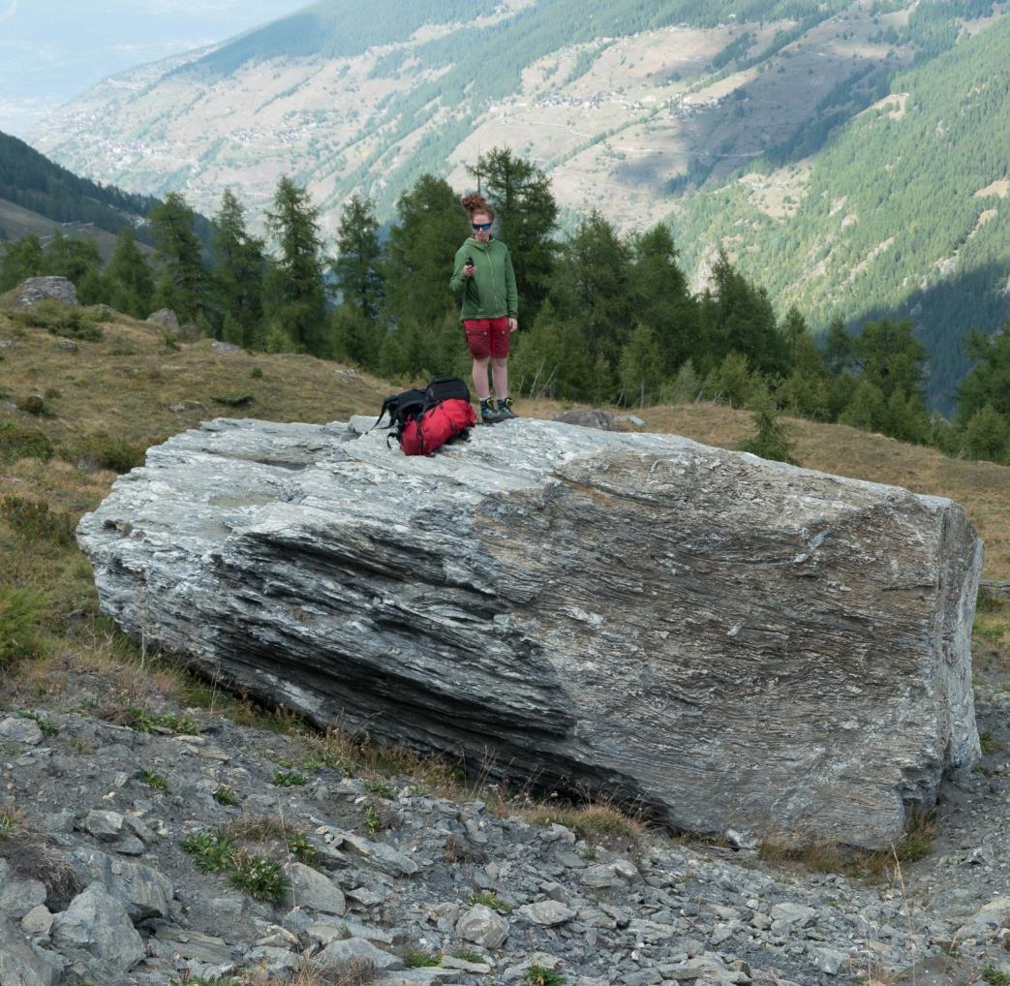
Other remarks
Dense ALS scans might be accurate enough to show similar features trough the forest cover.
Raw ALS data can be used to locate linear paths of missing trees trough forests.

Slide 19
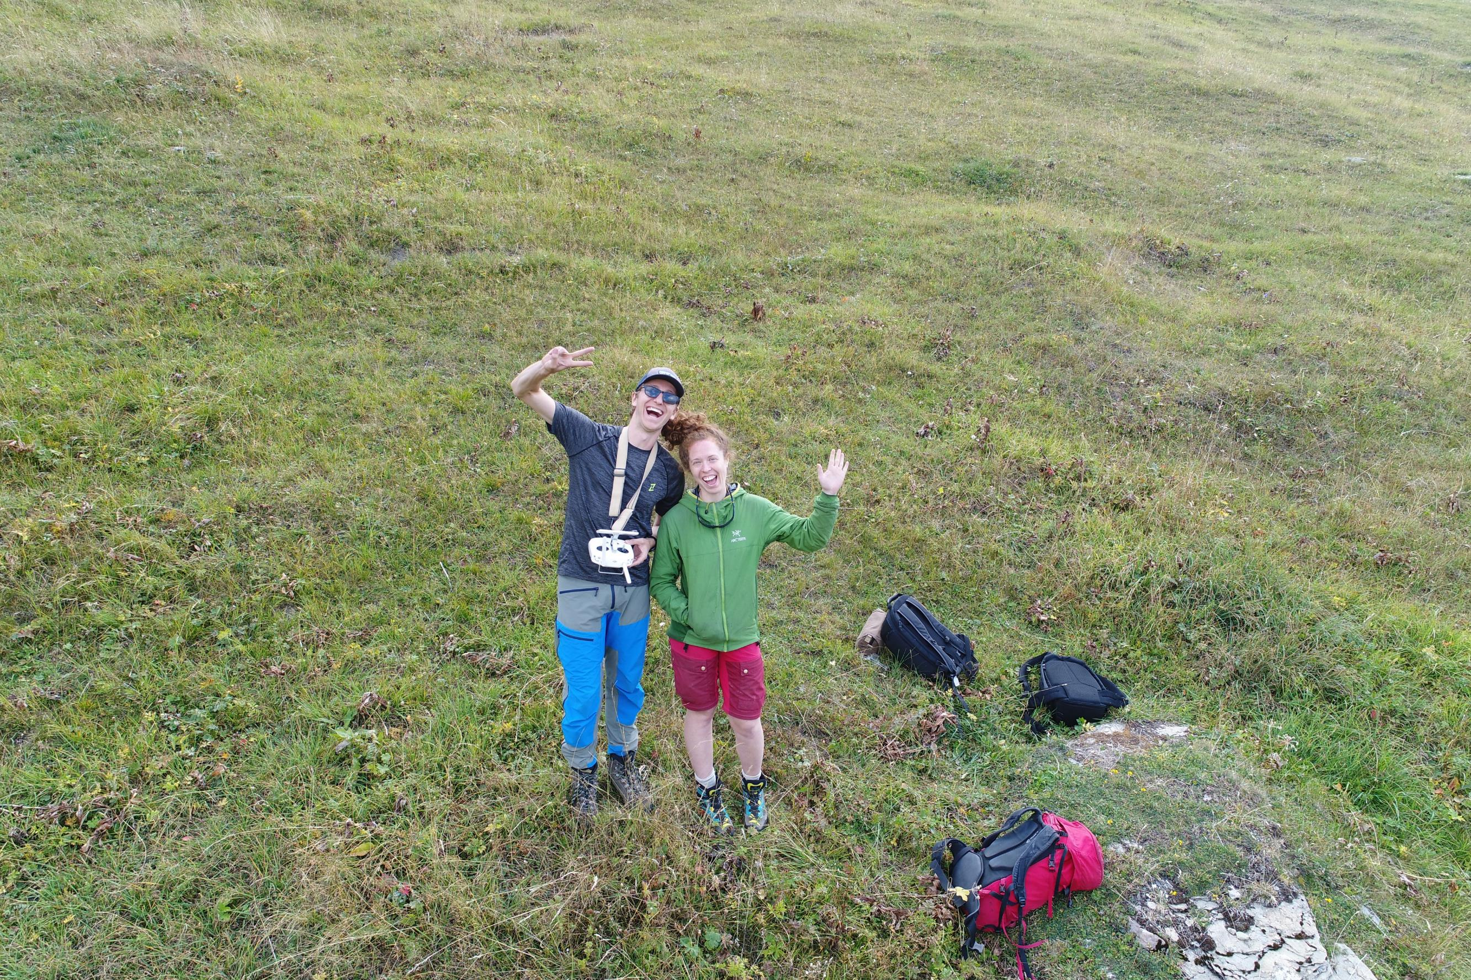
Thank you and happy ( serious ) field working!

