Slide 1
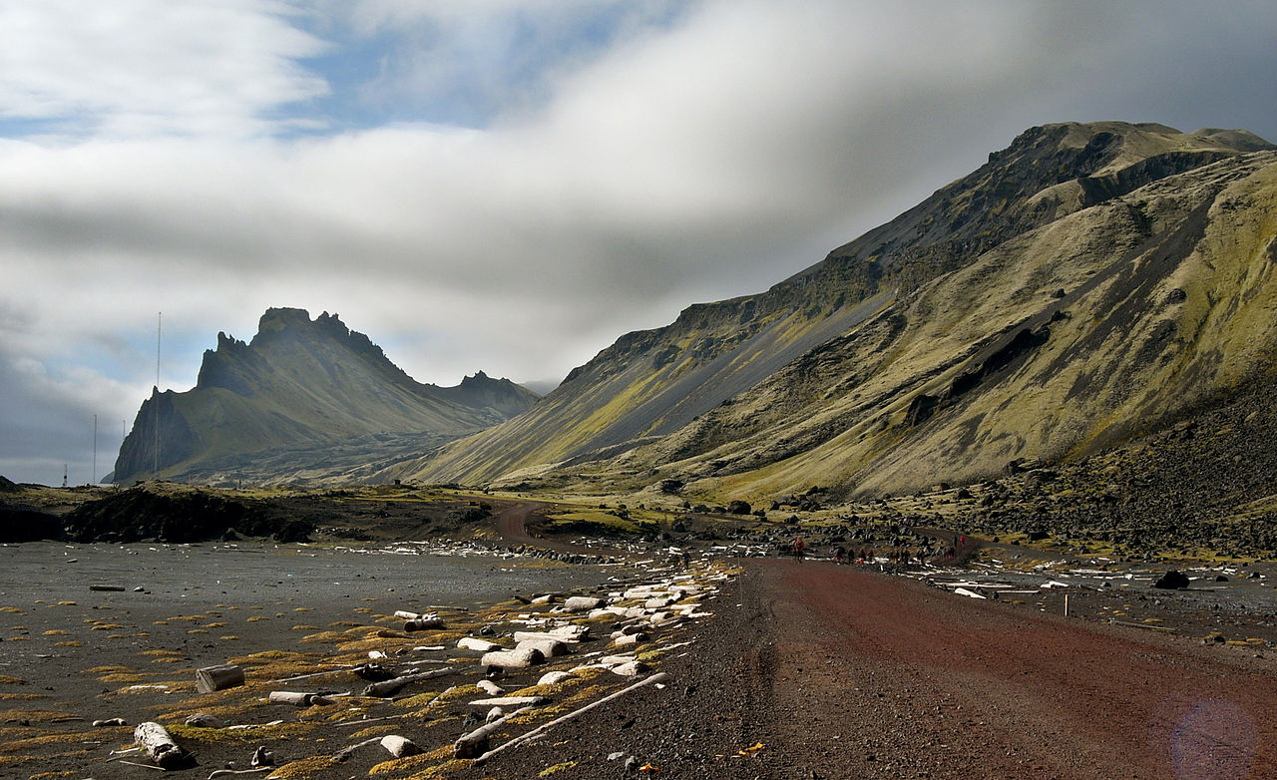
Physical modeling of the formation of the microcontinent Jan-Mayen
Agranov G.D., Dubinin E.P., Grokholsky A.L., Makushkina A.I.

Slide 2
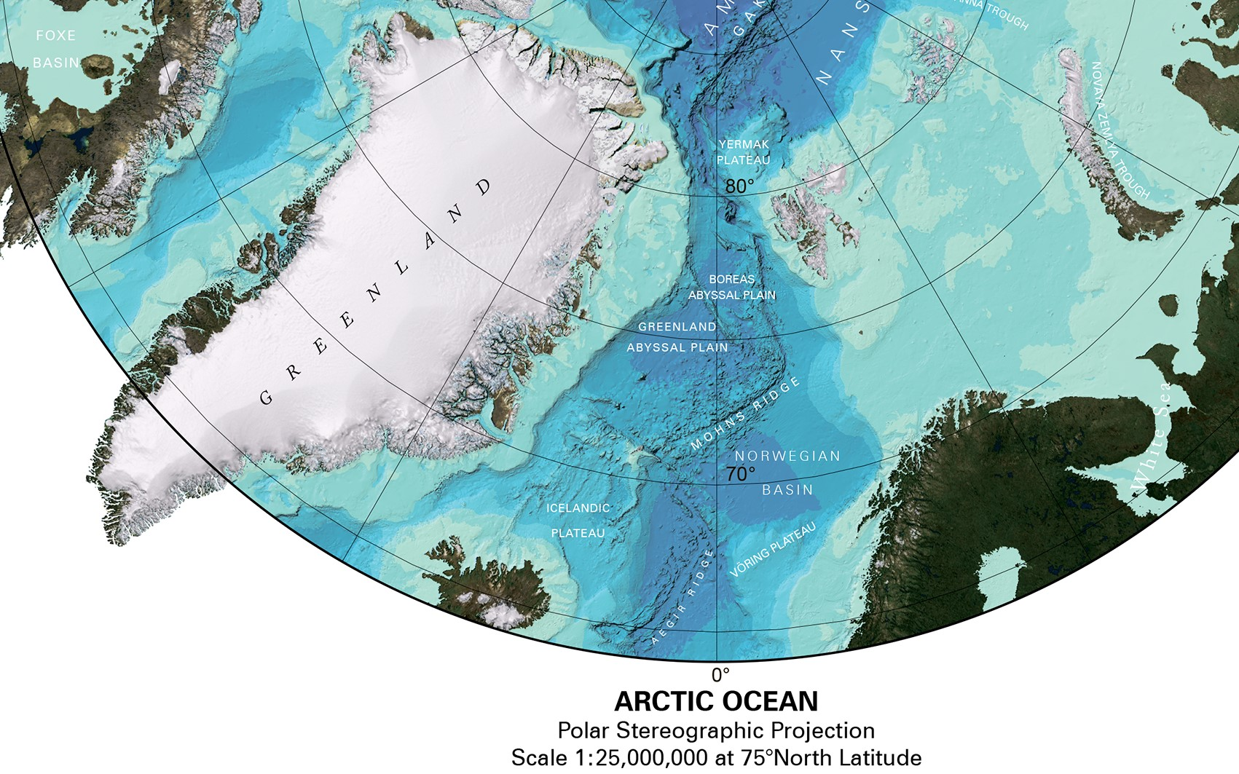

Slide 3
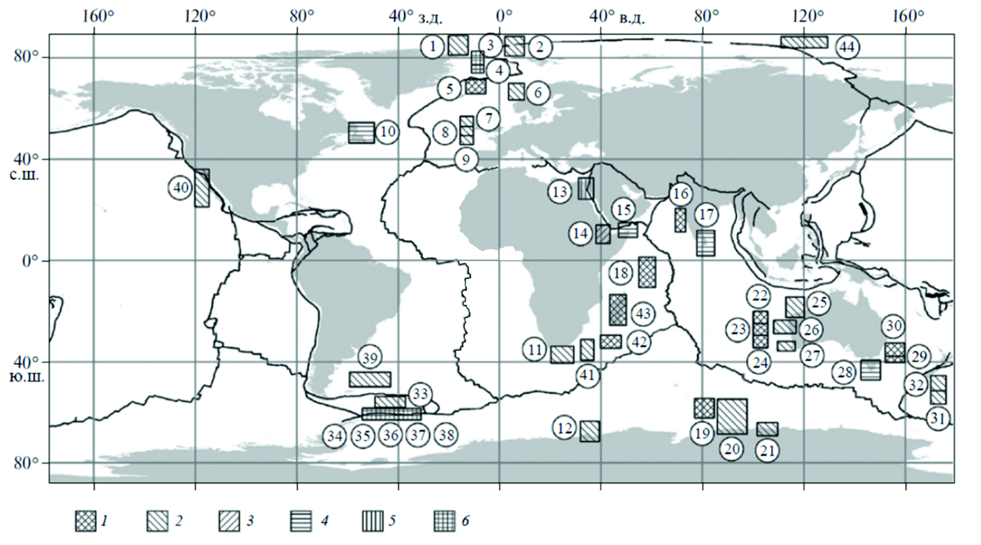
The distribution of microcontinent in the structure of the oceanic lithosphere and marginal plateaus and islands within the transition zones, taking into account the data. 1 - microcontinent; 2 - marginal plateaus; 3 - the initial stage of the formation of marginal plateaus under the conditions of the hot spot (Horst Danakil); 4 - islands within the continental margins; 5 - the initial stage of the formation of microcontinent or islands; 6 - microcontinents formed in shear-sliding conditions. The numbers in the circles indicate: 1 - Morris-Jesup plateau, 2 - Ermak plateau, 3 – Hovgard Ridge, 4 - Greenland Ridge, 5 - Ridge Jan Mayen, 6 - Voring Plateau, 7 - Hatton Bank, 8 - Rockall Bank. 9 - Porcupine Bank (Dubinin, 2018).

Slide 4
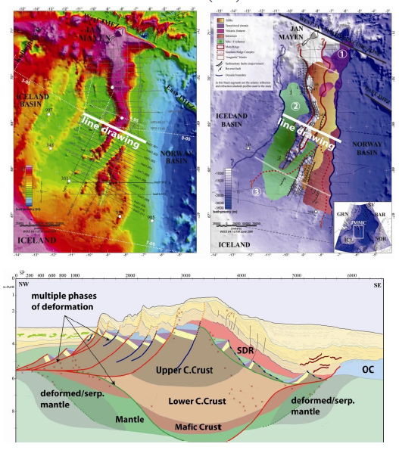
The structure of the JMMC
Left: JMMC bathymetric chart with MCS profiles.
Right: structural map
Schematic interpretation of the JMMC architecture.
(Péron-Pinvidic, G. et al, 2010)

Slide 5
Reconstruction of the North Atlantic Disclosure Jan-Mayen Microcontinent Formation Model
(Peron-Pinvidic et al, 2012)

Slide 6
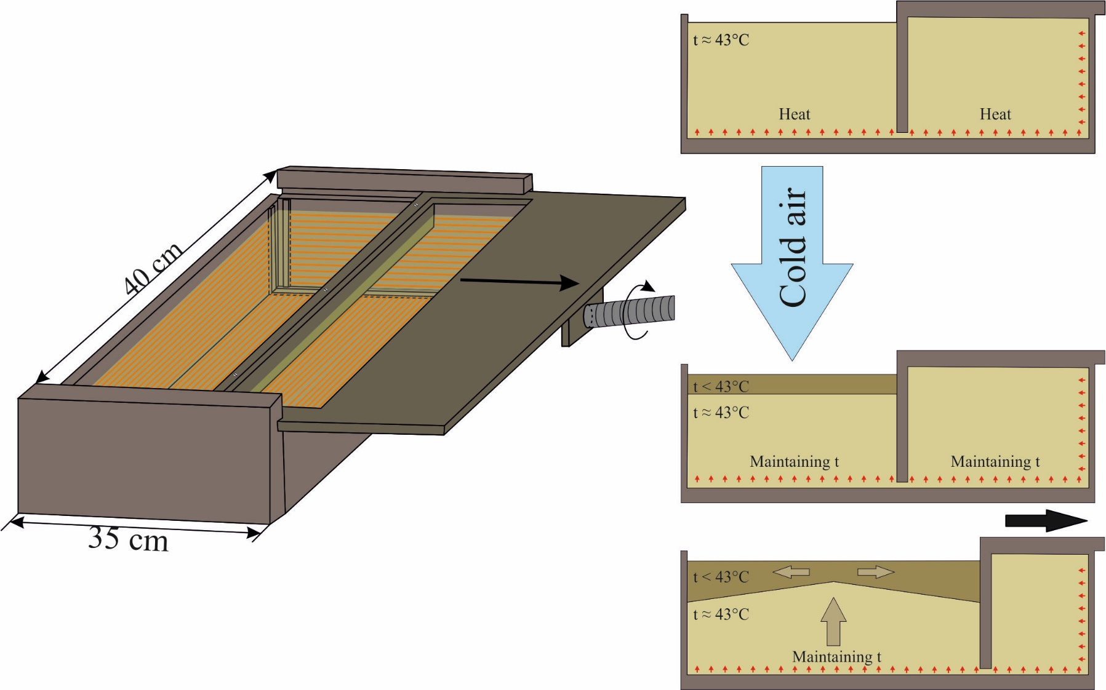
Physical Modeling Technique
Setting the initial parameters of the experiment (weakened zones, structural barriers, cutouts, etc.).
Re-cooling if necessary
Maintaining temperature, cooling the model from above, creating a model lithosphere
Heating the substance to 43 ° C, melting the substance
Starting the electric drive, the beginning of stretching at a given speed
The experimental setup of the Museum of Geography of Moscow State University

Slide 7
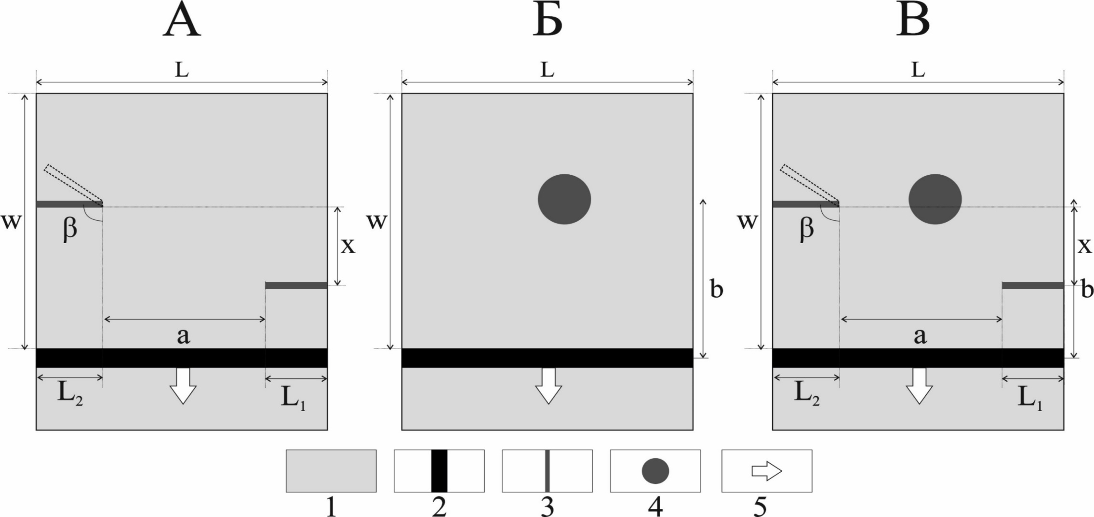
(1) - model lithosphere; (2) - piston; (3) - cutouts; (4) - Local heat source; (5) - direction of extension.
A – The influence of only the overlap zone on the formation of the microblock
B – The influence of only the hot spot on the formation of the microblock
C – Combined series
Schemes of the initial parameters of a series of experiments
B
C

Slide 8
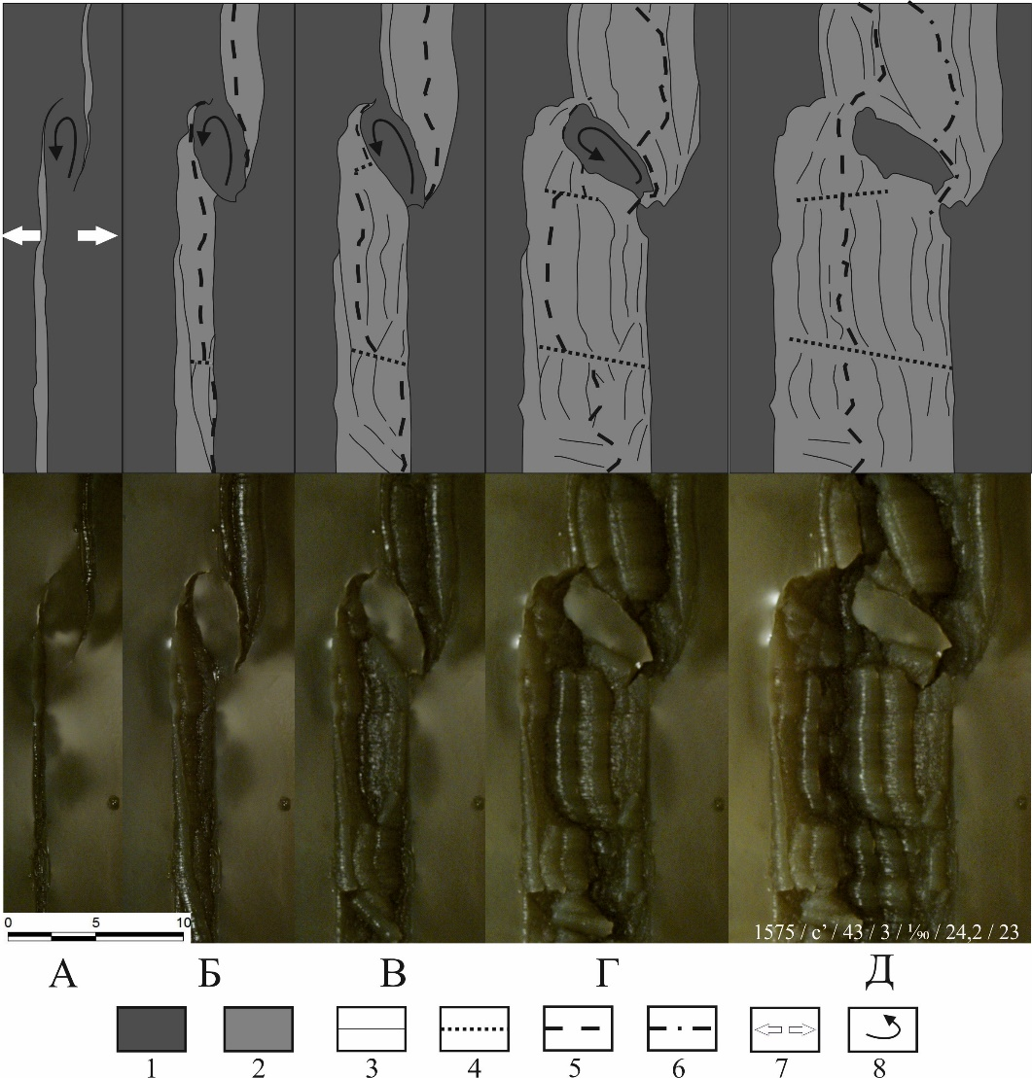
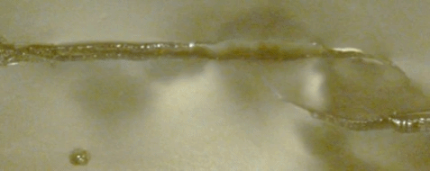
A completely separated fragment of the continent
Series № 1
A B C D E
The formation of a microblock with parallel extension of rift cracks with a small transverse displacement and a large longitudinal. Experience No. 1575. A – E the main stages of the formation of a separate block, photo and diagram (top view). (1) - initial model plate; (2) - newly formed lithosphere; (3) - sections and cracks moving from them, as well as the boundaries of the main forming structures; (4) - displacements and shifts; (5) - spreading axis; (6) - paleospreading axis; (7) - direction of extension; (8) - direction of rotation of the microblock.

Slide 9
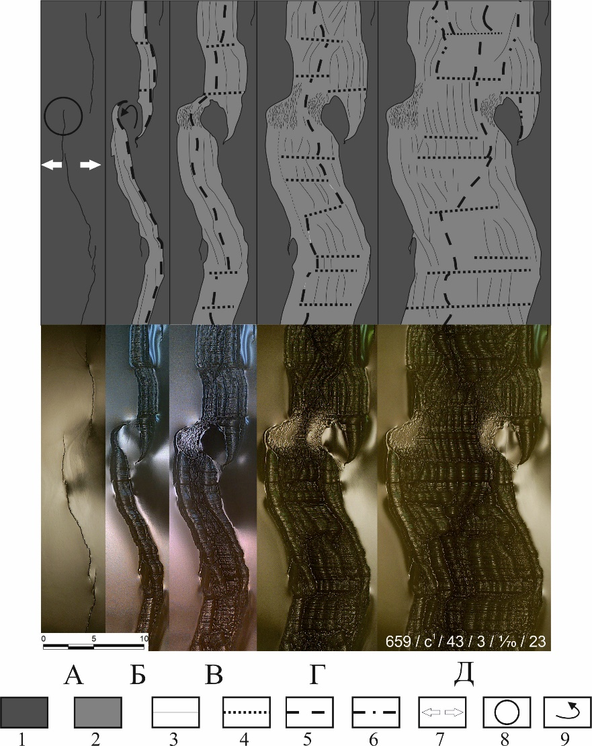
Deformed fragment of the continent
Series № 2
Low amplitude relief formed by LHS
Microblock formation during local heat source (LHS) operation. Experience No. 659. A – D, the main stages of the formation of a separate block, photo and diagram (top view). (1) - initial model plate; (2) - newly formed lithosphere; (3) - the boundaries of the main emerging structures; (4) - displacements and shifts; (5) - spreading axis; (6) - paleospreading axis; (7) - direction of extension; (8) - zone of influence of LHS; (9) - direction of rotation of the microblock.
A B C D E

Slide 10
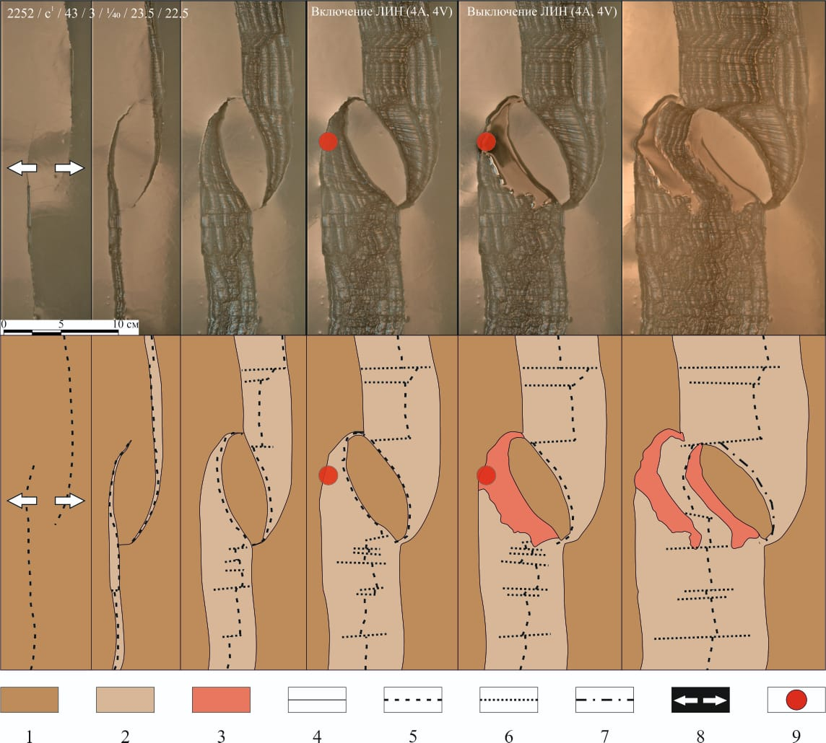
Local heat source works
A completely separated fragment of the continent
Серия № 3
Microblock formation during LHS operation. Experience No. 2252. The main stages of the formation of a separate block, photo and diagram (top view). (1) - initial model plate; (2) - newly formed lithosphere; (3) - magmatic outpourings; (4) - the boundaries of the main emerging structures; (5) - spreading axis; (6) - displacements and shifts; (7) - paleospreading axis; (8) - direction of extension; (9) - zone of influence of LHS;

Slide 11
Выводы
Comparison of the results of modeling the formation of a microblock with the relief of the basement obtained from seismic data give good agreement.
Modeling revealed the microblock formation conditions. For this, three series of experiments were carried out:
  The formation of a microblock in the presence of two rift cracks of parallel strike with a small horizontal spacing. In these experiments, microblocks and unseparated structures were formed with equal frequency.
  The formation of a microblock under the influence of a local heating source. Similar experiments showed the influence of a hot spot on the formation and development of a microblock.
  Combined experiments in which parallel rift cracks and a local heating source were specified. These experiments showed a better fit with the existing Jan Mayen microcontinent formation model. Initially, one rift axis was formed, and later, under the influence of LIN, the rift axis jumped, separating the microblock.

Slide 12

Thank you for the attention!

