Slide 1
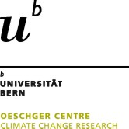
Historical climatology and hydrology EGU, 4 May 2020
Impacts of spring-summer droughts in England, 1200-1700
Kathleen Pribyl
Climatic Research Unit, School of Environmental Sciences, University of East Anglia, UK
Oeschger Centre for Climate Change Research (OCCR), University of Bern, Bern, Switzerland

Slide 2
Examples of extreme spring-summer droughts
Examples of major droughts 1200-1700:
1252 1473
1325-26 1540
1331-32 1556
1361 1635-36
1410s 1684-85
1464
Pribyl, K., Cornes, R., Droughts in medieval and early modern England, part 1: The evidence, 2019. The Old World Drought Atlas for sample years of drought mentioned in the written record. It provides a measure of the self-calibrating Palmer Drought Severity Index (PDSI), red (blue) values indicate dry (wet) conditions, during the summer season (Cook et al., 2015).

Slide 3
Drought frequency, 13th-15th centuries
June-July-August precipitation index 1256-1448
1325-26
1330s
1410s
Early 1430s
Pribyl, Farming, famine and plague, 2017. Index based on harvest length in Norfolk (East England). Very dry summers are also described in other written records.

Slide 4
Agriculture – Impacts
Problems in drought:
Broken ploughs
Problems with spring grain and legumes
Advantages in drought:
Wheat at its climatic bounderies in England
Wheat grown in English vales on clay soils
Wheat ripens earlier in warm-dry spring-summers and avoids the worst of the droughts

Slide 5
Agriculture
William Merle c. 1340: dry weather good for wheat
Meteo-pattern for good wheat harvests (1209-1450):
dry autumn hard or average winter dry spring and summer (Titow, Evidence of weather, 1960).
Warm-dry spring-summers can even lead to a glut

Slide 6
Wheat price and drought 1256-1431
Wheat price is often lower after drought years, than in previous years, and generally low
Pribyl, Farming, famine and plague, 2017. Warm-dry sping-summers: red, cold-wet spring-summers: blue. Wheat price first difference shows movement of price of given year (fall or rise) compared to previous year.

Slide 7
Agriculture – Impacts
Dry, warm conditions good for wheat growing
Interchangebility of grains prevents famine
No major harvest failure or grain price rise

Slide 8
Pastoral farming - Impacts
Problems in drought:
Water shortage
Heat stress and sun stroke
Low grass and hay production: - Dairy production - Fattening of livestock - Survival of calves and lambs - Fertility - Winter survival (sale/slaughter before/after winter)
Susceptibility to disease

Slide 9
Health - Impacts
Raised (infant) mortality
Heat stress and sun stroke
Water shortage
Malaria (Quartan agues, fevers)
Gastro-intestinal disease - transmitted by insects - transmitted by contaminated water
Plague

Slide 10
Plague and summer weather, 1348-1500
Pribyl, Farming, famine and plague, 2017.
Used data: Van Engelen, Buisman, Ijnsen (2001), A millennium of weather, winds and water in the Low Countries, Johnes et al. (eds), History and climate, New York, 101-24. (data: www.knmi.nl/klimatologie/daggegevens.html) . Marked are plague years and their weather condition.
Cooper et al. (2012), A tree-ring reconstruction of East Anglian (UK) hydroclimate variability over the last millennium, in: Climate Dynamics 40/3, 1019-39.

Slide 11
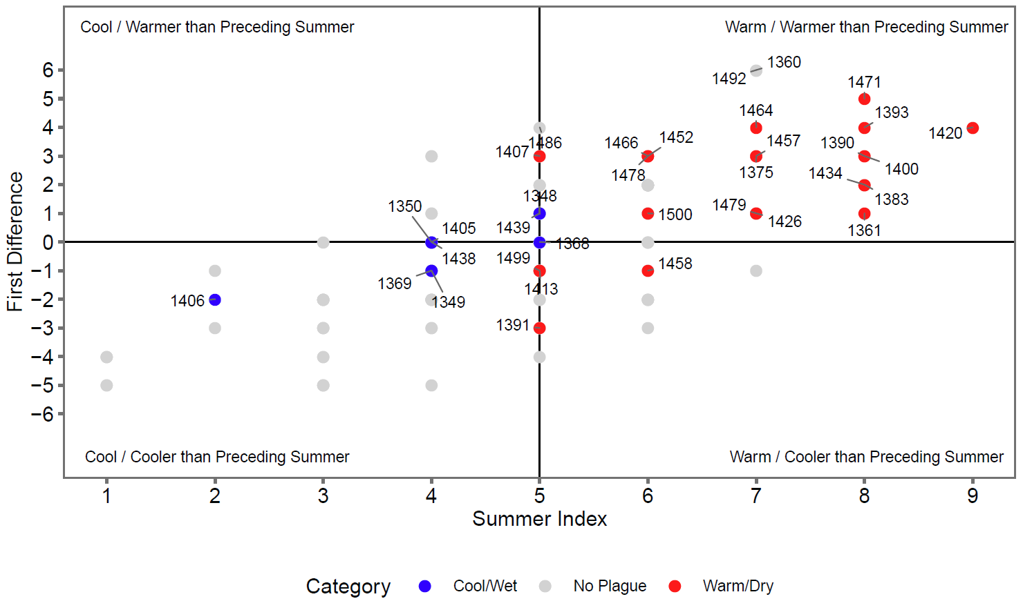
Plague and summer weather, 1348-1500
Pribyl, Farming, famine and plague, 2017.
Used data: Van Engelen, Buisman, Ijnsen (2001), A millennium of weather, winds and water in the Low Countries, Johnes et al. (eds), History and climate, New York, 101-24. (data: www.knmi.nl/klimatologie/daggegevens.html) . Marked are plague years and their weather condition.
Cooper et al. (2012), A tree-ring reconstruction of East Anglian (UK) hydroclimate variability over the last millennium, in: Climate Dynamics 40/3, 1019-39.

Slide 12
Fire risk
Water levels – Impacts
Thames water levels low
Hindered water transport
Marshland drying up
Springs drying up
Mills standing idle
Townfires
Field and turf fires
Preventative measures
Installation of ladders Planning of new wells Building regulations

Slide 13
Water levels and supply – Adaptation
Public water supply: - new wells / water supply systems are often installed during drought periods, even though the need for them is recognised for substantial periods of time before
Non-water mills: - in times of drought it is likely that mills not relying on water, such as windmills and horse-mills, were constructed
Draining of Fenland: - periods of drought offer the opportunity to drain marshland, and the Great Fen in eastern England was drained in the dry 1630s and 1650s - this increased available agricultural land and improved health over time by increasing water quality and reducing malaria affected areas

Slide 14
Pribyl, K., Cornes, R., Droughts in medieval and early modern England, part 1: The evidence, Weather (in press), https://doi.org/10.1002/wea.3599
Pribyl, K., Cornes, R., Droughts in medieval and early modern England, part 2: Impacts, Weather (in press), https://doi.org/10.1002/wea.3529
Pribyl, K. , A survey of the impacts of summer droughts in England, 1200–1700, Clim. Past Discuss., https://doi.org/10.5194/cp-2019-116, in review, 2019.
Pribyl, K., Farming, famine and plague. The impact of climate in late medieval England, Springer 2017.

