Slide 1
BepiColombo
Status and first results from the Earth Flyby
Johannes Benkhoff
Joe Zender
Go Murakami
Project Scientists
EGU Meeting 2020

Slide 2
Sciences Objectives
Origin and evolution of a planet close to its parent star
Mercury's figure, interior structure, and composition
Interior dynamics and origin of its magnetic field
Exogenic and endogenic surface modifications, cratering,
tectonics, and volcanism
Composition, origin and dynamics of Mercury's exosphere and
polar deposits
Structure and dynamics of Mercury's magnetosphere
Test of Einstein's theory of general relativity

Slide 3
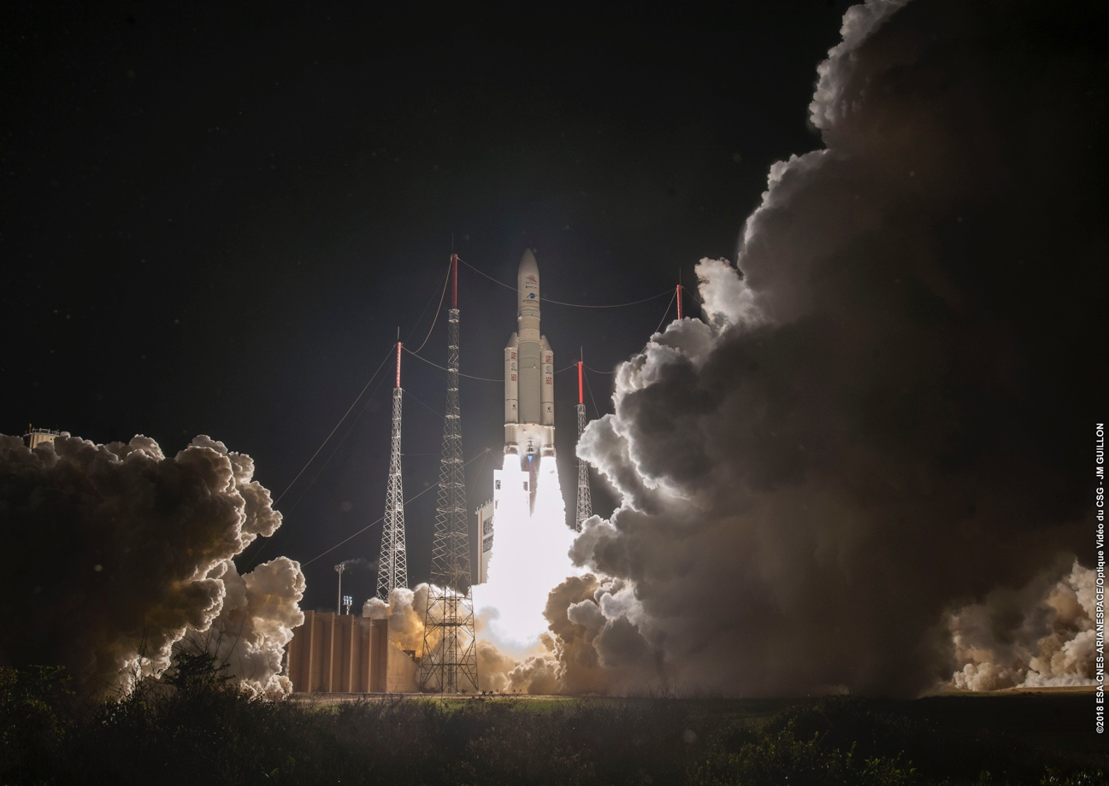
20 October 1:45 UTC Launch

Slide 4
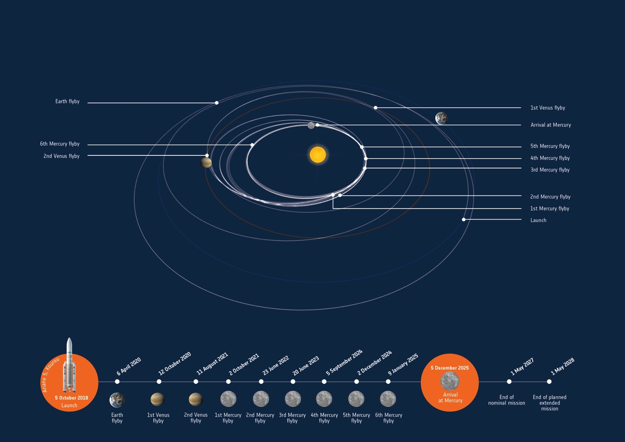
Mission design
Launch
20 October 2018
Arrival
5 Dec. 2025
Earth Flyby
10 April 2020
Start Science
March 2026
Nominal Mission
until May 2027

Slide 5
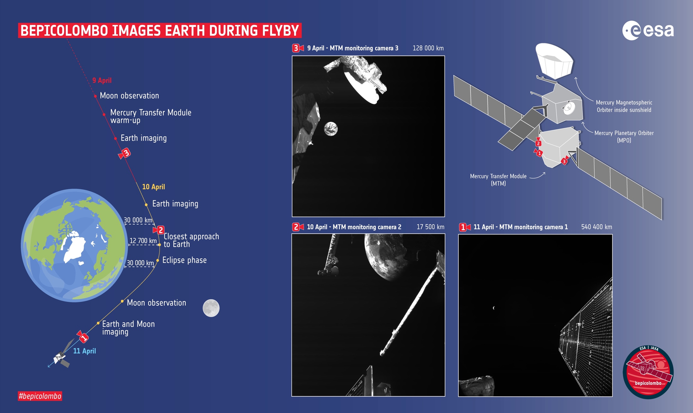
Monitoring Camera Observations

Slide 6
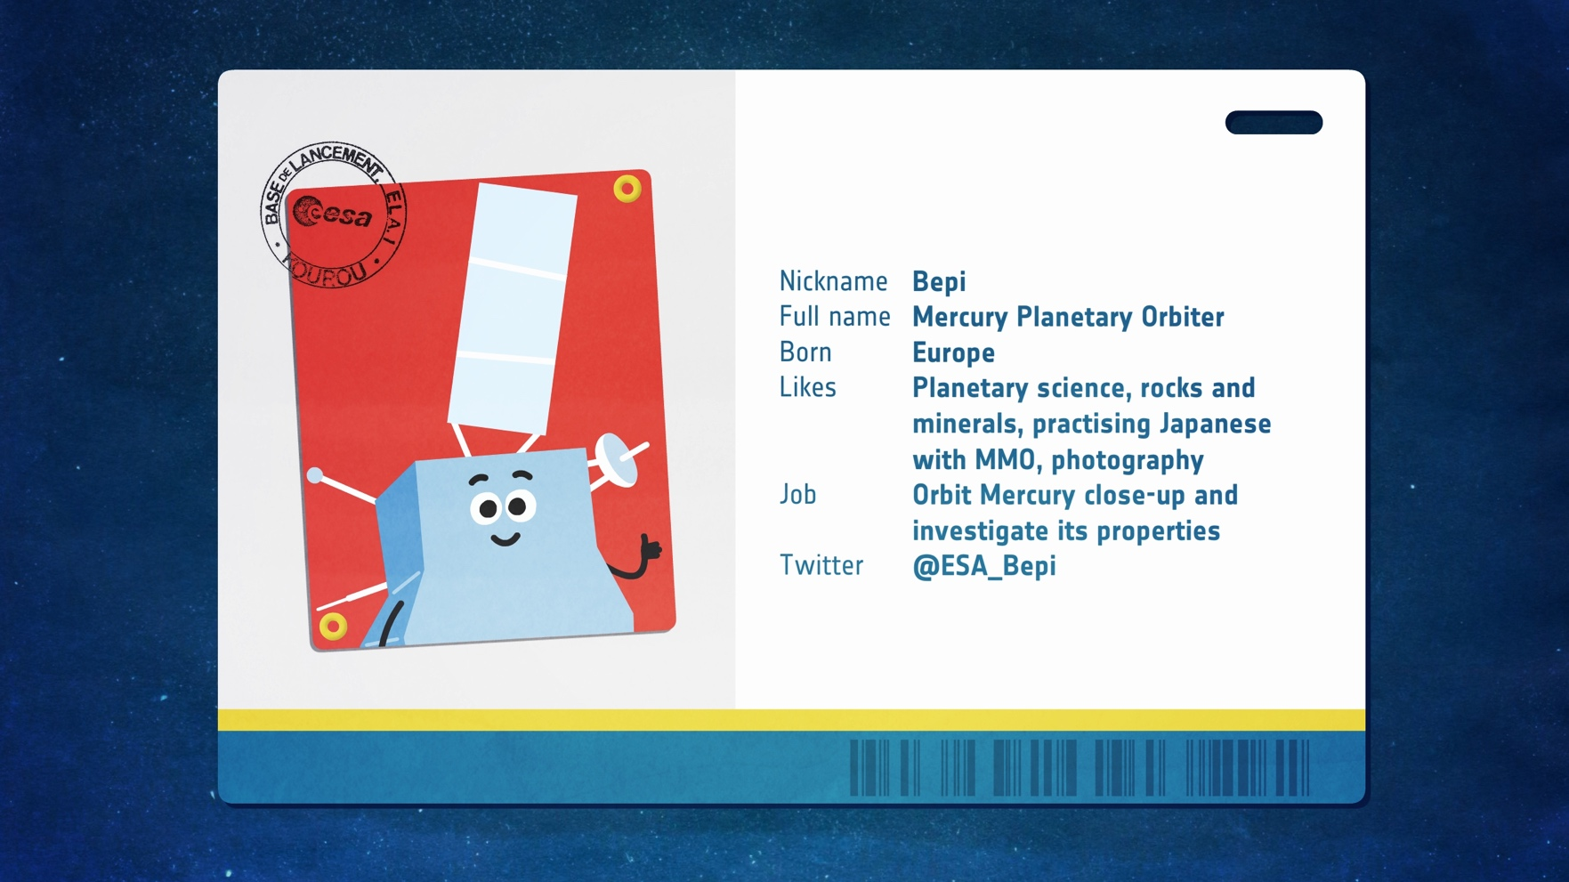
MPO – Mercury Planetary Orbiter

Slide 7
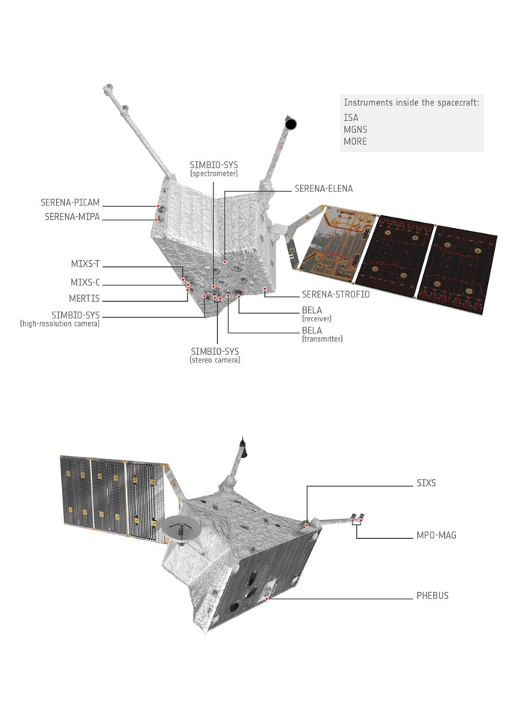
MPO – Instruments
 | Instrument description
BELA | Characterise the topography and surface morphology of Mercury.
MORE | Determine Mercury’s gravity field as well as the size and physical state of its core.
ISA | Study Mercury’s interior structure and to test Einstein’s Theory of Relativity.
MPO-MAG | Describe Mercury’s magnetic field and its source.
MERTIS | Study of Mercury’s mineralogical composition, global temperature maps.
MGNS | Elemental composition of Mercury’s surface distribution of volatiles in polar areas
MIXS | Use X-ray fluorescence analysis a global map of the surface atomic composition.
PHEBUS | Characterisation of the composition and dynamics of Mercury’s exosphere.
SERENA | Study the interactions between the surface, exosphere, magnetosphere & the solar wind.
SIMBIO-SYS | Provide global, high-resolution, and IR imaging of the surface
SIXS | Perform measurements of solar X-rays and particles at high time resolution.

Slide 8
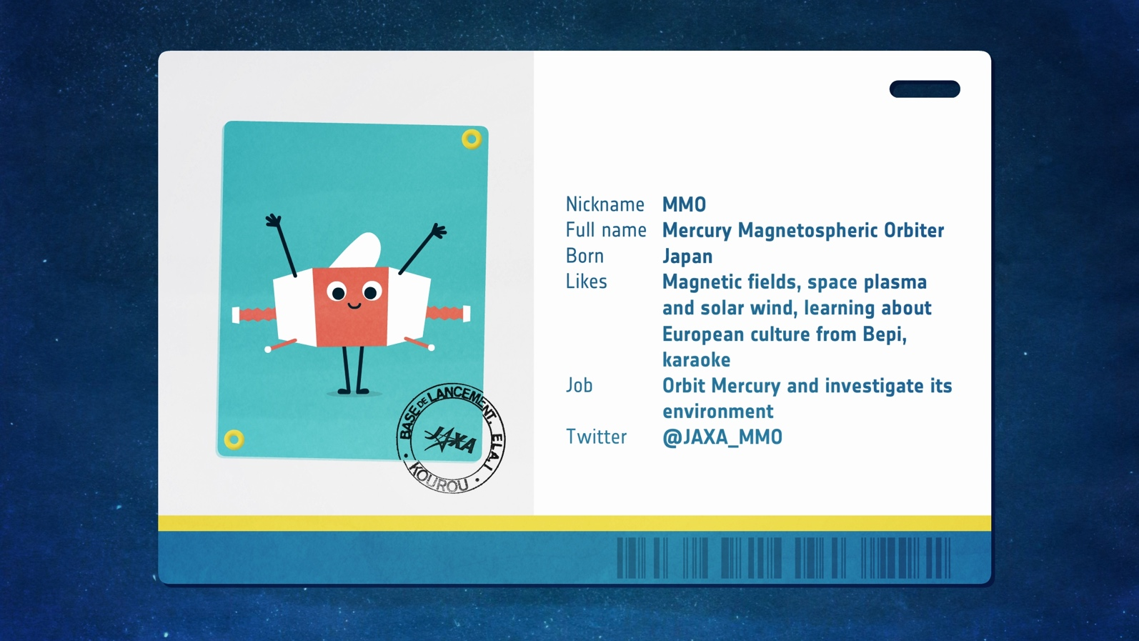
MMO – Mercury Magnetospheric Orbiter
Mio

Slide 9
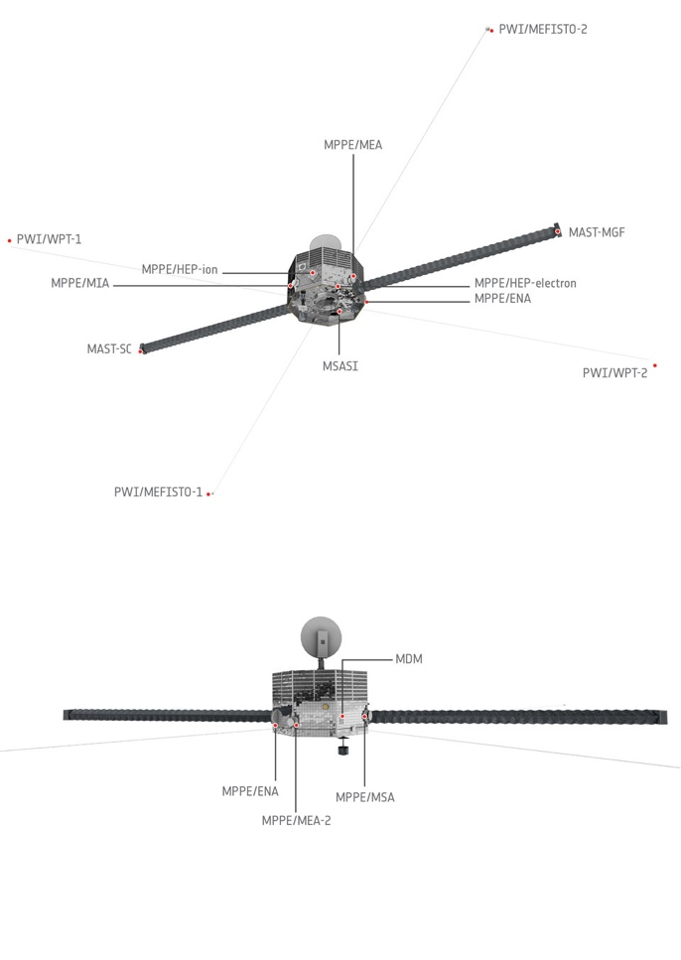
Mio – Instruments
 | Instrument description
MGF | Provide a detailed description of Mercury’s magnetosphere and of its interaction with the planetary magnetic field and the solar wind.
MPPE | Study low- and high-energetic particles in the magnetosphere. MEA- Electron Analyzer MIA – Ion Analyzer HEP-ion – High Energy Particles HEP-electron – High Energy Particles ENA – Energetic Neutrals Analyzer MSA – Mass Spectrum Analyzer
PWI | Make a detailed analysis of the structure and dynamics of the magnetosphere. MEFISTO, WPT – two sets of electric field sensors LF-SC and DB-SC -- two kinds of magnetic field sensors
MSASI | Measure the abundance, distribution, and dynamics of sodium in Mercury’s exosphere.
MDM | Study the distribution of interplanetary dust in the orbit of Mercury.

Slide 10
BepiColombo Earth Flyby
Time: 10 April 2020 04:24:57.213
Distance from Earth Center: 19063.905 km

Slide 11
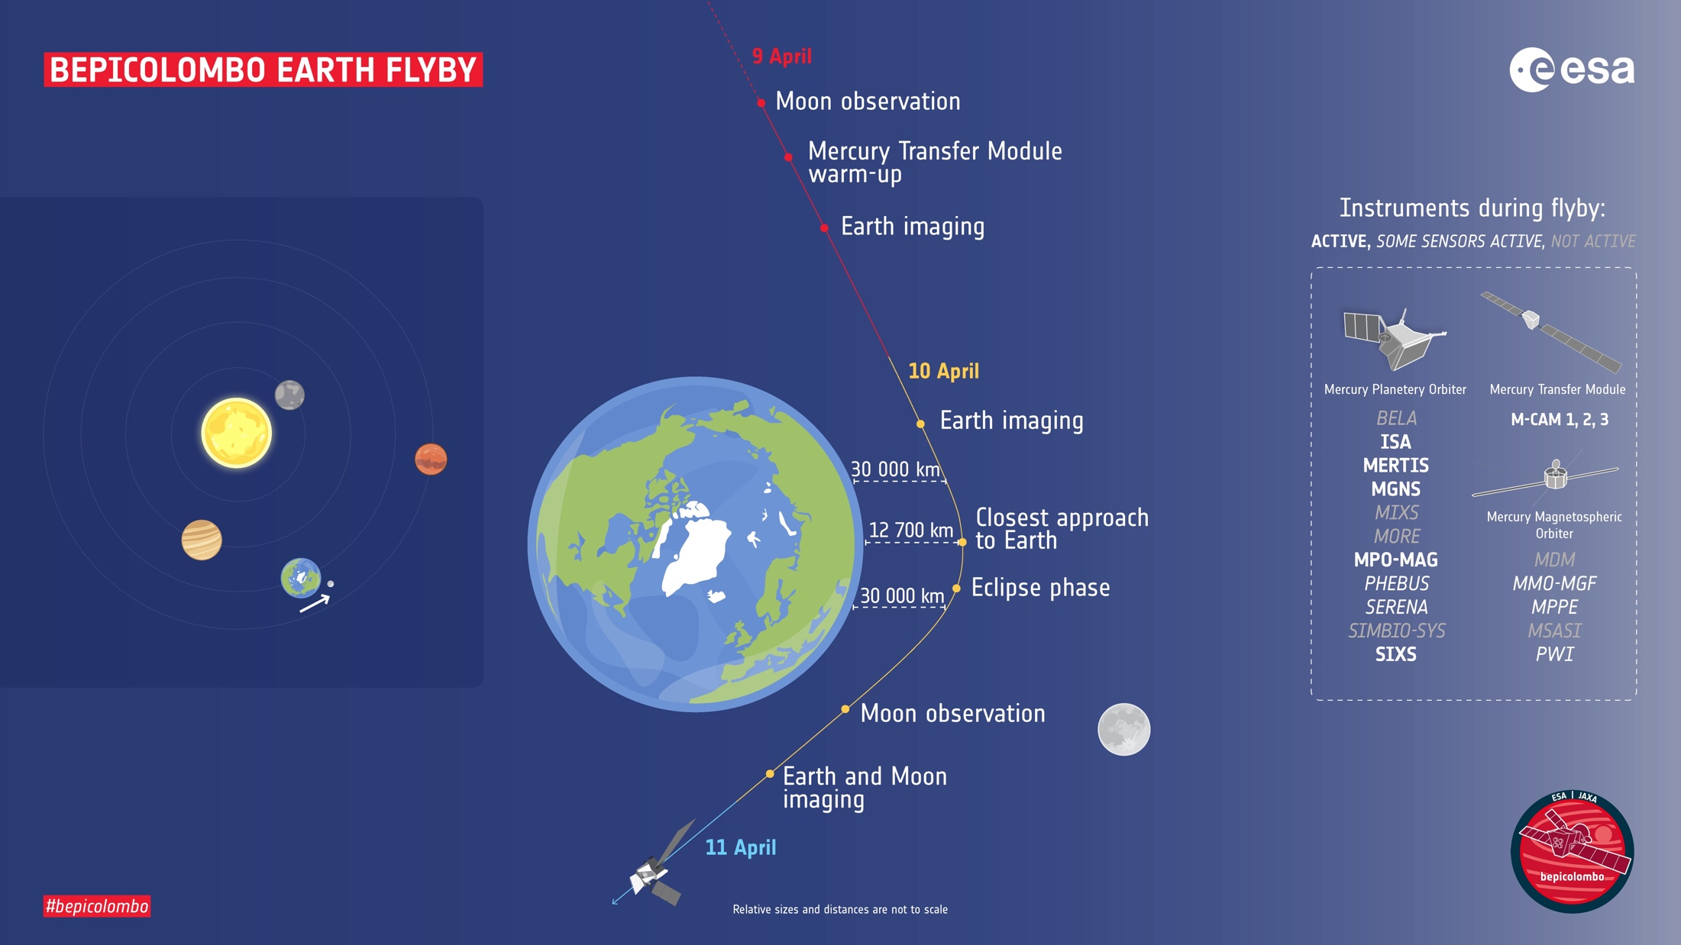
BepiColombo Earth Flyby
MERTIS
MGNS
MPO-MAG
SIXS
M-Cam
Mio -sensors
SERENA
M-Cam
PHEBUS
M-Cam

Slide 12
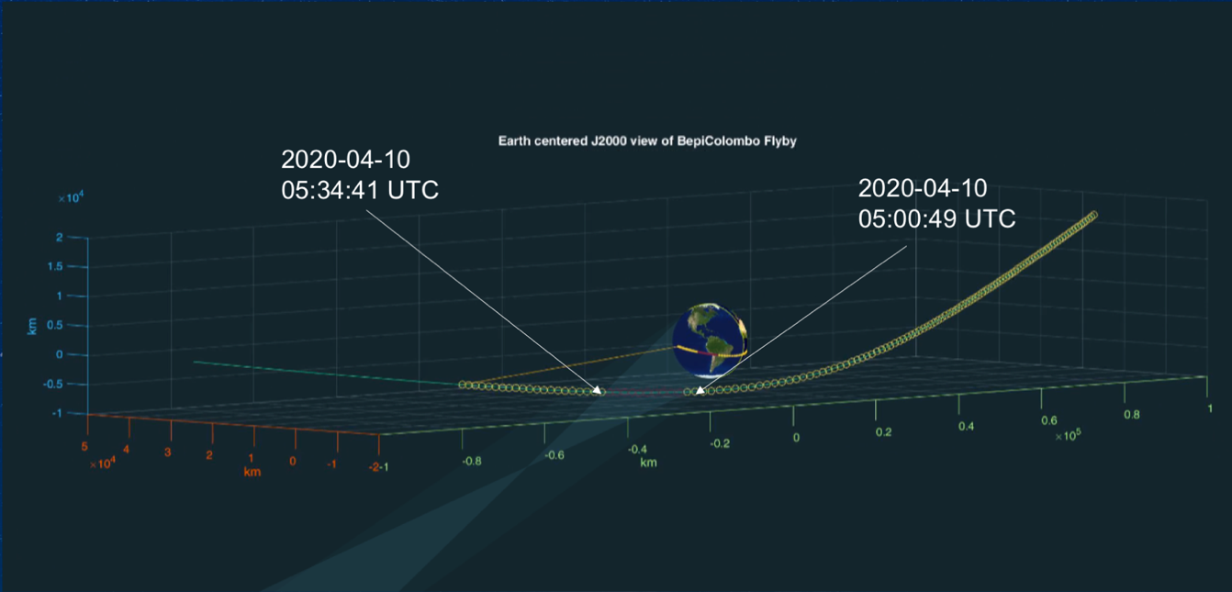
33:55 minutes Eclipse during Flyby

Slide 13
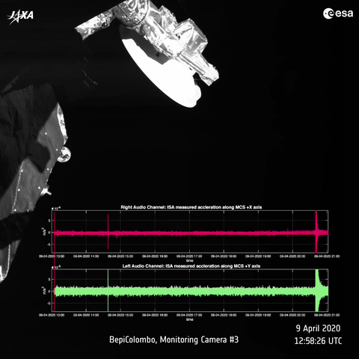
MCAM and ISA
ESA/BepiColombo/ISA/ASI-INAF – CC BY-SA 3.0 IGO

Slide 14
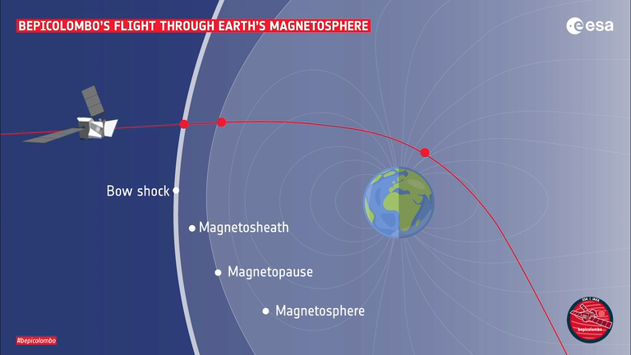
MPO-MAG
ESA/BepiColombo/MPO-MAG/IGEP-IWF-IC-ISAS, CC BY-SA 3.0 IGO

Slide 15
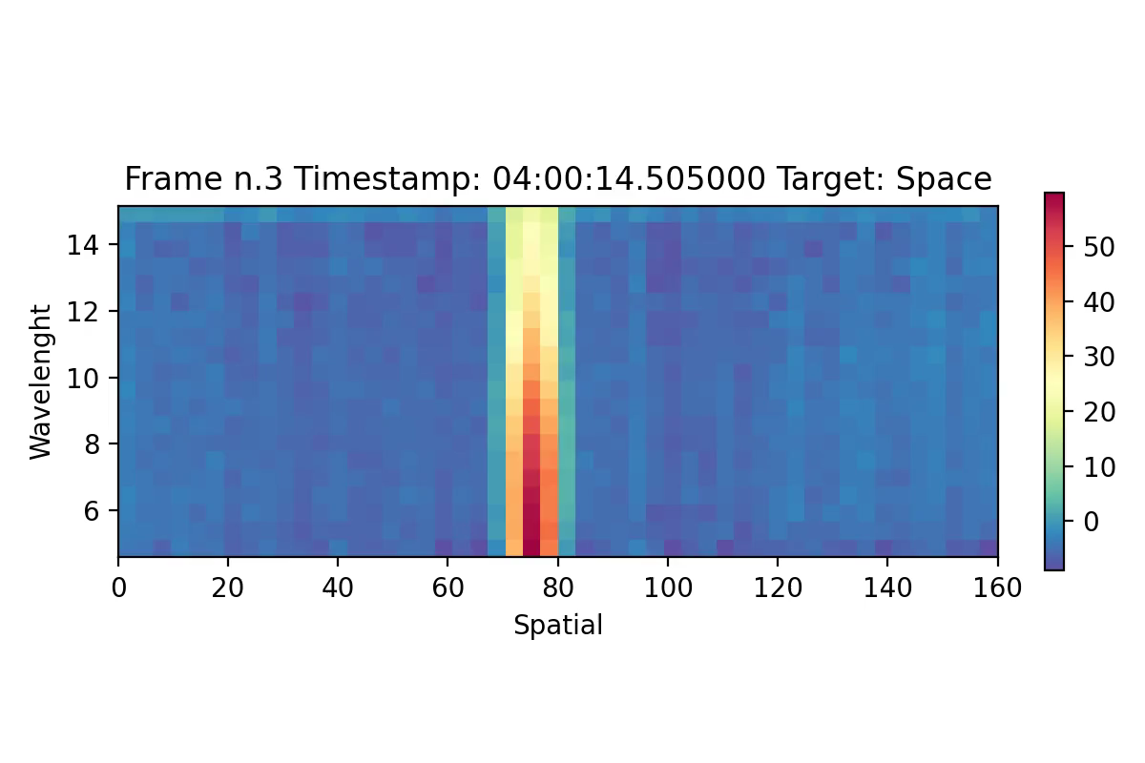
MERTIS: first results of a
novel instrument
H. Hiesinger, J. Helbert, M D’Amore
MERTIS Team
University Münster, Germany
DLR Berlin, Germany
Credit: DLR Berlin and Westfälische Wilhelms Universität Münster, Germany
Notes:
MERTIS calibrated image: These are the very first observations of the Moon that MERTIS obtained. The reddish line in the middle is the Moon. To the left and red we go away from the center of the Moon so the radiance decreases until we look into space which is all the blue. From bottom to top is the spectral direction. As the Moon has a surface temperature of about 100C one sees the most radiance at approximately 7.5-8 micrometer.
Credit is DLR and Westfälische Wilhelms Universität Münster

Slide 16
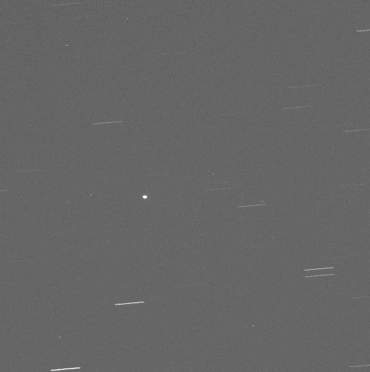
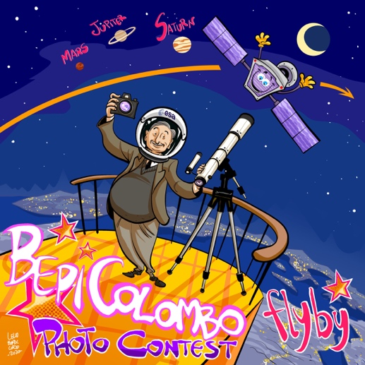
Professionals/Amateurs
Ground Based Observations
25 cm Telescope - the OCTOPUS telescope in San Pedro de Atacama (Chile) from the 6ROADS network.
Image credit ESA/6ROADS, Marcin Gedek, Rafal Reszelewski, Michal Zolnowski".

Slide 17
MPO & MIO Science @ Venus
PHEBUS
sense the atmosphere; may give a novel detection of the hot oxygen population (detected only by Pioneer Venus and Venera 11 in early 80’s)
SERENA/MIPA & SERENA/PICAM
hot plasma and ion mass spectra
SIXS
solar radiation monitoring
MERTIS
sound the middle atmosphere in the altitude range 55-100 km and its cloud layer; observations of CO₂, SO₂ and H₂SO₄ ; retrieving temperature profiles
MPO-MAG/ MIO sensors
sense all plasma boundaries that the spacecraft will pass through

Slide 18
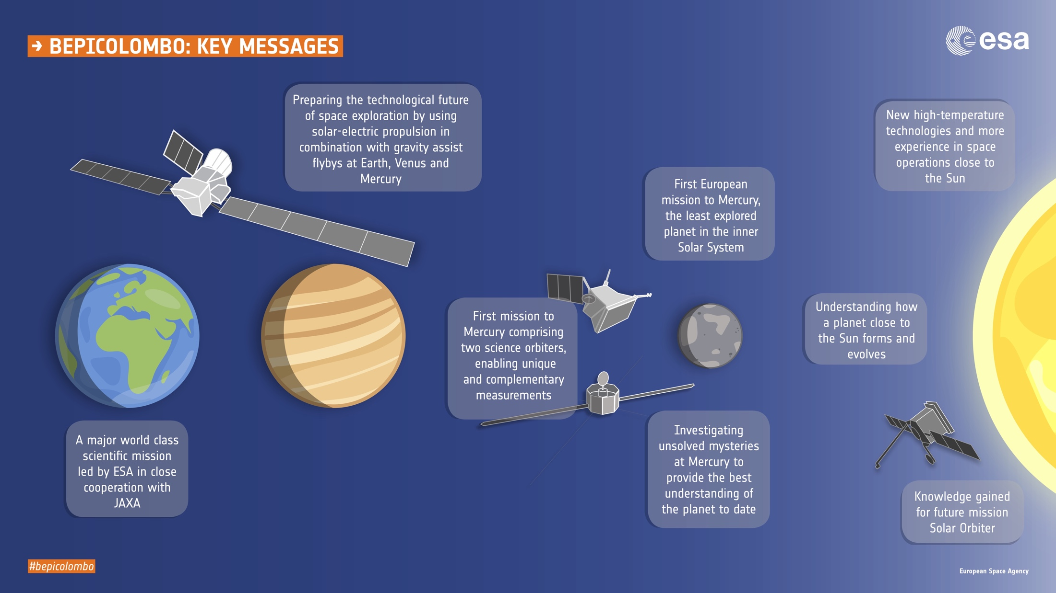

Slide 19
