Slide 1
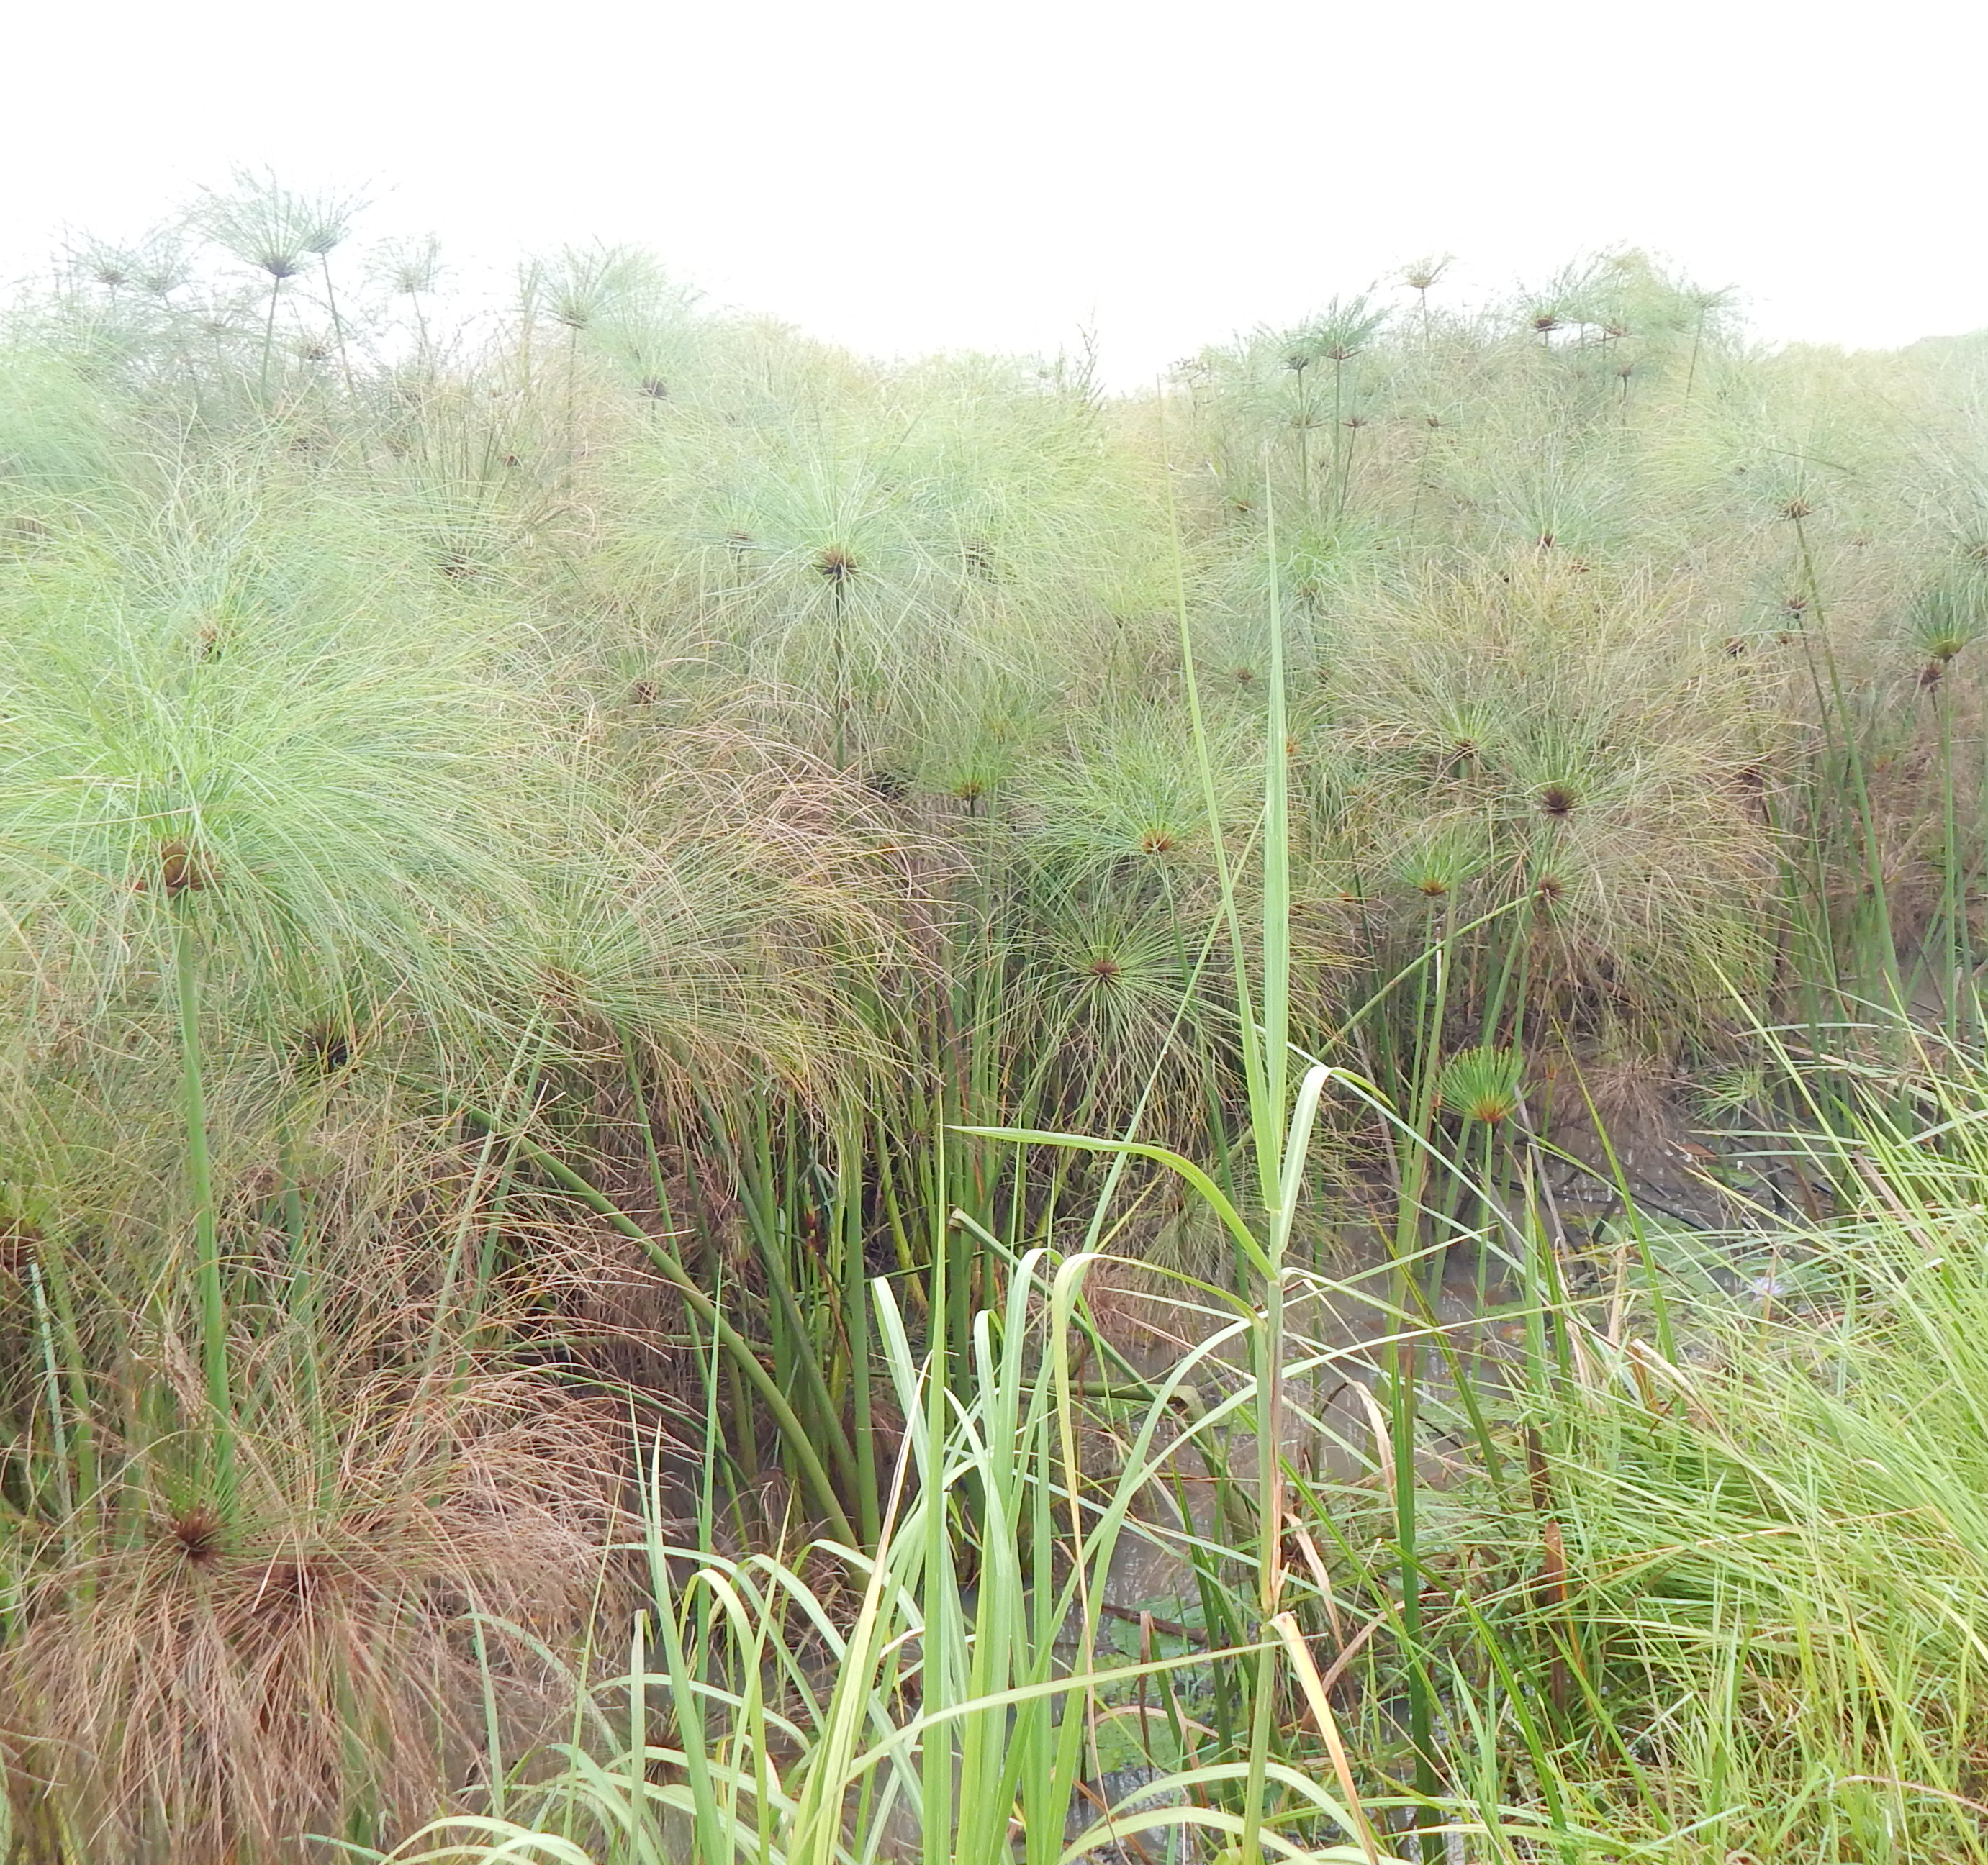
Socio-economic determinants of land use/cover change in wetlands in East Africa: a case study analysis of the Anyiko wetland in Kenya
Risper Ajwang’ Ondiek ¹, Francesco Vuolo ², Julius Kipkemboi ³, Nzula Kitaka ³,Erwin Lautsch ¹, Thomas Hein ^{1,4} and Erwin Schmid ⁵
¹ Institute for Hydrobiology and Aquatic Ecosystem Management, University for Natural Resources and Life Sciences, Vienna, Austria
² Institute of Geomatics, University for Natural Resources and Life Sciences, Vienna, Austria,
³ Department of Biological Sciences, Egerton University, Nakuru, Kenya
⁴ Wassercluster Lunz, Lunz am See, Austria,
⁵ Institute for Sustainable Economic Development, University for Natural Resources and Life Sciences, Vienna, Austria

Slide 2
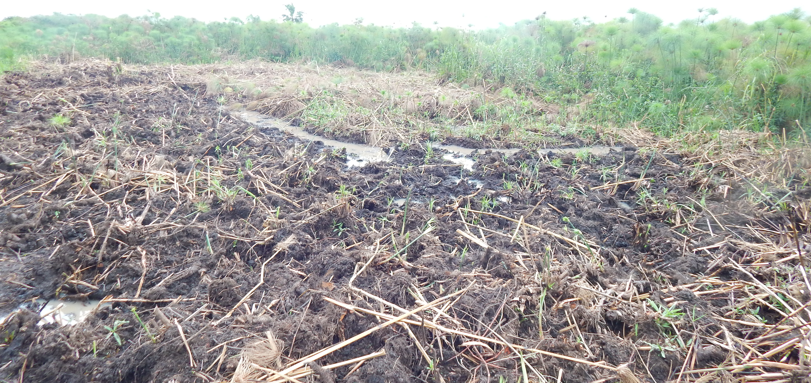
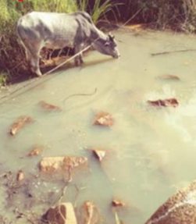
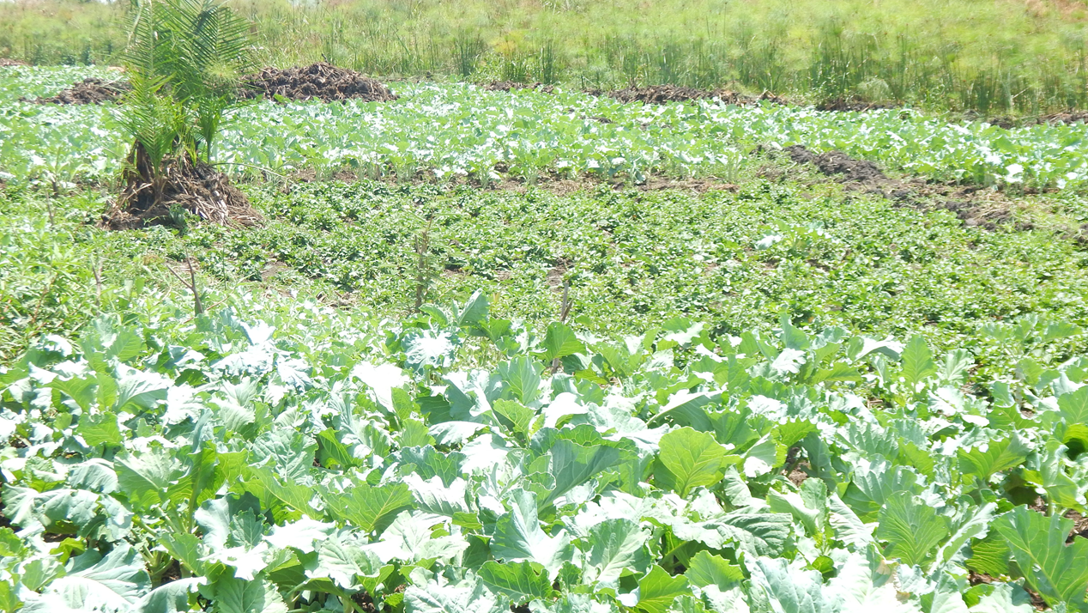
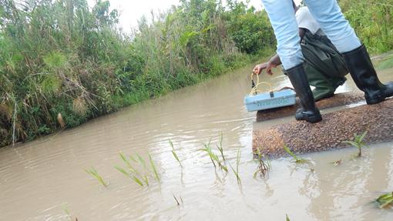
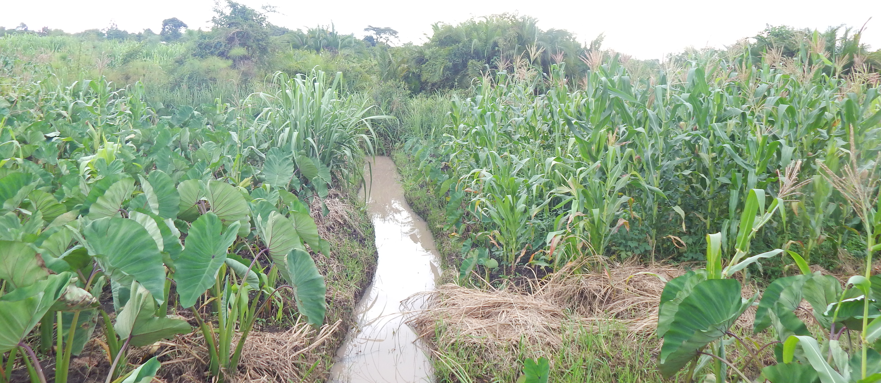
Ecosystem Services
Wetland conversion to agriculture
Turbid water
Enhance food production
Vegetables
Turbid water
Reduction in Regulating Ecosystem Services
Coco yam and Maize
Figure from: http://www.metrovancouver.org/planning/development/ecologicalhealth/Pages/default.aspx
Pictures taken by Risper

Slide 3
Introduction
Wetlands conversion to agriculture is mainly attributed to:
Increasing demand for food production
Inadequate understanding of wetlands’ values by stakeholders
Perceived as:
“Wasteland”
Minimal value in comparison to other uses of their land that may produce more tangible, immediate and higher monetary benefits
Studies explicitly quantifying spatio-temporal extents of wetlands encroachment by agriculture in sub-Saharan Africa are limited
Not only the perceptions about wetlands values are important, but also other socio-economic determinants contributing to their conversion
Understanding the linkages is important for sustainable utilization of wetlands

Slide 4
Objectives
Analyzed socio-economic determinants of land use/cover change in wetlands at household level using the Anyiko wetland in Kenya as a case study.
To determine spatio-temporal change of agriculture in the wetland
To analyze socio-economic determinants of wetland utilization for agriculture

Slide 5
Study area: Anyiko wetland, Kenya

Slide 6
Materials and methods
Spatio-temporal land use/cover change
Historical land use/cover
CORONA image
The image data was taken on 17th November 1966
Spatial resolution of 3m
Current land use/cover
Google Earth image
The image data were taken on 13th June 2016 and 28th December 2018
Spatial resolution of 0.5m
Visual interpretation of the images
Minimum mapping unit of 1 acre

Slide 7
Materials and methods
Analyze socio-economic determinants
Household survey: 226 households
Between July and December 2017
CHi- squared Automatic Interaction Detector (CHAID) decision tree approach
12 predictor independent variables were tested against the dependent variable of wetland cultivation status of the households

Slide 8
Spatio-temporal change in Anyiko wetland

Slide 9
Spatio-temporal change in Anyiko wetland
Land cover type | 1966 | 2016/18 | Change (1966-2016/18)
 | Areas (acres) | Areas (acres) | Areas (acres) | Percentage (%) change
Wetland | 390 | 174 | -216 | -55
Open shrubland | 999 | 489 | -510 | -51
Closed shrubland | 170 | 21 | -149 | -87
Wetland/closed shrubland | 196 | 0 | -196 | -100
Farmland | 0 | 1070 | +1070 | +

Slide 10
Inter-class land cover changes (1966 -2016/18)
 | Land use/cover changes (acres) |  |  | 2016/18
 |  | Open Shrubland | Wetland | Close Shrubland | Wetland/Close Shrubland | Farmland
 | Open Shrubland | 38% | 2% | 1% | 0% | 59%
1966 | Wetland | 15% | 40% | 2% | 0% | 43%
 | Close Shrubland | 23% | 0% | 2% | 0% | 75%
 | Wetland/Close Shrubland | 5% | 0% | 0% | 0% | 95%
 | Farmland | 0% | 0% | 0% | 0% | 0%

Slide 11
Socio-economic determinants of wetlands utilization for agriculture
Households were more likely to cultivate the wetland if they did not harvest papyrus for artisanal products, were male-headed and lacked alternative sources of income.
The perceptions that wetland is “wasteland” and conversion to agriculture provides higher net monetary benefit did not influence wetland cultivation.

Slide 12
Conclusion
Anyiko wetland area coverage has reduced by more than a half between 1966 and 2018, majority (43%) of which is due to conversion to farmland.
At household level, the conversion of the wetland was determined by the socio-economic status of the households rather than perceptions on its value.
Ondiek RA, Vuolo F, Kipkemboi J, Kitaka N, Lautsch E, Hein T and Schmid E (2020) Socio-Economic Determinants of Land Use/Cover Change in Wetlands in East Africa: A Case Study Analysis of the Anyiko Wetland, Kenya.Front. Environ. Sci. 7:207.

