Slide 1




Parameters of İnfiltration Models as Affected by the Measurement Technique and Land Use
Gülay KARAHAN Seongyun KIM Yakov PACHEPSKY

Slide 2
1- Objective
The measurement technique and the land use are two soil structure-related attributes that are typically available in descriptions of infiltration experiments.
We hypothesized that;
these attributes may be good predictors of the performance of different infiltration models,
and of the parameter values in those models.

Slide 3
2- Data
The international soil infiltration database SWIG assembled in the Institute of Agrosphere in Jülich, Germany, was used as the data source. The database encompasses about 5000 experiments all over the world.
Figure 1. Locations of infiltration measurement sites that were represented in the SWIG database (after Rahmati et al. 2018).

Slide 4
Soil properties that site-specific data included
-Texture
-Measurement method
-Land use
-Organic carbon content
-Bulk density
-Saturated hydraulic conductivity (Ksat)
-The electrical conductivity of saturated paste
-Initial water content varied
-pH

Slide 5
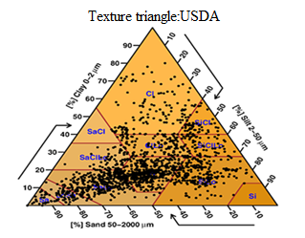
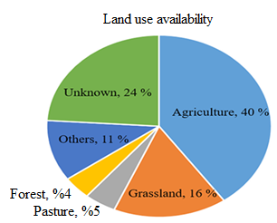
Figure 2. (a) Textural distributions of soils and (b) land use of soils in the database (Rahmati et al. 2018).

Slide 6
Table 1. Methods using for infiltration measurement of soils (Rahmati et al. 2018)
Methods | Number | Methods | Number
The single ring infiltrometer | 570 | Aardvark permeameter | 50
The double ring infiltrometer | 828 | The linear source method | 10
Rainfall simulator | 375 | The point source method | 4
Guelph permeameter | 181 | Hood infiltrometer | 23
Disc infiltrometer | 607 | Tension infiltrometer | 753
Micro infiltrometer | 37 | The Beerkan Estimation of Soil Transfer parameters (BEST) | 197
Mini infiltrometer | 1141
Table 2. Land use types of soils (Rahmati et al. 2018)
Land use | Number | Land use | Number
Agriculture | 2018 | Forest | 204
Grass | 821 | Garden | 152
Pasture | 229 | Urban | 405

Slide 7
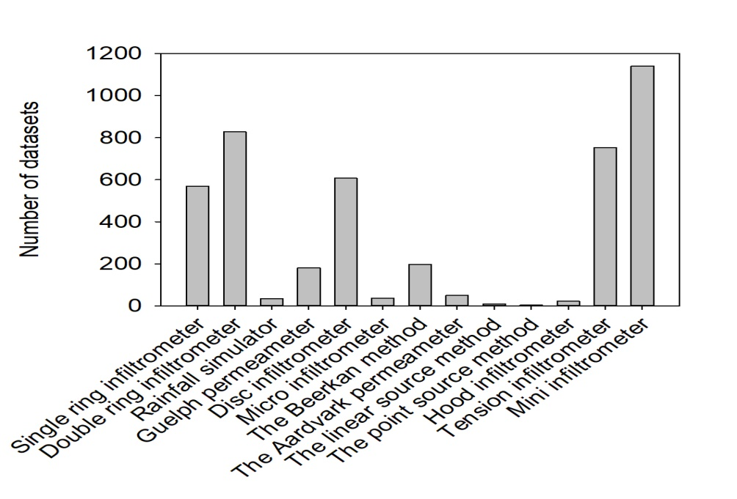
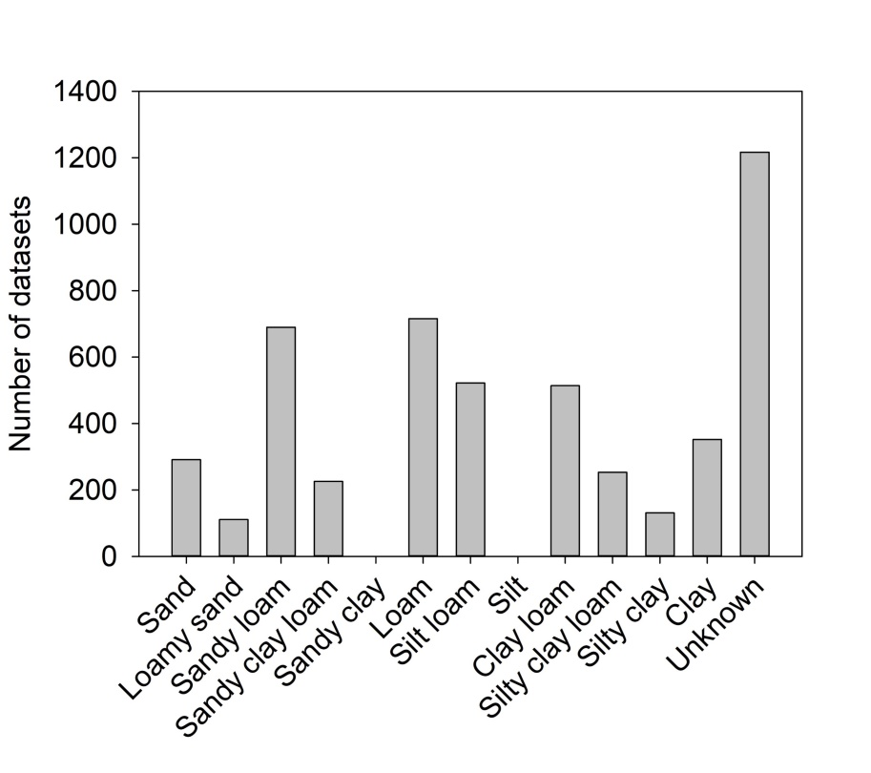
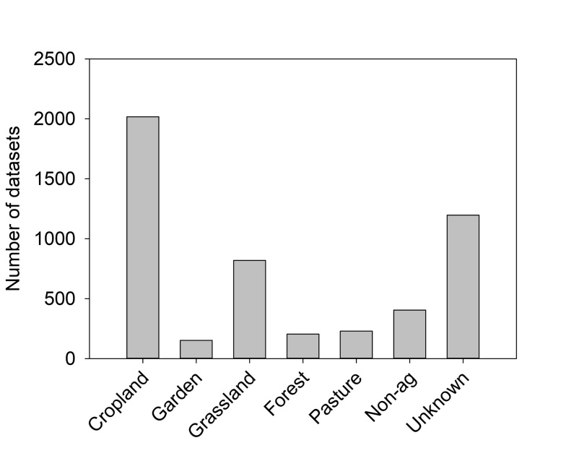
Figure 3. Histogram of categorical variables in the database (N=5022)

Slide 8
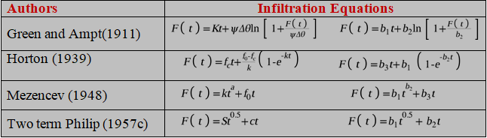
Infiltration models used in this study differ by their mathematical structure and they are different according to their used conditions and the number of fitting parameters that can be estimated based on observed data (Table 3).
Table 3. Equations of commonly used infiltration models
F(t)= Cumulative infiltration capacity at time t (mm h-1), f_{c}= final or equilibrium infiltration rate (mm h-1), f₀ = initial infiltration rate (mm h-1), k= a constant representing the rate of decrease in f capacity, t=time in hour (h), S= sorptivity (cm min^{0.5}), k and a are empirical constants (unitless) (k> 0 and 0 < a < 1) for the Mezencev equation, b₁, b₂, b₃ = fitting parameters.

Slide 9
3- Model Performance Comparison
Two metrics – the root-mean-squared error (RMSE) and the corrected Akaike information criterion (AICc) were used to compare model performance
p= number of parameters, n= number of dataset, and RSS= Residual sum of squares

Slide 10
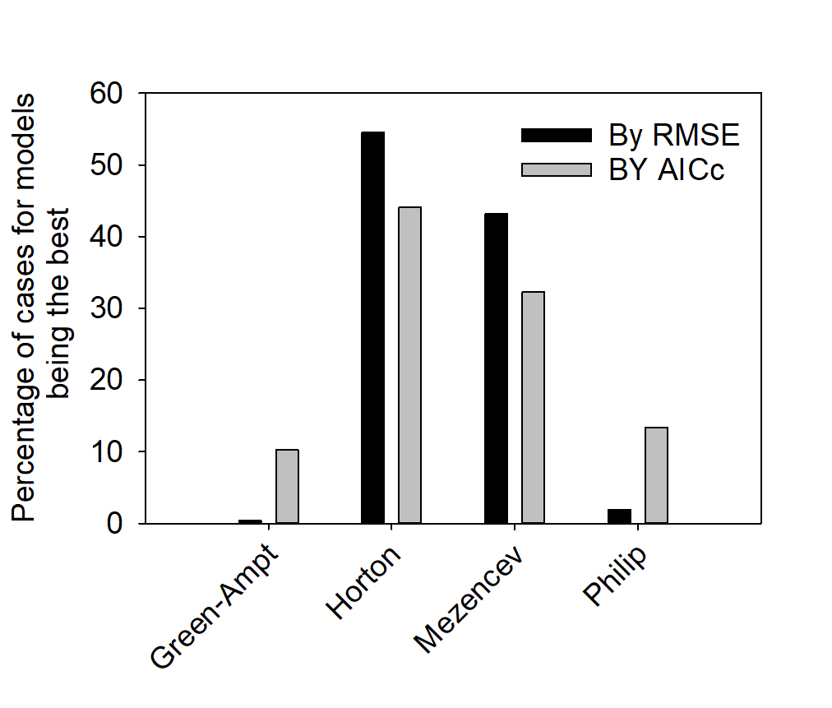
4- Results and Discussion
Figure 4. Percentage of cases for model being the best

Slide 11
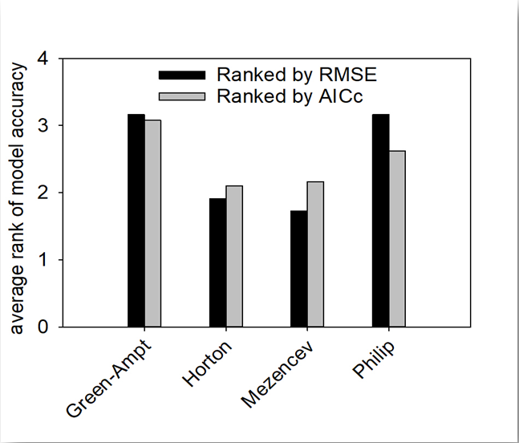
Figure 5. Average rank of models (1 – the best, 4 – the worst)

Slide 12
Table 4. Exploratory statistics of soil properties in data set (N=5022).
Soil properties | Max. | Min. | Mean | SD | CV (%)
Sand, % | 100.00 | 1.00 | 38.51 | 23.77 | 61
Silt, % | 81.60 | 0.00 | 35.80 | 18.50 | 51
Clay, % | 80.00 | 0.00 | 23.55 | 15.12 | 64
OC, % | 87.90 | 0.00 | 3.10 | 6.22 | 200
Db, g cm⁻³ | 2.81 | 0.14 | 1.31 | 0.27 | 21
Dp, g cm⁻³ | 2.96 | 1.73 | 2.51 | 0.62 | 2.8
K_{s}, cm h⁻¹ | 3004.33 | 0.00 | 41.03 | 174.94 | 426
Wc_s, cm³cm⁻³ | 0.87 | 0.01 | 0.43 | 0.11 | 24
Wc_i, cm³cm⁻³ | 0.63 | 0.00 | 0.17 | 0.19 | 67
Wc_r, cm³cm⁻³ | 0.38 | 0.00 | 0.09 | 0.08 | 85
WAS, % | 96.18 | 4.99 | 60.56 | 22.36 | 37
FC, cm³cm⁻³ | 0.54 | 0.12 | 0.27 | 0.09 | 33
PWP, cm³cm⁻³ | 0.36 | 0.05 | 0.18 | 0.08 | 47
EC, dS m⁻¹ | 357.70 | 0.02 | 24.54 | 61.15 | 249
pH | 8.60 | 4.66 | 7.42 | 0.90 | 12
Gypsum, % | 48.6 | 0.00 | 4.43 | 6.09 | 137
CCE, % | 55.99 | 0.05 | 14.44 | 14.57 | 100
CEC, cmol_{c} Kg⁻¹ | 25.6 | 3.00 | 16.99 | 3.54 | 21
SAR | 89.00 | 0.20 | 4.71 | 16.53 | 350

Slide 13
Comparison of the performance of eight infiltration models showed that Horton and Mezencev models outperformed all others, and that one of these two models could be preferred based on the infiltration measurement method.
The machine learning method regression trees was applied to find the most influential predictors of parameters of Horton and Mezencev models.

Slide 14
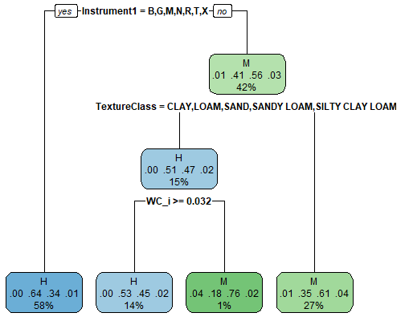

yes
Beerkan, Guelph,
Microinfiltrometer,
Miniinfiltrometer,
Rainfall,
Tension infiltrometer
no
yes
no
yes
no
Figure 6. Application of the classification and regression tree method

Slide 15
The measurement method, the textural class, and the land use were the most influential predictors in 80% of cases for both models (Figure 6).
The measurement method was the most influential input in 40% of cases.

Slide 16
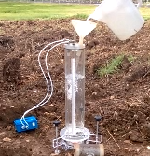
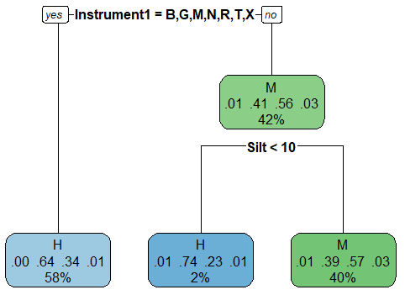
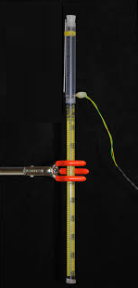
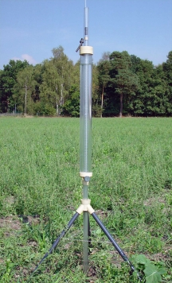
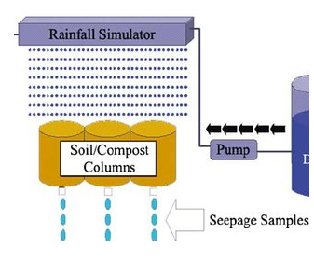
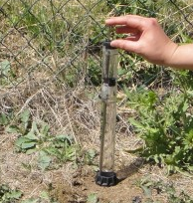
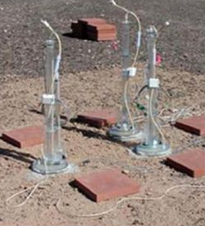
yes
Beerkan, Guelph,
Microinfiltrometer,
Miniinfiltrometer,
Rainfall,
Tension infiltrometer
no
Beerkan
Microinf.
yes
no
Guelp
Rainfall
Minidisc
Tension
Figure 7. Using clay, silt, and sand contents instead of the texture class

Slide 17
Table 5. Modeling design: for each parameter of M and H models
Datasets
Textural class
Sand, Silt, Clay
Parameters of H or M model across all datasets
Parameters of H or M model only across the datasets where this model was the best
Parameters of H or M model only across the datasets where this model was the best for the method where
that model was the best

Slide 18
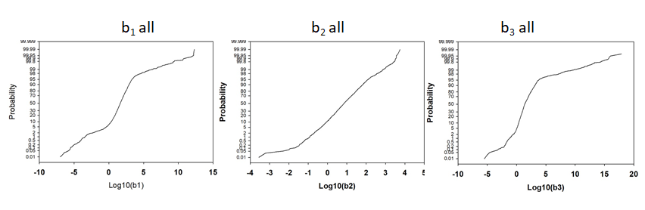
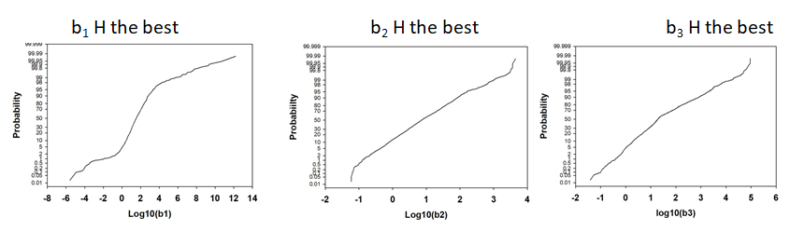

Figure 8. Parameters of the Horton model
$$F\left(t\right)=b_{3}t+b_{1}(1−e^{−b_{2}t})$$

Slide 19
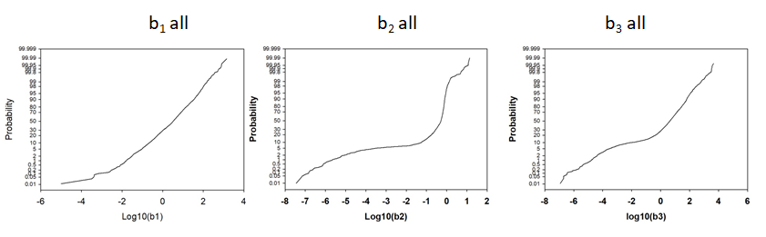
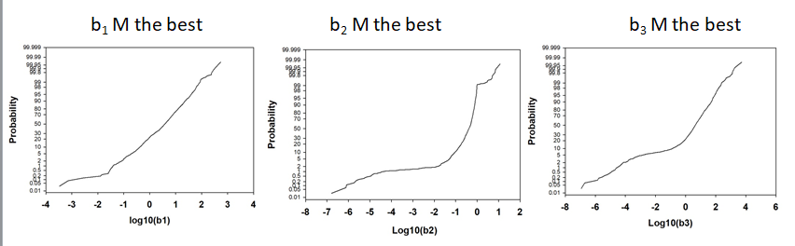

Figure 9. Parameters of the Mezencev model
$F\left(t\right)=b_{1}t^{b_{2}}+b_{3}t$

Slide 20
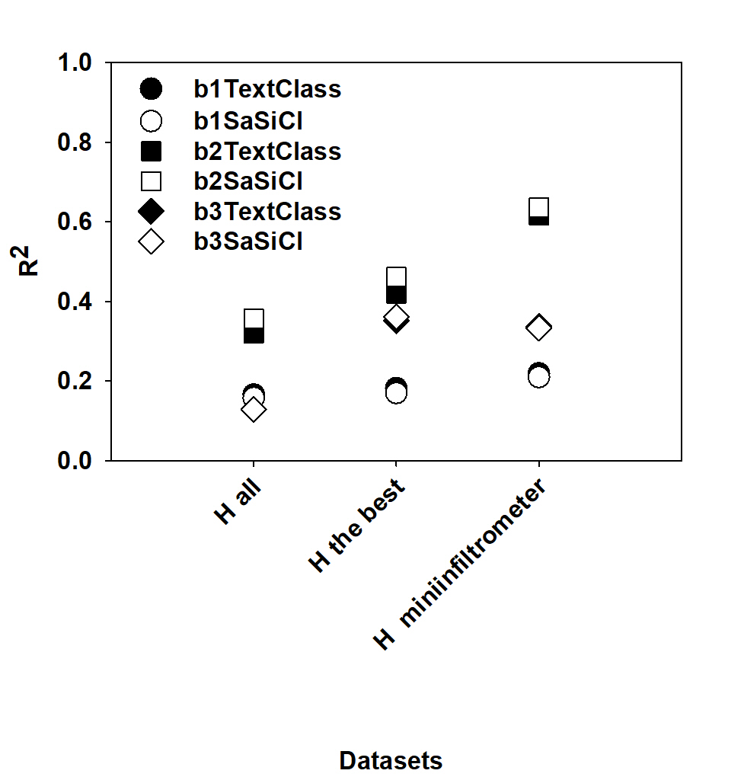
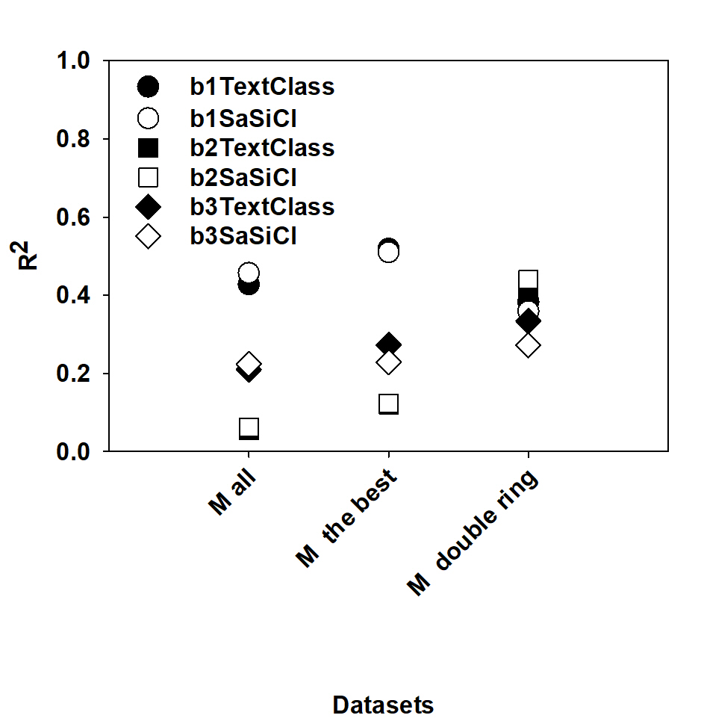


Horton model
Mezencev model
$$F\left(t\right)=b_{3}t+b_{1}(1−e^{−b_{2}t})$$
$F\left(t\right)=b_{1}t^{b_{2}}+b_{3}t$
Figure 10. Accuracy of regression tree models relating infiltration parameters to the site-
specific data

Slide 21


Table 6. Best explanatory variables of Horton model
$$F\left(t\right)=b_{3}t+b_{1}(1−e^{−b_{2}t})$$
Datasets | b1 |  |  | b2 |  |  | b3
 | Top split | Second splits |  | Top split | Second splits |  | Top split | Second splits
Horton all | Method | Ksat | BD | Method | OC | Ksat | Method | Method
H the best | Method | Method | Ksat | Method | WC_i | Ksat | Method | Method | TextClas
H miniinfiltr. | BD | Ksat | TextClas | Ksat | TextClas | OC | BD | BD | OC
Table 7. Best explanatory variables of Mezencev model
$F\left(t\right)=b_{1}t^{b_{2}}+b_{3}t$
Datasets | b1 |  |  | b2 |  |  | b3
 | Top split | Second splits |  | Top split | Second splits |  | Top split | Second splits
M all | Method | TextClas | Ksat | Method | TextClas |  | Method | Method | Ksat
M the best | Method | Method | Method | Method | TextClas | BD | Method | TextClas | Ksat
M miniinfilt. | Landuse | WC_i |  | WC_i | OC | BD | Landuse | TextClas | TextClas

Slide 22


Table 8. Most important variables to build the trees given missing data command imputation
of Horton model
$$F\left(t\right)=b_{3}t+b_{1}(1−e^{−b_{2}t})$$
Datasets | b1 |  |  | b2 |  |  | b3
Horton all | Method | Landuse | Ksat | Method | TextClass | Landuse | Method | Landuse | TextClass
 | 54 | 18 | 11 | 32 | 21 | 19 | 90 | 5 | 5
H the best | Method | TextClass | Landuse | Method | TextClass | Landuse | Method | TextClass | Landuse
 | 43 | 25 | 18 | 29 | 22 | 17 | 59 | 19 | 11
H miniinfilt. | TextClass | Landuse | Ksat | TextClass | Ksat | BD | TextClass | OC | BD
 | 26 | 20 | 20 | 27 | 24 | 20 | 36 | 30 | 19
Table 9. Most important variables to build the trees given missing data command imputation
of Mezencev model
$F\left(t\right)=b_{1}t^{b_{2}}+b_{3}t$
Datasets | b1 |  |  | b2 |  |  | b3
M all | Method | TextClass | Landuse | Method | TextClass | Landuse | Method | Landuse | TextClass
 | 50 | 22 | 20 | 51 | 42 | 7 | 45 | 23 | 19
M best model | Method | Landuse | TextClass | TextClass | Method | Landuse | TextClass | Method | Db
 | 62 | 17 | 16 | 48 | 26 | 14 | 34 | 28 | 12
M double ring | Landuse | TextClass | OC | Landuse | TextClass | OC | TextClass | Landuse | OC
 | 42 | 21 | 20 | 36 | 23 | 21 | 38 | 33 | 24

Slide 23
Factors limiting evaluation of model applicability
Experimental setup
were both the stationary and the stationary infiltration stages were sampled well?
was the stationary infiltration stage actually achieved?
was the vertical heterogeneity encountered?
…..
Structure is reflected poorly in the inputs
Scale/size of probed soil domain

Slide 24
Ultimate case of the need in missing data treatment.
Frequency of representation may reflect the need in accuracy (at least in areal estimation)
Land use category as an excellent surrogate
Not much advantage of using sand – silt - clay vs. textural class.
Is it method or it is the regional/local specifics?
Absolute vs. relative errors
Functional evaluation
Future applications
Exploratory rather than predictive modeling.
An individual regression tree is not oriented on the accuracy per se.
Random forest to get true prediction R² …next

Slide 25
Infiltration model performance depends on the infiltration measurement methodology and landuse.
Other influential factors are soil texture and initial water content.
The next question is whether predictive equations for infiltration model parameters are much more accurate in the samples for which a particular infiltration model is the most accurate.

Slide 26
Thank you for your attention

