Slide 1
The effects of flooding and drought on water quantity and quality in agricultural drainage systems and streams in Latvia
A. Lagzdins, L. Grinberga, A. Veinbergs, R. Sudars, K. Abramenko
Dr.sc.ing., Professor
Latvia University of Life Sciences and Technologies
Department of Environmental Engineering and Water Management
e-mail: ainis.lagzdins@llu.lv

Slide 2
Outline
According to the Fifth Baltic Sea Pollution Load Compilation (PLC-5) agriculture contributed from approximately 70% to over 90% of the anthropogenic diffuse riverine nitrogen load and 60-80% of the corresponding phosphorus load.

Slide 3
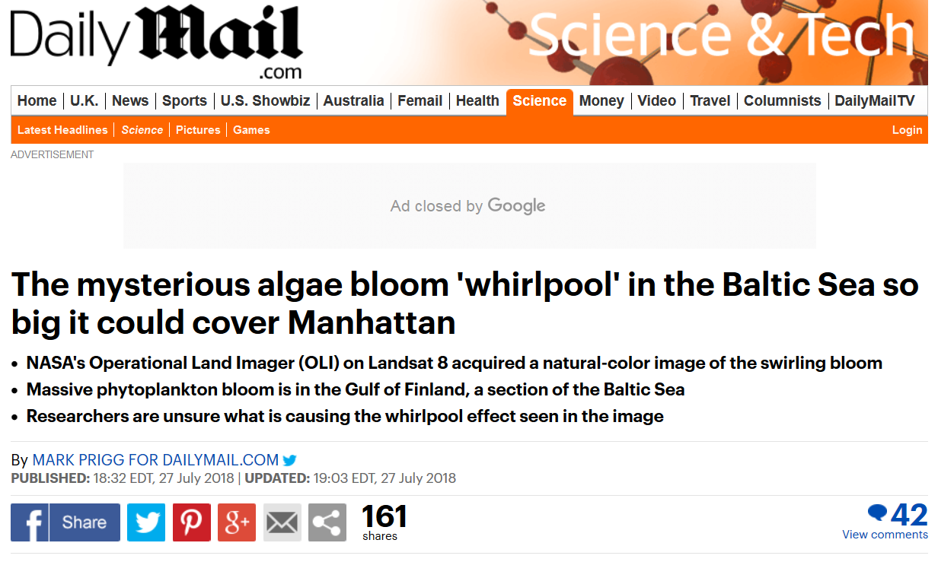
Outline

Slide 4
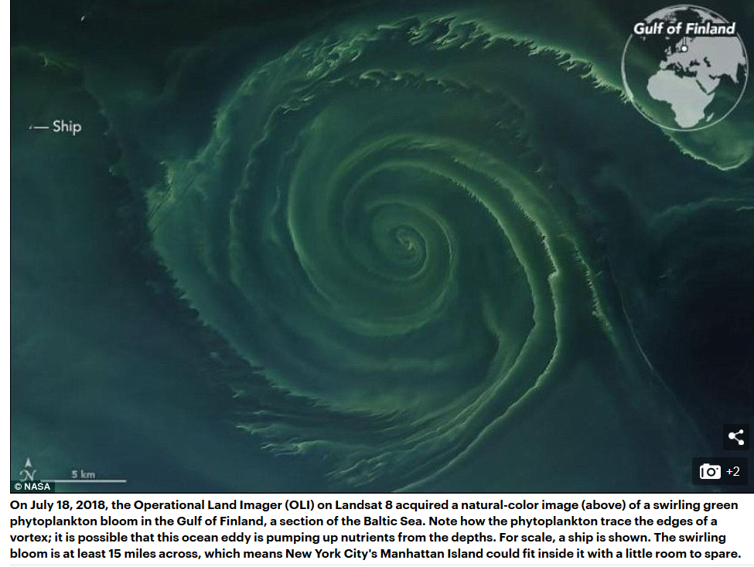
Outline

Slide 5
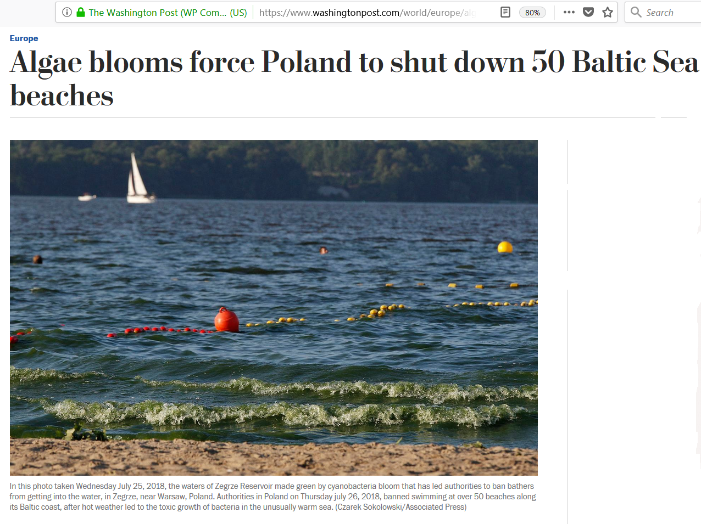
Outline

Slide 6
Outline – Flooding in 2017

Slide 7
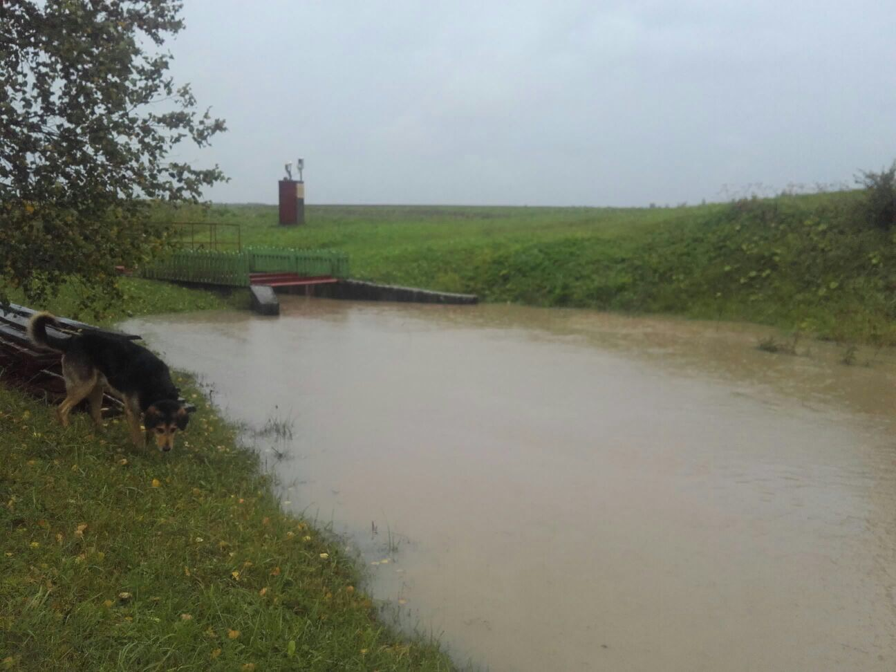
Outline – Flooding in 2017

Slide 8
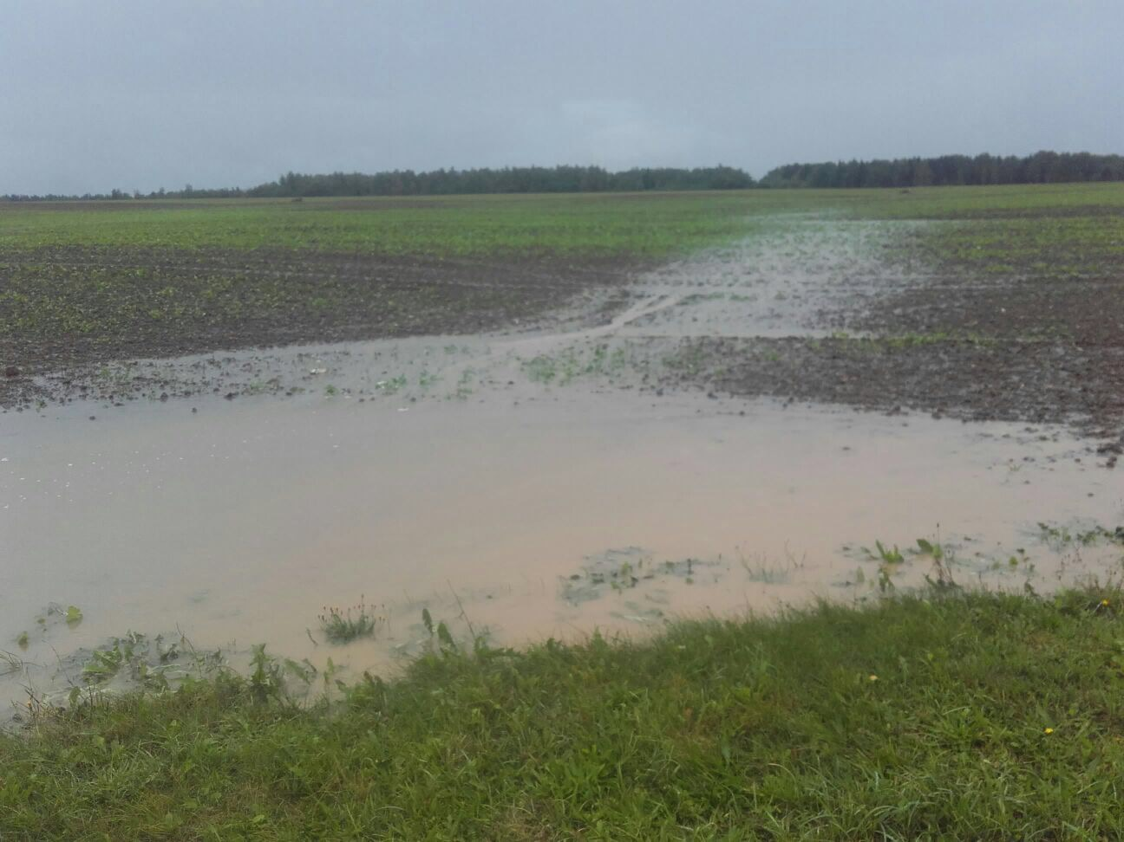
Outline – Flooding in 2017

Slide 9
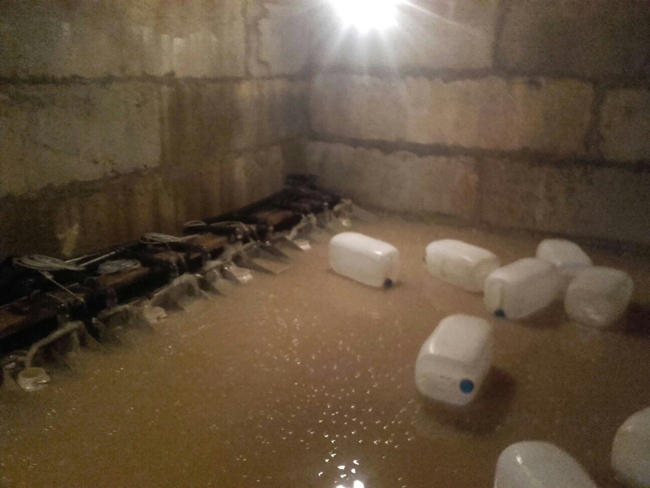
Outline – Flooding in 2017

Slide 10
Outline – Flooding in 2017
Spring flood in 2010

Slide 11
Outline – Drought in 2018

Slide 12
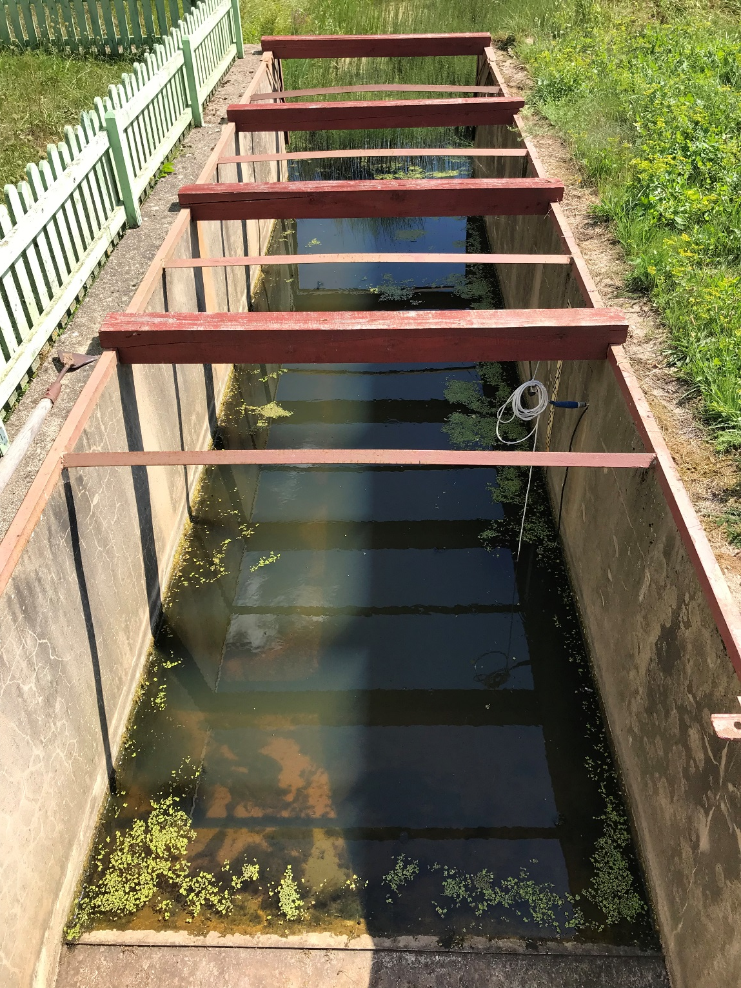
Outline – Drought in 2018

Slide 13
Agricultural Runoff Monitoring Programme in Latvia
Based on systematic and regular water quality and quantity monitoring activities this programme aims to document and assess the current status and long-term trends of nutrient concentrations and losses in different spatial and temporal scales

Slide 14
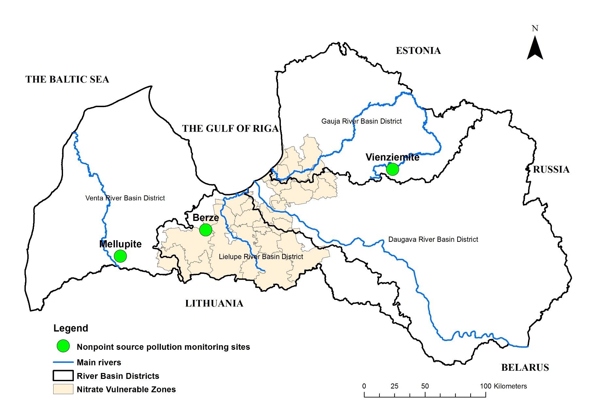
Agricultural nonpoint pollution monitoring sites

Slide 15
Description of monitoring sites and scales
Monitoring site | Scale of research | Area, ha | Agricultural land, % | Dominant soil texture | Flow measurement structure | Water sampling procedure
Mellupīte | Small catchment | 960 | 69 | Loam | Crump weir, data logger | Flow proportional
 | Drainage field | 12 | 100 |  | Triangular weir, data logger | Flow proportional
 | Experimental plots | 0.12 x 16 | 100 |  | Tipping buckets | Flow proportional
Bērze | Bērze River | 87205 | 58 | Loam, sandy loam, sand * | LEGMC hydrological monitoring station | Manual
 | Ālave River | 9368 | 84 | Loam, silty clay loam, clay * | No measurements | Manual
 | Small catchment | 368 | 98 | Silty clay loam | V-shape Crump weir, data logger | Flow proportional
 | Drainage field | 77 | 100 |  | Triangular weir, data logger | Flow proportional
Vienziemīte | Small catchment | 592 | 78 | Sandy loam | Combined profile weir, data logger | Manual
 | Drainage field | 67 | 100 |  | Triangular weir, data logger | Manual

Slide 16
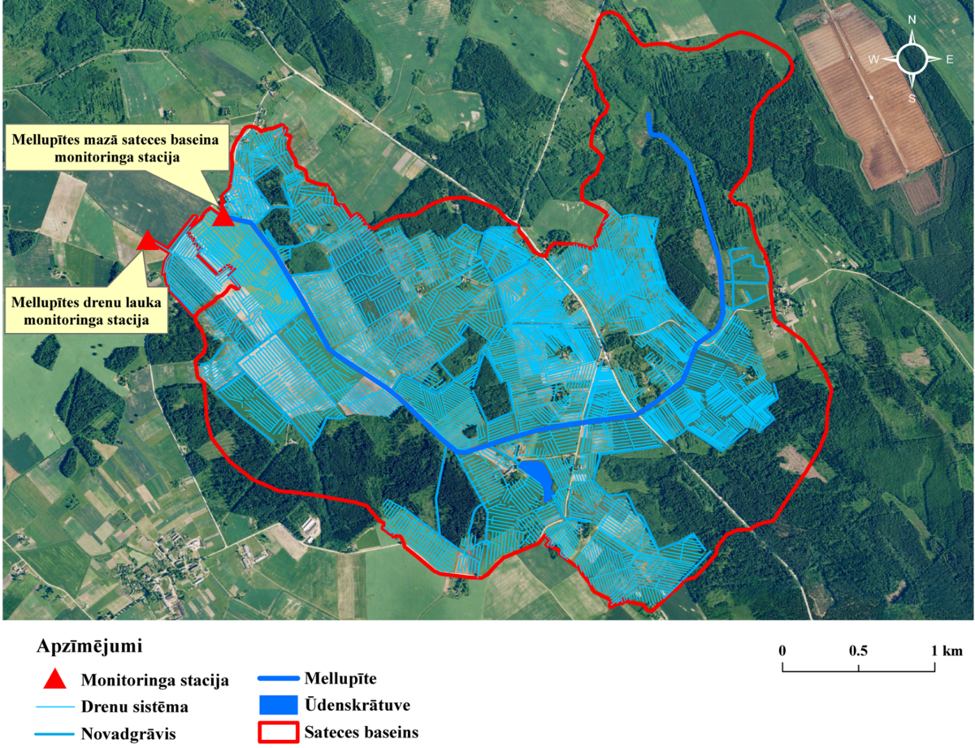
Agricultural nonpoint source pollution monitoring sites – scales of measurements

Slide 17
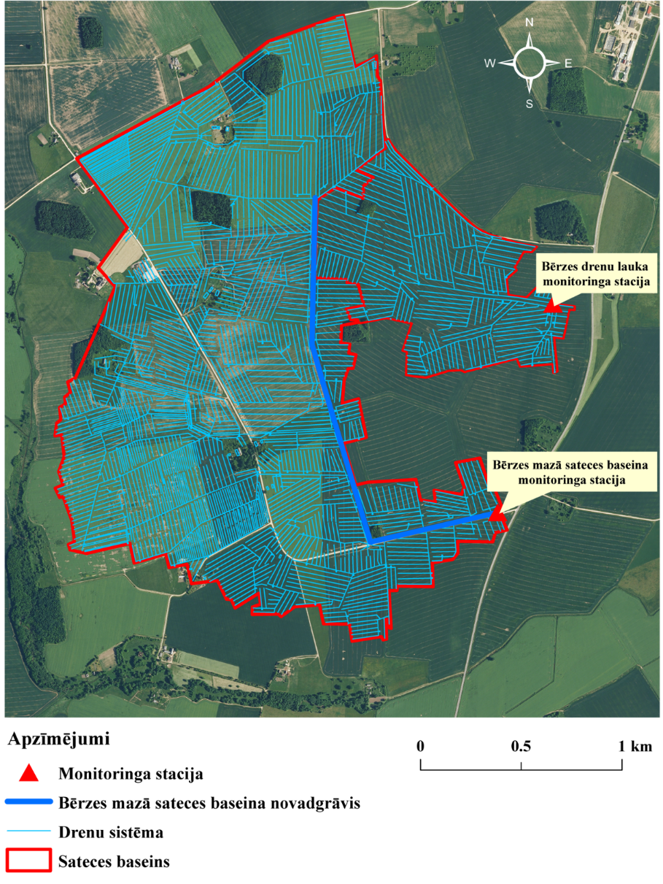
Agricultural nonpoint source pollution monitoring sites – scales of measurements

Slide 18
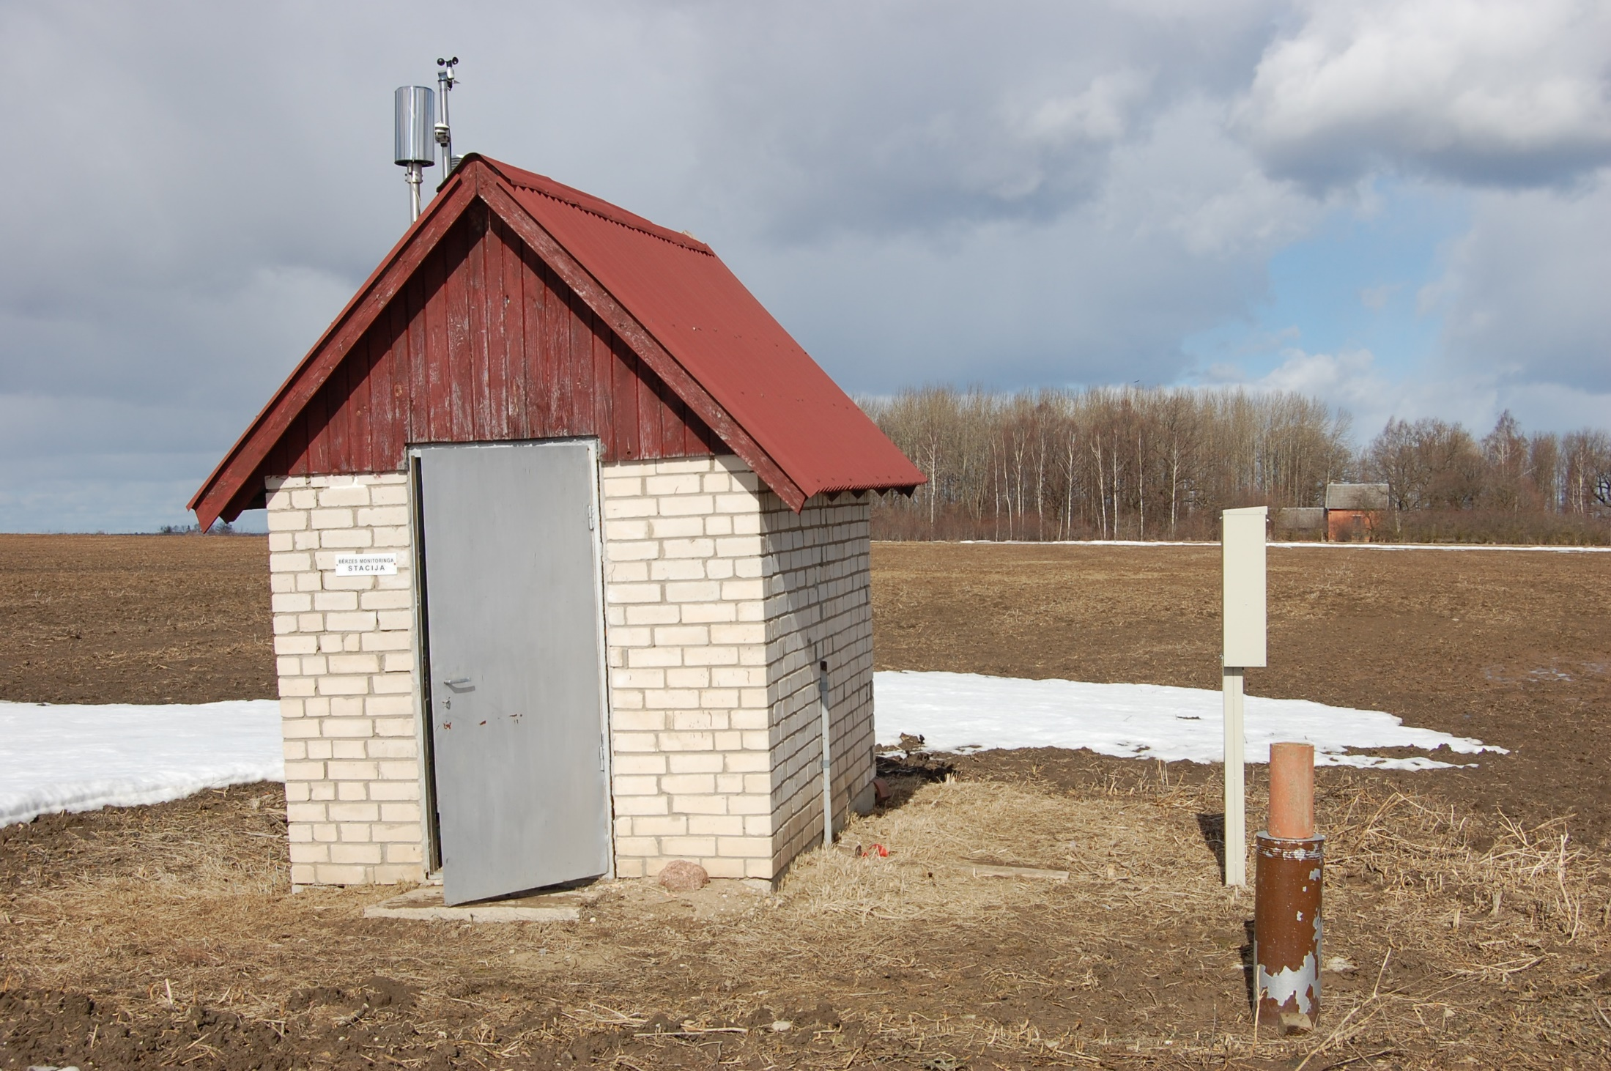
Berze site

Slide 19
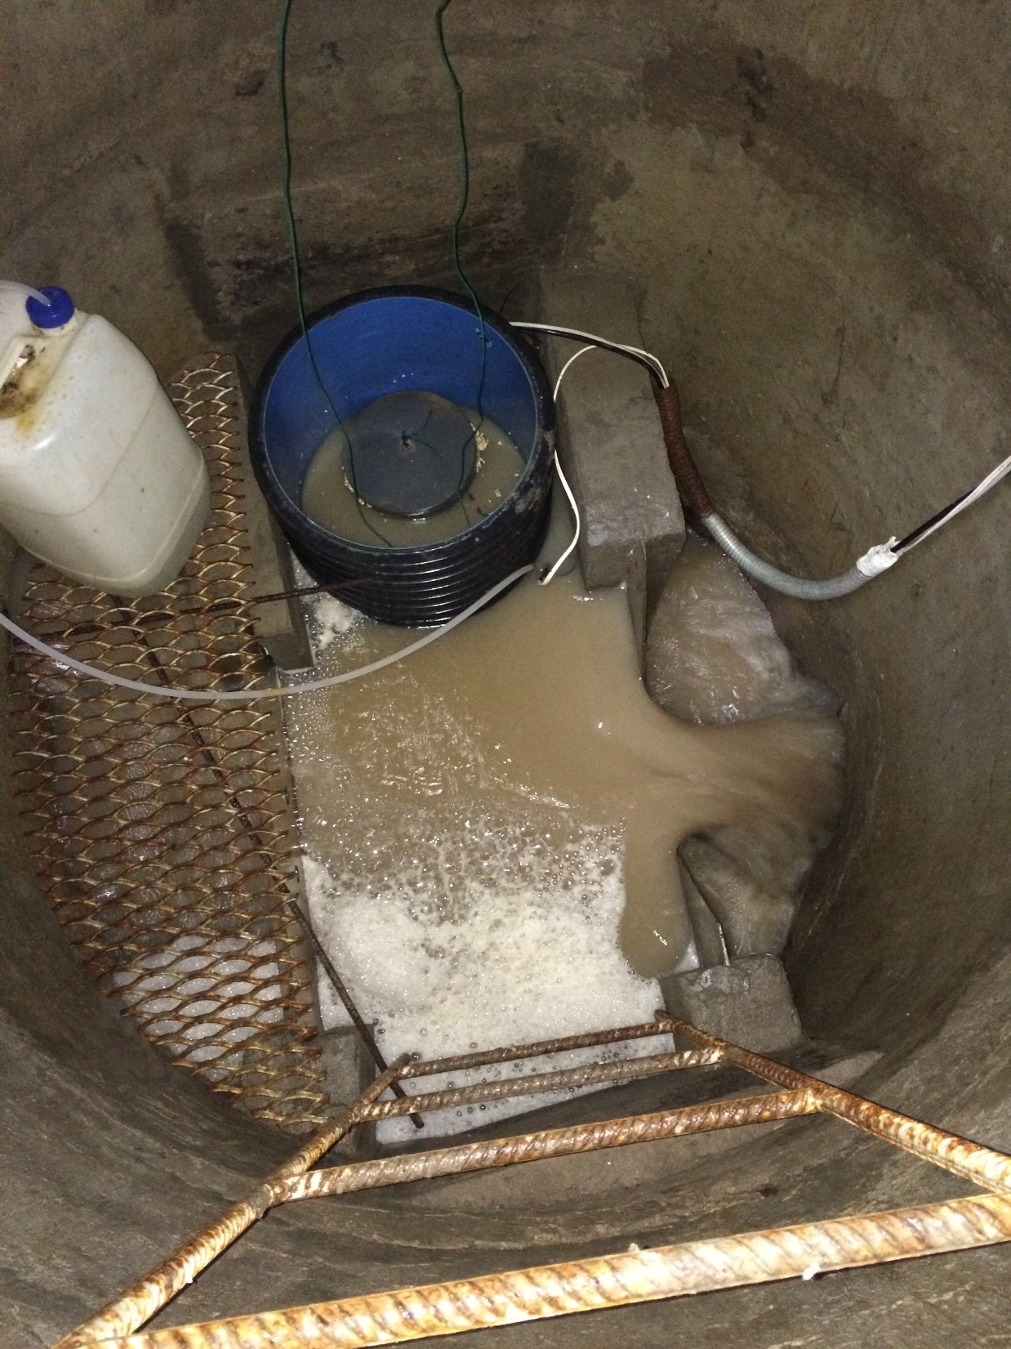
Berze site

Slide 20
Results: Climate and annual drainage for the Berze drainage field scale
Mean annual precipitation - 588.3 mm, mean annual temperature - 7.5º

Slide 21
Results: Climate and annual drainage for the Mellupite drainage field scale
Mean annual precipitation - 669.2 mm, mean annual temperature - 6.7º

Slide 22
Results: Climate and annual drainage for the Vienziemite drainage field scale
Mean annual precipitation - 732.7 mm, mean annual temperature - 5.8º

Slide 23
Results: Discharge and NO₃-N concentration (Auce)

Slide 24
Results: NO₃-N concentrations in 2017 and 2018 (Auce)

Slide 25
Results: Discharge and TN concentration (Auce)

Slide 26
Results: TN concentrations in 2017 and 2018 (Auce)

Slide 27
Results: Discharge and NH₄-N concentration (Auce)

Slide 28
Results: NH₄-N concentrations in 2017 and 2018 (Auce)

Slide 29
Results: Discharge and TP concentration (Auce)

Slide 30
Results: TP concentrations in 2017 and 2018 (Auce)

Slide 31
Diffuse pollution monitoring sites

Slide 32
Experimental plots – N application rate

Slide 33
Streams of Nitrate Vulnerable Zones

Slide 34
Sub-catchments of the Berze River

Slide 35
Groundwaters

Slide 36
Thank you for your attention!
Questions or comments?

