Slide 1
Environmental Defense Fund Permian Basin Campaign: a science and advocacy-based approach to quantify and mitigate methane emissions from the oil and gas industry (EGU2020-11640)
David Lyon
dlyon@edf.org

Slide 2
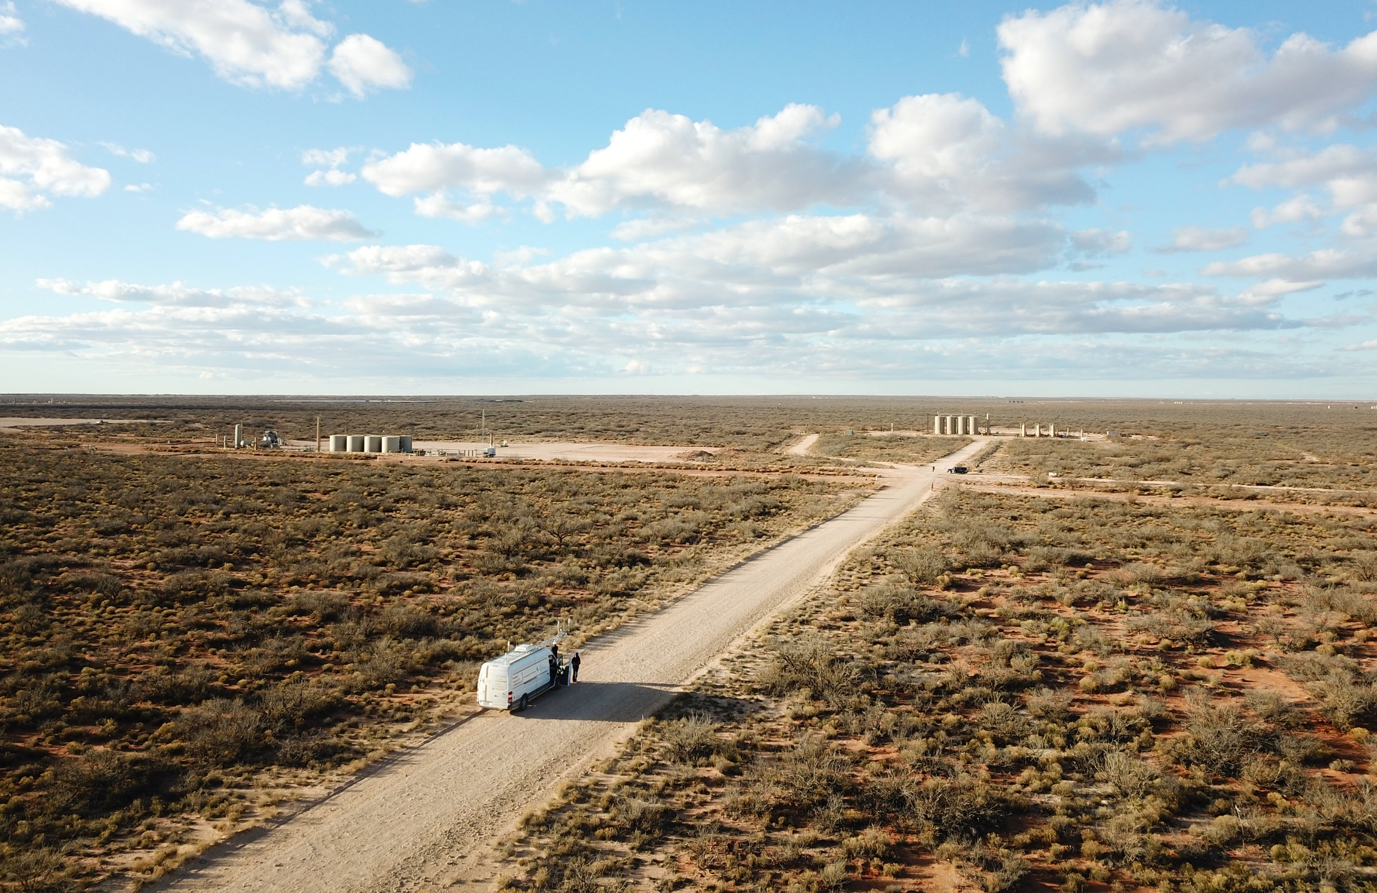
PermianMAP
Methane Analysis Project
Going deep into the world’s largest oilfield
to track methane pollution like never before

Slide 3
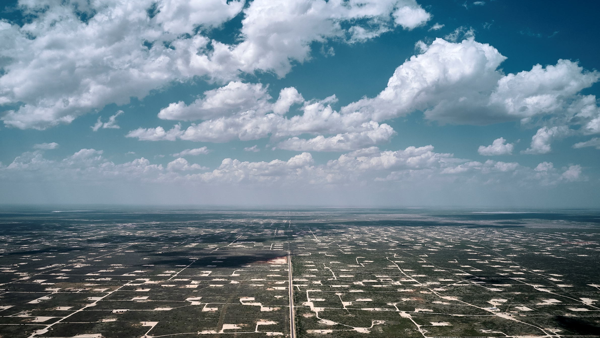
Why the Permian Basin?
Estimated to be nation’s biggest methane emitter
Nearly 100,000 active oil and gas wells
Need for improved oversight
Major focus area for companies, investors

Slide 4
Project Goals
Estimate methane emissions from the Permian at different spatial scales from site to basin
Assess emission trends in 2020 including affects of COVID and price collapse
Identify companies associated with measured emissions and develop a metric such as loss rate to compare performance
Understand the operational performance and emissions of flares
Make data publicly available to encourage action by companies and policymakers

Slide 5
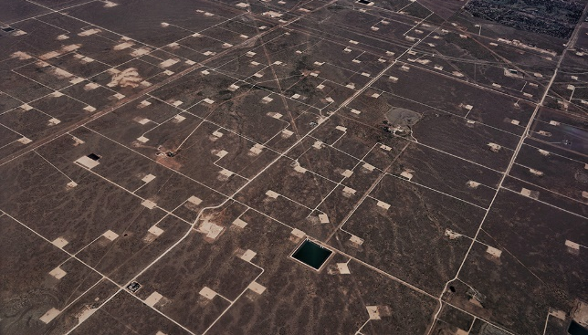
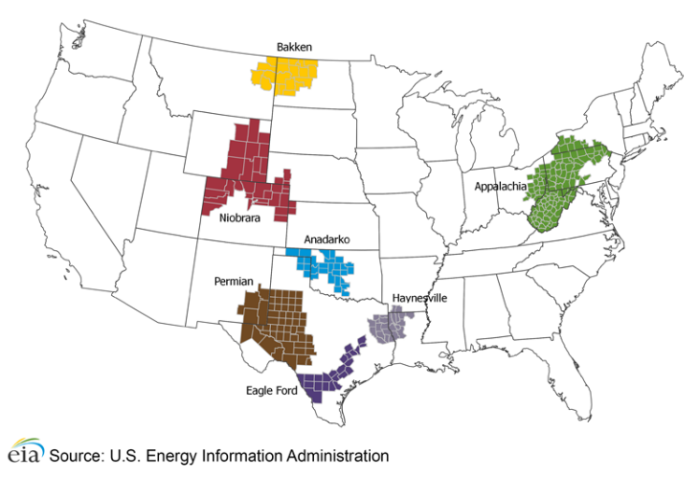
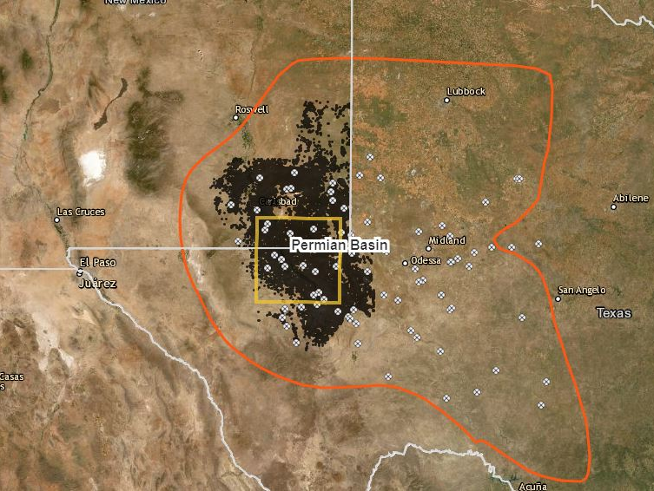
The Study Area
10,000 square-kilometer grid that spans the Delaware Basin in Texas and New Mexico
High-producing zone: it contains 10% of the active wells and produces 37% of the region’s gas and 28% of the oil.
Over 100 different companies operate nearly 11,000 wells in the study area

Slide 6
Our Approach
Partner with leading scientists
Use multiple, independent, peer-reviewed methods to estimate and compare emissions at different spatial scale
Make the quality assured data publicly available prior to peer-review
Mobile, ground- based measurements
Aerial surveys
Continuous methane detection

Slide 7
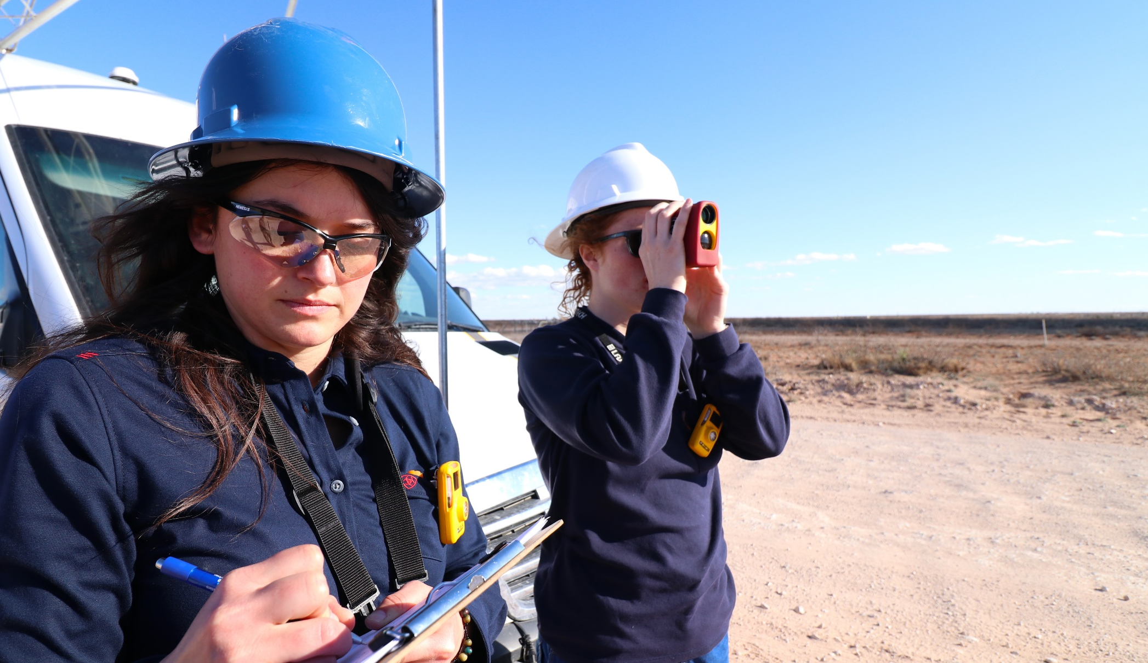
Methods
From the Air: Scientific Aviation (aerial mass balance)
Will survey study area 2 – 3 times over 100 flight days with new data about bi-weekly
Quantify emissions at different spatial scales ranging from a few sites to the full study area
Can only quantify high emissions, but measured areas are randomly selected to be representative
From the Ground: University of Wyoming (OTM 33A)
Random survey of several dozen sites with EPA-developed method
Site-specific measurements of methane and VOCs
Info about emission sources from fence-line infrared camera survey
From Towers: Pennsylvania State University (inversion model)
5 towers continuously measure methane concentrations
Atmospheric transport model used to estimate regional emissions on a quarterly basis
From the Air: Leak Surveys Inc (optical gas imaging)
3 aerial surveys of randomly selected flares
Infrared camera will identify malfunctioning flares
We will compare emission estimates to independent data studies, such as a Zhang et al. 2020 that estimates emissions from the TROPOMI satellite.

Slide 8
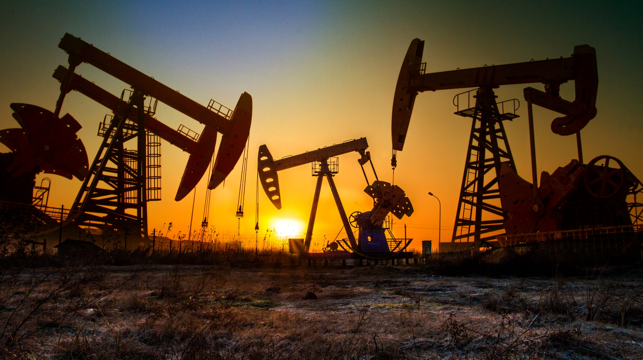
Campaign Status &
Preliminary Observations
Website launched on April 7 with over 100 measurements
https://www.permianmap.org/
Based on large mass balance flights, study area emissions are ~1.4 Tg CH₄, equivalent to 3.5% of natural gas production and 3X higher than the EPA estimate for U.S. upstream emissions.
Site cluster emission rate distributions are highly skewed.
~11% of flares have combustion issues, including ~5% unlit.

Slide 9
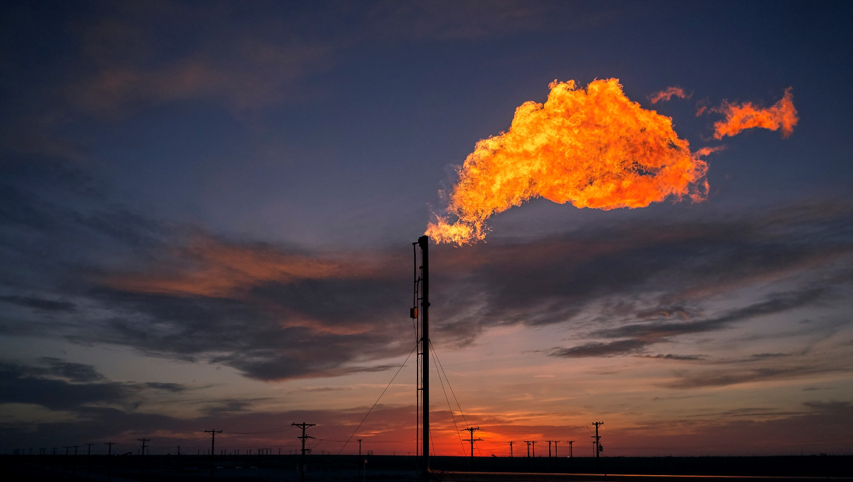
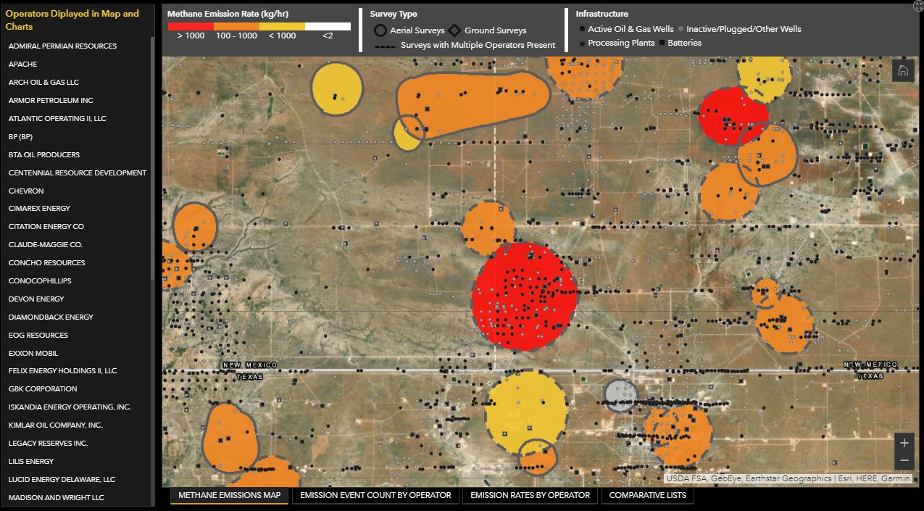
PermianMAP
https://www.permianmap.org/

Slide 10
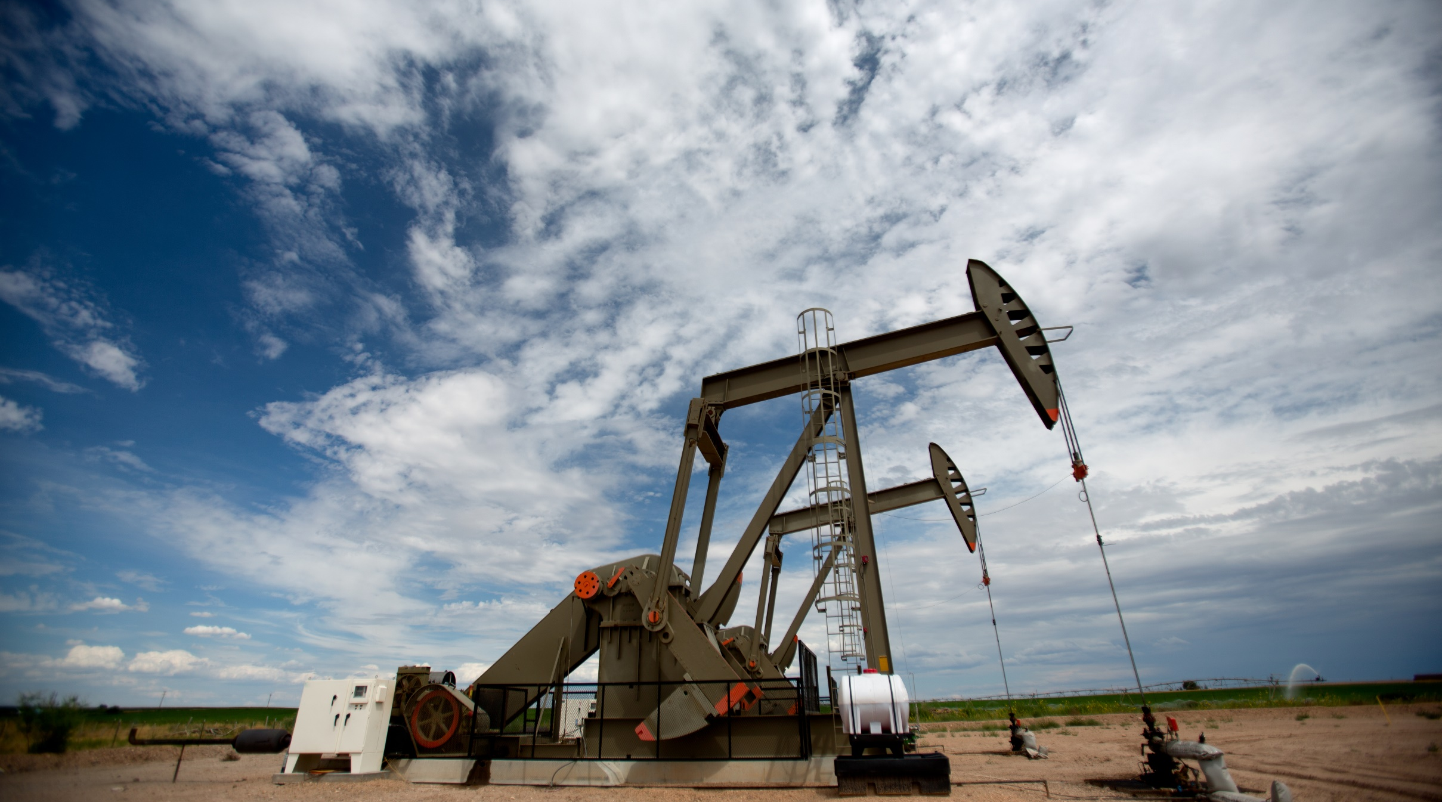
Next steps
Aerial measurement data updated ~biweekly
Flaring survey data added early May
Tower-based regional estimated added quarterly
Additional ground data to be collected this fall
Develop metrics to compare operator performance
Submit papers for peer-review

