Slide 1




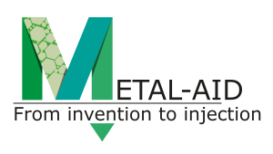
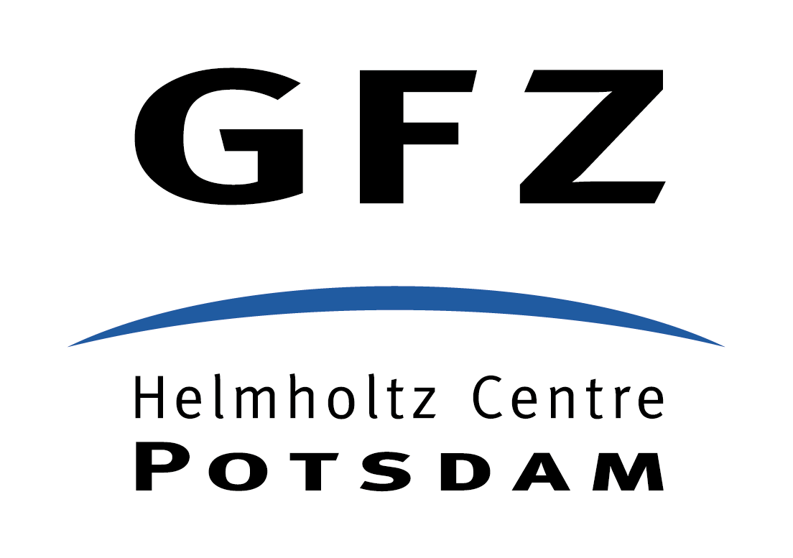










IDEA
METHOD
PROBLEM
RESULT
IMPACT
Copper(II) reduction and removal from wastewaters by natural siderite
Lisa C. Füllenbach*¹, Jeffrey Paolo H. Perez², Helen M. Freeman^{2,3}, Andrew N. Thomas⁴, Liane G. Benning^{2,5}, Eric H. Oelkers¹
¹Department of Earth Sciences, University College London, London, WC1E 6BT, United Kingdom. *l.fuellenbach@ucl.ac.uk
²GFZ German Research Center for Geosciences, Telegrafenberg, 14473 Potsdam, Germany
³School of Chemical and Process Engineering, University of Leeds, Leeds, LS2 9JT, United Kingdom
⁴Department of Applied Geosciences, Karlsruhe Institute of Technology, 76125 Karlsruhe, Germany
⁵Department of Earth Sciences, Freie Univeristät Berlin, 12249 Berlin, Germany
NAVIGATION:
Click on text comb for more information, click for citation and acknowledgements.
Back arrow will bring you to the title page.

Slide 2
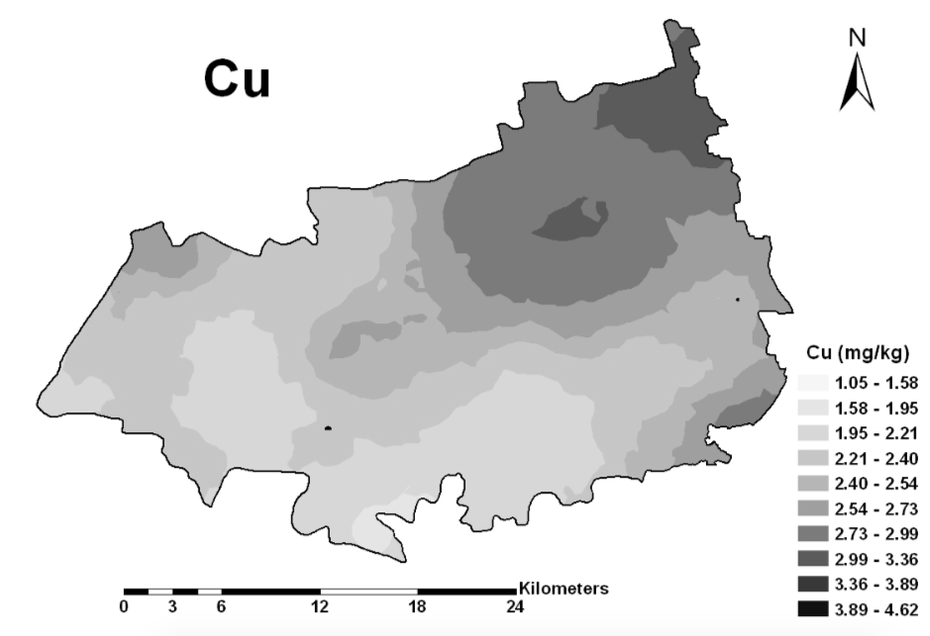
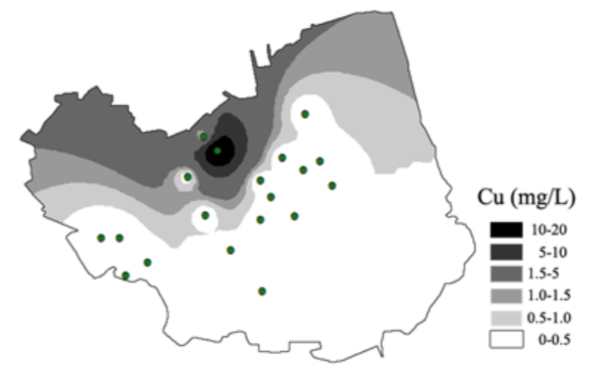
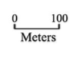

IDEA
METHOD
PROBLEM
RESULT
IMPACT
The Problem
Heavy metal contamination
The use of land and resources can lead to vast soil and water contamination with heavy metals.
Copper(II) is one of the most widely occurring heavy metal contaminants, which is introduced into the environment from anthropological land use, including industrial discharge, landfill leakage, agricultural and mining sources.
The examples to the right show the distribution of Cu (mg kg⁻¹) in A) an contaminated agricultural soil in Southeast China (Zhao et al., 2015), and in B) groundwater from a brownfield in Central China (Li et al., 2017), can be found around the globe.
The major hazard for humans, live stock, crops and wildlife is the bioavailability of such high heavy metal dosages present in polluted sites. The bioavailability of a metal is controlled by its solubility and therefore its chemical state in which it is present in soil fluids, ground- and freshwaters.
A
Zhao et al. (2015)
B
Li et al. (2017). Green circles are sampling spots.

Slide 3

IDEA
METHOD
PROBLEM
RESULT
IMPACT
The Idea
Kill two birds with one stone – siderite.
Most metals, including Cu, are highly soluble in acidic aqueous environments.
Siderite provides two major advantages:
High solubility at low pH → increase of alkalinity and therefore increases the solution pH → lowers metal solubility
Fe(II) → readily oxidizes to insoluble Fe(III) (oxyhydr)oxides, which are commonly used as metal sorbents.
The idea is hence to use siderite as neutralization agent and source for highly reactive Fe(III) (hydr)oxides which act as effective sorbents for the metal.
Additionally, Cu(II) potentially promotes Fe(II) oxidation and therefore the production of sorbent material even under anoxic conditions.
O₂
H₂O
Fe³⁺ oxy-
hydroxides
adsorption
Eh
H₂O
H₂
Cu reduction
Fe oxidation
neutralization
FeCO₃
dissolution
pH
Schematic of iron stability field with arrows indicating the principle idea of the experiments in this study.

Slide 4
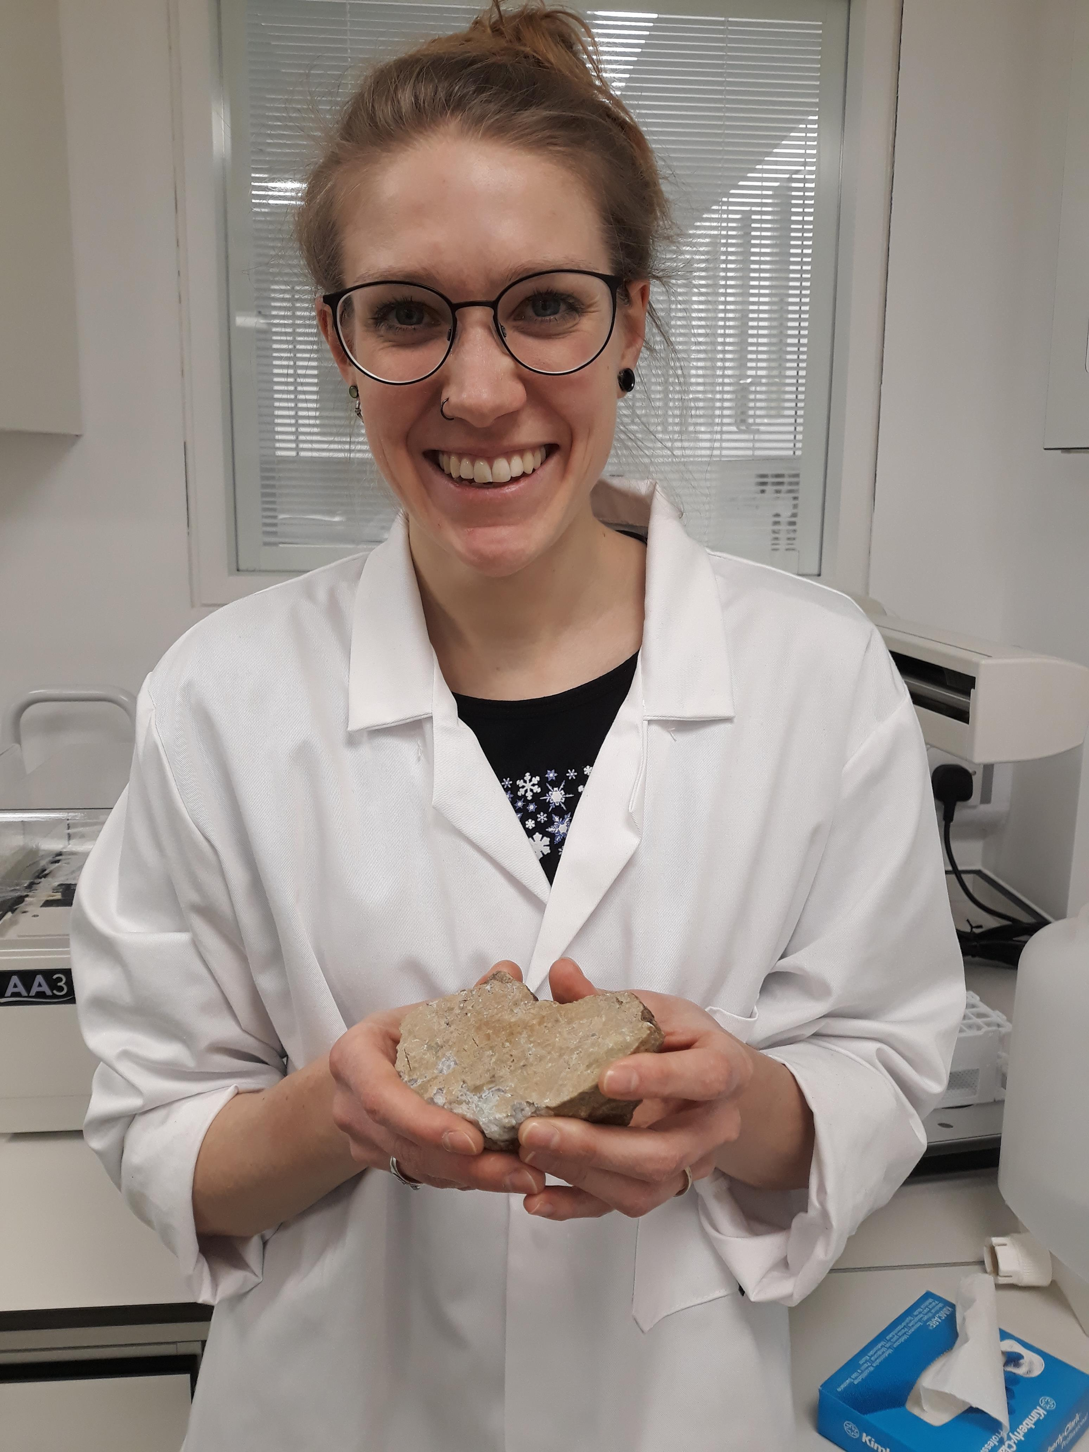
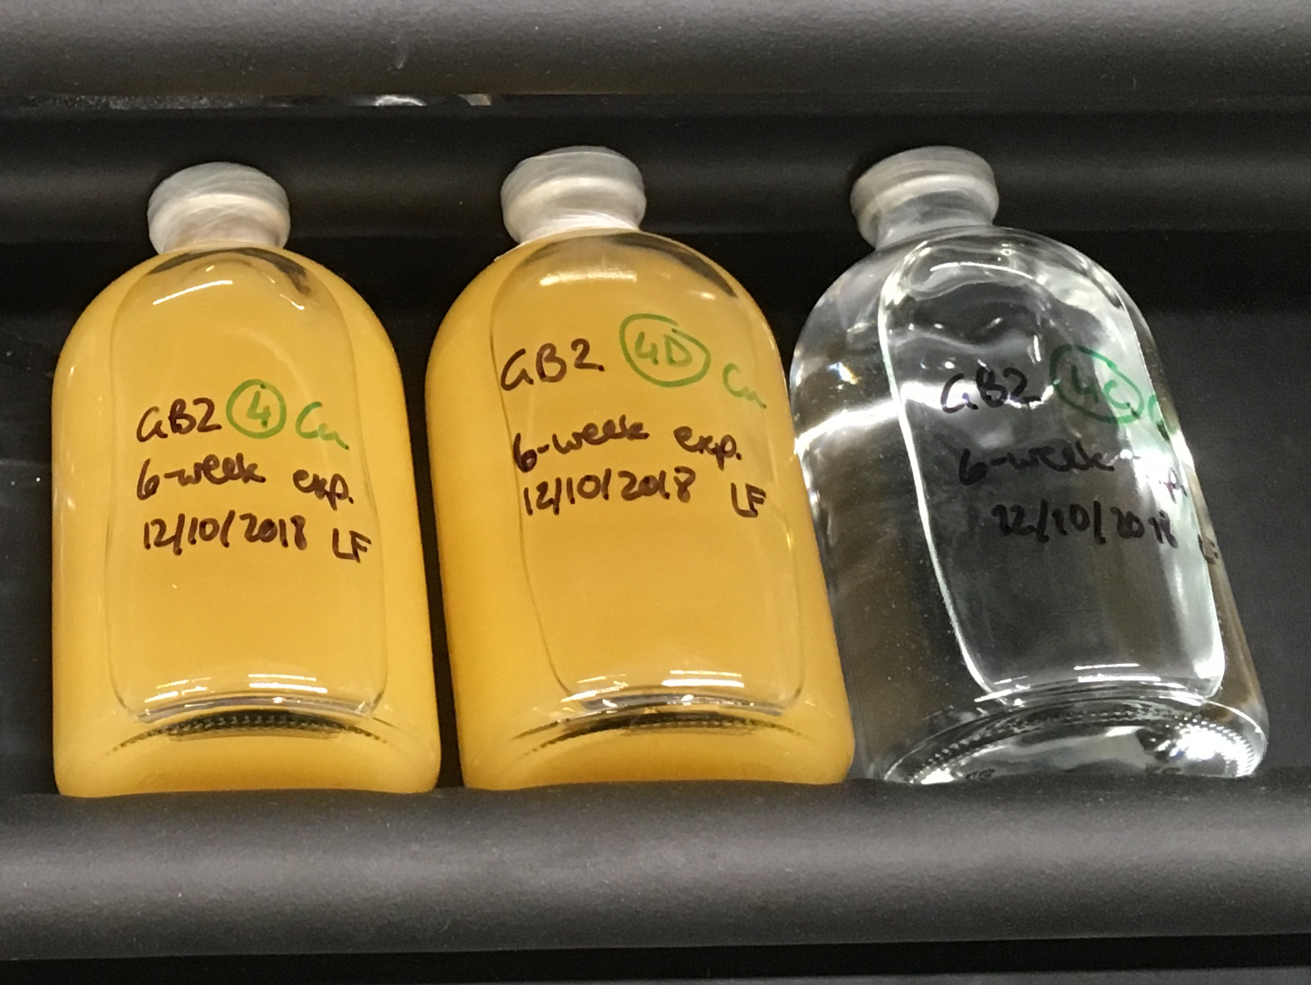
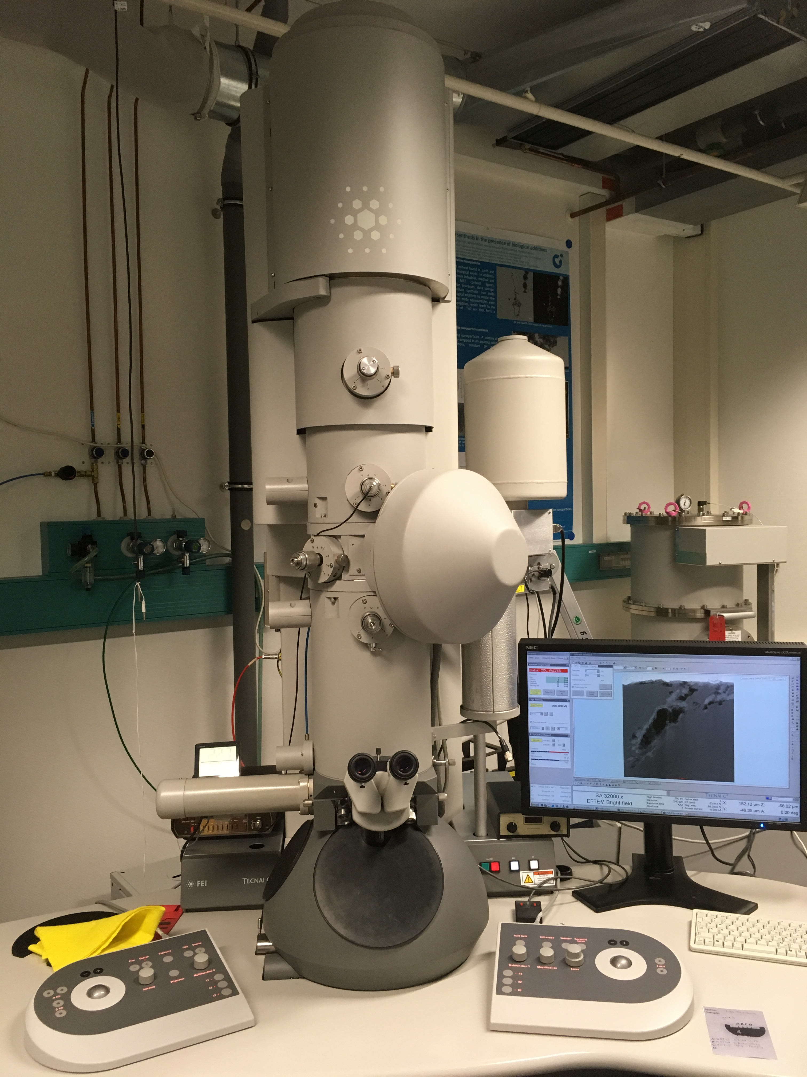
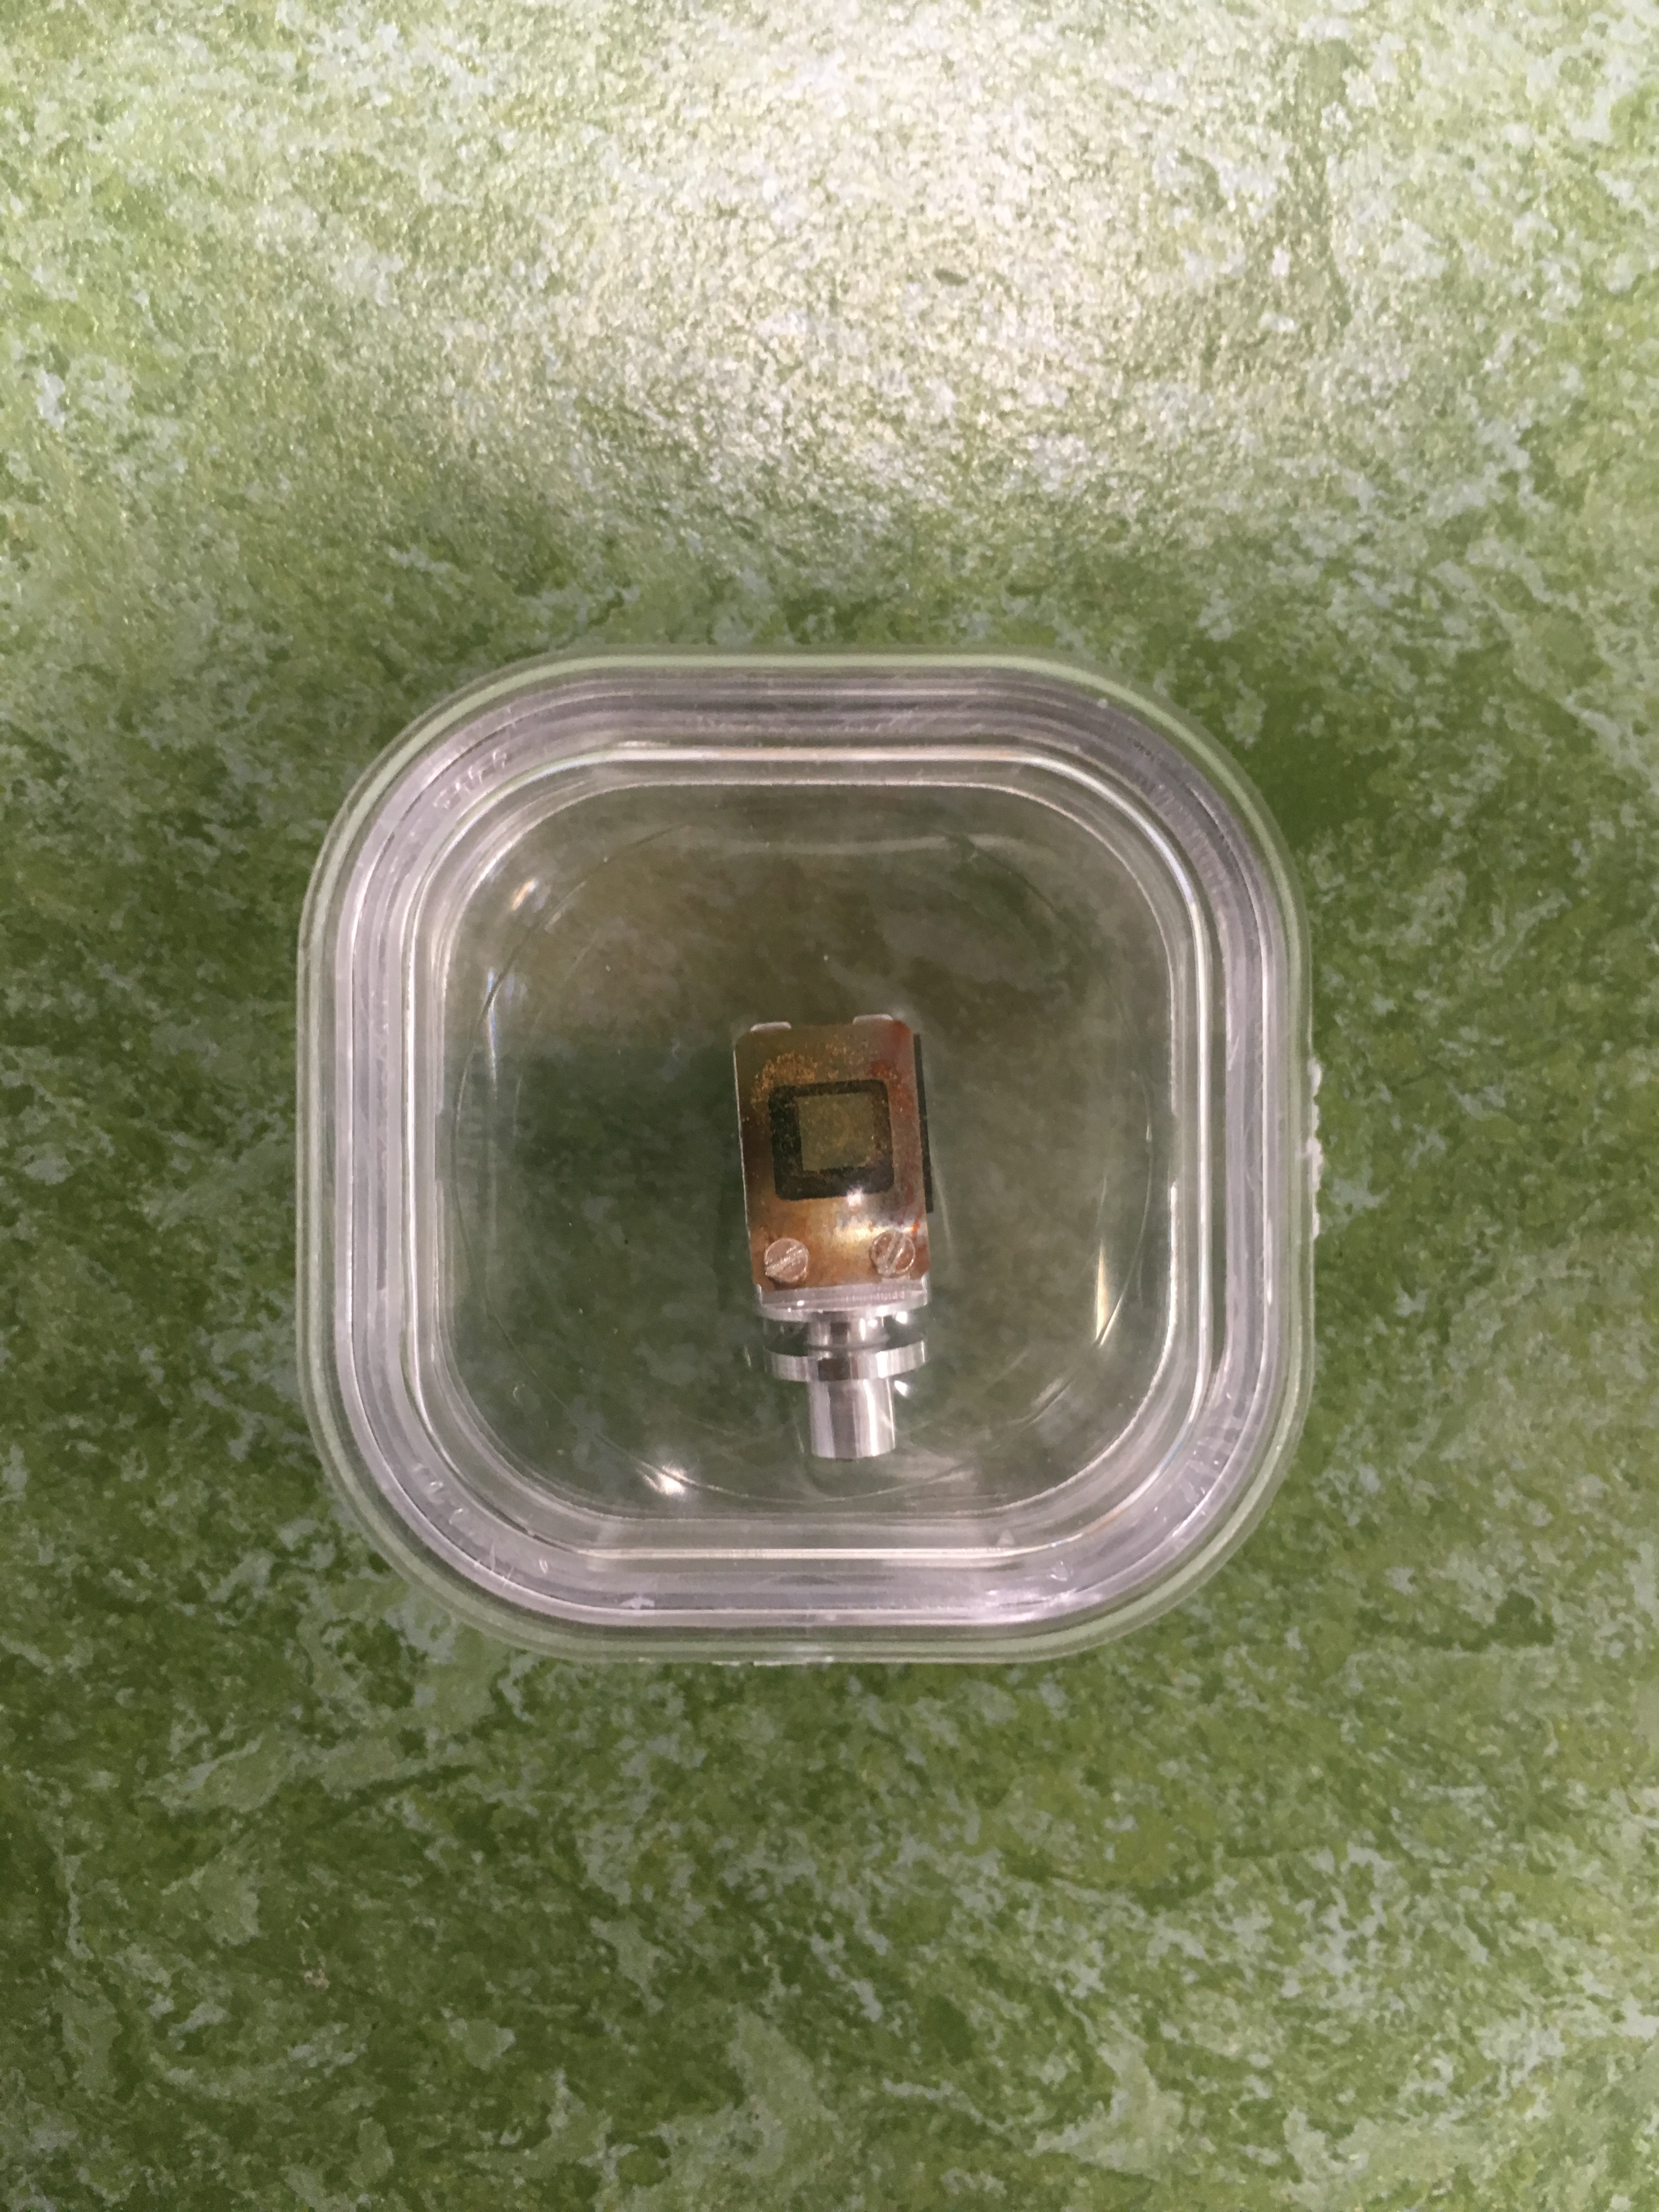
IDEA
METHOD
PROBLEM
RESULT
IMPACT
Material and Methods
Dissolution–precipitation experiments under oxic and anoxic conditions
Natural crystalline siderite was dissolved in batches of Cu(II)-containing aqueous solutions of initial pH of 3 for 1008 h under ambient (oxic) laboratory conditions and in an anaerobic chamber.
Solid reaction products obtained from the siderite dissolution experiments were characterized i.a. using Transmission Electron Microscopy (TEM).
Copper speciation and local bonding environment were determined using synchrotron techniques including:
X-Ray Absorption Near Edge Spectroscopy (XANES) and X-Ray Fluorescence (XRF) mapping
Extended X-Ray Absorption Fine Structure (EXAFS)
X-Ray Photoelectron Spectroscopy (XPS)

Slide 5
IDEA
METHOD
PROBLEM
RESULT
IMPACT
Results
Dissolution–precipitation experiments under oxic and anoxic conditions
Solution chemistry after 1008 h of siderite dissolution in Cu(II)-bearing aqueous solutions:
Under oxic conditions:
  pH increased from 3.1 to 4.7
  Fe(II) released into solution oxidized and precipitated as Fe(III) phase
  Initial aqueous Cu(II)-concentrations decreased by 80 %
Under anoxic conditions:
  pH increased from 3.1 to 5.7
  Fe(II) released into solution oxidized and precipitated as Fe(III) phase
  Initial aqueous Cu(II)-concentrations decreased by 100 %
OXIC
1.6
1.2
80 % uptake!
0.8
0.4
0.0
ANOXIC
1.6
1.2
0.8
100 % uptake!
0.4
0.0
Cu concentrations in the aqueous solution decreased during siderite dissolution over the course of the experiment duration of 1008 h. Circles show control solution concentrations.

Slide 6
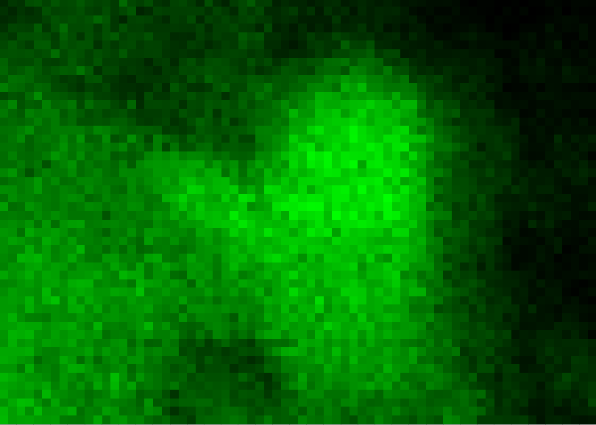
IDEA
METHOD
PROBLEM
RESULT
IMPACT
Results
Solid reaction products collected from oxic experiments.
Solid reaction products were identified as goethite ± hematite.
Cu was bound as Cu(II) carbonate and hydroxide.
Surface sensitive XPS analyses indicated 11-33 % of the adsorbed Cu to be reduced to Cu(I).
B
Sample
area (not shown):
Cu(II) hydroxide + carbonate
area in C: Cu(II) hydroxide
bulk sample:
Cu(II) carbonate
Cu(OH)₂
Cu₂(OH)₂CO₃
Cu₂O
C
Cu K-edge
A
goethite
Cu
A TEM image of the goethite precipitates collected from the oxic sample, showing polycrystalline rods growing out from nanoparticulate goethite clusters. Scale bar = 20 nm.
B XANES Cu K-edge spectra of the bulk sample and of areas mapped on single grains. Fits are highlighted in blue dashed line. One mapped area is shown in the respective XRF-map in C (1.5 x 4.5 µm). XRF mapping indicated an even distribution of Cu throughout the granular sample.

Slide 7
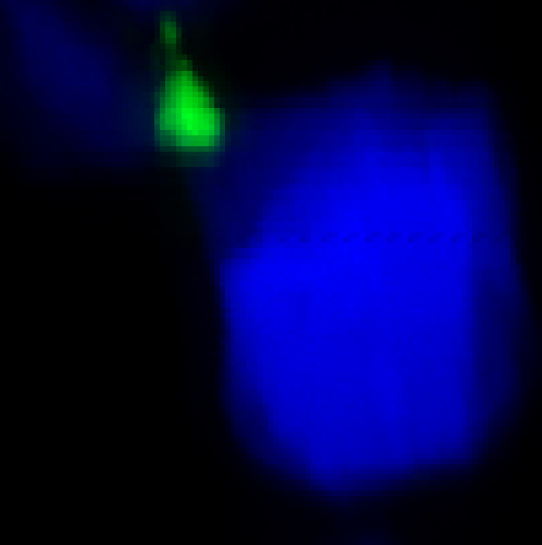
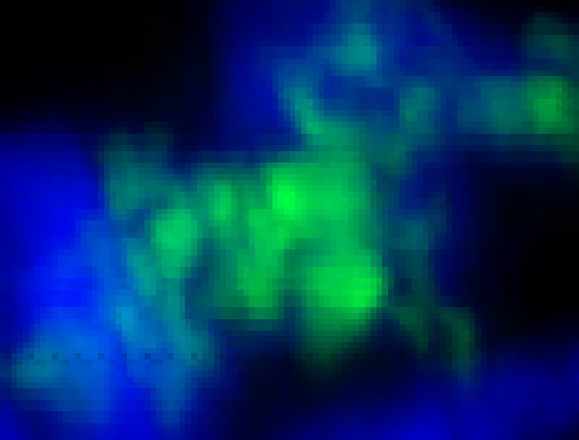
IDEA
METHOD
PROBLEM
RESULT
IMPACT
Results
Solid reaction products collected from anoxic experiments.
Solid reaction products were identified as lepidocrocite and native copper Cu(0).
Only < 10 % of Cu was bonded as Cu(II) carbonate and hydroxide, while ~30 % was bonded as Cu(I) oxide.
60-70 % of Cu was reduced to Cu(0).
B
Cu(OH)₂
Cu₂(OH)₂CO₃
Cu₂O
siderite grain
bulk
sample
Fe
Cu-foil
Cu
C
Cu K-edge
A
Cu⁰ nano-particles
A TEM image of the crystalline lepidocrocite precipitates collected from the anoxic sample, including nanoclusters of crystalline native copper particles. Scale bar = 50 nm.
B XANES Cu K-edge spectra of the bulk sample. The fit is highlighted as blue dashed line.
C XRF-maps (5 x 5 and 5 x 6 µm) indicated a clustered distribution of Cu in the granular sample.
lepidocrocite

Slide 8











IDEA
METHOD
PROBLEM
RESULT
IMPACT
Environmental Implications
Potential use for surface and subsurface wastewater treatment
In oxic aqueous systems, Cu(II) sorbs to the poorly soluble ferric hydroxide goethite and forms Cu-carbonate.
In anoxic aqueous systems, Cu(II) removal is dominated by reductive precipitation of Cu(I) oxide and native copper.
These secondary solid phases
retain Cu from reaching
drinking water sources.
Natural siderite is a low-cost, abundant mineral resource. It’s use as remediation agent for acid neutralization and metal retention under either redox condition has great potential.

Slide 9
IDEA
METHOD
PROBLEM
RESULT
IMPACT
Cited Literature:
Zhao, K., Fu, W., Ye, Z., Zhang, C. (2015) Contamination and spatial distribution of heavy metals in the soil-rice system in Nanxun County, Southeast China. Int. J. Environ. Res. Public Health 12, 1577-1594. doi:10.3390/ijerph120201577
Li, F., Qiu, Z., Zhang, J., Liu, W., Liu, C., Zeng, G. (2017) Investigation, pollution mapping and simulative leakage health risk assessment for heavy metals and metalloids in groundwater from a typical brownfield, Middle China. Int. J. Environ. Res. Public Health 14, 768-785. doi:10.3390/ijerph14070768
Acknowledgements
G. Tarbuck, UCL
I. Wood, UCL
S. Mayanna, GFZ
A. Schreiber, GFZ
J. Parker, Diamond Light Source
J. Göttlicher, ANKA
R. Steininger, ANKA
J. Radnik, BAM
NAVIGATION:
Click on Logo to follow the link.
Back arrow will bring you to the title page.

