Slide 1
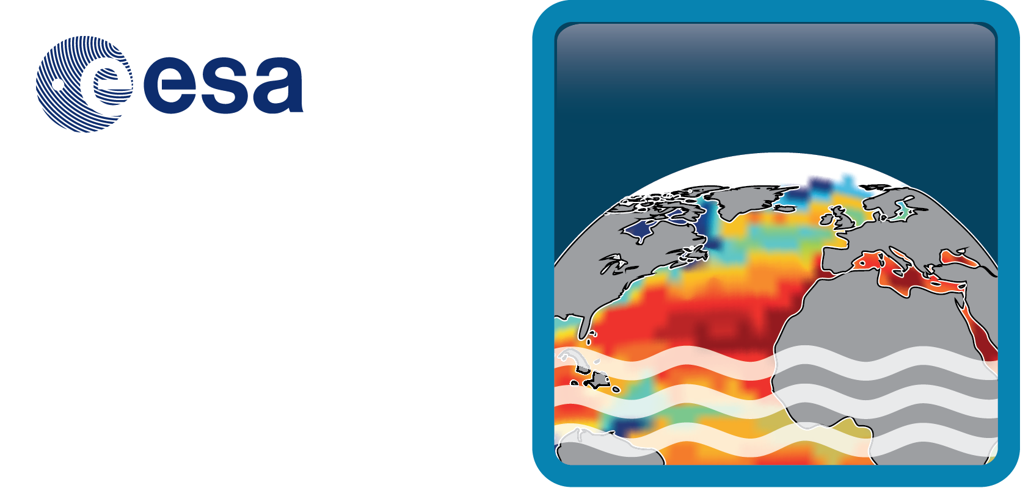
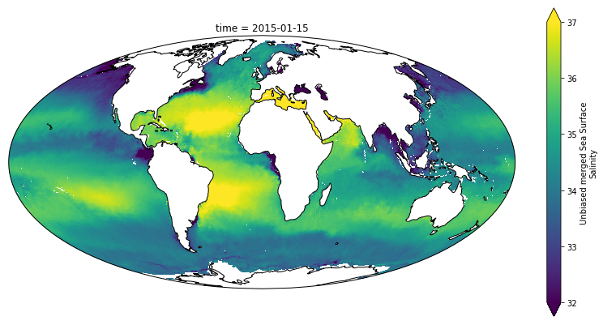







Global validation of ESA CCI+SSS products
A. Martin (NOC); S. Guimbard (Ocean Scope); J. Boutin (LOCEAN); N. Reul, N. Kolodziejczyk (LOPS); R. Catany (Argans) & ESA CCI consortium

Slide 2

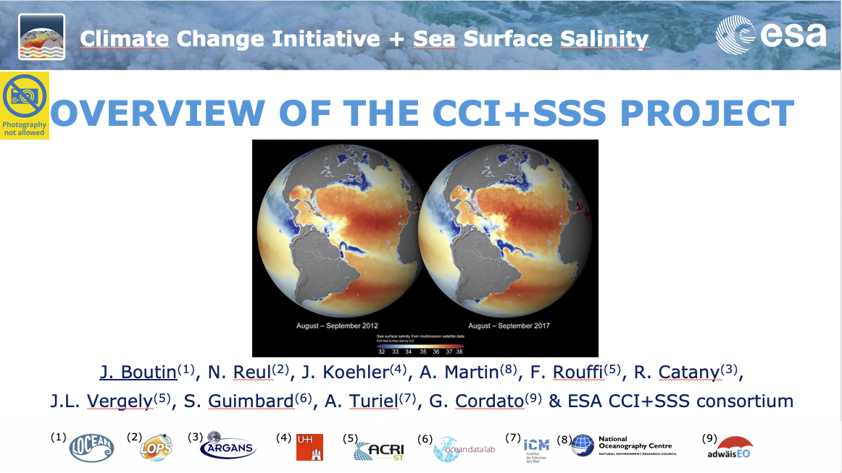
Introduction
For the introduction on the CCI+SSS project please see:
This session: Overview of the CCI+SSS project, J. Boutin et al.

Slide 3
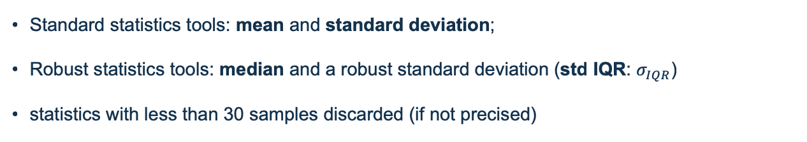
Data & Method
CCI+SSS
Gridded resolution of ~25 km on a EASE-2 (Equal Area) grid.
Time series [Jan 2010 – Oct 2018]
Monthly products (+ weekly if precised)
SSS Reference datasets – Argo & ISAS
Argo: Near surface In situ measurements (<10m) Argo from Pi-MEP (7.5 days; 12.5 km radius)
ISAS: Interpolated maps of ISAS Near Real Time product available on Copernicus Marine Environment Service (NRT ISAS; 5m depth; PCTVAR < 95%)
Quality Metrics
Standard statistics tools: mean and standard deviation;
Robust statistics tools: median and a robust standard deviation (std IQR: $σ_{IQR}$)
statistics with less than 30 samples discarded (if not precised)

Slide 4
Accuracy & Precision against reference dataset

Slide 5
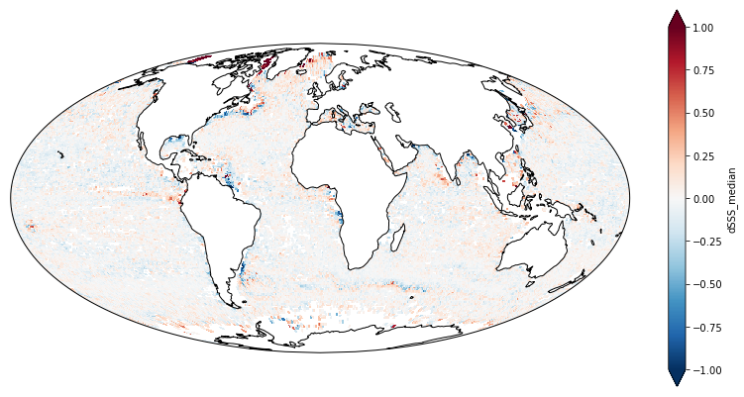
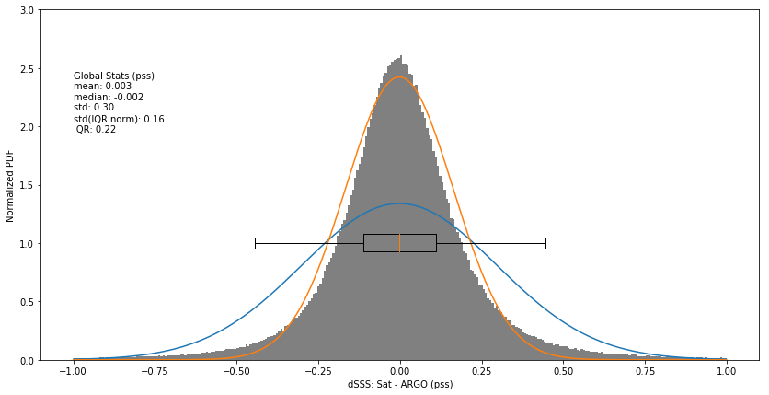
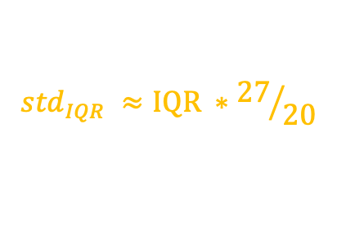
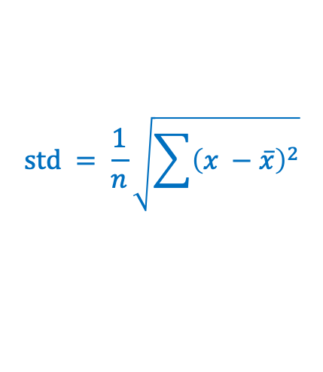
Accuracy & Precision versus Argo
Accuracy: No global systematic bias
Precision (robust): 0.16 pss (Argo) / 0.13 pss (ISAS)
Need to take robust estimator
$$std = \frac{1}{n}\sqrt{\sum{{\left(x −\overline{x}\right)}^{2}}}$$
$${std}_{IQR} ≈IQR ∗{27}/{20}$$
InterQuartile Range [25-75]
Notes:
Looking at the distribution of differences between CCI and references (Figure 4 with Argo as reference) highlight the non-normal distribution of the data (larger tails). There is no systematic bias (versus Argo lower than 0.003 pss in absolute value; versus ISAS lower than 0.006 pss). The robust standard deviation is respectively of 0.16 pss and 0.14 pss using Argo or ISAS as reference. Using the simple standard deviation, the estimate is much higher with 0.30 pss and 0.59 pss using respectively Argo or ISAS as reference. This much bigger difference using ISAS is certainly due to the fact that both products CCI or ISAS produce data where both datasets are unreliable (inner seas, Arctic ocean) but represents a very small surface of the globe.

Slide 6
Pi-MEP Argo match-up report - summary
Global rmsd against Argo of 0.16 pss
  Decreasing to 0.13 pss for optimal region (>800 km from the coast; area with temporal standard deviation smaller than 0.2 pss);
  Increasing to 0.27 pss for area closer than150 km from the coast (larger variability);
  Increasing to 0.20 pss for area characterised by one of the following conditions: rain and low wind; mixed layer depth < 20m; area with temporal standard deviation >0.2pss; SSS < 33 pss.
No global bias against Argo except for filtered collocations where:
  SSS < 33 pss (CCI saltier by 0.06 pss);
  Mixed layer depth < 20m (CCI saltier by 0.04 pss);
  SST < 5°C (CCI saltier by 0.02 pss);
  SSS > 37 pss (CCI fresher by 0.04 pss);

Slide 7
Stability

Slide 8
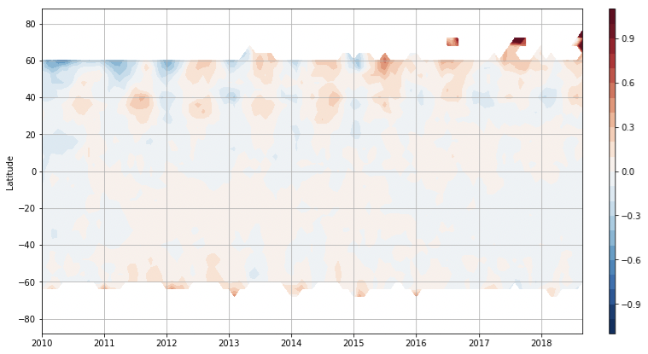
Global latitude-time Hovmöller CCI-reference difference
dSSS = CCI - Argo
Long-term stability mean difference within +/-0.05 pss between 40S and 20N
Warming: Oscillation against reference > 0.2 pss in the high northen latitudes;
CCI are fresher/saltier in winter/summer than references;
CCI fresher than reference over [2010-2012]
Notes:
Argo with latitude bins of 4°, with monthly timestep. Each pixel represents the median value when there is more than 30 observations. Otherwise no value is shown. (bottom) median value at the same spatiotemporal scale as the ISAS field.
We have further assessed the temporal variability of the CCI difference against reference using a latitude-time Hovmöller over the global ocean (Figure 6). The Hovmöller using Argo data does not have enough data in high latitude (< 30 observations per pixel) even after having coarsen the Hovmöller pixel resolution to 4° in latitude and monthly field (instead of bi-weekly). In both Argo and ISAS based Hovmöller, there is a strong oscillating signal with stronger amplitude at higher latitude. The oscillation is in phase opposition between Northern and Southern hemisphere. This means the CCI data are fresher in winter than references. In addition, we remark the CCI freshening occurring at the beginning of the time series is particularly important in the Northern hemisphere at high latitude.

Slide 9
Spatial & Temporal effective resolution

Slide 10
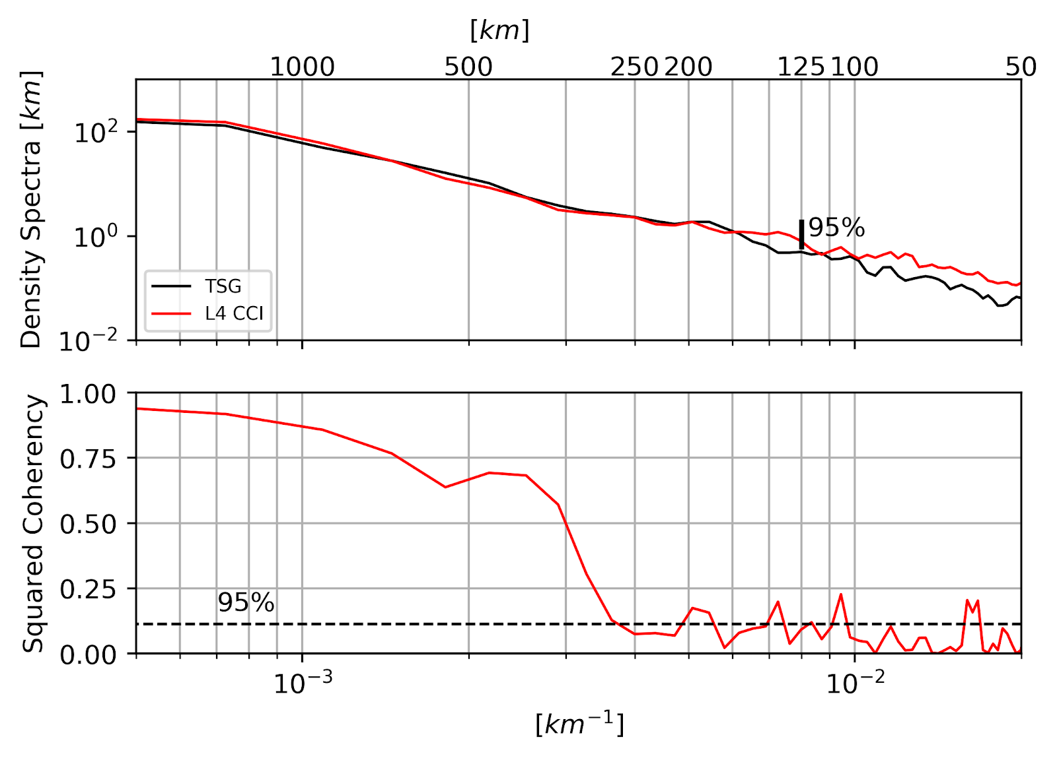
Spectra and Coherency spectra for Tropical Atlantic (CCI & TSG)
(N.Reul, N. Kolodziejczyk, O. Houdegnonto, C. Maes and T. O’Kane)
  TSG and CCI+SSS spectra have comparable spectral slopes between 50-1000 km
  CCI+SSS monthly & TSG are coherent for wavelength of ~300km (150km eddy)
Notes:
Upper panel: Density spectra from from 26 colocated TSG(black)/CCI+SSS(red) SSS transects in Tropical Atlantic. Vertical thick black bar is the level of confidence at 95%. Lower panel: Coherency between the TSG and CCI+SSS SSS transects. Dashed line is the level of significance at 95%.

Slide 11
Pi-MEP mooring match-up report
Average Power Spectra
Weekly
SSS power spectra at mooring position are similar with in-situ and Mercator up to a period of:
  About 14 days for the weekly CCI product
  About 60 days for the monthly CCI product
Monthly

Slide 12
Uncertainty

Slide 13
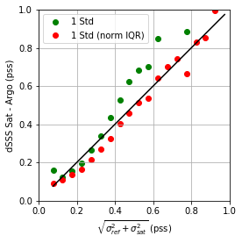
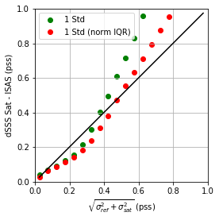


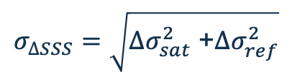
Uncertainty validation
$$σ_{∆SSS}=\sqrt{{∆σ}_{sat}^{2} \text{+}{∆σ}_{ref}^{2}}$$
with the reference error being characterized by its spatial representativeness error:
${∆σ}_{ref}= σ_{0}$ * 0.35
and $σ_{0}$ the temporal std for each pixel
Argo
ISAS
Good estimate of CCI uncertainties once
spatial representativeness considered
Notes:
Measured standard deviation of the difference between (left) CCI and Argo; (right) CCI and ISAS for each uncertainty bins. Green dots are for standard deviation estimate; red dots for robust standard deviation.
There is a very good agreement between the standard deviation of the difference and the estimated uncertainty. This is true using both the ‘simple’ and robust standard deviation particularly up to 0.4 pss (Figure 9 left) suggesting the behaviour of the difference distribution for low total uncertainty bins is close to normal. For higher total uncertainty, there is nearly a one to one relation between the difference standard deviation and the estimate uncertainty as long as we use the robust standard deviation (Figure 9 left). Using ISAS as a reference for the difference with CCI SSS field (Figure 9 right), the behaviour is very similar to (Fig 9 left) up to 0.4 pss (corresponding to most of the open ocean, well sampled by Argo), but divert from the one-to-one line above. This means the difference is higher than expected. This might be explained with the SSS temporal variability which is not well capture by ISAS or in area where there are few observations.
Figure 10 represents, estimated total uncertainty on the left and observed uncertainty using ISAS as reference on the right. As highlighted in Figure 9 right and Figure 10, the total uncertainty is overestimated for most of the ocean by more than 25%. This is certainly partly due to the averaging which occurred when CCI has been regridded on the coarser ISAS grid without improving the uncertainty by a sqrt(N) factor. With N the number of independent observations.

Slide 14
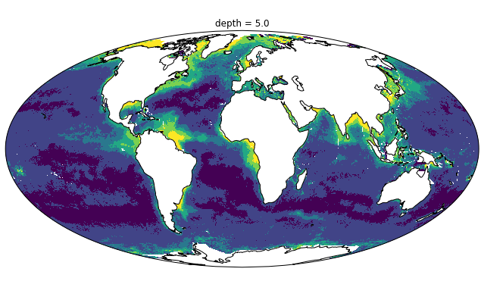
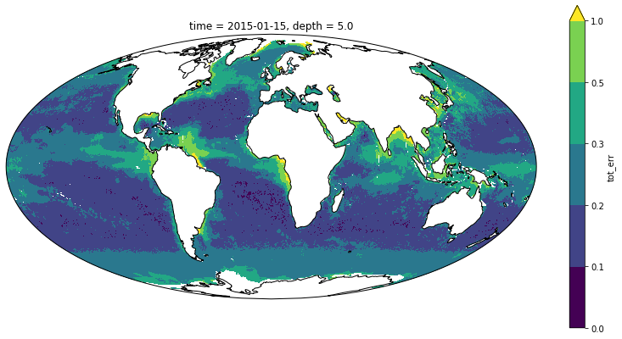
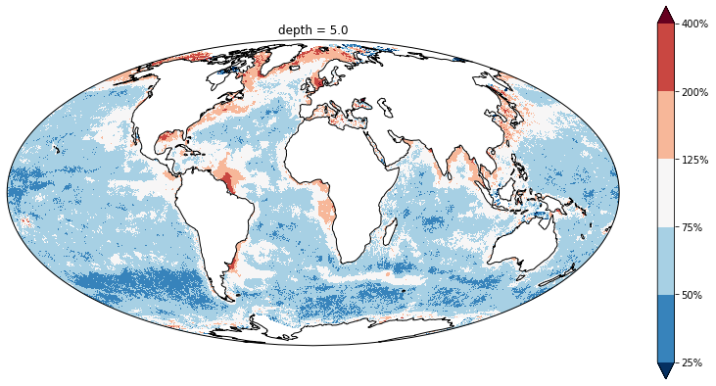
Uncertainty validation 2
dSSS std
Tot uncertainty mean
ISAS
Ratio
=
Overestimation at low uncertainty
Underestimation at high variability (reference variability?)
Notes:
err_ratio = cci_isasDM.dSSS.std(dim='time')/cci_isasDM.tot_err.mean(dim='time’)
(top left) total estimated uncertainty error in pss from the satellite random error and the representativeness error.
Mean Uncertainty. (top right) observed uncertainty as the standard deviation of the SSS difference between CCI and ISAS. (top) the colourbar is not linear, steps are [0,0.1,0.2,0.3,0.5,1]. (bottom) Ratio of the observed over estimated total uncertainty.

