Slide 1
How does deforestation affect local climate across the tropics?
Callum Smith, Dominick Spracklen, Jessica Baker
School of Earth and Environment, University of Leeds
EGU Assembly 2020, BG3.11 session, 7 May 2020
Notes:
My work takes a pan-tropical look at the climate effect of deforestation on local climate. Over 2001-2018, I use remotely sensed datasets to analyse the local effects of land cover change. Preliminary results suggest that for deforested pixels relative to forested pixels, leaf area index and evapotranspiration decreases, whilst temperature increases. Precipitation has variable magnitude across the three regions examined.

Slide 2
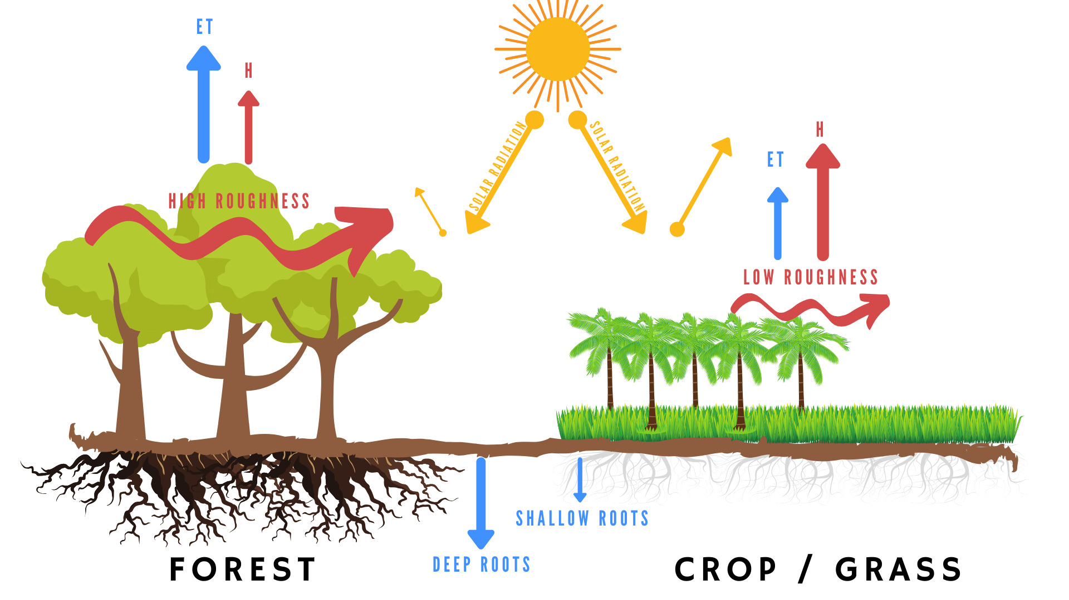
Introduction
How vegetation impacts the surface
This project aims to bring together existing knowledge of how tropical forests affect climate and increase our understanding of the climate response to deforestation in the tropics at local and regional scales.
Objectives:
Explore the local and regional climate impacts of deforestation across the Amazon, the Congo Basin and South East Asia (SEA).
Understand what is creating and driving these differences.
Diagnose the chain of events and the direction of parameter change.
Categorise the aspects of deforestation that are most critical to the change.
Figure 1 outlines the key biophysical differences between forests and croplands. The observed climate response that occurs when the two states are transitioned between is the key focus of this study.
Fig 1
Notes:
Fig 1: Forest diagram shows how forests differ from crops and pasture. Forests have darker surfaces so absorb more radiation than pasture and crops, in this way, forests warm the surface (relatively).
However, due to forests heterogenous surface, their varied vertical structure, they have higher aerodynamic roughness, which generates eddies and turbulence and moves this warmer air away from the surface and up into the boundary layer. Crops and pasture have a lower roughness, so don’t vertically mix air as efficiently.
Lastly, forests have deeper roots, with better access to soil moisture. They have higher ET flux than crops. This higher evaporative process cools the surface too. This combined with higher roughness means that in the tropics, forests cool the surface.

Slide 3
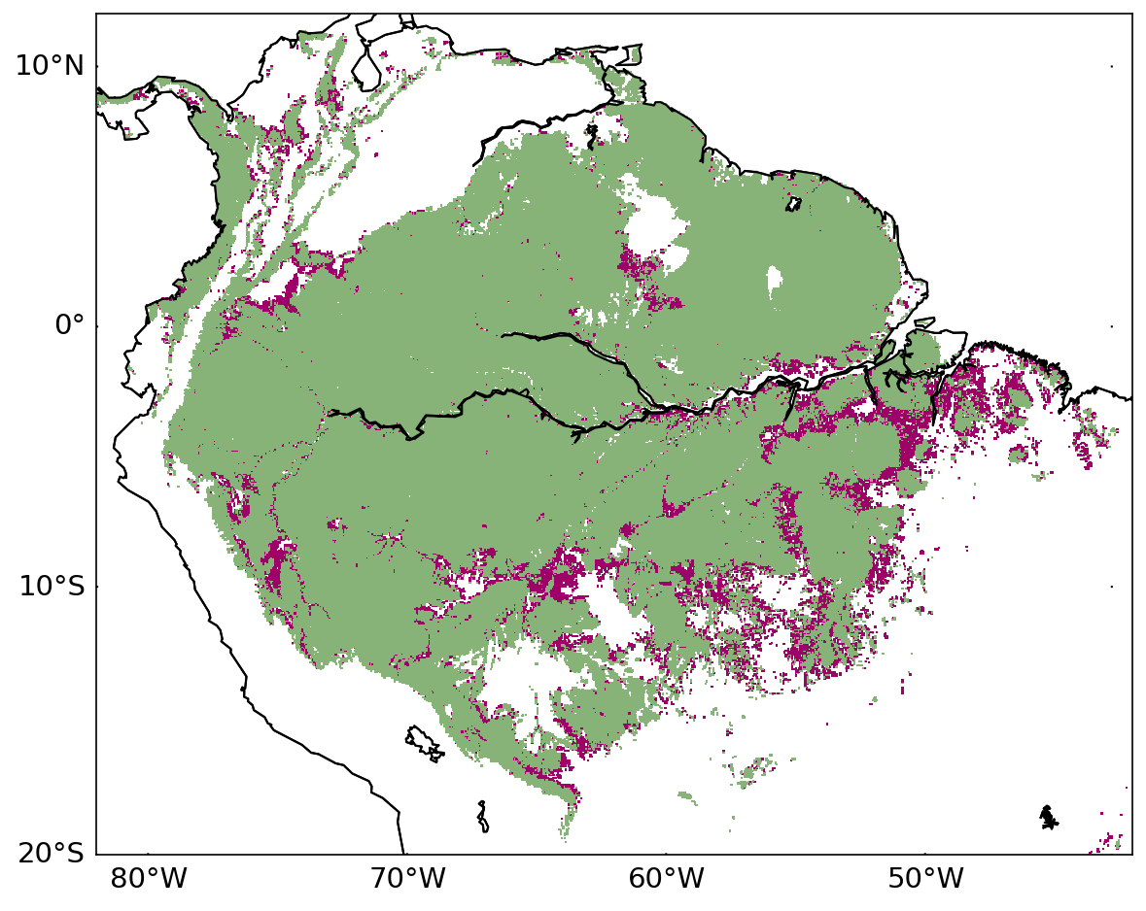
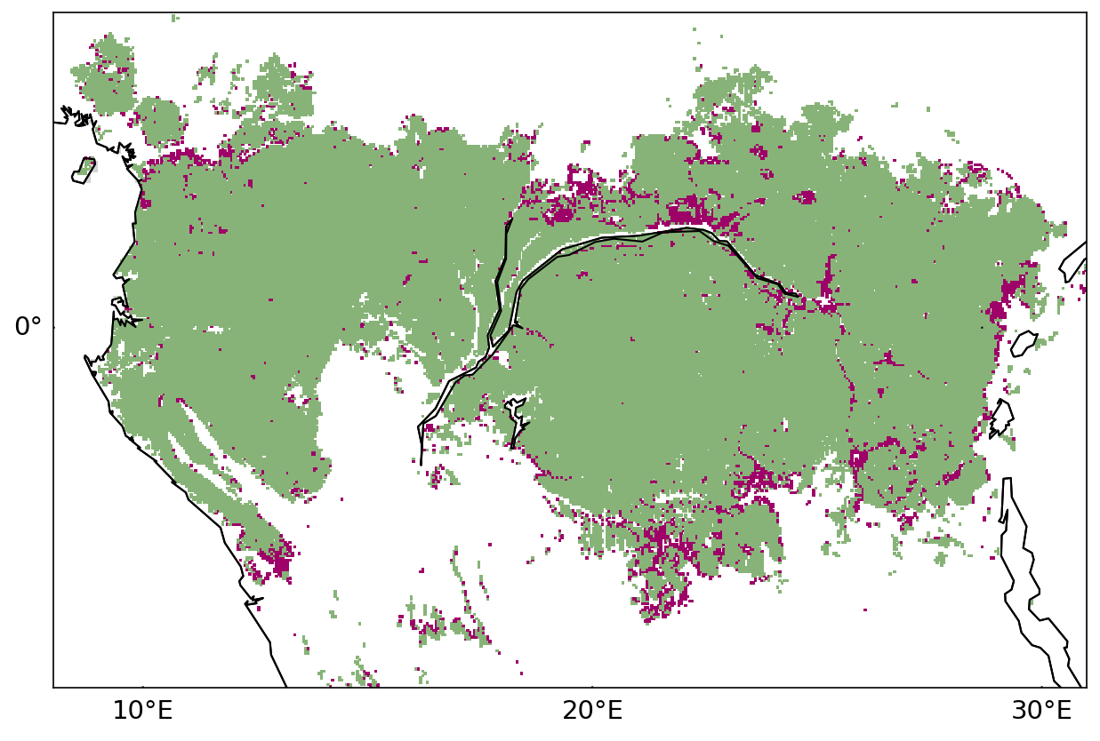
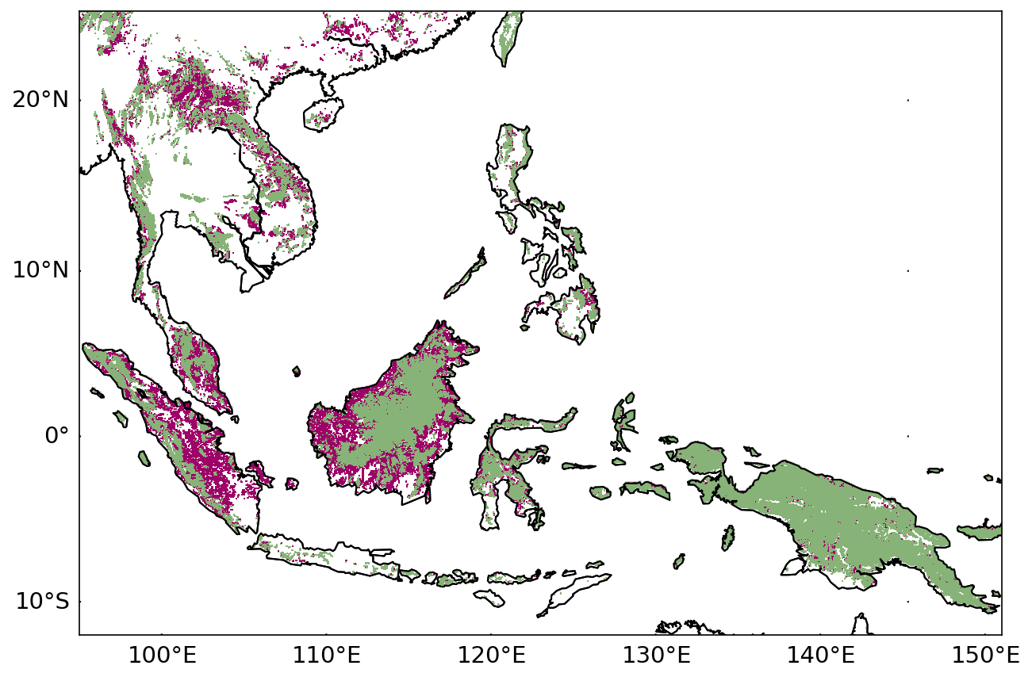
Methodology
Table 1. Canopy cover categorisation
Category | State in 2001 | State in 2018 | Datasets
Forest | >70% forest | >70% forest | Tree cover 2000 – tree loss
Deforested | >70% forest | <70% forest | Tree cover 2000 – tree loss + tree gain
a)
Fig 2. Forest and deforested areas in the Amazon, Congo and SEA
I identified areas that were deforested in the Amazon (Fig 2a), Congo (b) and SEA (c) between 2001 and 2018 using GFC data.
Changes (∆) in land-surface and climate variables were calculated for each region, taking the difference between the 5 years at the start and end of the analysis period.
Fig 3. Deforested (def) pixels are compared to local forest (for) pixels. This 5x5 grid further isolates response of deforestation from climate change.
b)
for | for | def | def | def
for | def | def | def | def
def | def | def | def | def
def | def | def | def | def
def | def | def | def | def
Table 2. Climate datasets analysed
Variable | Product | Resolution
Leaf Area Index (LAI) | MOD15A2H | 0.05º
Evapotranspiration (ET) | MOD16A2 | 0.05º
Land Surface Temperature (T) | MOD11C3 | 0.05º
Precipitation (P) | CHIRPS v2.0 | 0.05º
Canopy Cover | Global Forest Change (GFC) v1.6 | 30 m
c)
Forest
Deforested
~25 km
Notes:
Why 70% - the definition of forest varies a lot depending on where in the world you are and what type of forest you look at, but 70% seems acceptable for the tropics
To examine the local climate effects of deforestation, I compared the change over deforested pixels against local forest pixels (see Figure 3). Deforested pixels with no forest neighbours were discounted.
building on methods from Baker and Spracklen (2019).
This method aims to compare geographically similar pixels to ensure differences arise only from land cover differences
Baker, J.C.A. and Spracklen, D. V 2019. Climate Benefits of Intact Amazon Forests and the Biophysical Consequences of Disturbance. Frontiers in Forests and Global Change. 2, pp.1–13.
Hansen, M.C., Potapov, P. V., Moore, R., Hancher, M., Turubanova, S.A., Tyukavina, A., Thau, D., Stehman, S. V., Goetz, S.J., Loveland, T.R., Kommareddy, A., Egorov, A., Chini, L., Justice, C.O. and Townshend, J.R.G. 2013. High-Resolution Global Maps of 21st-Century Forest Cover Change. Science. 850(November), pp.850–854.

Slide 4
Climate change during observation period
Difference in LAI, ET, T and P over three domains between the start and end periods (5 year average) of the analysis.
Reductions in LAI correspond to known areas of deforestation, however much of the rainforests show widespread greening
ET mostly increased, except in the western Amazon and equatorial Congo
The strongest T increases occurred in areas where LAI decreased, e.g. in ‘south-eastern arc of deforestation’ and the plantations in SEA.
P changes were spatially variable in each continent
Fig 4

Slide 5
Summary and future work
Summary:
The Amazon, Congo and Southeast Asia displays different geographic patterns of deforestation.
My analysis showed changes in LAI, ET, T and P over tropical forests between 2001 and 2018. Understanding the impact that deforestation can have on local climate is critical for quantifying the benefits of forest biomes.
Future work:
I will analyse the effect, relative to nearby forest, that deforestation has on the four key variables, LAI, ET, T and P.
Further research will focus on incorporating additional remotely sensed datasets to build on our understanding of the relationships between land cover change and local climate. These datasets will include the MODIS products; aerosol optical depth (AOD), fire hot spots, total column water and cloud fraction.
I will analyse how the difference in deforestation pattern and driver links to observed changes in local climate.

