Slide 1
Continuity and discontinuity in fluvial systems: why we need both perspectives
Gordon E. Grant
PNW Research Station USDA Forest Service Corvallis, Oregon
Jim O’Connor
U.S. Geological Survey, Portland, Oregon
Liz Safran
Lewis & Clark College, Portland, Oregon

Slide 2
Connectivity
noun con·nec·tiv·i·ty \(ˌ)kä-ˌnek-ˈti-və-tē, kə-\
: the quality, state, or capability of being connective or connected
antonym: discontinuity
Continuity
noun con·ti·nu·i·ty \ˌkän-tə-ˈnü-ə-tē, -ˈnyü-\
: the quality of something that does not stop or change as time passes
antonym: discontinuity
Merriam-Webster (since 1828)

Slide 3
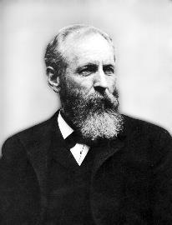
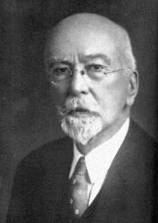
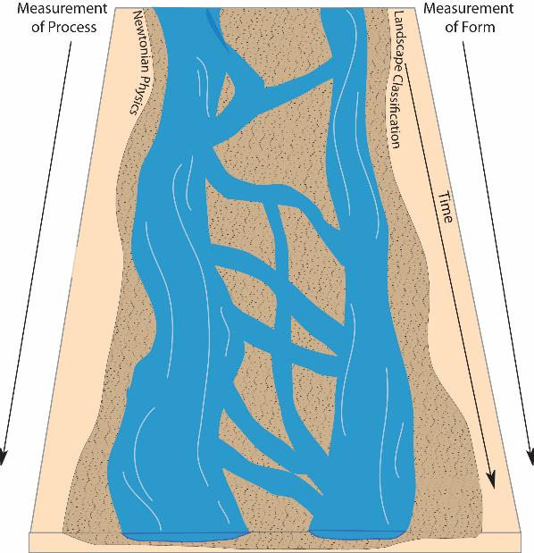
The Roots of Continuum
Grove
Karl
Gilbert
(1843-1918)
William
Morris
Davis
(1850-1934)
Balance of Forces
Equilibrium
Least work
“timeless”
Cycle of Erosion
Landforms = f(structure, process time)
Sequence of forms
“time-bound”
Grant et al., 2013
Notes:
Braided river of concepts and conceptual models in fluvial geomorphology

Slide 4
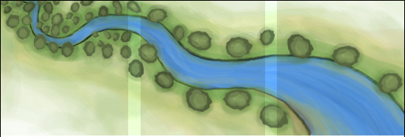
The Roots of Continuum
“A graded stream is one in which, over a period of years, slope is delicately adjusted to provide, with available discharge and the prevailing channel characteristics, just the velocity required for transportation of all of the load supplied from above”
J. Hoover Mackin (1948)
Notes:
Examples of continuum Thinking

Slide 5
Lane’s (and Borland’s) Balance: Lane’s (1955) mathematical relationship between available sediment and available energy was succinctly illustrated as a literal balance by Borland (1960)
The Roots of Continuum
Notes:
Lane’s balance. One of the most recognized conceptual models in geomorphology. Reproduced with permission from Borland, 1960.

Slide 6
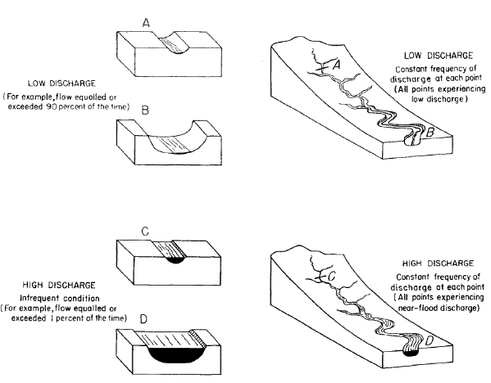
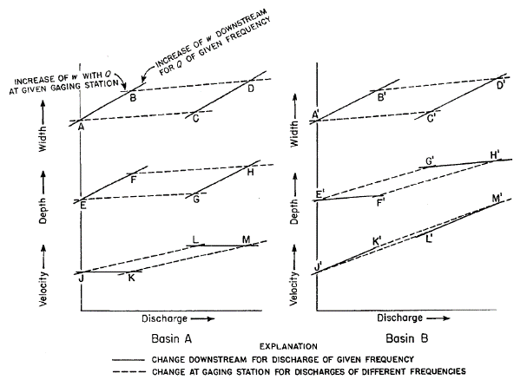
Frequency and Magnitude of Geomorphic Processes
(Wolman & Miller, 1960)
Analysis of Hydraulic Geometry
(Leopold & Maddock, 1953)

Slide 7
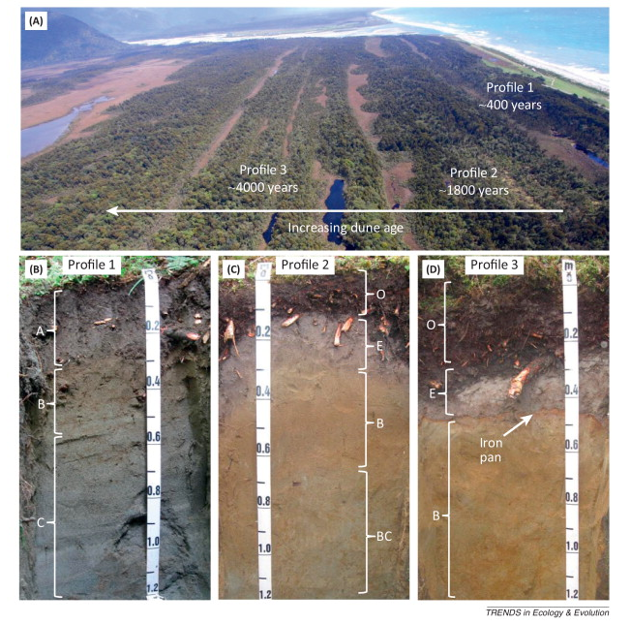
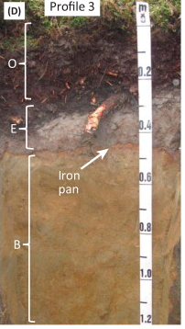
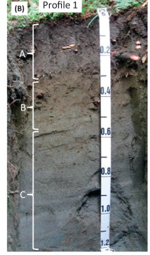
Increasing dune age
Soil Chronosequence
Haast, New Zealand; Laliberte et al., 2013

Slide 8
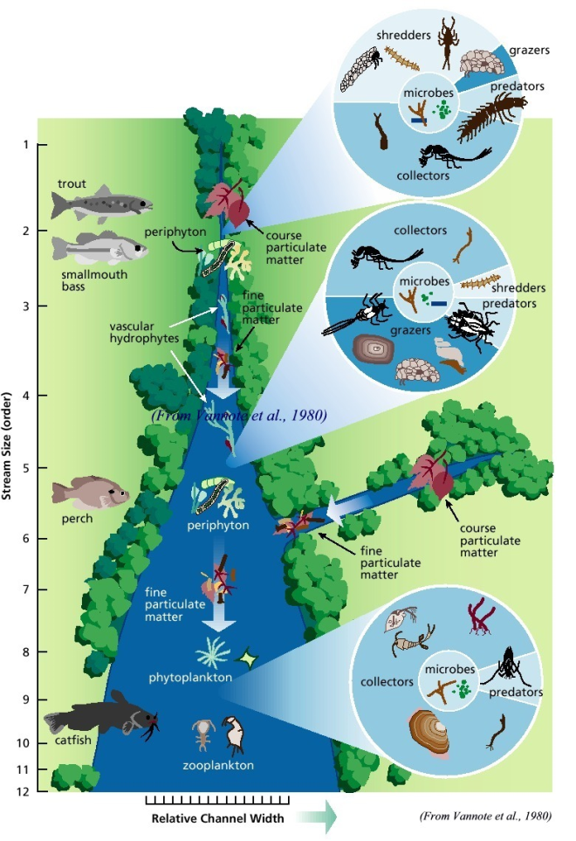
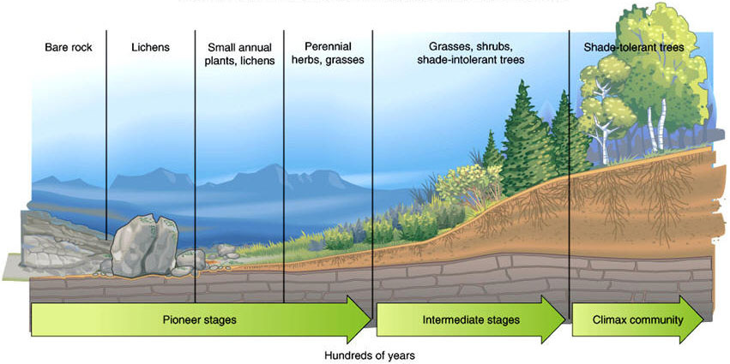
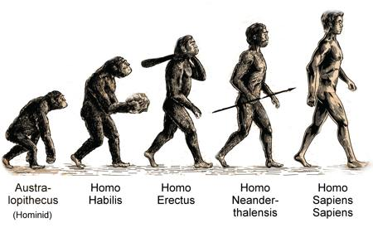
Primary succession (after Clements)
River Continuum Concept
Primate succession
Vannote et al., 1980

Slide 9
Discontinuity
noun dis·con·ti·nu·ity \(ˌ)dis-ˌkän-tə-ˈnü-ə-tē, -ˈnyü-\
: the quality or state of not being continuous
: lack of continuity
: a change or break in a process
Discontinuities relevant to fluvial geomorphology
Spatial arrangement/singular events
Processes or process domains
Physical dynamics (changes in state)

Slide 10
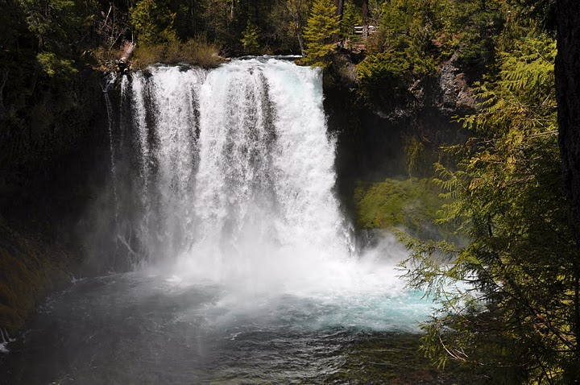
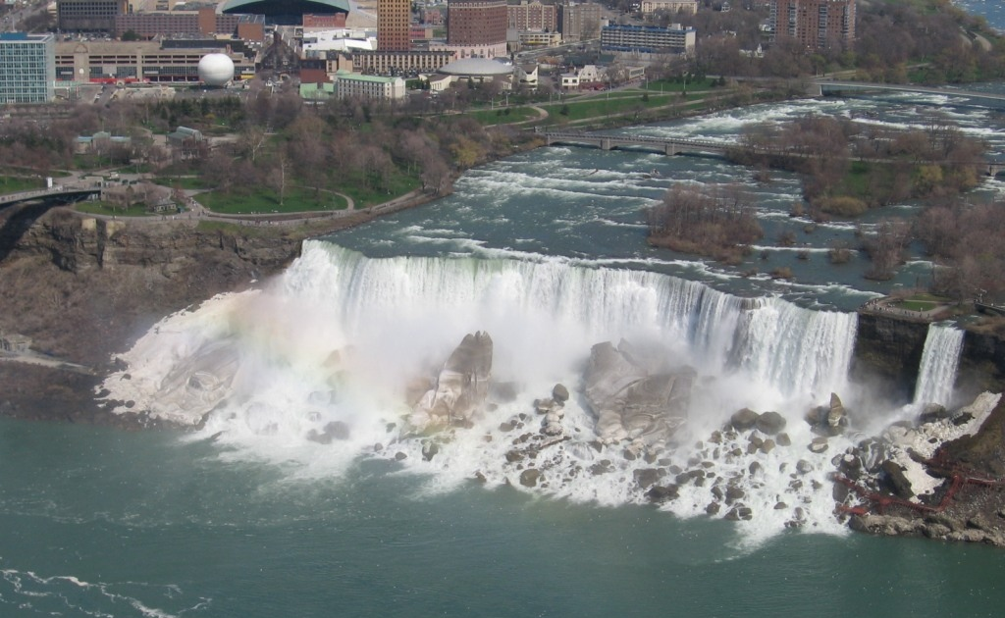
Knickpoints
Lyell (1830); Davis (1884)
Niagara Falls,
Canada/US
Koosah Falls
McKenzie River, Oregon

Slide 11
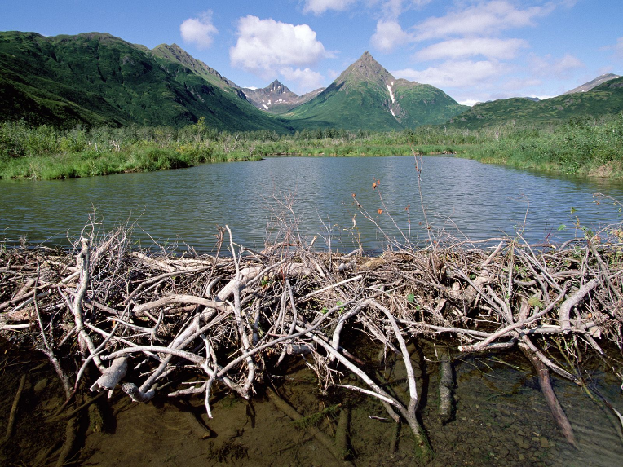
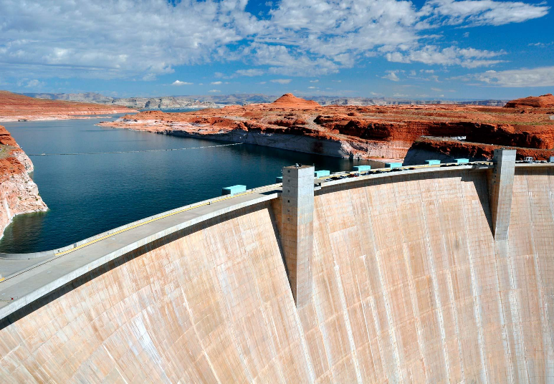
Dams
Hoover Dam
Colorado River, Nevada
Beaver Dam
Tikchik State Park, Alaska
Notes:
https://tempethoughts.files.wordpress.com/2011/10/beaver-dam-tikchik-state-park-alaska.jpg

Slide 12
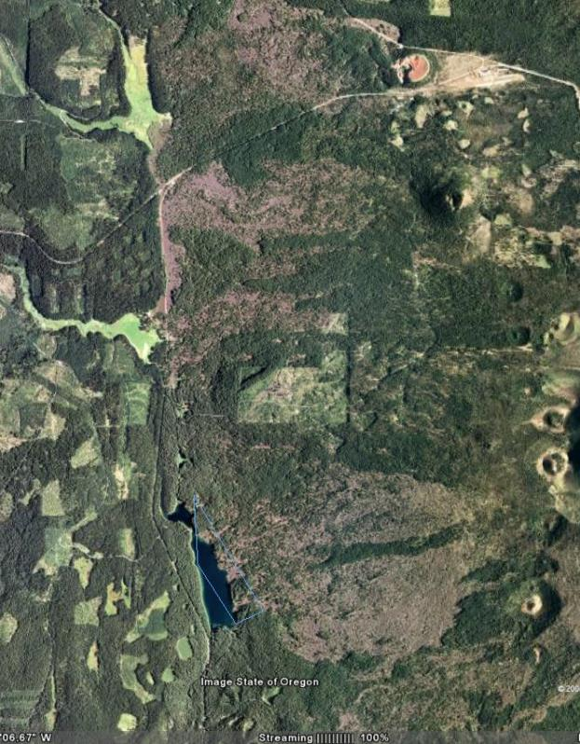
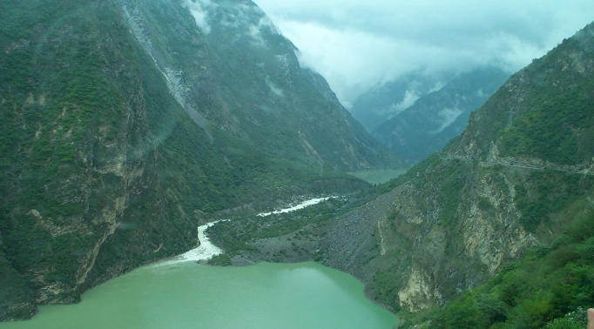
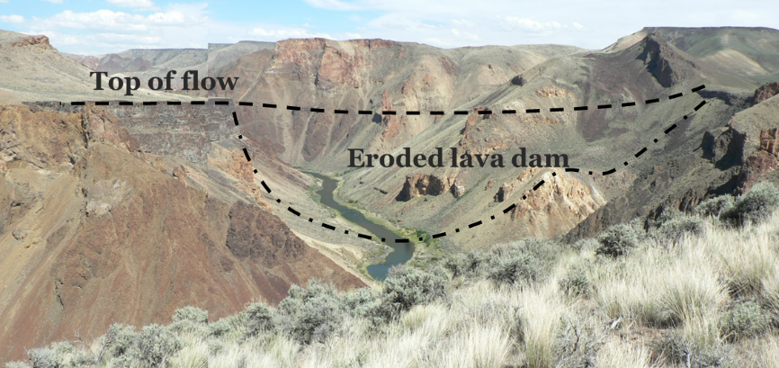
Extrafluvial Perturbations
Lava dam
Landslide dam
Lava dam
Upper Min Jiang River, China
Lava dam
Upper McKenzie River Oregon
Owyhee River, Oregon

Slide 13
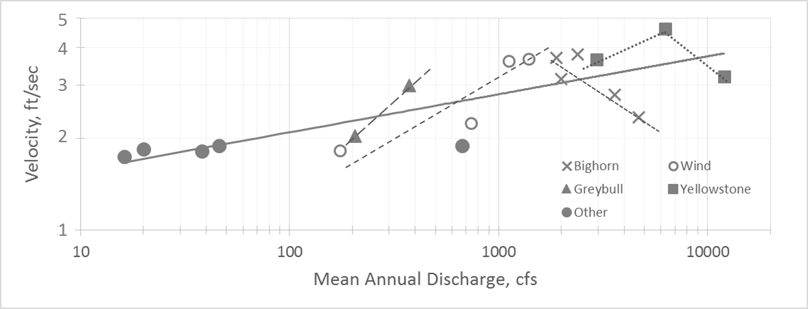
Tributary Junctions
Downstream hydraulic geometry relation for velocity for selected rivers, after Mackin (1963). Note non-uniform and opposite trending relations between velocity and discharge (Grant et al., this paper)

Slide 14
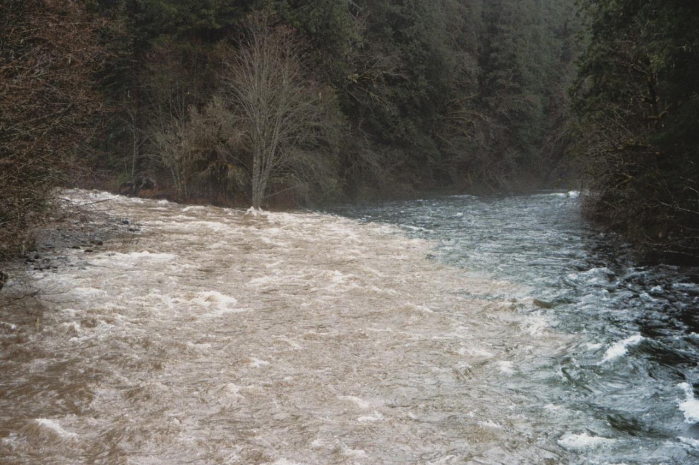
Tributary Junctions
Tributary
(muddy)
Mainstem
(crystal clear)

Slide 15
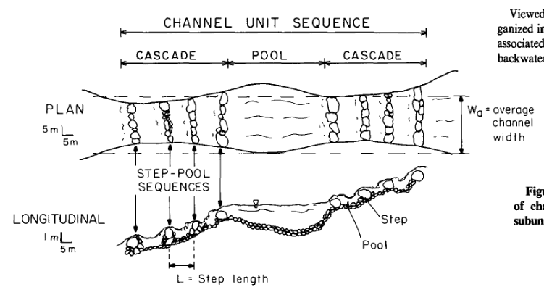
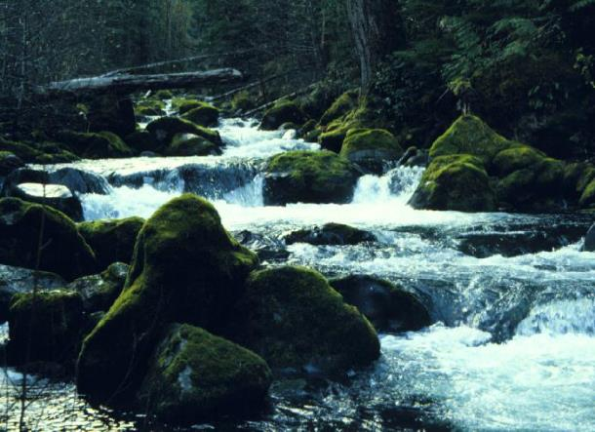
Channel Units
Grant et al., 1990

Slide 16
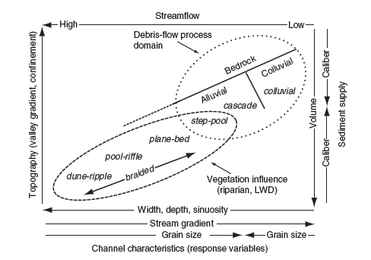
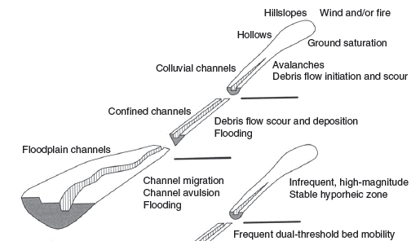
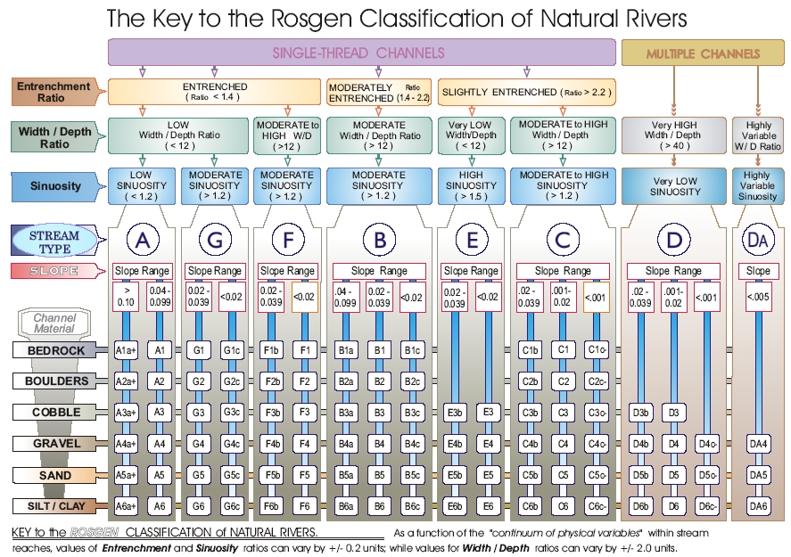
Montgomery & Buffington, 1997
Upstream Controls
(climate, diastrophism, land-use)
Downstream
Controls
(base level, diastrophism)
Montgomery , 1999
The Fluvial System
(Schumm, 1977)
Notes:
Schumm’s model of the fluvial system. Schumm (1977).

Slide 17
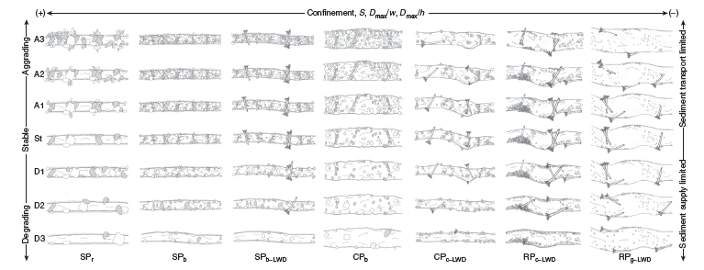
Montgomery & Buffington, 1997
Upstream Controls
(climate, diastrophism, land-use)
Downstream
Controls
(base level, diastrophism)
Montgomery , 1999
FPC, 1996
Notes:
Schumm’s model of the fluvial system. Schumm (1977).

Slide 18
Discontinuity
noun dis·con·ti·nu·ity \(ˌ)dis-ˌkän-tə-ˈnü-ə-tē, -ˈnyü-\
: the quality or state of not being continuous
: lack of continuity
: a change or break in a process
Discontinuities relevant to fluvial geomorphology
Spatial arrangement/singular events
Processes or process domains
Physical dynamics (changes in state)

Slide 19
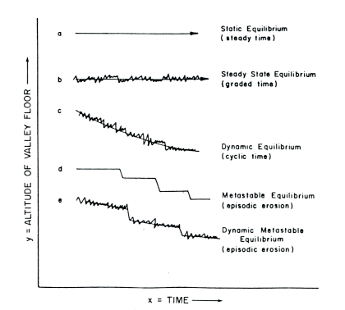
Dynamic Equilibrium and Thresholds
Alternative models for characterizing the evolution of geomorphic systems over time
Schumm, 1977

Slide 20
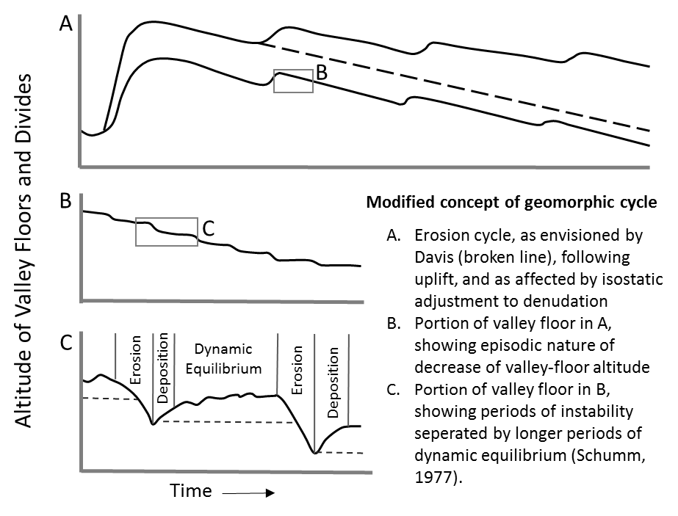
Thresholds of Bedrock Erosion
Alternate models of landscape evolution showing both continuous (dynamic equilibrium) and threshold-punctuated evolutionary trajectories. After Schumm (1979). (Grant et al., this paper)

Slide 21
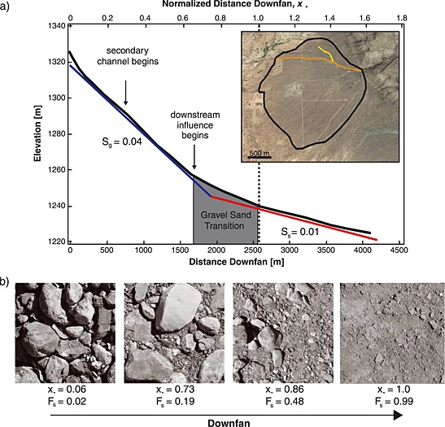
Gravel/Sand Transition
Dog Canyon alluvial fan, New Mexico; Miller et al., 2014
Notes:
https://www.researchgate.net/figure/267103573_fig2_Figure-1-Dog-Canyon-alluvial-fan-a-Main-channel-profile-from-smoothed-DGPS-data-The

Slide 22
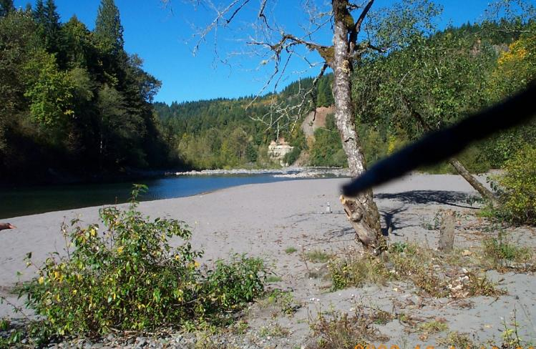
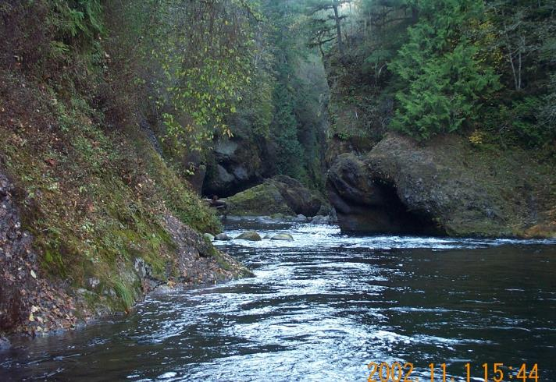
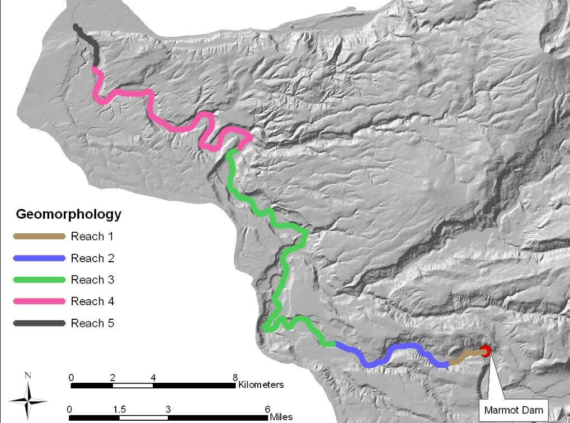
Alluvial/Bedrock Channel
Sandy River Oregon
G. Stewart unpublished

Slide 23
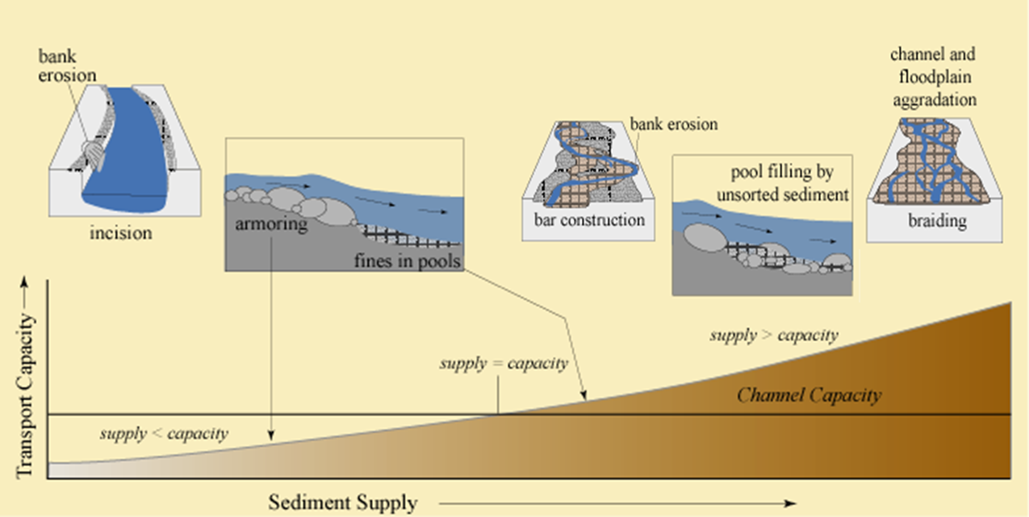
Thresholds of channel incision
Grant et al., 2003

Slide 24
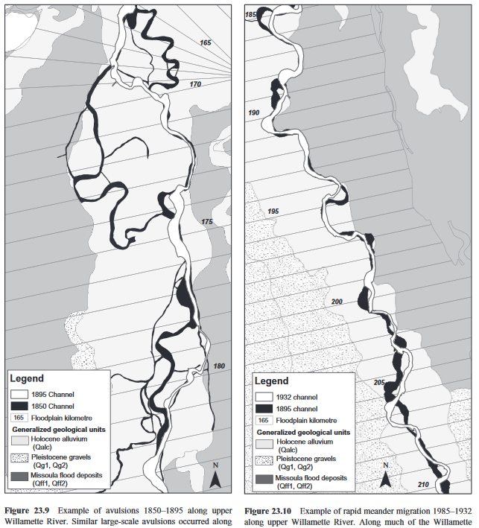
Rapid changes of channel pattern
Avulsion
1850 to 1895
Migration 1895 to 1932
Upper Willamette River
Oregon
Wallick et al., 2008

Slide 25
Bed material entrainment
Anderson Creek, Oregon
Video: L. Hempel

Slide 26
Discontinuity
noun dis·con·ti·nu·ity \(ˌ)dis-ˌkän-tə-ˈnü-ə-tē, -ˈnyü-\
: the quality or state of not being continuous : lack of continuity
: a change or break in a process
Discontinuities relevant to fluvial geomorphology
Spatial arrangement/singular events
Processes or process domains
Physical dynamics (changes in state)

Slide 27
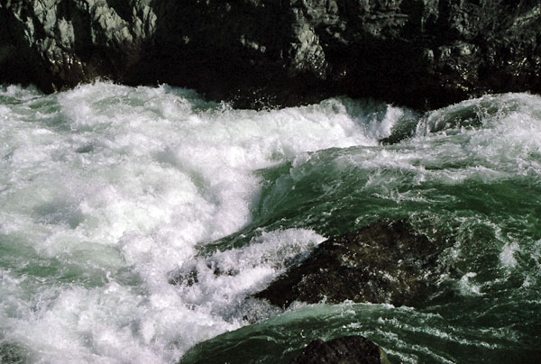
Sub- to super critical flow
direction of flow
Sub-critical
Fr <1
Sub-critical
Fr <1
Super critical
Fr >1
Hydraulic jump
Critical
Fr =1
(rock)
Green Wall Rapid, Illinois River, Oregon

Slide 28
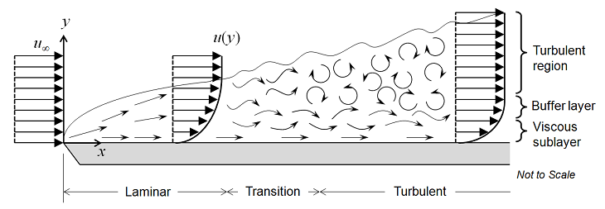
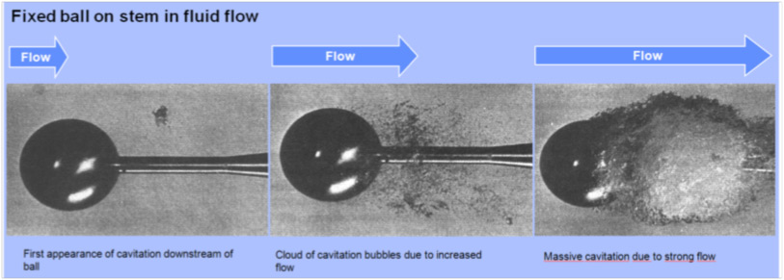
Turbulence
Incropera & DeWitt (2007)
Cavitation
http://www.whirlwindi.nl/files/cavitation_bg.jpg
Notes:
Laminar/turbulent: https://scienceofdoom.com/2011/01/02/heat-transfer-basics-convection-part-one/

Slide 29
Discontinuity
noun dis·con·ti·nu·ity \(ˌ)dis-ˌkän-tə-ˈnü-ə-tē, -ˈnyü-\
: the quality or state of not being continuous
: lack of continuity
: a change or break in a process
Other examples of discontinuous thinking

Slide 30
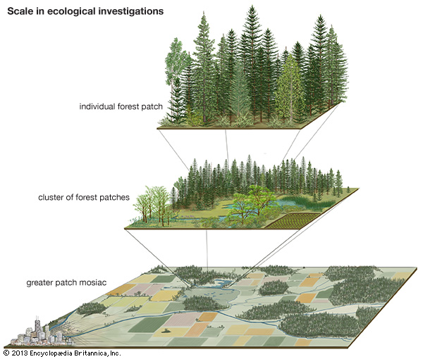
Patch Dynamics
Notes:
https://www.britannica.com/science/patch-dynamics

Slide 31
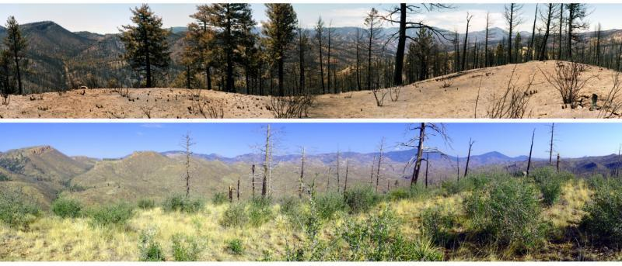
Disturbance ecology
One month after Hayman Fire (2002) photo: M.Kaufmann
Ten years later (2012) photo: P.Fornwalt
95 mi SW of Denver, Colorado (USDA Forest Service)

Slide 32
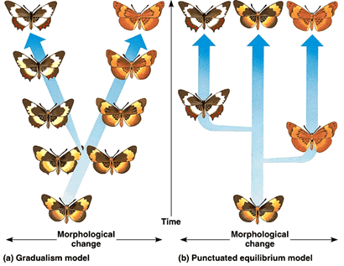
Punctuated equilibruim

Slide 33
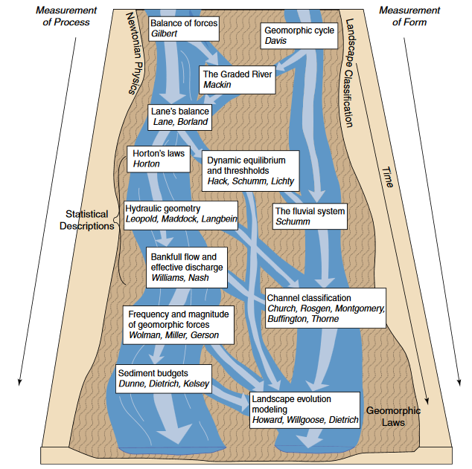
Bringing it all together
Braided river of concepts and conceptual models in fluvial geomorphology (Grant et al., 2013)

Slide 34
Bringing it all together
continuous
discontinuous
both
Braided river of concepts and conceptual models in fluvial geomorphology (Grant et al., 2013)

Slide 35
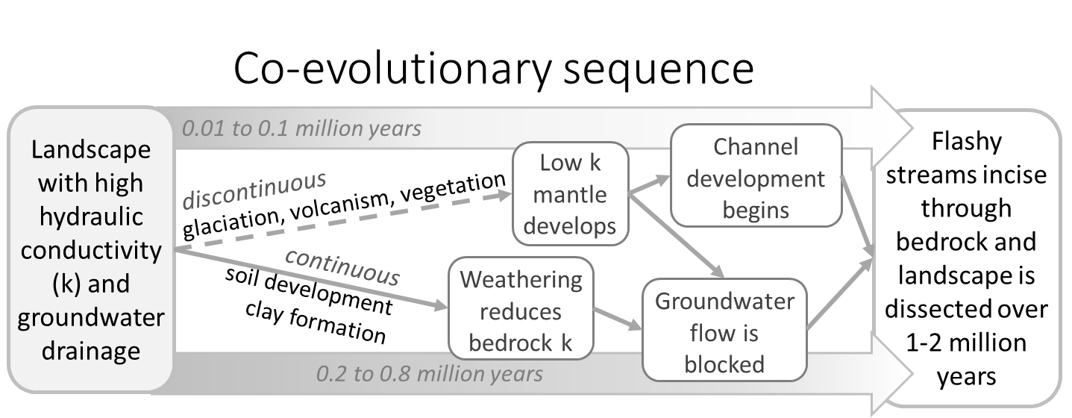
Landscape Evolution
Proposed trajectory for development of drainage density in the Oregon Cascades, after Jefferson (2006). Note that both continuous and discontinuous processes are actors in this scenario. While the continuous processes may take hundreds or thousands of years to play out, discontinuous processes acting over a much shorter timescales can jump start or accelerate the evolutionary sequence. (Grant et al., this paper)

Slide 36
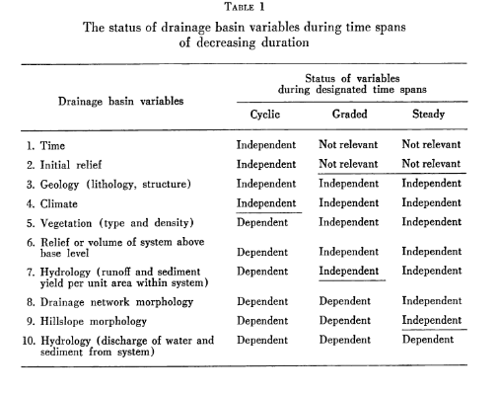
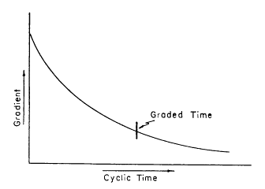
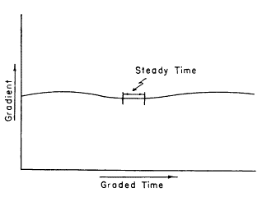
Time, Space and Causality in Geomorphology
Schumm & Lichty, 1965

Slide 37
Time, Space and Causality in (Dis)continuity
 | Cyclic | Graded | Steady
Sediment Transport | con | dis | dis
Bedload | con | dis | dis
Suspended load | con | dis | con
Knickpoint retreat | con | con | dis/con
Planform adjustments | con | dis | dis/con
Long profile evolution | con | dis | dis/con
Drainage network development | dis/con | con | con
Grant et al., yesterday

Slide 38
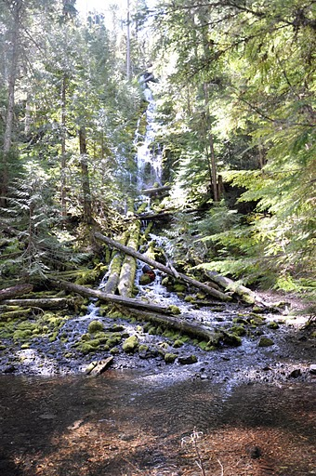
The End
G.Grant, J.O’Connor, and E.Safran Excursions in (dis)continuity http://dx.doi.org/10.1016/j.geomorph.2016.08.033
Proxy Falls
Lost Creek, Oregon

Slide 39
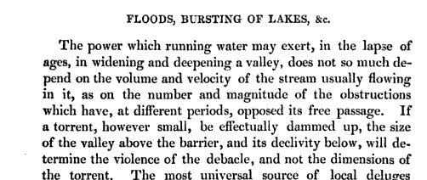
Discontinuity is a geologic fact of fluvial life…deal with it!
Lyell, 1830. Principles of Geology

Slide 40
Knickpoints
“At the end of the Glacial period, while the streams well south of the ice limits were still persevering in their perfect ways, those on the glaciated area often found that much of their previous work was lost and had to be done over again. As fast as the ice melted back, the rivers took possession of the country, and while the larger and stronger ones in nearly all cases found escape along their accustomed channels, many of the smaller streams were quite bewildered, and lost their way among the heaps and sheets of drift that masked their old valleys, and had to settle down as best they might on the lowest ground they could find. They were restrained in lakes and ponds behind drift barriers, and were turned aside from a life of comparative ease in their well prepared old channels to an age of hard work in active rock cutting-and here we now see them, just accommodated to their new lines of life.”
William Morris Davis (1884)

