Slide 1
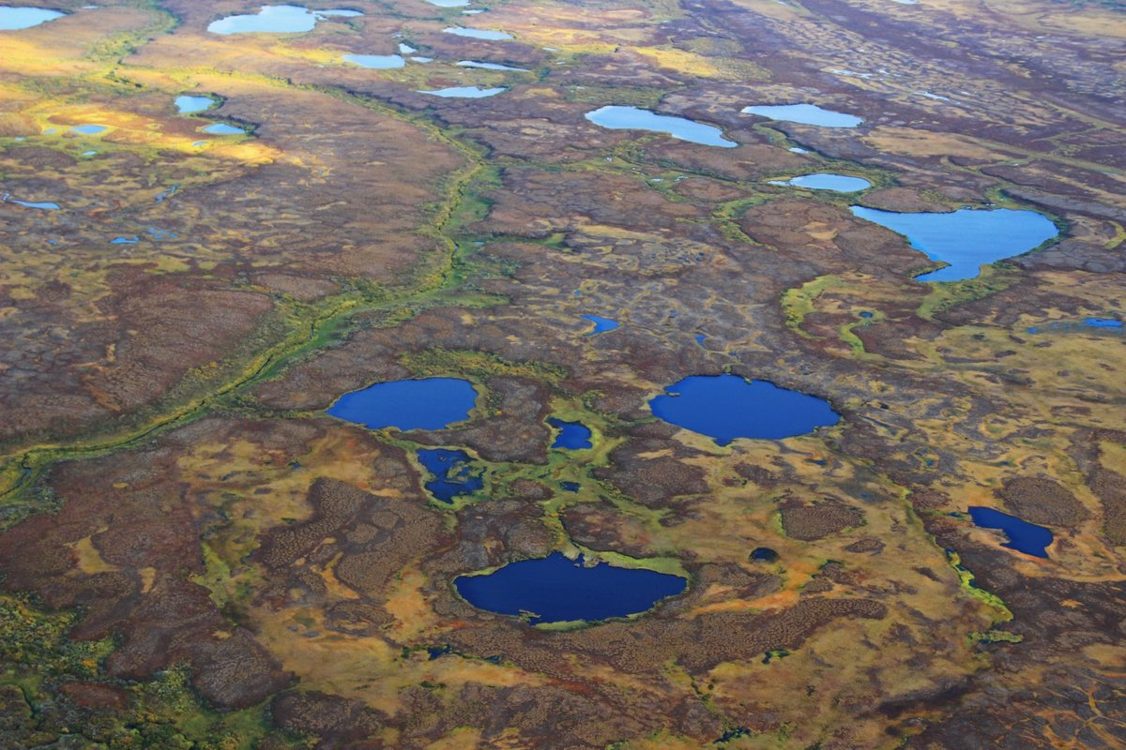
Bottom Sediments of Arctic Lakes as Indicators of Mercury Biogeochemical Migration
Yury Tatsiy
Vernadsky Institute of Geochemistry and Analytical Chemistry
Moscow, Russian Federation
yutatsy@mail.ru

Slide 2
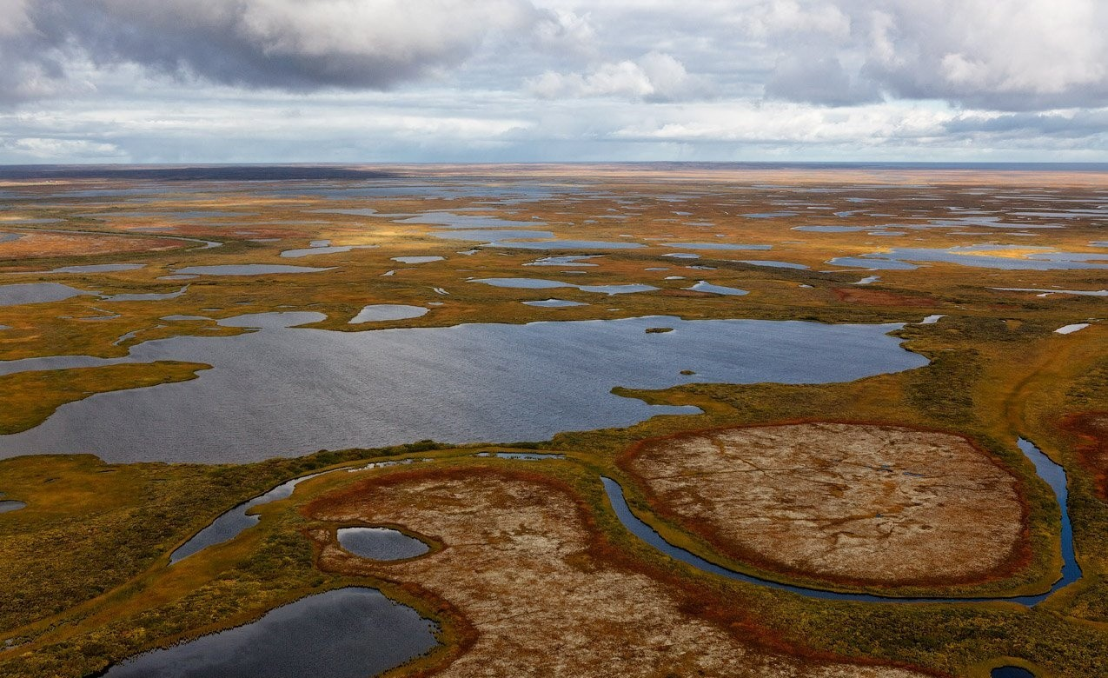
Studies of dated cores of bottom sediments from Arctic lakes are widely used to determine flows and sedimentation history of heavy metals. This is largely due to the need to understand the spatial and temporal trends of pollution in the Arctic and the ways of influencing wildlife and people, especially in a changing climate. Arctic lakes are sensitive indicators of global changes in the environment and climate, as well as the effects of regional and long distance transport of pollutants.
Bottom sediments of Arctic lakes that are not subject to direct anthropogenic influences are a kind of paleoclimatic and paleogeochemical archives that contain information about biogeochemical processes on the catchment and in the lake itself, informatively reflect environmental changes.

Slide 3
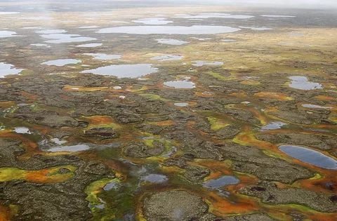
Mercury is an element of the first hazard class and a global pollutant.
Mercury vapors are present in large quantities in emissions from coal-fired power plants and non-ferrous smelters. Once in the atmosphere, it can be transported over long distances.
The accumulation of mercury in the arctic environment is a matter of particular concern. Unfortunately, the published data on mercury in the bottom sediments of Arctic lakes are much less than for other heavy metals.
The aim of the research is to assess the dynamics of sedimentation of mercury and identify a possible anthropogenic contribution to the period of industrial activity.

Slide 4
METHODS
Dating: layer-by-layer measurement of 210Pb and 137Cs isotopes
Loss on ignition (LOI) - 550°С up to constant weight
Grain-size analysis by dry sieving into several fractions.
Mercury was determined by pyrolysis from a solid sample (20–100 mg, n = 3) with the preliminary accumulation on a gold collector and recording on АА spectrometer. Calibration by saturated mercury vapor at 0ºC.
The element composition (63 elements) after acid digestion was determined
by inductively-coupled plasma mass spectrometry (ICP-MS).
Enrichment factor (EF) = C_{Hg}/C_{HgBkg} or (C_{Hg} x E_{Bkg})/(C_{HgBkg} x E)
Sedimentation rate = Weight x Slice volume x Dating [g/cm²year]
Mercury flux (F_{HgT}) = C_{Hg} x Sedimentation rate [μg/cm²year]
“Antropogenic” mercury flux (F_{HgA}) = (F_{HgT}) – F_{HgBkg}(F_{ET}/F_{EBkg}),
were E - referent element (Sc, Al, Ti);
Hg_{Bkg} and E_{bkg} – background fluxes

Slide 5
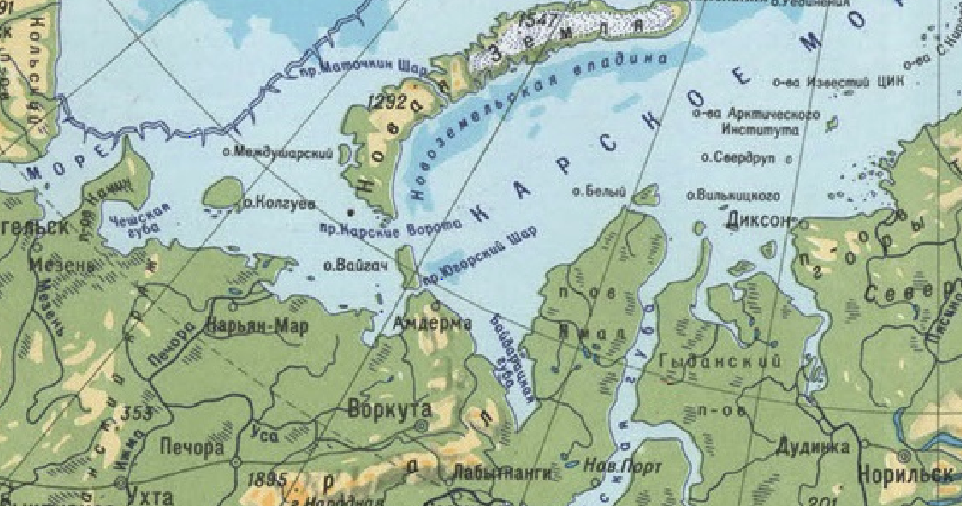
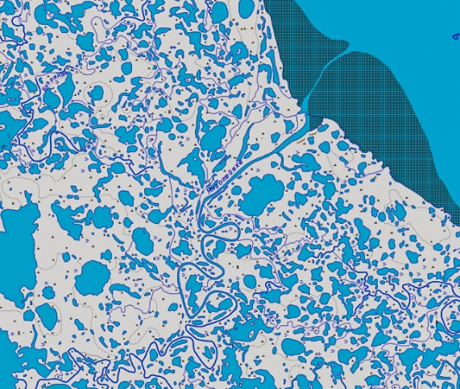
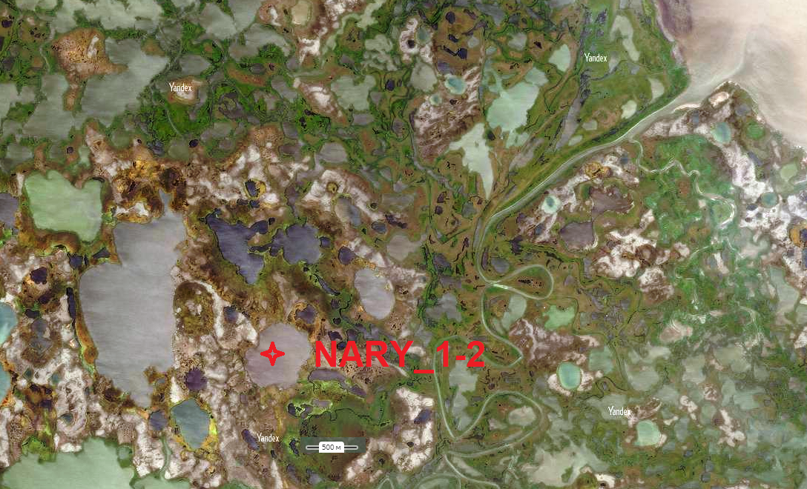
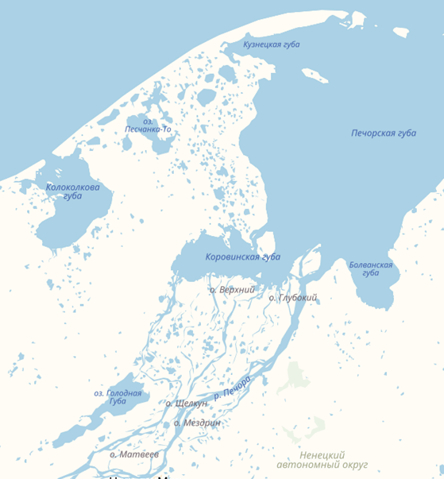
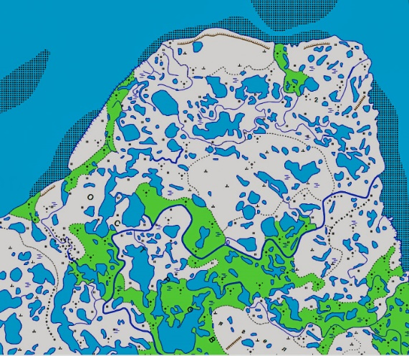
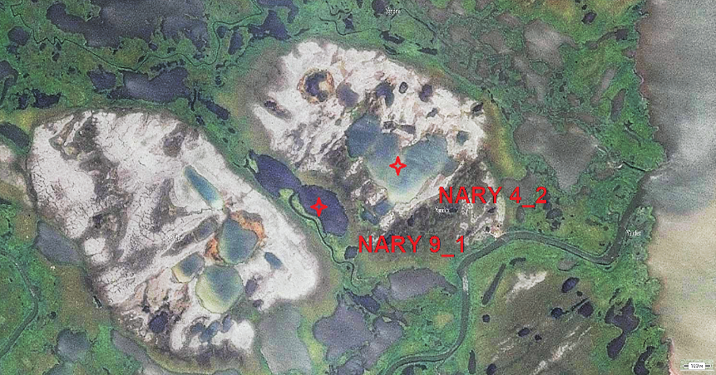
The coring device was a 50cm HON-Kajak sediment gravity corer
Thermokarst Lakes

Slide 6
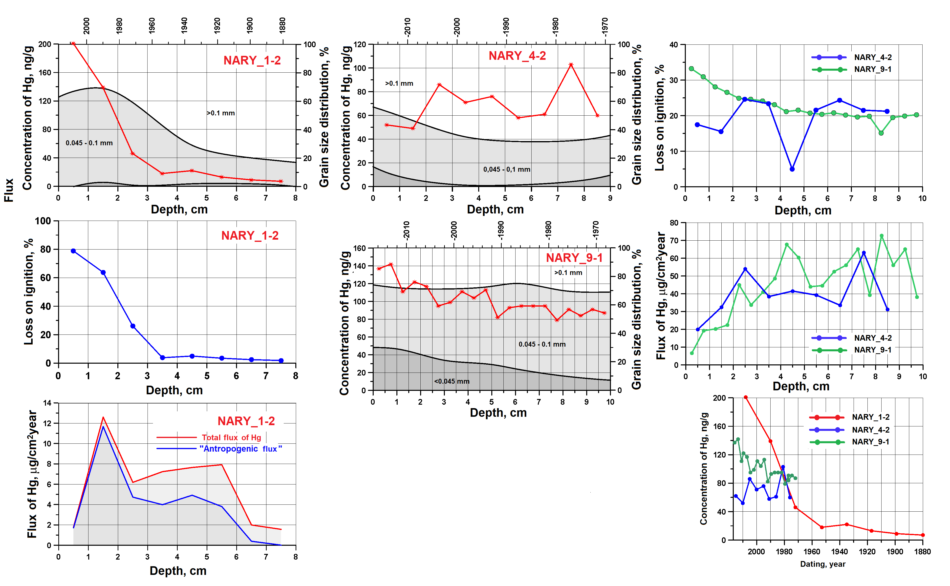
The Hg flux in the NARY_1-2 and NARY_9-1 cores correlates with the sedimentation rate, but in NARY_4-2 with the Hg concentration.

Slide 7
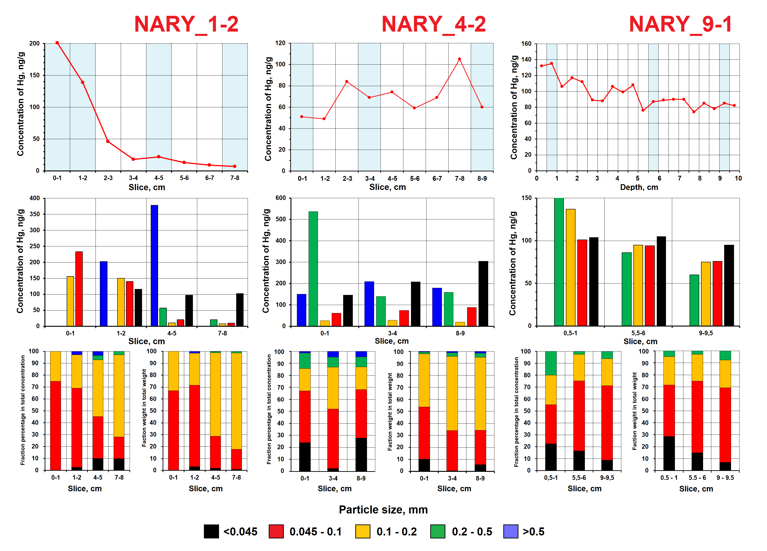

Slide 8
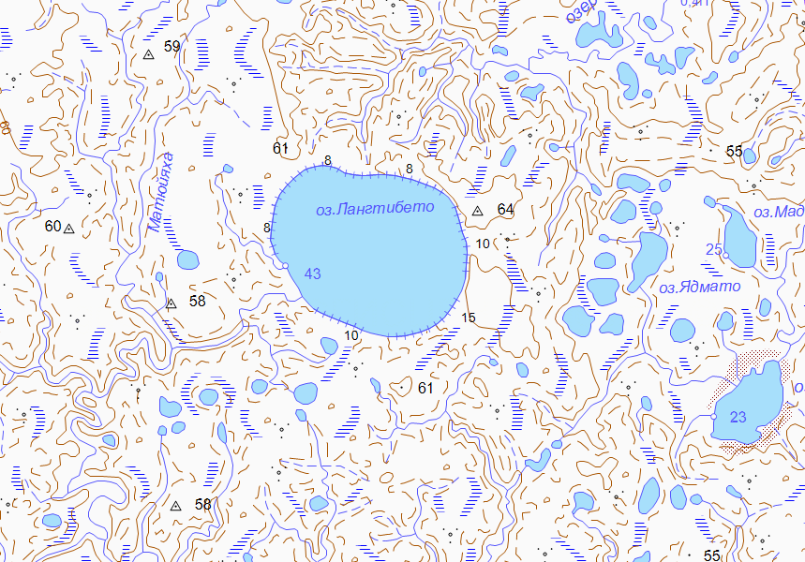
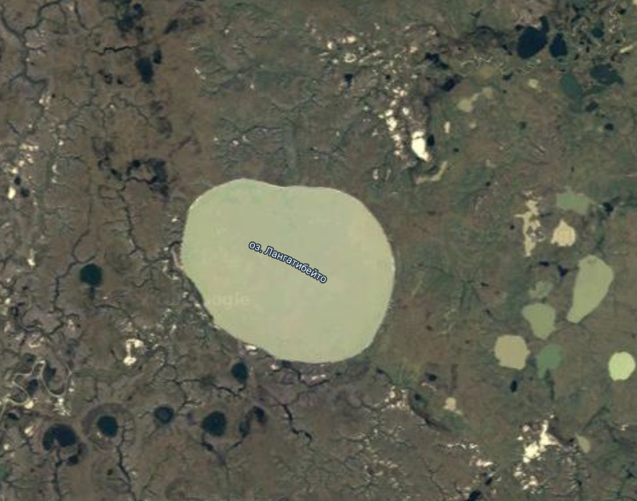
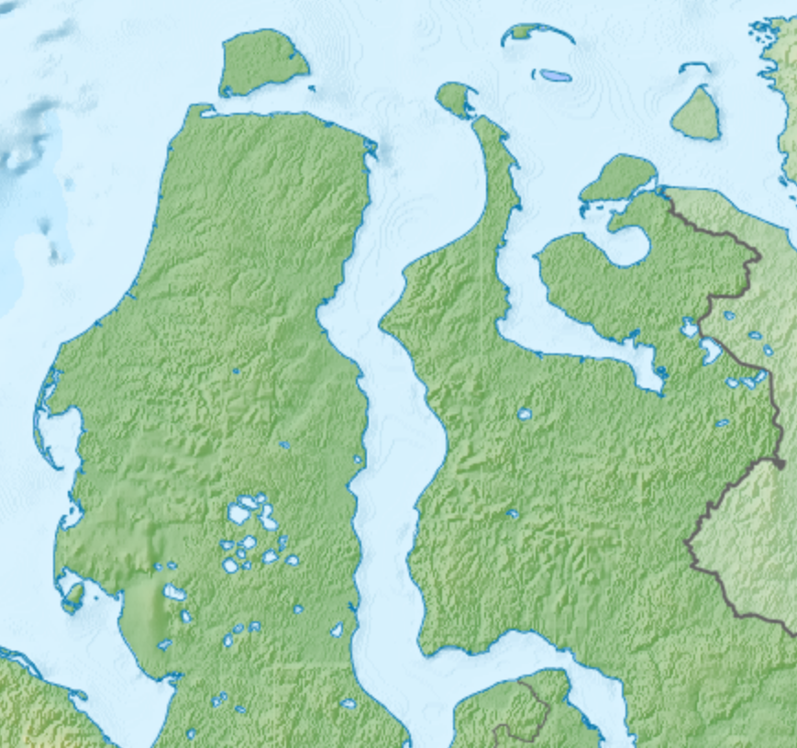
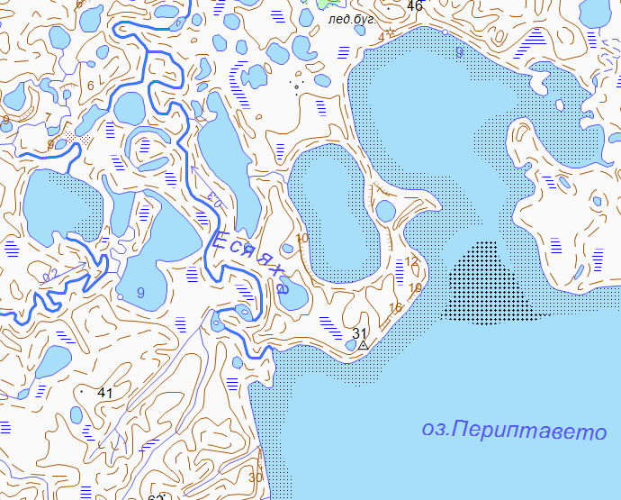
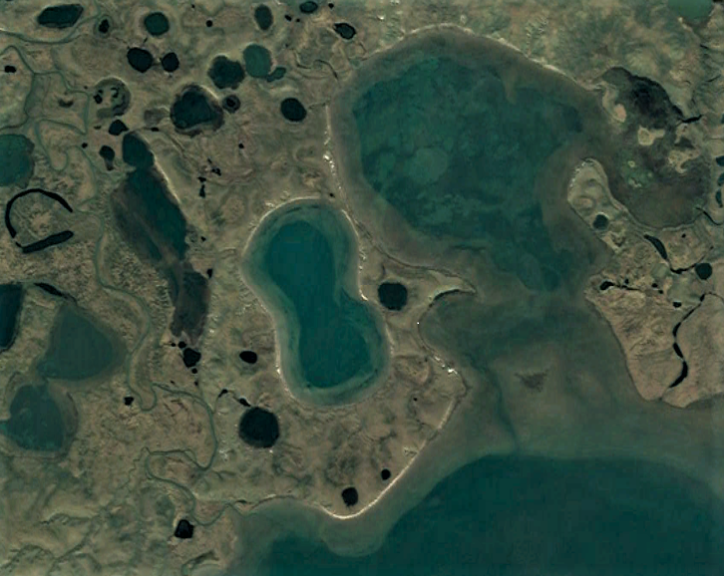
The coring device was the Edelman Eijkelkamp corer and stratometer C-1

Slide 9
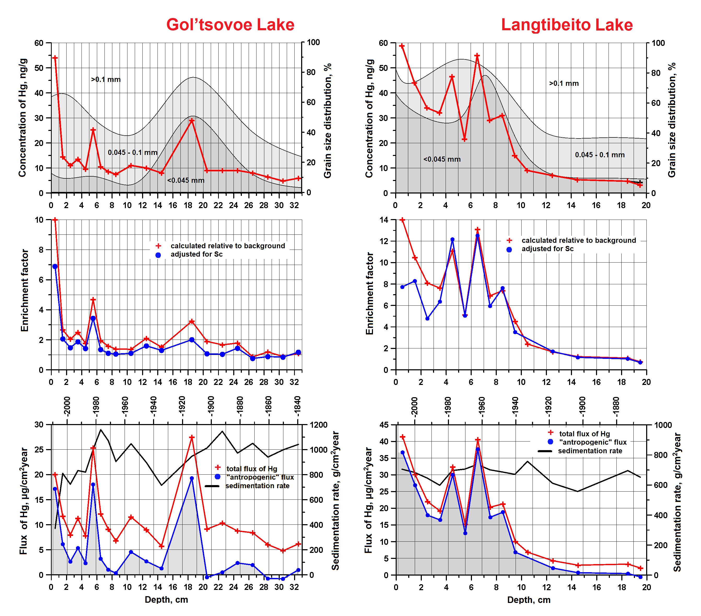

Slide 10
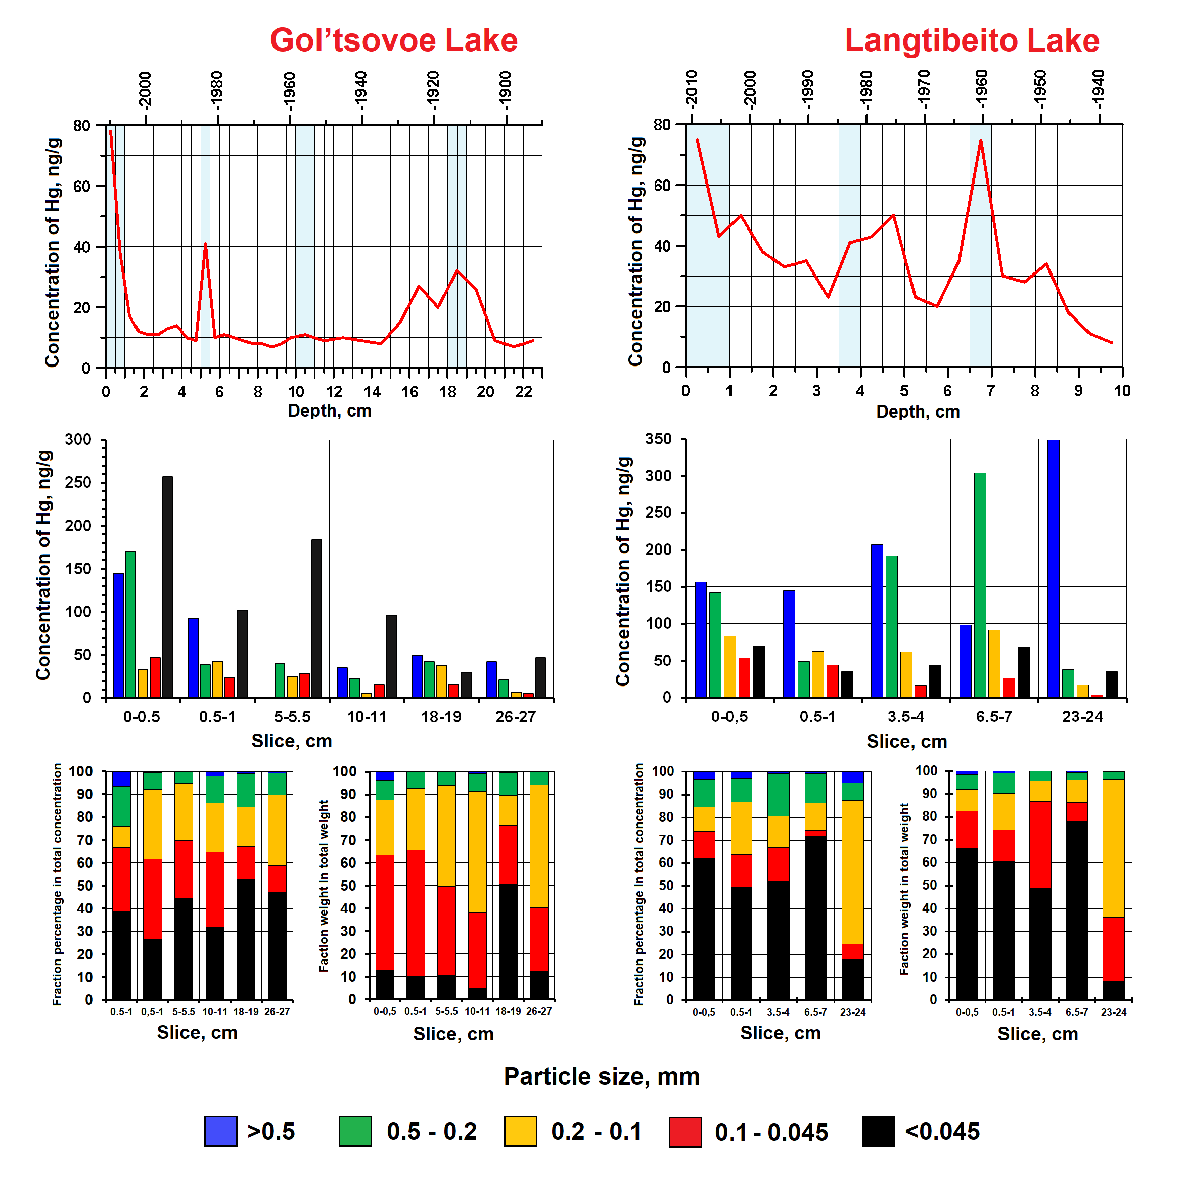

Slide 11
Conclusion
In the cores of bottom sediments from 5 Arctic lakes of the European part of Russia and north-west of Siberia, the features of mercury distribution, changes in the nature of its input in sediments from pre-industrial times to the present day have been investigated.
The results showed a marked decrease in Hg flux over the past 15 years in four of the five lakes studied.
The use of particle size analysis with the simultaneous determination of Hg not only in each core layer, but also in individual particle size fractions, allows to better understand the features of Hg distribution in bottom sediments in various Arctic lakes.
The use of various methods of analysis in conjunction with dating for the study of lake sediments allows better understand the behavioral features, the history of Hg accumulation, and the potential impact of Hg on the Arctic environment.
All results and conclusions are preliminary and are subject to discussion.
This work was supported by the Russian Science Foundation (project 18-17-00184)

Slide 12
Thank you for your attention!

