Slide 1
SWARM observations of the artificial ionospheric plasma disturbances and field‐aligned currents induced by the SURA power HF heating
Renata Lukianova¹, Vladimir Frolov², Alexander Ryabov²
¹ Space Research Institute, Moscow, Russia
² Radiophysical Research Institute, Lobachevsky State University, Nizhny Novgorod, Russia

Slide 2
Motivation
It has long been a goal of active experiments to understand the response of the ionosphere to the high-power high-frequency (HF) radio wave pumping.
The altitudes of 400-500 km are of particular interest since they correspond to the transition from the region, in which the most intense plasma heating and artificial ionospheric turbulence are observed, to the region where the disturbed plasma escapes to the magnetosphere.
No observational data on the properties of plasma turbulence induced by the high-power HF pumping at this altitudinal range existed, until the emergence of a multi-satellite low-orbiting SWARM mission.
A series of experiments were conducted with a conjunction between the midlatitude SURA ionospheric heating facility and the SWARM satellites. We present the first observations made by SWARM on the plasma perturbations and electric currents induced in the F2 region ionosphere by the O‐mode radio wave pumping.

Slide 3
SURA ionospheric heating facility
SURA is the heating facility. It is located near Nizhny Novgorod, Russia (56.15° N, 46.1° E). The SURA radiates powerful radio waves into the ionosphere. The effective radiation power from the three transmitter modules varies from 80 MW for f_{PW} ≈ 4.3 MHz to 150 MW for f_{PW} ≈ 4.3 MHz.

Slide 4
The SURA-Swarm conjugated experiments
In the conjugate SURA‐SWARM experiments the powerful HF radio waves of O‐polarization are emitted, and the SURA pump beam pattern is tilted 14° southward of the vertical in order to enhance the generation of AIT due to the “magnetic zenith” effect. Heating in this direction is the most efficient for changing the electron temperature in the ionosphere.
The PW emission started about 15 min before the satellite crossing through a HF‐perturbed magnetic flux tube. This time interval is sufficient for the development of AIT and filling the flux tube with irregularities in the plasma density up to altitudes
of about 700 km.

Slide 5
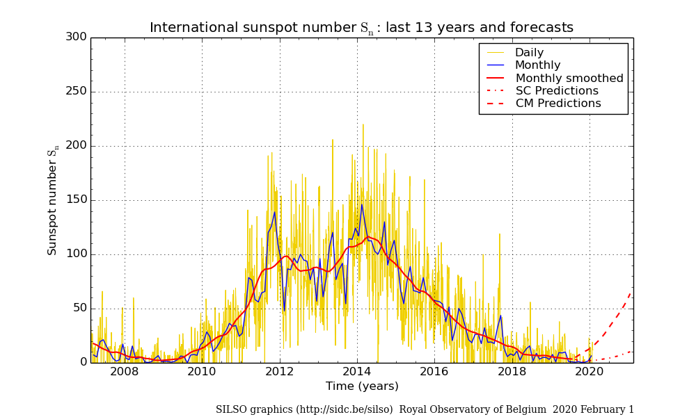
Solar and ionospheric conditions
A series of HF pumping experiments, coordinated with the passage of the SWARM satellites over the SURA site were performed in 2016-2019.
Solar activity
The local ionosonde observations
SWARM mission
Period of experiments
The experiments were conducted under conditions of low solar activity.
The ionosphere was “empty”
2 МHz < f₀F2 < 6 МHz
Occurrence of an artificial ionospheric turbulence (AIT) is better detected in the evening ionosphere with the following heating parameters: f_{PW} < f₀F2 < 6 MHz, P_{eff} > 40 MW, the power wave (PW) reflection height exceeds 200 km, when the satellite trajectory traverses the HF‐perturbed magnetic flux tube at the horizontal distance less than 60 km from the tube axis.

Slide 6
In 2016-2019 more than 50 heating experiments have been conducted in conjugation with Alfa/Charley and Beta.
Each satellite trajectory passed closer than 100 km from the center of the perturbed magnetic flux tube.
The artificial plasma perturbations associated with the development of AIT include:
electron density, Ne
electron temperature, Te
spacecraft electric potential, U_{sc}
magnetic signature of field-aligned currents, BE_res, FAC
Of the whole series of our experiments, several showed the most pronounced effects indicative of the development of strong AIT. One of the most successful experiments is presented below.

Slide 7
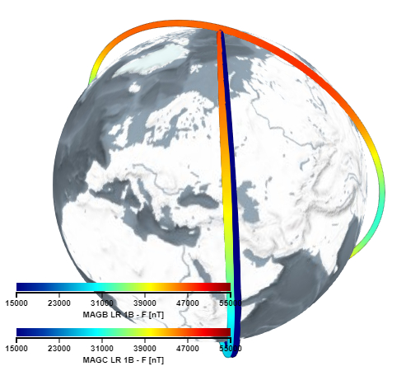
Experiment of 27 August 2016
Alfa and Charley fly side‐by‐side at the distance of ~100 km from each other, with only one of the satellites crosses the perturbed plasma tube. The distance from the satellite trajectory to the center of the disturbed plasma tube is 20 km (Charley) and 95 км (Alfa), Н = 452 км.
Beta
Alfa
Charley
The heating parameters:
Time: 17:06:00 - 17:23:00 UT Frequency: f_{PW} / f₀F2 = 4.3 / 5.0 МHz
Power: P_{eff} = 55 МВт The HF wave reflection height: 230 km

Slide 8
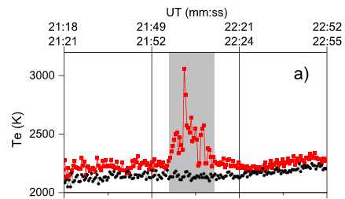
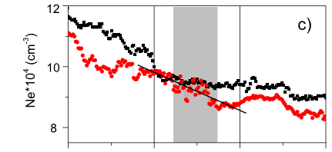
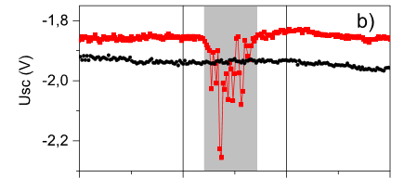
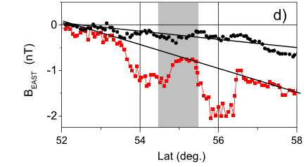
Plasma and magnetic perturbations (1 Hz data) observed by Alfa and Charley
Straight line depicts the linear trend
Notable features:
(a) Increase of Те up to ~30% and (b) corresponding decrease of U_{sc};
(c) Stratification of Ne of ~2%; (d) Magnetic field of ~1 нТл (CHAOS is subtracted).
Charley (20 km from the center of the disturbed plasma tube) observes strong perturbations of all parameters, while Alfa (95 km from the center) flies through unperturbed plasma.

Slide 9
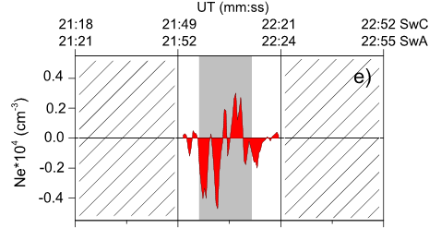
The detrended Ne from Charley (only in latitudes 54–56°N)
Distribution of Ne obtained by low-orbit radio tomography
A strong heating increases the electron pressure and pushes the plasma both downward and upward from
the heated region due to the diffusion processes.
orbit
The satellite likely passes through the transition region: Higher is the duct with increased Ne, and lower is the formation of a cavity with decreased Ne.

Slide 10
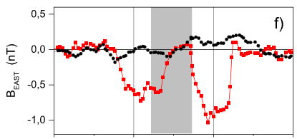
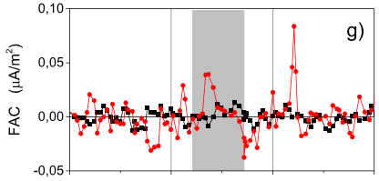
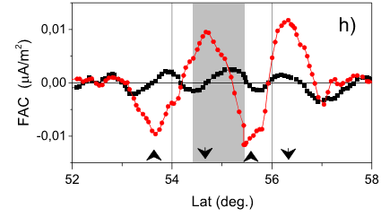
Field-aligned currents induced in the heated (gray‐shaded) region
The detrended BE_residual
FAC density (calculated as dB/dx)
The 21-point smoothed FAC
The induced FAC system consists of the downward current in the center of the heated region surrounded by the upward current.
The current density is ~0.02 μA/m².
The FAC flowing into (from) the ionosphere is denoted by black arrow pointed down (up).

Slide 11
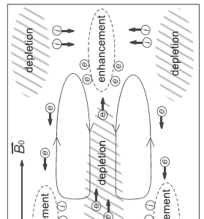
Interpretation of the satellite observations
A spreading of the artificial plasma irregularity is accompanied by excitation of the eddy electric current flowing along the magnetic field lines. In the center of the locally closed FAC system, the electrons flow away from the heated area, while the return flow channel is formed in the ambient plasma.
Applying this scheme to our observations, in the region of elevated Te and slightly depleted Ne, the current system consists of a (quasi)circular downward FAC surrounding by an upward FAC. The FAC system is likely closed within the perturbed magnetic flux tube, and the surrounding plasma is also involved.
The physical mechanism underlying the observed plasma disturbances accompanied by the generation of a local FAC system, is likely associated with the processes of a specific unipolar diffusion, in which the irregularities in collisional plasma can evolve much faster than in the classical ambipolar diffusion regime The possibility of the effects observed by SWARM was previously demonstrated in laboratory experiments (Aidakina et al., 2018).
Notes:
Амбиполярная диффузия определяется наиболее медленными частицами (ионами)
Электрическое поле, которое во всех направлениях тормозит более подвижные частицы (вдоль Η — электроны, поперек— ины) и уравнивает потоки в каждой точке, в общем случае не реализуется.При этом протекающие по плазме вихревые токи определяющим образом влияют на эволюцию профиля концентрации плазмы.
Протекание глобального тока сквозь неоднородность в этих условиях Приводит к ряду новых явлений — возмущение концентрации может двигаться и деформироваться, расщепляясь на отдельные сгустки плазмы; выравнивание концентрации при этом происходит значительно быстрее, чем безтока
Возникает вихревой ток, который переносится вдоль Η электронами, поперек — ионами и замыкается
Квазинейтральность обеспечивается за счет движения фоновой плазмы
В определенных местах образуются области обеднения. Вихревой ток приводит к уходу из них частиц плазмы.
В определенных местах образуются области обеднения. Вихревой ток приводит к уходу из них частиц плазмы.

Slide 12
Conclusion
A series of experiments were conducted with a conjunction between the SURA ionospheric heating facility and the SWARM satellites. We present the first observations made by SWARM on the plasma perturbations and electric currents induced in the F2 region ionosphere by the O‐mode radio wave pumping.
In the heated region, significant effects include a localized increase of the electron temperature accompanied by stratification of the electron density and the magnetic signatures of field‐aligned currents (FAC) of 0.01-0.02 μA/m2 densities. The upward FAC is confined within the central part of the artificially perturbed magnetic flux tube, while the return downward current flows through the ambient plasma adjoining to the boundary of the HF disturbed region. The spatial structure and amplitude of FACs indicate the current system is likely associated with the unipolar diffusion and excitation of eddy electric currents in the topside ionosphere. Similar effects are revealed in the laboratory experiment but not previously observed in space.

