Slide 1
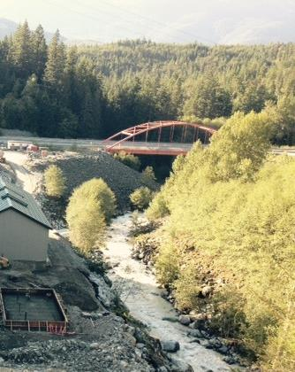
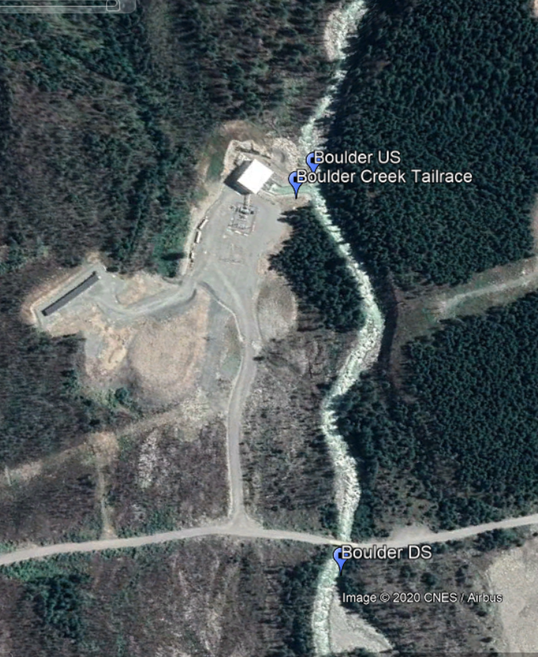
Water Quality Mixing Model for EFN: 2 Case Studies
Mixing Reach ~430m
Width ~10-20m
Mixing Reach ~190m
Width ~10-15m
Culliton CreekHydropower Project (Squamish, B.C. )
Boulder Creek Hydropower Project
(Pemberton, B.C.)
Gabe Sentlinger (Fathom Scientific Ltd)
©Fathom Scientific 2020

Slide 2
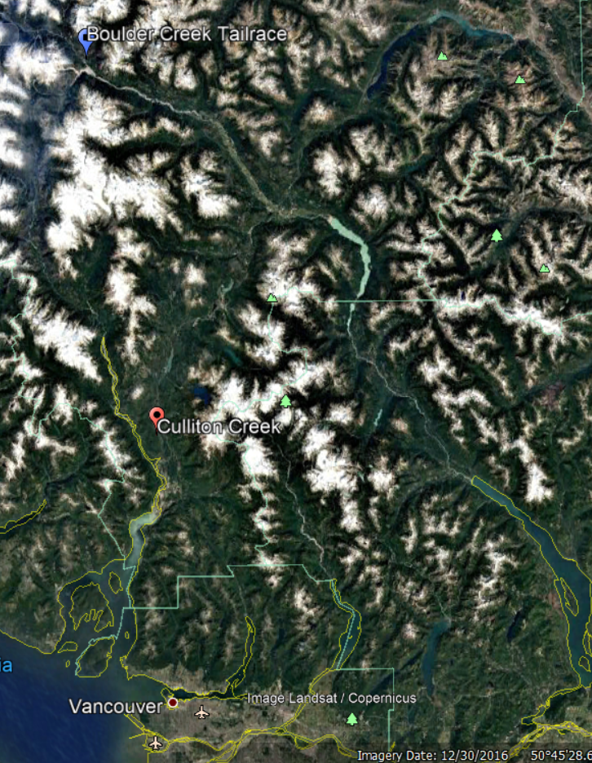
Both:
-have a run-of-river hydropower project on their lower reaches.
-Tailrace Q uncertainty generally +/-1%
-are very active waterways with hydraulic control that changes often.
-have Environmental Flow Needs (EFNs) in the water license that require a Grade A (<7% Uncertainty) or Grade B (<15% Uncertainty).
-are time consuming (expensive) to get to.
-difficult to measure in conventional ways.
Culliton Creek near Squamish B.C.
Boulder Creek near Pemberton B.C.

Slide 3
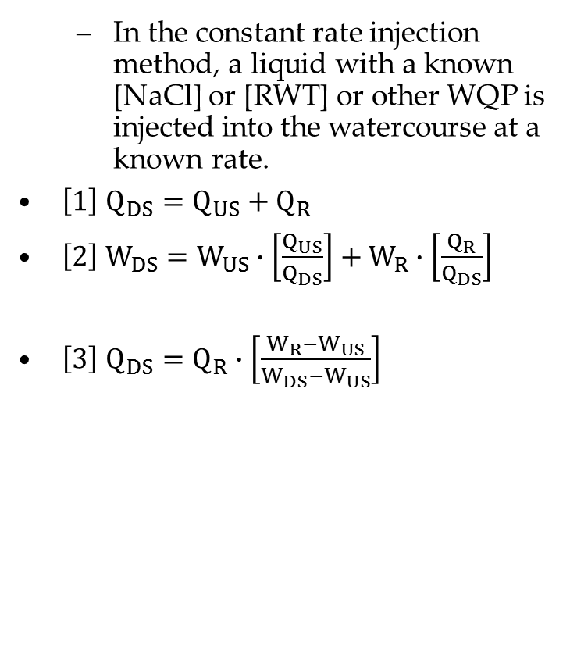
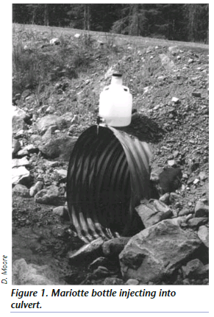
Constant Rate Tracer Method
Where DS is Downstream,
US is Upstream
R is Reference
W is Conservative Water Quality such as Temperature or Temperature Compensated Electrical Conductivity (ECT)

Slide 4
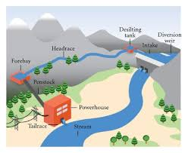

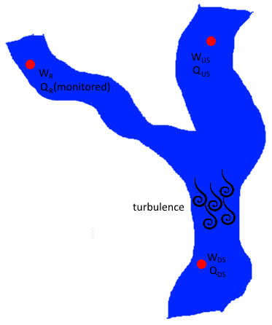
Constant Rate Tracer Method for Hydropower
=
-We can apply this same concept to a confluence of streams, where one input Q, Q_{R}, is known to a high accuracy AND inputs a significantly detectable amount of tracer.
-This is the case for a Hydropower project.

Slide 5
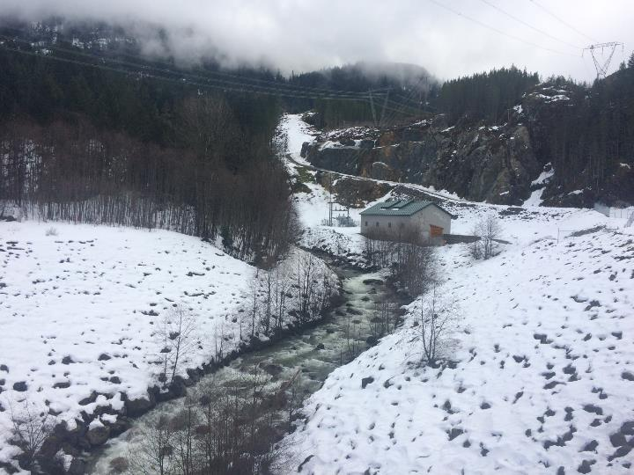
Culliton Creek Probe Locations: Looking Upstream
US PH Gauge
Tailrace Gauge
-In 2016-2017 we installed high accuracy-high resolution ECT and Temp gauges Upstream of the Powerhouse, in the Tailrace, and Downstream of the Powerhouse at Culliton Creek as a Proof of Concept experiment.

Slide 6
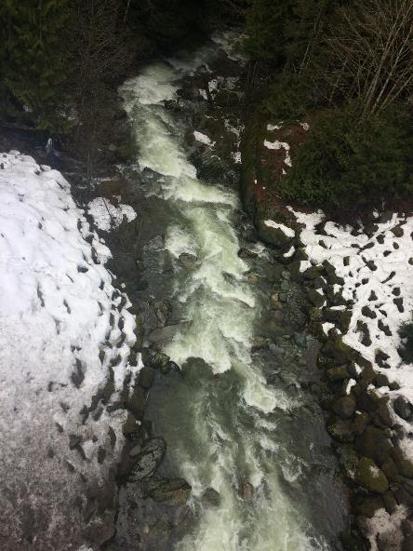
Culliton Creek Probe Locations: Looking Downstream
-DSPH gauge is downstream of mixing length and upstream of local inflow.
-It was very tricky to position the gauges to sample moving, non- aerated water free from any local influences.
-Avoid backeddies, subsurface inflow, pools, turbulence.
-Keep the mixing reach as short as possible.
-We also had the benefit of an active water level gauge with an active rating curve.
Small ditch inflow
Existing Active Water Level Gauge with Rating Curve
DS PH ECT Gauge

Slide 7
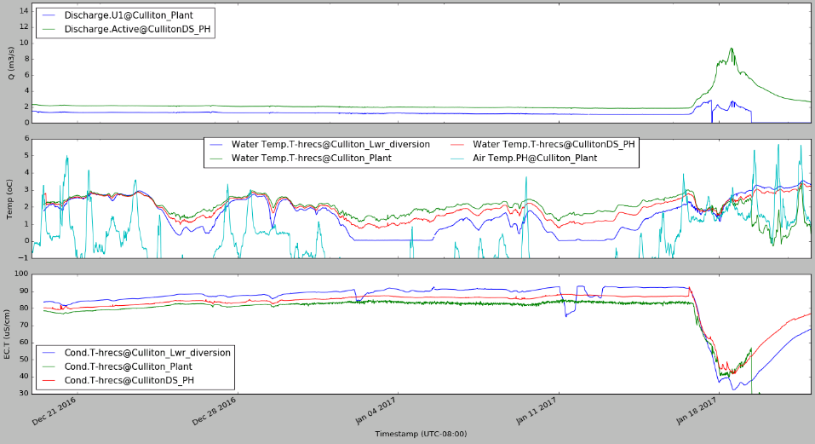
U1 shut off
US PH Gauge experiences freezing temperatures
Freezing affects EC.T
Storm causes dWQ = 0
Top figure compares the Tailrace Q to the Active DS PH Gauge.
Culliton Creek DSPH gauge temperatures and EC.T values in between the USPH and the Tailrace (Reference)

Slide 8
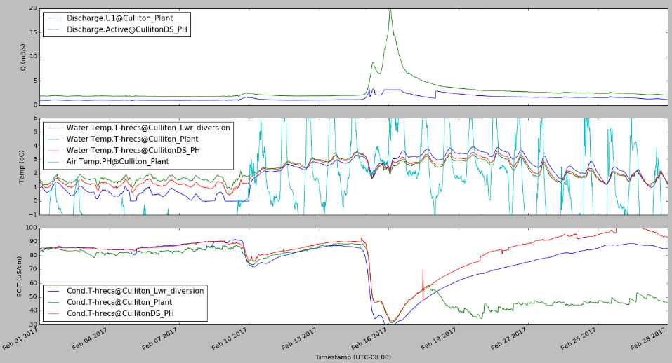
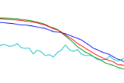
Air Temp >Water temp so USPH flips
Fouling by sediment, air entrainment cause all kinds of trouble for Tailrace EC
Culliton Creek DSPH gauge temperatures and EC.T values in between the USPH and the Tailrace (Reference)

Slide 9
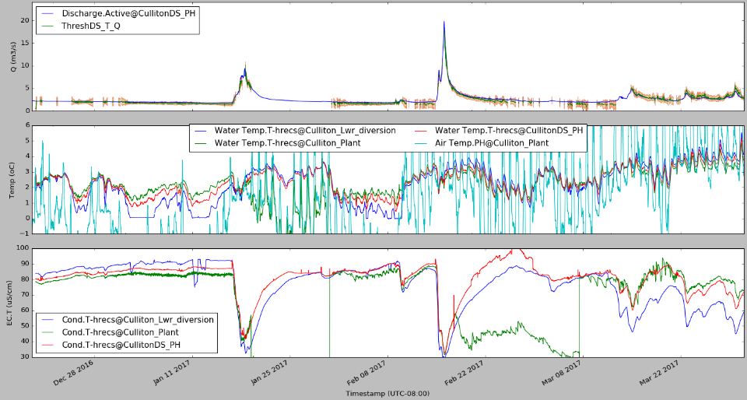
Peak event of 19 cms
-ThreshDS_T_Q is the Temperature Derived Q after a Delta T Threshold is applied.
-ECMM works in theory, but difficult to maintain required accuracy.
-TMM works very well with little maintenance.
-Using a min dT of 0.17ºC and min dEC.T of 1uS/cm. U1Q > 0 and US T > 0.2 ºC.
Results

Slide 10
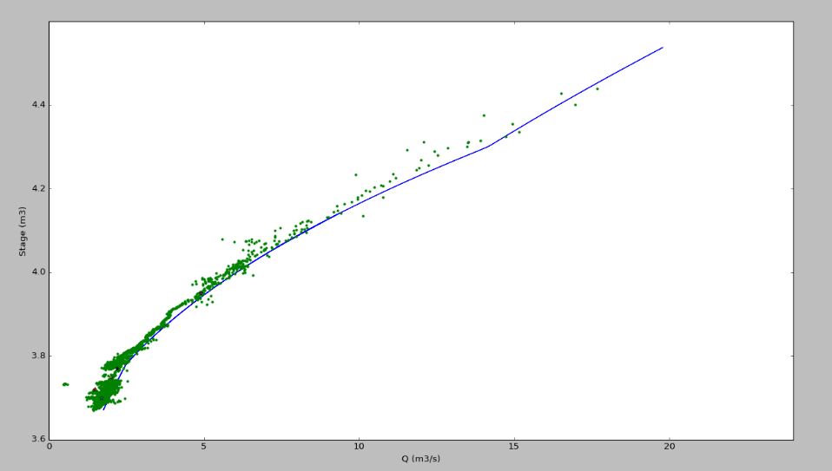
Manual measurements agree better with TMM
Existing RC probably overestimating low flows
-Blue is established RC.
-Evidence to support adjusting lower end of RC.
Results: Compared to Established RC

Slide 11
-RC retrained using manual measurements and TMM results.
- A histogram of dT vs %Error between new RC and TMM derived Q
-Error explodes below 0.2°C. 95% confidence for 7% error at 1.0°C.
-If the error is random, averaging n measurements could reduce error by 1/sqrt(n).
Results: Compared to RC

Slide 12
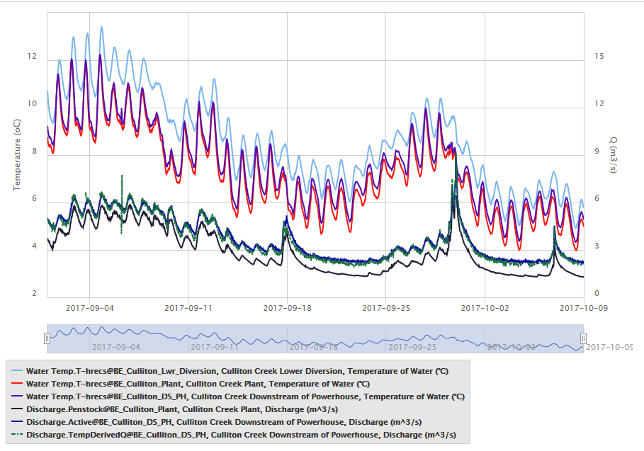
Culliton Creek Summary
-WQMM potentially powerful method to estimate Q continuously from known Q (PowerPlant) and Temp and/or EC.
-Currently best to use in conjunction with stage record to assist in RC derivation.
-Currently active as realtime report

Slide 13
-Not as much data at Boulder (installed Sep 3, 2019: last data Oct 27, 2019)
-Longer Mixing (430m vs 130m) meant more solar influx during summer (heating up to 0.1°C
-Needed to relocate Tailrace probe to avoid backeddy and subsurface inflow
-More remote location resulted in fewer visits
-Required accuracy of temperature probes: 0.04°C.
-Minimum DT 0.23°C. Minimum Tailrace Q 0.5cms.
Boulder Creek: Compared to RC

Slide 14
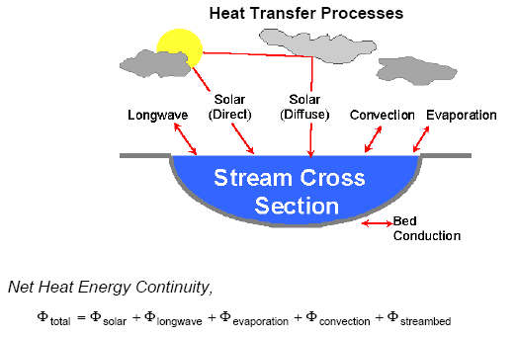

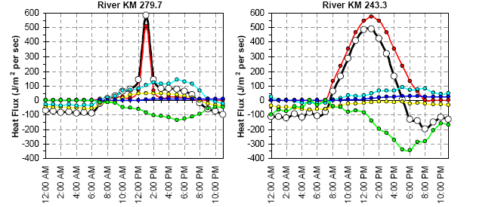
(From Boyd and Kasper 2003: Heat Source Model V0.7)
-Have not yet compensated for thermal flux.
-Largest components are likely Solar Radiation and Evaporation
Possible solution: Only consider inflection points (7am-8am)

Slide 15
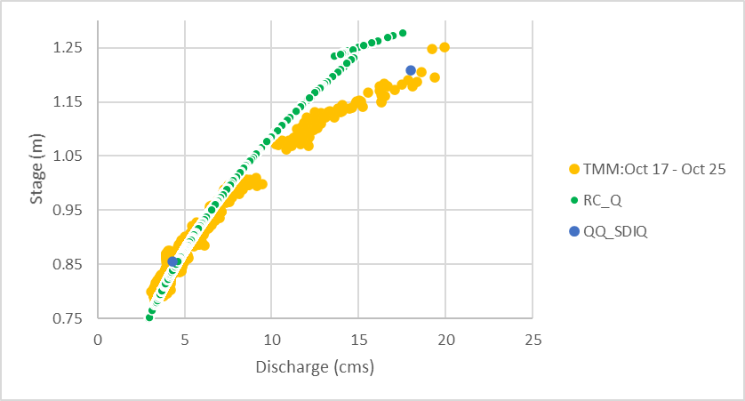
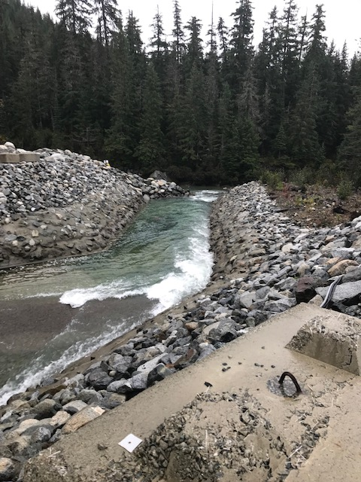
Initial Temp Probe Placement in backeddy at lower Tailrace Q and also subject to subsurface inflow
Moved it slightly DS
-Only 2 validation points for this site and period. Validation agreed with TMM (within uncertainty), however RC Q was not accurate.
-Current State: Trying to tie everything into Plant HMI-PLC to have alternate method of EFN Q.
Boulder Creek: Compared to RC

Slide 16
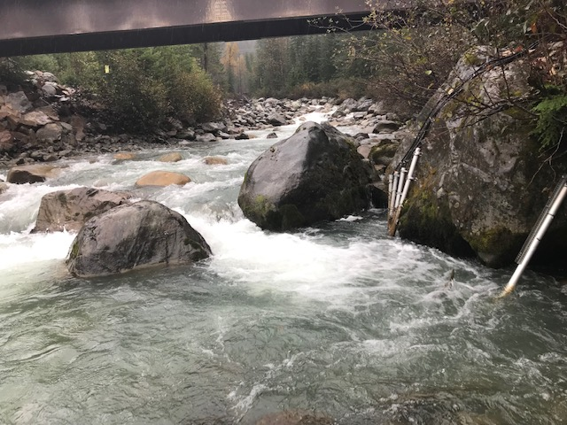
DS EC-T Probe Placement (no issues)
-Longer mixing reach resulted in warming of 0.1°C in September, beyond required accuracy of 0.04 °C. Results were best when air temp and stream temp closer (October).
-Many pitfalls in probe placement (subsurface flow, drying, freezing, backeddy)
-In theory, once probe placement sorted and temp probes calibrated to within 0.04°C, continuous Q based on dT and Tailrace Q.
-Build heat flux model to further reduce error.
Boulder Creek: Summary

Slide 17
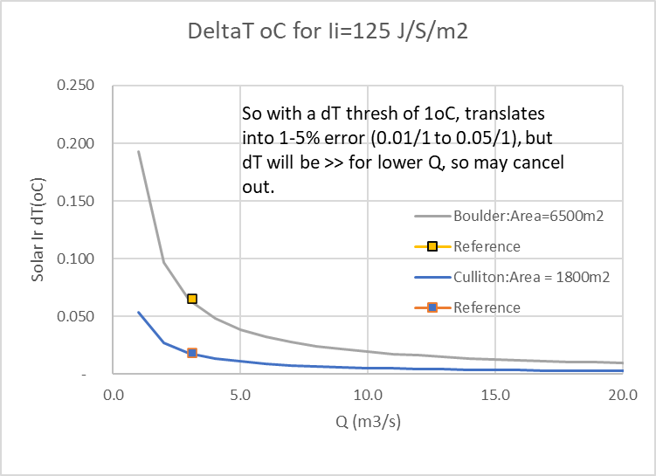
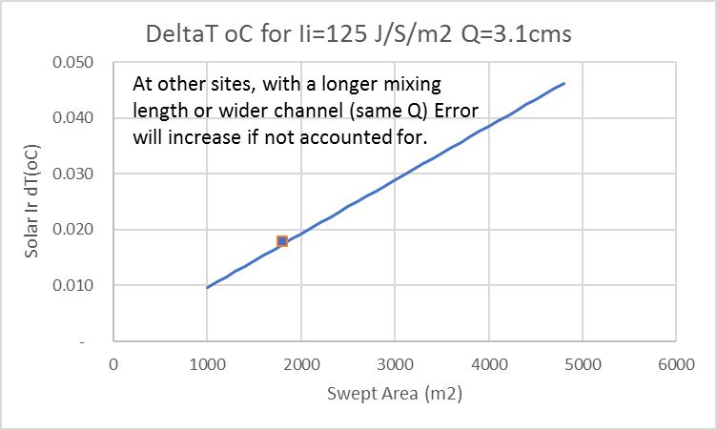

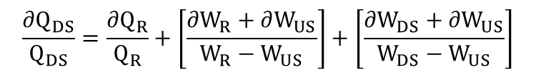
$$\frac{∂Q_{DS}}{Q_{DS}}=\frac{∂Q_{R}}{Q_{R}}+\left[\frac{∂W_{R}+∂W_{US}}{W_{R}−W_{US}}\right]+\left[\frac{∂W_{DS}+∂W_{US}}{W_{DS}−W_{US}}\right]$$
-If you assume the heating of the water column is just error, $∂W_{DS}$, then it’s a linear component of the error function
-Error of 1-5% based on daily averages, larger for instantaneous. But we also get a larger dT signal, so it’s a negative feedback loop (self-regulating).
The larger the Q, the lower the Ii error
The lower the Swept Area, the lower the Ii error
WQMM Uncertainty

Slide 18
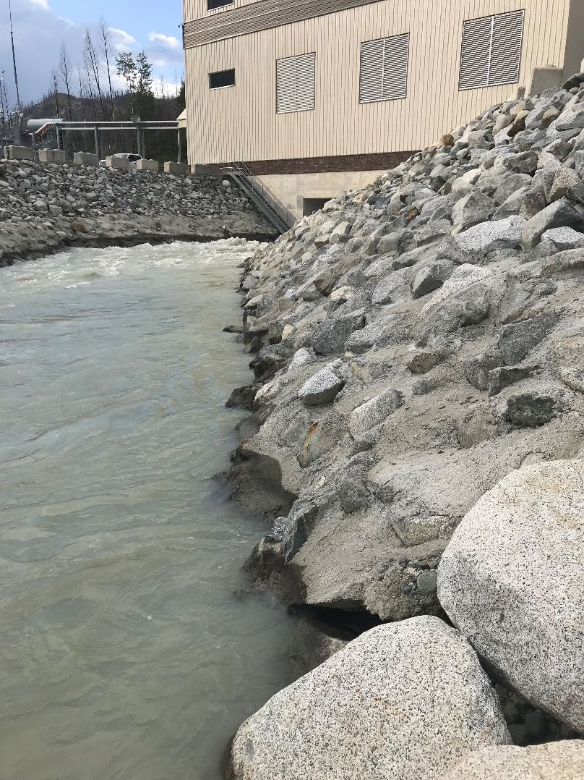
-Possible to use the Powerhouse as a very expensive flow meter.
-Requires high accuracy temp probes (~0.04 °C)
-Requires calibration of probes. Trying to achieve 0.02oC Accuracy.
-More studies required.
Thank you BluEarth Renewables and Innergex Renewable Energy Corp.
WQMM: Summary

