Slide 1

can we learn more from hydrologic tracer data?
Ciaran Harman
Johns Hopkins University

Slide 2

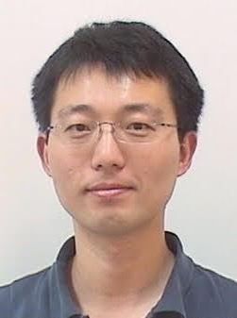

Acknowledgments
Esther Xu
Env. Health and Eng., JHU
graduate student
Fei Lu
Math, JHU
Mauro Maggioni
Math & Applied Math, JHU

Slide 3
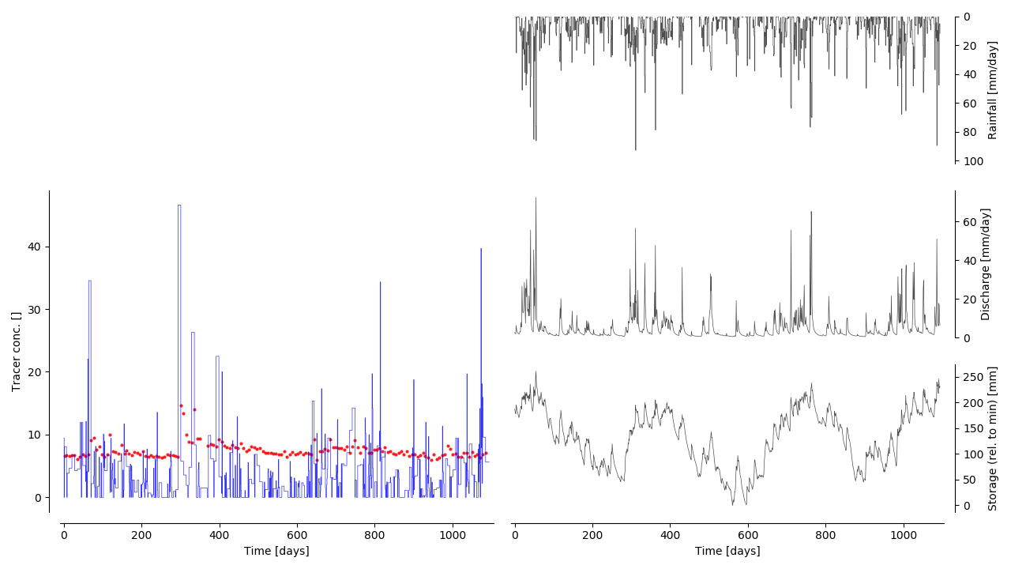
How do we learn from tracer
timeseries data?
Tracer is Chloride
Weekly bulk precip
Weekly stream samples
3 year subset (2002-2004)

Slide 4

Water input
Discharge
Transit time
distribution
StorAge Selection
(SAS) function
Overview of the concept of StorAge Selection (SAS)
Storage

Slide 5


Slide 6
What happens when a new storm event recharges the watershed?
?
?

Slide 7
‘Flowpath acceleration’
All flow paths increase proportionally

Slide 8
‘Flowpath activation’
All additional flow in new ‘fast’ pathways

Slide 9
‘Partial acceleration/activation’
New ‘fast’ pathways activated
Some ‘intermediate’ pathways accelerated
Old ‘slow’ pathways remain steady

Slide 10
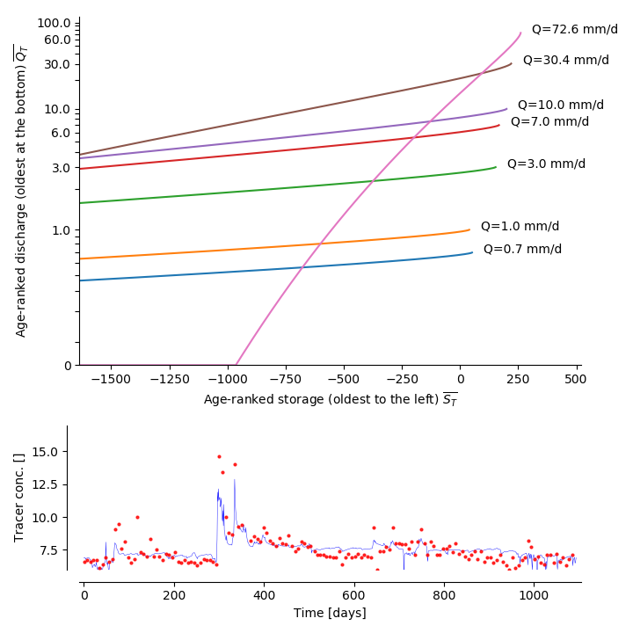
Hard to know what’s really happening because of a-priori structural assumptions
…much more
than here
Is suppression of
old water real?
Data probably
constrain here…
Harman (2015) assumptions:
SAS is a gamma distribution
with shape parameter coupled to discharge
Lots of structure in residuals
= information still on the table
β

Slide 11

What about statistical learning?
“In god we trust – all others must bring data”
  Let the data tell us what is the right model structure
  (and therefore something about system)
In mass balance we trust – all others must bring data
  Can this ‘philosophy’ wring more information from data…
  …without ‘contaminating’ it with process assumptions…
  …apart from conservation of mass?

Slide 12
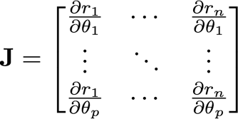
a DIY statistical learning method must:
Avoid underfitting
Allow many degrees of freedom so data can express itself
Avoid overfitting
Limit degrees of freedom so we’re not fitting to the noise
Learn fast
Computable solution for the Jacobian makes training fast

Slide 13
Can we maximize our ‘information extraction’ from data by optimizing model complexity?

Slide 14

MESAS
Multi-resolution Estimation of StorAge Selection

Slide 15
statistical learning of SAS functions
As a first step, let us assume:
We know nothing
  About the shape of the SAS function
Same ‘state’ + same ‘recent history’ = same SAS
  …where ‘state’ ~ spatial disAtribution of potential gradients driving flow
  Proxy timeseries (with temporal delays/averaging) correlate with state
    (e.g. storage, discharge, precip today, yesterday, over last month, etc)
Smooth-ish variation in state space
  The SAS function varies smoothly as the state varies (no jumps in state space)

Slide 16
Use multi-resolution manifold learning to get recursively refined approximations of the SAS function
Approximate SAS as a single linear segment.
Train segment end-points to minimize tracer RMSE
Subdivide segment
(adds 1 new end point).
Train all segment end-points to minimize RMSE
Compare 1&2 to decide whether this subdivision has added information
If so, subdivide one of the new segments and repeat.
Otherwise move on

Slide 17
Use multi-resolution manifold learning to get recursively refined approximations of the SAS function
Approximate SAS as a single linear segment.
Train segment end-points to minimize tracer RMSE
Subdivide segment
(adds 1 new end point).
Train all segment end-points to minimize RMSE
Compare 1&2 to decide whether this subdivision has added information
If so, subdivide one of the new segments and repeat.
Otherwise move on

Slide 18
Use multi-resolution manifold learning to get recursively refined approximations of the SAS function
Approximate SAS as a single linear segment.
Train segment end-points to minimize tracer RMSE
Subdivide segment
(adds 1 new end point).
Train all segment end-points to minimize RMSE
Compare 1&2 to decide whether this subdivision has added information
If so, subdivide one of the new segments and repeat.
Otherwise move on

Slide 19
Use multi-resolution manifold learning to get recursively refined approximations of the SAS function
Approximate SAS as a single linear segment.
Train segment end-points to minimize tracer RMSE
Subdivide segment
(adds 1 new end point).
Train all segment end-points to minimize RMSE
Compare 1&2 to decide whether this subdivision has added information
If so, subdivide one of the new segments and repeat.
Otherwise move on

Slide 20
Use multi-resolution manifold learning to get recursively refined approximations of the SAS function
Approximate SAS as a single linear segment.
Train segment end-points to minimize tracer RMSE
Subdivide segment
(adds 1 new end point).
Train all segment end-points to minimize RMSE
Compare 1&2 to decide whether this subdivision has added information
If so, subdivide one of the new segments and repeat.
Otherwise move on

Slide 21
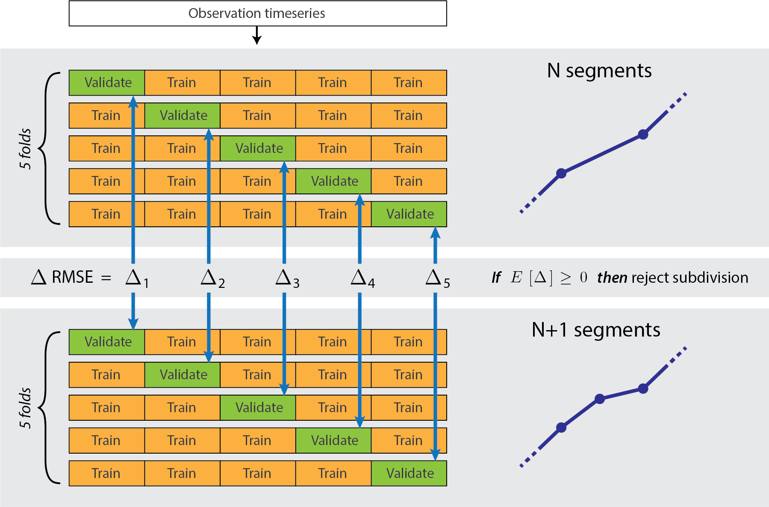
Use k-fold cross validation to accept/reject subdivisions
Minimum validation error
=
Maximum information extraction

Slide 22
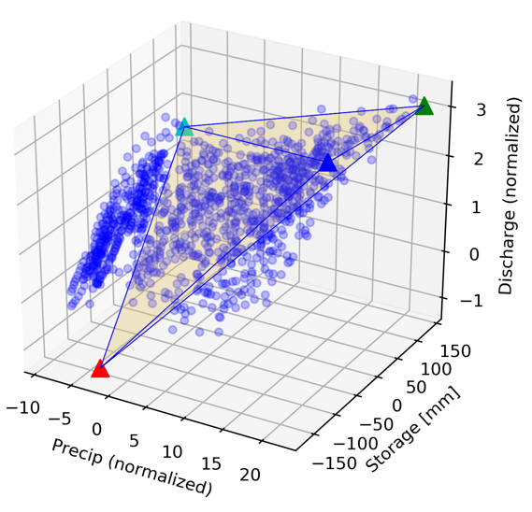
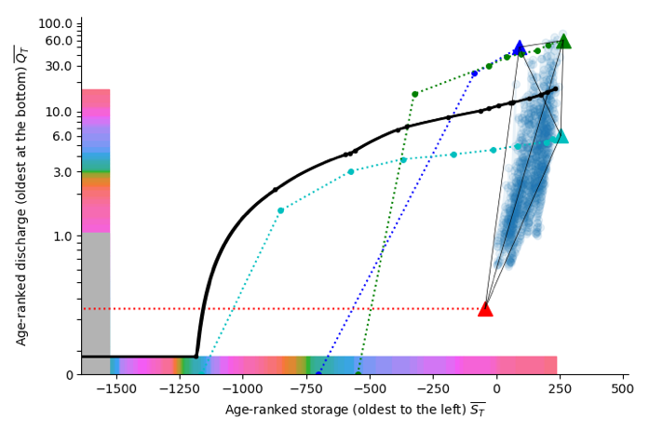
interpolate SAS functions in state space between extremal end-member ‘states’
Efficiently choose end-members using ML
An N-dimensional state can be approx. expressed as a weighted average of N+1 end-members (rather than N²)
…is weighted average of SAS for each end-member
SAS function at each timestep…
Choose end-members efficiently using Convex Hull Non-Negative Matrix Factorization

Slide 23
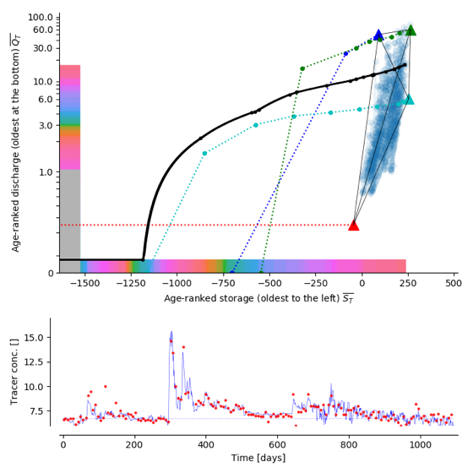


Use Jacobian to train/validate fast
Jacobian
Change in residual r_{i}
with respect to parameter θ_{j}
Jacobian for piecewise-linear SAS:

Slide 24
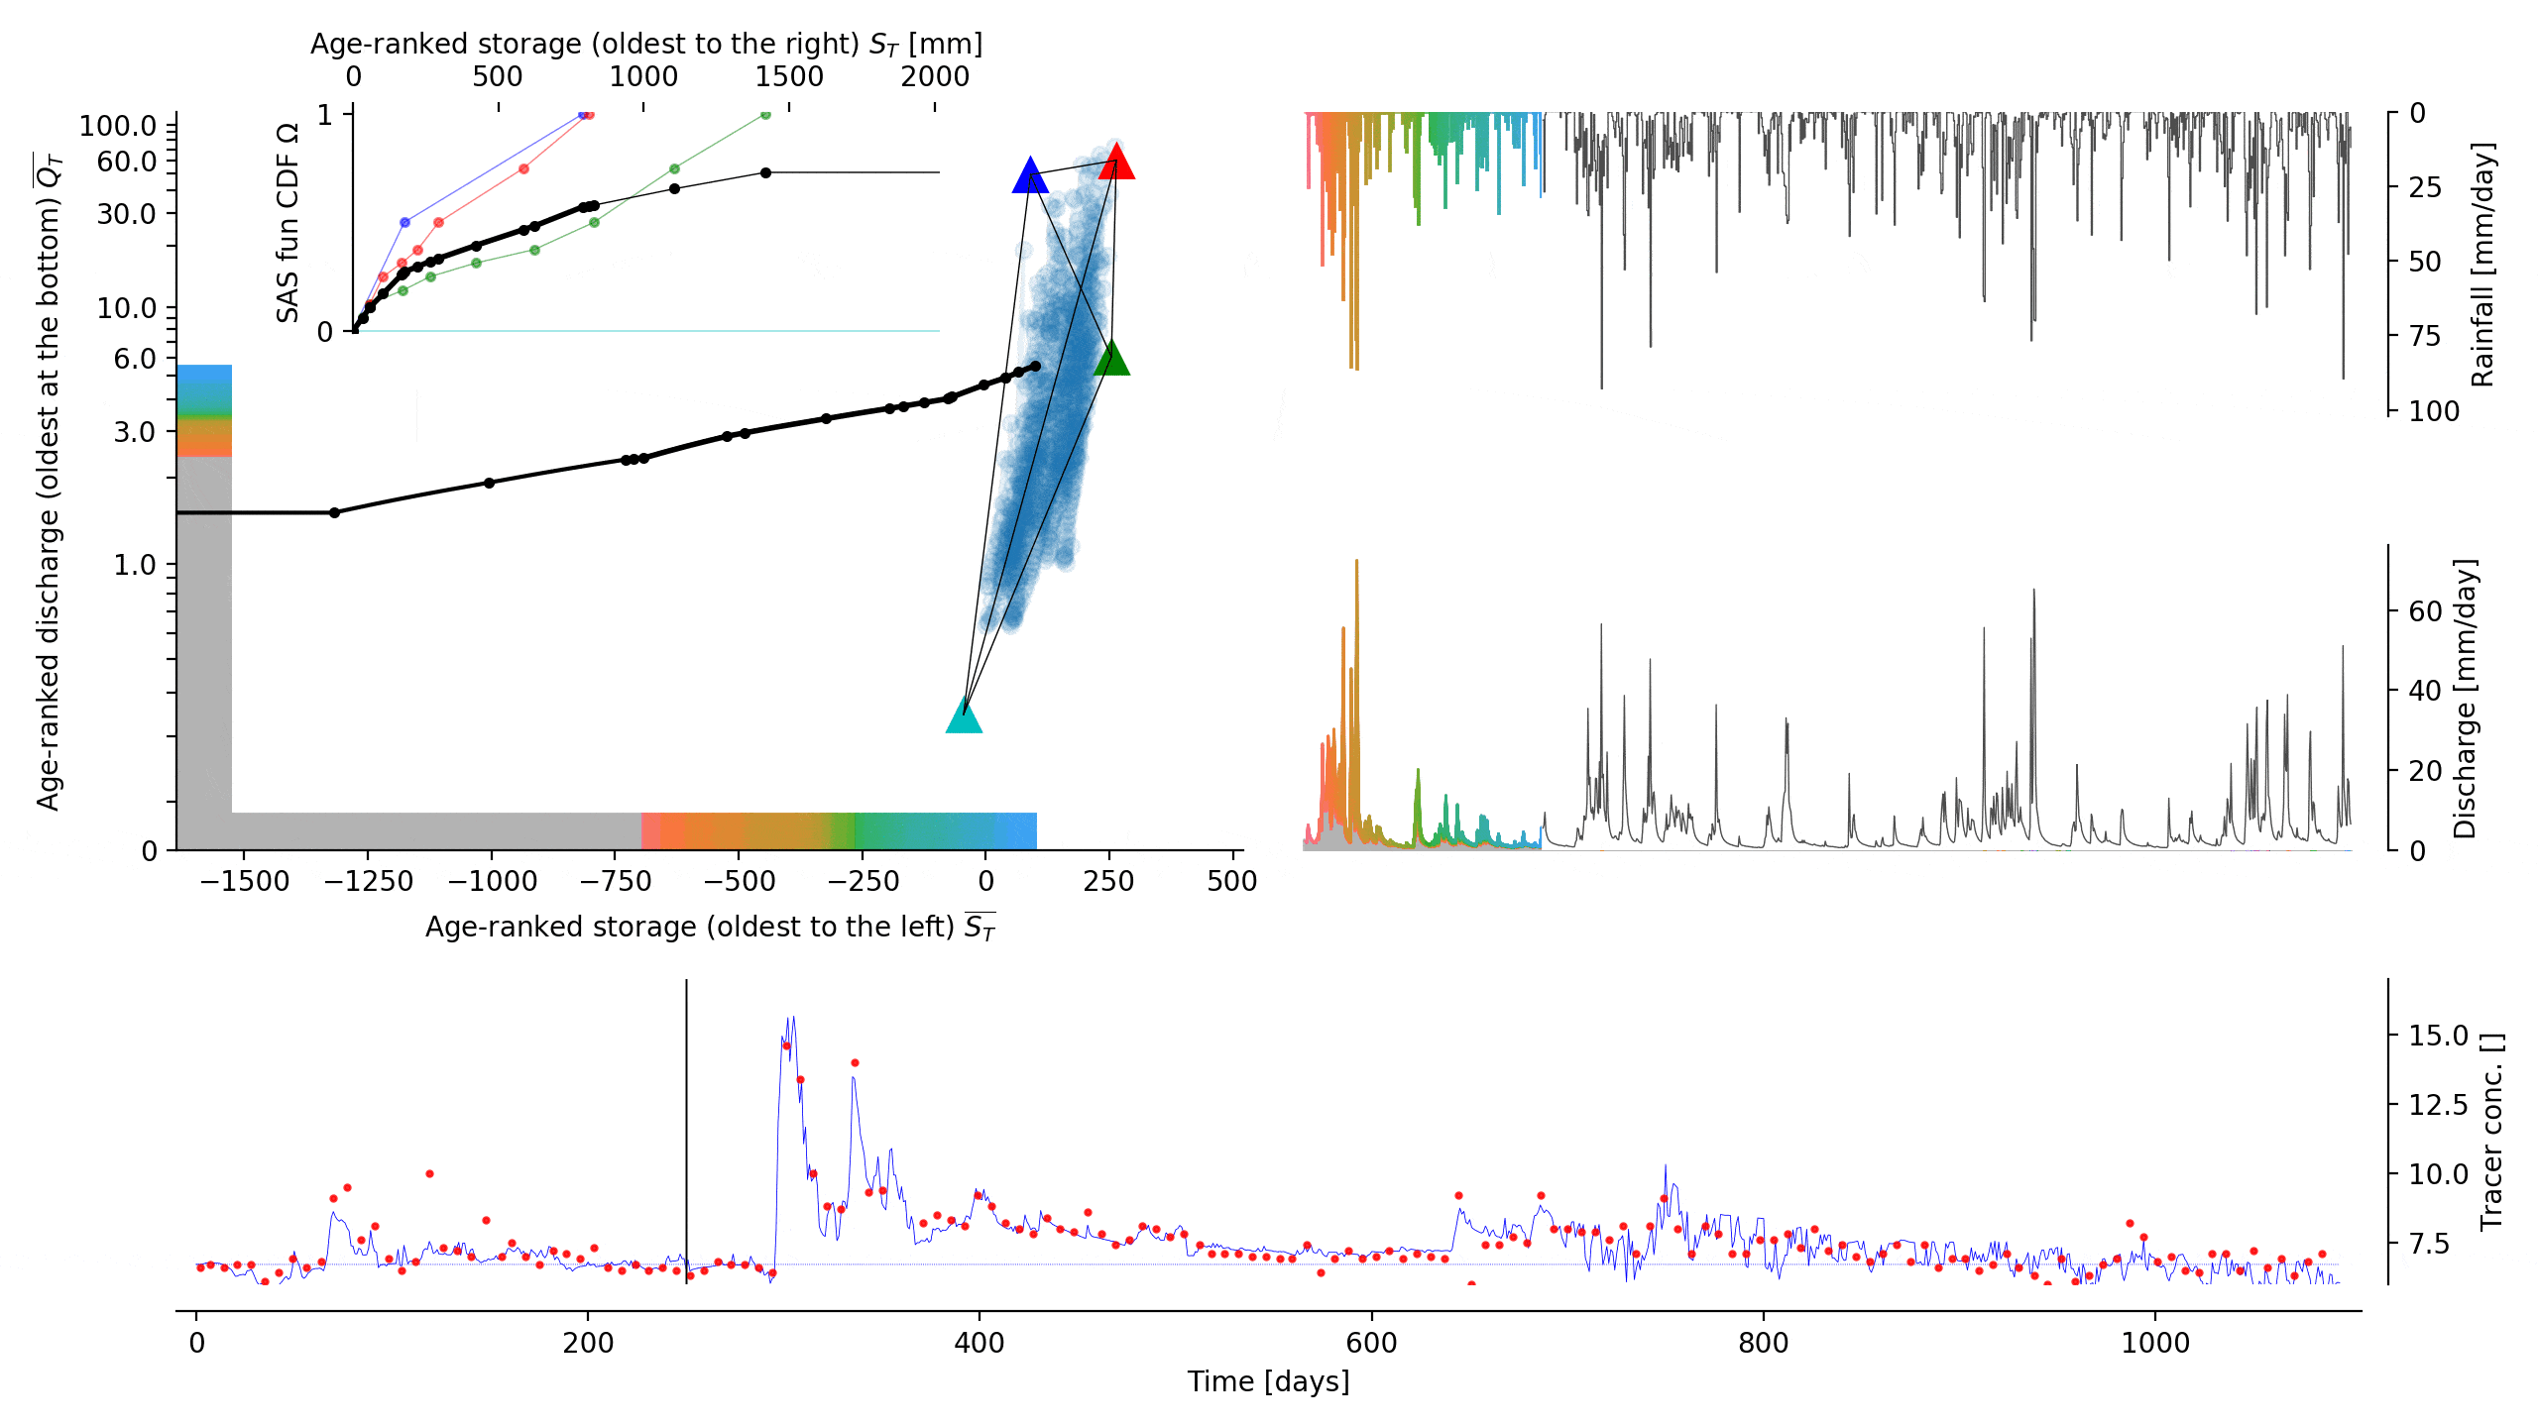

Slide 25
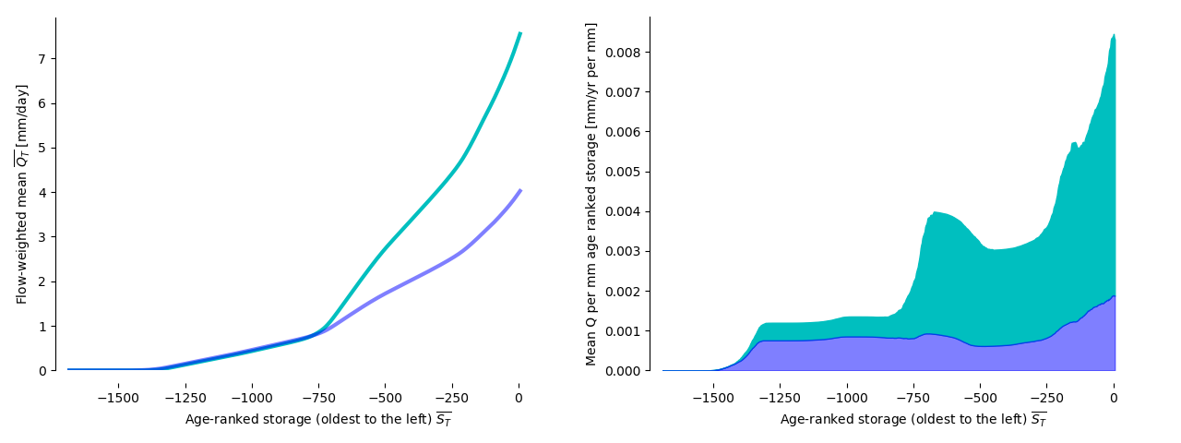
we Find Clear ranges of both steadiness and activation
Is this real?
Stay tuned…
Total from
high rainfall periods
Average from
high rainfall periods
Flow-weighted average
Total from other periods

Slide 26
Also find an unexpected bimodal distribution of discharge per age-rank
Is this real?
Stay tuned…
Total from
high rainfall periods
Average from
high rainfall periods
Flow-weighted average
Total from other periods

Slide 27
Wrap-up
What MESAS means for you
  You no longer have to make decisions about SAS function shape or state dependence
To do
  Refine accept/reject criteria
  Add uncertainty estimation
Available for beta-testing later this year
  Will be easy to install using conda
  Or access through CUAHSI JupyterHub

