Slide 1
Analysis of 60-y record of surface ¹³⁷Cs concentrations in the global ocean
Yayoi Inomata¹, Michio Aoyama²
(1) Kanazawa University, (2) University of Tsukuba

Slide 2
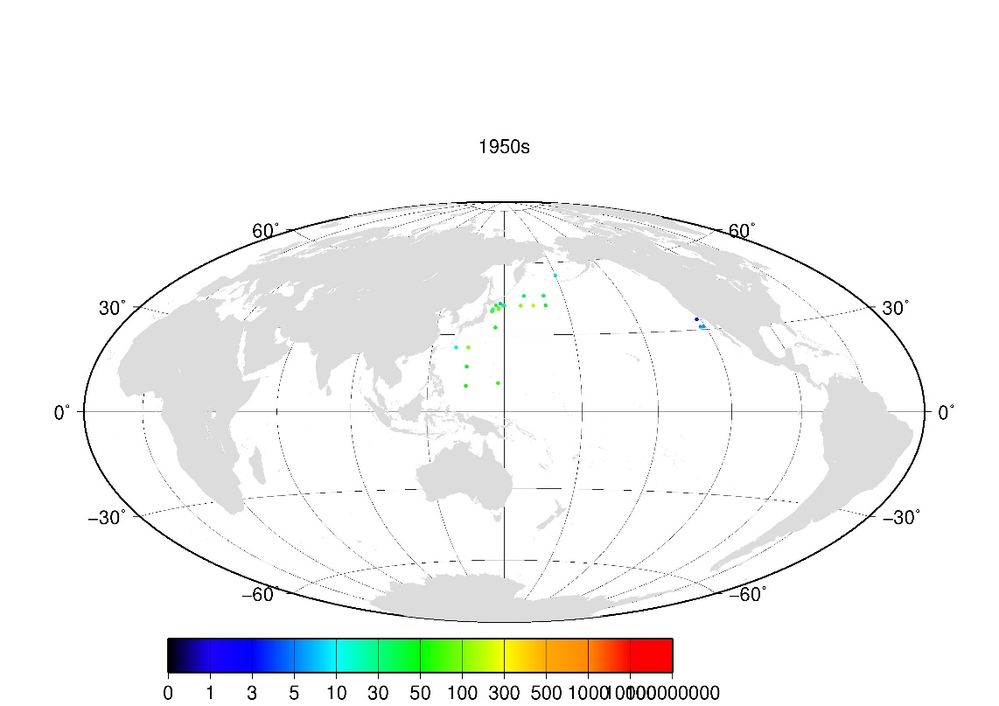
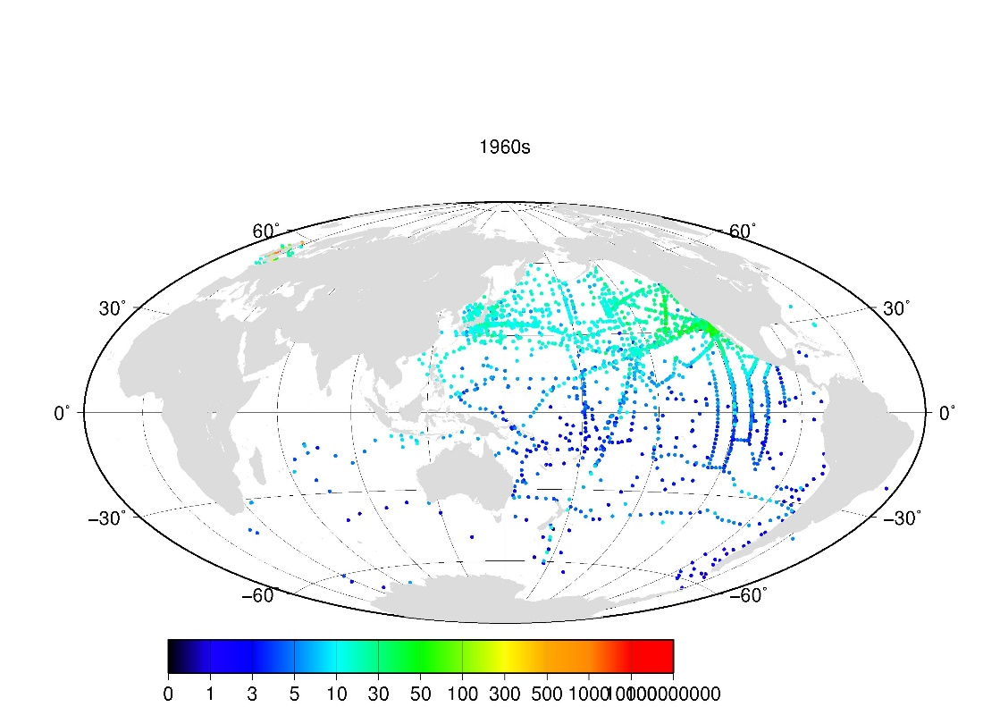
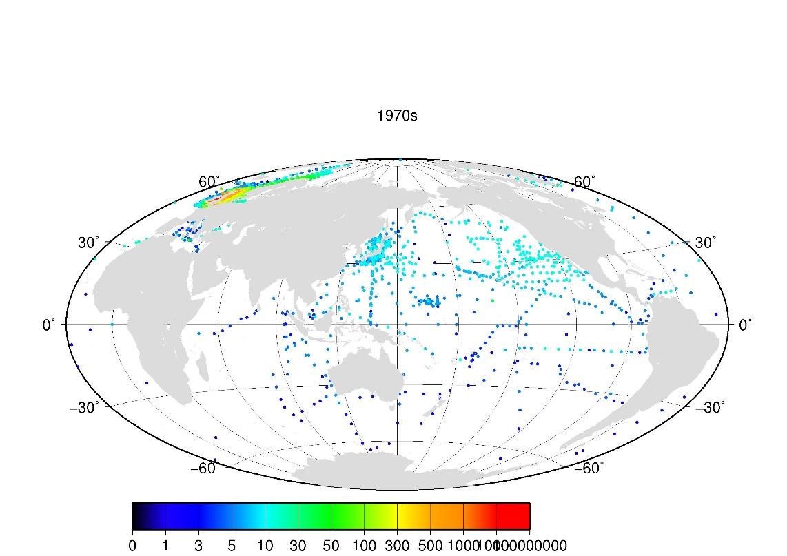
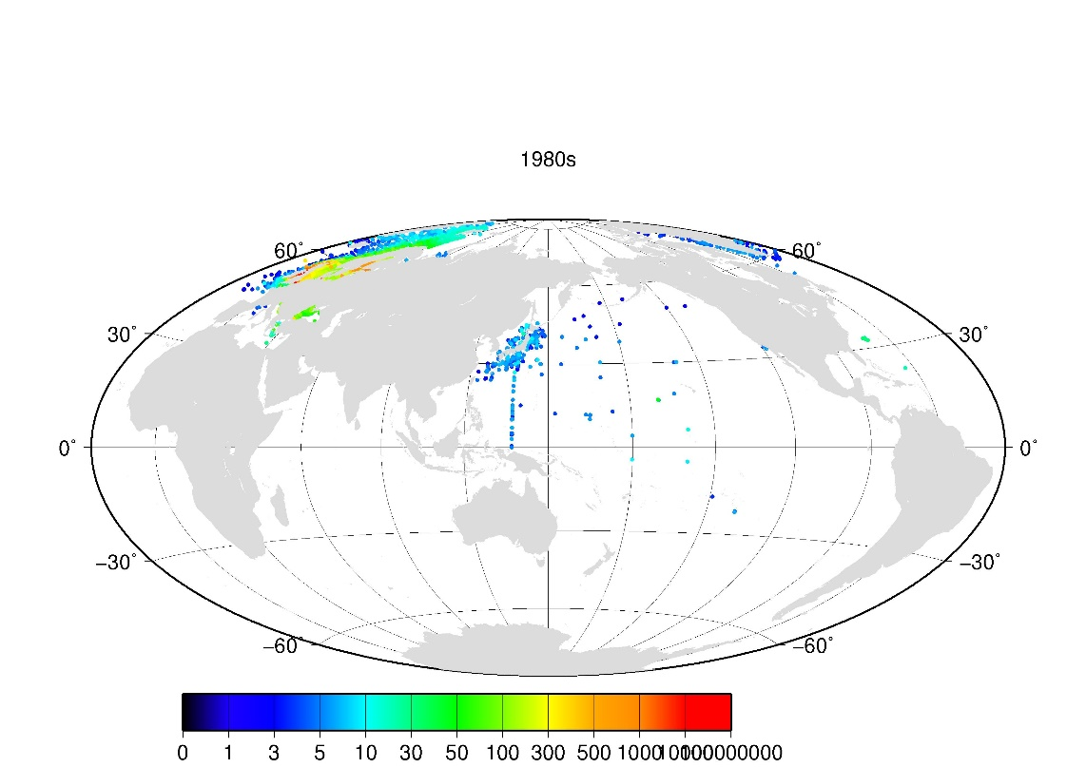
Distribution of ¹³⁷Cs concentrations in the surface seawater
in the global ocean

Slide 3
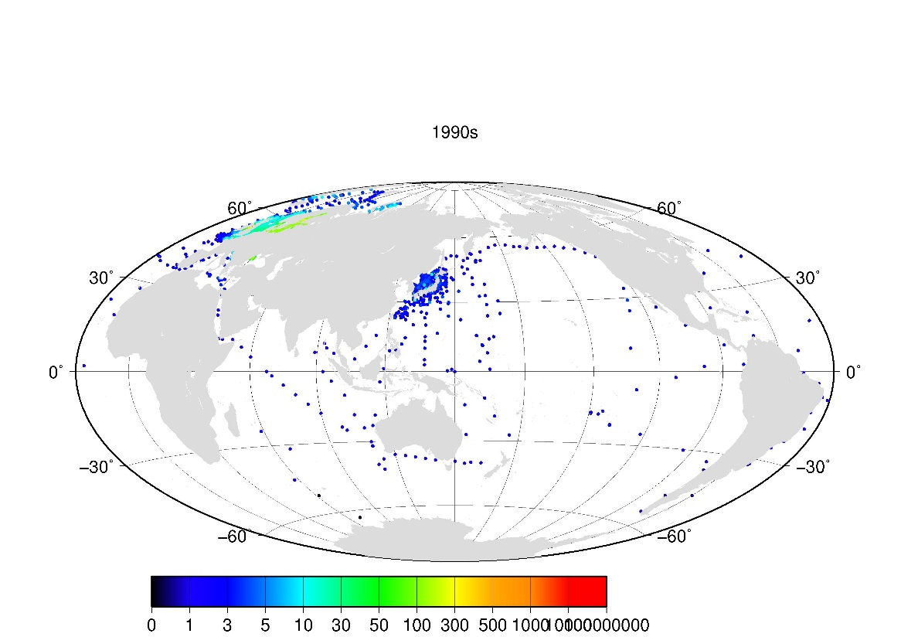
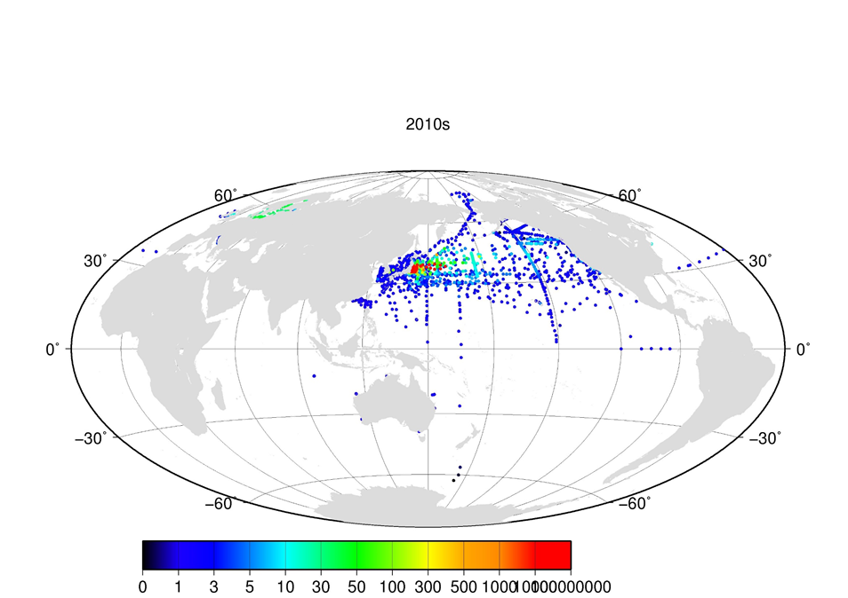
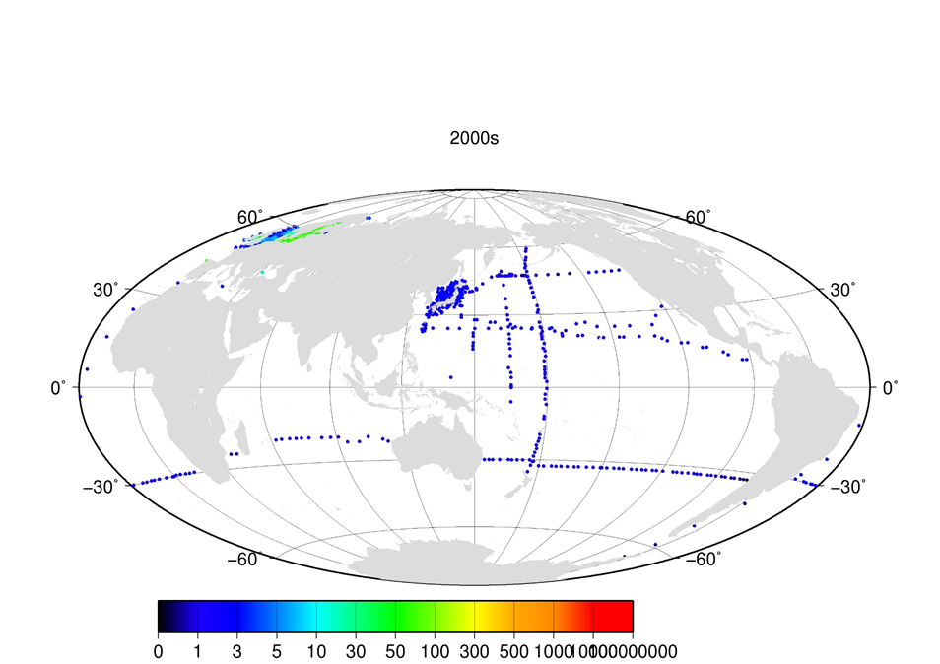
Distribution of ¹³⁷Cs concentrations in the surface seawater
in the global ocean

Slide 4
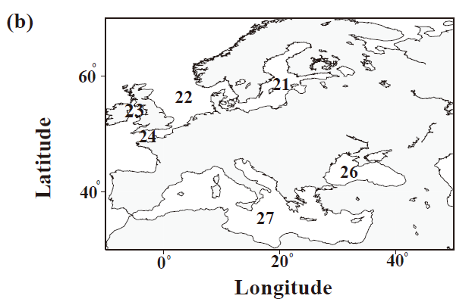
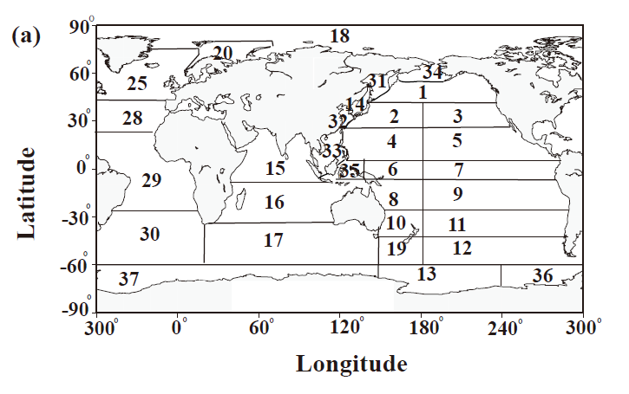
Boxes in the global Ocean

Slide 5
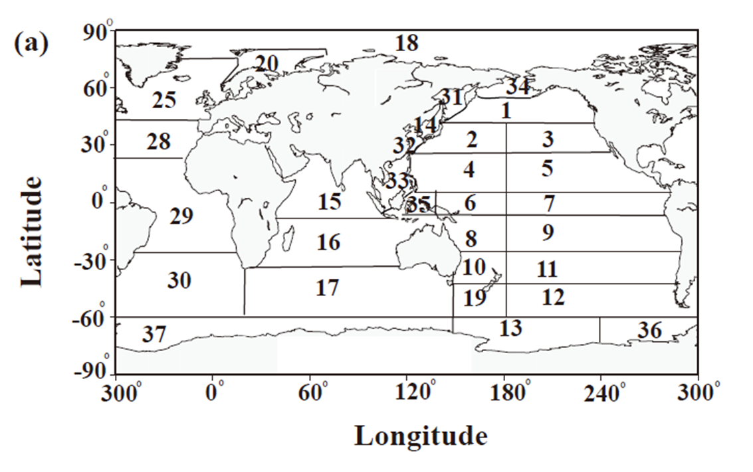
Comparison of ¹³⁷Cs (Grid value) in the North Pacific Ocean
Box 1-3

Slide 6
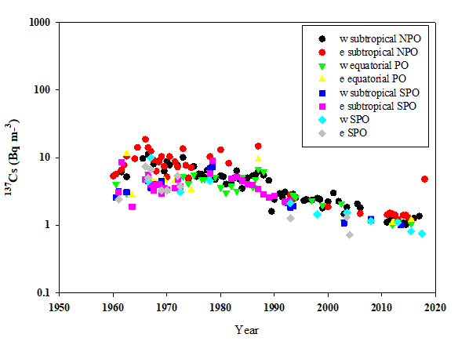
Grid value in the Pacific Ocean
Box 4-11

Slide 7
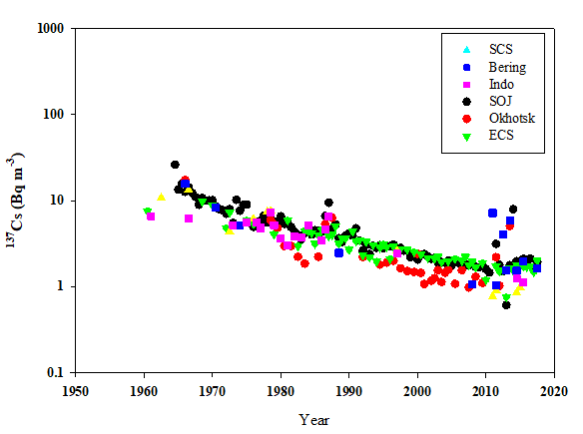
Grid value in the marginal sea of the North Pacific Ocean
Box 14,31-35

Slide 8
Grid value in the Indian Ocean
Box 15,16,17

Slide 9
Grid Value in the Antacric Ocean
Box 13,36,37

Slide 10
Average ¹³⁷Cs concentrations in the global Ocean
N.Pacific
Marginal Sea
Atlantic
BLAS, MED
S.Pacific
N.Pacific
Marginal Sea
Atlantic
N.Pacific
Antarctic
Indian Ocean
England, French
BLAS, MED
S.Pacific
N.Pacific
Antarctic
Indian Ocean
England, French

Slide 11
Conclusions
60years record of ¹³⁷Cs concentrations in the global ocean by global database were analyzed.
In the western North Pacific Ocean, ¹³⁷Cs concentrations were exponentially decreased after 1970, and the decreasing rate became to be slow or almost constant in the 1990s.
After 2012, re-circulation of ¹³⁷Cs concentrations were observed in the marginal seas in the North Pacific Ocean.
The average ¹³⁷Cs concentrations in the global ocean were ranged from 1 to 716 Bq/m³, and those were decreased to 0.2-28 Bq/m³ in the year of 2010.

