Slide 1
An implicit, physical water percolation model
Willem Jan van de Berg

Slide 2
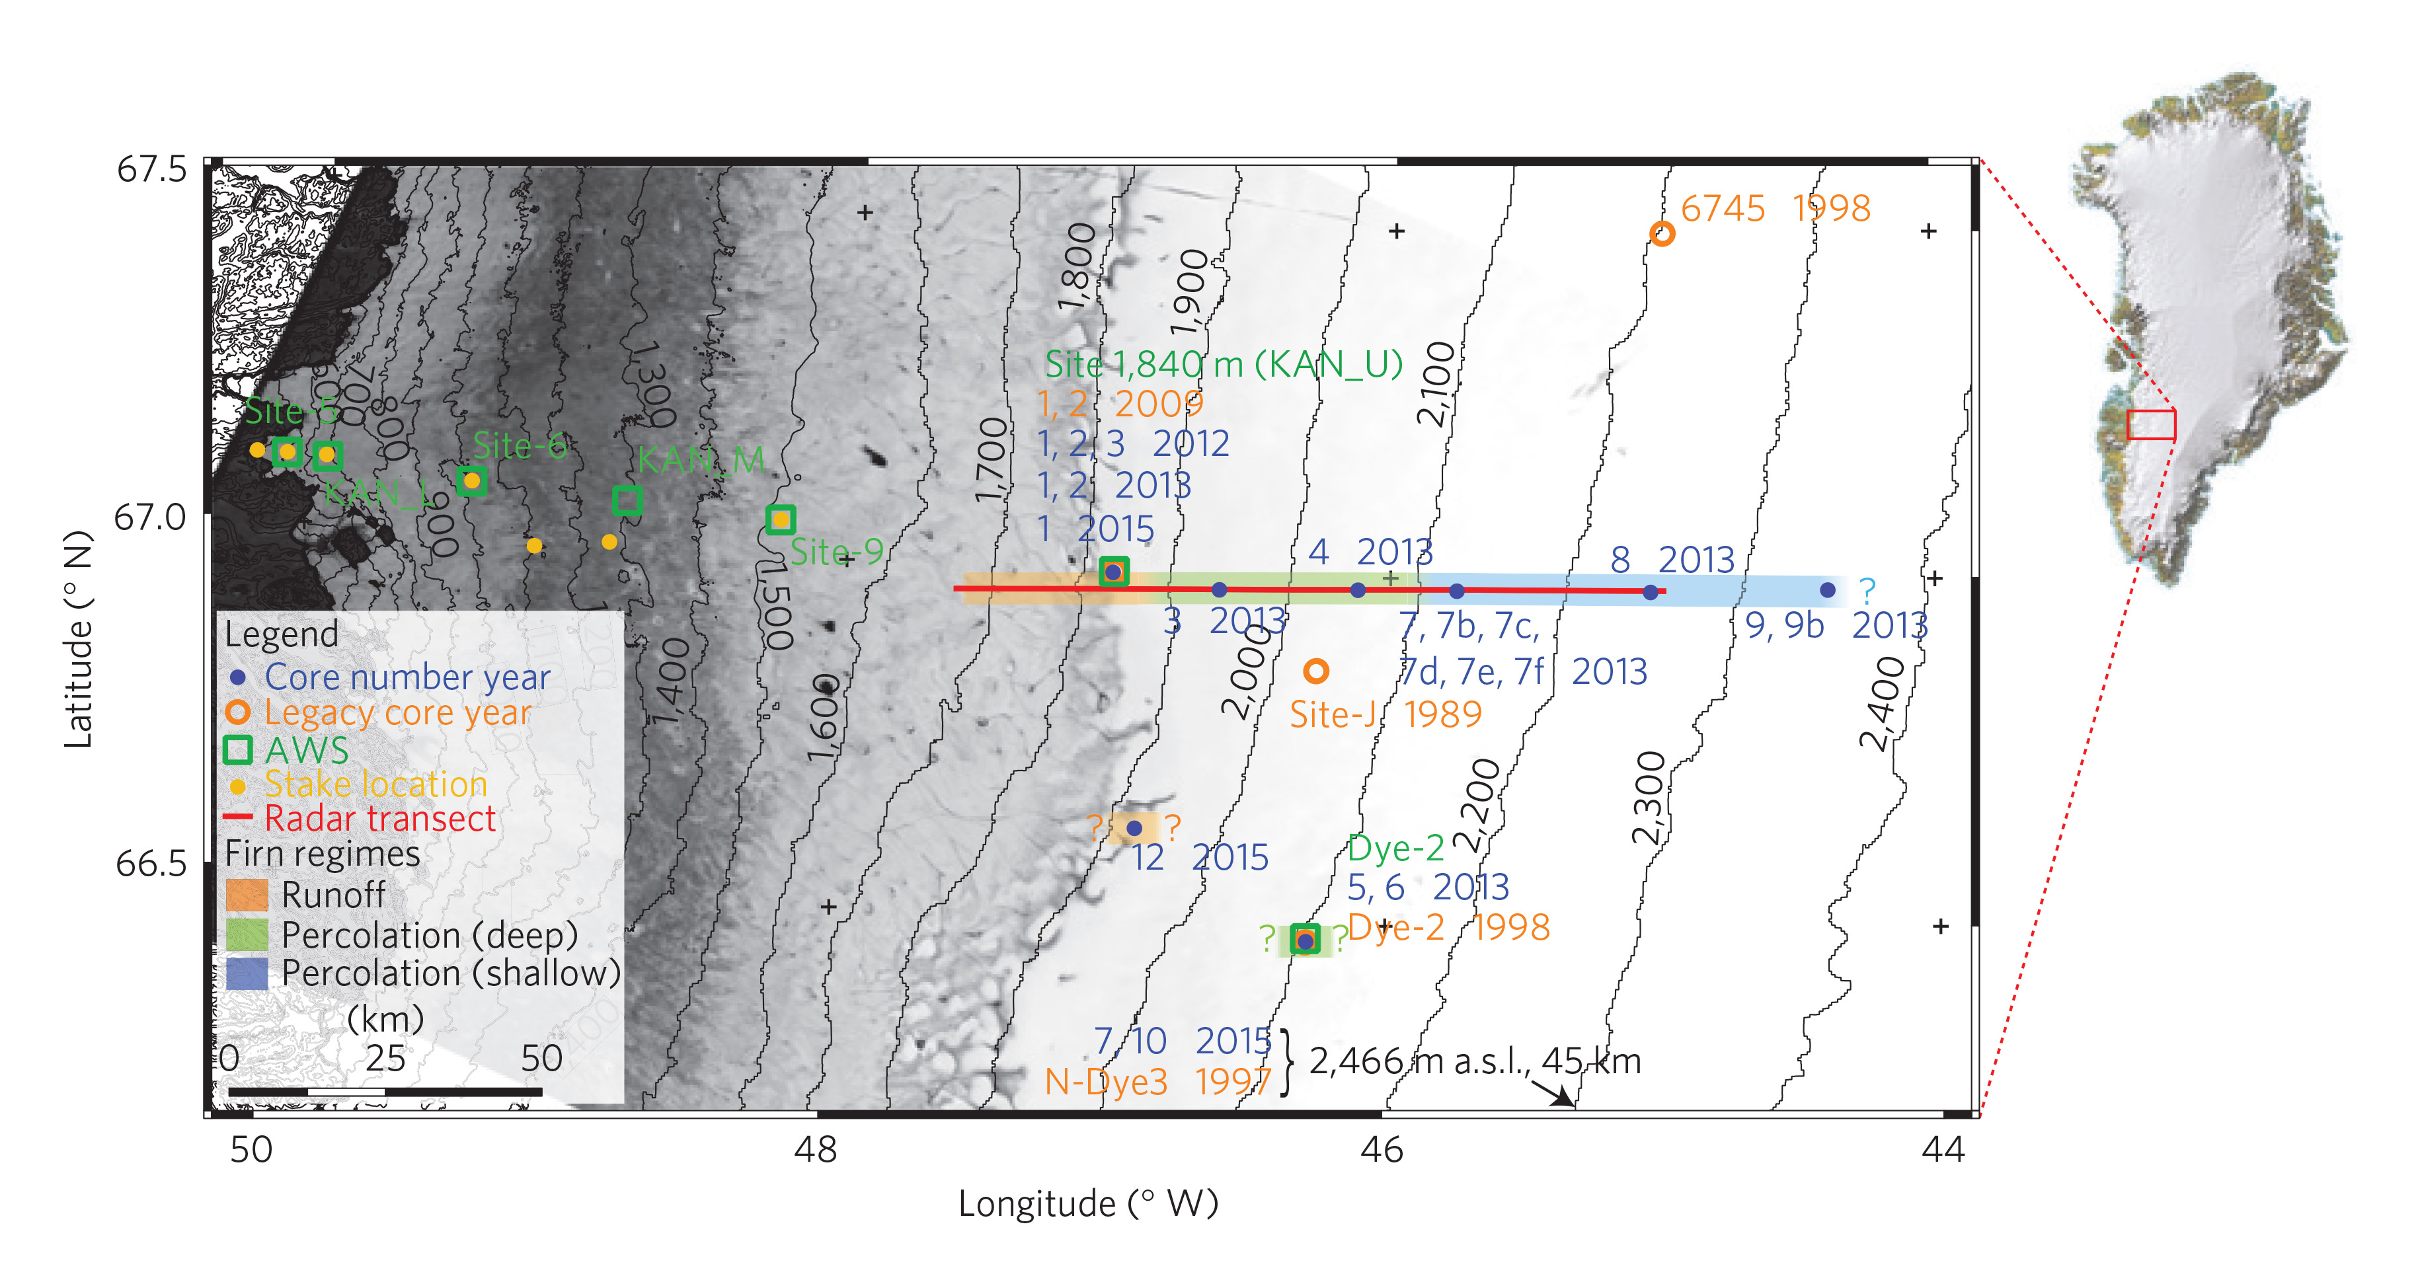
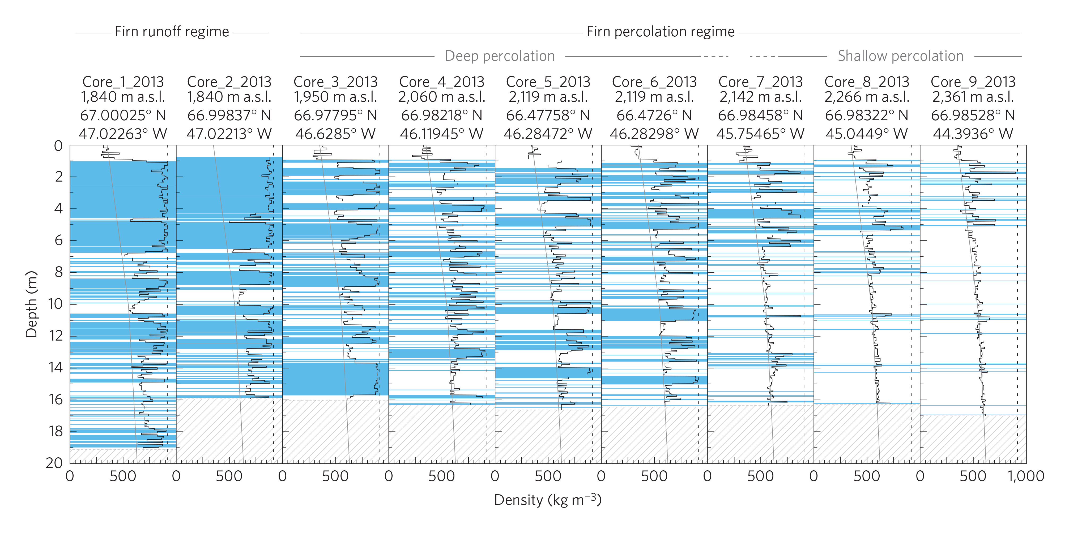
Motivation: Impermeable ice lenses change the SMB of the Greenland Ice Sheet
Widespread ice lenses cause surface runoff and limit refreezing
Impact on integrated MB may be limited now.
However may become significant under sustained warming
The figures show that recent warming caused formation of widespread ice lenses in the lower percolation zone
Figures from Machguth and others, Nature Climate Change, 2016

Slide 3
Background: How does an ice lens form?
Refreezing increases density
Reduces permeability
Water percolation
Latent heat advection
Negative feedback:
Melt water front moves down
Melt water front
Melt water flux diminishes
Heat flux diminishes
Heat conduction
Energy removal
Positive feedback:
Ice lens is created
Underlaying snow heats up

Slide 4
Background: Two types of models and their physics
Bucket method models
Richards Equation models
Layer can retain a certain amount of water, rest percolates down
Simple and fast
Flow governed by pressure differences
Gravity force
Capillary force
Unsaturated snow
Pressure head
All pores filled
Permeability limits flux
Dual domain approach
Separate treatment matrix & preferential flow

Slide 5
Background: Why construct a new model?
Bucket method models
Richards Equation models
Effect of limiting permeability on water flow not included
Solution:
Parameterize ice lenses and piping
Computationally demanding
To local oriented
Solution:
Start from scratch with a 100 km² patch of snow in mind
We opted for this

Slide 6
Model: Intentions and subsequent choices
Stable for 2-10 minute timesteps -> Implicit time stepping
Stable for all realistic cases -> Bullet proof troubleshooting
Representative for $\sim$100 km² grid box -> Only thick (multimeter) ice slabs impermeable
Implicit time stepping -> Continuous differentiable relations of water content and water flux (or at least as few jumps as possible)
-> Single domain but fractional wet layer
-> Adjust relations for permeability, capillary pressure and irreducible water content (IWC) near limits (e.g. firn reaches ice density, dry snow, soaked snow)

Slide 7
Prognostic variable: Fractional wet layer
Water content ($ρ_{w}$)
Firn mass
Pore space
Concept:
${ρ_{w}}/{f≥}IWC$, so wet spots of snow always fulfil IWC requirement
So for any $ρ_{w}$, there is a maximum wet fraction, to obey the above, and a minimum fraction, in order to let water spread horizontally
Sketch:
Representation of the relation of $f$ to $ρ_{w}$ once water starts filling the pores.
Maximum fraction:
No more water can be extracted by water flow
Only removal by refreezing (light blue region) -> water fraction decreases
Minimum fraction
IF more water added (in light green region) -> water fraction increases
Curve is 2nd order polynomial
For $ρ_{w}\sim 0$: $f≥0.8{ρ_{w}}/{IWC}$
Smooth transition for $f=1$
1
0
Maximum fraction
Dry
Irreducible water content (IWC)
Wetted fraction ($f$)

Slide 8
Numerical set-up: Newton method to converge implicit system
Approach during a timestep:
We have an initial state of $ρ_{w}$ ($ρ_{i}$) an estimated final state of $ρ_{w}$ ($ρ_{e}$)
Calculate
the inter-layer water flux for $ρ_{e}$: ${\vec{q}}_{e}$
the derivative of $\vec{q}$ to $ρ_{e}$: ${\left.\frac{∂\vec{q}}{{∂ρ}_{w}}\right|}_{ρ_{e}}$
Solve for $Δρ$: $ρ_{i}+∇∙\left({\vec{q}}_{e}+Δρ{\left.\frac{∂\vec{q}}{{∂ρ}_{w}}\right|}_{ρ_{e}}\right)+M−R=ρ_{e}+Δρ$
Leads to tridiagonal matrix to be solved as water flows only to adjacent layers
Converges typically in 3-6 iterations for 95% of cases
Troubleshoot implemented for cases with discontinuous derivatives
Refreezing just (not) starts decreasing $f$
Initiation of surface runoff of slush water
High instantaneous input of water to dry firn column

Slide 9
Results: model version 1
Example simulation
accumulation: 460 mm w.e. yr⁻¹; melt 260 mm yr⁻¹
Temperature ($℃$)
Setup:
Idealized climate forcing
10 minute time steps; layers at least 2 cm thick
Outcome:
Ice lenses are formed – the desired result
Thin layers are impermeable – an undesired result
Solution:
Require sub-zero temperatures for refreezing in high-density firn
Depth w.r.t. initial surface height (m)
All scaled variables
Legend
Thick green Scaled density
Thin green Porosity
Thick blue Water fraction
Thin blue left Scaled irreducible water content
Thin blue right Wet fraction
Blue dots Water fraction w.r.t. pore space
Light blue Scaled water flux
Red line Temperature (°C)

Slide 10
Results: model version 2
Drier climate run:
Gradually an ice slab is formed
Cold deep snow due to high firn densities
Wetter climate simulation:
Temporary aquifers are almost formed
Warm deep snow due to lower firn densities
Accumulation: 460 mm w.e. yr⁻¹; melt 260 mm yr⁻¹
Accumulation: 960 mm w.e. yr⁻¹; melt 260 mm yr⁻¹
Temperature ($℃$)
Temperature ($℃$)
Legend
Thick green
Thin green
Thick blue
Thin blue left
Thin blue right Blue dots
Light blue
Red line
Scaled density
Porosity
Water fraction
Scaled irreducible water content
Wet fraction
Water fraction w.r.t. pore space
Scaled water flux
Temperature (°C)
Depth w.r.t. initial surface height (m)
Depth w.r.t. initial surface height (m)
All scaled variables
All scaled variables

Slide 11
Conclusions
Implicit and simplified Richardson Equation water flow model possible for applications in climate models
First results very promising
Additional tuning required and possible to match observations
Poorly resolved remains processes like ‘pipe efficiency increase’ if melt water supply increases greatly

