Slide 1
Aerothermal Modeling Challenges for Ice Giant Entry Probes
Louis Walpot, ESA
Stefan Loehle, IRS
Matthew McGilvray, Oxford University
Michael Wright, NASA Ames Research Center
Brett Cruden, AMA Corp.
Heiko Ritter, Gonzalo Saavedra, G. Ortega, ESA
07/05/2020
European Geosciences Union, May 4-8 2020, Austria

Slide 2
Background
In 2017, NASA published the Ice Giants Pre-Decadal Survey Mission Study Report (JPL D-100520), which took a fresh look at science priorities and mission concepts for missions to the Uranus and Neptune systems including an entry probes.
In 2019, the Future Missions Department of the Science Directorate at the European Space Agency (ESA) explored a potential ESA participation in a NASA-led mission to the Ice Giants, Uranus and Neptune. This will be among the missions examined by the next Planetary Sciences Decadal.
As a first step a palette of possible configurations of varying complexity were studied, keeping in mind the need for clear interfaces.
In cooperation with both the European planetary scientific community and experts from NASA, two ESA Concurrent Design Facility (CDF) studies have taken place in order to analyse the feasibility of “stand-alone” elements potentially provided by ESA.
The ESA study used the mission architectures described in the NASA Ice-Giants Pre-Decadal Survey Mission Report as a reference.

Slide 3
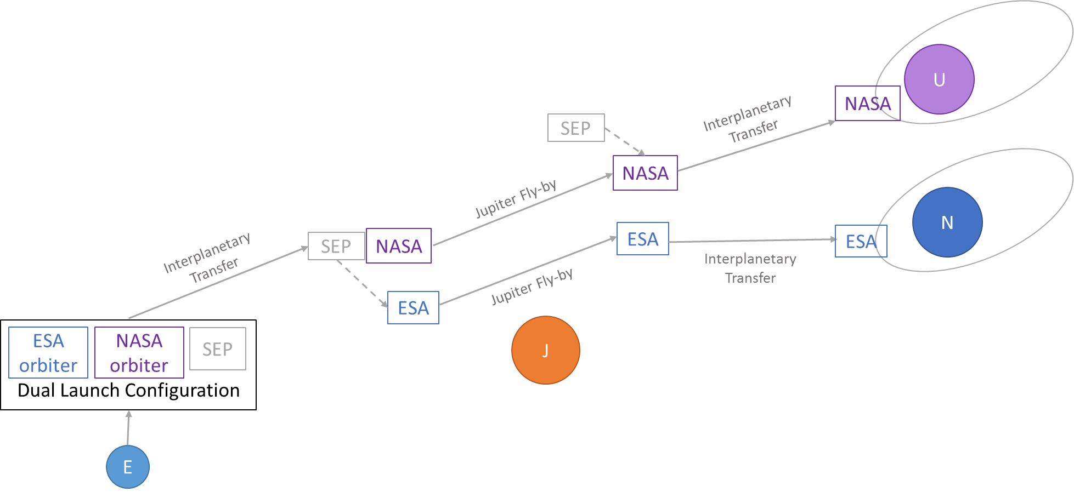
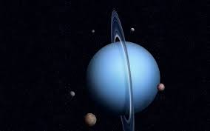
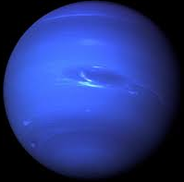
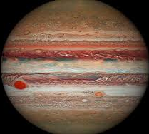
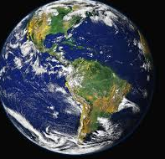
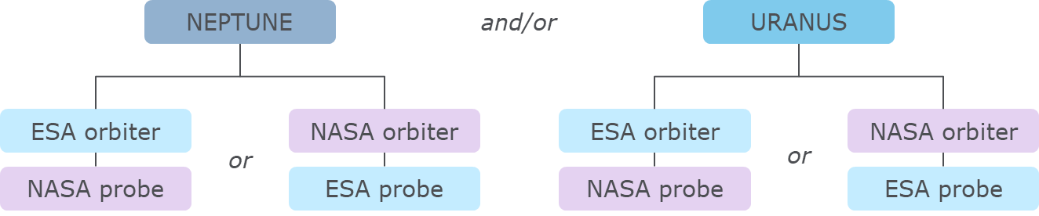
Mission Architecture and Timeline
There are no trajectories that allow a single spacecraft to encounter both Uranus and Neptune in the same arc. Two individual spacecraft with different transfers would be required to reach both planets, but a single SLS launch vehicle could launch both spacecraft towards Jupiter.
Neptune orbit
2 years
Arrival Neptune
September 2044
In order to maximize the delivered mass, the availability of a Jupiter gravity assist results in preferential launch windows for Uranus missions in the 2030-2034 timeframe and corresponding window of 2029-2030 for Neptune.
Jupiter swing-by
December 2032
Launch
February 2031
The use of a SEP stage for inner solar system transfer has the potential to significantly reduce flight times and/or increase the delivered mass.
Multiple other configurations feasible:

Slide 4
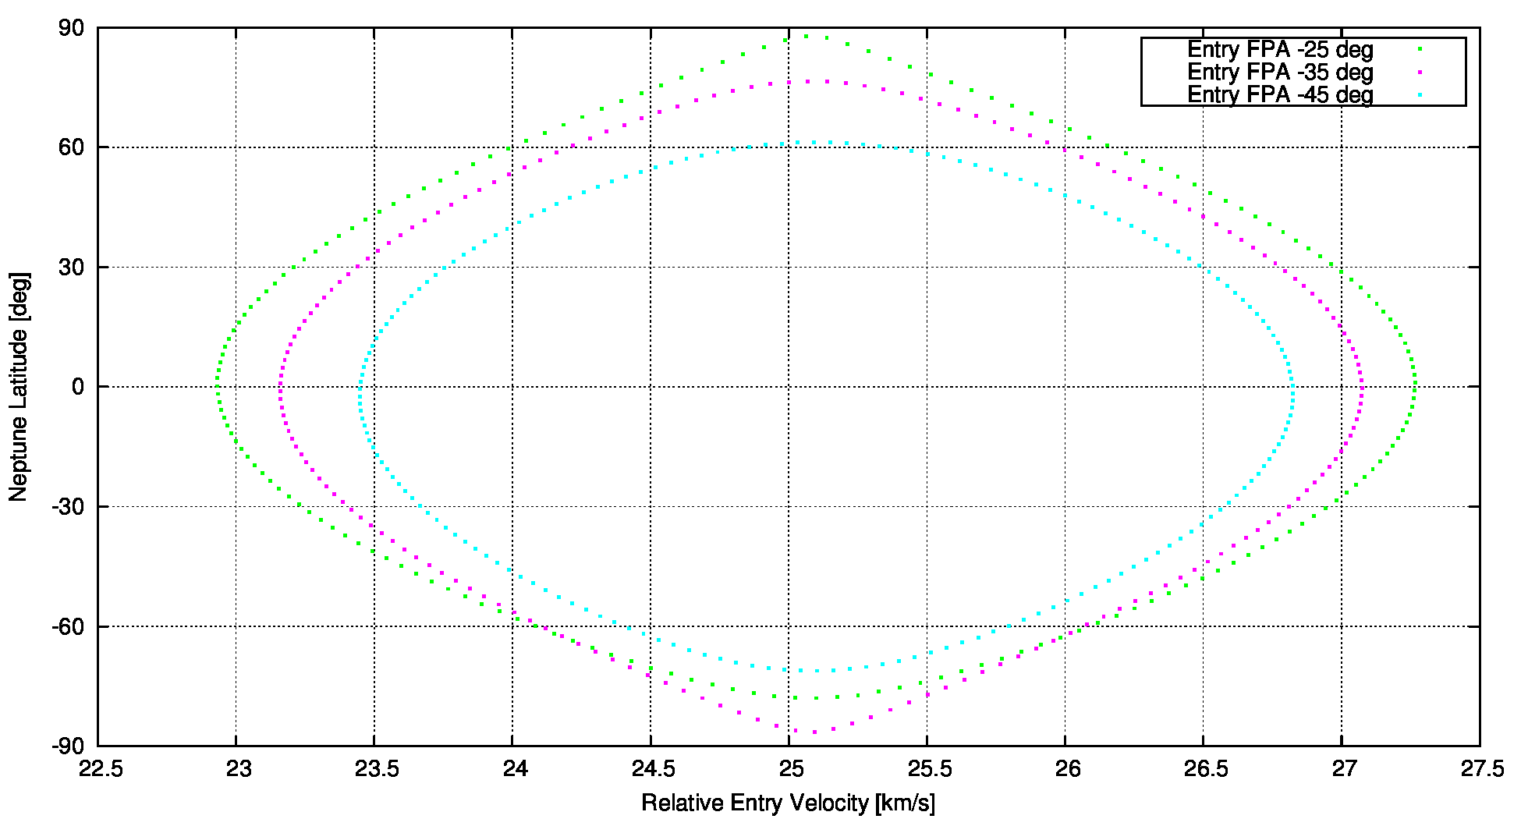
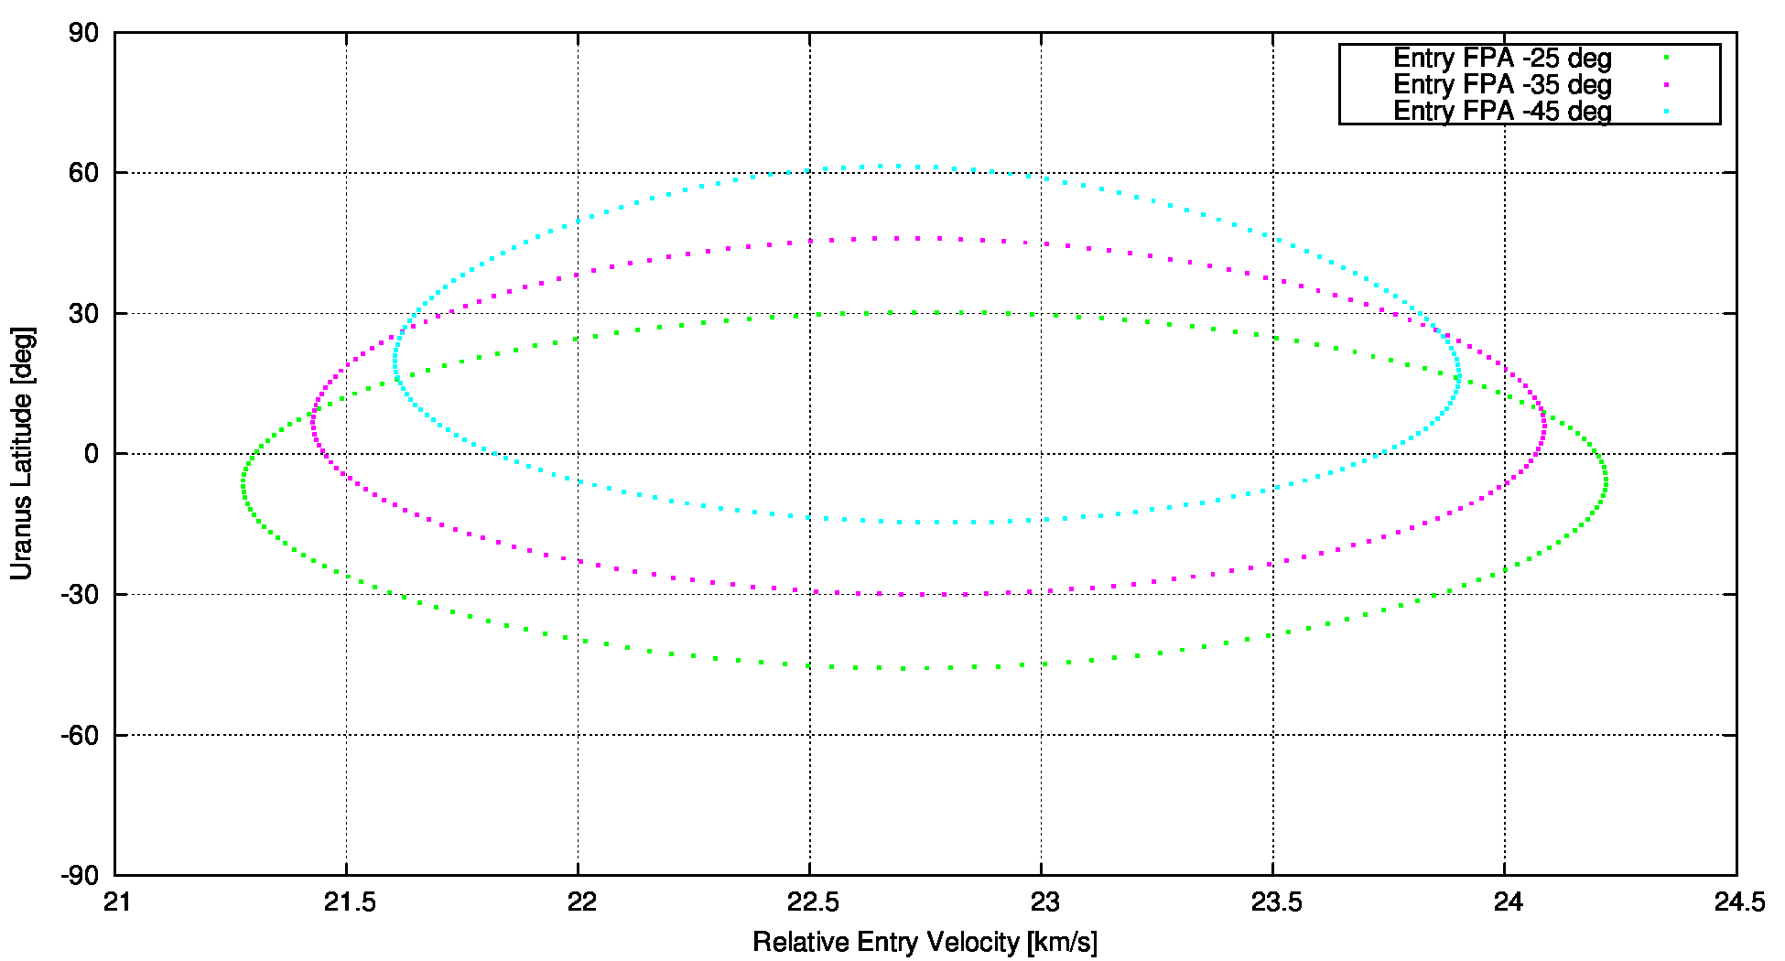
Probe Transfer & Arrival
Transfer:
11.5 years for Uranus, 13.5 years for Neptune
Probe batteries are charged by the carrier up until probe release
Probe separates from the orbiter 20 days before atmospheric entry (only timer ON, 30 min GNC/PL checkout, RHU’s for heater control)
Arrival:
Neptune mission probe is assumed to arrive on 2044/9/1 at a velocity of 9.48 km/s.
Uranus mission probe is assumed to arrive on 2042/4/6 at a velocity of 8.35 km/s.
Neptune probe entry baselined at latitude 30 deg South Prograde atmospheric entry
Entry flight path angles from -35 to -20 degree considered
Resulting relative entry velocities are 23.4 to 23.2 km/s Lower relative entry velocities for Uranus
Neptune
Uranus

Slide 5
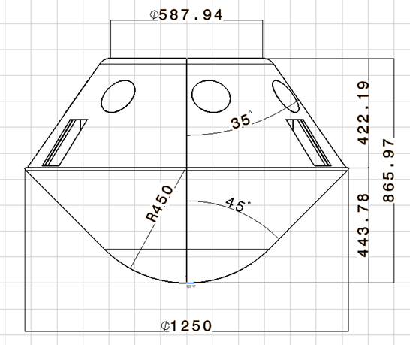
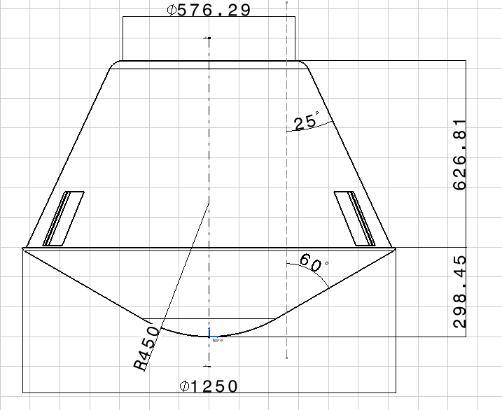
Probe Design
Base & Nose Diameter:
Trade-off was done for base diameters 1.50m, 1.35m & 1.25m
Trade-off was done for nose diameters 0.512m & 0.900m
Selected baseline design:
  d_{base} = 1.25m (mass optimization)
  d_{nose} = 0.900m (reduced convective heating and total heat load)
Two baseline configurations were studied further:
45 deg half-cone angle (Galileo heritage) (Cases A, C, D)
60 deg half-cone angle (reduced heating, increased drag) (Case B)
Total of four design cases were further assessed:
 | Case A | Case B | Case C | Case D
visibility from Earth | Yes | Yes | No | No
half-cone angle [deg] | 45 | 60 | 45 | 45
probe diameter [m] | 1.25 | 1.25 | 1.25 | 1.25
nose diameter [m] | 0.9 | 0.9 | 0.9 | 0.9
inertial entry FPA [deg] | -35 | -35 | -25 | -20
relative entry velocity [km/s] | 23.42 | 23.42 | 23.23 | 23.20
entry direction | prograde | prograde | prograde | prograde
time from EIP at Ma = 1.8 [s] |  | 50.8
time from EIP at Ma = 0.8 [s] | 62.0 | 65.2 | 85.8 | 109.0

Slide 6
Probe Entry & Descent
Entry flight path angles from -35 to -20 degree considered
1-2 minutes for entry and braking
60 minutes science during descent from 1 to 10 bars
Data relay to orbiter
NOI
Probe
Orbiter
Two parachutes baselined (drogue and main)
45 degree probe: Drogue parachute opens at Ma=0.8 (subsonic)
60 degree probe: Drogue parachute opens at Ma=1.8 (supersonic)
Backshield is released with pilot chute thereby extracting the main parachute
Frontshield released after main parachute inflation dynamics damp out

Slide 7
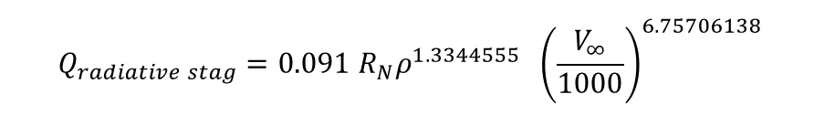
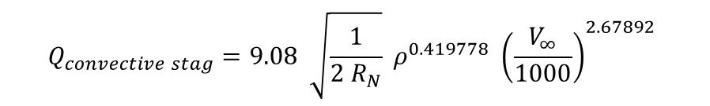
Aerothermodynamic Environment (1/3)
Convective heat flux based on correlation from Sutton & Graves:
Radiative heat flux based on correlation from Simmonds & Moss (tailored for Jupiter):
Convective heat fluxes are in good consistency with NASA assumptions.
Radiative fluxes are extremely high for the low entry velocities
  Correlation is being used outside its valid range and requires additional experimental validation for these conditions
Nevertheless 100% margin added to convective and radiative fluxes.
20% reduction (convective and radiative) assumed for pyrolysis gas blocking effects, based on a conservative correlation from Galileo.
For backcover 2.5% of convective and 1% of radiative margined stagnation point fluxes assumed (consistent with previous studies).
$$Q_{convective stag}=9.08 \sqrt{\frac{1}{2 R_{N}}} ρ^{0.419778} {\left(\frac{V_{∞}}{1000}\right)}^{2.67892}$$
$$Q_{radiative stag}=0.091 R_{N}ρ^{1.3344555} {\left.\left(\frac{V_{∞}}{1000}\right.\right)}^{6.75706138}$$

Slide 8
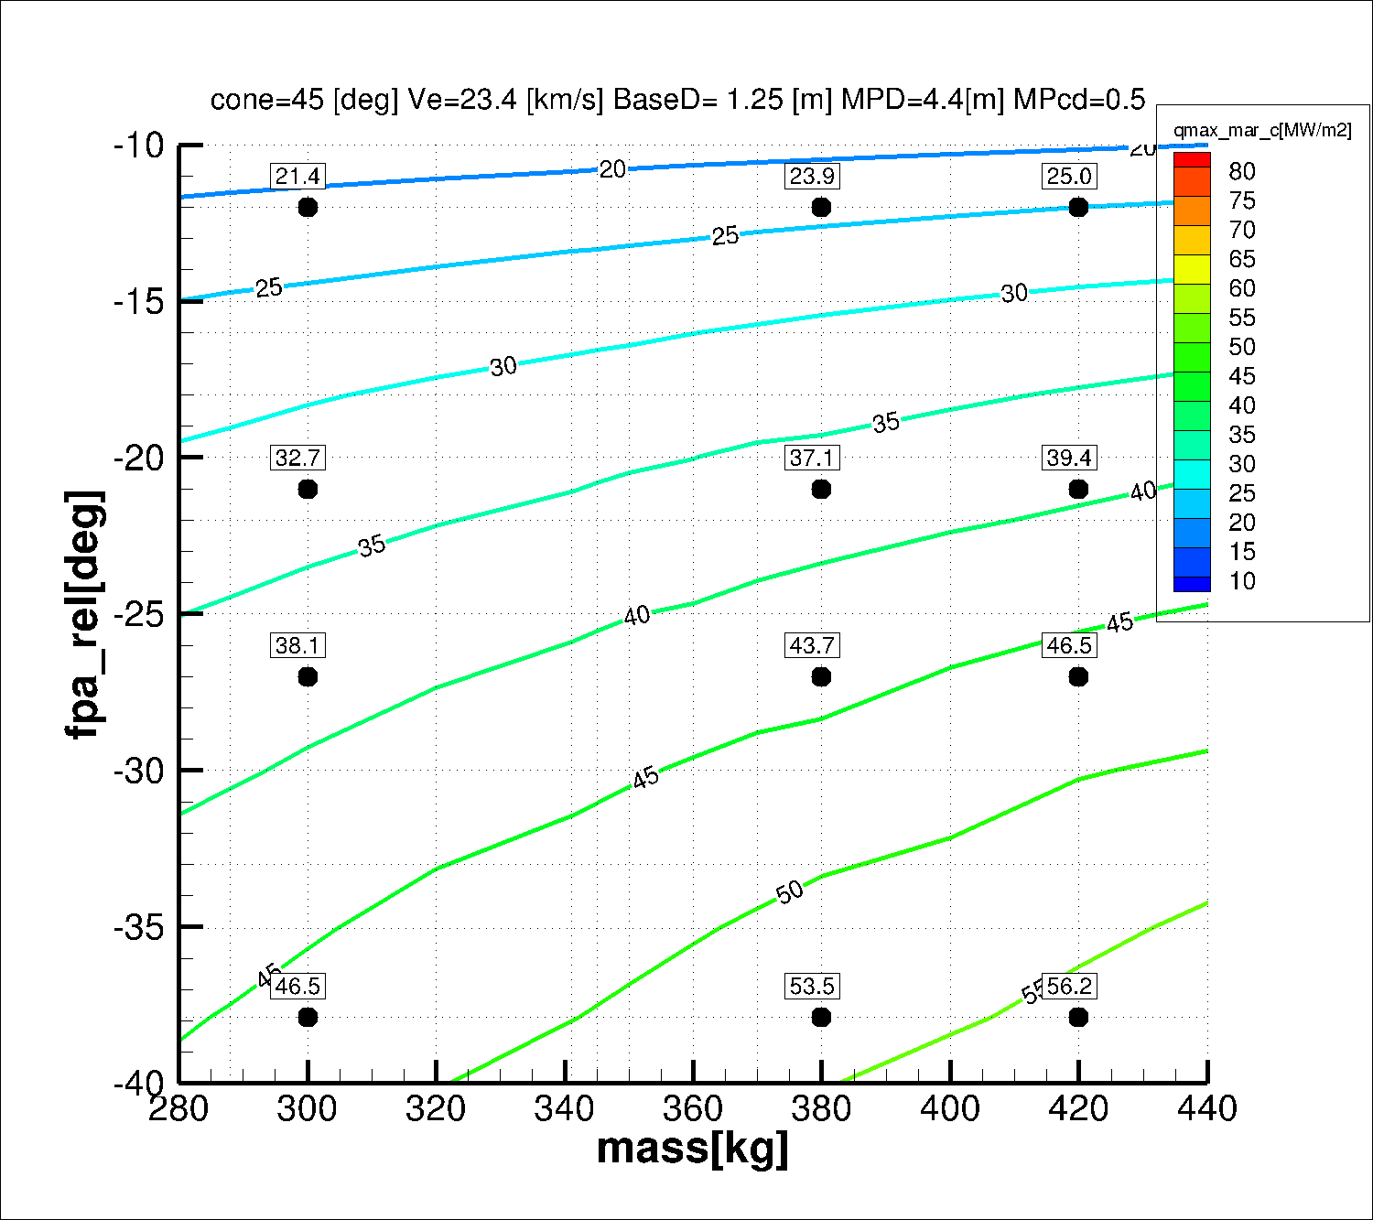

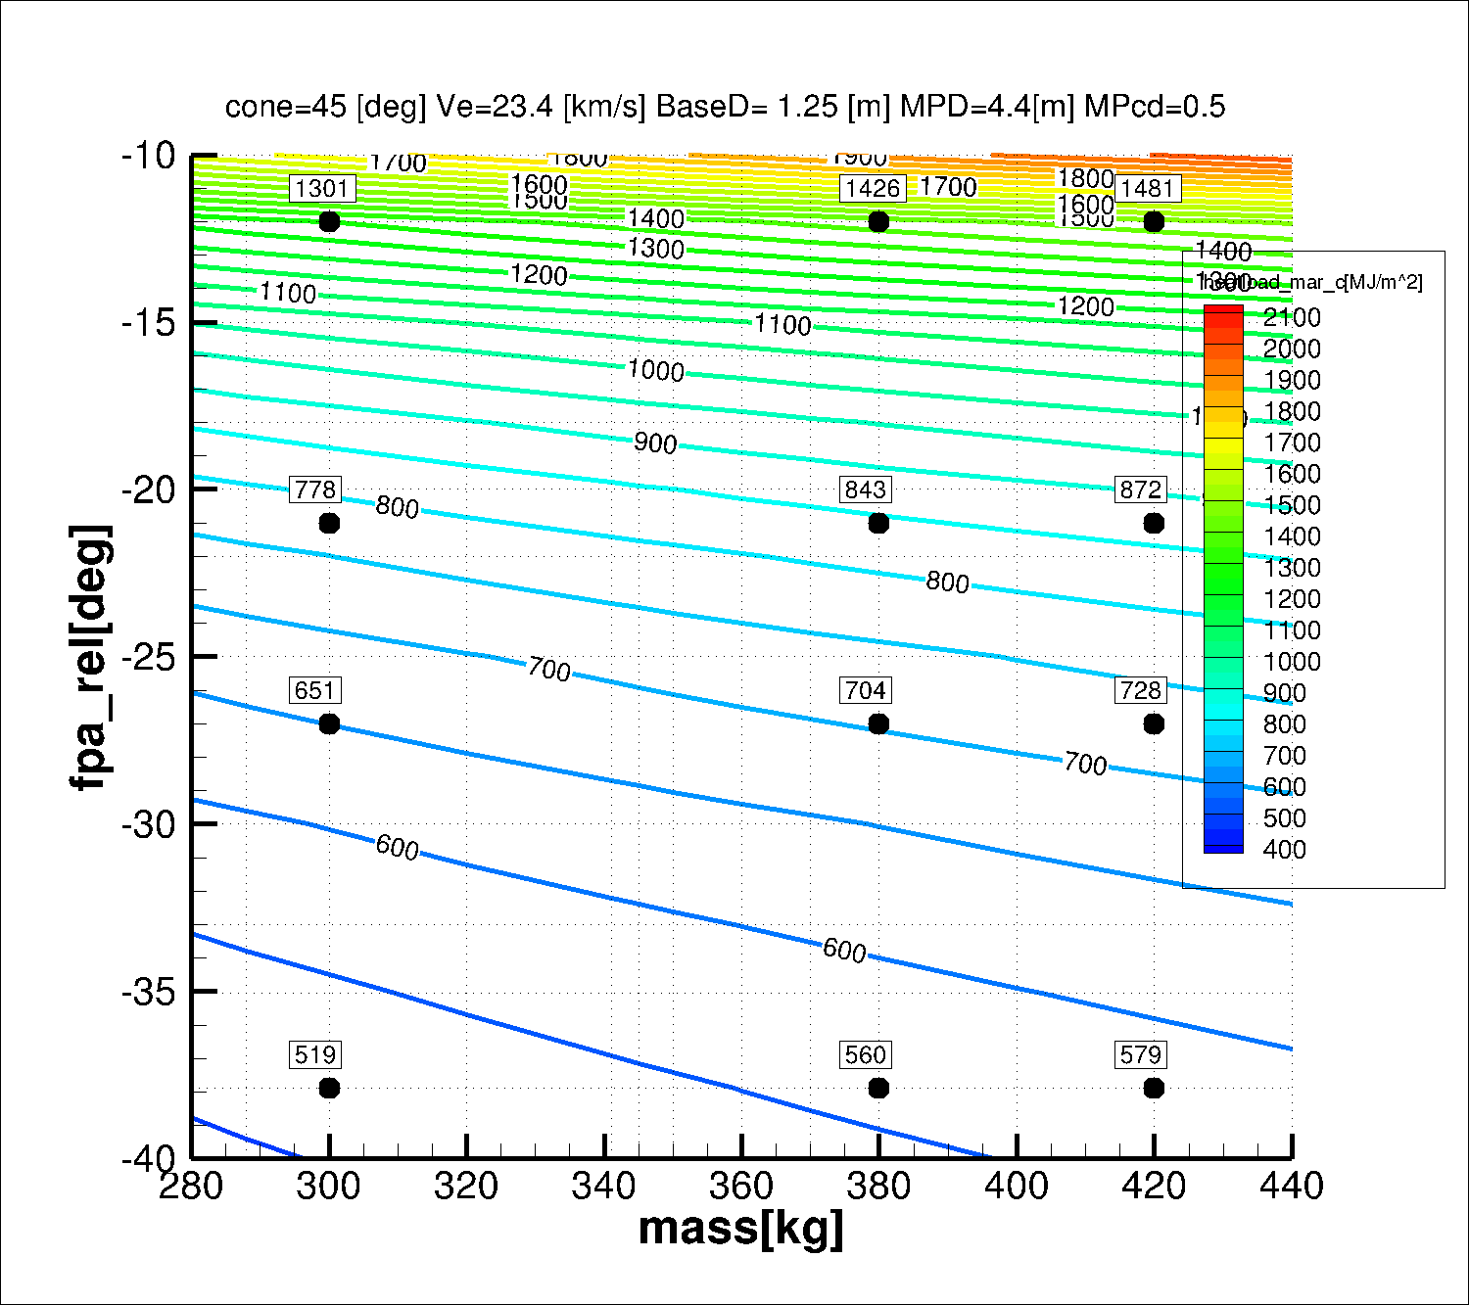
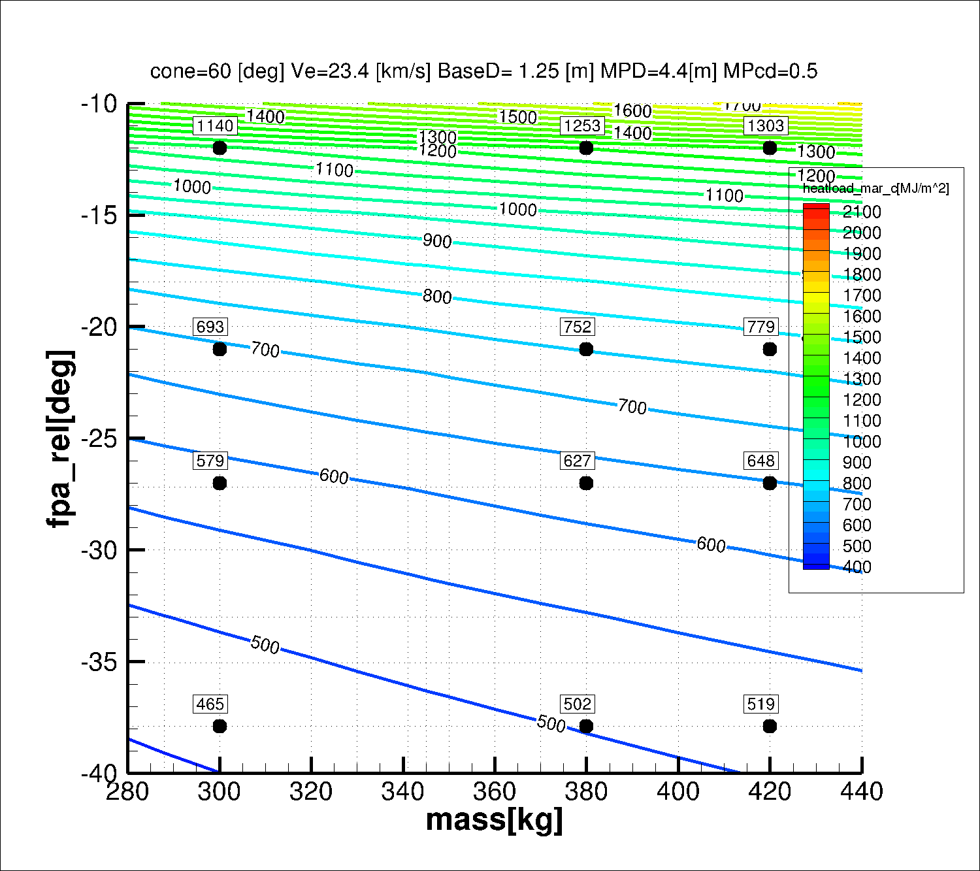
Aerothermodynamic Environment (2/3)
Convective heat flux for 45 deg cone (left) & 60 deg cone (right)
Convective heat load for 45 deg cone (left) & 60 deg cone (right)

Slide 9
Aerothermodynamic Environment (3/3)
 | Case A | Case B | Case C | Case D
visibility from Earth | yes | yes | no | no
half-cone angle [deg] | 45 | 60 | 45 | 45
probe diameter [m] | 1.25 | 1.25 | 1.25 | 1.25
nose diameter [m] | 0.9 | 0.9 | 0.9 | 0.9
inertial entry FPA [deg] | -35 | -35 | -25 | -20
relative entry velocity [km/s] | 23.42 | 23.42 | 23.23 | 23.20
entry direction | prograde | prograde | prograde | prograde
time from EIP at Ma = 1.8 [s] |  | 50.8
time from EIP at Ma = 0.8 [s] | 62.0 | 65.2 | 85.8 | 109.0
visibility from Earth | Yes | Yes | No | No
 | Case A | Case B | Case C | Case D
marg. conv. peak heat flux [MW/m2] | 53.5 | 44.2 | 43.2 | 39.2
marg. rad. peak heat flux [MW/m2] | 118.1 | 67.5 | 65.2 | 50.1
marg. total peak heat flux [MW/m2] | 171.6 | 111.7 | 108.4 | 89.3
marg. conv. heat load [MJ/m2] | 560 | 502 | 688 | 834
marg. rad. heat load [MJ/m2] | 511 | 325 | 437 | 456
marg. total heat load [MJ/m2] | 1071 | 828 | 1125 | 1290
frontshield area [m2] | 1.67 | 1.43 | 1.67 | 1.67
backcover area [m2] | 2.00 | 2.54 | 2.00 | 2.00
Extreme radiative fluxes & loads ➔ Likely not real
60° cone design allows >20% reduction in total heat load while also surface area is reduced (~10% on convective load)

Slide 10

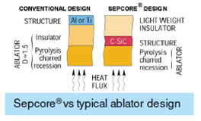
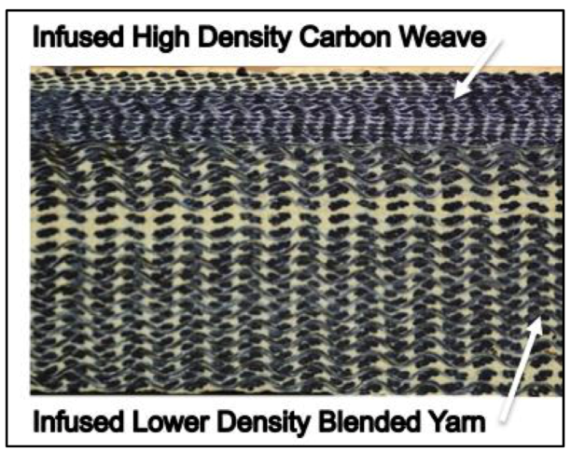
TPS Material Selection
Solutions available in Europe:
Fully-dense carbon-phenolic
3D Carbon-carbon / Carbon-SiC baselined within this study
ASTERM® (low density carbon-phenolic ablator, 280 kg/m³) considered for backcover
Hybrid hot structure Sepcore
Solutions available in the US:
HEEET (3D-Woven) for heatshield
PICA for backshell
Dual-Layer HEEET Cross Section

Slide 11
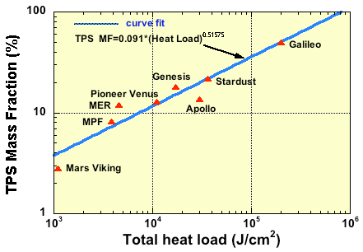
Preliminary Heatshield Sizing
 | Case A | Case B | Case C | Case D
visibility from Earth | yes | yes | no | no
half-cone angle [deg] | 45 | 60 | 45 | 45
probe diameter [m] | 1.25 | 1.25 | 1.25 | 1.25
nose diameter [m] | 0.9 | 0.9 | 0.9 | 0.9
inertial entry FPA [deg] | -35 | -35 | -25 | -20
relative entry velocity [km/s] | 23.42 | 23.42 | 23.23 | 23.20
entry direction | prograde | prograde | prograde | prograde
time from EIP at Ma = 1.8 [s] |  | 50.8
time from EIP at Ma = 0.8 [s] | 62.0 | 65.2 | 85.8 | 109.0
visibility from Earth | Yes | Yes | No | No
Heatshield mass fractions consistent with expectation from previous missions, but probably very conservative due to radiative load assumptions.
60° cone design allows to significantly reduce heatshield mass fraction and overall probe mass.
Further iteration needed as final probe masses are different than assumed for sizing (B & D slightly oversized, B slightly undersized).
Very conservative assumptions and significant margins taken.
Radiation component could be negligible for the low entry speed considered
marg. conv. peak heat flux [MW/m2] | 53.5 | 44.2 | 43.2 | 39.2
marg. rad. peak heat flux [MW/m2] | 118.1 | 67.5 | 65.2 | 50.1
marg. total peak heat flux [MW/m2] | 171.6 | 111.7 | 108.4 | 89.3
marg. conv. heat load [MJ/m2] | 560 | 502 | 688 | 834
marg. rad. heat load [MJ/m2] | 511 | 325 | 437 | 456
marg. total heat load [MJ/m2] | 1071 | 828 | 1125 | 1290
frontshield area [m2] | 1.67 | 1.43 | 1.67 | 1.67
backcover area [m2] | 2.00 | 2.54 | 2.00 | 2.00
 | Probe A | Probe B | Probe C | Probe D
half-cone angle [deg] | 45 | 60 | 45 | 45
inertial entry FPA [deg] | -35 | -35 | -25 | -20
FS ablator thickness (w/ margin) [mm] | 44 | 36 | 52 | 59
resulting heatshield mass (w/ margins) | 152 | 119 | 174 | 193
probe mass total [kg] assumed for TPS sizing | 380 | 380 | 380 | 420
final total probe mass | 375 | 345 | 395 | 414
TPS mass fraction | 41% | 34% | 44% | 47%
Neptune
CDF assumption
Ref.: B. Laub & R. Venkatapathy, IPPW-2003

Slide 12
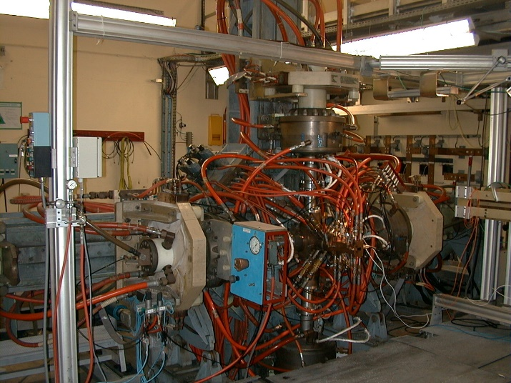
Test Facilities
Response and performance testing of heatshield materials under relevant conditions is indispensable (atmosphere, enthalpy, flux, pressure, shear).
There are currently no plasma test facilities available which are capable to reproduce the expected entry environment.
L3K at DLR in Cologne allows up to ~16 MW/m² at somewhat above 1 bar in air
In Scirocco at CIRA probably around 20-25 MW/m² can be achieved, again in air.
JP200 at ArianeGroup in Bordeaux is an open 20 MW Huels arc-heater facility capable to achieve in stagnation point configuration up to about 80 MW/m² at 5-50 bars (TBC). Operation in air.
The magnetoplasmadynamic PWK1 arcjet facility at IRS Stuttgart may allow to test within the same facility under air and H₂. Achievable fluxes are TBC (>10 MW/m² ?).
Potential approach (under discussion):
1/ Comparative testing at e.g. IRS in both, air and H₂/He, at otherwise as far as possible identical conditions but at lower flux levels, thereby allowing to correlate the material response behavior expected in H₂/He against the one observed in air.
2/ Testing in JP200 under representative convective heat flux levels in air,
JP200 ArianeGroup, Bordeaux

Slide 13
Technology maturation of the Aerothermal entry environment
A GSTP activity is approved to explore 2 unique European facilities able to operate with H2/He and CH4 traces
  Plasma test capabilities
  Shock tube testing
Technology maturation
  Super/transonic probe stability (including 60° cone)
System Trade-offs
  Probe design (45° versus 60° cone, base diameter, nose diameter, rear design)
  Entry trajectory
Heatshield Trade-offs
  Frontshield ablator (3D-CP, C-C, HEEET)
  Backcover ablator (ASTERM, cork-based)
  Heatshield concept (hybrid or classical cold structure)

Slide 14
Aeroheating Uncertainty
Convective Heating
  Primary uncertainties include turbulence, roughness and blowing
Radiative Heating
  Current ESA estimates for radiative heating are likely too high
  Recent testing by Cruden et al in pure H2/He demonstrated minimal radiation below 27 km/s
    Root cause is slow ionization; free electrons are required to electronically excite the atoms and precipitate radiation
    However, additional testing is required including known atmospheric impurities (primarily CH₄) which could provide an early source of free electrons and substantially increase radiation levels
Backshell Heating
  Correlation based approach needs to be replaced by high-fidelity modeling. Radiation in particular is a concern based on recent results from MSL and Mars2020
Proposed NASA/ESA Collaborative study would systematically explore largest uncertainties and propose appropriate models and margins for this problem
Testing would take place at:
  EAST shock tube at NASA Ames for H2/He/CH4 mixtures at relevant velocity and pressure
  The T6 Shock tube at the Oxford University reaching high velocities in expansion mode
  The PWK one plasma wind tunnel to test TPS
  State-to state simulations by Bari CNR for the above (to be approved)

Slide 15
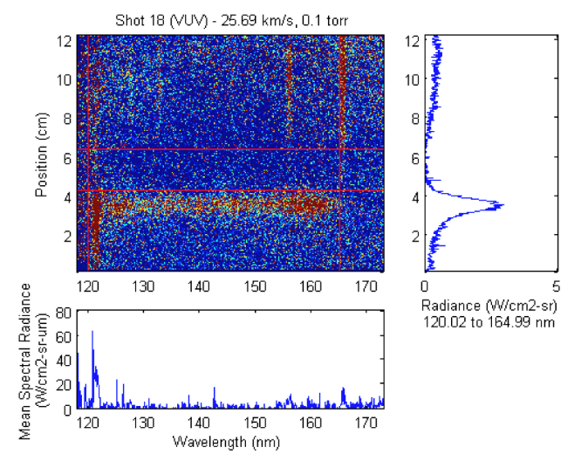
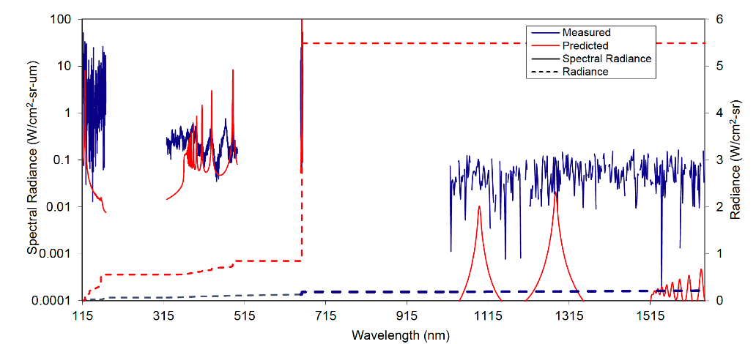
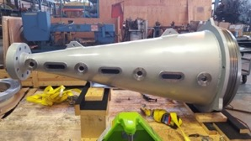
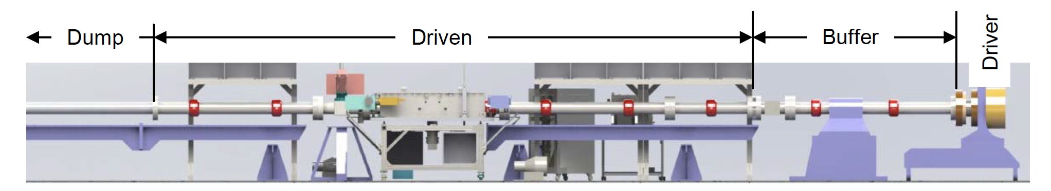
NASA Electric Arc Shock Tube
Capable of testing at velocities above 30km/s in H2/He.
Recent addition of expansion cone allows direct measurement of radiation in expanding flow with application to backshell environments

Slide 16
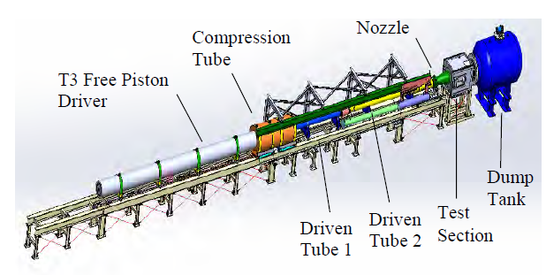
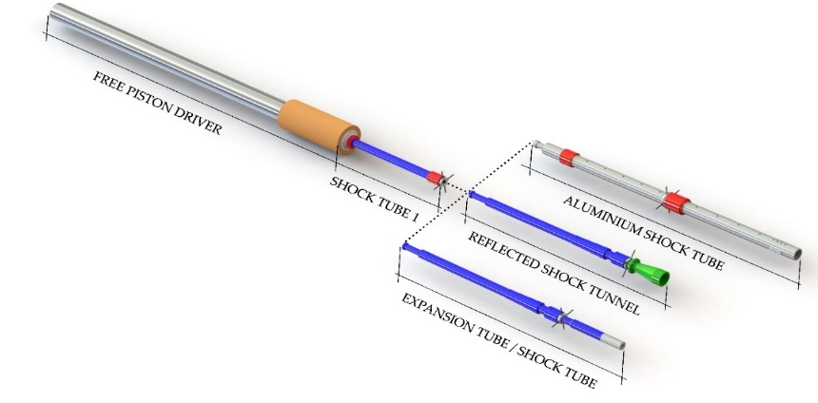
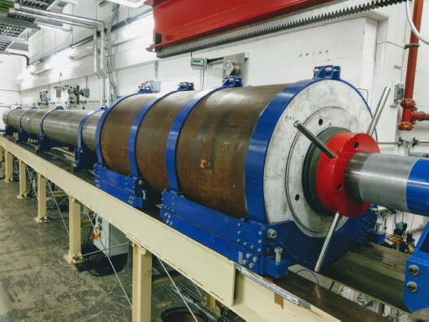
Oxford T6 Stalker multimode testing
the free-piston driver may be coupled to a range of downstream components to allow operation of the facility as either a shock tube, expansion tube or reflected shock tunnel.
Operational enveloped is foreseen to be explored
Mode | Reflected Shock Tunnel | Expansion Tunnel | Shock Tube
Test Type | Sub-scale model | Sub-scale model | Shock layer radiation
Length, m | 8.1 | 8.8 | 9.9
Exit Diameter, mm | 282.0 | 96.3/280.0 | 96.3/225.0
Test Duration, µs | 1000-300 | 50-500 | 2-50
Max flow speed, km/s | 6.5 | 15.0 | 18.0/12.0

Slide 17
Oxford T6 Stalker Expansion tube testing
  the test gas is initially shock heated and then undergoes an unsteady expansions allowing longer test times
  has a large total pressure and total enthalpy multiplication of the test gas
  is able to test small blunt body, enthalpy and binary scaled
  Optional Stalker substitution scaling (composition is altered to achieve higher post shock temperatures) , allowing radiative matching in the non-equilibrium zone
Tunnel Properties |  |  |  |  | Flow conditions
D_{exit} | H₂:He | psd₁ | p₁ | p₅ | U∞ (eff) | T_{2,f} | T_{2, eq} | rho_{2, eq} | rho_{2,eq}-L
(mm) | (%) | (kPa) | (kPa) | (Pa) | (km/s) | (K) | (K) | (kg/m³) | (kg/m²)
96.3 | 85:15 | 10 | 2 | 0.5 | 28.26 | 17867 | 11171 | 2.03E-03 | 8.12E-05
96.3 | 85:15 | 10 | 2 | 5 | 23.91 | 10633 | 7677 | 1.00E-02 | 4.00E-04
96.3 | 85:15 | 10 | 2 | 50 | 19.34 | 7016 | 5090 | 5.60E-02 | 2.24E-03
280 | 85:15 | 10 | 2 | 0.5 | 28.26 | 30277 | 10400 | 3.90E-04 | 5.27E-05
280 | 85:15 | 10 | 2 | 5 | 23.91 | 13507 | 7609 | 1.96E-03 | 2.65E-04
280 | 85:15 | 10 | 2 | 50 | 19.34 | 7370.1 | 4550 | 1.20E-02 | 1.62E-03
96.3 | 85:15 | n/a | 2 | 0.5 | 23.53 | 21640 | 7148 | 1.82E-03 | 7.28E-05
96.3 | 85:15 | n/a | 2 | 5 | 18.77 | 9640 | 4505 | 1.56E-02 | 6.24E-04
96.3 | 85:15 | n/a | 2 | 50 | 15.49 | 5650 | 4210 | 4.45E-02 | 1.78E-03
96.3 | 40:60 | n/a | 2 | 0.5 | 23.5 | 33730 | 1311 | 1.61E-03 | 6.44E-05
96.3 | 40:60 | n/a | 2 | 5 | 18.74 | 11116 | 1139 | 9.81E-03 | 3.92E-04
96.3 | 40:60 | n/a | 2 | 50 | 15.47 | 7388 | 7237 | 3.91E-02 | 1.56E-03

Slide 18
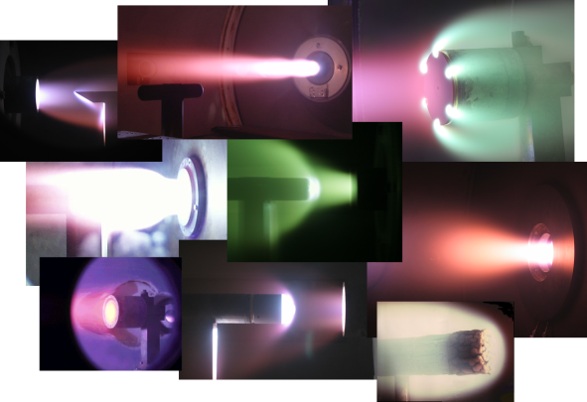
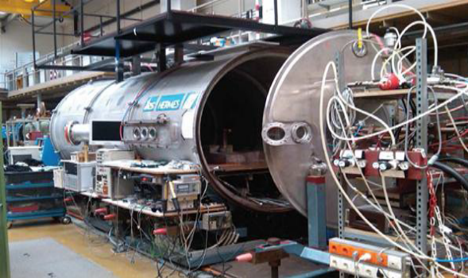
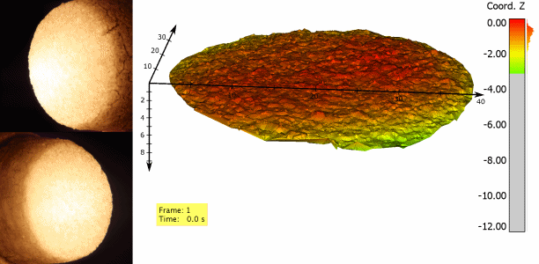
IRS TPS Plasma testing PWK1
  the magnetoplasmadynamic PWK1 is an arcjet facility at IRS.
  The plasma source used was the self-field MPD plasma generator RD5
  Exploration of performance envelope of the PWK1 in a H2/He/Methane environment, essential in order to properly assess the performance of the materials.
  Currently it is the only certified facility in Europe able to qualify material samples for high enthalpy hydrogen-Helium mixture.
  It has been developed in the 1980s based on the expertise in electric propulsion devices. The corresponding propulsion used as a baseline for today’s system was designed and certified for hydrogen. Potential conditions for hydrogen/helium testing with effective enthalpies in the order of 85MJ/kg with peak values 450MJ/kg. It is expected that PWK1 can reach effective enthalpies larger than 400MJ/kg, at total pressures in the hPa-range and heat fluxes >0.5MW/m^2. Further investigations to adjust performance of the facility are part of the present investigation
  Free stream characterisation and material response measurement techniques
  the diagnostics of photogrammetry,
  thermography and possibly shear influences using sphere
  Radiation heating (possibly provided by additional radiative heating)
  Material testing to be conducted with carbon phenolic ablator materials. Additional material instrumentation for the application of inverse methods for material performance characterization.

Slide 19
Bari State–to state modeling
To support the T6 and PWK1 testing and asses the non-Boltzmann behavior.
Construction of an advanced atmospheric model for
H2/He in ionization regime.
Inclusion of impurities (CH4, Ar) in the atmospheric model.
Development of physics-based macroscopic models from accurate STS models
Implementation of the chemical STS models in a 2D CFD
code accelerated on GPU’s.
Database of thermodynamic and transport properties of the relevant atmospheres (pure and contaminated) including ablation products

Slide 20
Conclusions for Probe Concept
A preliminary probe design for a Neptune entry mission has been established . Similar design is considered suitable also for Uranus.
Convective heat fluxes in good consistency with NASA assumptions. However, radiative fluxes are subject of debate and may likely be much less severe than assumed (or even negligible depending on the entry speed).
Results indicate that heatshield design based on existing 3D dense carbon-phenolic TPS material appears feasible.
Option of 60° cone angle appears very interesting, but requires further assessment (including probe stability).
Proposed NASA/ESA Collaborative study would systematically explore largest uncertainties and propose appropriate models and margins for this problem
Testing would take place:
  EAST shock tube at NASA Ames for H2/He/CH4 mixtures at relevant velocity and pressure
  The T6 Shock tube at the Oxford University reaching high velocities in expansion mode
  The PWK one plasma wind tunnel to test TPS
  State-to state simulations by Bari CNR for the above

Slide 21
Co-Authors and Acknowledgment
CDF team, ESA
Link to Ice Giants 1 CDF Study Report (Ice Giant 2 study report will come shortly)
http://sci.esa.int/future-missions-department/61307-cdf-study-report-ice-giants/
Ice Giants 2 CDF Study Report will be issued shortly.

