Slide 1
Felix Houphouet-Boigny University
Laboratory of Science and Technology of Water and Environment
International Support Network for African Developpement
PROGRESS OF WORK
Presented by :
AKA Kouadio Prudence
Aka.strm@gmail.com
Research local Director : Dr KOFFI Yao Blaise (Lectureship)
yaomonie@yahoo.fr
Research Internatinal Director : Dr Ir. Gerald Augusto Corzo Perez (Lectureship) g.corzo@un-ihe.org

Slide 2
THEME :
DYNAMIC ASSESSMENT OF FLOOD INUNDATION BASED ON A SPATIOTEMPORAL HYDROLOGICAL MODEL FEED BY A DYNAMIC REPRESENTATION OF HUMAN ACTIVITIES
1

Slide 3
WORK PLAN
I. INTRODUCTION
II. METHODOLOGY (MATERIAL AND METHODS)
III. RESULTS
IV. DISCUSSION
V. CONCLUSION
2

Slide 4
INTRODUCTION

Slide 5
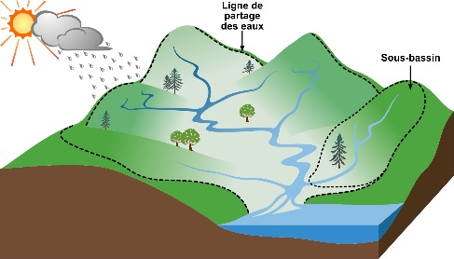
INTRODUCTION
A watershed is the space drained by a stream and its tributaries on a set of slopes.
Growing urbanization is changing the natural flow of runoff.
The study of urban watersheds is a major concern for hydrologists.
3

Slide 6
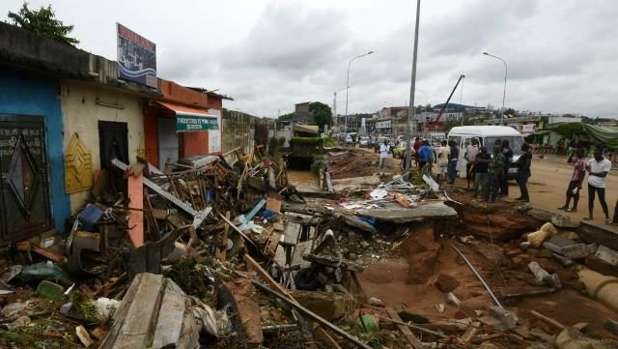
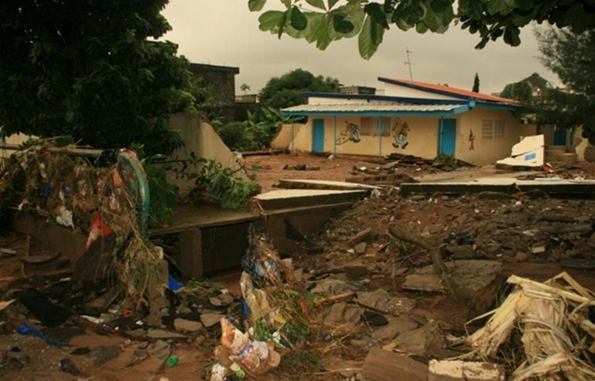
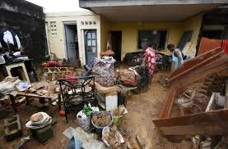
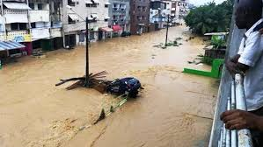
INTRODUCTION
Problem of flooding in the city of Abidjan
The loss of human lives and material damage
Economic loss
Economic activities perturbation
4

Slide 7
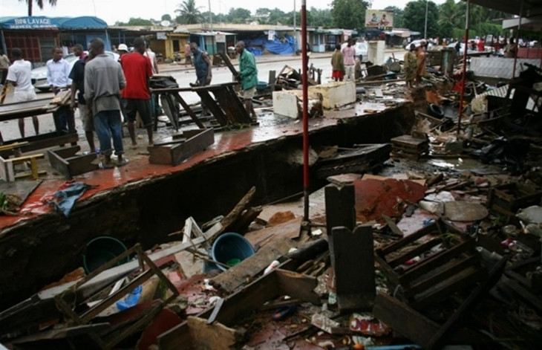
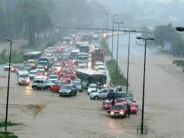
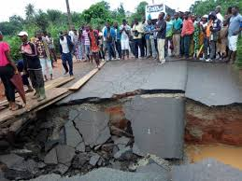
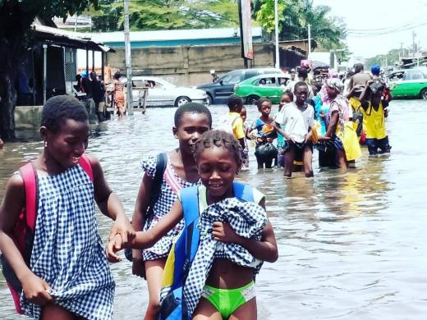
INTRODUCTION
Problem of flooding in the city of Abidjan
Insalubrity increase
Road degradation
Increase of fear in rainfall season
Children school year perturbation
5

Slide 8
INTRODUCTION
Problem of flooding in the city of Abidjan
Torrential rain
Surface and subsurface runoff
Flood
Hydrological functioning of watersheds ?
6

Slide 9
INTRODUCTION
Study the dynamics of floods and assess the impact of human activities on the hydrological functioning of the Gourou and Bonoumin watersheds in order to anticipate the risks of flooding.
MAIN OBJECTIVE
Characterize each watershed ;
Study the role of rainfall in the resurgence of floods in each basin ;
Study the dynamics of floods through a prospective study.
SPECIFIC OBJECTIVES
7

Slide 10
GENERAL
OF THE STUDY AREA

Slide 11
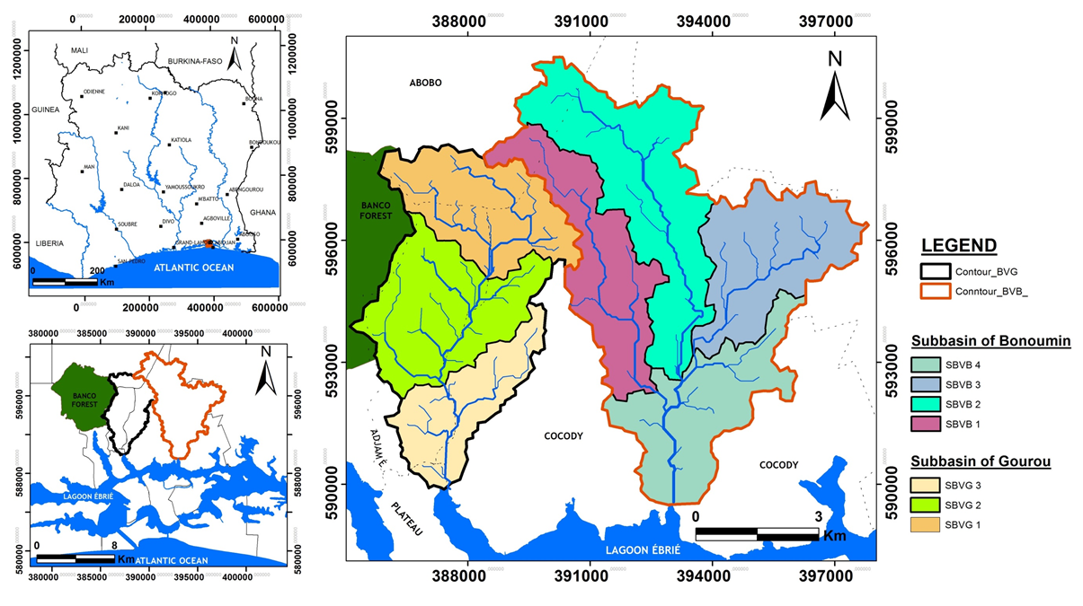
GENERAL OF THE STUDY AREA
Longitudes : 3°10’ et 3°50’ W
Latitudes : 5°80’ et 5°30’ N
Geographical location
Study area : 73.79 km²
Population : 1 075 055 habitants
8

Slide 12
GENERAL OF THE STUDY AREA
Geographical location
Study area characteristics : Located in the south of Côte d'Ivoire. highly urbanized basins
Flood characteristics : Caused by runoff
Geology : located in the coastal sedimentary basin and dominated by the Moi-Pliocene formations (Sands. Clay and Ferriginous Sandstone)
Climat : Four seasons :
Rainy season : April to July and October to November
Dry season : August to September and December to March
Hydrology : The study area is bordered by the Ebrié lagoon into which runoff water flows
9

Slide 13
EQUIPMENT AND METHODS

Slide 14
EQUIPMENT AND METHODS
Data
Equipment
Field equipment :
Limnimetric scales
Rain gauges
Infiltrometer
Venturi tube
Softwares :
R
ARCGIS 10.2.2
Goldsim
Satellite image of 1986. 2000. 2010 et 2020
DEM with resolution of 30 meters
Flow data
Climate data
Historical flood data
Survey data
10

Slide 15
EQUIPMENT AND METHODS
Method
Historical data acquisition
Bibliographic research on the internet and in the various past flood management structures in the Abidjan District ;
Survey of populations and flood management structures.
11

Slide 16
EQUIPMENT AND METHODS
Method
Realization of field work : Study of the condition of the rainwater drainage canals in the various flooded areas but also in the upstream areas
Verification of channel sizing
Verification of canal maintenance
Measurement of water level during past floods
List of environmental issues related to these channels
In order to make the link with the
recurrence of floods
12

Slide 17
EQUIPMENT AND METHODS
Method
Morphometric characterization of each basin
Acquisition of a DEM from the city of Abidjan ;
Treatment and determination of the morphometric characteristics of each basin (Surface. perimeter. size of the equivalent rectangle. Gravelus compactness index. relief. etc.) ;
Mapping of the hydrographic network of each watershed.
13

Slide 18
RESULTS ET DISCUSSION

Slide 19
RESULTS
Historical data
Majority of work deals with the mapping of floodplains
Two works carried out deal with the implication of climatic parameters in the resurgence of floods in the study area
On average 16 dead each year and the probability of a flood occurring each year is 84.6%
14

Slide 20
RESULTS
Historical data
The majority of floods occur during the long rainy season with an occurrence frequency of 83%
9% of floods occurred during the short rainy season
8% floods occurred in both seasons at the same time
15

Slide 21
RESULTS
Historical data
75% of floods occur during the month of June
8.83% of floods occur during the months of May. September and October
16

Slide 22
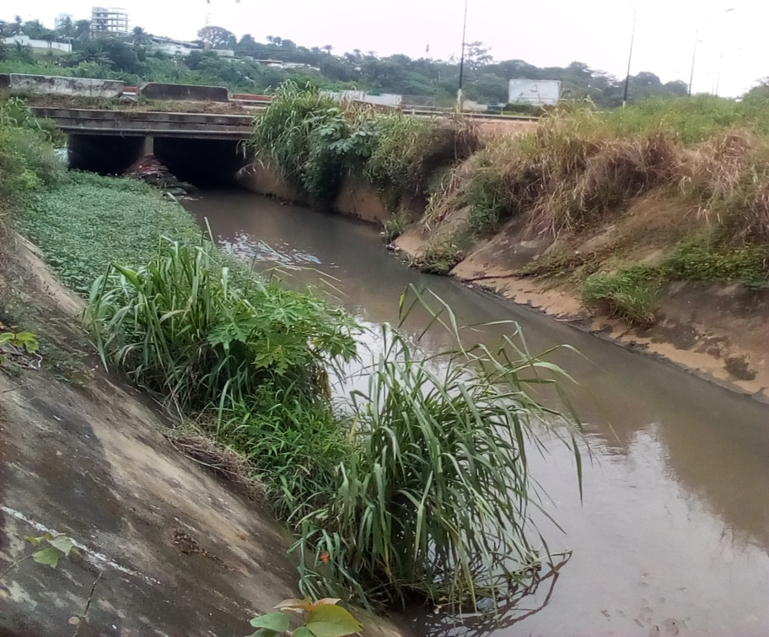
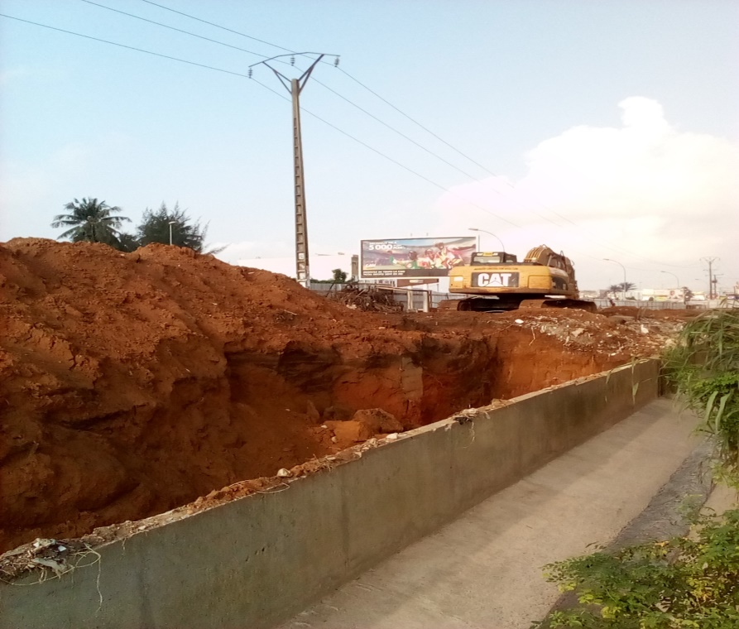
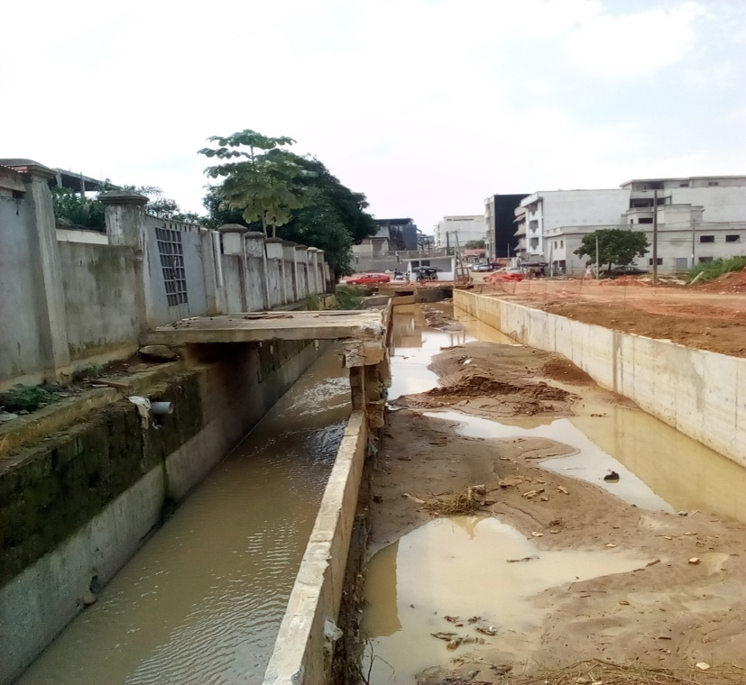
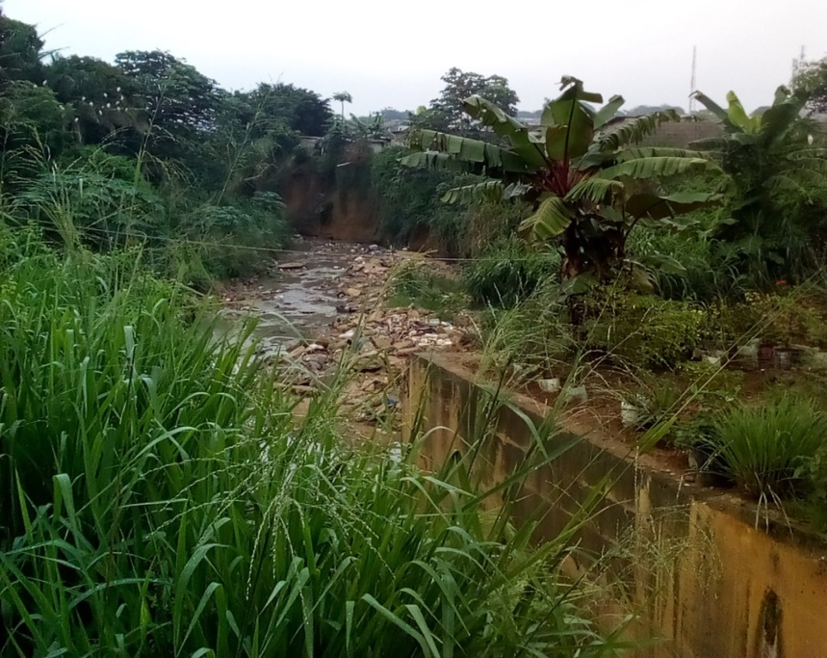
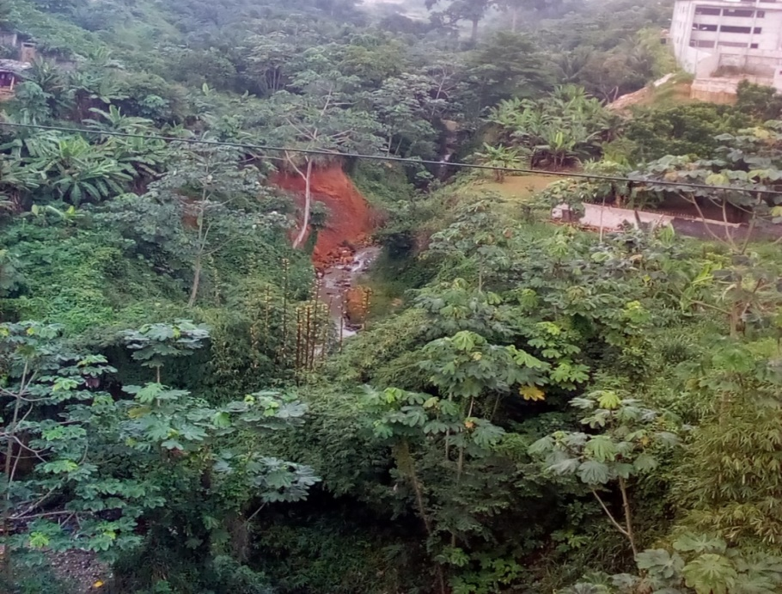
RESULTS
Field work
Resized Canal à la Palmerais
Extension of the Palmerais Canal
Canal built at Abobo Anador
7 m
3 m
Plate II: Overview of some natural and artificial rainwater drainage networks in the study area
Natural canal in Saint Villateur
Overview of a natural channel in the 7ème Tranche Angré
17

Slide 23
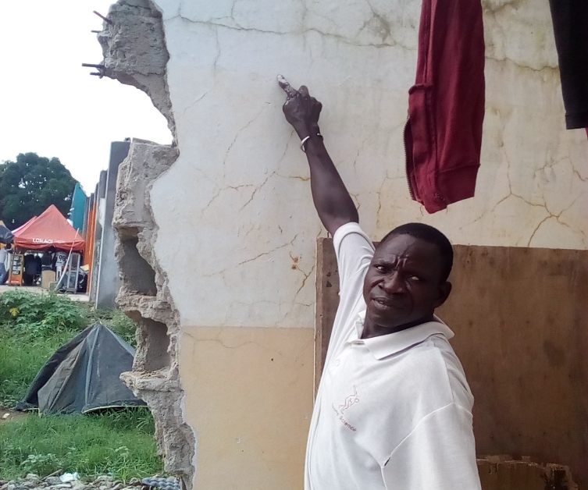
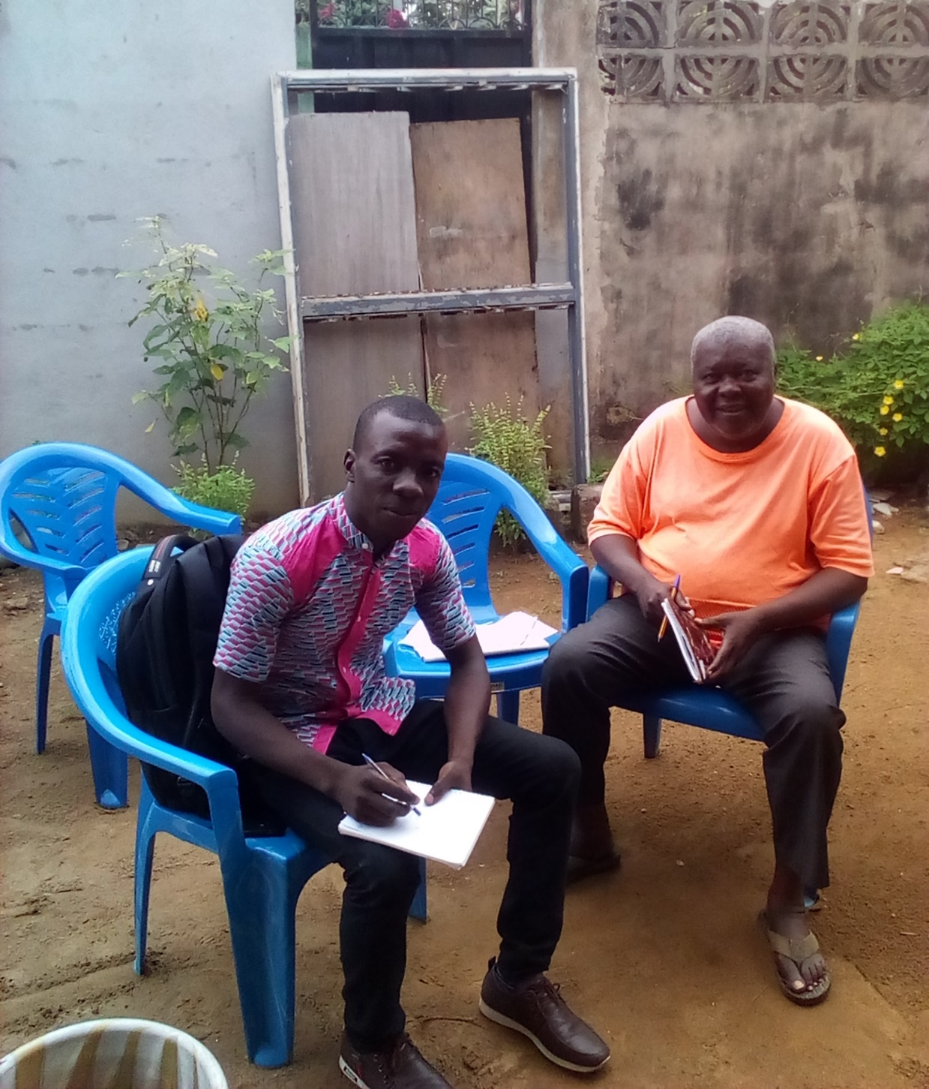
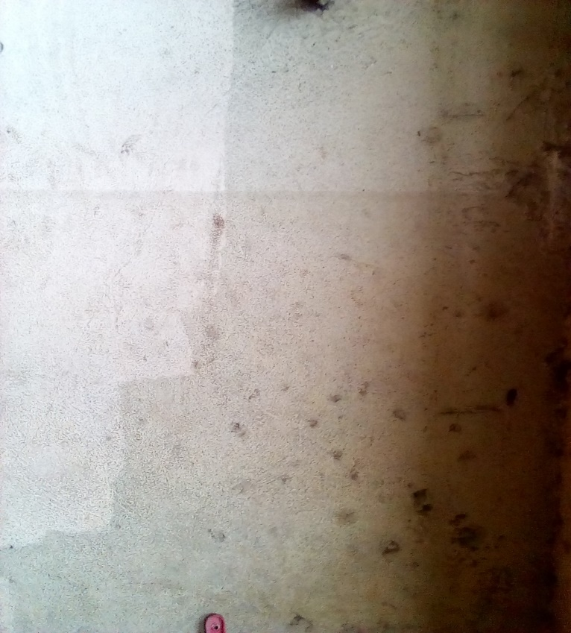
RESULTS
Field work
Victim
AKA Kouadio Prudence
1.85 metre
1.45 metre
Planche III : Preview of water level measurements during the flood of June 2018 and survey of one of the victims of this flood
1.75 metre
18

Slide 24
RESULTS
Morphometric characteristics of each basin
 |  | Caractéristiques de forme |  |  | Dimensions du Rectangle équivalent |  | Relief
Basin | Subasins (SBV) | Surface in km² | Perimeter in km | K_{G} | Length in km | Width in km | H mini in m | H maxi in m | H moy in m | Long stream in m | I_{moy} in %
Gourou (G) | S BVG 1 | 9.40 | 17.00 | 1.55 | 7.12 | 1.32 | 25 | 197 | 93.97 | 6110 | 2.82
 | S BVG 2 | 11.15 | 18.36 | 1.54 | 7.66 | 1.46 | 3 | 141 | 65 | 4440 | 3.11
 | S BVG 3 | 6.87 | 16.82 | 1.80 | 7.43 | 0.93 | 2 | 112 | 37.97 | 7850 | 1.40
Bonoumin (B) | S BVB 1 | 10.90 | 25.67 | 2.18 | 11.82 | 0.92 | 12 | 131 | 73.93 | 10040 | 1.19
 | S BVB 2 | 15.31 | 29.44 | 2.11 | 13.48 | 1.14 | 9 | 119 | 76.36 | 10910 | 1.01
 | S BVB 3 | 10.16 | 19.24 | 1.69 | 8.33 | 1.22 | 13 | 117 | 68.54 | 6250 | 1.66
 | S BVB 4 | 10.00 | 24.49 | 2.17 | 11.27 | 0.89 | 1 | 90 | 36.33 | 7130 | 1.25
19
H mini = Minimum height ; H maxi = Maximum height ; Long = Length ; I_{moy} = Average slope index

Slide 25
Discussion
Historical data
The long rainy season and particularly the month of June must be taken seriously by decision-makers in the fight against floods
83% of the floods occurred during the long rainy season and 75% of these floods occurred in June
The culture of the population on the risk of flooding at the approach of the great rainy seasons and the reinforcement of the sensitization of the populations on the respect of the prevention measures as well as the sensitization to be informed on the weather must be one priorities of decision makers
On average 16 dead each year and around 85% chance of a flood
20

Slide 26
Discussion
Field work
The thickness of the rainwater drainage channels (Palmerais) is 3 m for a depth of 2.5 m in places
Absence of flood clipping dam on the main tributary of Rue Minister
Responsible for the severity of the floods in the Palmerais districts. Nine kilograms and the city of Allabrah
21

Slide 27
Discussion
Caractéristiques morphométriques de chaque bassin
K_{G} > 1 for all sub basin Tous les sous bassins sont de forme allogée
K_{G} Bonoumin sub-basin > K_{G} Gourou sub basin The Bonoumin sub-basins are more elongated than those of the Guru. The water concentration time therefore longer at the Bonoumin sub-basins than those of the Gourou.
I_{moy} Gourou sub-basins > I_{moy} Bonoumin sub-basins Runoff likely to be stronger at the outlet of the Guru than that of Bonoumin.
22

Slide 28
CONCLUSION

Slide 29
Conclusion
First part of this doctoral research deeply based on bibliographic research and data collection
It made it possible to learn about the work that has been done on the theme of floods in the Abidjan area.
It allowed to know the period of occurrence for the occurrence of floods
It made it possible to know the regularly flooded areas and to know that floods are much more frequent in the Bonoumin basin than in the Gourou basin
23

Slide 30
THANK YOU FOR YOUR
KIND ATTENTION

