Slide 1
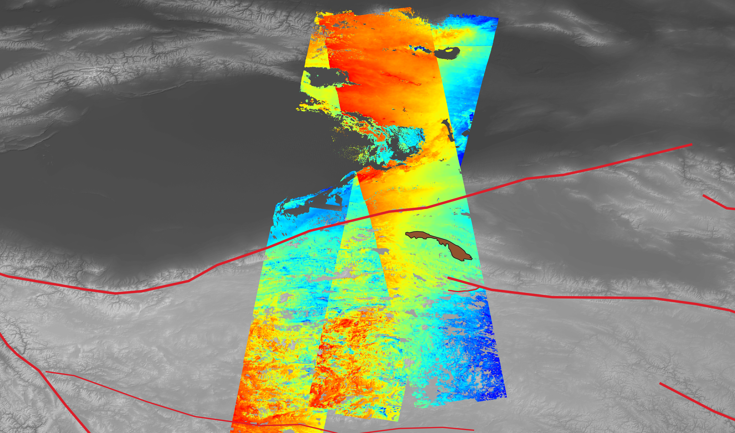

Tectonic Deformation and Surface Processes of the Tibetan Plateau from Sentinel-1 InSAR Data
Robert Zinke¹, Gilles Peltzer^{1,2}, Eric J. Fielding¹, Simran S. Sangha^{1,2}, David P. S. Bekaert¹, Susan Owen¹, and the ARIA Team
¹ NASA Jet Propulsion Laboratory, California Institute of Technology; ² University of California, Los Angles, Department of Earth, Planetary, and Space Sciences

Slide 2
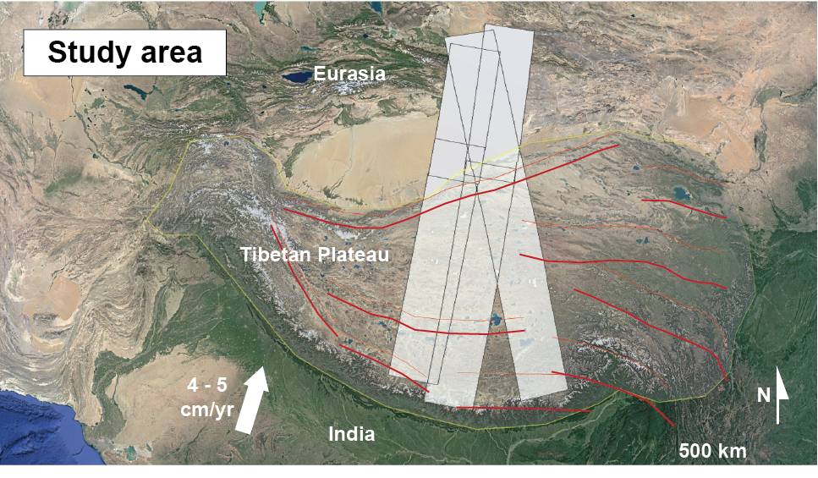
Motivation and data
The ongoing collision between India and Eurasia, produces the Tibetan Plateau. Tectonic shortening (at a rate of 4-5 cm/yr) is accommodated on major faults and distributed throughout the crust and upper mantle. Additionally, soil "active layer" and permafrost processes cause cm-scale movements within the upper few meters of the crust. We use nearly 5 years of Sentinel-1 interferometric synthetic aperture radar (InSAR) data to study these processes over broad spatial scales.

Slide 3
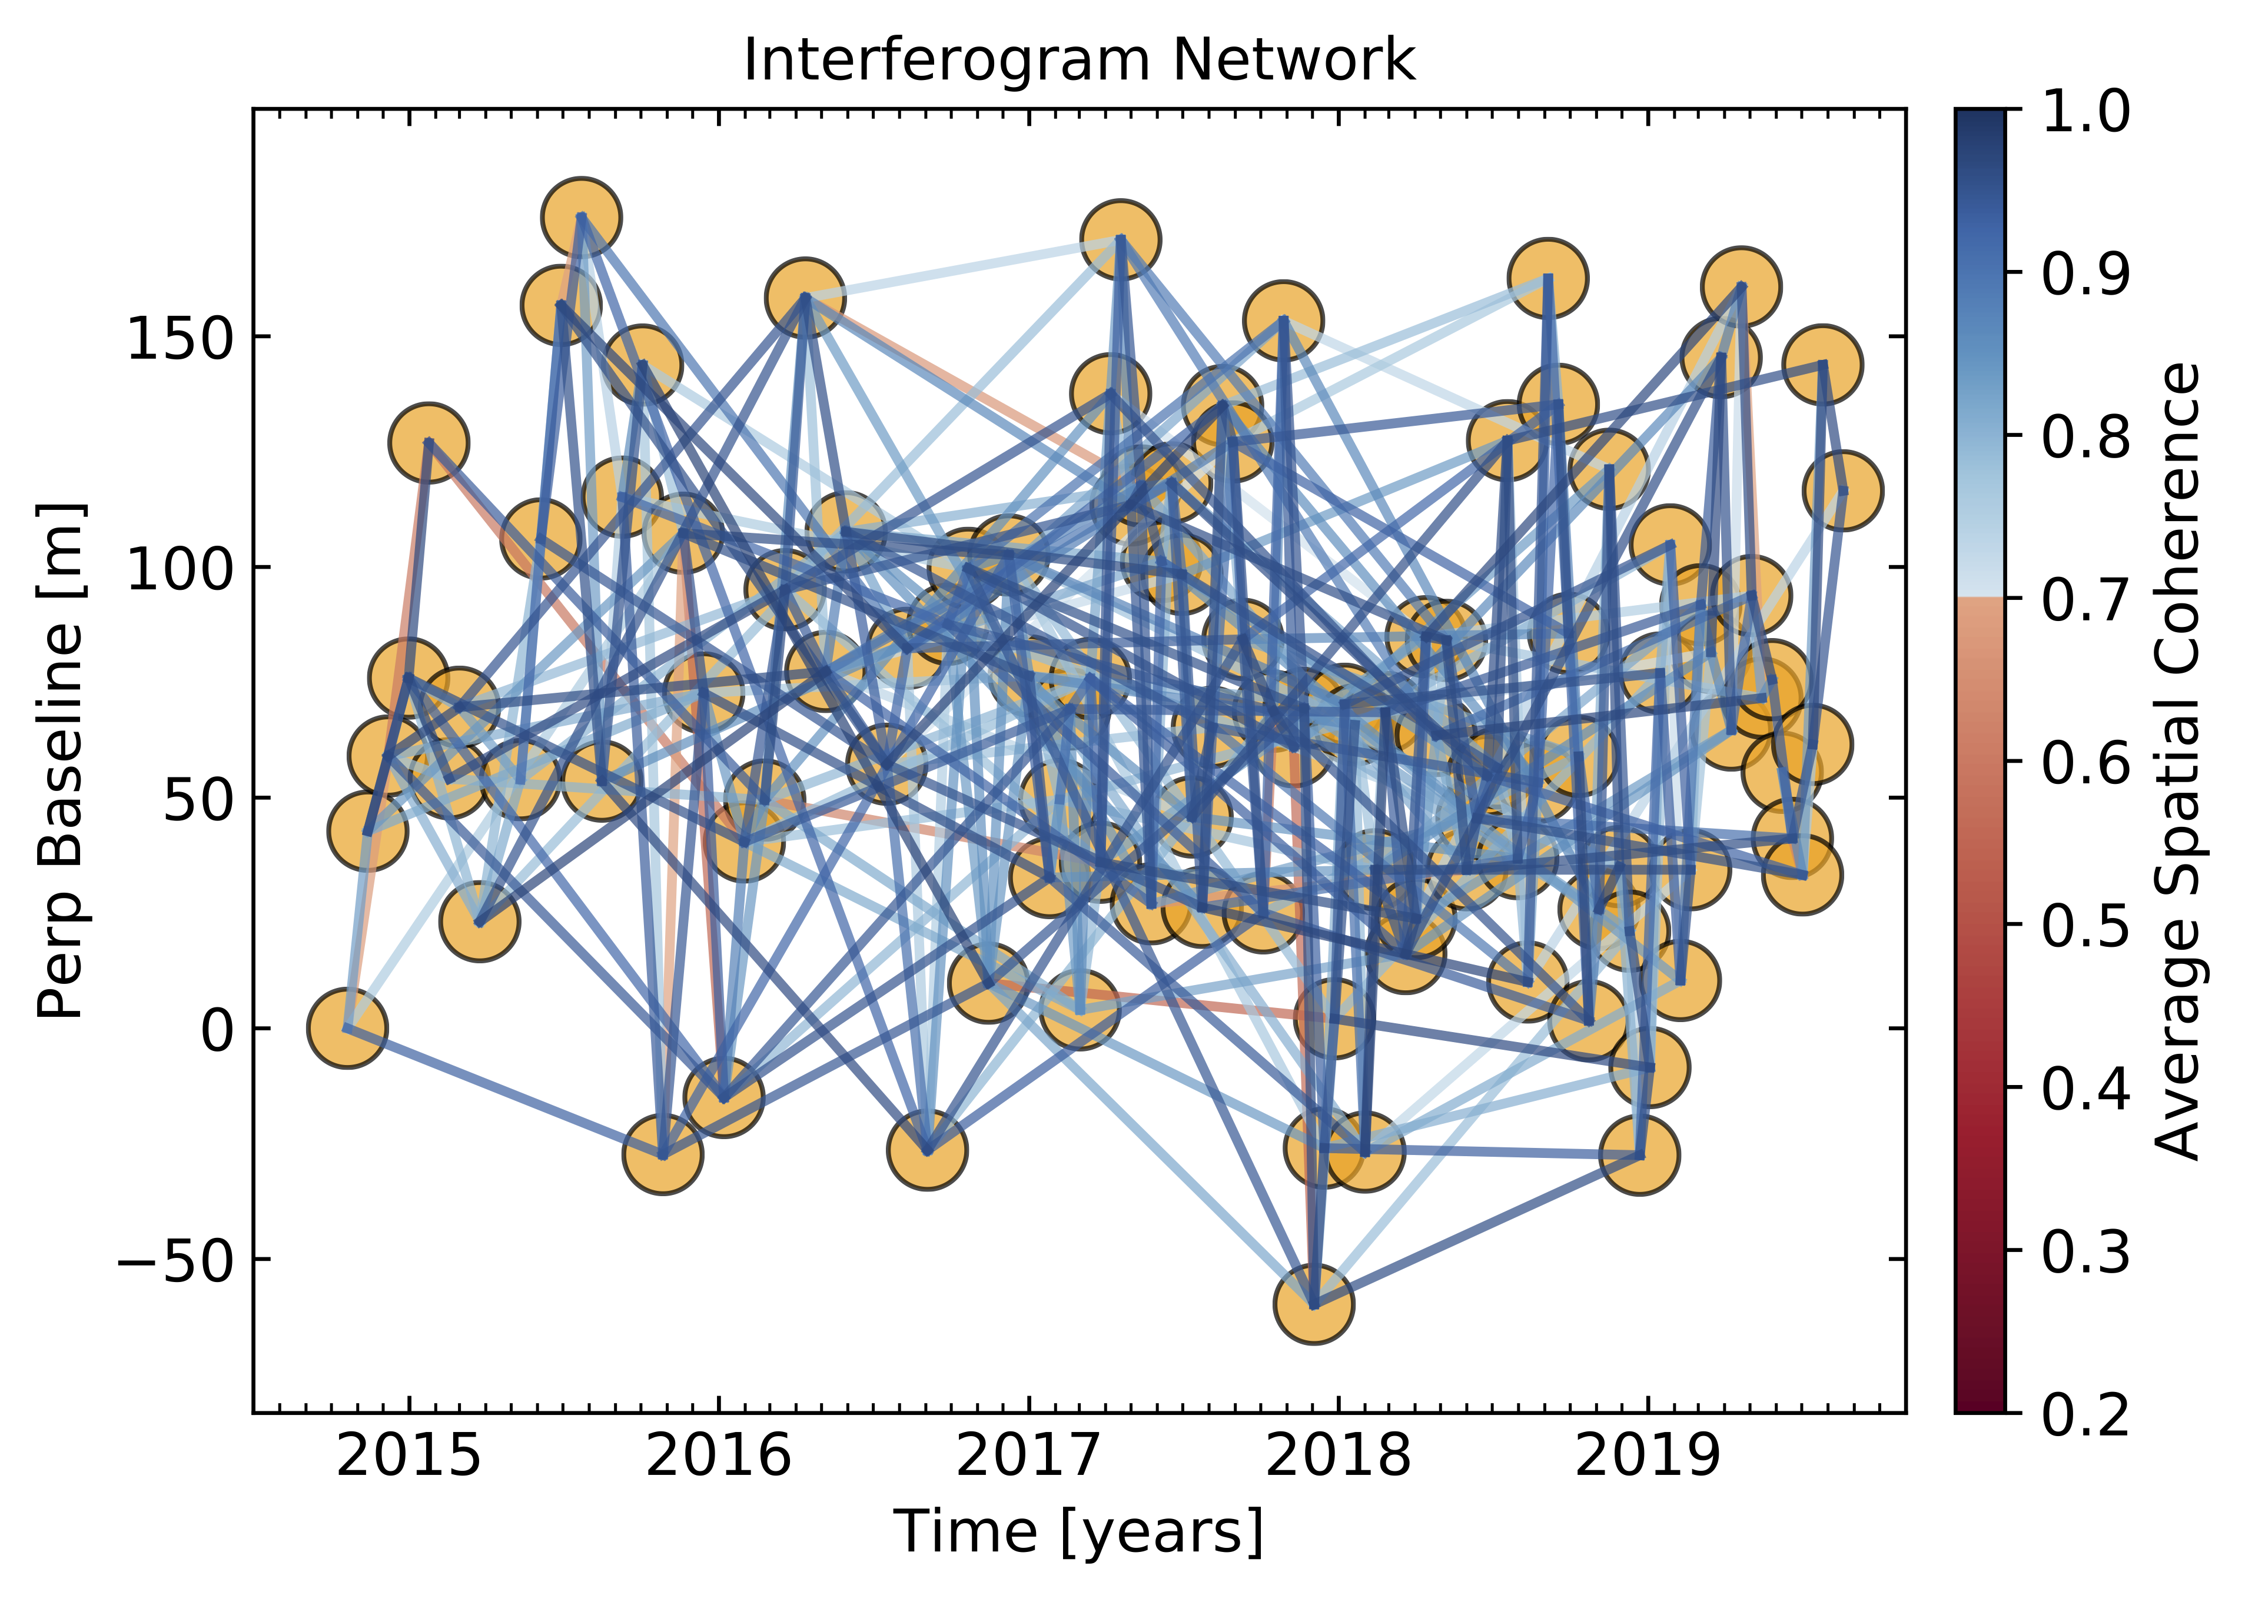
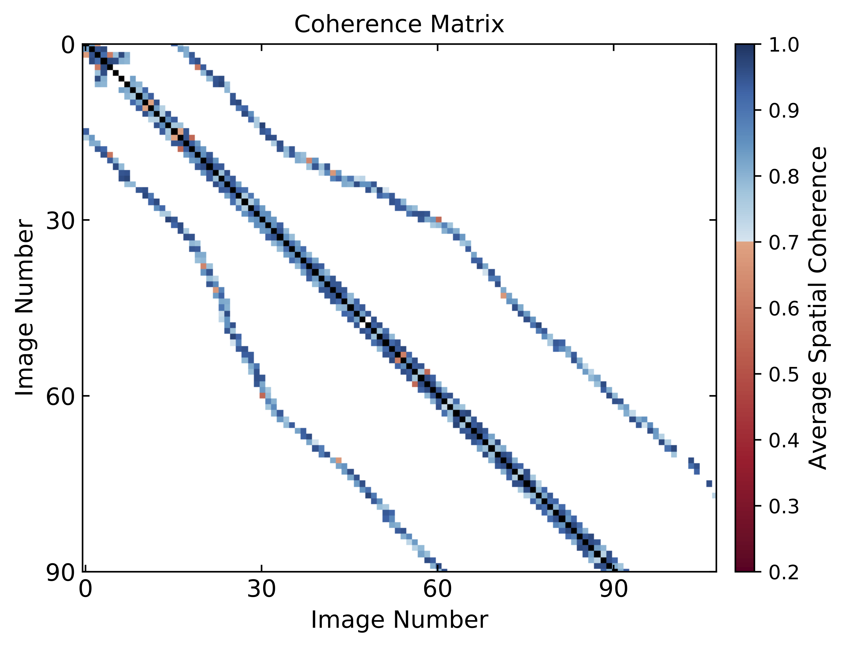
Motivation and data
We used Advanced Rapid Imaging and Analysis (ARIA) standard products (aria-products.jpl.nasa.gov/) to produce interferograms for three Sentinel-1 tracks across Tibet. We used more than 10,000 ARIA interferograms, including ~100 dates of acquisition per track since late 2014. For each track, we processed pairs with 12- and 24-day repeat times, as well as 1-year pairs. Below is an example of the interferogram networks and coherence statistics for track 41. Spatial coherence values > 0.7 (blue colors) are generally considered good.

Slide 4
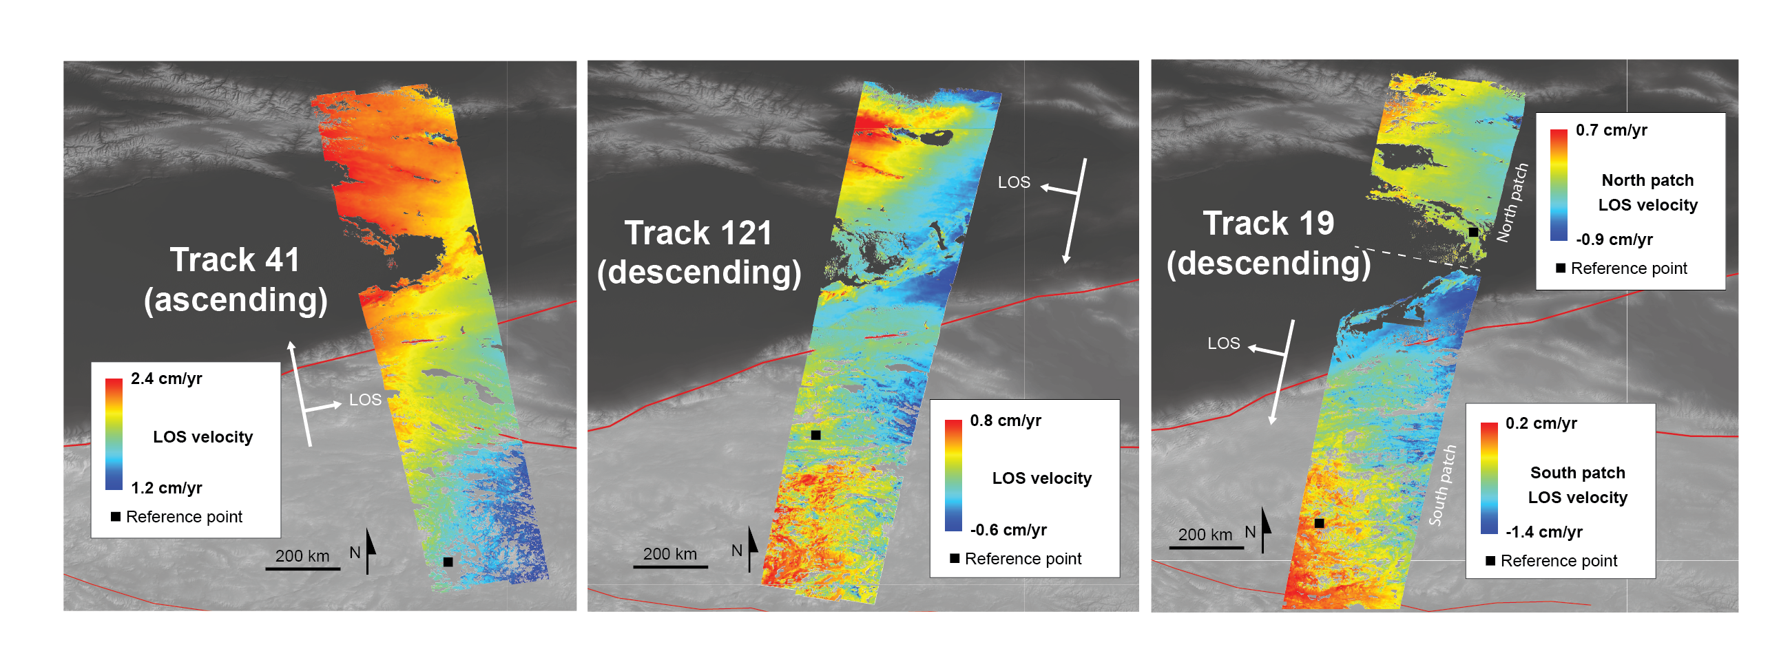
InSAR velocity maps
From the interferograms, we computed line of sight (LOS) velocity maps using the Miami Insar Timeseries software in Python (MintPy). For each track, the linear fit to LOS velocity is shown for each point in space. Warm colors indicate motion toward the satellite.

Slide 5
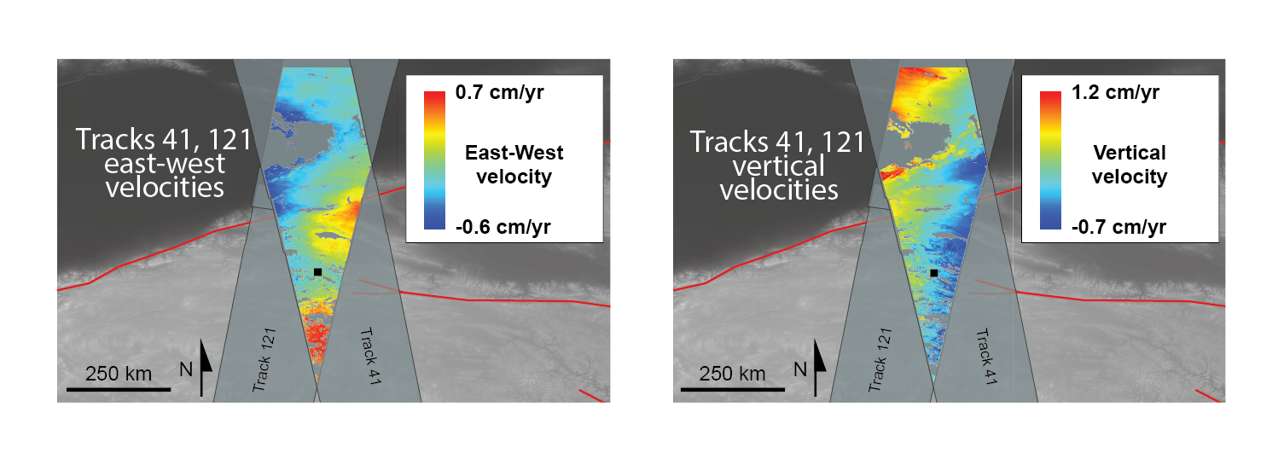
East/West, Vertical Velocity Maps
Overlapping ascending and descending tracks allow us to determine the east-west and vertical ground velocities, assuming negligible north-south velocity.

Slide 6
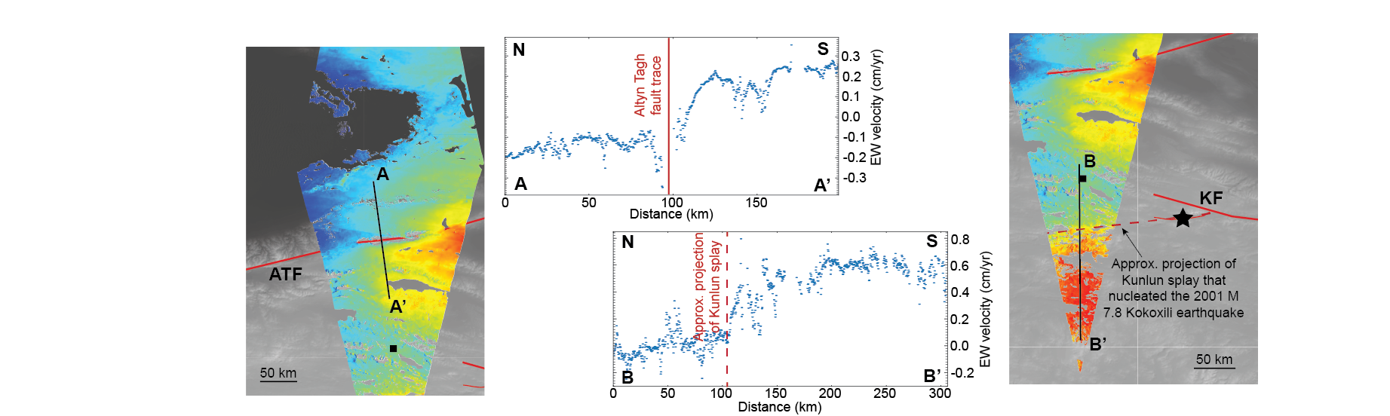
Tectonic faults
The tracks cross two large tectonic strike-slip faults: the Altyn Tagh fault (ATF) and Kunlun fault (KF). Our data show velocity gradients, particularly in the east-west component, near both these faults. The gradient in the left image closely coincides with the ATF. The gradient in the right image is south of the main Kunlun fault trace, and coincides with the westward projection of a splay fault on which the 2001 M 7.8 Kokoxili earthquake nucleated (black star = epicenter).

