Slide 1


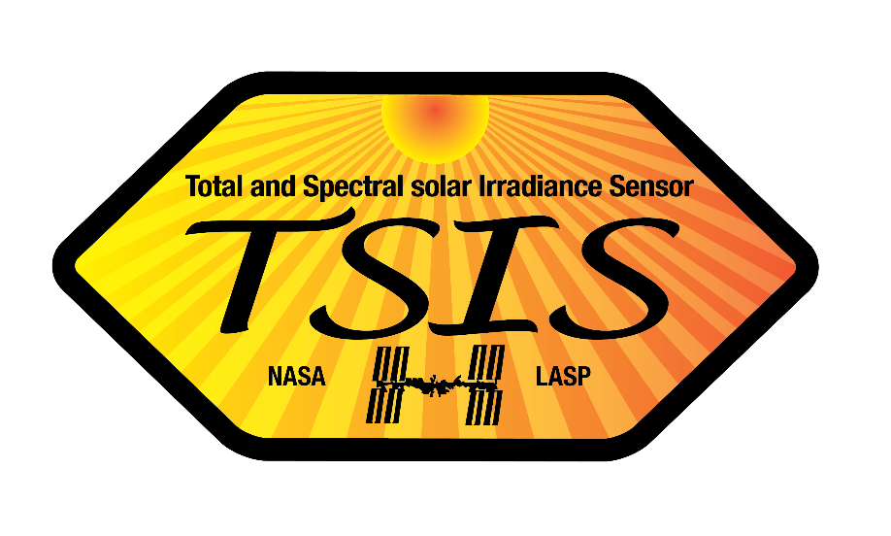


Solar Cycle Modulation of Nighttime Mesospheric Ozone as Observed by MLS
Jae N. Lee^{1,2} and Dong L. Wu²
1. Joint Center for Earth Systems Technology, University of Maryland, Baltimore County, 2. NASA Goddard Space Flight Center
Acknowledgments : NASA Sun Climate Research
J. Yue and M. Mlynczak, N. Livesey and L. Froidevaux , M. Snow and J. Harder

Slide 2


Secondary Ozone Maximum in the Mesosphere
Nighttime Ozone Climatology (2005-2018)
in the Tropics
Production
O₂ + hv → O + O
O + O₂ + M→ O₃ +M
Loss
O₃ + hv → O + O₂
O₃ + O → 2 O₂
O₃+ H → OH + O₂
For mesospheric Ozone, solar radiation
is important in chemistry.
- Very low Daytime Ozone due to short $τ$
less observation with less validation
compared to stratospheric O₃
Ozone maximum in the Stratosphere
- Chemistry of NOx and HOx compounds
Impacted by emissions of ozone depleting substances (i.e. CFCs)
largely driven by ENSO and QBO

Slide 3
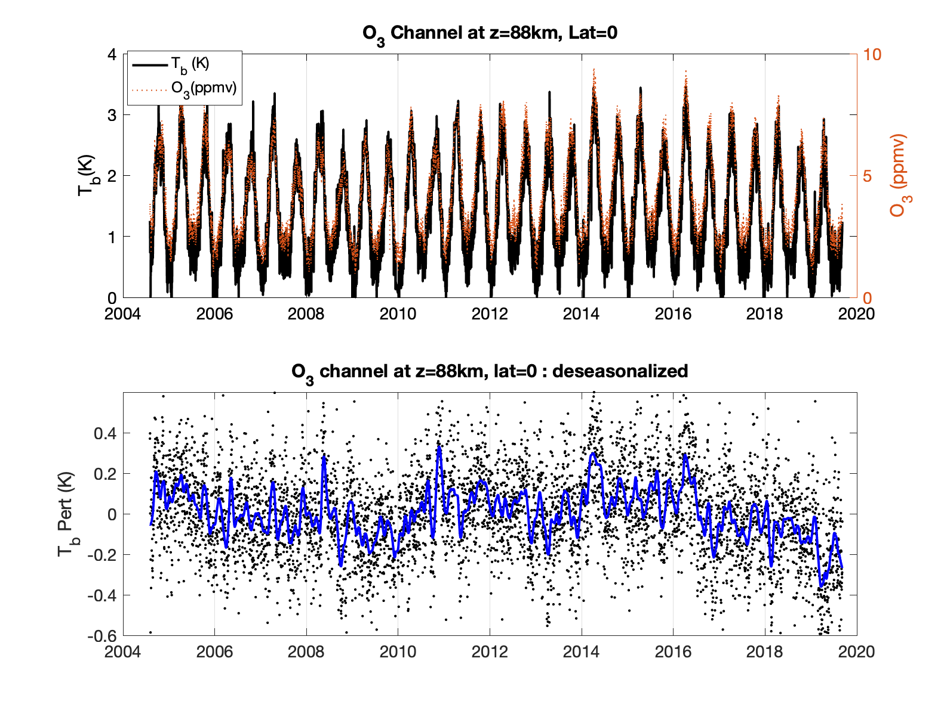

Feasibility of mesospheric ozone data at secondary ozone maximum
15-years measurement of MLS nighttime ozone data is compared with MLS radiance in 235.71 GHz at 88 Km
De-seasonalized time series of radiance shows inter-annual variation comparable to 11-yr solar cycle
Validated that MLS ozone at this level (0.002hPa) contains useful information
Lee and Wu [2020] , Earth and Space Science

Slide 4
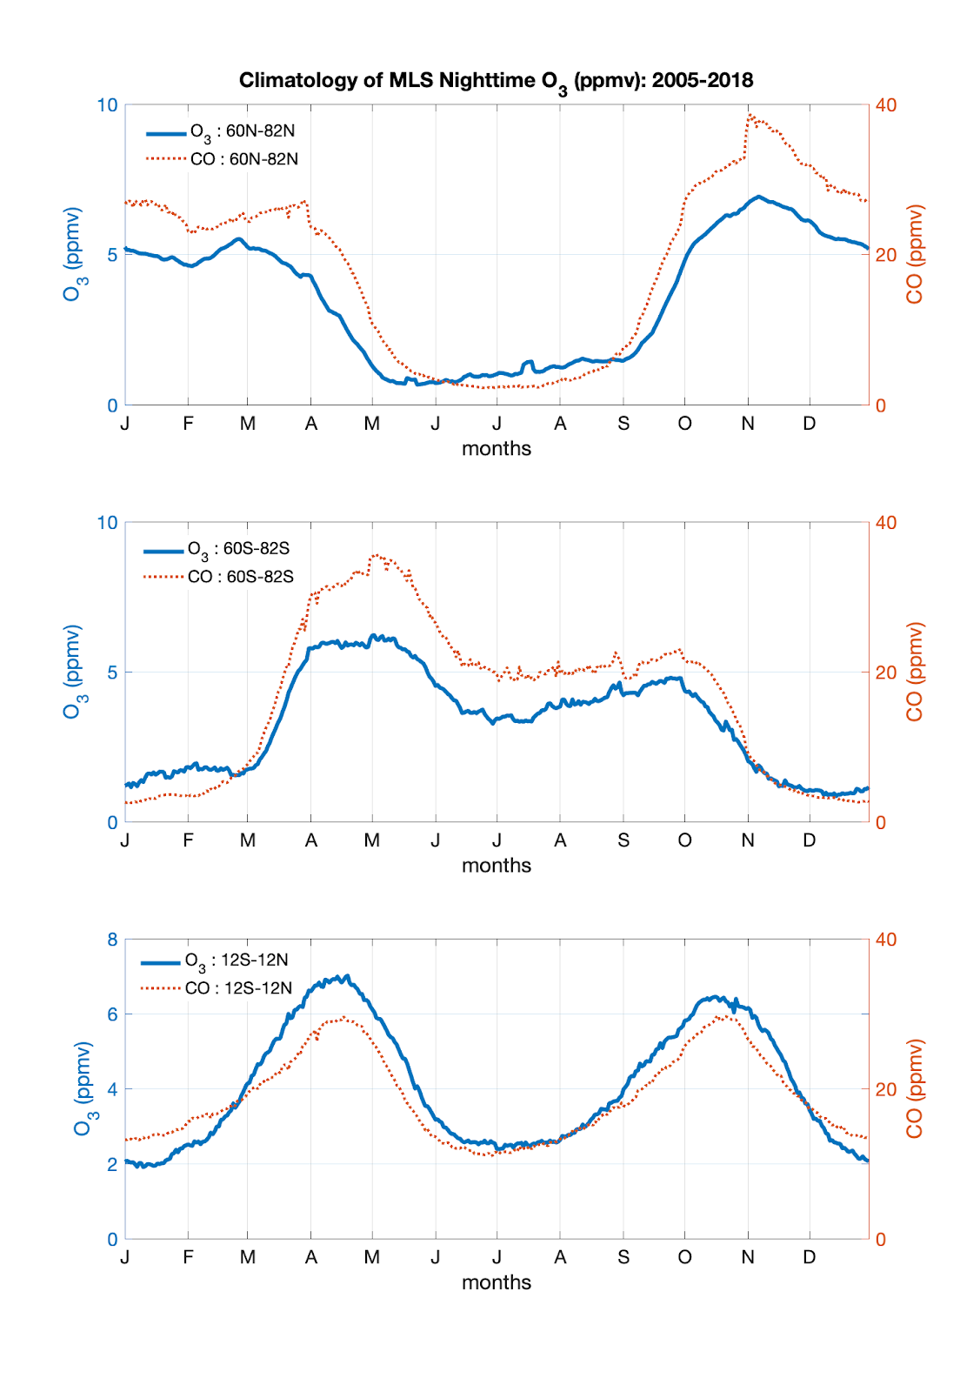
Seasonal Climatology of Mesospheric Ozone
(and Carbon Monoxide) in 2005-2018 at 0.002 hPa
NH
Seasonal variations of MLS nighttime ozone and
nighttime CO are very similar
Maximum amount in local winter
Minimum amount in local summer
Semi-Annual Oscillation (SAO) are present
Secondary peaks at local spring in high latitudes
Equally dominant peaks in the tropics
SH
Tropics

Slide 5
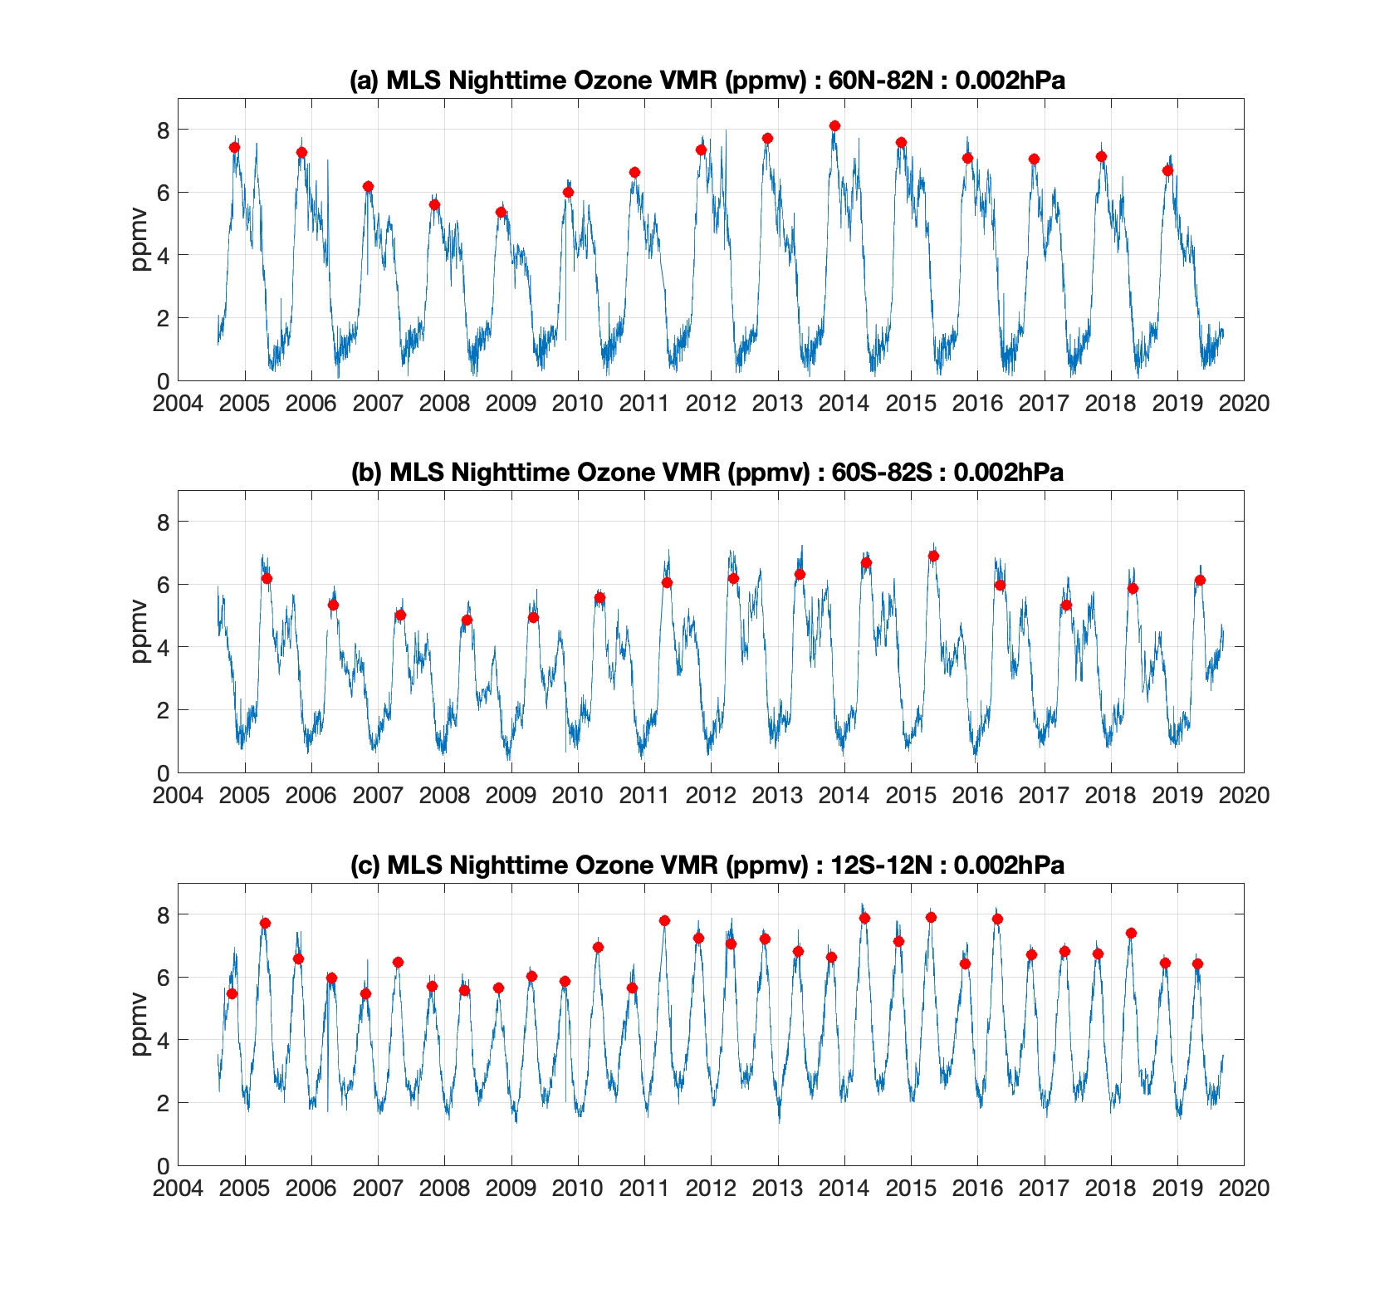
Inter-annual variation of MLS nighttime mesospheric Ozone at 0.002 hPa
15-yrs of MLS nighttime ozone data
shows ~ 20% of inter-annual variability
associated with 11-year solar cycle
in high latitudes.
Lee and Wu [2020], JGR, in review

Slide 6
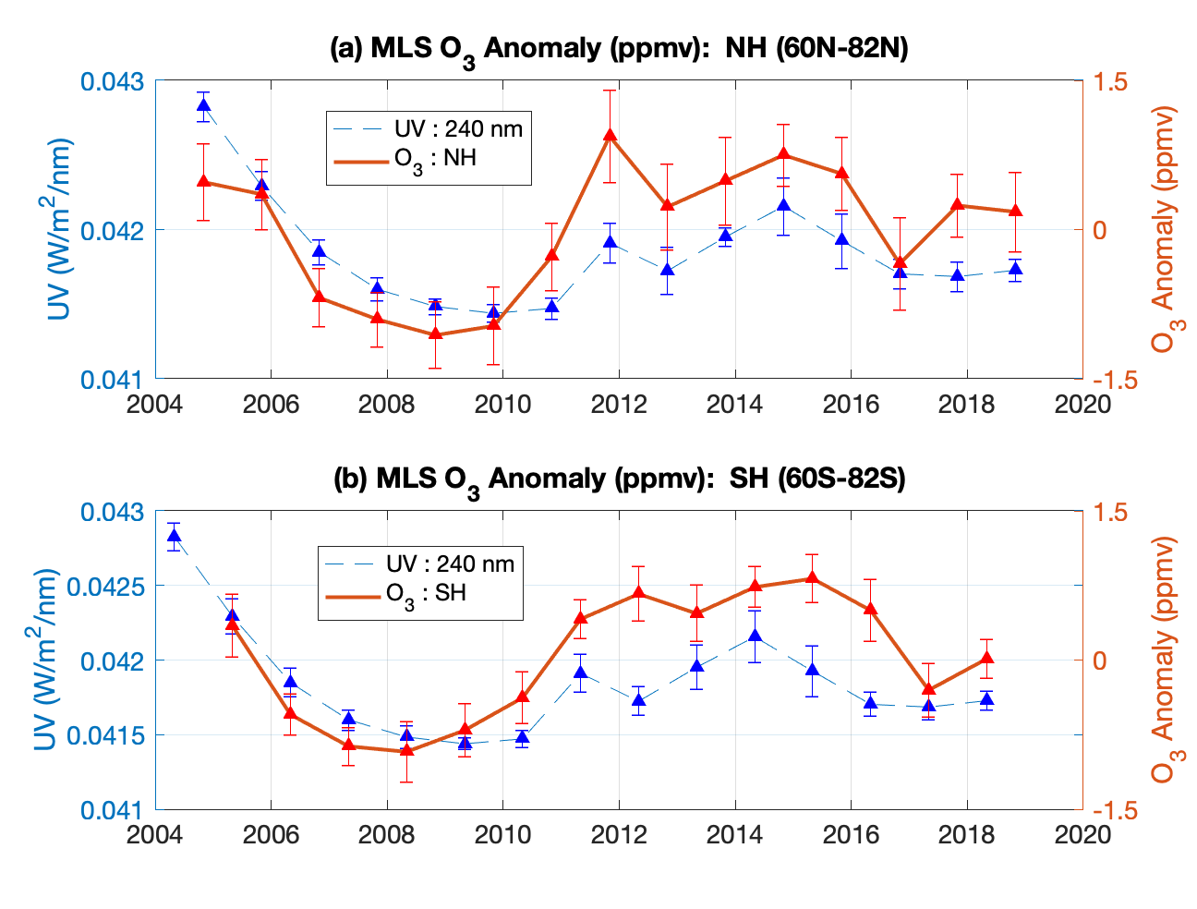
Solar cycle variation of nighttime mesospheric ozone at 0.002hPa
MLS nighttime Ozone local winter anomaly is
overlaid with SOLSTICE measured UV
Nighttime ozone shows in-phase variation
with UV at 240 nm
~20% of solar cycle variation
While nighttime ozone increases with UV in the
upper mesosphere, lower mesospheric ozone
is expected to be decreased
Increased ozone → less UV is transmitted to lower
Mesosphere → less O₂ photolysis → less O₃
SC 23
SC 24

Slide 7
Solar cycle variation and zonal mean distribution of Ozone
The amplitude of 11-year variation of nighttime O₃ (in percentage). Overlaid red curves are zonal mean O₃ VMR.
Amplitude of solar cycle variation is not always proportional to the zonal mean ozone amount.
Indicating dynamic control is also effective besides direct photo-chemical effect
Spring time (March and April) tropical Ozone enhancement is due to longer lifetime of Ozone caused by low Eddy diffusion (kzz)

Slide 8
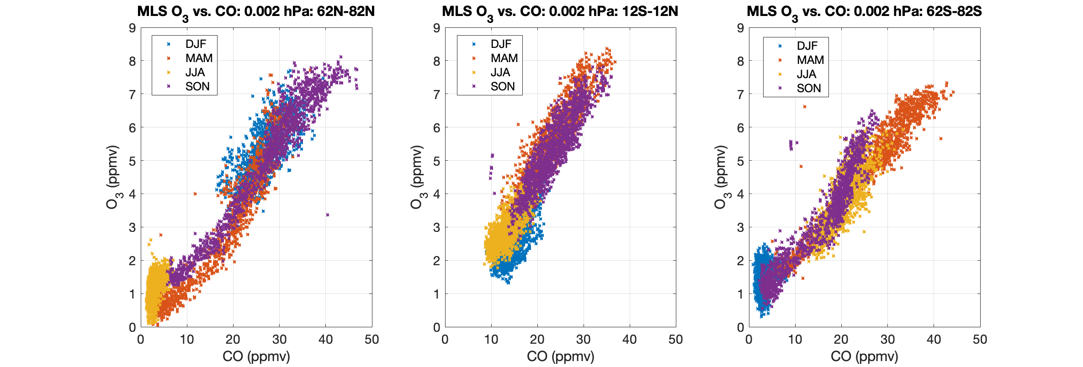
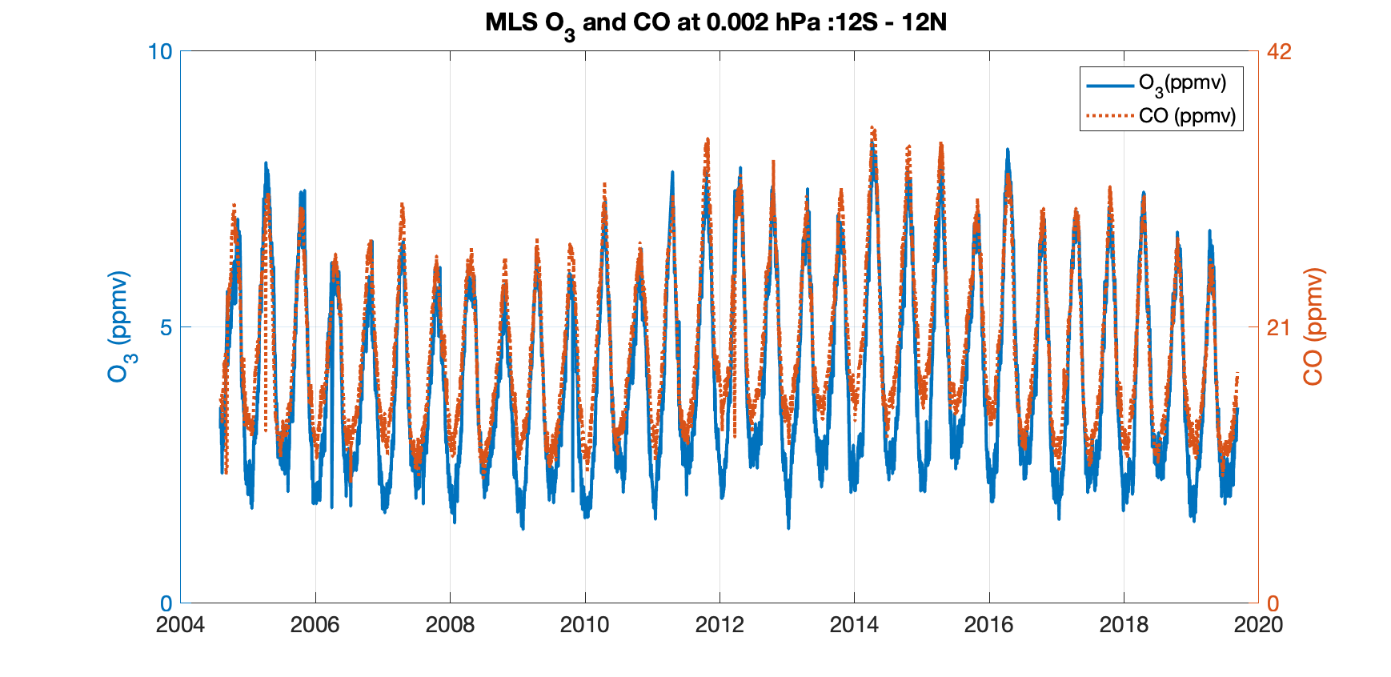
Correlations between Ozone and CO
Ozone and CO are highly correlated because both are strongly depending on UV photolysis and dynamics
Same seasonal and solar cycle variations are expected.
Similar SAO can be explained by Eddy diffusion (Kzz)
High Kzz during summer induces low Ozone and CO.

Slide 9
Summary

