Slide 1
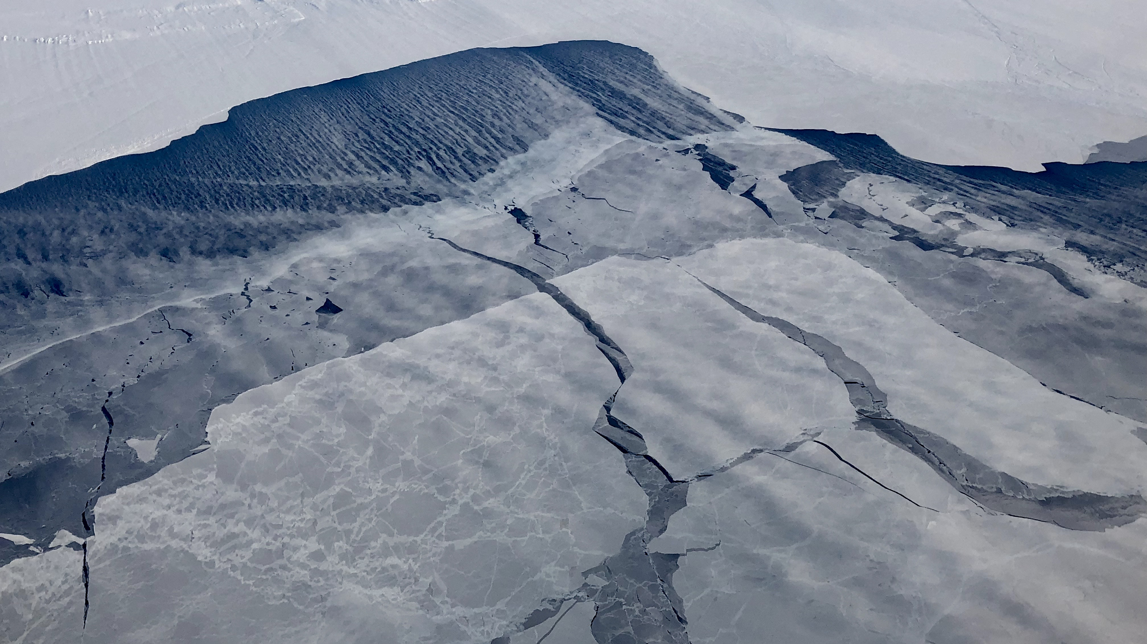
Preliminary Results: Understanding Moisture Transport Associated with Strong Cyclones in the New Arctic
Linette Boisvert, Mircea Grecu and Chung-Lin Shie
NASA Goddard Space Flight Center

Slide 2
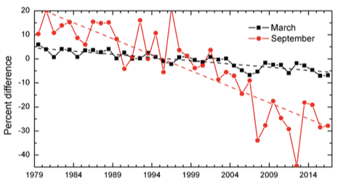
The ‘New Arctic’
Drastic change witnessed with the decline in Arctic sea ice extent since the late 1970s [Parkinson and DiGirolamo, 2016].
Worth mentioning, since the early 2000’s:
The sea ice has experienced an increased rate of decline in extent & thickness
Arctic has become warmer and wetter [Boisvert and Stroeve, 2015]
Evaporation from the ice-free ocean has been increasing [Boisvert et al., 2015]
These large changes observed in the Arctic climate system since the 2000’s has been coined the ‘New Arctic’, where sea ice:
Is more responsive to atmospheric forcing (e.g. increases in ice dynamics) [Kwok et al., 2013]) and the role of cyclones in anomalous sea ice melt events (Simmonds and Rudeva, 2012)
‘New Arctic’
Time series of Arctic sea ice extent anomalies in March & September.
The anomaly value for each year is the difference (in %) in ice extent relative to the mean for 1981-2010.

Slide 3
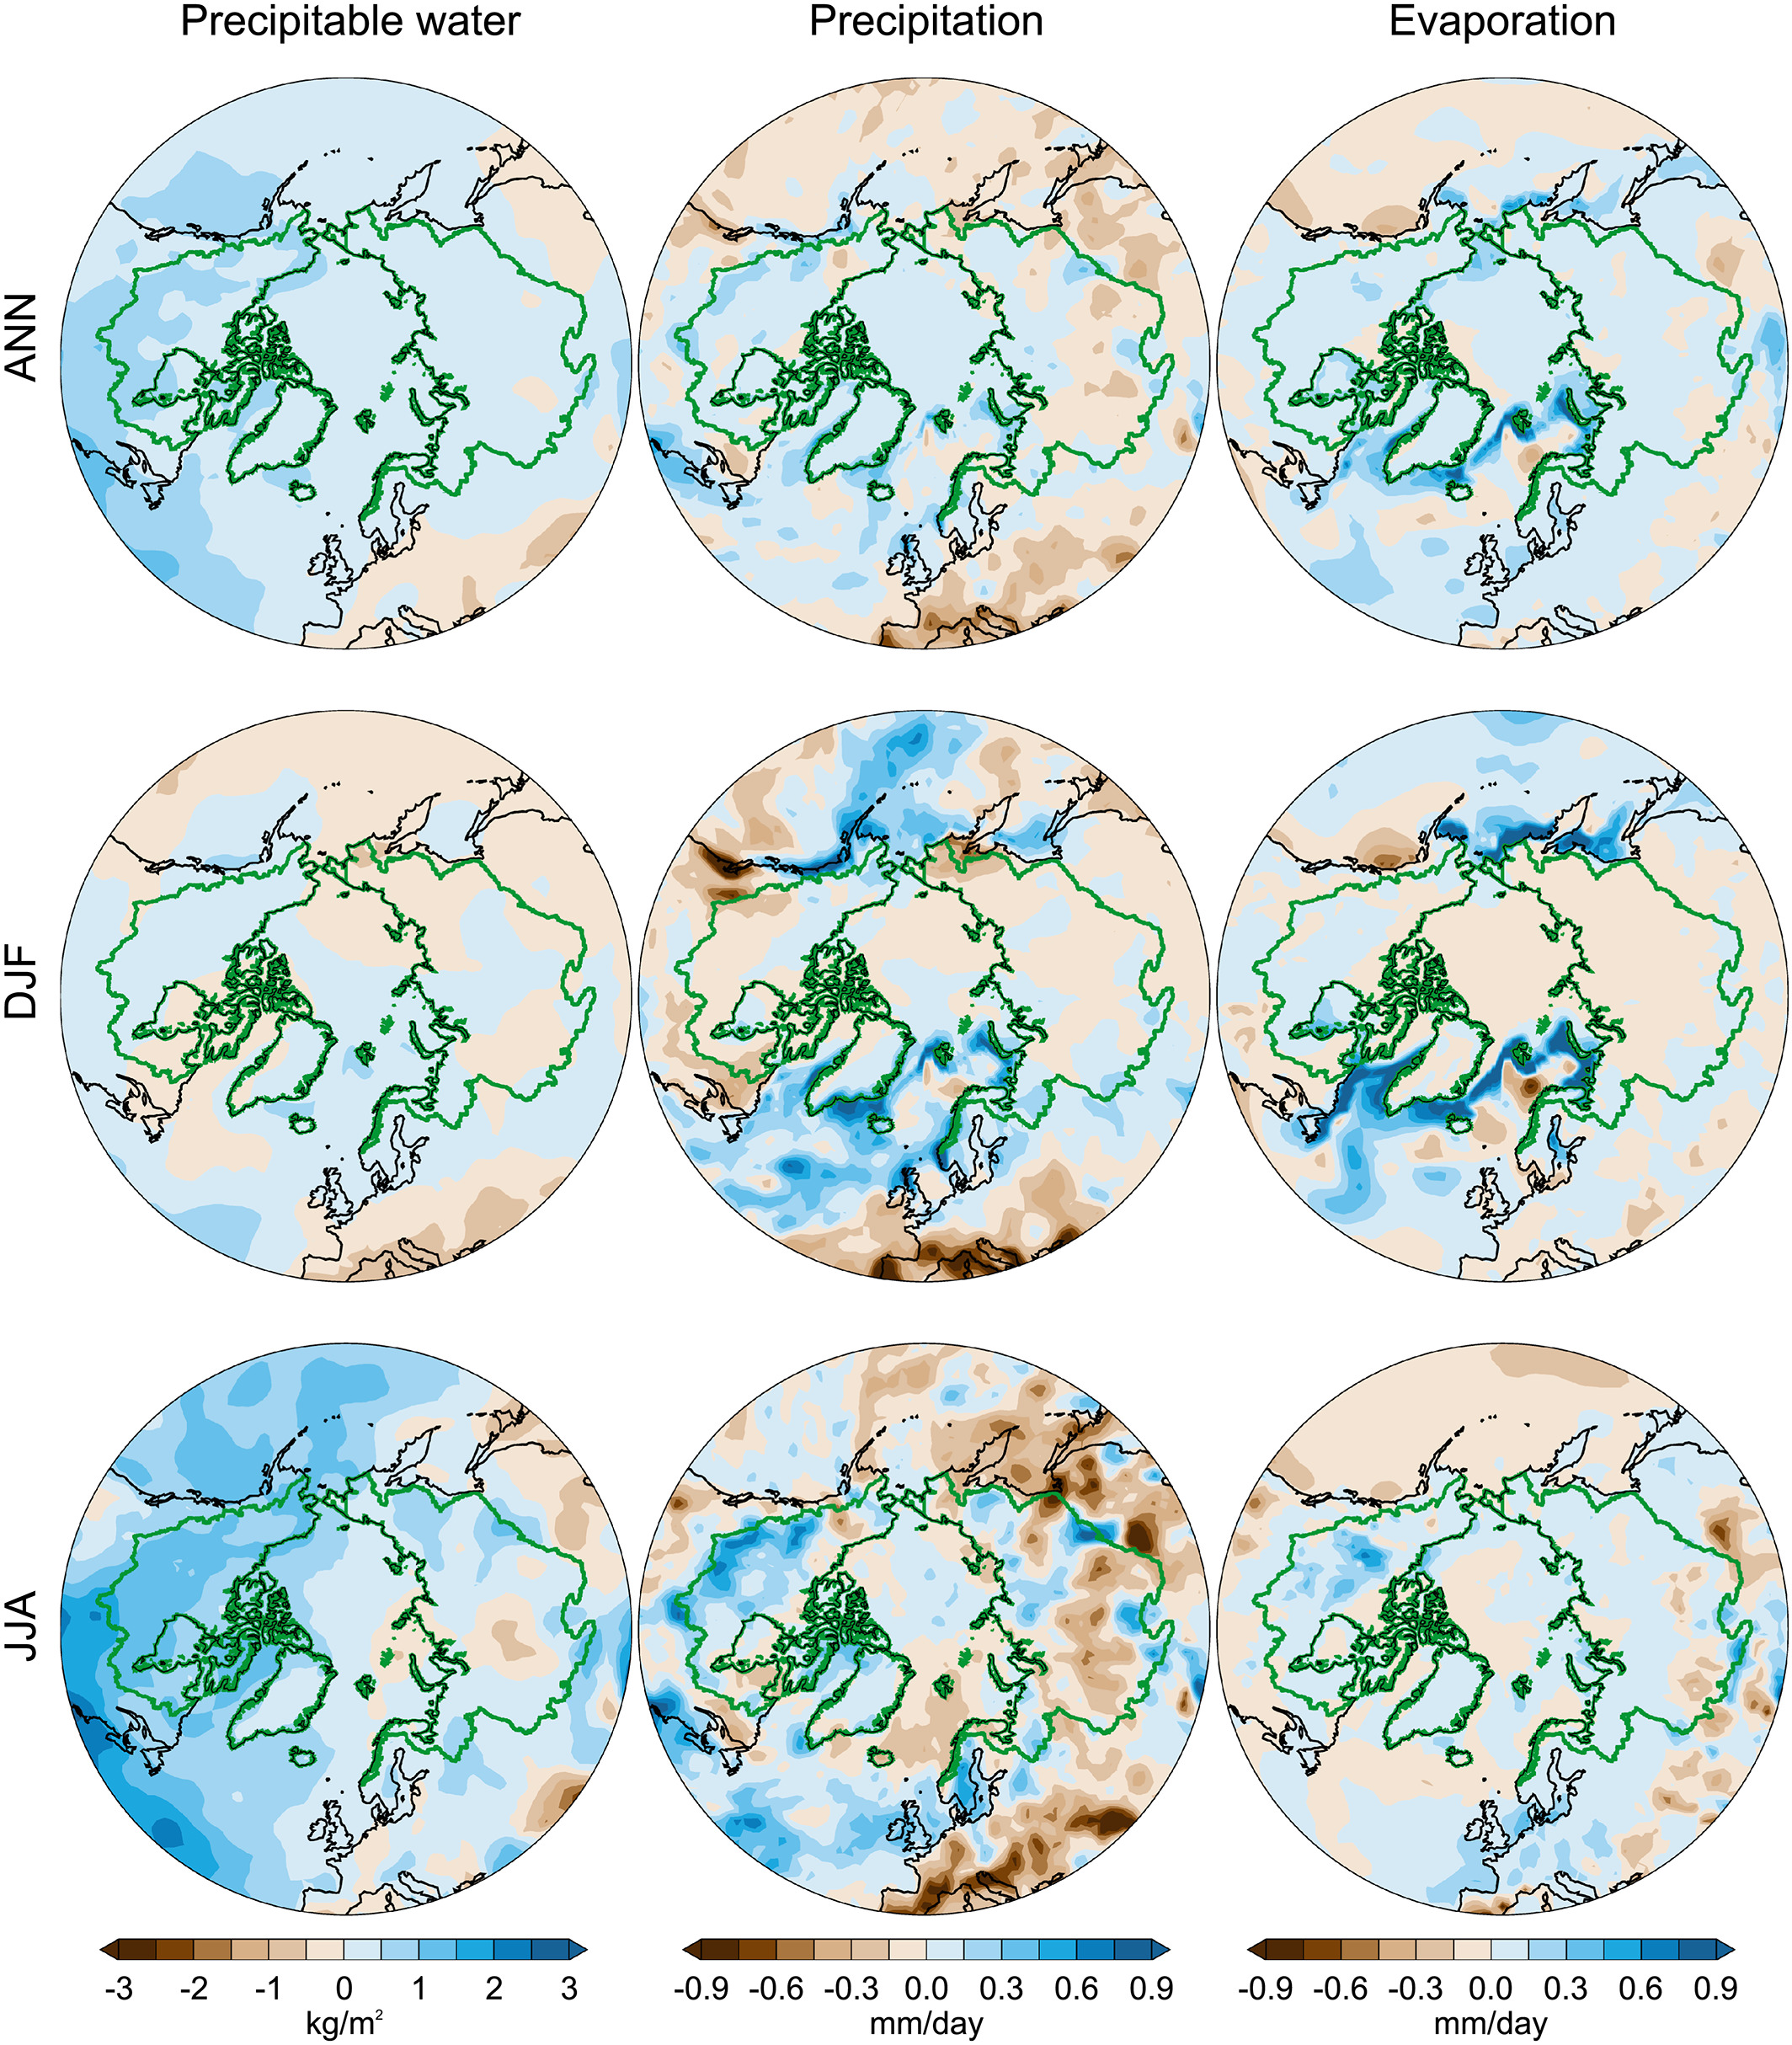
‘New Arctic’ Climate System
Currently: all aspects of the hydrologic cycle are likely affected by & also feedback on these large & rapid changes in the ‘New Arctic’ [Vihma et al., 2016].
Cyclones bring a large majority of moisture to the Arctic from lower latitudes [Jakobson and Vihma, 2010]
Changes in their frequency & intensity will also impact the hydrologic cycle significantly.
A better understanding of Arctic E-P is requisite for closing the local and global freshwater [Lique et al., 2016] & energy budgets where large uncertainties remain currently and in the future.
Figure shows increases in precipitable water, precipitation and evaporation are all increasing on an annual basis in a more recent Arctic compared to years past, likely due to warming conditions and loss of sea ice.
Epoch differences between 1986–2013 and 1958–1985 for precipitable water, precipitation, and evaporation on the basis of JRA‐55 reanalysis for annual (ANN) means, winter (DJF), and summer (JJA). The green lines indicate the boundaries of the Arctic river catchment. Taken from Vihma et al., 2016 JGR

Slide 4
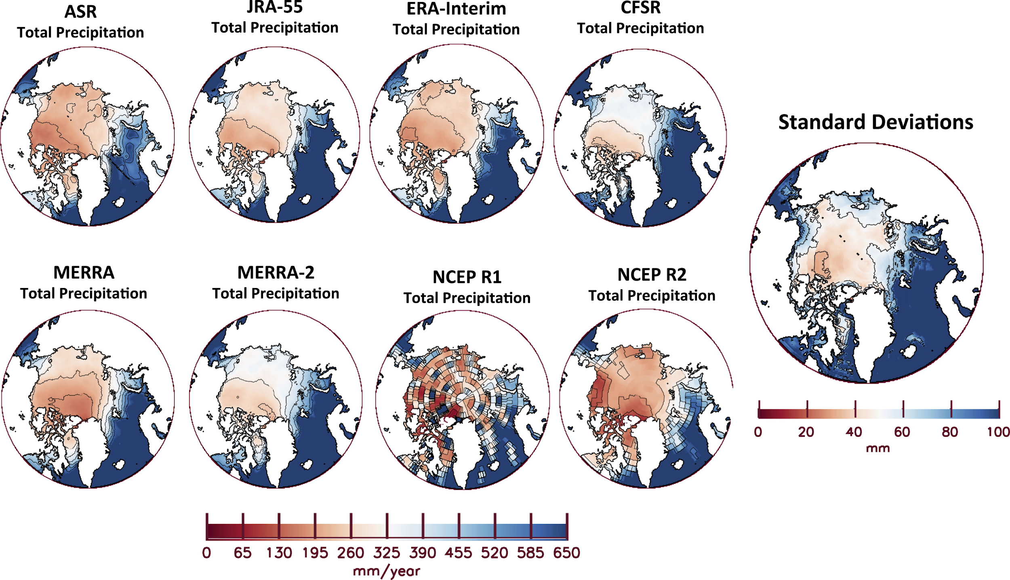
Problems with Arctic Precipitation
(E-P) associated with Arctic cyclones is one of the most important yet uncertain climate variables, whether it be modeled or observed [Vihma et al., 2016].
Observations:
Lack & difficulty of collecting long term, large-scale observations in the vast, harsh environment
Issues associated with measuring snowfall.
Direct measurements of evaporation (E) do not exist.
Modeling:
Large uncertainty & spread across precipitation (P) products from reanalyses [Boisvert et al., 2018]
Lack of knowledge on clouds & the microphysical processes that are unique to the Arctic climate.
Averaged 2000–10 yearly total precipitation accumulations (mm yr⁻¹) from each of the eight reanalyses. The image on the right shows the standard deviations (mm) between the eight reanalyses. Contour lines are on the color bars. Taken from Boisvert et al., 2018, J. Climate.
Notes:
Major features of figure: Spatial patterns of reanalyses precipitation products are fairly similar (except for NCEP R1), however the magnitudes of the total precipitation vary drastically between products.

Slide 5
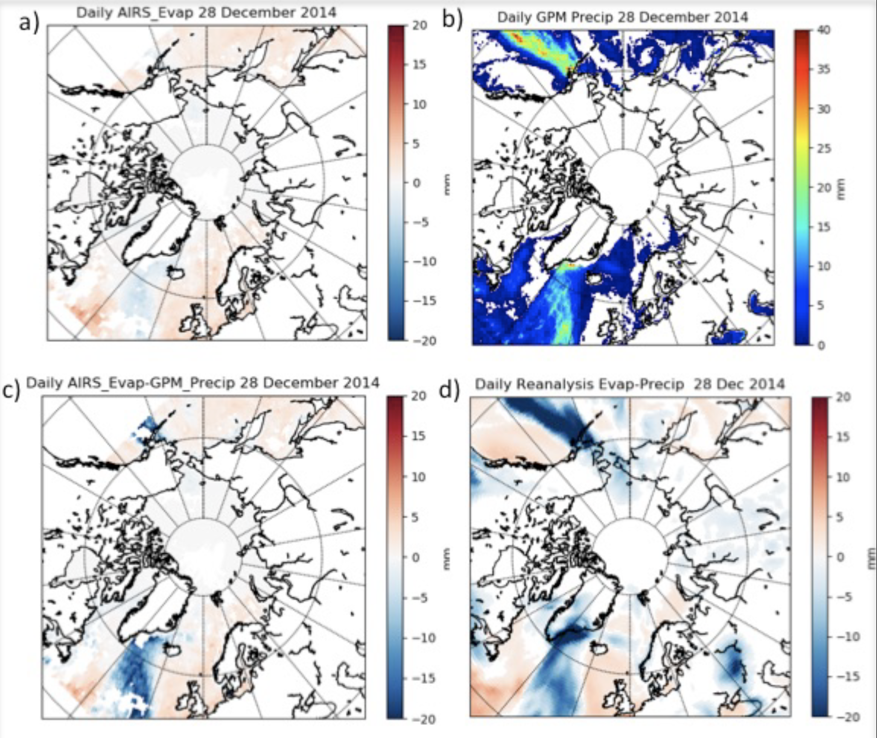
Motivation
As the New Arctic continues to undergo rapid change, observational data of P from GPM (IMERG) and E from AIRS [Boisvert et al., 2013; 2015] can give us critical information on:
Changes in (E-P) associated with cyclones
Their effects on the Arctic climate system & moisture processes therein.
Process-oriented (E-P) observations can provide invaluable insight into the potential feedbacks of (E-P) changes in the future.
a) Daily E derived using AIRS data. b) Daily GPM surface P estimates overice-free oceans. The daily estimates are derived by averaging the GPROF daily gridded P estimates from 12 passive sensors. c) AIRS E - GPM P. d) Reanalysis E-P. Note that while there is good correlation between the satellite and reanalysis E-P, there are also significant magnitude differences. These differences are difficult to reconcile based on water vapor conservation principles because the water vapor is not conserved in reanalyses.

Slide 6
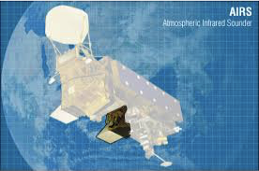
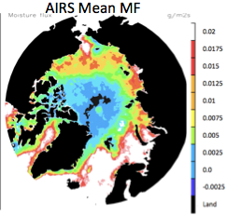
Evaporation with AIRS
Variable | Unit | Source
Skin Temperature | K | AIRS
1000 hPa Air Temperature | K | AIRS
1000 hPa Relative Humidity | % | AIRS
1000 hPa Geopotential Height | m | AIRS
10 m wind speed | m/s | MERRA-2
Ice Concentration | % | SSMI
AIRS is a cross-track high spectral resolution infrared sounder on NASA’s Aqua satellite.
AIRS has daily, global coverage & allows for accurate retrievals under most cloud conditions
Important in the Arctic where data is sparse and clouds are prevalent.
AIRS V6 Ts and q data produce accurate estimates in the Arctic when compared to in-situ data
E is estimated with the bulk-aerodynamic method using Monin-Obukhov Similarity Theory (MOST) and an iterative calculation scheme based on Launiainen and Vihma [1990] with a few modifications tailored to boundary conditions and roughness of sea ice in the Arctic. [Boisvert et al., 2013]
Table of variables used to compute E.
AIRS Mean moisture flux (MF), equivalent to mean evaporation for September 2003-2012. Units are in g/m²s. Positive values are form the surface to atmosphere.
Notes:
MOST=monin-obukhov similarity theory

Slide 7
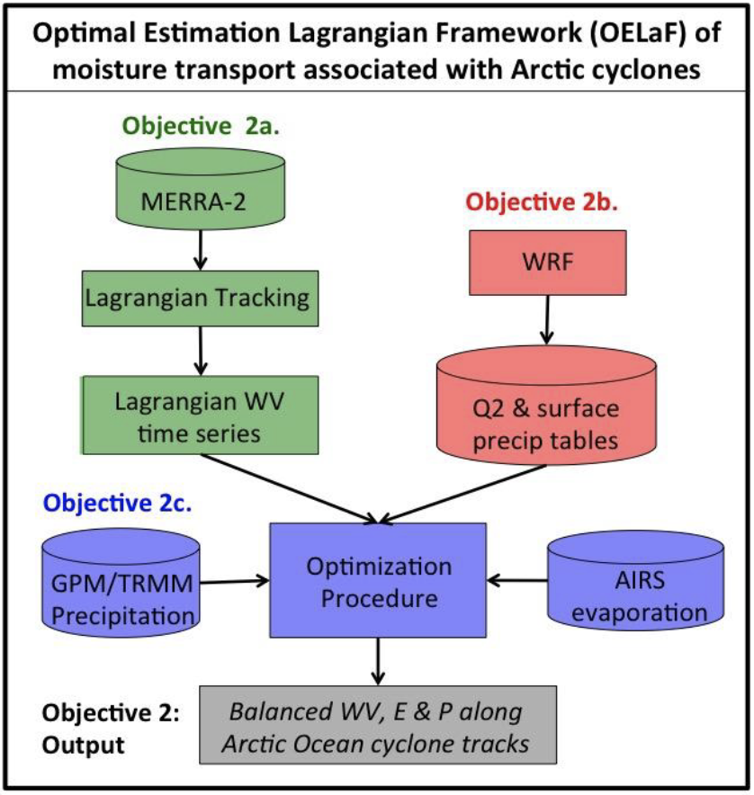
Long Term Plan
Lagrangian framework to track Arctic moisture from cyclones and adjust the moisture term at each timestep to observational E-P.
provides more intuitive insight into physical processes
Integration of GPM precipitation estimates & AIRS based evaporation product into the analysis.
Backwards integration of reanalysis transport and conservation equation starting at the end of the Arctic cyclone trajectories
GPM P & AIRS E along the trajectories will be attached to the Lagrangian series and used in an optimal estimation framework to provide the most likely q estimates in agreement with both GPM P and AIRS E.
Outcome: more accurate Arctic cyclone moisture transport and optimally balancing the moisture transport along cyclone tracks, where this could not have been done previously using just reanalysis data alone.

Slide 8
Case Study: December 2015
IMERG data are not present over sea ice
Magnitude of precipitation in North Atlantic between IMERG and ERA-I vary
Large evaporation from North Atlantic sea ice free areas

Slide 9
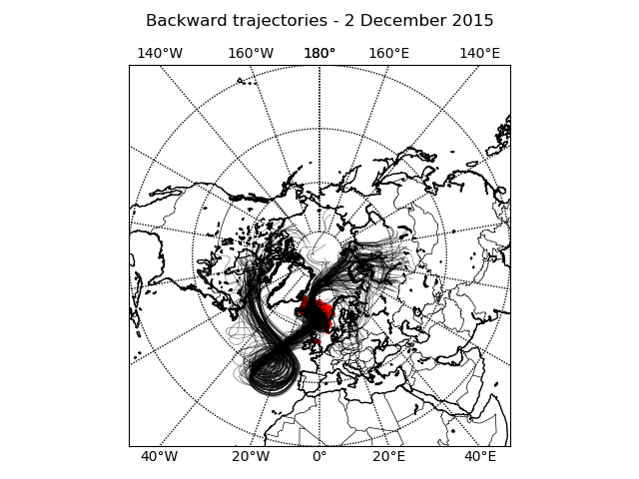
Case Study: Single Cyclone Event December 2015 Backwards trajectories
ERA-Interim moisture particles are Langrangian tracked backwards 10 days for a cyclone event
Moisture is drawn in from Canadian Archipelago and Northern Russia.

Slide 10
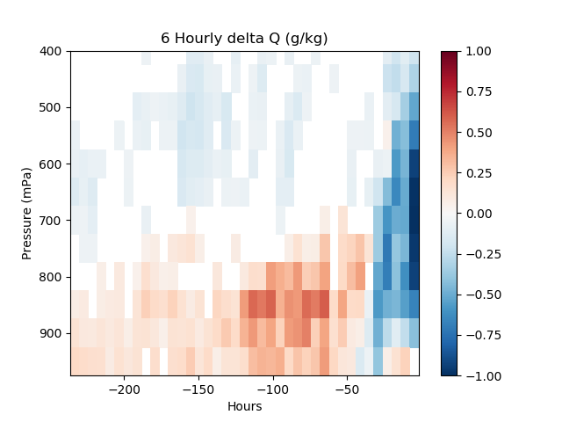
10-day composite moisture changes from December Cyclone
Moisture is gained along the trajectory at low levels (+positive values i.e. mainly via evaporation)
Just a few days before where the cyclone ended moisture was lost (-negative values, i.e. mainly via precipitation)
Note slight moisture gain at low levels at time of cyclone (likely local evaporation)

Slide 11
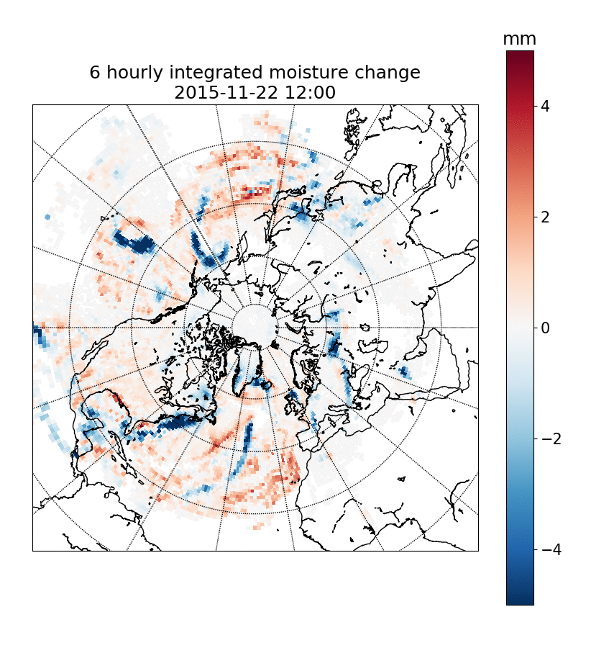
Vertically integrated 6 hourly water vapor changes
Red colors show where the moisture is coming from (evaporation) and blue colors are where the moisture is going (precipitation).

Slide 12
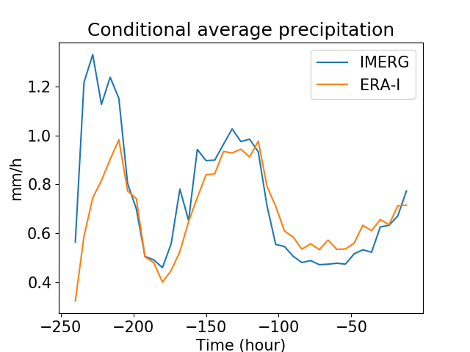
ERA-5 and IMERG particle-averaged precipitation
The precipitation along the trajectories for the December 2015 cyclone from IMERG are compared with ERA-I
Large differences exist along the moisture trajectories.

Slide 13
Summary:
A Lagrangian transport scheme has been used to track the transport of moisture into a North Atlantic cyclone.
Reanalysis and IMERG precipitation associated with the tracked atmospheric flows have been analyzed and found to exhibit notable differences.
A similar analysis will be carried out for the reanalysis and satellite evaporation products.
The analysis tools are automatized and ready for production
Systematic differences will be investigated and the water vapor transport dq/dt will be updated using an optimal estimation procedure.

Slide 14
Future Work
Development of an Arctic cyclone trajectory database for 2003-2020.
Development and implementation of the OELaF in order to track and balance moisture associated with Arctic cyclones.
Utilization of NASA GPM and AIRS data to constrain moisture transport from reanalysis along Arctic cyclone trajectories.
Multiple scientific studies dealing with strong cyclone precipitation, behavior (intensity, frequency, phase), and the impact on the Arctic sea ice pack.
Improved understanding of precipitation and moisture processes associated with strong cyclones in the Arctic.

