Slide 1


The Next Generation Drought Index Project
Daniel Osgood and Markus Enenkel

Slide 2

World Bank Next Generation Drought Index
WHY?
Basis risk and sensitivity remain major challenges for anticipatory financing mechanisms.
WHAT?
Cogeneration of anticipatory financing mechanisms with improved datasets, methods, and technologies to reduce basis risk
HOW?
Developed a conceptual framework and tools for a set of indices or indicators which will better monitor and trigger financial responses to severe drought events
TAKE-HOME MESSAGE
Co-design/co-generation approach is required to triangulate evidence and build on the convergence of evidence to tackle basis risk and sensitivity of anticipatory financing mechanisms.
Notes:
Respond to need to
create robust, simple indexes that are easy to validate, communicate, improve with feedback and not sensitive to a few mm measurement error.
must be tailored and co-generated with stakeholders to meet key performance criteria, design, calibration, and validation process.
Cogeneration Process
Start with “benchmark” index, a set of the most critical use cases in design
Go through them with demo tools for a step by step design/feedback/evaluation
different elements tailored for different groups and tasks.
These tools are updated based on stakeholder’s live based feedback

Slide 3
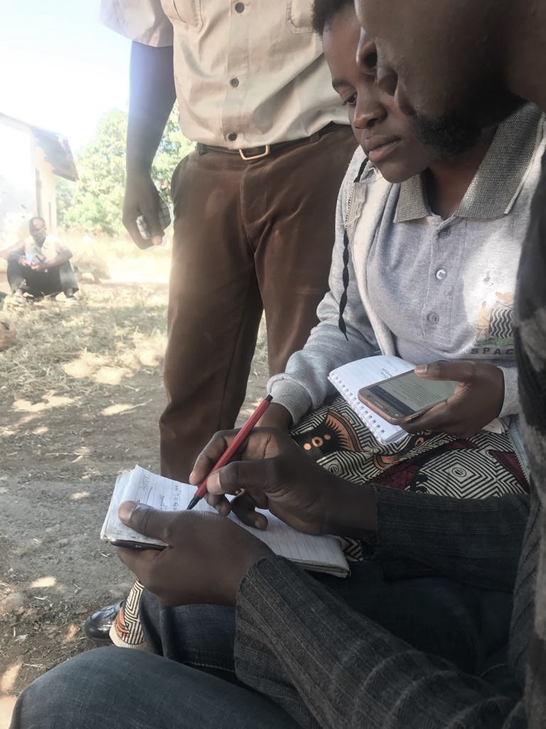
BACKGROUND
Anticipatory financing mechanisms are becoming popular mechanisms for drought risk management
Basis risk and sensitivity remain major challenges
Improved datasets, methods, and technologies key to reducing basis risk

Slide 4
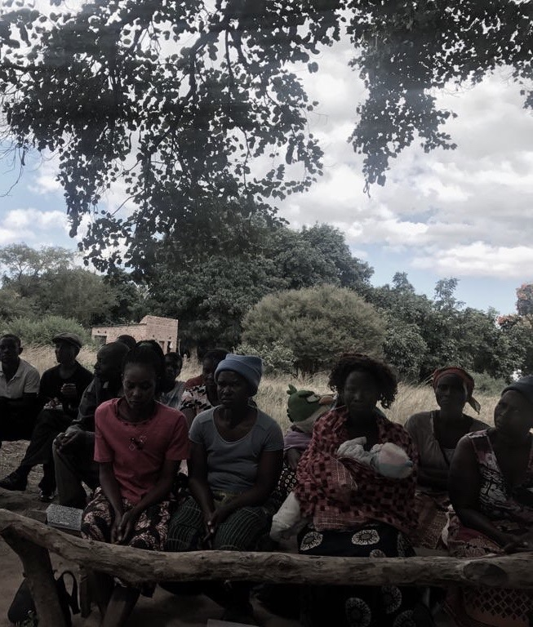
Background
Remote sensing data often used because there are few other data sources
Paucity of validation/calibration data, incorrect, estimates lack of knowledge of extent of errors
Models may miss key local features
Phenology (crop timing) may be assumed incorrectly by couple of weeks
Eg due to elevation, temperature, availability of inputs, labor.
Couple of weeks off can lead to very different water stress results, missing major events

Slide 5
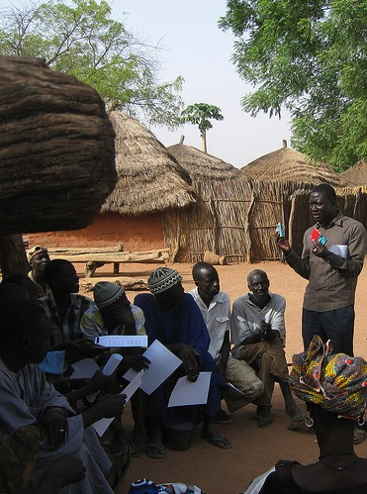
Co-Production essential
The next generation of drought indexes must be
  tailored and co-generated with stakeholders
  meet key performance criteria
  design, calibration and validation process

Slide 6
NEXT GENERATION DROUGHT INDEX PROJECT
The World Bank contracted a research consortium lead by IRI and including IWMI and AIR worldwide to develop a conceptual framework for a set of indices or indicators which will better monitor and trigger financial responses to severe drought events.

Slide 7
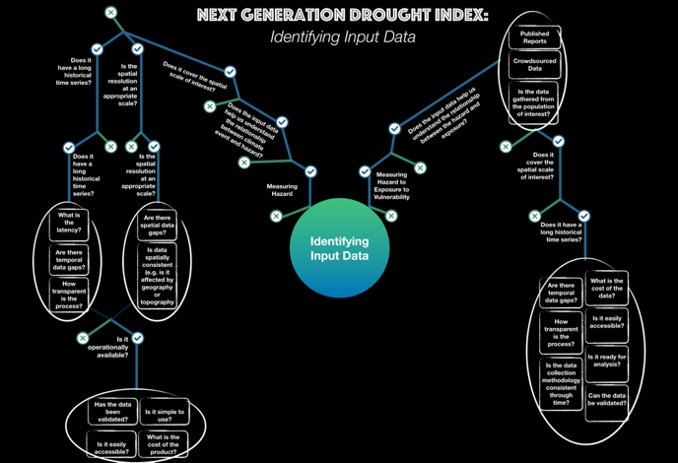
DECISION FRAMEWORK
The consortium is utilizing a decision tree framework that provides an easily implementable structure on how to assess and develop a drought index.

Slide 8
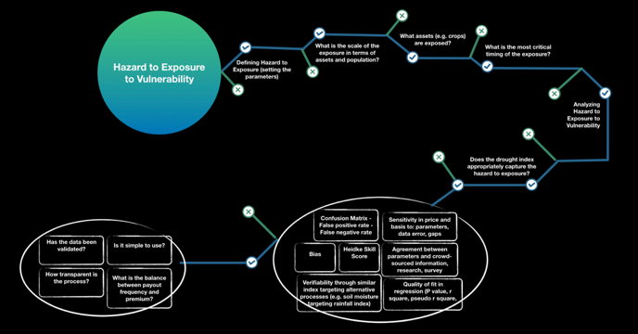
DECISION FRAMEWORK

Slide 9
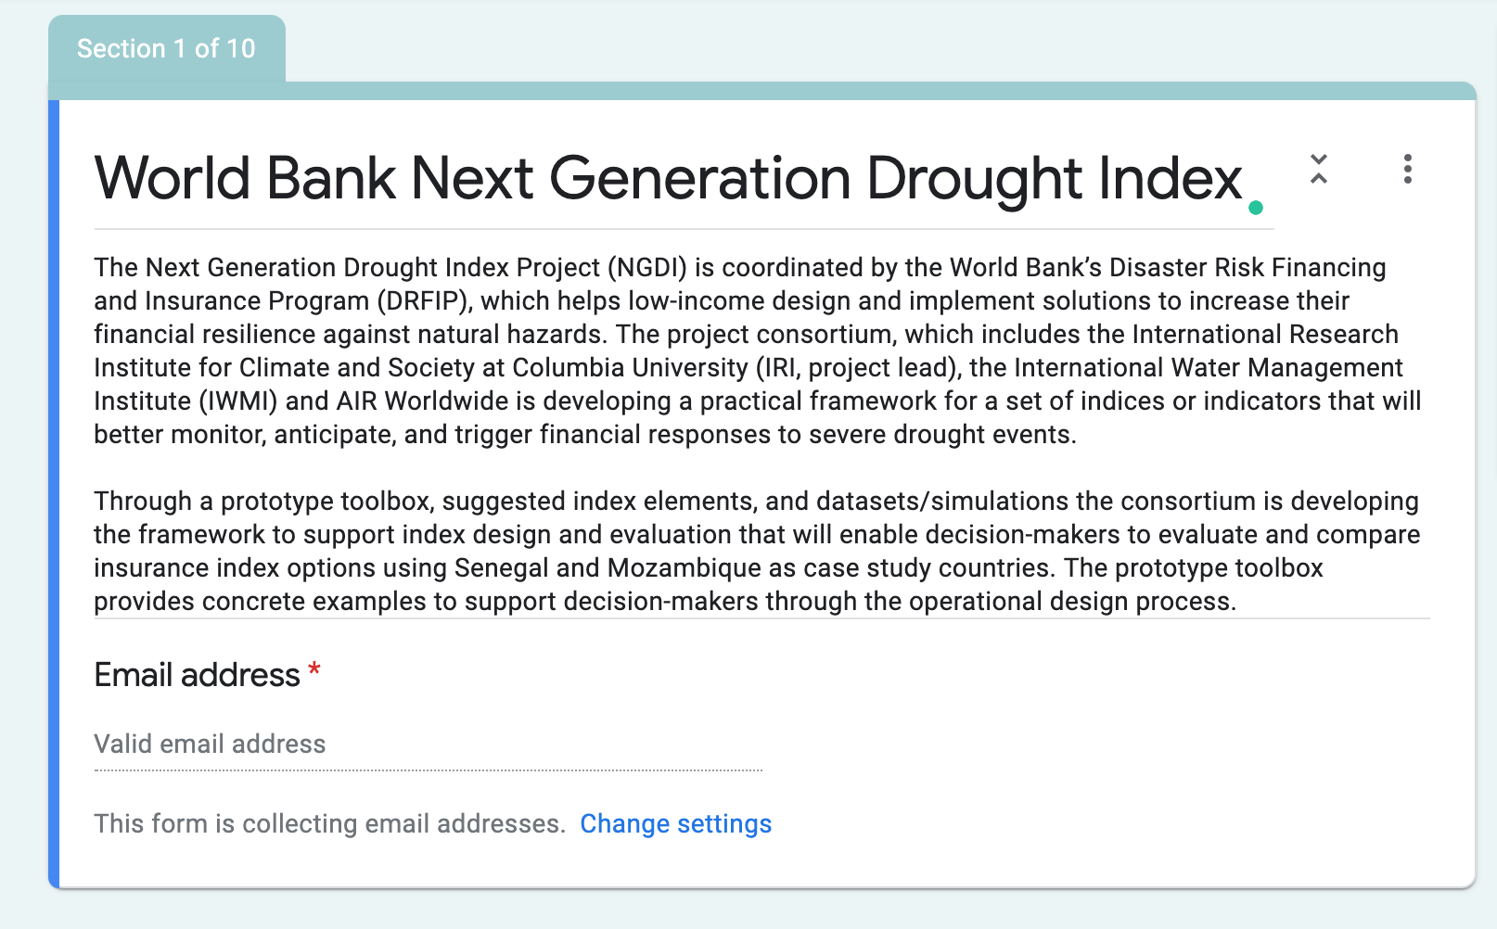
DECISION FRAMEWORK
The project has assembled together various data and tools that illustrates how a decision maker can go through the different stages of the index design process.

Slide 10
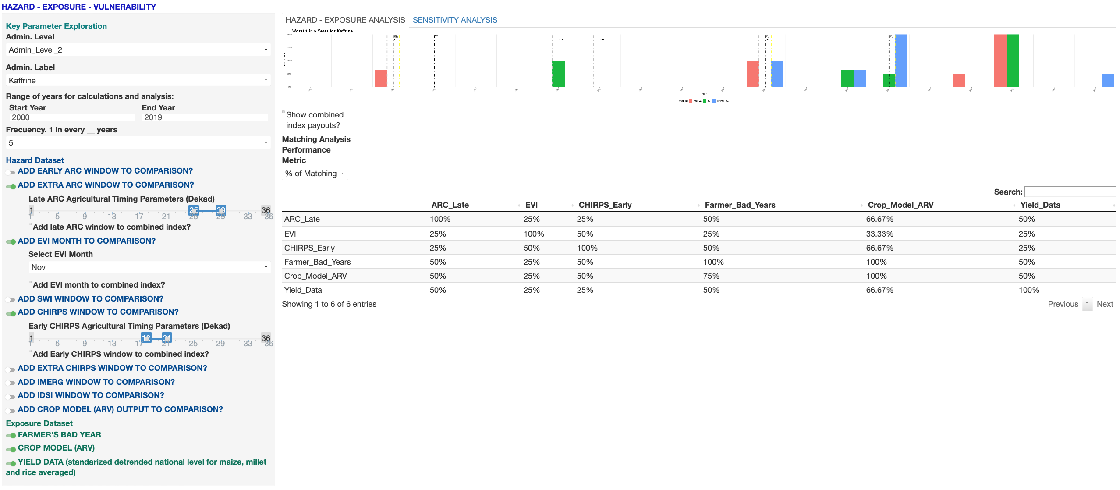
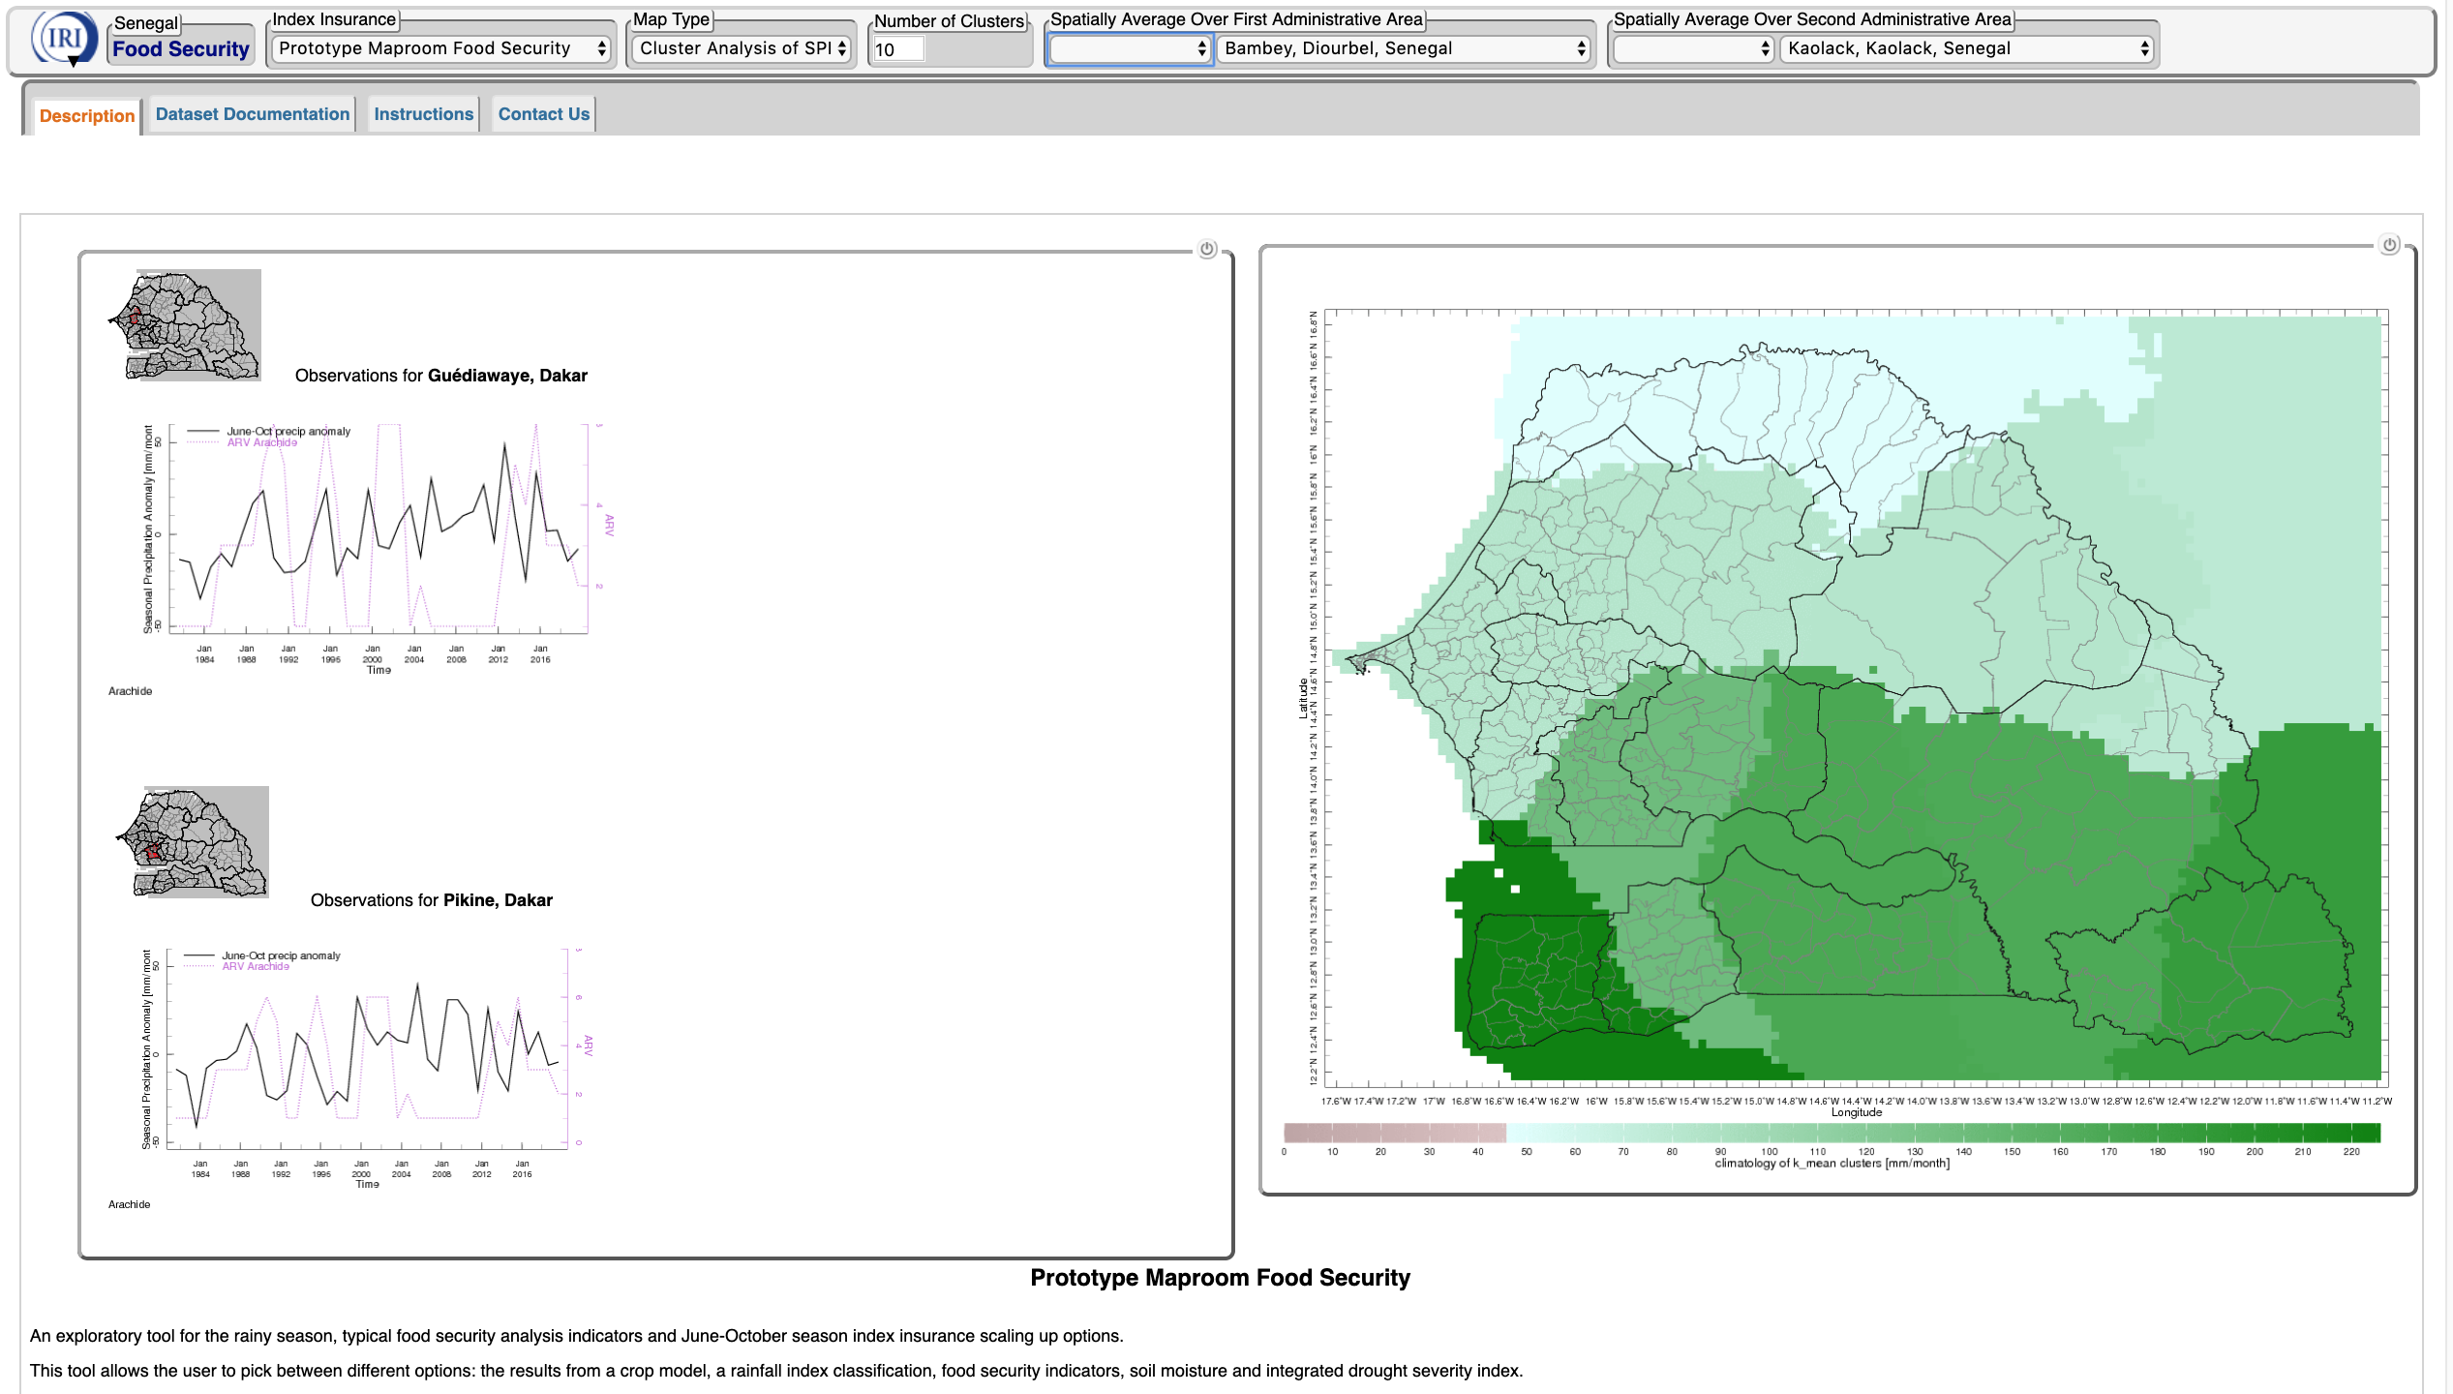
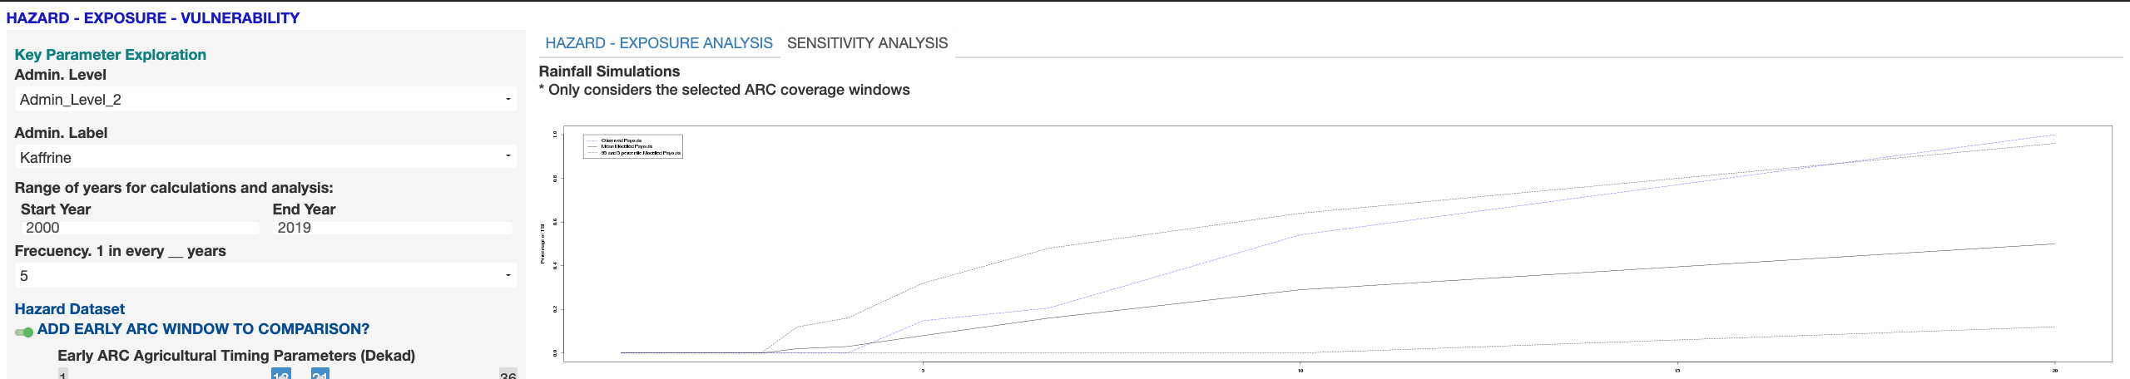
DECISION FRAMEWORK
The project has assembled together various data and tools that illustrates how a decision maker can go through the different stages of the index design process.

Slide 11
DECISION FRAMEWORK
The project has assembled together various data and tools that illustrates how a decision maker can go through the different stages of the index design process.

Slide 12
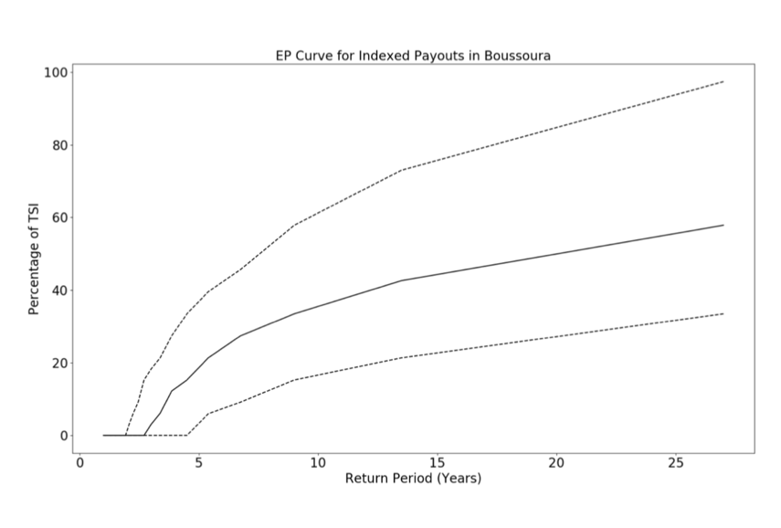
Performance Review
One of the most important performance indicator for an drought index is its stability. The project provides approaches to study stability built upon the stochastic precipitation catalogue provided by AIR Worldwide.

Slide 13
Thank You!

