Slide 1
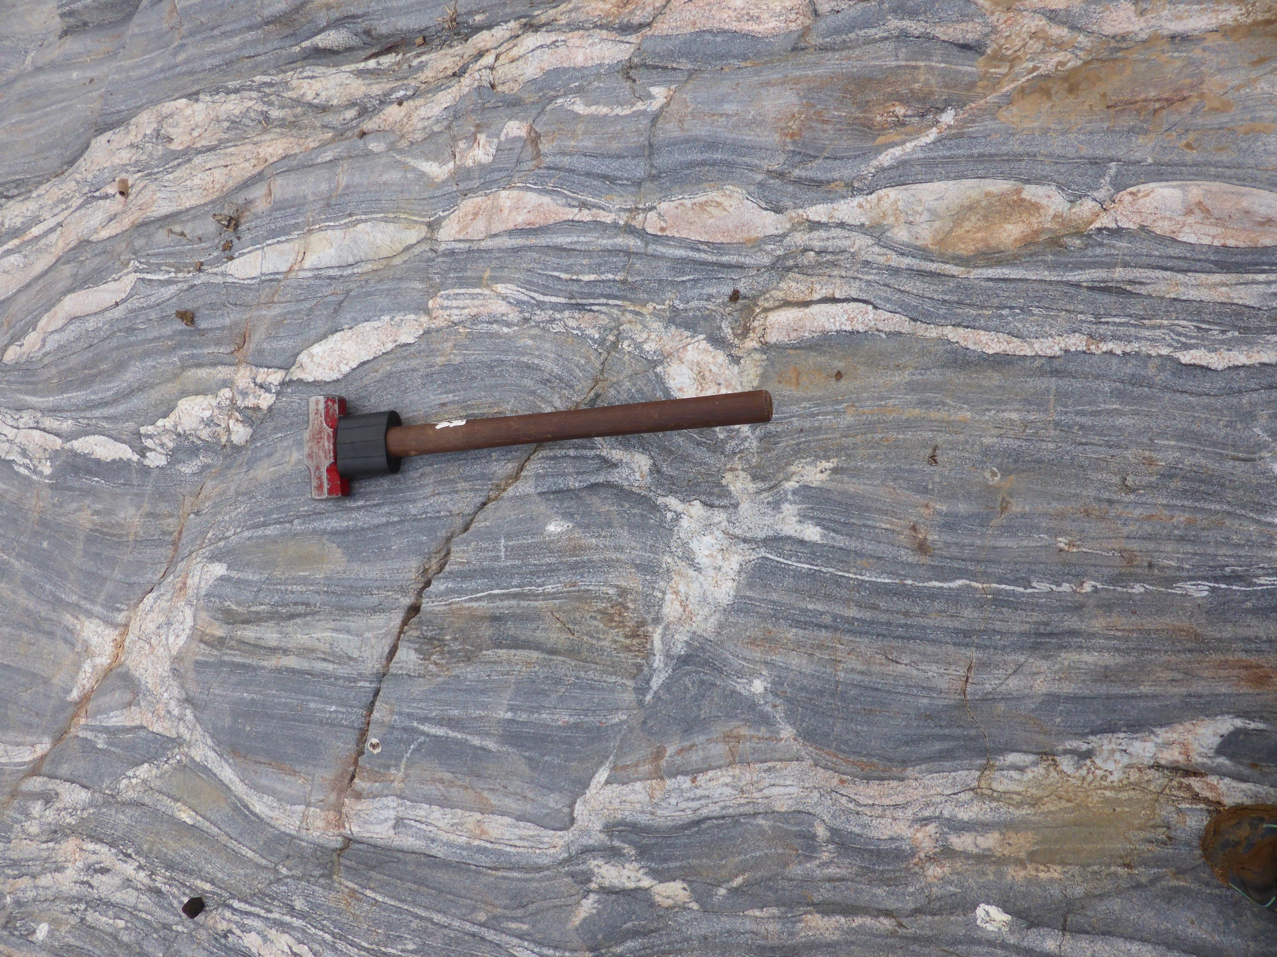


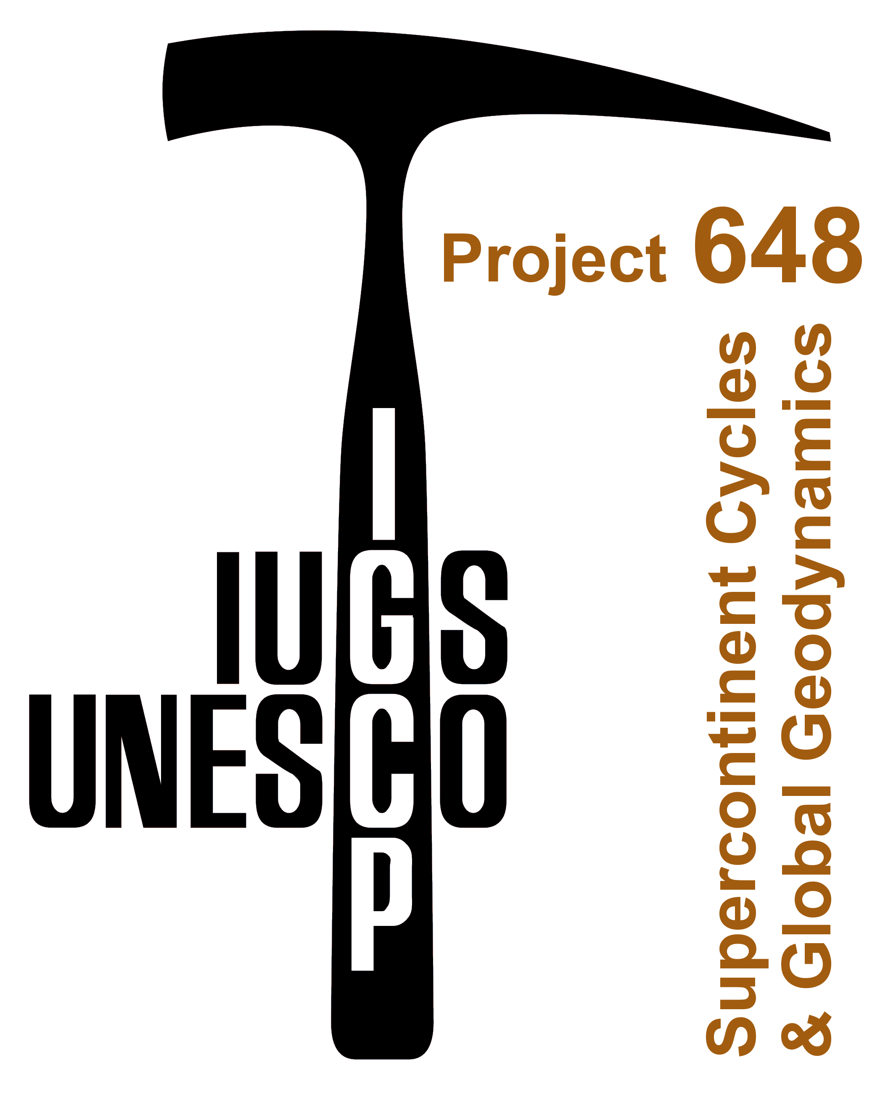
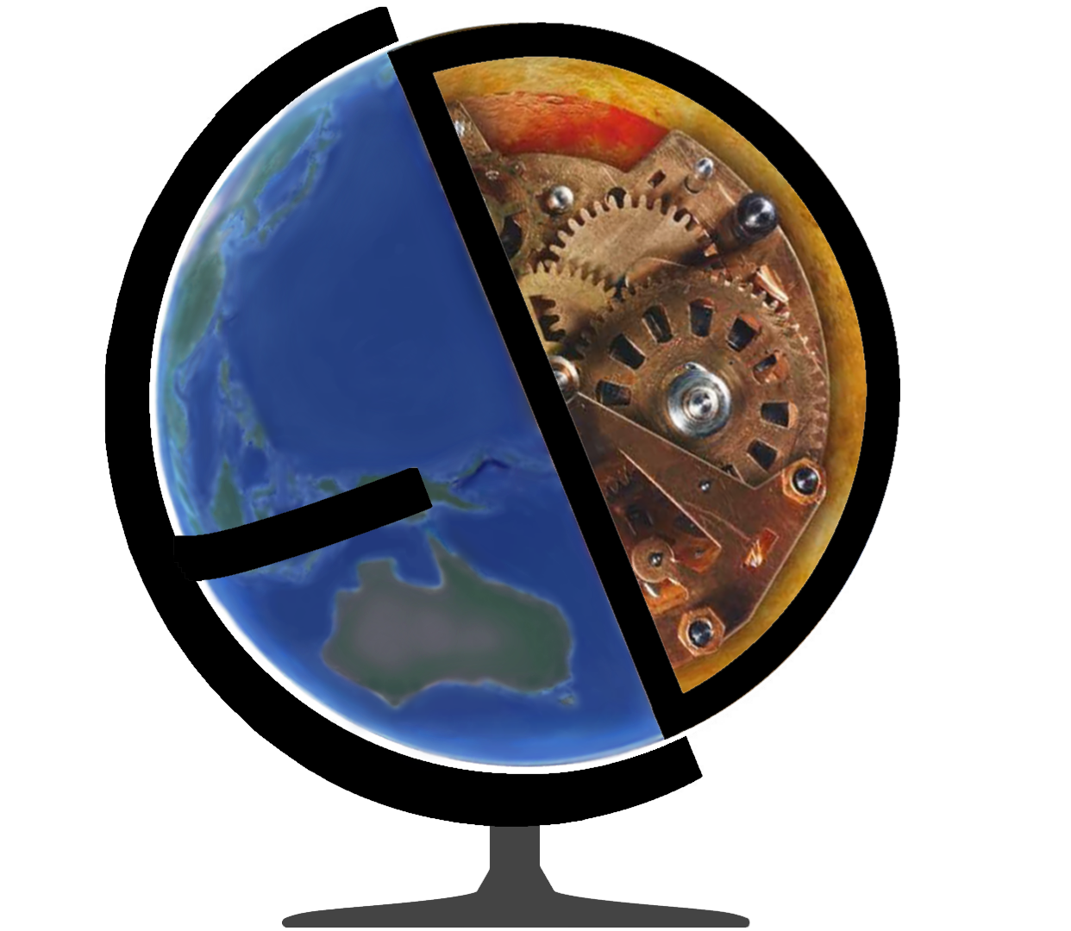



Silvia Volante | 06.05.2020
Reconciling zircon and monazite thermometry with thermodynamic modelling:
the impact of water
Silvia Volante
Collins B., Blereau E., Pourteau A., Spencer C.,
Evans N., Barrote V., Nordsvan A., Li Z.-X. & Li J.

Slide 2
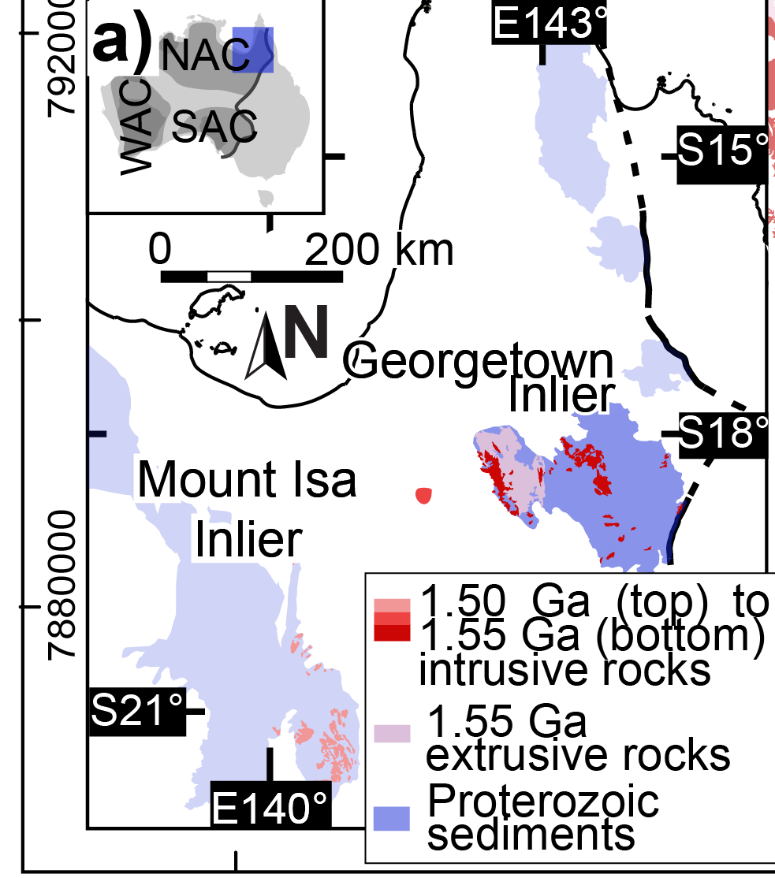
Aims of this study
Silvia Volante | 06.05.2020
Reconciling accessory minerals (e.g. zircon & monazite) geothermometry
What is the role of water and what is its impact on magmas
Unravel the tectono-magmatic history of the 1550 Ma
Georgetown igneous complex (NE Australia)

Slide 3
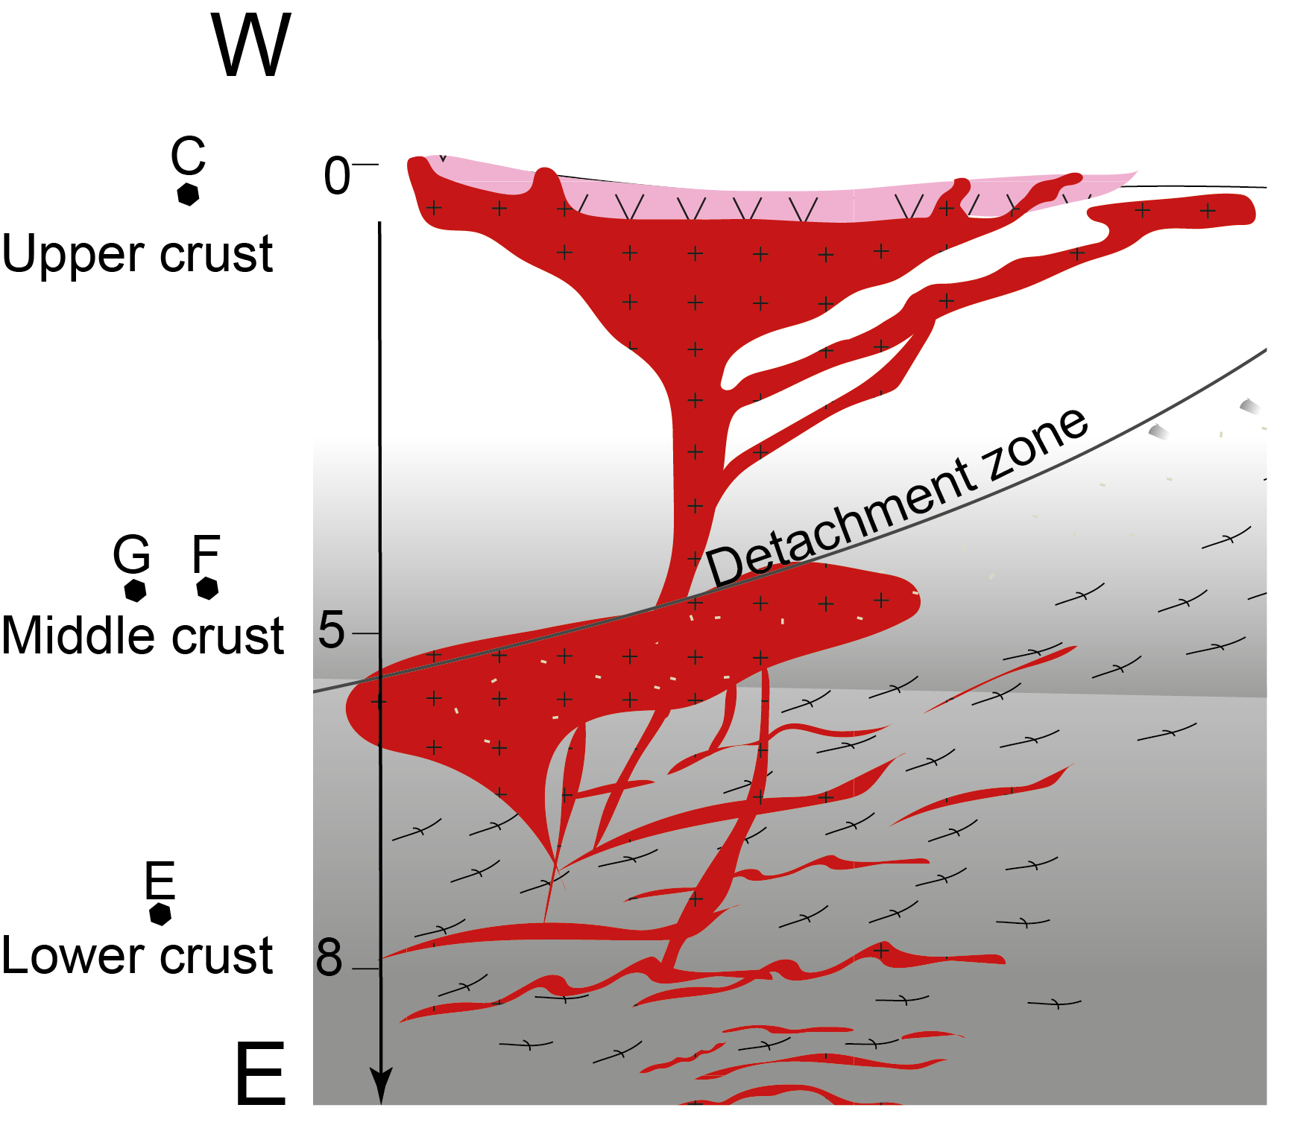
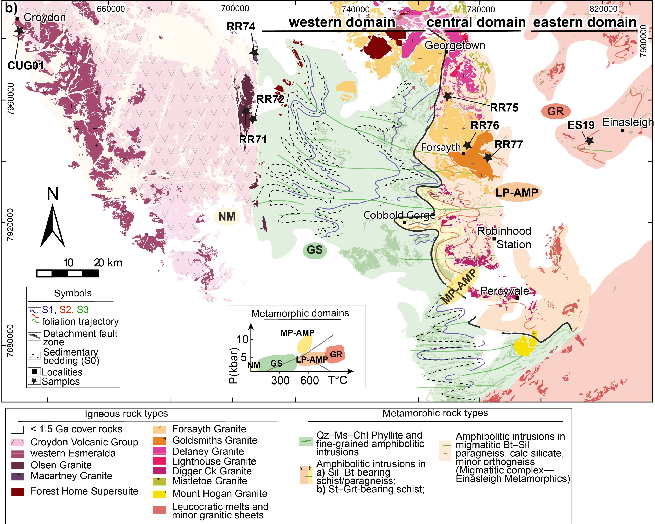
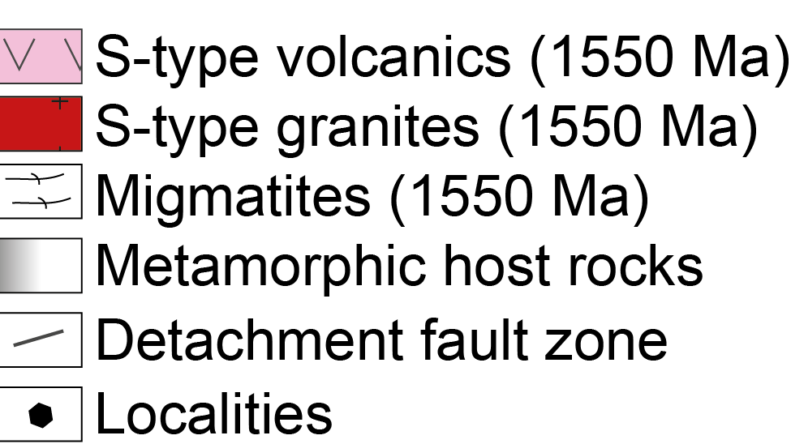
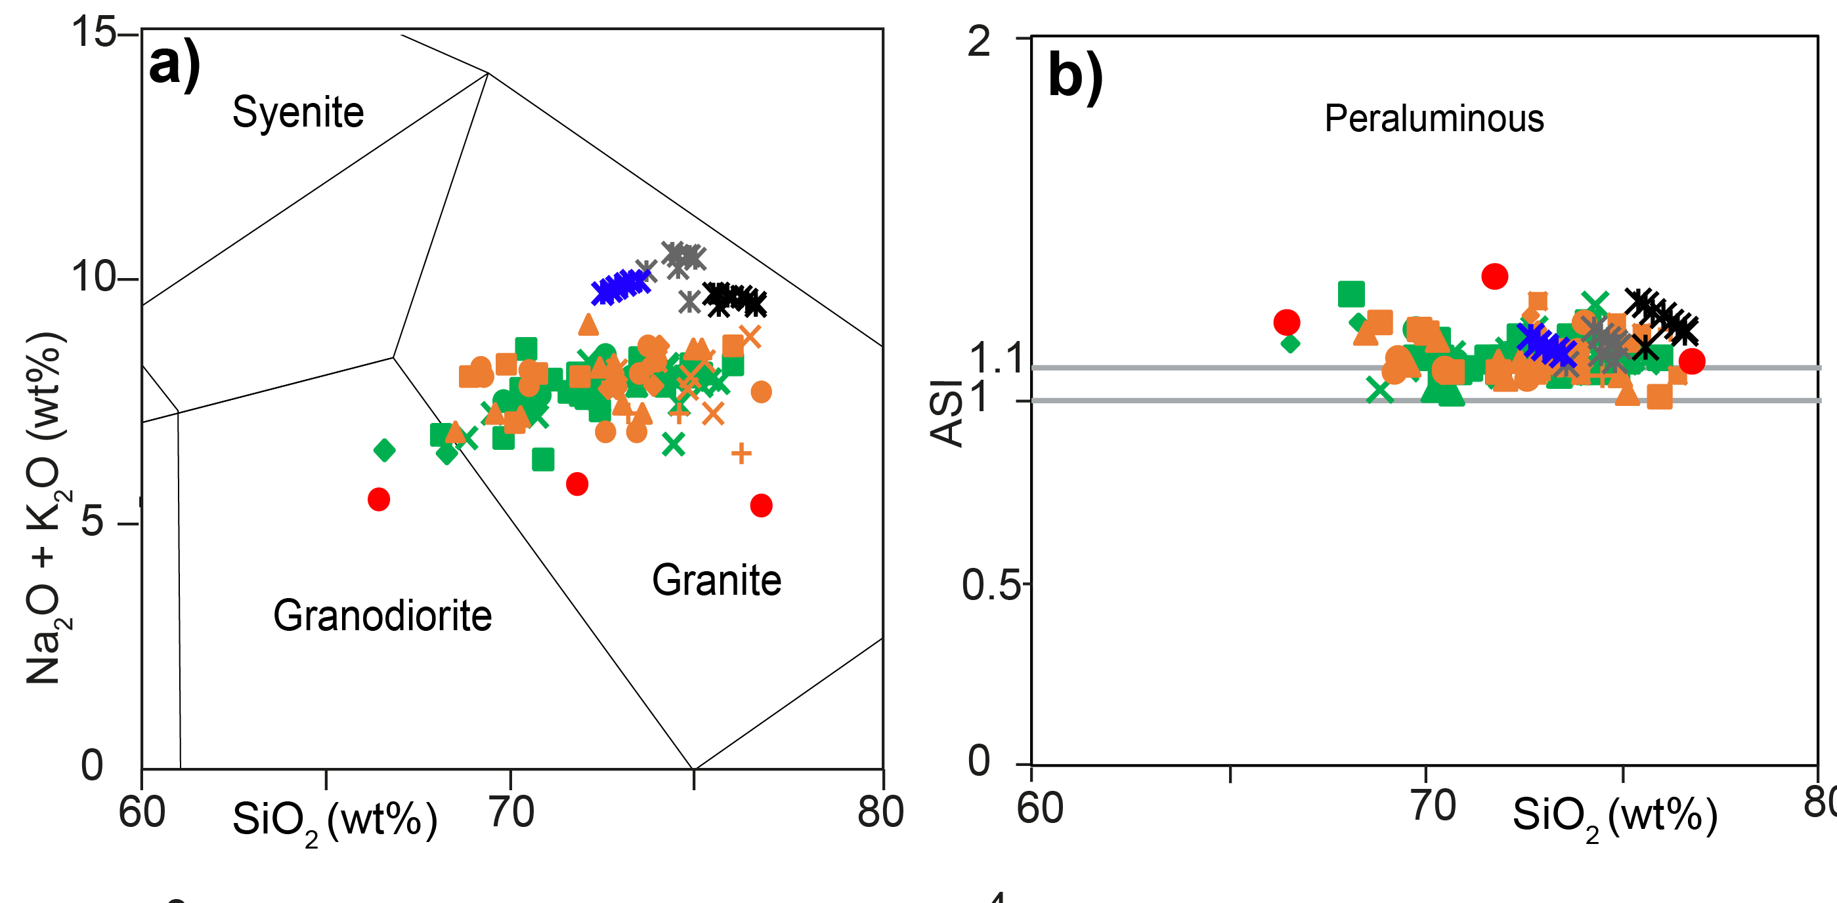
Study area
Silvia Volante | 06.05.2020
The Georgetown Inlier (GTI)
D2/M2 LP−HT 1550 Ma event
P=0–4 kbar
T~550°C
P=4–6 kbar
T~650°C
P=6–9 kbar
T~750°C
[Volante et al., 2020]
[Volante et al., in prep]
S-type granites

Slide 4
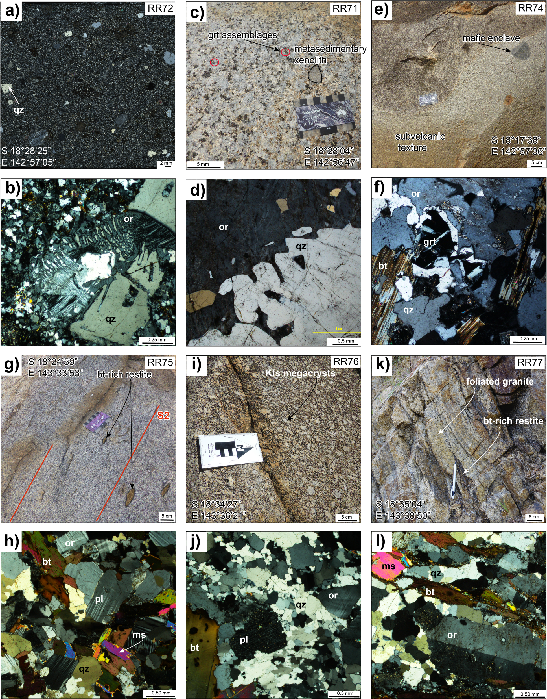
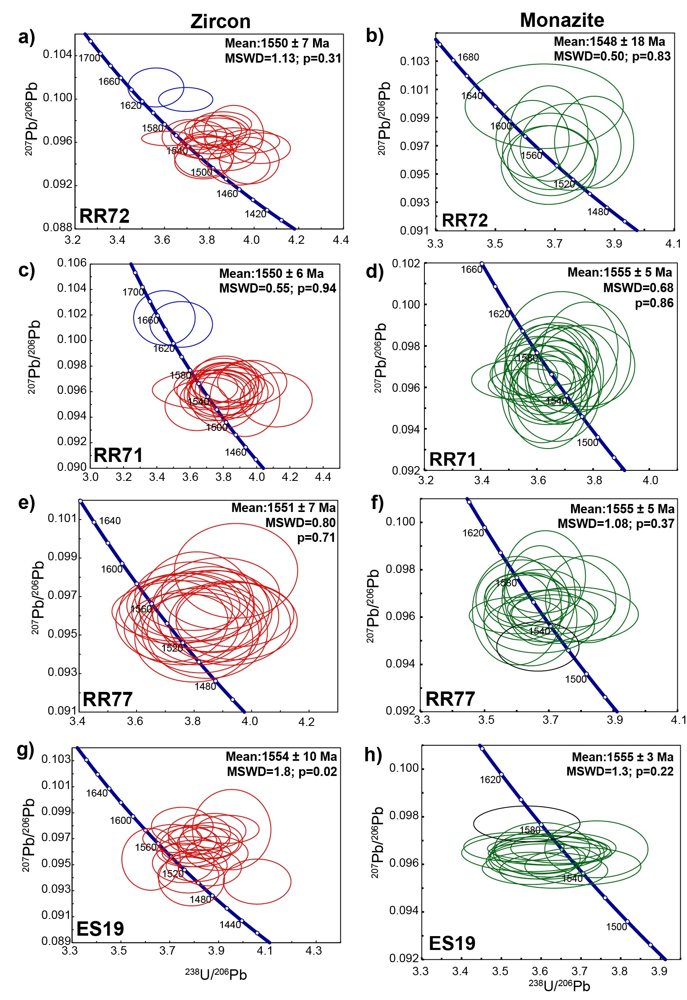
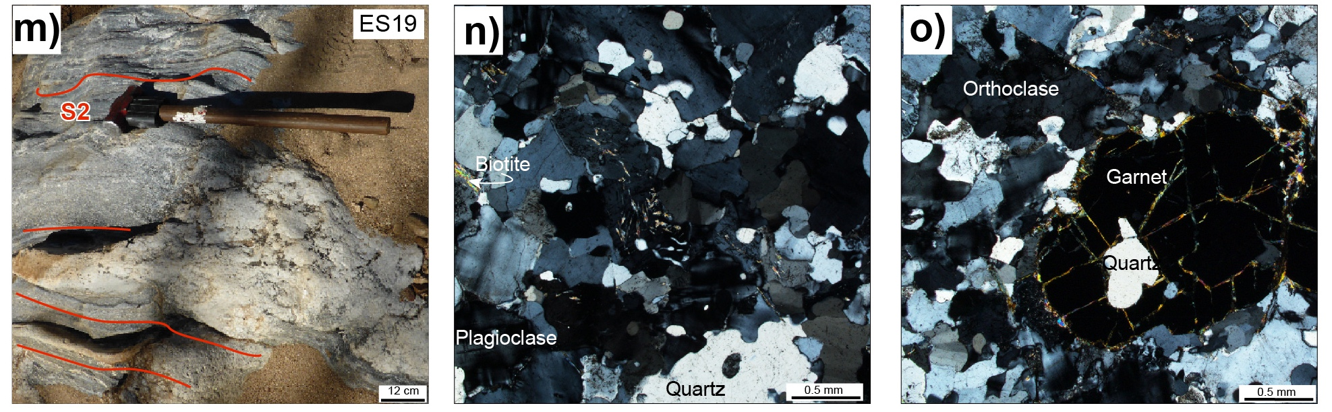
Granites composition and ages
Silvia Volante | 06.05.2020
W
c. 1550 Ma
E
[Volante et al., in prep]

Slide 5
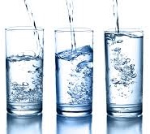


Zircon and monazite thermometry + thermodynamic modelling
Silvia Volante | 06.05.2020
Tmz
Tzr
H2O
T(Ti-zr)
P–T conditions of
granitic magmas
Thermodynamic modelling

Slide 6
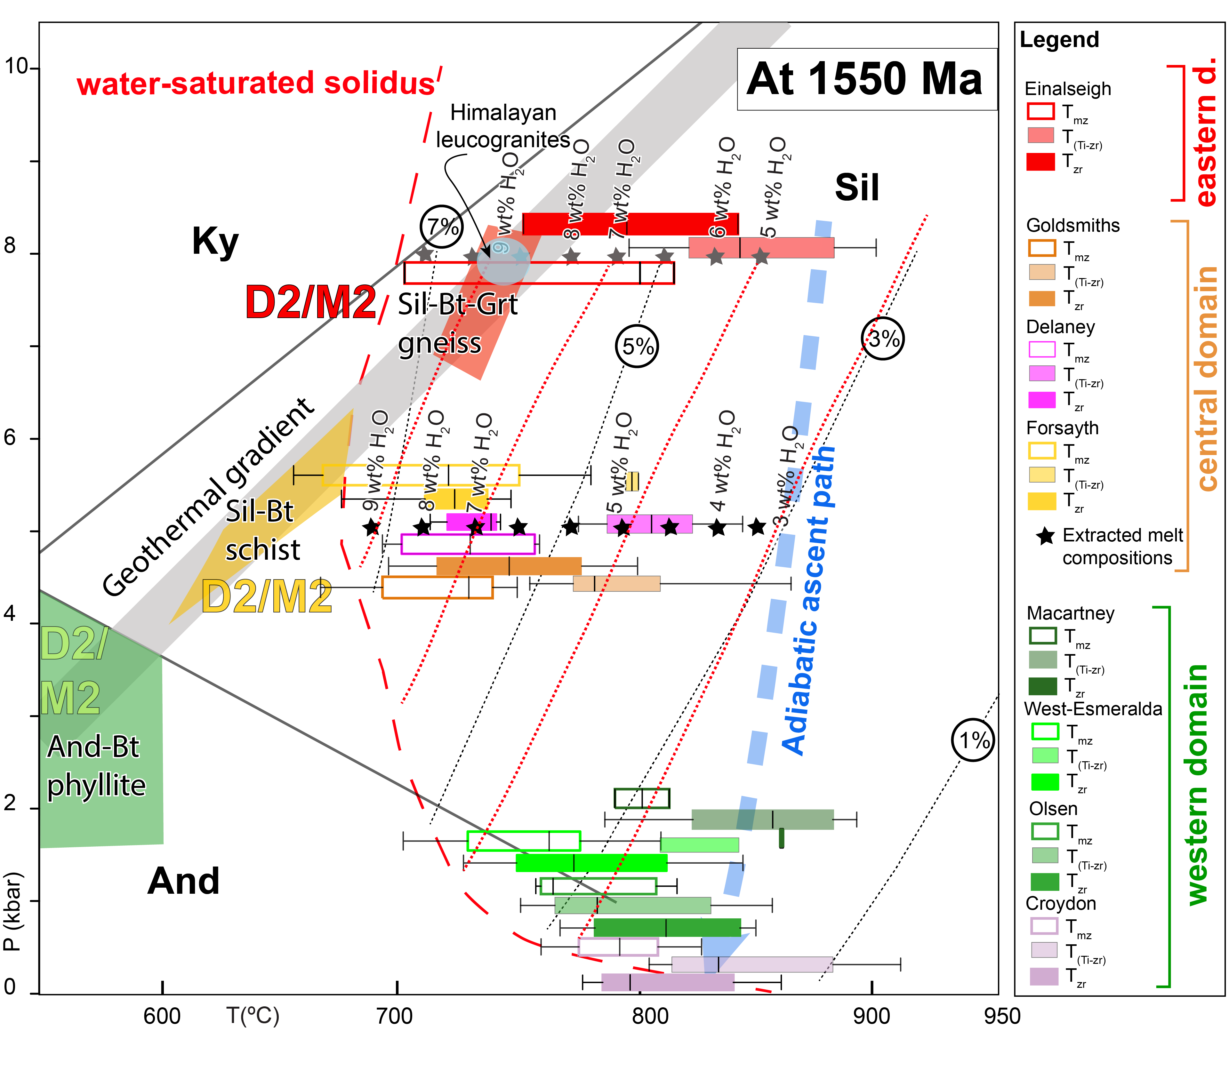
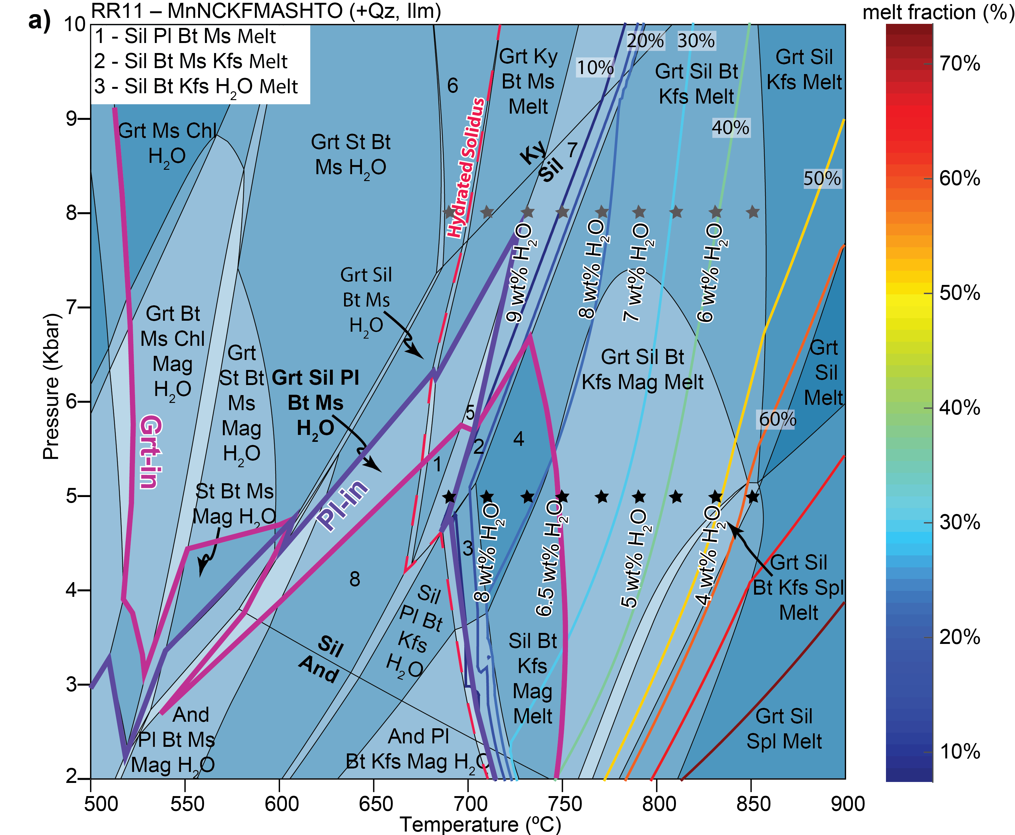
3. Petrogenesis of granitic magmatism in of the Georgetown Inlier (GTI)
P–T–X_{(H2O)} grid
Silvia Volante | 06.05.2020
4 – Sil Bt Kfs Melt;
5 – Grt Sil Pl Bt Ms Kfs Melt;
6 Grt Ky Bt Ms H2O;
7 – Grt Sil Bt Ms Kfs Melt;
8 – Sil Pl Bt Ms H2O.
[Volante et al., in prep]
[TC, this study]
Therefore, assuming adiabatic ascent through the crust our results suggest that:
Cool (~730°C) and hydrous (~7wt% H₂O ) granitic magmas were generated in the middle crust (~5 kbar) where they froze, forming the S-type Forsayth Supersuite.
Drier and hotter magmas (3–4 wt% H₂O ) ascended to higher crustal levels, forming volcanic and subvolcanic rocks in the western domain of the GTI. Additional heat (~100°C) was required in the deep crust for melt generation and we suggest this came from infusion of mafic magmas.
This study shows the robustness of monazite and zircon thermometers when reconciled, producing comparable magmatic temperatures.
[Holtz et al., 2001]
[Holtz et al., 2001; Patiño Douce and Harris 1998; Volante et al., 2020]

Slide 7
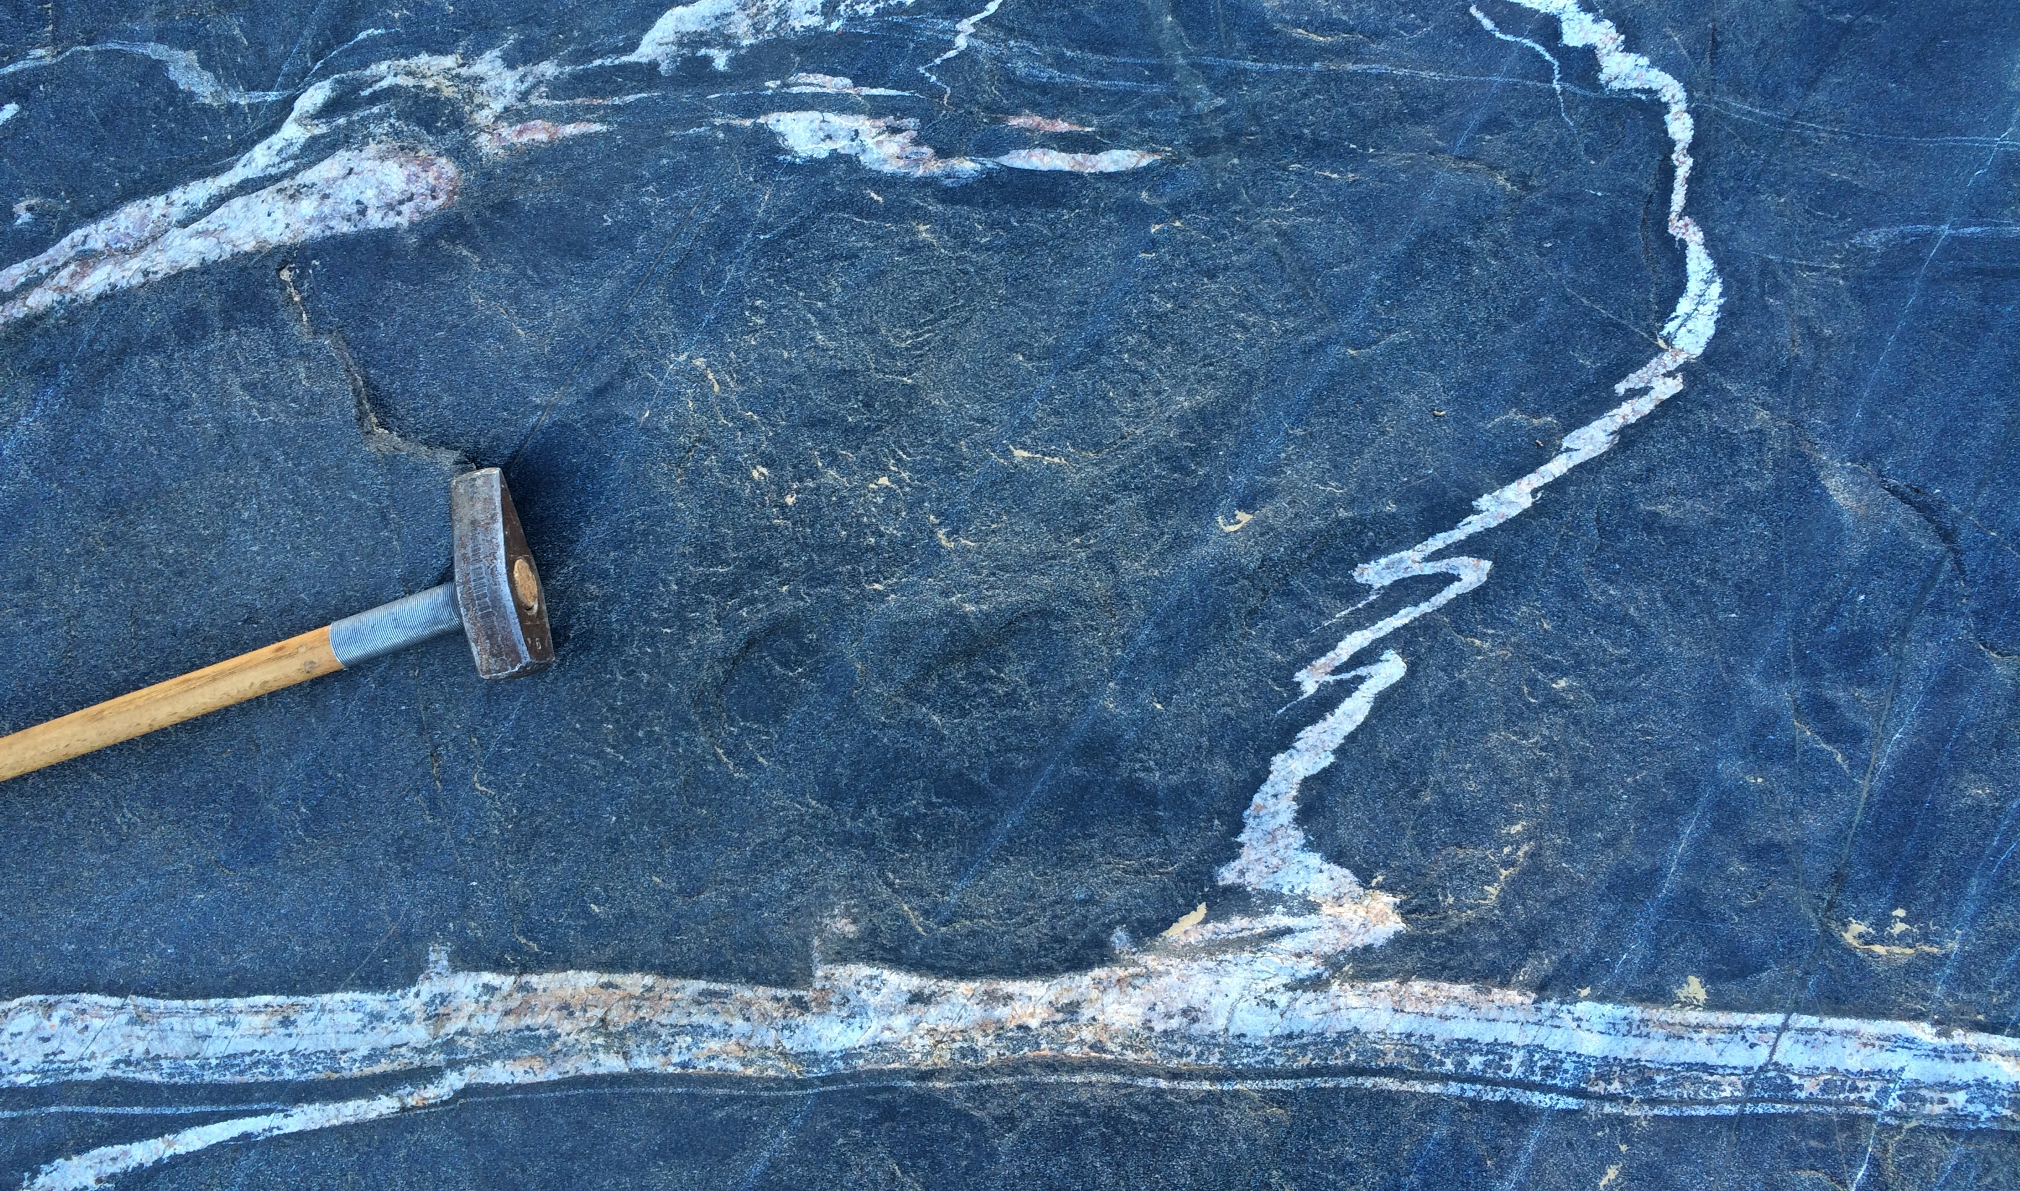
Questions?
Happy to discuss with you!

