Slide 1
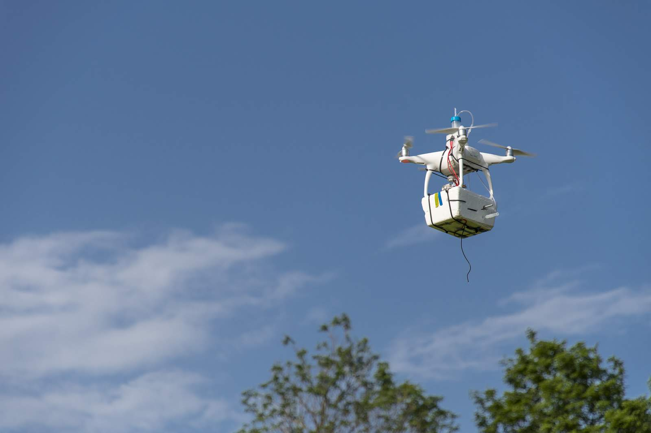




Development, Characterization and Testing of a Drone-based sampling Method for Investigations of Ice-Nucleating Particles
Paul Bieberª, Teresa M. Seifriedª, Julia Burkart^{b}, Jürgen Gratzl^{b}, Anne Kasper-Giebl^{c}, David G. Schmale III^{d} and Hinrich Grotheª
ªInstitute of Materials Chemistry, TU Wien, Vienna, 1060, Austria
^{b}Faculty of Physics, University of Vienna, Vienna, 1090, Austria
^{c}Institute of Chemical Technologies and Analytics, TU Wien, Vienna, 1060, Austria
^{d}School of Plant and Environmental Science, Virginia Tech, 24061-0390 Blacksburg, USA
Please start the presentation mode (F9) and click through the slides!
The following work has been published in Bieber et. al., 2020.

Slide 2




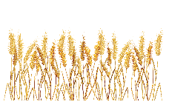

Terrestrial sources of biogenic INPs
Terrestrial ecosystems can contribute various particles to the troposphere, some of which are known for their ice nucleation activity.
Most of the land-surface in Europe is covered with forests and fields, representing potential sources of ice nucleation active bioaerosols in form of pollen grains, fungal spores and bacterial cells.
The presence of biogenic ice-nucleating particles (INPs) in clouds leads to heterogeneous freezing events and therefore influences the hydrological cycle and the Earth’s climate.
Plant tissues
Pollen grains
Fungal spores
Bacteria cells

Slide 3
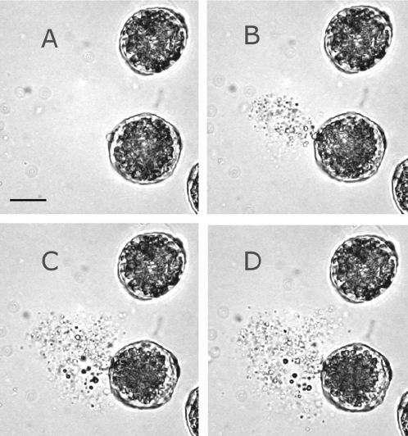
Smallest Bio-INPs
Ice nucleation in immersion freezing mode is not limited to particle sizes of INPs. We found biogenic ice-nucleating macromolecules (INMs) of silver birch (Betula pendula) pollen to be around 100 kDa (Pummer et al., 2012).
Pollen grains can rupture due to high humidity or mechanical forces
→ Sub-pollen particles (SPP) can be released and carry INMs to the free troposphere
→ For more information on SPP see display of Jürgen Gratzl
Similar INMs are extractable from wood, bark and leaves (Felgitsch et al., 2018, Seifried et al., 2020 in prep.)
→ INP aerosol formation during/after rain showers?
→ See display of Hinrich Grothe and Teresa M. Seifried
Rupturing of a Pollen grain in water. Figure adapted from: Ann G. Miguel et al., 2006

Slide 4
Emission and Transport
Free Troposphere
← Aircraft-based sampling
Many studies focus on measurements and characterizations of INPs in clouds using aircrafts or sample on ground with stationary devices. Less is known about the actual emission and transport to high tropospheric layers. We focused on the development of an efficient sampling device that can be attached to small scale drones, such as the DJI Phantom 4 model.
Transport of biogenic INPs
Land Surface
← Ground-based sampling

Slide 5
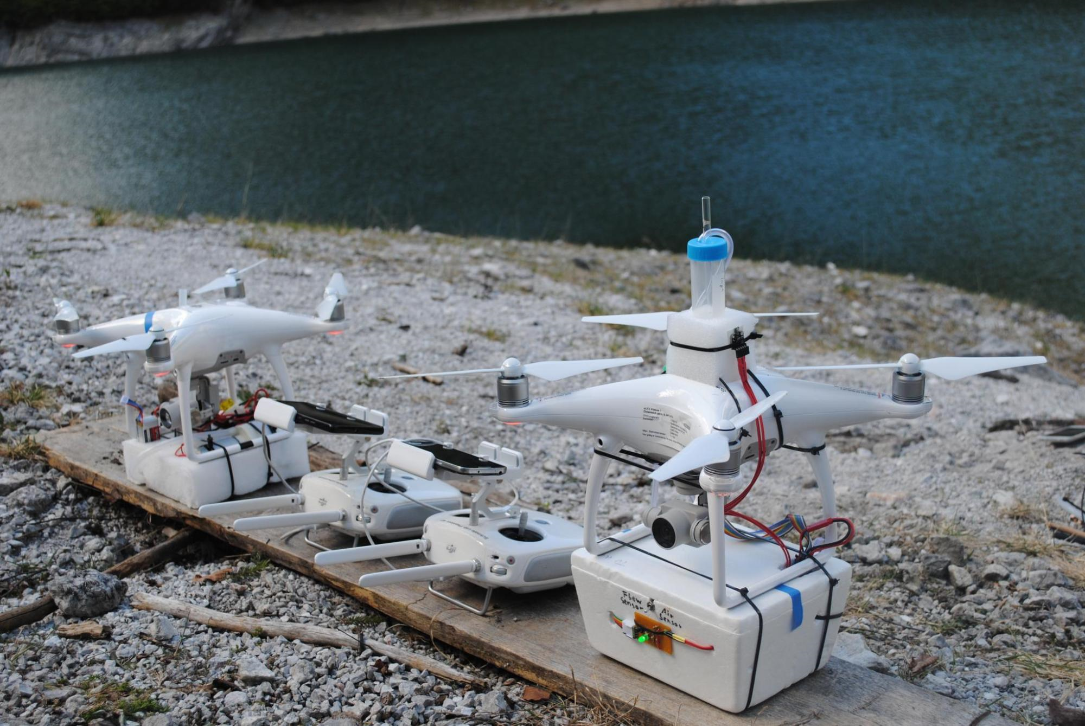
DAPSI - Setup
Drone-based Aerosol Particles Sampling Impinger
DAPSI includes a cascade impactor that collects particles with size resolution and a self-build impinging system that accumulates INPs in a sterile solution. Additionally, the system contains an electric sensor for environmental data records (temperature, relative humidity and air pressure) and an optical particle counter to monitor particular matter concentrations during flight times.
DJI Phantom 4 Drones
Impinger
Impactor setup
Remote controls
Electronic setup and
OPC
Temperature sensor

Slide 6
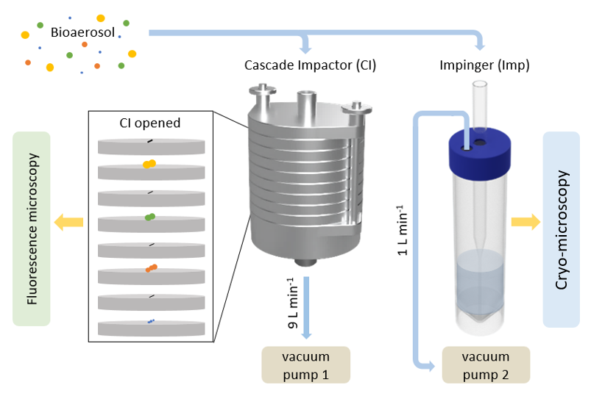
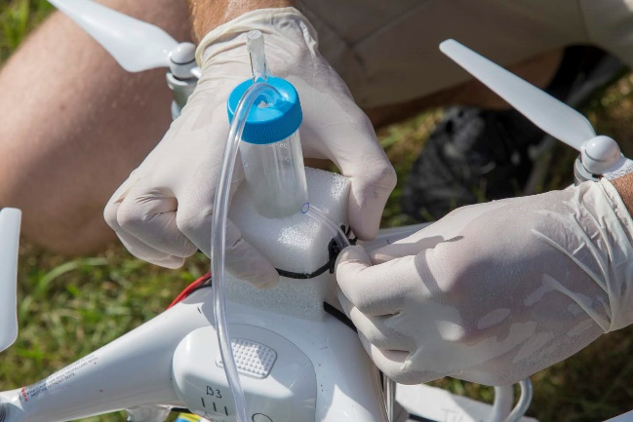
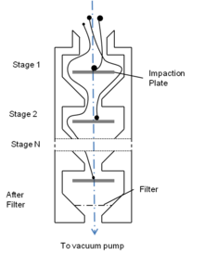
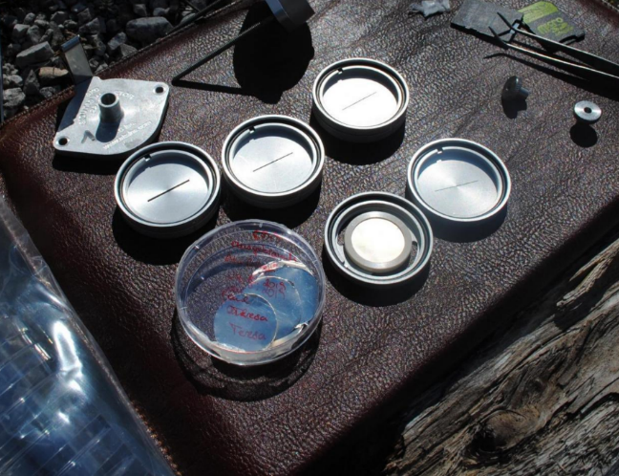
Methodology – Sampling
CI
Imp
2.5 µm
1.0 µm
0.5 µm
0.25 µm
CI

Slide 7
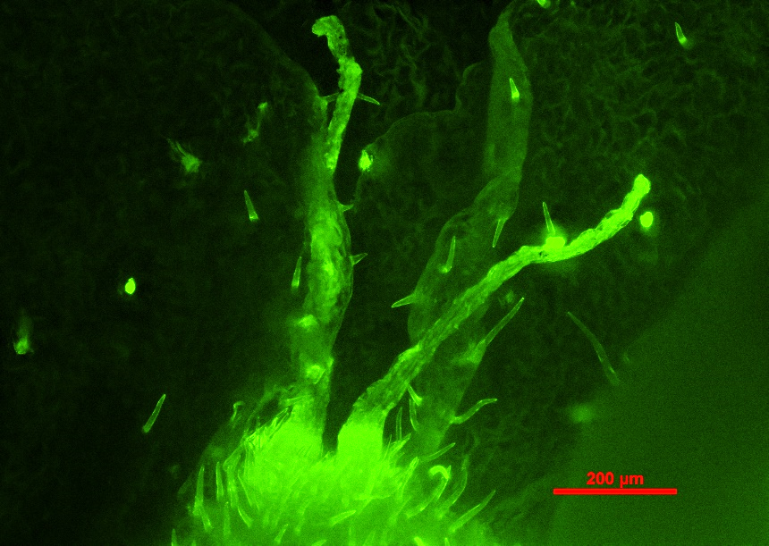
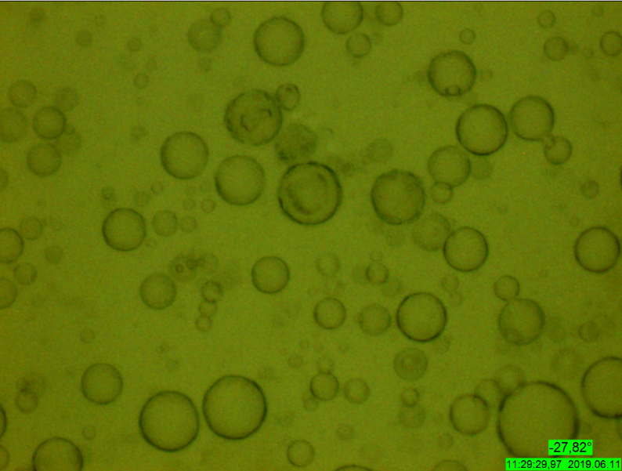
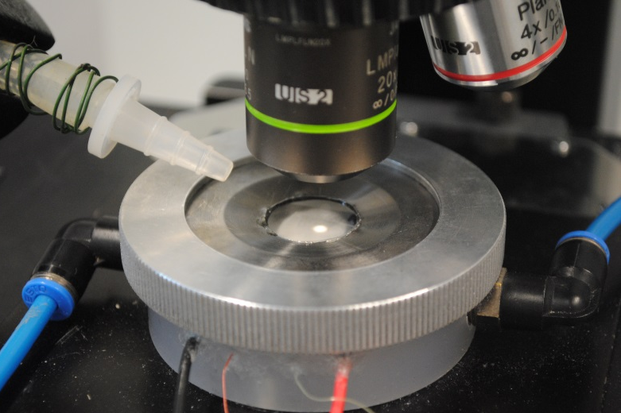
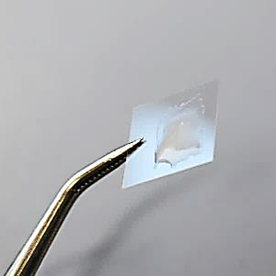
Methodology – Analysis
Fluorescence microscopy:
Biological molecules show auto-fluorescence characteristics
Cryo-microscopy:
Vienna Optical Droplet Crystallization Analyzer (VODCA) → Hinrich Grothe and Teresa M. Seifried for details
4 µL Oil
2 µL Sample
-27.4 °C
Em.: 480 nm; Exc.: 535 nm
cooling rate: -10 °C/min

Slide 8
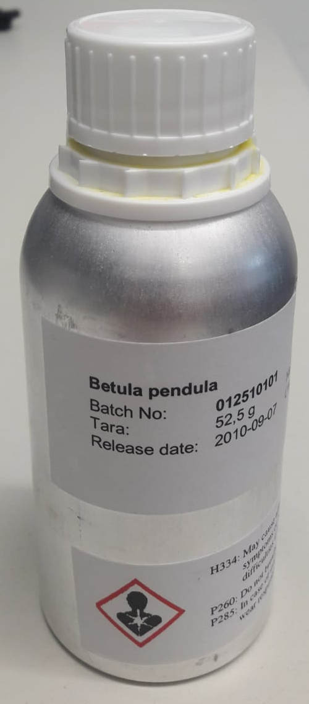
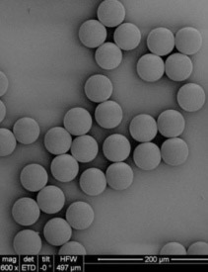
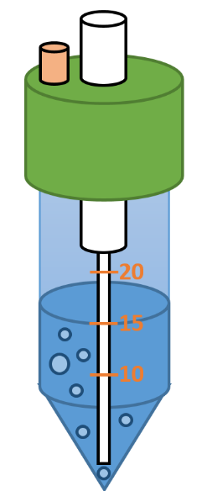
Validation of the Impinger
Validation with standardized aerosols
Polystyrene latex (PSL) spheres (dp = 2 µm and 0.6 µm)
Validation with biogenic INPs
Birch pollen (Betula Pendula) washing water (BP-WW, 50mg/mL, filtered 0.2 µm)
Diffusion Drying Tube
OPC
Particle Conc.
Imp 1
Imp 2
Nebulizer
OPC
Particle Conc.
Cumulative Nuclei Concentration 1
Cumulative Nuclei Concentration 2

Slide 9
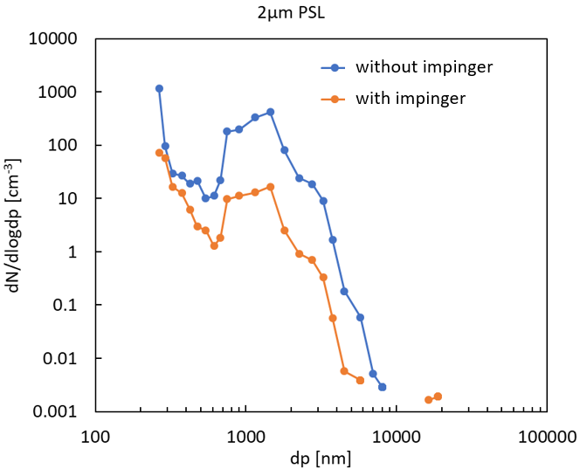
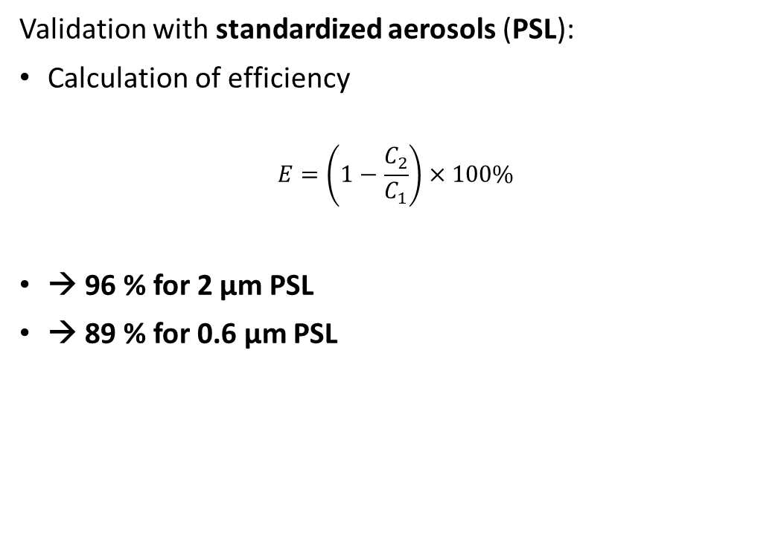
Results – Sampling efficiency PSL
Validation with standardized aerosols (PSL):
Calculation of efficiency
$$E=\left(1−\frac{C_{2}}{C_{1}}\right)×100\%$$
→ 96 % for 2 µm PSL
→ 89 % for 0.6 µm PSL

Slide 10
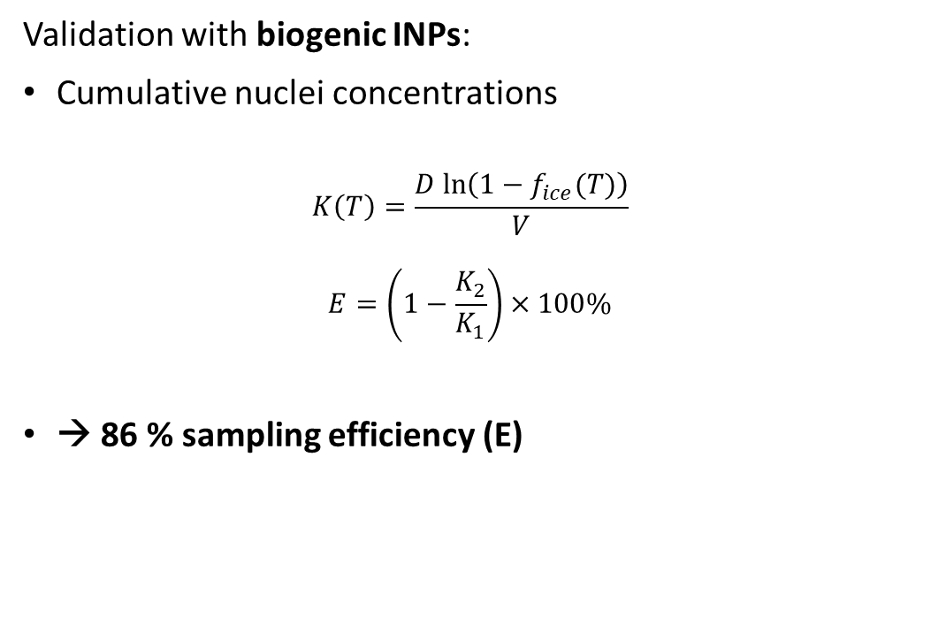
Results – Sampling efficiency bio INPs
Validation with biogenic INPs:
Cumulative nuclei concentrations
$$K\left(T\right)=\frac{D ln\left(1−f_{ice}(T)\right)}{V}$$
$$E=\left(1−\frac{K_{2}}{K_{1}}\right)×100\%$$
→ 86 % sampling efficiency (E)

Slide 11
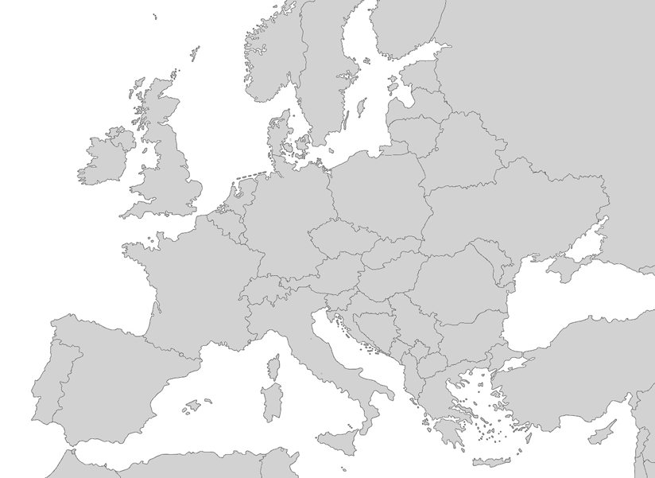
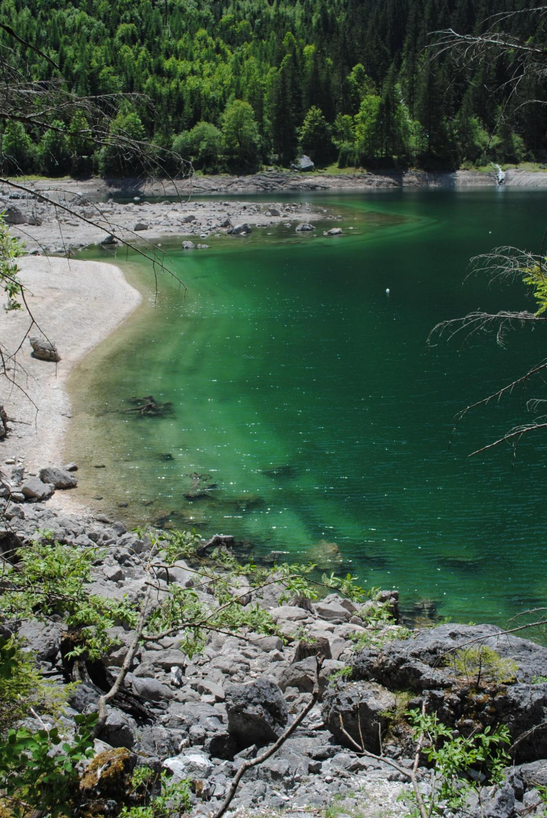
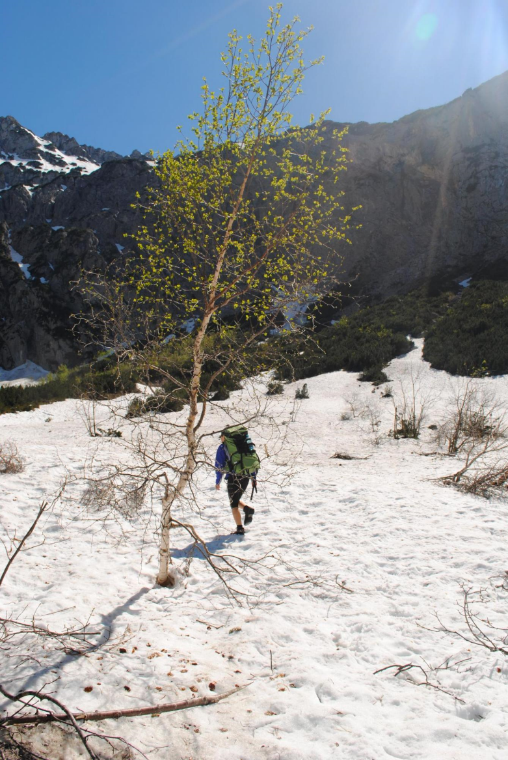
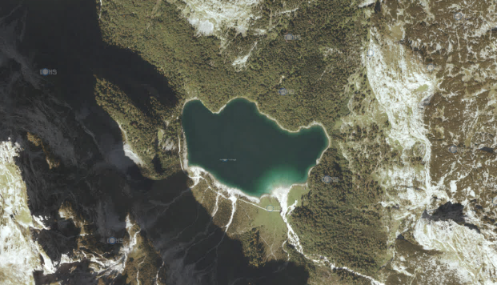
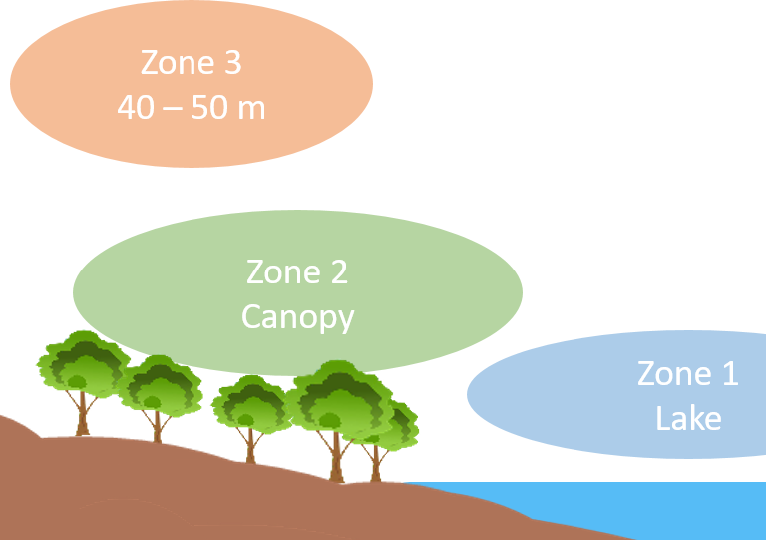
First field studies
Strategy: Sampling in 3 different air-zones
Every zone 10 min sampling
          → 90 L air impactor
          → 10 L air impinger
Gosau, Austria
“Hinterer Gosau See“

Slide 12
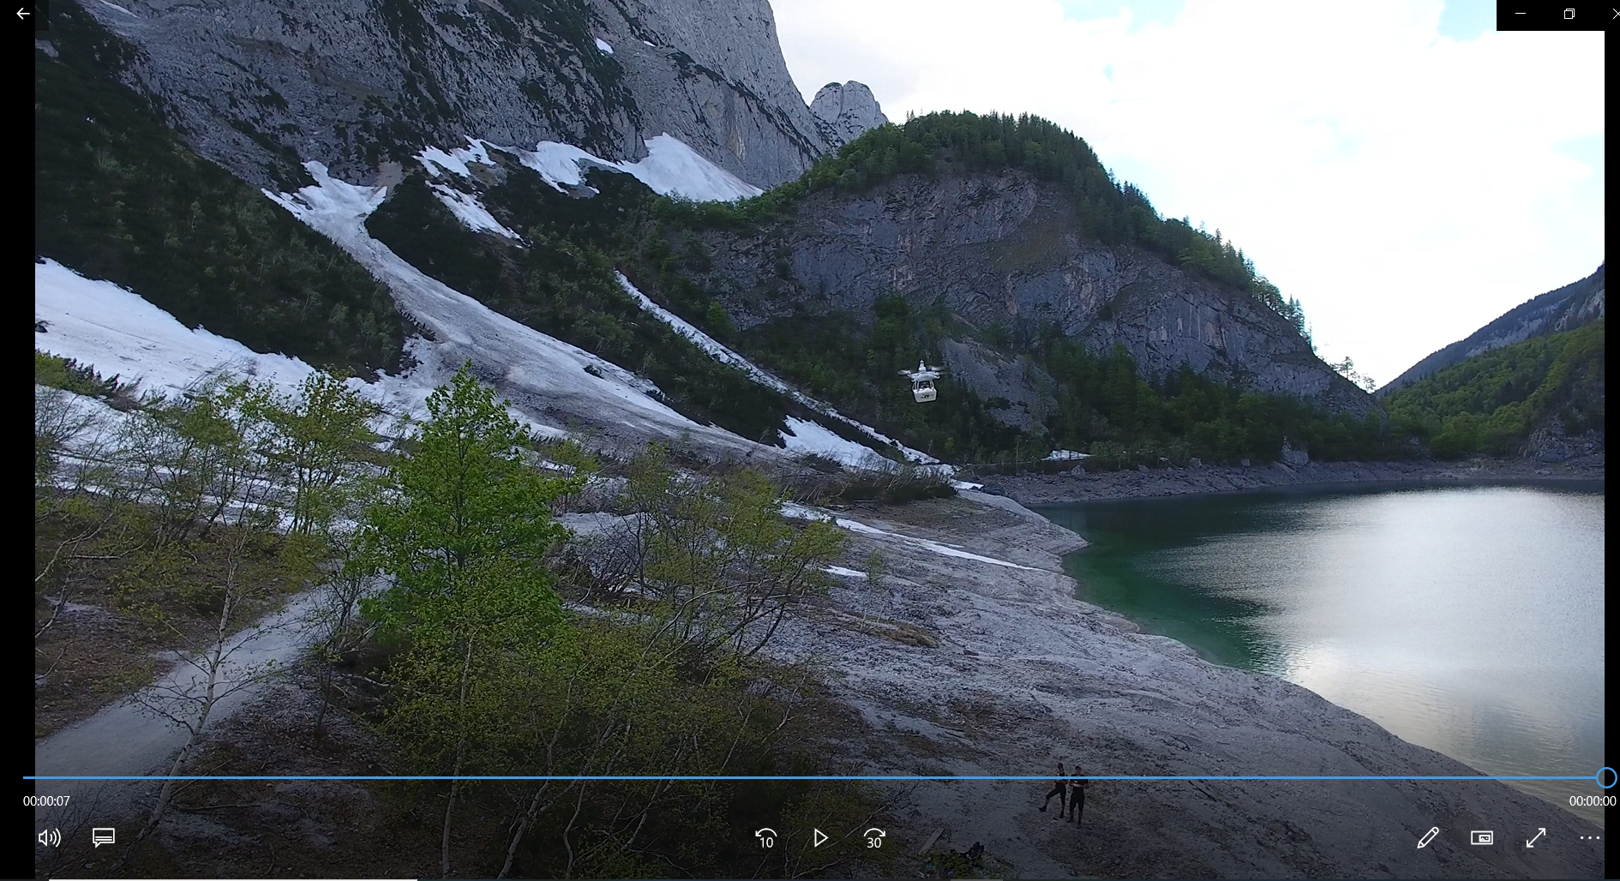
First field studies
For watching a video of our drone carrying DAPSI above the canopy of birches in Gosau, Upper Austria click the following link:
→ https://zenodo.org/record/3588399#.XqfkDMgzZPY

Slide 13
Results – environmental sensors
First sampling day:
Second sampling day:

Slide 14
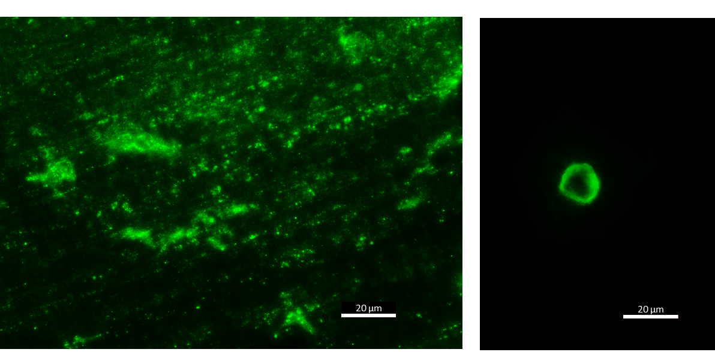
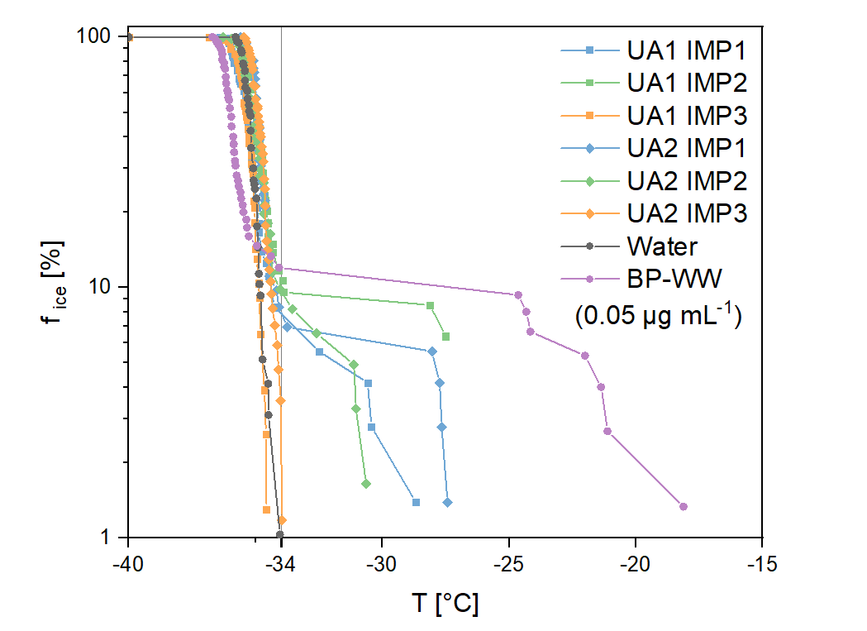
Results – bio particles and INPs
Fluorescent particles:
Ice nucleation activity:
Zone 3 (40-50 m), Stage D
Zone 3 (40-50 m), Stage A
Secondary Organic Aerosols (SOA)
Sub-pollen particles (including INMs)
Heterogeneous freezing (zone 1 and 2):
  Onset (-26°C – -31°C)
  Frozen fraction (7 % – 10 %)
Pollen grains

Slide 15
Conclusion
Outlook
Impinger system can sample standardized aerosols and INPs with a sufficient efficiency:
  2 µm PSL: 96%
  0.6 µm PSL: 89%
  BP-WW: 86%
Both units are light enough (0.57 kg Impinger, 0.69 kg impactor) to be carried with small UAVs like the DJI Phantom 4 multicopter drone
First field study showed fluorescent matter and ice nucleation activity of DAPSI samples
Improve the methodology:
  Increase flight time and altitude
  Carry DAPSI on ONE drone
  Precise spatial & height resolution (GPS-waypoints)
  More sensitive freezing assays (Cooperation?)
Further field studies above the canopy of forests (pine and birch):
  Pollination times in spring periods
  Measurements after rainfall

Slide 16
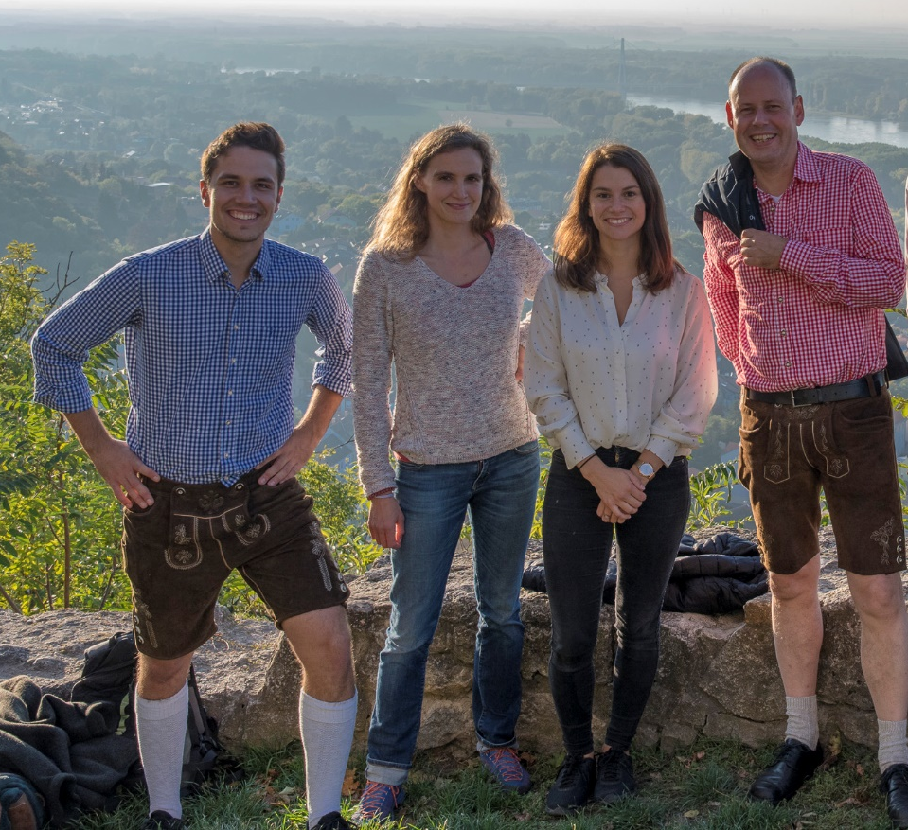

Acknowledgements
TU Wien
  Teresa M. Seifried
  Hinrich Grothe
  Anne Kasper-Giebl
University of Vienna
  Julia Burkart
  Jürgen Gratzl
Virginia Tech
  David G. Schmale III

Slide 17
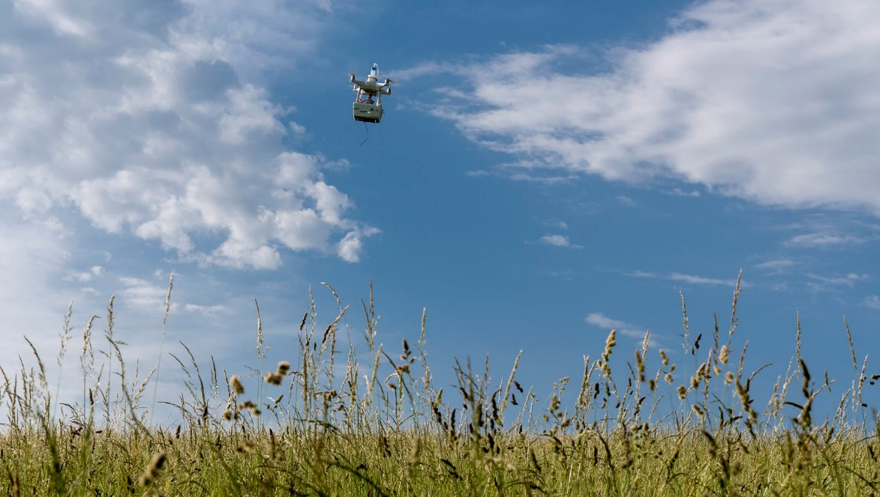
For more detailed Information read through the paper: Bieber et. al., 2020
Please ask questions in the EGU display chat

Slide 18
Materials
Impinger
vacuum pump (DC: 12 V, Delaman, China)
Raspberry Pi (Raspberry Pi 3 model B, Raspberry Pi Foundation, UK)
electric sensor module (SEN-BME680, Joy-it, Germany)
optical particle counter (SDS011, Nova Fitness Co., China)
flow-sensor (AWM5102 VN, Honeywell, USA)
Impactor
cascade impactor (CI) (SKC Ltd, GB)
vacuum pump (DC 12 V, Hilitand, China)

Slide 19
Materials
Validation:
atomizer (Constant Output Atomizer Model 3076, TSI Incorporated, USA)
OPC (model 1.109, Grimm Aerosol Techniques, Germany)
polystyrene latex (PSL) spheres (Postnova Analytics, USA)
birch pollen (Betula Pendula, Thermo Fisher Scientific, USA)

Slide 20
Flights
Sample Type | Date | Start time of Sampling (CEST) | Duration [min] | Approached Zone | Max. Height [m] ¹ | Flow-rate ± SD [L min⁻¹] | Sampled Air Volume [L]
UA1 Imp 1 | 3rd June, 2019 | 17:30 | 10 | 1 | 10 | 1.05 ± 0.03 ² | 10.5
UA1 Imp 2 | 3rd June, 2019 | 16:30 | 10 | 2 | 23 | 1.01 ± 0.03 ² | 10.1
UA1 Imp 3 | 3rd June, 2019 | 19:00 | 10 | 3 | 52 | 1.10 ± 0.03 ² | 11.0
UA1 CI 1 | 3rd June, 2019 | 17:30 | 10 | 1 | 11 | 9.02 ± 0.28 ² | 90.2
UA1 CI 2 | 3rd June, 2019 | 16:30 | 10 | 2 | 22 | 8.99 ± 0.10 ² | 89.9
UA1 CI 3 | 3rd June, 2019 | 18:30 | 10 | 3 | 53 | 9.10 ± 0.03 ² | 91.0
UA2 Imp 1 | 4th June, 2019 | 19:23 | 10 | 1 | 10 | 1.05 ± 0.05 ² | 10.5
UA2 Imp 2 | 4th June, 2019 | 17:34 | 10 | 2 | 14 | 1.00 ± 0.01 ² | 10.0
UA2 Imp 3 | 4th June, 2019 | 18:22 | 10 | 3 | 59 | 1.09 ± 0.03 ² | 10.9
UA2 CI 1 | 4th June, 2019 | 19:11 | 10 | 1 | 8 | 9.01 ± 0.08 ² | 90.1
UA2 CI 2 | 4th June, 2019 | 17:34 | 10 | 2 | 11 | 9.03 ± 0.03 ² | 90.3
UA 2CI 3 | 4th June, 2019 | 18:22 | 10 | 3 | 54 | 8.98 ± 0.04 ³ | 89.8
¹ According to data from DJI, Flight App, ² Mean value of 10 flow measurements, ³ Mean value of 9 flow measurements

