Slide 1








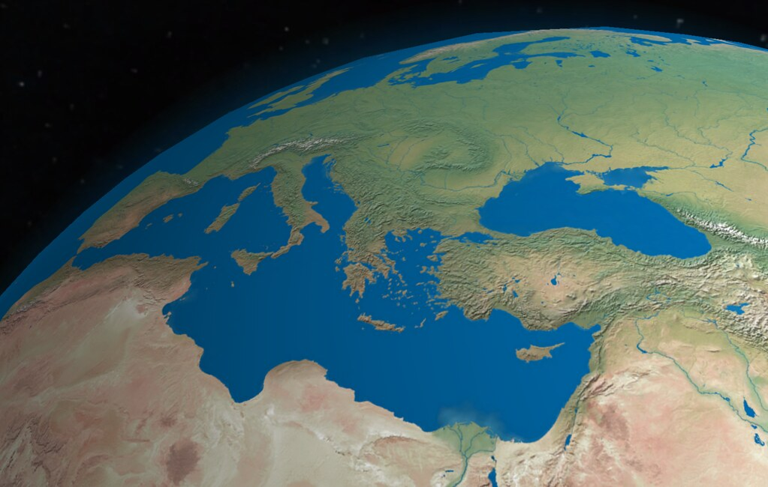

Mediterranean Marine Heatwaves:
On the physical drivers behind the
2003 and 2015 events
Sofia Darmaraki,
sofia.darmaraki@dal.ca
@Sofia_Darmaraki
The MARmaED project has received funding from the European Union's Horizon 2020 research and innovation programme under the Marie Sklodowska-Curie grant agreement No 67599.

Slide 2

Outline
1
Motivation
2
Numerical Tools
3
Marine Heatwave Detection
4
Drivers of Mediterranean
Marine Heatwave 2003
5
Drivers of Mediterranean Marine Heatwave 2015
6
Conclusions

Slide 3
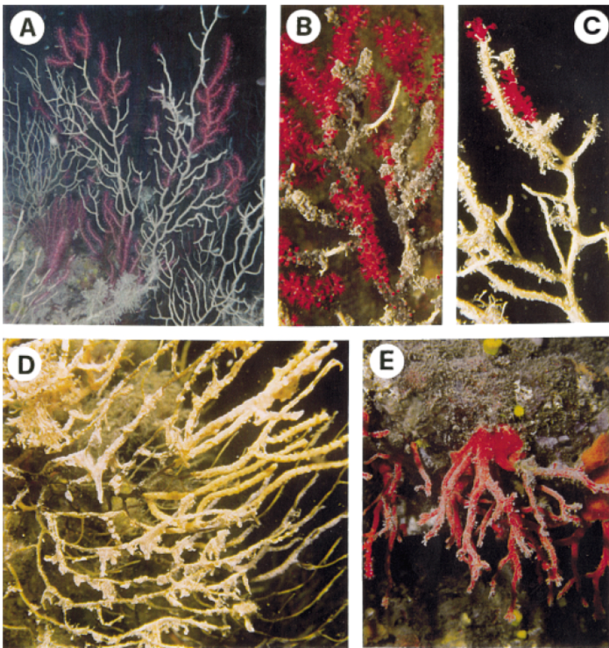
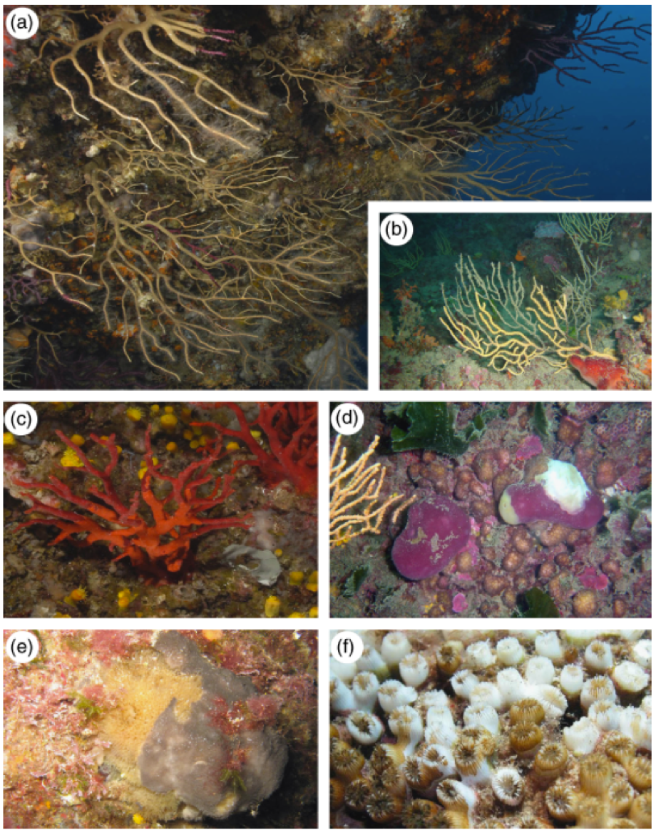
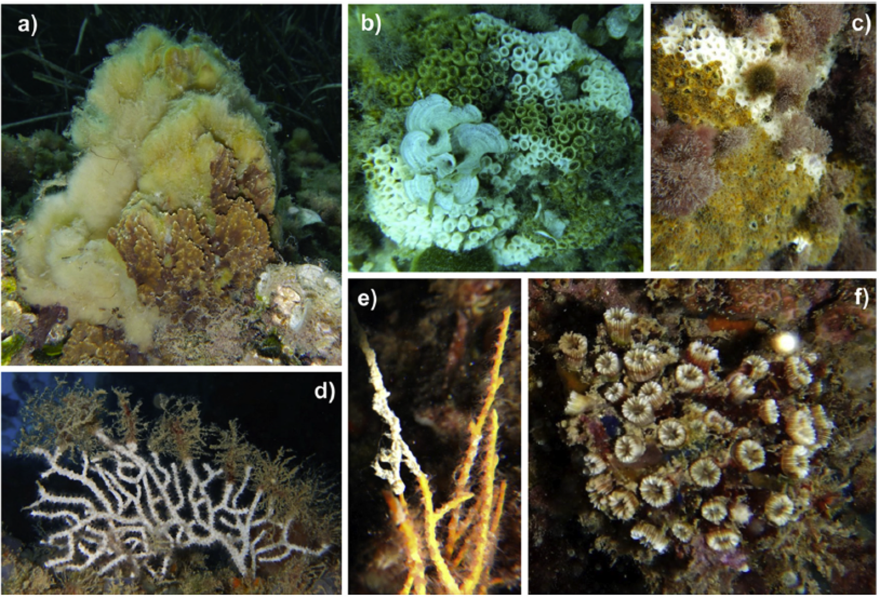
Mediterranean Sea
1999
1
Cerrano et al 2000
2
2003
Credits: Frank Ramspott,Circulation redrawn from De Madron et al., 2011 Modified by Sofia Darmaraki:
3
Transitional region
Large marine biodiversity
Mediterranean Thermohaline Circulation
Climate Change Hot Spot (Giorgi et al 2006)
Increasing basin mean SST in 21th century: ~1-4 ℃
Marine Heatwaves (MHWs) in the basin
26 events have occurred between 1982-2017, with record-warm sea water temperatures, resulting in:
Mass mortalities of benthic invertebrates e.g. sponges gorgonians, red corals (e.g. Garrabou et al.2009,2001)
Most intense MHWs: 2003, 2015
👉 No investigation of their driving mechanisms so far with online model diagnostics !
4
Garrabou et al 2009
2015
5
6
Rubio-Pοrtillo et al 2015

Slide 4

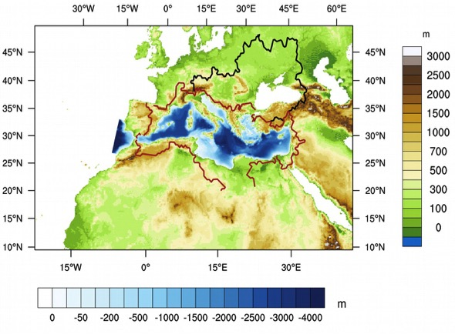
Numerical & Observational Tools
To study the development of the 2003 & 2015 MHWs we used:
1: Fully Coupled Regional Climate System Model: CNRM –RCSM6
Domain covered by CNRM-RCSM6
A Mediterranean Sea-dedicated model:
6-8km ocean resolution (NEMOMED12)
12km atmosphere resolution
Hindcast simulation between 1980-2017
High-resolution & Frequency of coupling: Important for representation of Mediterranean Sea features
Free Air-Sea fluxes: Important for MHW atmosphere-ocean interactions
Part of the MedCordex Initiative:
(https://www.medcordex.eu, Ruti et al 2016)
More info : https://www.umr-cnrm.fr/spip.php?article1098
1
2
3
4
5
6
We also used:
2: Observational SST dataset (OBS): Mediterranean Sea High Resolution (0.04 °) L4 SST Reprocessed (1982-2017) by Copernicus Marine Service (Pisano et al., 2012)

Slide 5
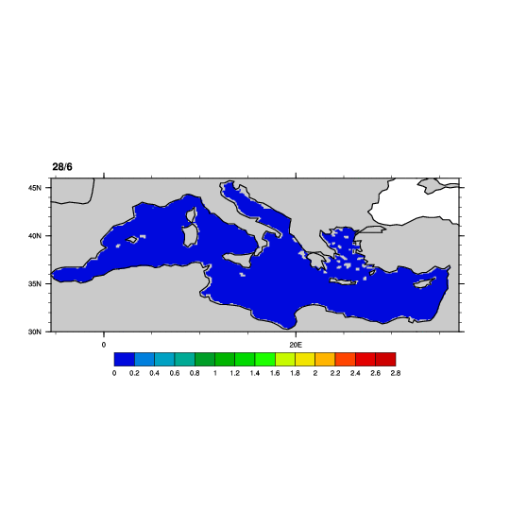
Marine Heatwave Detection
Marine Heatwave
Grid-point MHW Characteristics
1
2
Imax: Maximum Intensity
Imean: Mean Intensity
Icum: Cumulative Intensity
3
4
Time (Days)
SST (℃)
5
This is how a MHW looks like on a 2D scale.
“A discrete, prolonged anomalously warm water event at a particular location” (Hobday et al., 2016)
And this is how a MHW looks like on a single point.
6
Detection Method
Using as a threshold the 30-year average (1982-2012) of the 99th quantile of SST (2D map), we identified which & when grid points were above threshold for 5 days in a row, every year (Darmaraki et al., 2019).
Every time 20% of basin grid points were found above threshold, a Marine Heatwave was detected!
This way we targeted:
Mediterranean MHWs
Summer
Long-Lasting
Large-scale

Slide 6
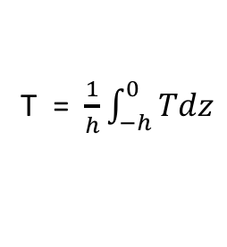
Ocean & Atmosphere Heat Budgets
h
T = $\frac{1}{h}\int_{−h}^{0}{Tdz}$
1
Physical processes driving MHWs are explored through the analysis of heat sources and sinks within the surface mixed layer:
2
Holbrook et al., 2019
3
For the first time, an online Mixed Layer temperature budget (daily scale) was used to describe changes in Mixed Layer temperature during the MHWs of 2003 and 2015, according to:
4
Mixed Layer Temperature Rate of Change
5
$\frac{∂T}{∂t}=− ∇\left(Tu\right) +$ $\frac{Qnet −QSW(−h)}{ρ0Cwh} + ∇H\left(kH∇HT\right) + \frac{(kZ\frac{∂T}{∂z}) (−h)}{h} − \frac{1}{h}\frac{∂h}{∂t}(T−T(−h))$
6
Total Trend
Advection
Forcing
Lateral Diffusion
Vertical Diffusion
Entrainment
Further decomposition of atmosphere forcing was also performed according to:
Atmosphere Heat Flux decomposition
! Heat fluxes warming (cooling) the ocean are considered positive (negative)
Q_{net} = Q_{LH} + Q_{SH} + Q_{SWD} + Q_{LWD} + Q_{SWUP} + Q_{LWUP}
Net Surface Heat fluxes
Latent
Sensible
Shortwave
down
Longwave
down
Shortwave
up
Longwave
up
Darmaraki et al., in prep

Slide 7
MHW 2003 basin-scale signature
Darmaraki et al., in prep
Mean event intensity
Daily MHW-area averaged anomalies
OBS
Temp (MLD)
SST
MLD
4
3
1
1
2
(℃ )
(m)
2
MODEL
3
4
MHW duration
ρ = 0.78
5
(℃)
6
Characteristics
Duration: 18 July – 3 Sep (48 days)
Mean Intensity: 0.8 ℃
Max Coverage: 79 %
Mostly in NW Mediterranean
! Abnormally high SST, Mixed layer Temperature
! Shallower than normal Mixed Layer Depth
👉
Split in 4 phases based on increasing/decreasing SST anomalies to better disentangle driving processes

Slide 8
MHW 2003: Atmosphere forcing & wind
Darmaraki et al., in prep
Time-integrated Mixed Layer Heat Budget
Time-integrated Atmosphere Heat flux
Anomalies
Anomalies
P1
P2
P3
P4
1
(℃)
W/m²
2
3
4
Time-integrated Windspeed
P1,P3 (Increasing SST anomalies – MHW development)
- Lower/Higher than normal Forcing, Shortwave (Q_{SWD}),
Anomalies
5
P1
P2
P3
P4
6
Lower than normal: Windspeed, Latent(Q_{LH})
Higher/Lower than normal Vertical Diffusion (Zdf)
(m/s )
P2-P4 (Decreasing SST anomalies – MHW decay)
- Opposite ocean & atmosphere forcing than P3
Longwave down (Q_{LWD}) abnormally high at all times
Span of time-integrated period matters !
👉

Slide 9
MHW 2015 basin-scale signature
Darmaraki et al., in prep
Mean event intensity
Daily MHW-area averaged anomalies
OBS
Temp (MLD)
SST
MLD
1
2
3
5
6
1
4
2
(℃ )
(m)
MODEL
3
4
MHW duration
ρ = 0.80
5
(℃)
6
Characteristics
Duration: 14 July – 10 Sep (56 days)
Mean Intensity: 0.9 ℃
Max Coverage: 82 %
Covered almost the whole basin
! Abnormally high SST, Mixed layer Temperature
👉
! Shallower than normal Mixed Layer Depth (at most times)
Split in 6 phases based on increasing/decreasing SST anomalies to better disentangle driving processes
👉

Slide 10
MHW 2015: Atmosphere forcing & wind
Darmaraki et al., in prep
Time-integrated Mixed Layer Heat Budget
Time-integrated Windspeed
Anomalies
Anomalies
P1
P2
P3
P4
P5
P6
P1
P2
P3
P4
P5
P6
1
(℃)
(m/s )
2
3
29Jun 24Jul 3Aug 8Aug 24Aug 5Sep 22Sep
29Jun 24Jul 3Aug 8Aug 24Aug 5Sep 22Sep
4
P1,P3,P5 (Increasing SST anomalies - MHW development)
- Higher than normal Forcing, Shortwave (Q_{SWD}),Advection
5
- Lower than normal: Windspeed, Vertical Diffusion (Zdf),Entrainment
6
P2,P4,P6 (Decreasing SST anomalies – MHW decay)
- Opposite ocean forcing than P2,P4,P6, except Windspeed in P2.
Atmosphere forcing and windspeed appear to drive this MHW on a basin scale, however:
The influence of entrainment and advection processes become more important on local scale
👉

Slide 11
Mediterranean Marine Heatwaves in short
Definition
Qualitative : A discrete, prolonged anomalously warm water event at a particular location
Quantitative: Long-lasting, large-scale, summer MHWs, Thresholds: 99th quantile of SST, 5 days minimum duration, 20% minimum spatial coverage
Model Representation
Fully-coupled Regional Climate System Model with high ocean & atmosphere resolution
Key driving mechanisms of MHW 2003
Anomalously high atmospheric forcing (shortwave), low Latent Heat Flux, low Vertical Diffusion & weaker than average winds
Time scale of integration affects the results on the contribution of each budget term to the MHW development/decay: Too long → influence of some factors can be counteracted, Too short → Not representative of the conditions before the MHW
Key driving mechanisms of MHW 2015
Anomalously high atmospheric forcing , low Vertical Diffusion & weaker than average winds
Large MHW spatial scale considered can “obscure” the contribution from smaller-scale processes (in the basin) such as, Advection,Entrainment

Slide 12
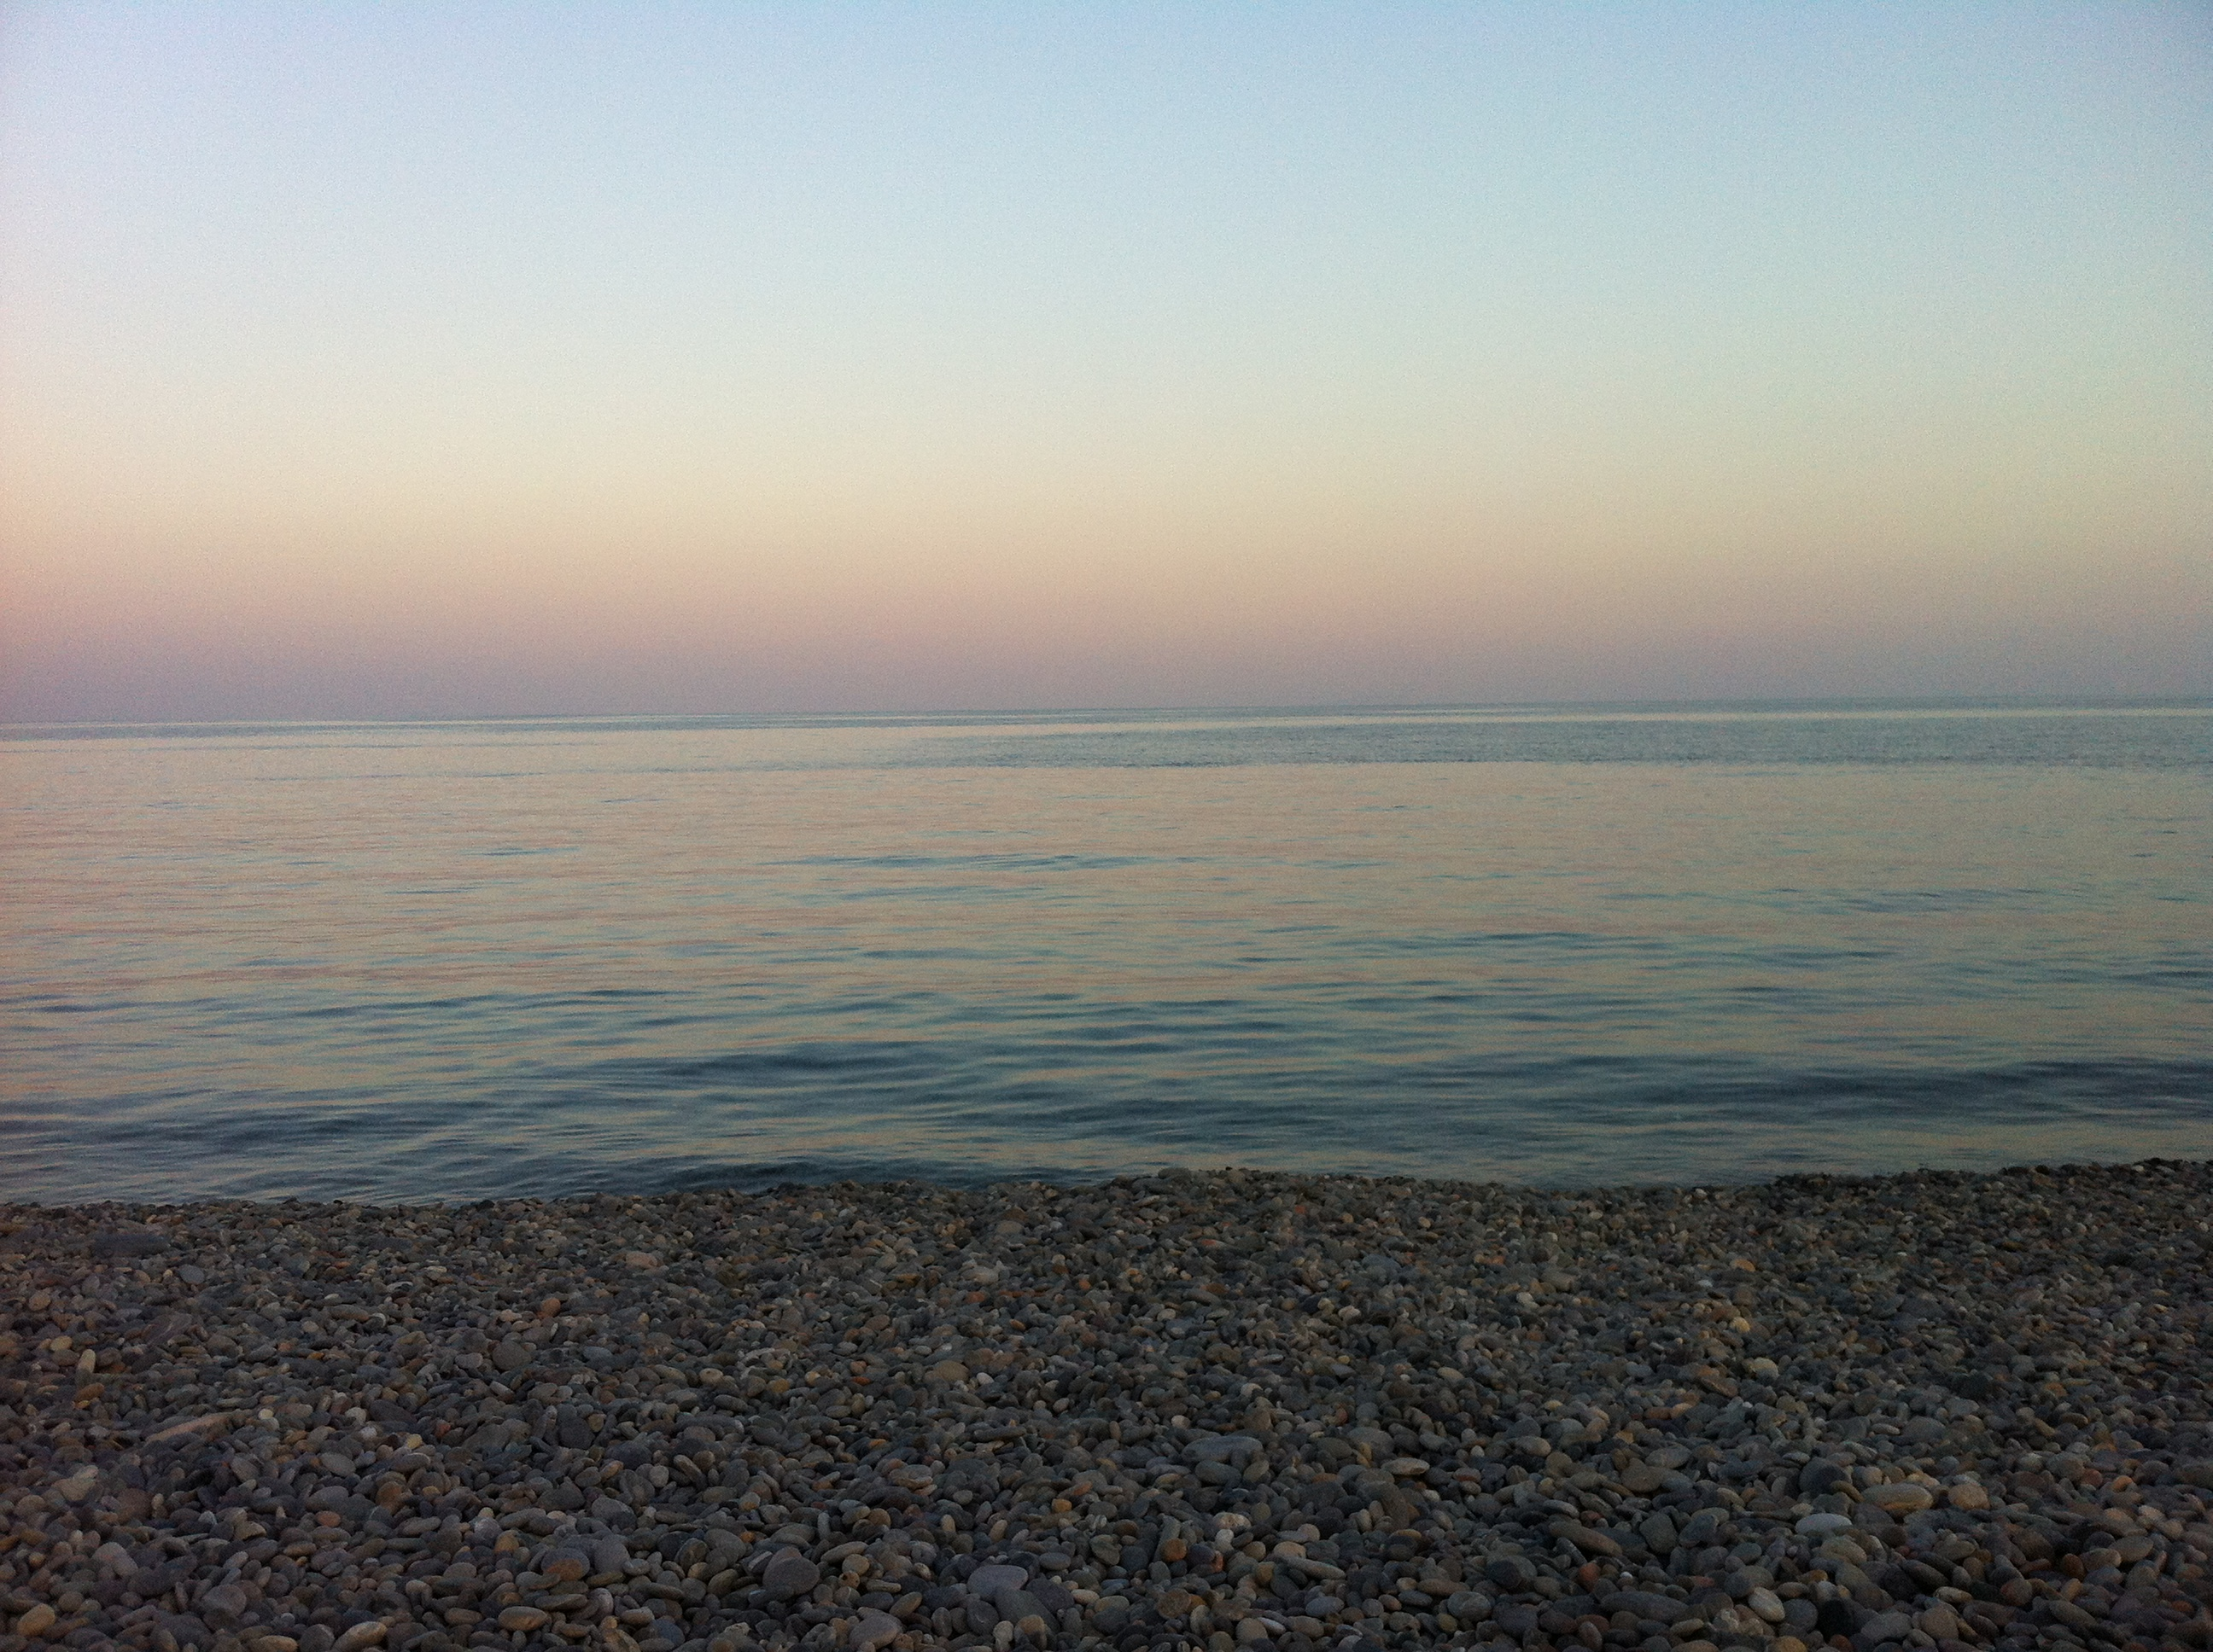


Do we choose an appropriate spatiotemporal MHW scale (how?) to investigate or do we adapt our research questions ?
Thank you for watching
sofia.darmaraki@dal.ca

Slide 13
References
Cerrano, C., Bavestrello, G., Bianchi, C. N., Cattaneo-Vietti, R., Bava, S., Morganti, C., Morri, C., Picco, P., Sara, G., Schiaparelli, S., et al. (2000). A catastrophic mass-mortality episode of gorgonians and other organisms in the ligurian sea (north-western mediterranean), summer 1999. Ecology letters, 3(4):284–293.
Darmaraki, S., Somot, S., Sevault, F., Nabat, P., Narvaez, W. D. C., Cavicchia, L., ... & Sein, D. V. (2019). Future evolution of marine heatwaves in the Mediterranean Sea. Climate Dynamics, 53(3-4), 1371-1392.
Garrabou, J., Perez, T., Sartoretto, S., & Harmelin, J. G. (2001). Mass mortality event in red coral Corallium rubrum populations in the Provence region (France, NW Mediterranean). Marine Ecology Progress Series, 217, 263-272.
Garrabou, Joaquim, et al. 2009 "Mass mortality in Northwestern Mediterranean rocky benthic communities: effects of the 2003 heat wave." Global change biology 15.5 (2009): 1090-1103.
Giorgi, F. (2006). Climate change hot‐spots. Geophysical research letters, 33(8).
Hobday, Alistair J., et al. "A hierarchical approach to defining marine heatwaves." Progress in Oceanography 141 (2016): 227-238.
Holbrook, N. J., Scannell, H. A., Gupta, A. S., Benthuysen, J. A., Feng, M., Oliver, E. C., ... & Moore, P. J. (2019). A global assessment of marine heatwaves and their drivers. Nature communications, 10(1), 1-13
Pisano, A., Nardelli, B. B., Tronconi, C., and Santoleri, R. (2016). The new Mediterranean optimally interpolated pathfinder AVHRR SST Dataset (1982–2012). Remote Sensing of Environment, 176:107–116.
Rubio-Portillo, E., Izquierdo-Muñoz, A., Gago, J. F., Rosselló-Mora, R., Antón, J., & Ramos-Esplá, A. A. (2016). Effects of the 2015 heat wave on benthic invertebrates in the Tabarca Marine Protected Area (southeast Spain). Marine environmental research, 122, 135-142.
Ruti, P., Somot, S., Giorgi, F., Dubois, C., Flaounas, E., Obermann, A., Dell’Aquila, A., Pisacane, G., Harzallah, A., Lombardi, E., et al. (2016). Med-cordex initiative for mediterranean climate studies, bams, doi: 10.1175. Technical report, BAMS-D-14-00176.1

Slide 14
Model capture well past MHW characteristics
IDF plot
NMHW
in 35y
(1982-2017)
(1982-2017)
1
MHW 2003
HINDCAST MODE:
ERA-Interim driven
2
Imean (℃ )
Imean (℃ )
3
4
29 events
5
31 events
6
MHW Duration (Days)
MHW Duration (Days)
MHW Duration up to ~ 50 days
Intensity up to 1 (℃)

Slide 15
P1,P3 (Increasing SST anomalies – MHW development)
- Lower/Higher than normal Forcing, Shortwave (Q_{SWD}),
- Lower than normal: Windspeed, Vertical Diffusion (Zdf), Latent(Q_{LH})
P2-P4 (Decreasing SST anomalies – MHW decay)
- Opposite ocean & atmosphere forcing than P3
Longwave down (Q_{LWD}) abnormally high at all times
Span of time-integrated period matters !
👉

