Slide 1
Air-sea Interface Exchanges and Rapidly Intensifying Tropical Cyclones
A.V. Soloviev¹, C.W., B. Vanderplow¹, R. Lukas² ¹Nova Southeastern University, Dania Beach, Florida, USA ²University of Hawaii, Honolulu, Hawaii, USA
7 May 2020
EGU 2020 (online)

Slide 2
Motivation
Rapid intensification is a serious challenge for the tropical cyclone intensity prediction
The role of microphysics at the air-sea interface has been underestimated in the problem of rapid intensification
The influence of sea spray is a significant uncertainty
To study the effect of spray on dynamics of tropical cyclones, we have implemented theoretical considerations by Emanuel (1995); Shay (2001); Lin et al. (2013), Andreas et al. (2015), Lee et al. (2019), Peng and Richter (2019) and a Volume of Fluid to Discrete-Phase Method (VOF to DPM)

Slide 3
Maximum Tropical Cyclone Intensity
depends on the Potential Intensity (PI) index (Emanuel 1995; Shay 2001; Lin et al. 2013),
Net energy gain rate (NGR), introduced by Lee et al. (2019) as the energy generation rate (G) minus the surface frictional dissipation rate (D), represents the potential for rapid intensification:
:

Slide 4
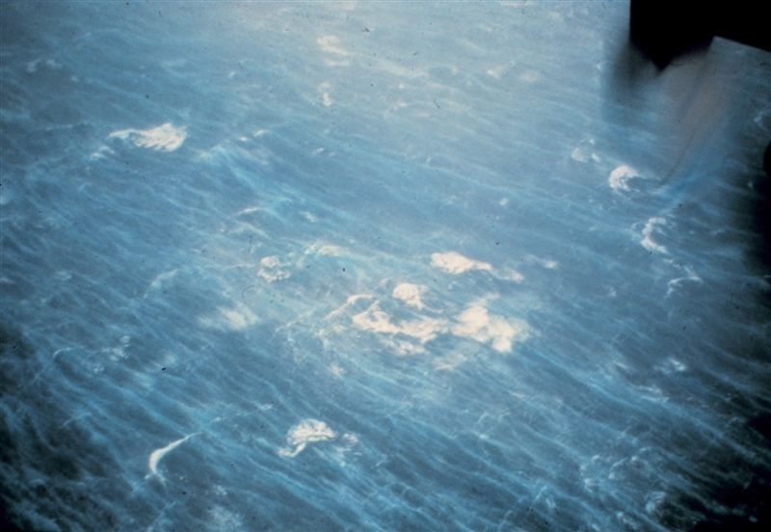
Sea Surface during Hurricane Hugo
Over 100 knot wind and 60-80 feet height waves
NOAA Photo Library
The white cap coverage increases with wind but at very high wind speeds remains at a constant 4% level, while the white out coverage increases toward full saturation (Holthuijsen et al. 2012).

Slide 5
Air-Sea Interface Under Tropical Cyclones
The streaks on photos cannot be always traced to white caps (breaking waves) and are the results of a different process
Analogy to the process of atomization in engineering applications such as fuel injection in combustion and rocket engines, food processing, inkjet printing (Ling et al., 2015; Shinjo & Umemura, 2010)
The instability occurs in different forms including the well-known interfacial mode (Helmholtz, 1868; Thomson [Kelvin], 1871) and the ‘‘liquid’’ mode (Yecko et al., 2002; Holmboe, 1962)
In engineering applications, the combination of all these modes is called the Kelvin-Helmholtz instability (somewhat extending the initial definition given by Kelvin and Helmholtz)

Slide 6
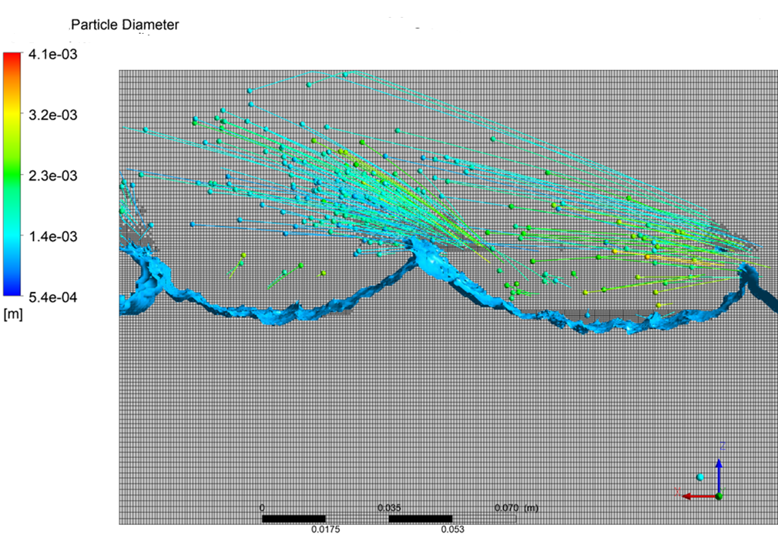
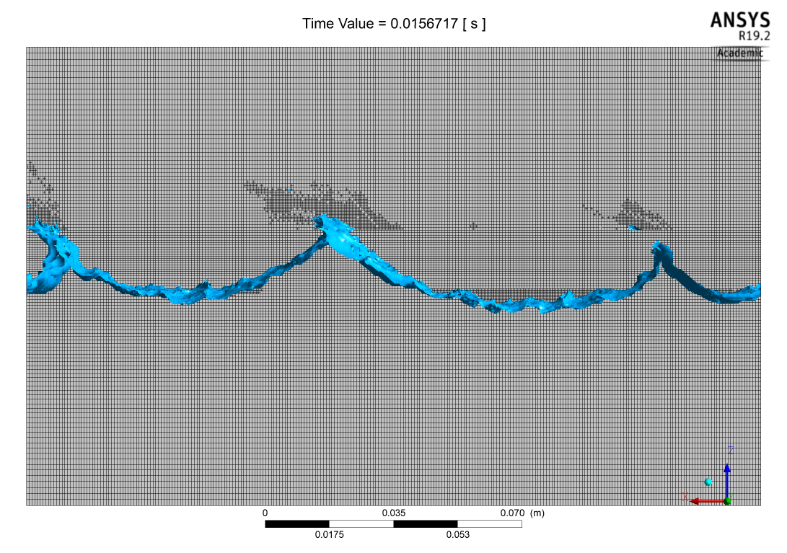
VOF to DPM: Mesh Adaption and Conversion to Lagrangian Particles

Slide 7
Formation of spray droplets under strong wind (U₁₀=40 ms⁻¹) is consistent with the Kelvin-Helmholtz instability at the interface with very large density difference
Laboratory experiment
(After Soloviev, A. V., Lukas, R., Donelan, M.A., Haus, B. K., Ginis, I. (2017). Is the state of the air-sea interface a factor in rapid intensification and rapid decline of tropical cyclones? JGR-Oceans 122, 10174-10183.)
VOF to DPM simulation

Slide 8
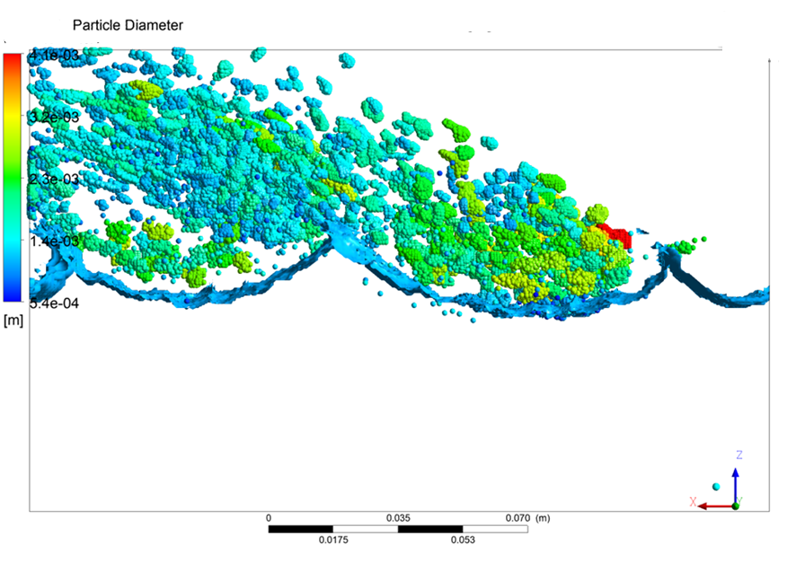
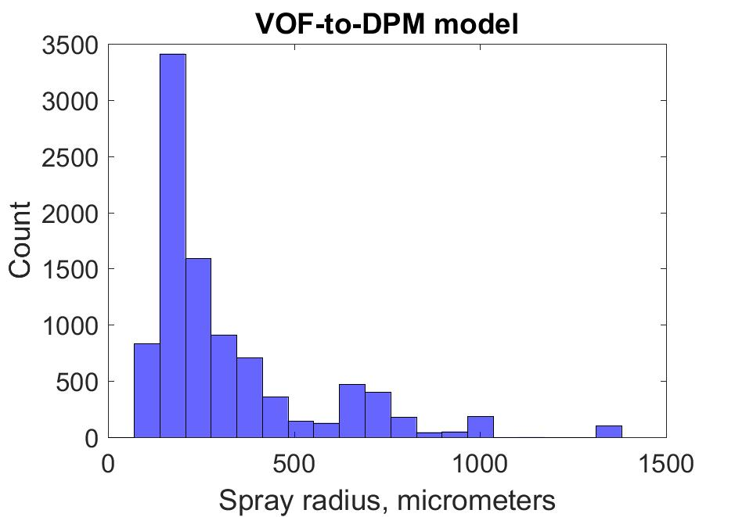
Spray Size Distributions for Category 1 Tropical Cyclone Conditions in the VOF-to-DPM Model

Slide 9
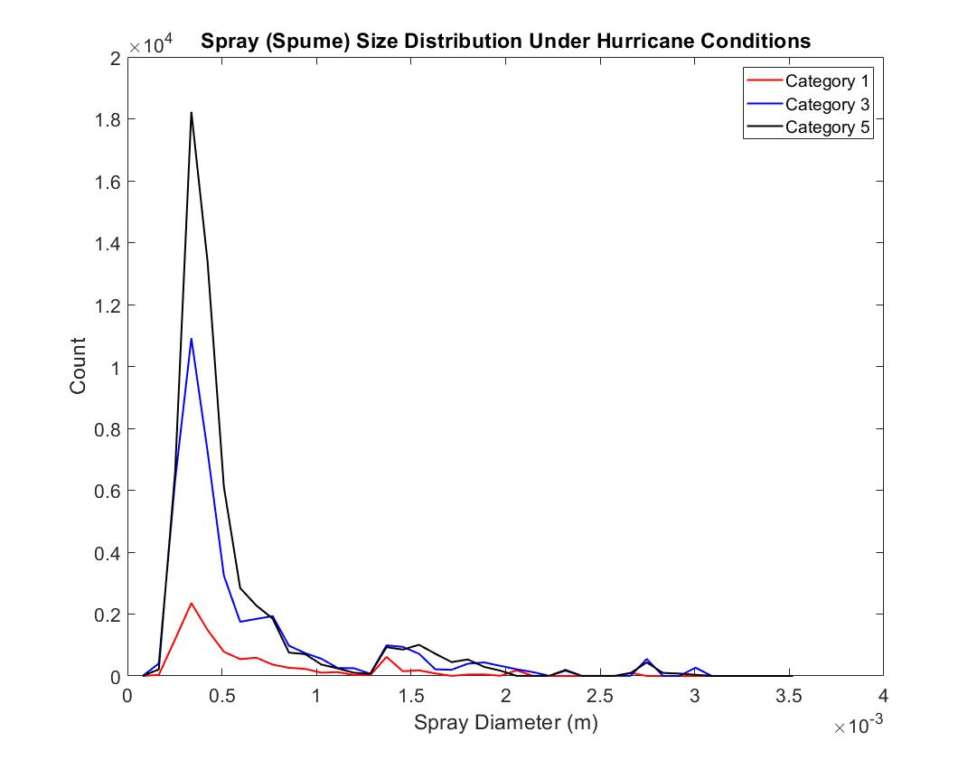
Spray size distributions for Category 1, 3, and 5 Tropical Cyclone Conditions Using the VOF-to-DPM Model
Spume particles are important for the enthalpy supply to tropical cyclones (Andreas et al. 2015, Peng and Richter 2019)
Scales simulation below 0.1 mm diameter is affected by the spatial resolution of the model

Slide 10
Conclusions
Microphysics of the air-sea interface is a key to understanding rapid intensification of tropical cyclones.
The volume of fluid to discrete phase method (VOF to DPM) significantly reduces computational costs and can model sub-millimeter size spray particles.
VOF to DPM next steps: verify with lab experiment at SUSTAIN, include heat exchange, spray evaporation, and surfactants.

Slide 11
Acknowledgements
We thank Cayla Dean (NSU) for the VOF-DPM model development and Brian Haus (UM) for discussion of the results.
This work has been supported by:
NOPP project “Advanced coupled atmosphere-wave-ocean modeling for improving tropical cyclone prediction models” (PIs: Isaac Ginis, URI and Shuyi Chen, UM)
Gulf of Mexico Research Initiative (GoMRI) Consortium for Advanced Research on the Transport of Hydrocarbons in the Environment Grant Award Number SA 18-14 (PI: Tamay Özgökmen, UM)
ONR Grant Award Number N00014-18-1-2835 (PI: Alex Soloviev)

