Slide 1
CFD Simulations of Flows in Step-up Street Canyons
Soo-Jin Park¹⁾, Jae-Jin Kim¹⁾, Eric Pardyjak²⁾, and Ji-Yoon Hong¹⁾
¹⁾ Department of Environmental Atmospheric Sciences, Pukyong National University
²⁾ Department of Mechanical Engineering, University of Utah, Salt Lake City, U.S.A.
Notes:
2장은 이상화된 도시협곡에서 반응성 오염물질 확산 특성 분석입니다.

Slide 2
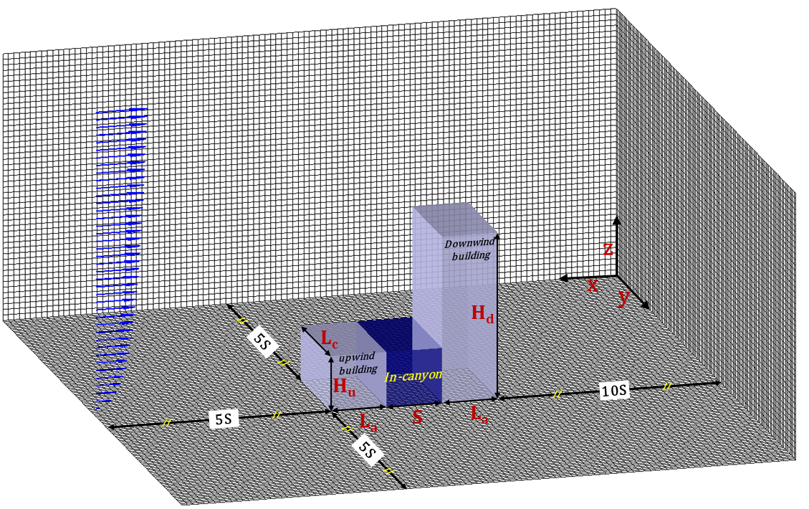
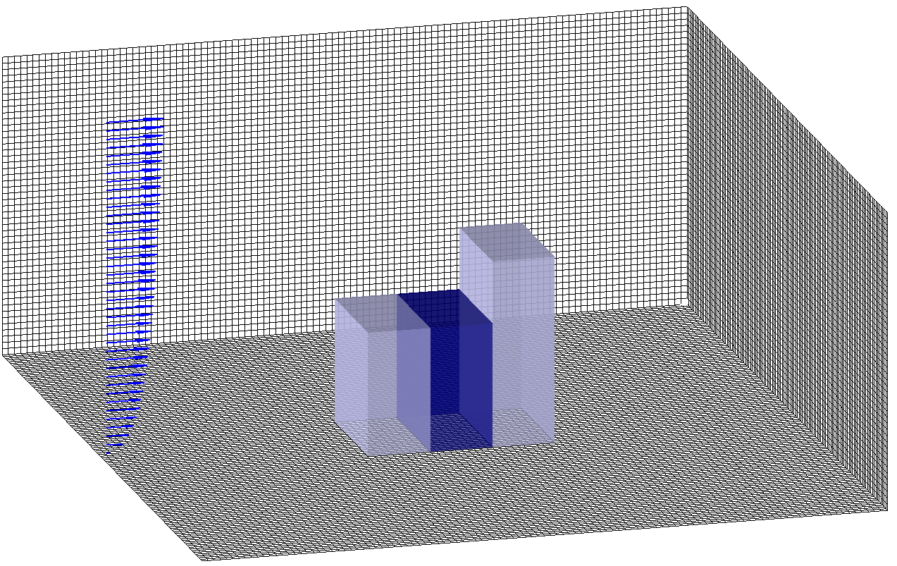
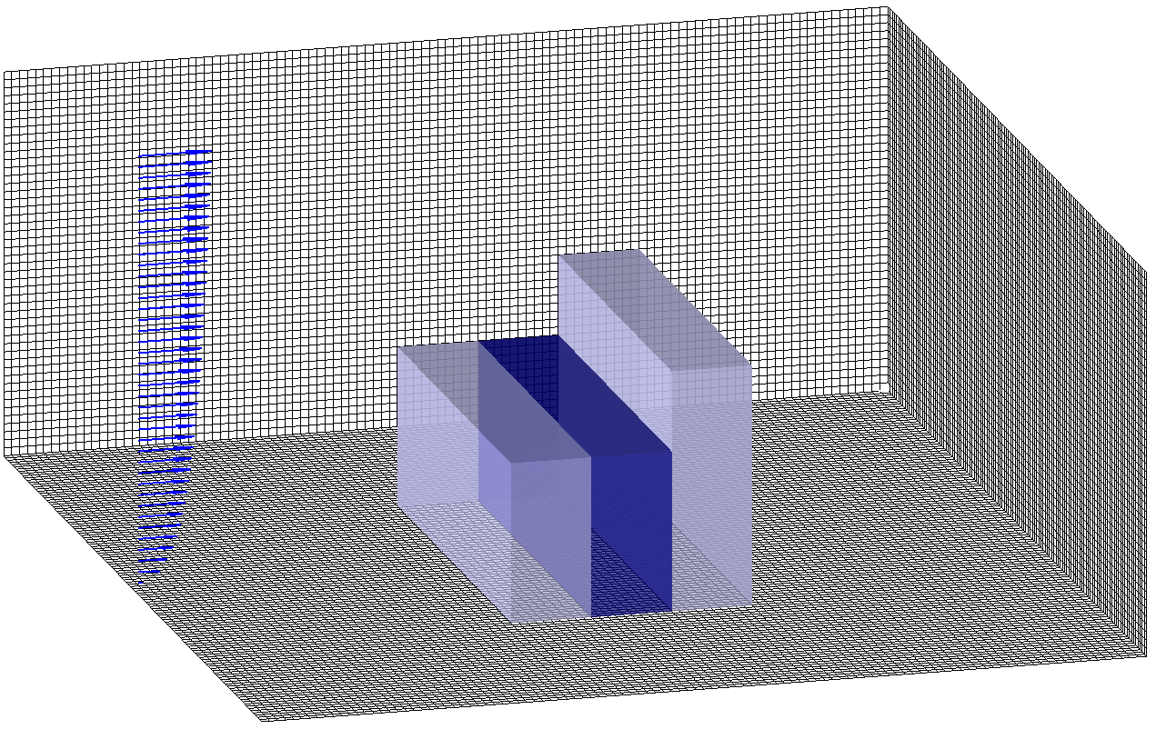
Numerical model set-up
Wind-tunnel experiment
Numerical domain
128 m
64 m
96 mm
64 mm
Step-up street canyon configuration
Domain size : 576 $×$ 336~448 $×$288 m
Domain number : 180 $×$ 105~140 $×$ 90
Grid size : 3.2 m
Inflow : 4.32 m s⁻¹ at 96 m (power law)
Integration time (time step) : 3600s (0.5s)
Boundary condition :
x-, y-direction : inflow/outflow boundary condition
z-direction : zero gradient boundary condition (at top boundary)
32 mm
Addepalli and Pardyjak (2013)
Step-up street canyon Design
Shallow step-up street canyon
: H_{u} = 32 m, H_{d} = 96 m ( H_{d}/H_{u} ≈ 3 )
Deep step-up street canyon
: H_{u} = 64 m, H_{d} = 96 m ( H_{d}/H_{u} ≈ 1.67 )
building-length ratios (L_{C}/S)
: L_{C}/S = 1, 2, 3, 4
2

Slide 3
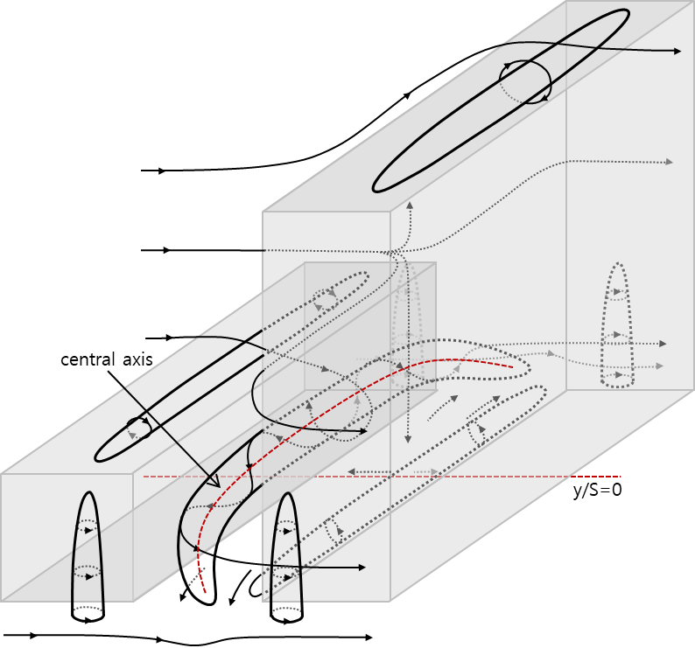
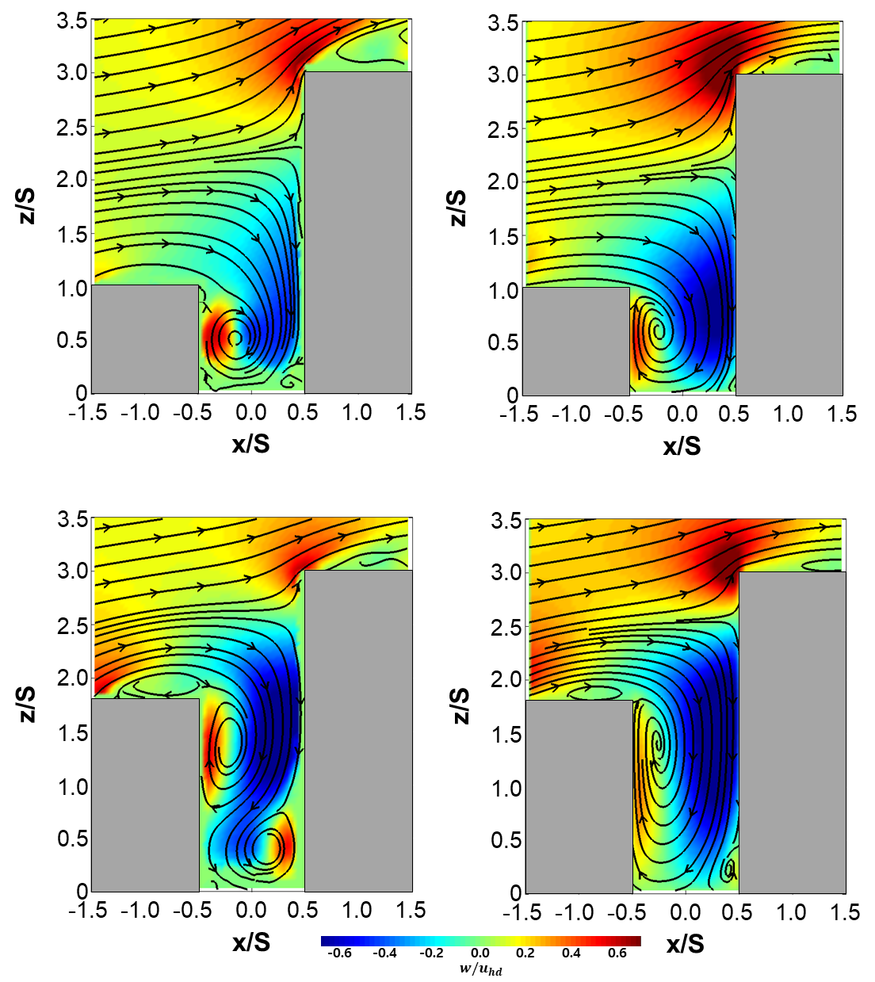
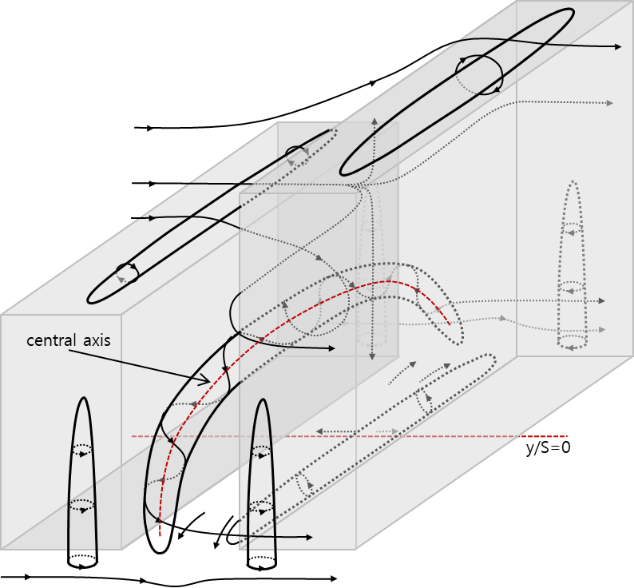
Streamlines and contours of the normalized vertical wind components
Shallow step-up street canyon
wind tunnel (2013)
This study
L_{C}/S = 4
flow
stagnation-point
* vertical wind component : W/U_{d}
Deep step-up street canyon
wind tunnel (2013)
This study
L_{C}/S = 4
flow
stagnation-point
3

Slide 4
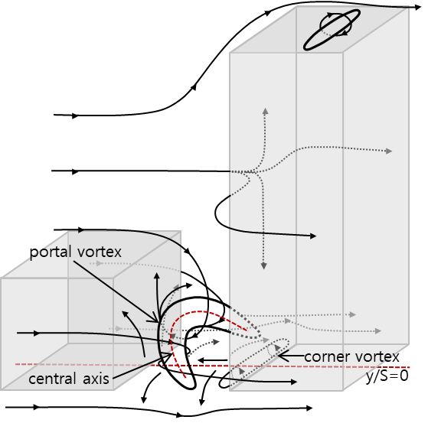
Maximum downdraft and Stagnation point heights
The measured and simulated maximum downdrafts and stagnation-point heights
4
4

Slide 5
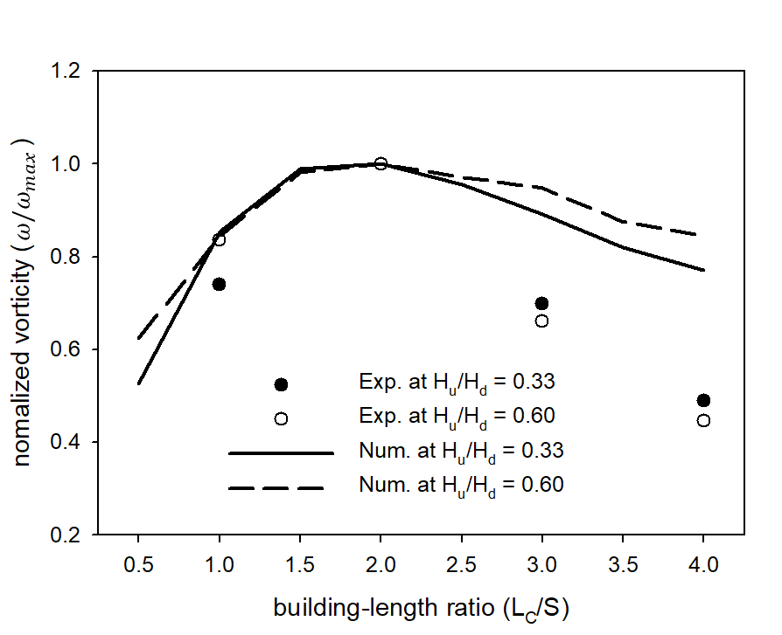
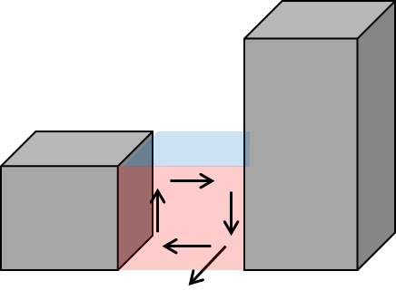
Normalized vorticity and velocity component with the LC/S
Normalized vorticity
Shallow step-up street canyon
Deep step-up street canyon
Development stage
Mature stage
Development stage
Mature stage
L_{C}/S ≲ 2.0
L_{C}/S ≳ 2.0
L_{C}/S ≲ 2.0
L_{C}/S ≳ 2.0
5

Slide 6
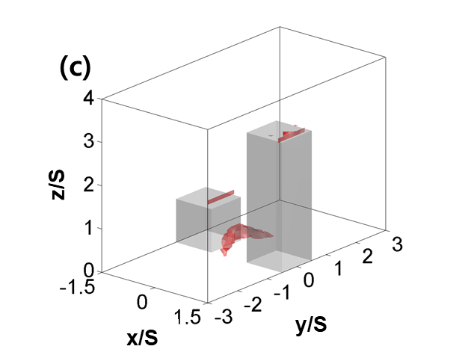
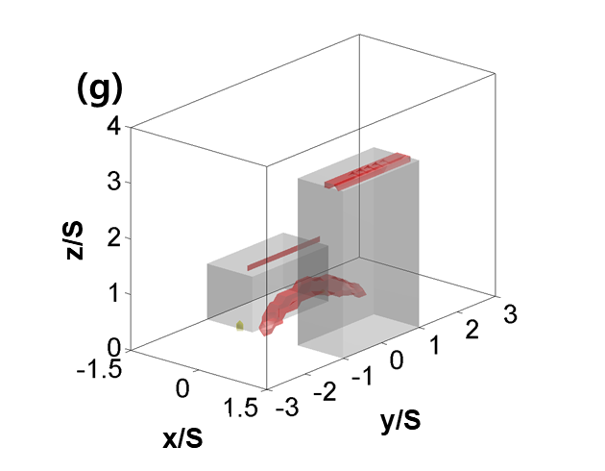
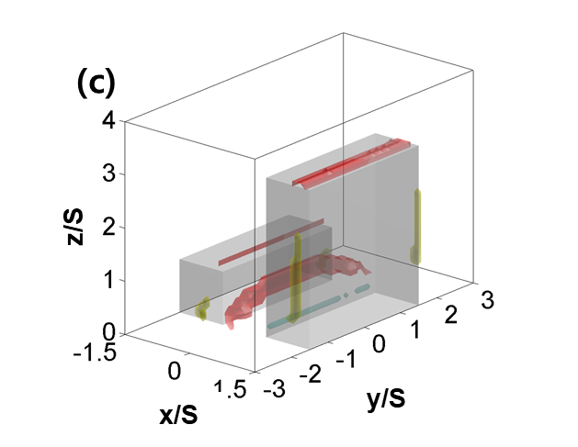
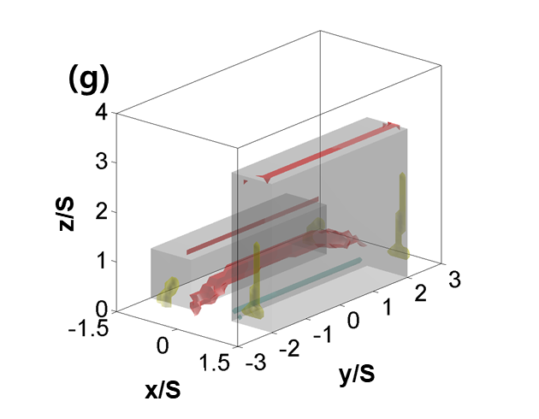
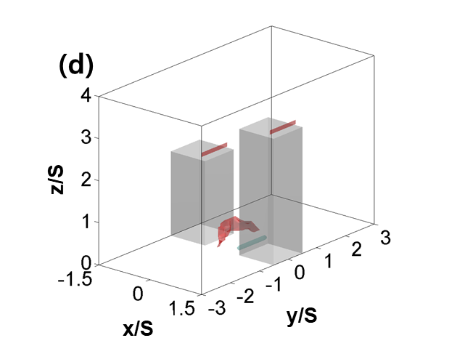
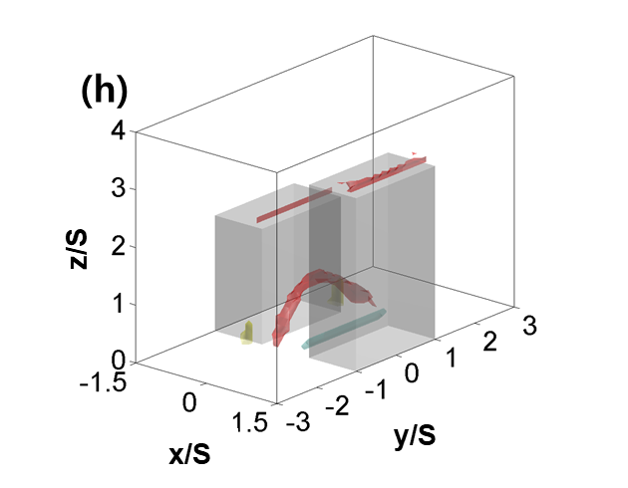
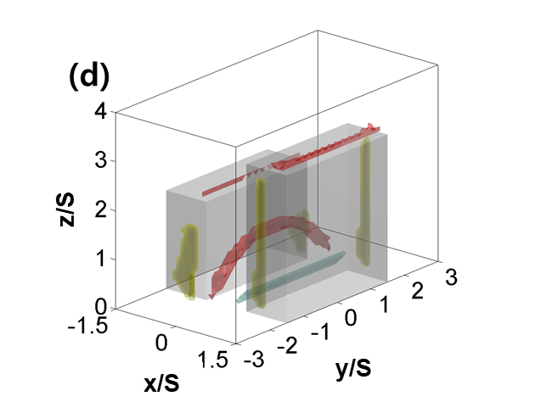
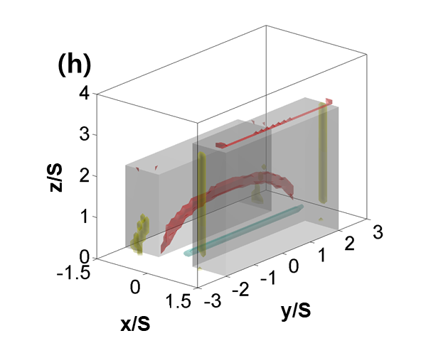
The recirculation zones and in-canyon vortices
Development stages
Mature stages
Lc/S=1
Lc/S=2
Lc/S=3
Lc/S=4
Lc/S=1
Lc/S=2
Lc/S=3
Lc/S=4
6

Slide 7
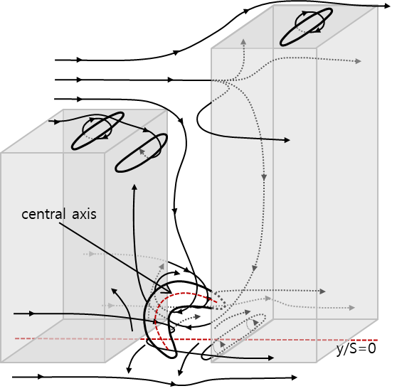
The schematics of the mean flow circulation
shallow step-up street
deep step-up street
L_{C}/S < 2.0
the development stage
L_{C}/S $≥$ 2.0
the mature stage
7

