Slide 1
Global Wave Data Assimilation Model using Optimal Interpolation Method
Kyeong Ok Kim¹, Hanna Kim¹, Kyung Tae Jung¹, and Young Ho Kim²
¹Korea Institute of Ocean Science and Technology, Busan, Korea (kokim@kiost.ac.kr)
²Pukyung University, Busan, Korea (yhokim@pknu.ac.kr)

Slide 2
Introduction to the Global Wave Data Assimilation Model
To construct are analyzed global ocean wave dataset with improved accuracy, which is important for the better understanding and simulation of various near-surface ocean dynamics, a data assimilation method has been embedded to the global spectral wave model based on WW3. The major factors controlling the wave simulation accuracy are the wind condition and the parameterization on the wave energy development, dissipation and nonlinear processes between wave components. However, the atmospheric prediction accuracy is still not sufficient, and the parameterization cannot be generalized due to the local geographic conditions.
The significant wave heights computed by the integration of wave energy spectra are showed to be quite similar with observed results. However, the wave periods and directions related to the shape of wave energy spectra are not sufficiently comparable. Generally there have been difficulties in predicting the propagation of long period waves such as swells.
The data assimilation using the optimal interpolation method has been applied, verification through the comparison with satellite altimeters and buoy observations has been made with examination of the data assimilation effects.

Slide 3
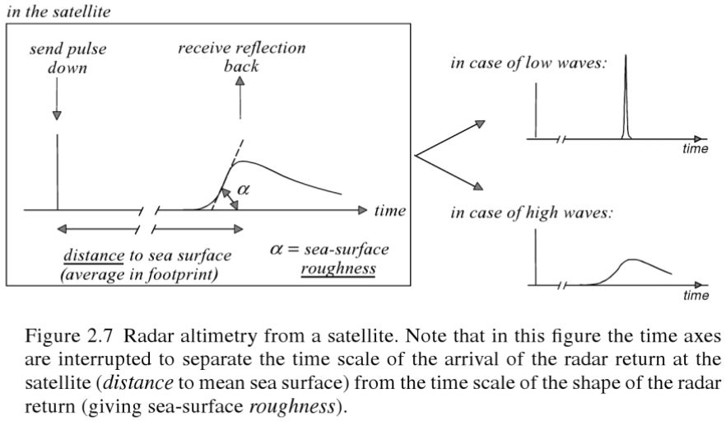
Satellite altimeters wave data ?
Wave Height observation using the satellite altimeters.
Extracts wave information from reflective signals of vertical radar signal
Extracts wave information from using the correlation between angle α to indicate the distortion of the received signal and sea level roughness cause by wave (Kim, 2012)
Low Wave : receive all signals in a short time. The sea level remains flat without curvature. At this point, the radar pulse in the footprint that reaches the sea level is reflected simultaneously.
High Wave : receive for a long time. Reflections take place first from the wave crest and continue to occur until radar signal reaches the wave trough.
(Holthuijsen, 2007)

Slide 4
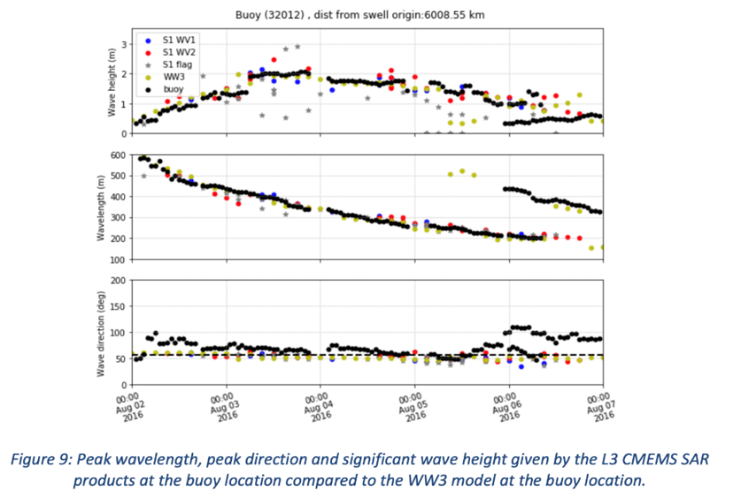
Wave Observation data
Global Ocean Wave Satellite provided by the CMEMS
Near-Real-Time production. Uploaded within 5 hours after the end of the observation time.
WAVE_GLO_WAV_L3_SWH_NRT_OBSERVATIONS_014_001 (07/2017~)
altimetry significant wave height L3 product based on SARAL/AltiKa, Cryosat-2, Jason-3, Sentinul-3A/3B
WAVE_GLO_WAV_L3_SPC_NRT_OBSERVATIONS_014_002 (06/2018~)
SAR spectral integral parameter L3 product based on Sentinel-1A /1B.
VAVH: sea surface significant wave height (~H1/3)
VTPK: sea surface wave period
at partition variance spectral density maximum (~Tp)
VPED: sea surface wave from direction
at partition spectral peak (~Dp)
Buoy wave observation data
QUALITY INFORMATION DOCUMENT (CMEMS-WAV-QUID-014-002)

Slide 5
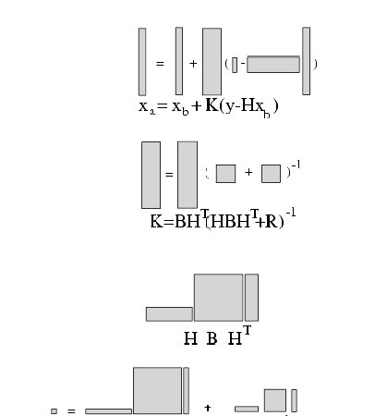
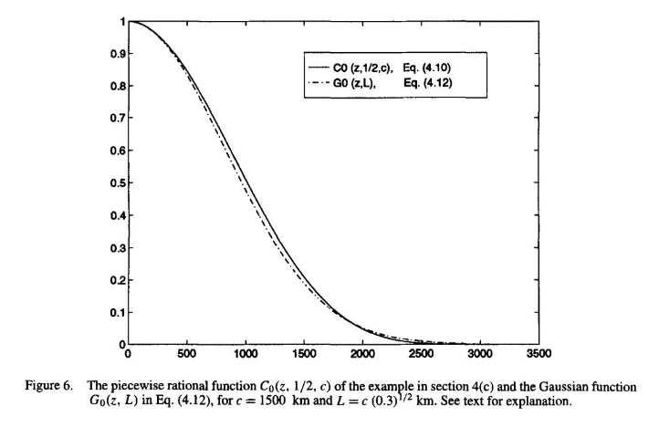
Data Assimilation Method - Optimal Interpolation(OI)
The fundamental hypothesis in OI :
For any limited domain of the model, only a limited amount of observations is important in determining the analysis increment.
Assume background-error covariance as Gaussian distribution
Calculate the statistically minimal error value considering the spatial correlation of model error
Nudging: considering distance only
OI: considering spatial correlation of model error
matrix of analysis stage & shape of vector
Shape of B Matrix
(Gaspari & Cohn, 1999)
model observation H:model->observation
then,

Slide 6
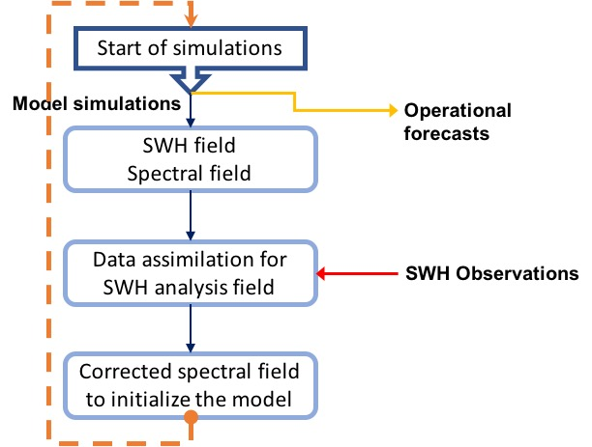
Data Assimilation Method - Optimal Interpolation(OI)
Optimal analyzed wave parameter
Significant Wave Height (SWH)
Time integral unit of global wave model(dt)
Converting satellite observation into 1hr interval data
Input the data into the model
OI data assimilation method
Calculate the statistically minimal error value considering the spatial correlation of model error
Assume background-error covariance as Gaussian distribution

Slide 7
Experiments model setup Global wave data assimilation model system
Global wave prediction model
WW3 latest version(v5.16)
Using source term and option of NCEP Operational model
Grid: global 1/2°
Atmosphere Forcing
Global FNL data of NCEP
Exp1 Simulation condition (No Data Assimilation)
Case 1: 11/Jul/2017 ~ 31/Jul/2017
No Spin-up
Case 2: 01/Jul/2017 ~ 31/Jul/2017
01/Jul/2017 ~ 11/Jul/2017 : Spin-up periods

Slide 8
Experiment 1 The effect of Spin-Up
No Spin-up
Comparison in satellite Orbit
After 10 days Spin-up
Spin-up is required on wave data assimilation model for 10 days (at least 8 days)

Slide 9
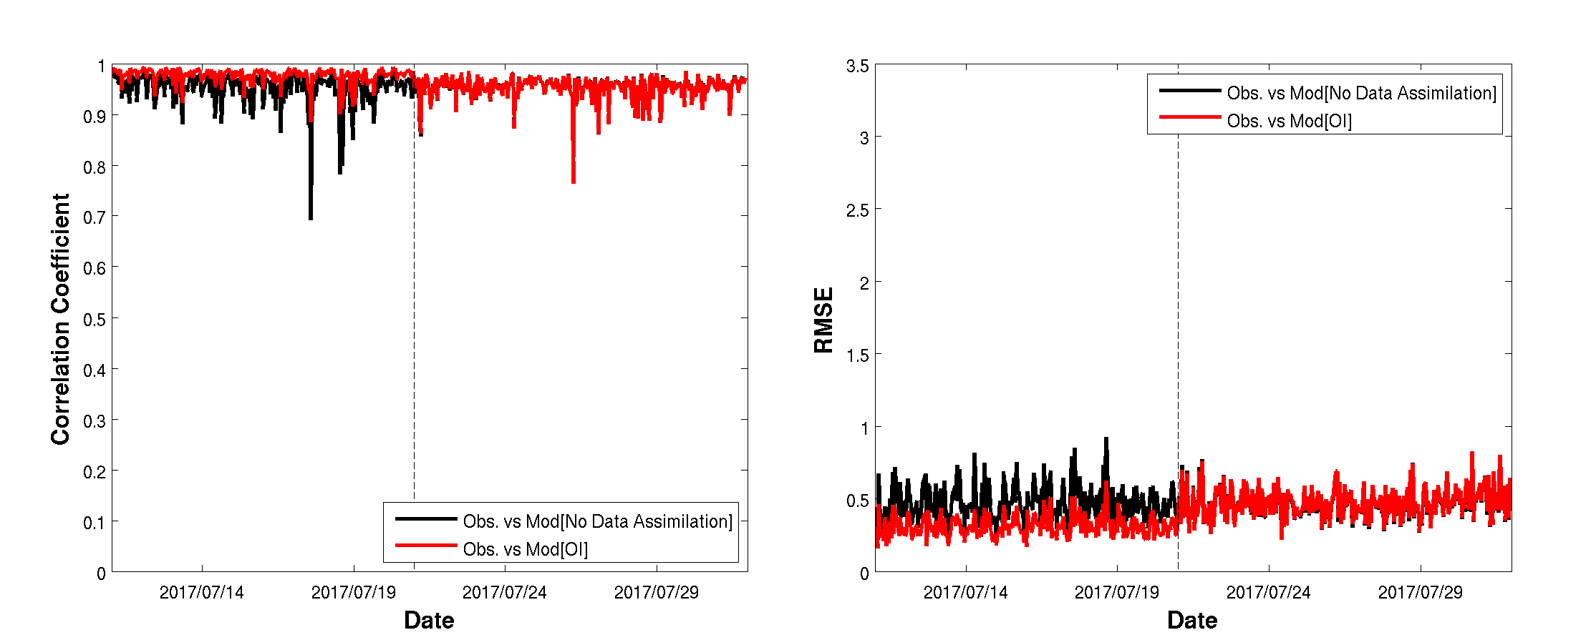
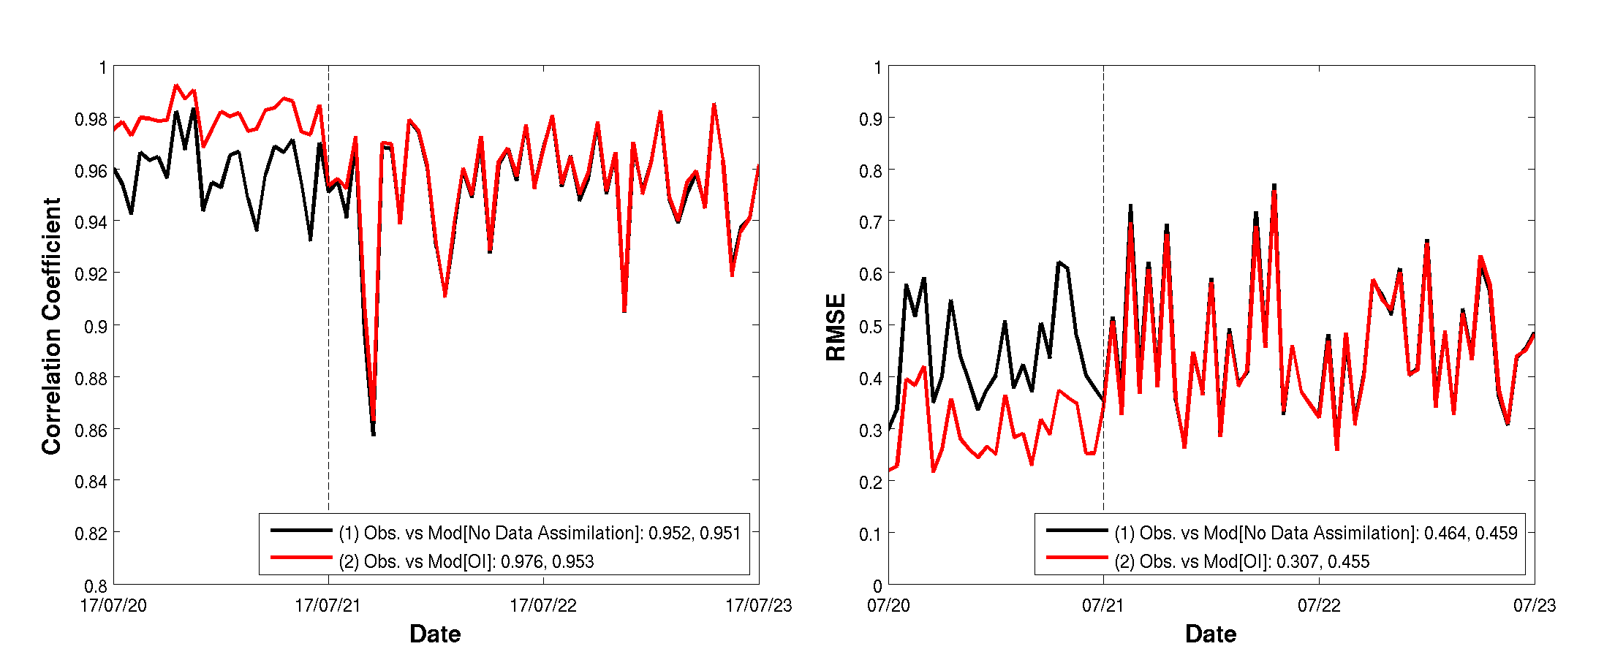
Experiment 2 The effect of data assimilation
Exp 2 Simulation condition
01/Jul/2017 ~ 11/Jul/2017 : Spin-up
11/Jul/2017 ~ 21/Jul/2017
No Data Assimilation
Data Assimilation
21/Jul/2017 ~ 31/Jul/2017 : No Data Assimilation
*comparison in satellite orbit
How long does the effect last when the data assimilation stop working?
DA (Past): Correlation between obs. And mod. Increases due to DA
No DA(future): no big impact.(due to the satellite’s distanced from its previous path)
Correlation coefficient | ~7/21 (DA O) | 7/21~ (DA X)
No data assimilation | 0.952 | 0.951
OI | 0.976 | 0.953

Slide 10
Experiment 3 Comparison with Buoy observations
Experiment 3
Simulation during 1 year using by WW3v5.16
Comparison of DA(OI-300km, Data Assimilation) and No DA
using the KMA GDAPS(Global Data Assimilation and Prediction System) for wind field
12hr interval analytical field + 1hr interval prediction filed
Comparison with Buoy observations
16 observation points surrounding South Korea.
Wave Buoy data provided by KMA(Korean Meteorology Administration)
Use for numerical simulation validation (Not for data Assimilation)
model version | DA | duration | Wind
WW3v5.16 | X | 2018.02 ~ 2019.04 | GDAPS 1hr
WW3v5.16DA | OI 300km | 2018.02 ~ 2019.04 | GDAPS 1hr

Slide 11
Experiment 3 Comparison with Buoy observations
Comparison with Buoy observations surrounding south Korea
Provided by KMA
 | WW3v5.16 |  | WW3v5.16DA
 | Correl. Coeff.. | RMSE | Correl. Coeff.. | RMSE
02/2018 | 0.97 | 0.22 | 0.97 | 0.21
03 | 0.93 | 0.25 | 0.94 | 0.25
04 | 0.97 | 0.18 | 0.97 | 0.18
05 | 0.94 | 0.18 | 0.94 | 0.17
06 | 0.95 | 0.15 | 0.94 | 0.13
07 | 0.88 | 0.18 | 0.87 | 0.17
08 | 0.94 | 0.22 | 0.94 | 0.21
09 | 0.88 | 0.20 | 0.89 | 0.18
10 | 0.95 | 0.26 | 0.96 | 0.24
11 | 0.96 | 0.21 | 0.95 | 0.20
12 | 0.97 | 0.23 | 0.97 | 0.22
01/2019 | 0.97 | 0.22 | 0.97 | 0.20
02 | 0.98 | 0.17 | 0.98 | 0.16
03 | 0.96 | 0.25 | 0.96 | 0.25
04 | 0.93 | 0.14 | 0.93 | 0.13
No big improvement.
Overall, model using the data assimilation are better than No data assimilation.
Especially, RMSE are reduced by about 10% in Jun 2018 and September 2018.

Slide 12
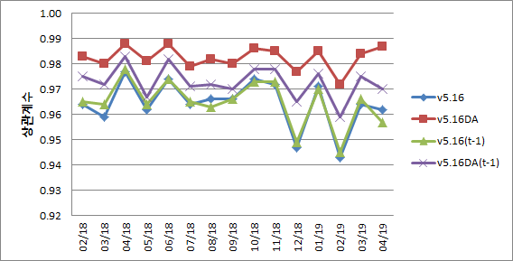
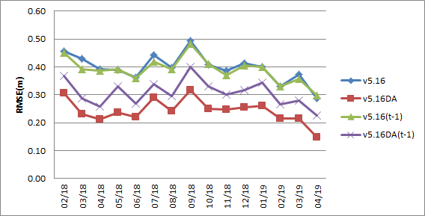
Experiment 3 Comparison with Buoy observations
Verification by compared Global satellite data with model output
Comparison of satellite observation data(used for DA) and model output
Comparison of 1 hour ago model output and obs. data to verify the effect of data assimilation.
v5.16 ~ v5.16(t-1) < v5.16DA(t-1) < v5.16DA
v5.16 ~ v5.16(t-1): (No DA) not much difference in 1 hour
v5.16(t-1) < v5.16DA(t-1): The effect of indirect data assimilation.
v5.16DA(t-1) < v5.16DA: The effect of direct data assimilation

Slide 13
Experiment 4 Wave prediction performance by improvement of initial field
72 hour Prediction experiment (every 12 hours)
Use the initial field with the results produced by the OI data assimilation.
Do not Data Assimilation during simulation(72hr prediction experiment)
Simulation is carried out for 07/2018(summer) and for 01/2019(winter)
Compared with Buoy observation data.
 | WW3v5.16 |  | WW3v5.16DA |  | WW3v5.16DA Prediction
 | Correlation Coefficient | RMSE | Correlation Coefficient | RMSE | Correlation Coefficient | RMSE
Average in Jul. (Summer) | 0.764 | 0.367 | 0.767 | 0.341 | 0.762 | 0.368
Average in Jan. (Winter) | 0.582 | 0.489 | 0.582 | 0.484 | 0.584 | 0.486

Slide 14
Summary
The data assimilation using the optimal interpolation method has been applied on the global ocean wave model WW3.
The reanalysis simulation during 1 year with the data assimilation shows better results than that without data assimilation.
The wave data assimilation for wave frequency and direction will be tested. The wave energy spectra on wave number and direction domains was multiplied by optimal interpolation method with the ratio of observed significant wave heights on first guessed simulated results. The energy spectra was thereafter shifted by the difference between simulated and observed peak wave periods and directions.

Slide 15
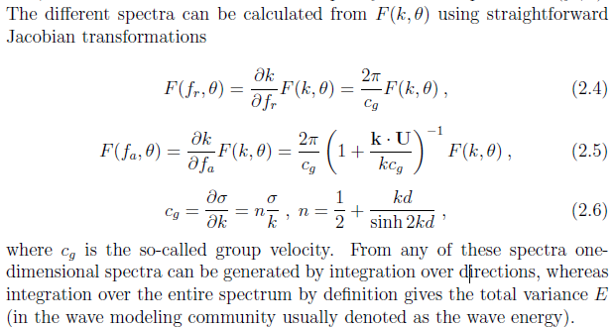
Data Assimilation Method Improvement
Application of OI data assimilation method for wave period and wave direction
Significant Wave Height: calculate the amount of energy with the integral of the spectrum and apply it as a ratio of energy.
Wave Period and Wave Direction: Applied by modifying the maximum frequency and major direction of the spectrum while preserving the amount of energy.
circle spectrum
E_{low}
E_{high}
E_{low}
E_{high}
To preserve energy, wave period is changed by interpolating divided value of the group velocity of wave(C_{group}) and wave number difference (dk) of the spectrum
wave height change wave direction change wave period change

