Slide 1



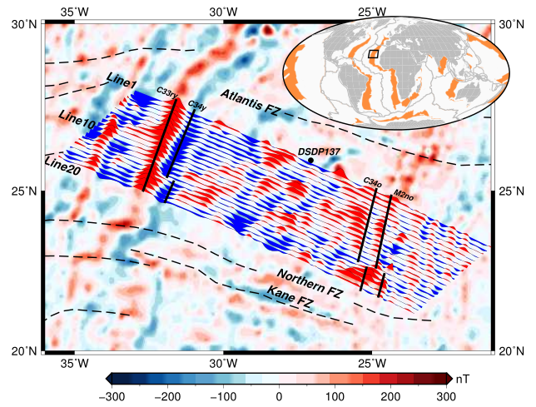
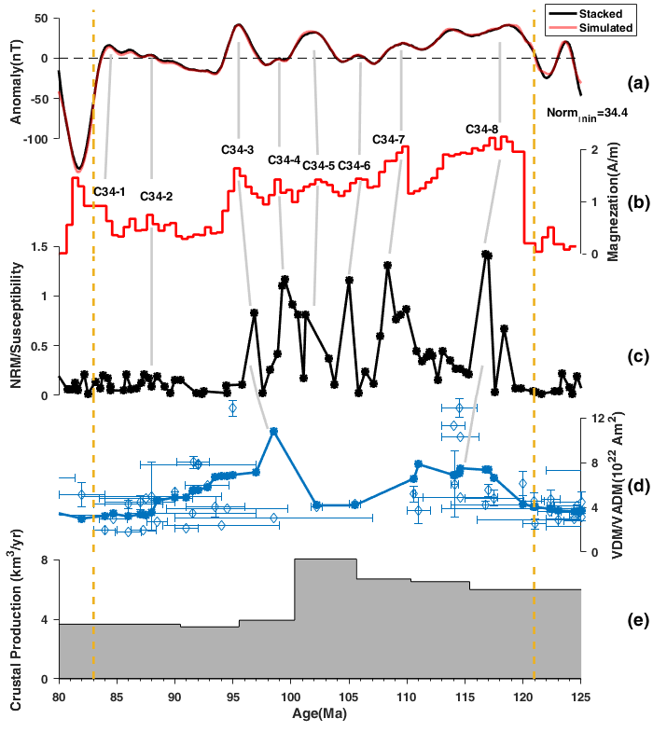
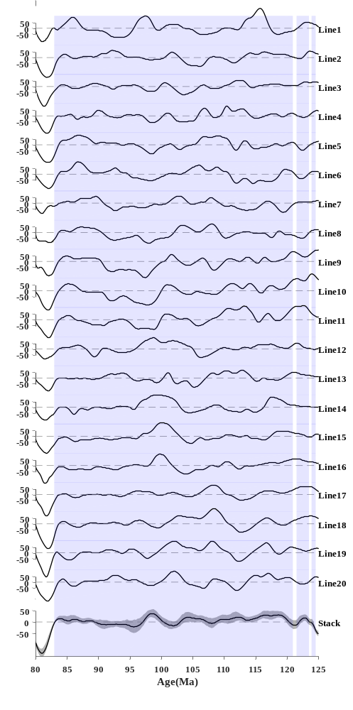

Geomagnetic Field Paleointensity during the Cretaceous Normal Superchron from Marine Magnetic Anomalies
Yuanjie Li¹, Qingsong Liu^{1,2}
1. Department of Ocean Science and Engineering, Southern University of Science and Technology of China, Shenzhen, China.
2. Laboratory for Marine Geology, Qingdao National Laboratory for Marine Science and Technology, Qingdao, China
1. Introduction
It is difficult to construct continuous long-term variations of paleointensity during the CNS due to inadequate sampling or variable data fidelity.
In this study, we investigated multiple marine magnetic anomaly profiles across the Cretaceous quiet zone. An integrated magnetization profile was calculated using a forward modeling method, and then was compared with other paleointensity records. This should be the most practical approach to test the fidelity of geomagnetic field behaviors during the CNS.
5. Results
The amplitudes are higher at the early CNS than those at the late CNS for most profiles, which is also present in the stacked profile, with less local anomalies.
There is a fluctuated change in the synthetic magnetization curve during the CNS, generally with the high magnitude and long wavelength at the early CNS, and depression and short wavelength at the late CNS, that is also similar to that of the stacked magnetic anomaly profile.
2. Data
Earth Magnetic Anomaly Grid
(EMAG2v3)
20 profiles along from contour
map
the resolution of 2'
space distance of 20 km
sample interval of 3 km
(a) Stacked magnetic anomaly profile and Simulated anomaly profile; (b) Equivelent magnetization; (c) Relative paleointensity from sediments; (d) Absolute paleointensity from volcano rocks; (e) Crustal production rates.
3. CRM and TRM
The total magnetization would consist of CRM and thermoremanent (TRM) which is the equivalent magnetization need to be determined
6. Conclusions
The synthetic marine magnetization profile shows a generally gradual decrease trend during the CNS.
The broad correlation among three different paleointensity records confirms the fidelity of the fluctuation pattern of the geomagnetic field intensity during the CNS.
Short-wavelength paleointenisty anomalies are also identified from the synthetic magnetization profile.
4. Forward modeling method
Aim to estimate the equivalent magnetization.
Magnetic layer |  | Geomagnetic parameters
thickness | 1 km | present declination | 0°
depth | 5 km | remanent declination | 0°
spreading rate | 18 km/Myr | present inclination | 90°
azimuth | 0° | remanet inclination | 90°
the width of the transition zone | 3 km | GPTS | CK95,MHTC12
References
Meyer, B., Saltus, R., & Chulliat, A. (2017), EMAG2: Earth magnetic anomaly grid (2-arc-minute resolution) version 3, edited, National Centers for Environmental Information, NOAA. Model. https://doi.org/10.7289/V5H70CVX
Raymond, C., & LaBrecque, J. (1987), Magnetization of the oceanic crust: Thermoremanent magnetization of chemical remanent magnetization?, Journal of Geophysical Research: Solid Earth, 92(B8), 8077-8088.

