Slide 1
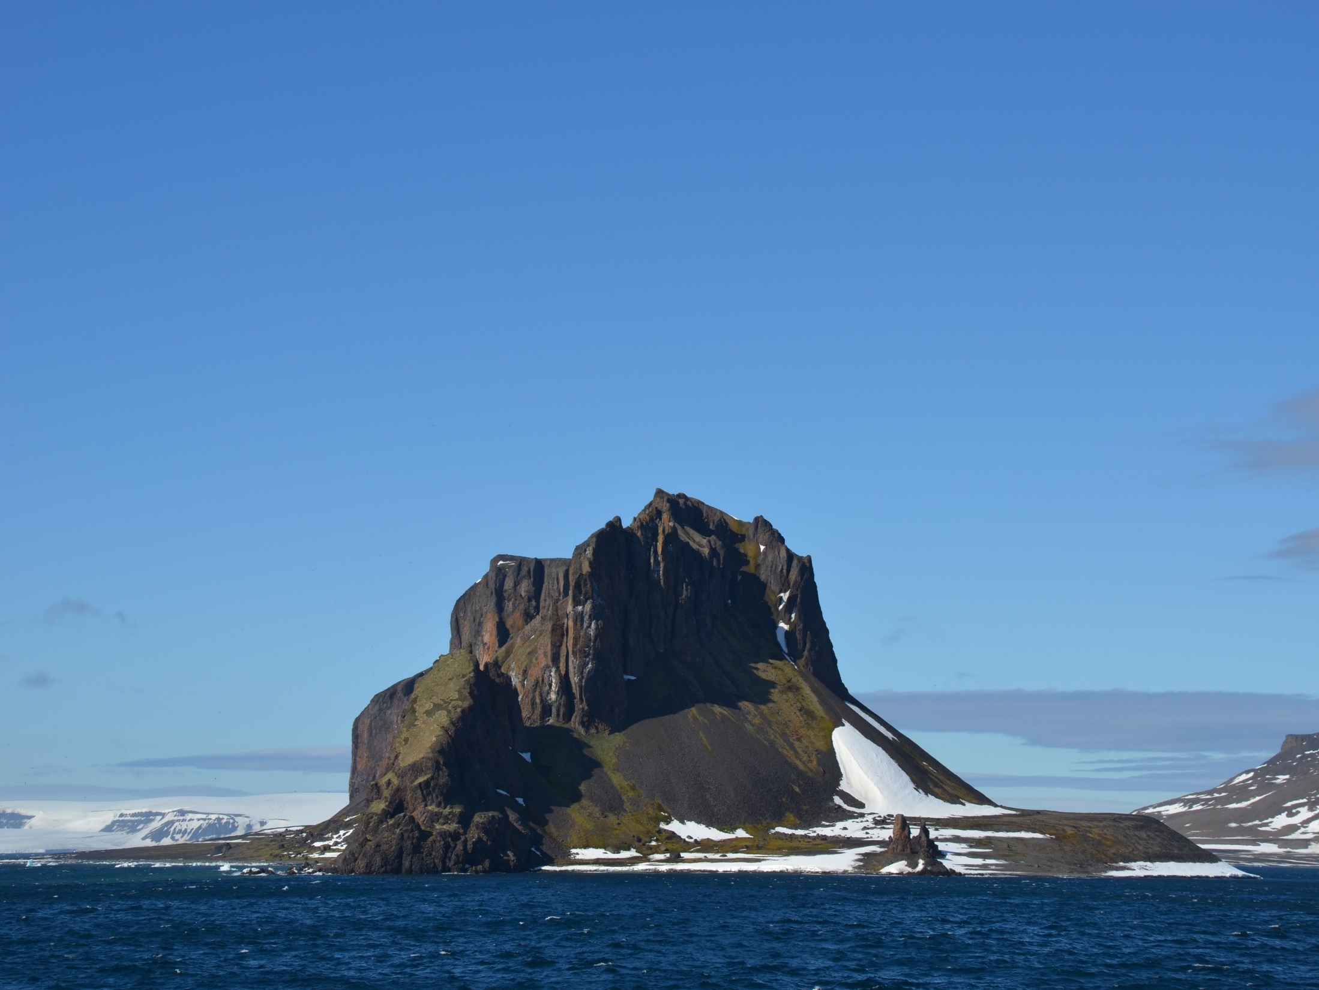



Magnetic fabric and flow directions in magmatic rocks
of the Franz Josef Land, Arctic Ocean
Anna Chernova,
Victor Abashev, Dmitry Metelkin, Valery Vernikovsky, Nikolay Mikhaltsov
Online | 4-8 May 2020 | European Geosciences Union General Assembly 2020

Slide 2
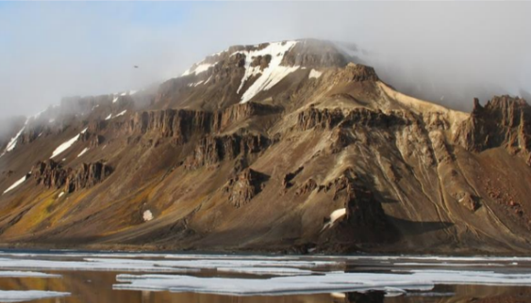
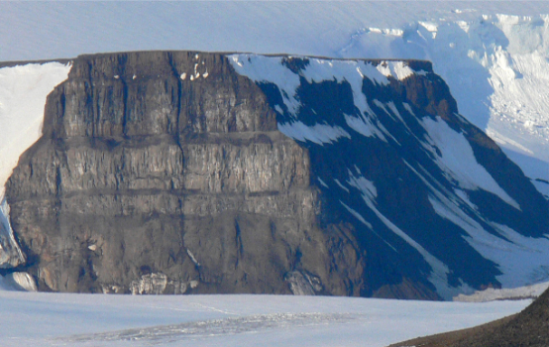
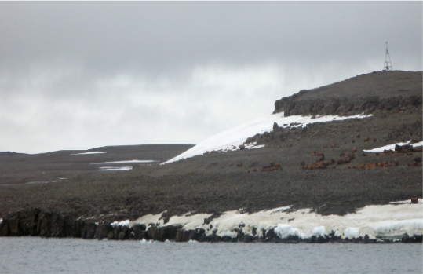
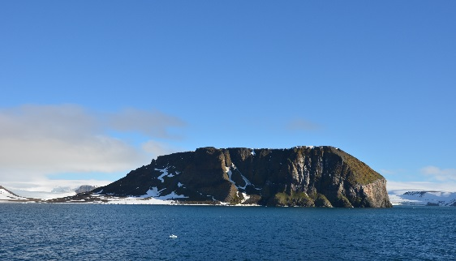
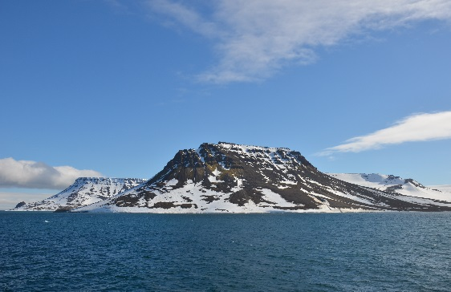
Objects:
The results of a study of the anisotropy of magnetic susceptibility (AMS) were completed in the Early Cretaceous magmatic complexes from the Franz Josef Land (FJL). Present study was focused on the tholeiitic basaltic lava flows and dolerite sills, dykes, that crop out on several Islands. The previous studies of the basalts from FJL was published in (Abashev et al., 2019).
Methods:
Samples were cored for 10.8 cm3 standard cylinders. For each flow, dike, sill, a minimum of ten specimens were extracted. The initial AMS was measured for all specimens. The AMS measurements were conducted by a MFK1–FA Kappabridge multifunctional meter (AGICO, Czech Republic). AMS can be described as a symmetric second-rank tensor with three principal axes (kmax ≥ kint ≥ kmin). The axes form an ellipsoid and are best displayed in a lambert azimuthal equal area projection, the Schmidt net.
AMS was measured before and after heating the samples in a furnace at a temperature ~450°C.
The composition of magnetic minerals present in the rock was determined from the results of the study of the temperature dependencies of the magnetic susceptibility k(T) with a MFK1–FA Kappabridge.
Magnetic hysteresis of the specimens was studied with the J-Meter coercivity spectrometer (Kazan, Russia).
Questions addressed:
The study of the AMS (i.e., the magnetic fabric of rocks) is important for determining morphology of volcanic bodies, the locations of eruption centers, and the directions of melt motion.

Slide 3
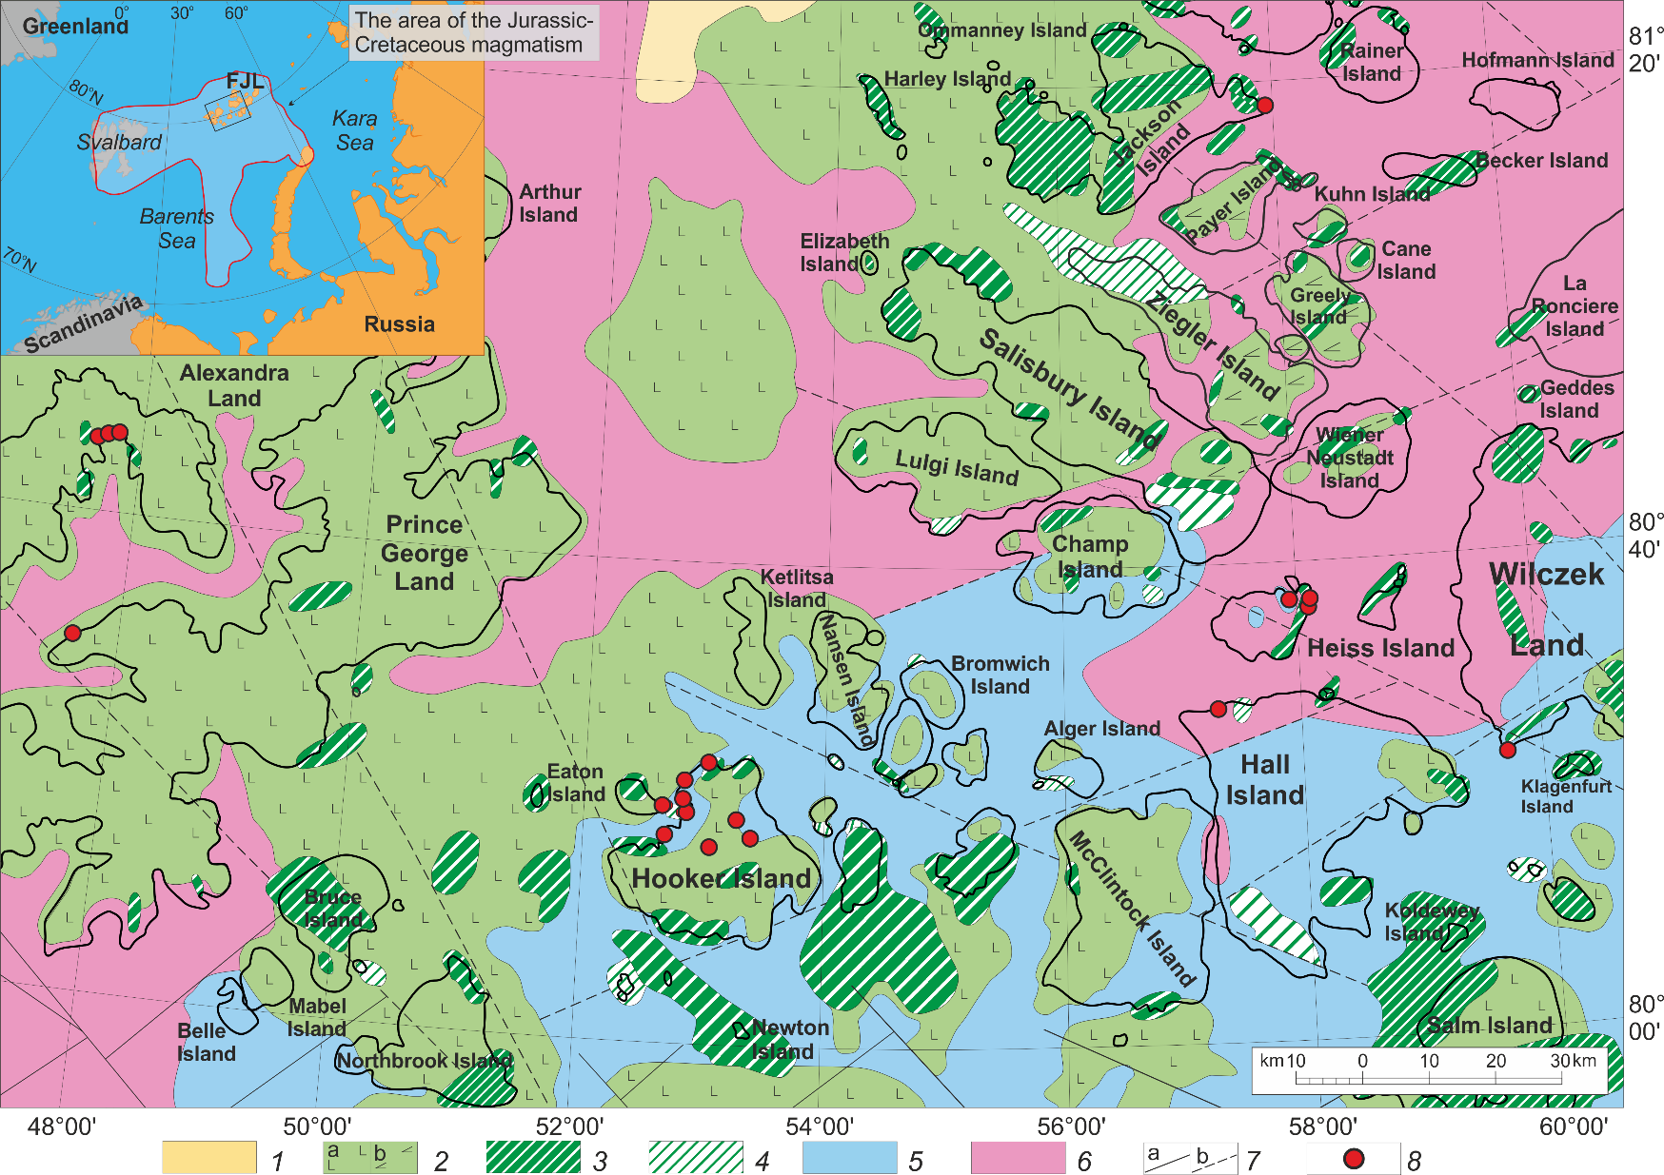
Geology and sampling
Schematic geological map of the studied Franz Josef Land Archipelago area, after (State Geological Map..., 2006) (revised). The red line in the inset delineates a tentative area of basaltoid magmatism distribution in the Barents Sea LIP, after (Polteau et al., 2016).
1, Oligocene–Pliocene deposits (siltstones, clays); 2–4, Early Cretaceous trap complex: 2, tuffs and basalt flows (a) and andesibasalts (b), 3, hypabyssal complex (dikes, sills, laccolites) gabbro, gabbro-diorites, gabbro-dolerites, dolerites and monzonites, 4, vent facies holding extrusive bodies (stocks and nekks) of basalts, andesibasalts; 5, Jurassic deposits (mudstones, siltstones, sands, sandstones); 6, Triassic deposits (sands, sandstones, clays, mudstones, siltstones); 7, faults: established (a) and inferred (b); 8, paleomagnetic and rock-magnetic sampling sites.

Slide 4
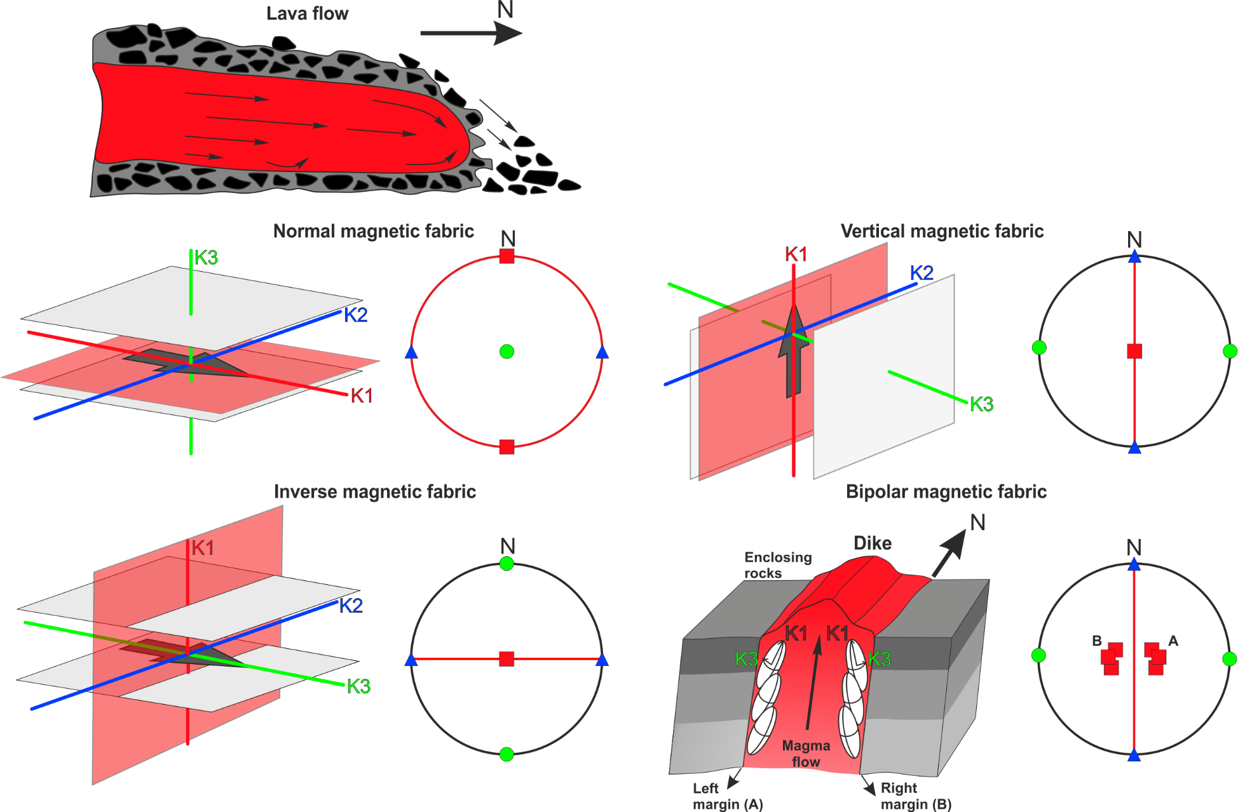
Magnetic Fabric Geometries
Idealized normal and inverse magnetic fabric in respect to the flow axes as it is explained by the SD effect for a N-trending, horizontal lava flow, modified after (Schöbel and de Wall, 2014). A normal magnetic fabric is characterized by a low fraction of SD particles, while inverse magnetic fabrics can be caused by a high portion of SD grains.
Idealized normal vertical and bipolar magnetic fabric in respect to the flow axes for vertical magma flow, modified after (Tauxe et al., 1998). K1 = max axes of the AMS ellipsoid; K2 = int axes of the AMS ellipsoid; K3 = min axes of the AMS ellipsoid.

Slide 5
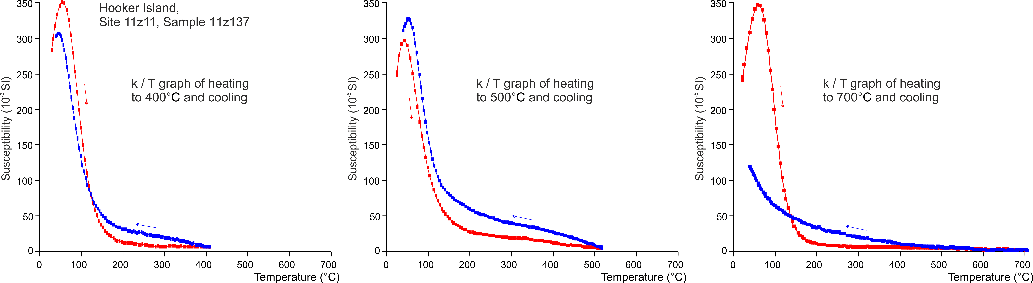
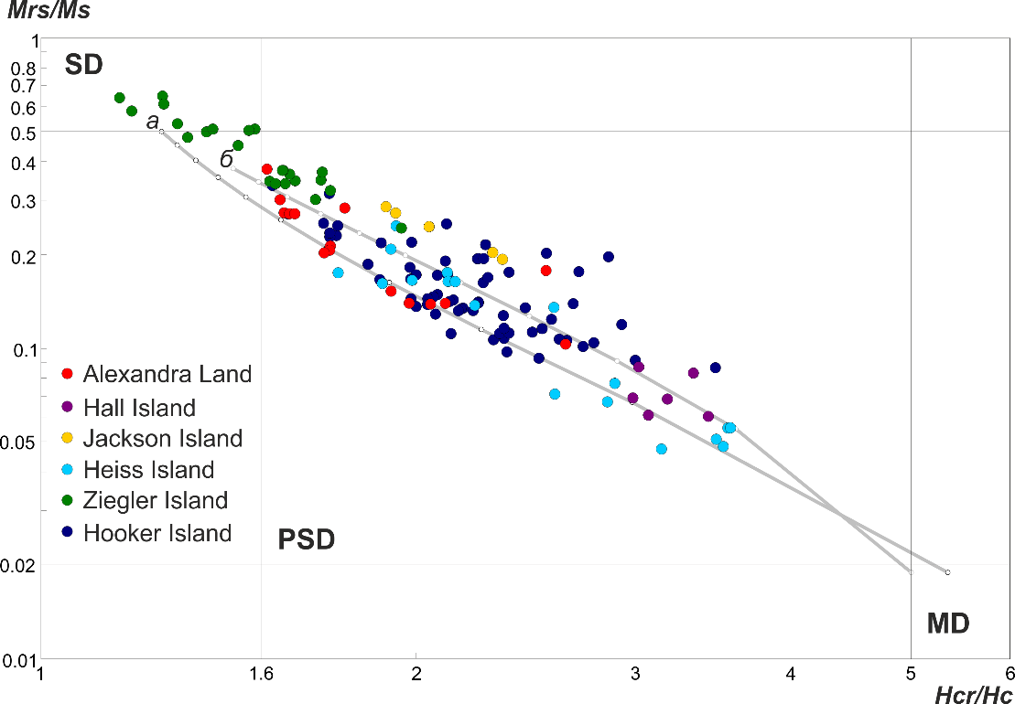
Rock-magnetism
Magnetic susceptibility versus temperature curves of basaltics showing irreversible mineralogical changes during laboratory heating and cooling. Red and blue lines show heating and cooling cycles, respectively.
Day-plot for the FJL samples (Day et al., 1977). Abbreviations are the following: SD single domain; PSD pseudo-single domain; MD multidomain; Mrs saturation remanence; Ms saturation magnetization; Hc coercivity field; and Hcr coercivity of remanence. Gray lines show SD-MD mixture models from Dunlop (2002).
The rock magnetic analysis results thus allow to infer that the studied FJL flood basalts are dominated by small grains of primary magmatic or single-phase-oxidized during cooling titanomagnetite rocks.

Slide 6
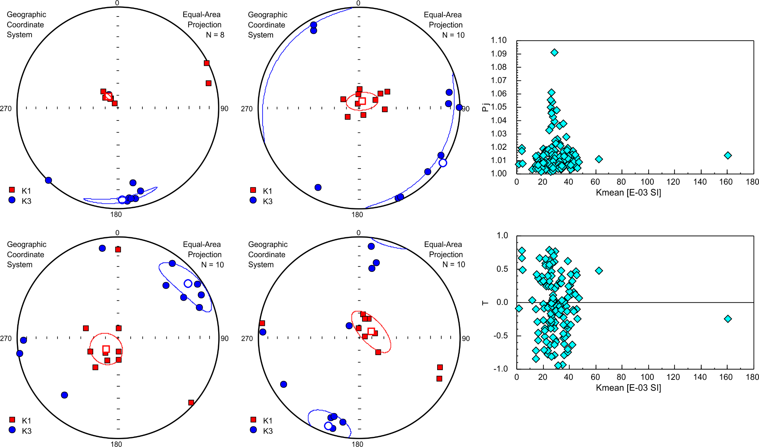
Anisotropy of Magnetic Susceptibility (AMS)
The degree of anisotropy Pj is 1.01-1.06 for most sites that is typical for the primary igneous magnetic fabric.
The form factor T characterizing the shape of the AMS ellipsoids demonstrates both planar and linear magnetic fabric in studied magmatic bodies.
The majority of studied basalts possess low the degree of AMS - Pj, less than 1.06, indicating the absence of superimposed stress effects (Tarling, Hrouda, 1993). Note that more than half of the studied layered igneous bodies are characterized by the inverse type of magnetic fabric, when the principal axis K1 of the ellipsoid is oriented perpendicularly to the plane of the flow or the sill. This AMS type can be primary, reflecting the predominantly vertical motion of the melt; however, more often it is secondary and caused by the presence of single-domain ferrimagnetic particles that formed by oxidation or decay of unstable low-Fe titanomagnetites (Boiron et al., 2013).

Slide 7
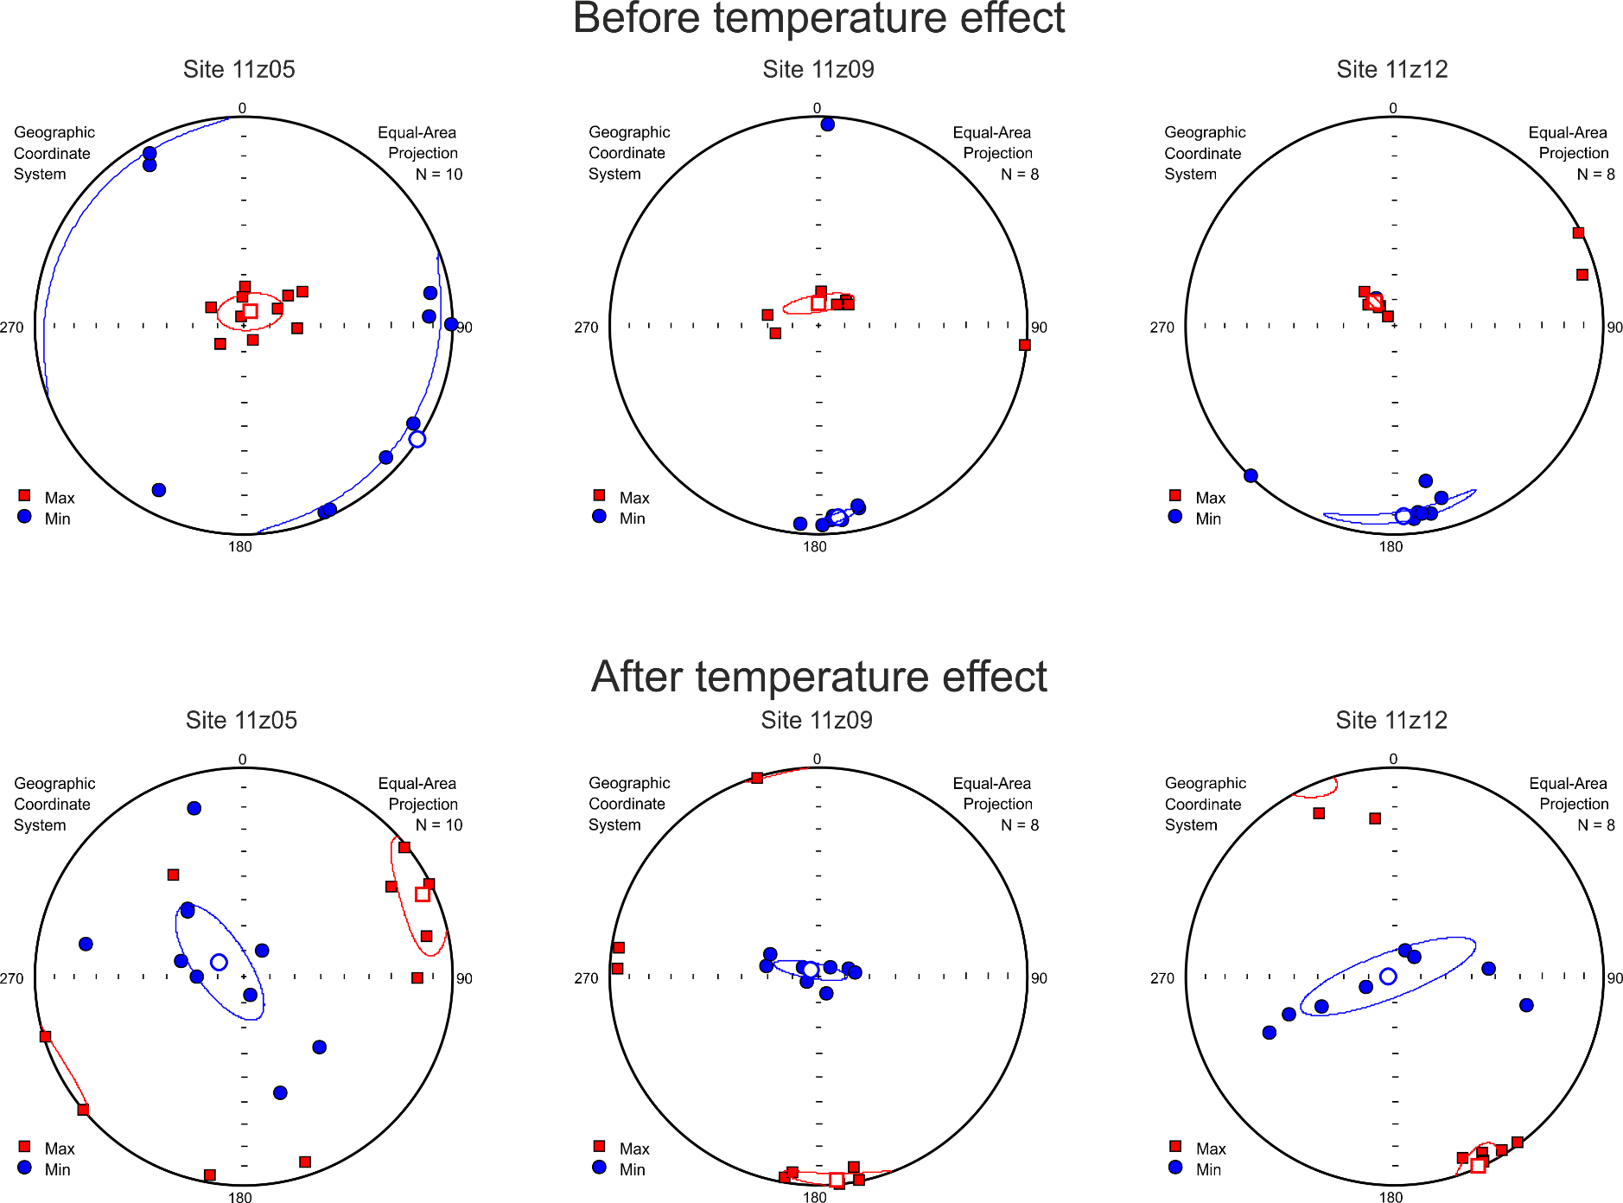
Anisotropy of Magnetic Susceptibility (AMS)
Inverse magnetic fabric
Normal magnetic fabric
The results of a study of the AMS before and after a temperature effect. K1 = max axes of the AMS ellipsoid; K3 = min axes of the AMS ellipsoid.

Slide 8
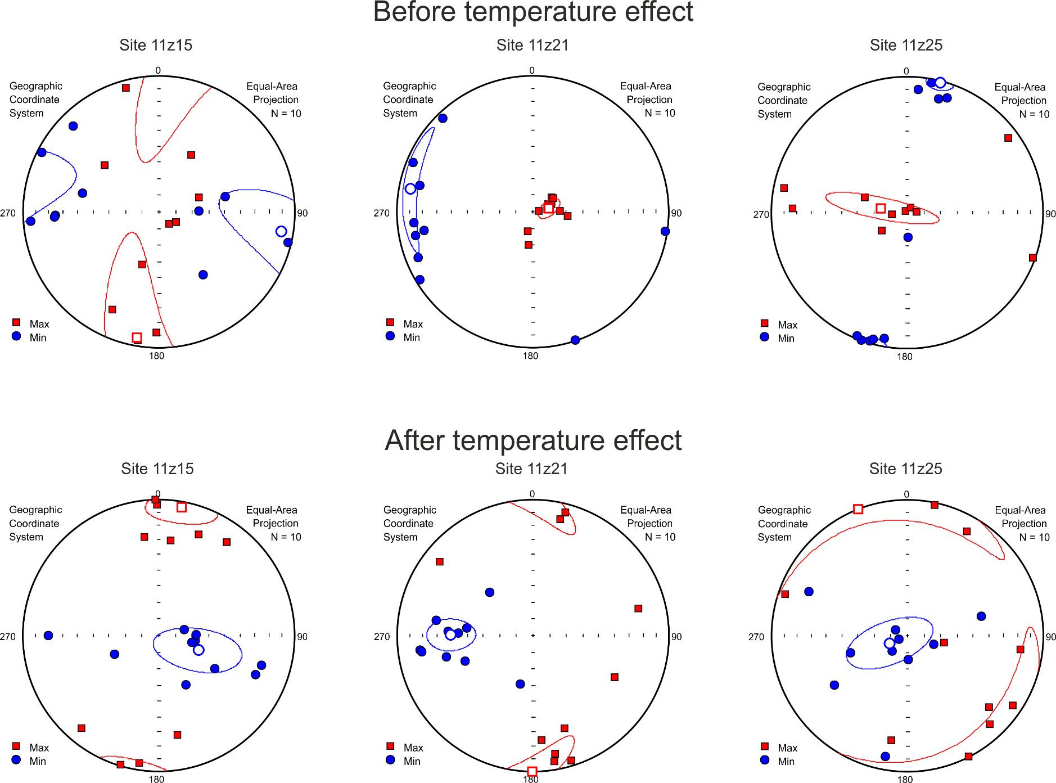
Anisotropy of Magnetic Susceptibility (AMS)
Inverse magnetic fabric
Normal magnetic fabric
The results of a study of the AMS before and after a temperature effect. K1 = max axes of the AMS ellipsoid; K3 = min axes of the AMS ellipsoid.

Slide 9
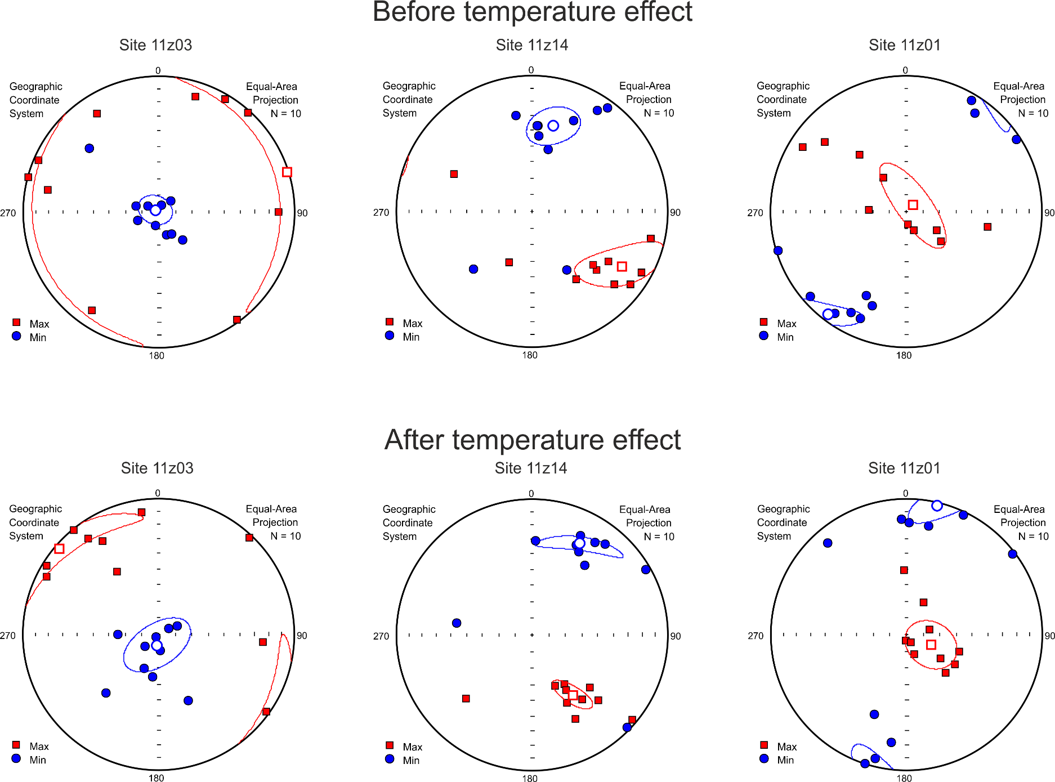
Anisotropy of Magnetic Susceptibility (AMS)
Normal horizontal magnetic fabric
Normal Inclined magnetic fabric
Normal vertical magnetic fabric
The results of a study of the AMS before and after a temperature effect. K1 = max axes of the AMS ellipsoid; K3 = min axes of the AMS ellipsoid.

Slide 10
Conclusions
The experiments show that the primary orientation of the AMS ellipsoid could be recovered after a temperature effect or demagnetization by alternating magnetic field (Boiron et al., 2013; Schöbel et al., 2013). In the case studied, demagnetization by a field of 140 mT in amplitude was not successful. Noticeable changes were revealed at heating up to ~450°C, which generally corresponds to deblocking temperatures of titanomagnetites identified in the rocks by rock-magnetic methods. The magnetic susceptibility slightly increases after heating, whereas Pj decreases. Notably, the shape of the AMS ellipsoid remains, but the orientations of its primary axes change considerably. Based on the results of our experiments, we can recover primary magnetic fabrics, which allows us to reconstruct the direction of melt motion and morphology of the studied igneous bodies.
References
Abashev V.V., Vernikovsky V.A., Kazansky A.Yu., et al. Formation Peculiarities of the Franz Josef Land Volcanic Province, Arctic Ocean: The Melt Movement Direction Estimated from Anisotropy of Magnetic Susceptibility. 2019. V. 486. P. 481–484.
Boiron T., Bascou J., Camps P., Ferre E.C., Maurice C., Guy B., Gerbe M.C., Launeau P. Internal structure of basalt flows: insights from magnetic and crystallographic fabrics of the La Palisse volcanics, French Massif Central. Geophys. J. Int. 2013. V. 193. P. 585-602.
Schöbel S., de Wall H., Christian Rolf C. AMS in basalts: is there a need for prior demagnetization?. Geophys. J. Int. 2013. V.195. P. 1509–1518.
Schöbel S., De Wall H. AMS–NRM interferences in the Deccan basalts: Toward an improved understanding of magnetic fabrics in flood basalts. J. Geophys. Res. Solid Earth. 2014. V. 119. P. 2651-2678.
Tarling D.H., Hrouda F. The magnetic anisotropy of rock. London: Chapman and Hall. 1993. 217 p.
Tauxe L., Gee J.S., Staudigel H. Flow directions in dikes from anisotropy of magnetic susceptibility data: The bootstrap way. Journal of Geophysical Research. 1998. V. 103. P. 17,775-17,790.
Acknowledgments
This work was supported by the RSF (project no. 19-17-00091) and the RFBR (project nos. 18-35-00273, 18-05-70035)

Slide 11
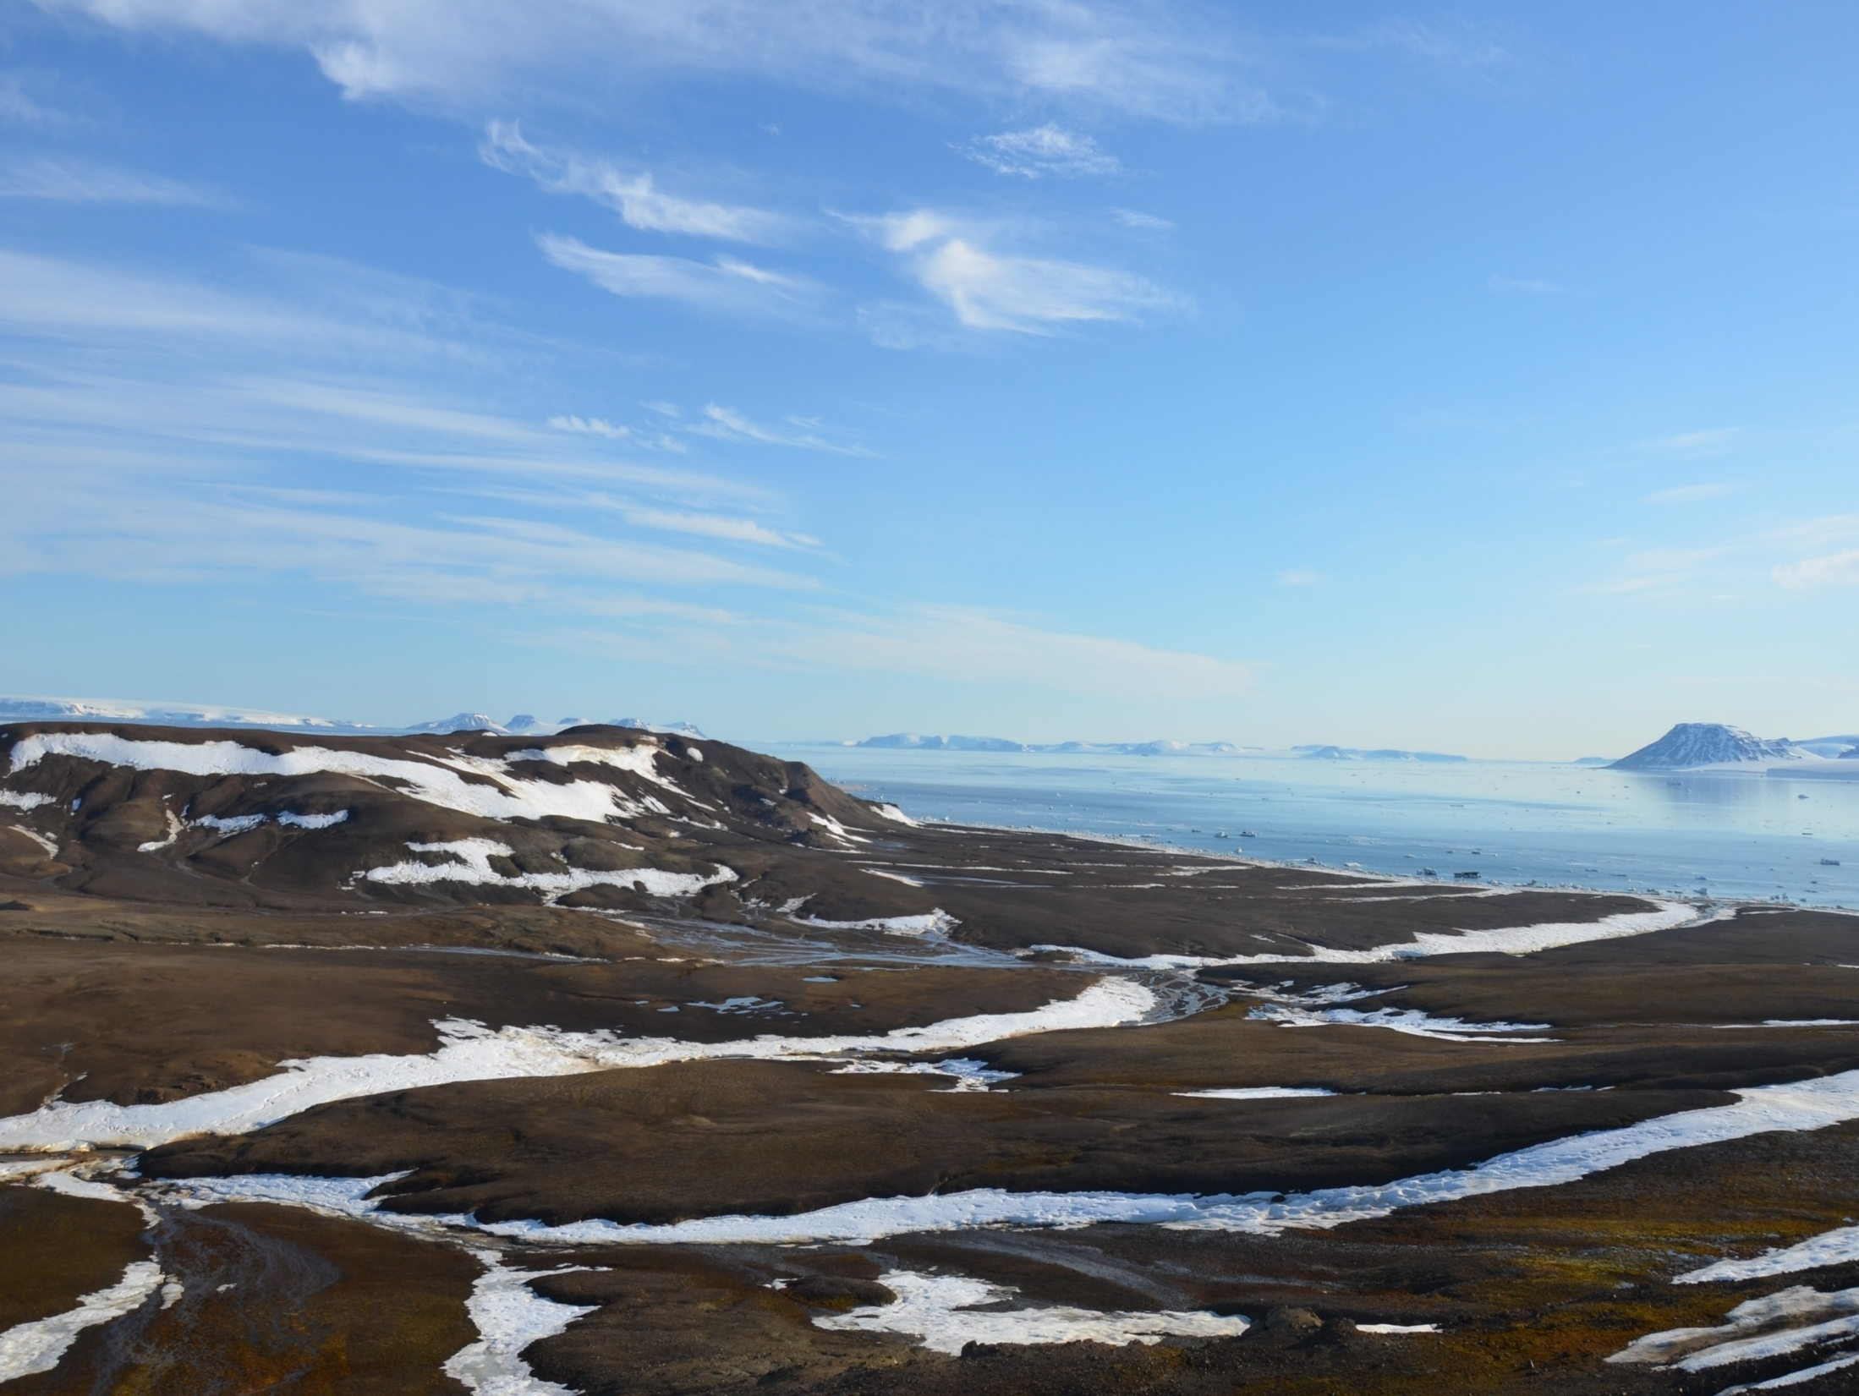
Thank you for your attention!

