Slide 1
The response of VLF signals to the passage of an atmospheric/ionospheric seismic wave after an earthquake in Chile
EGU2020-1240 Session NH4.5
Kamil Yusupov, Rozhnoi Alexander, Solovieva Maria, Shalimov Sergey, Fedun Viktor, Mathews John, Sherstyukov Ruslan, Safiullin Anvar, and Maruyama Takashi
Kazan Federal University, Kazan, Russian Federation (kamil.usupov@kpfu.ru)
Schmidt Institute of Physics of the Earth, Russian Academy of Sciences, Moscow, Russia
University of Sheffield, Sheffield, UK
Pennsylvania State University, University Park, USA
National Institute of Information and Communications Technology, Tokyo, Japan

Slide 2
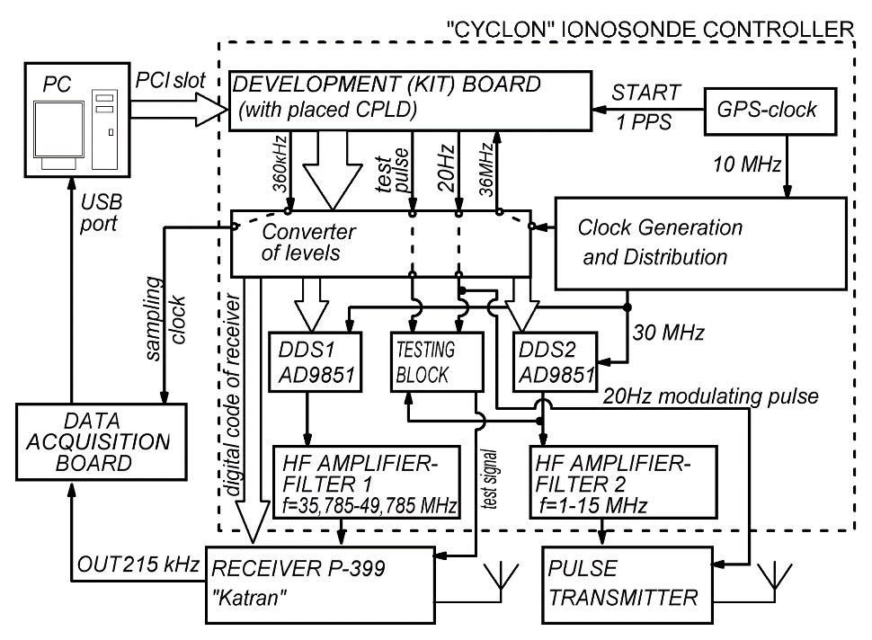
Equipment and research objectives
“CYCLON” IONOSONDE CONTROLLER
Ionozond Cyclone is classical digital pulse monostat (reception and radiation from one point) radar with sweeping frequency in a range of 1-10 MHz and with registration of a phase (phase recording). Azimuthal angles and angles of an elevation aren't registered.
In 2008-2010, he was upgraded to study fast processes in the ionosphere (scale ~ 1min).
Since February 2010 it works in a minute mode constantly (except for intervals of equipment failure)
Technical characteristics in particular, accuracy of tuning of frequency is provided with DDS chips and the highly stable reference generator with GPS synchronization, and also with schemes of frequencies distribution with PLL.

Slide 3
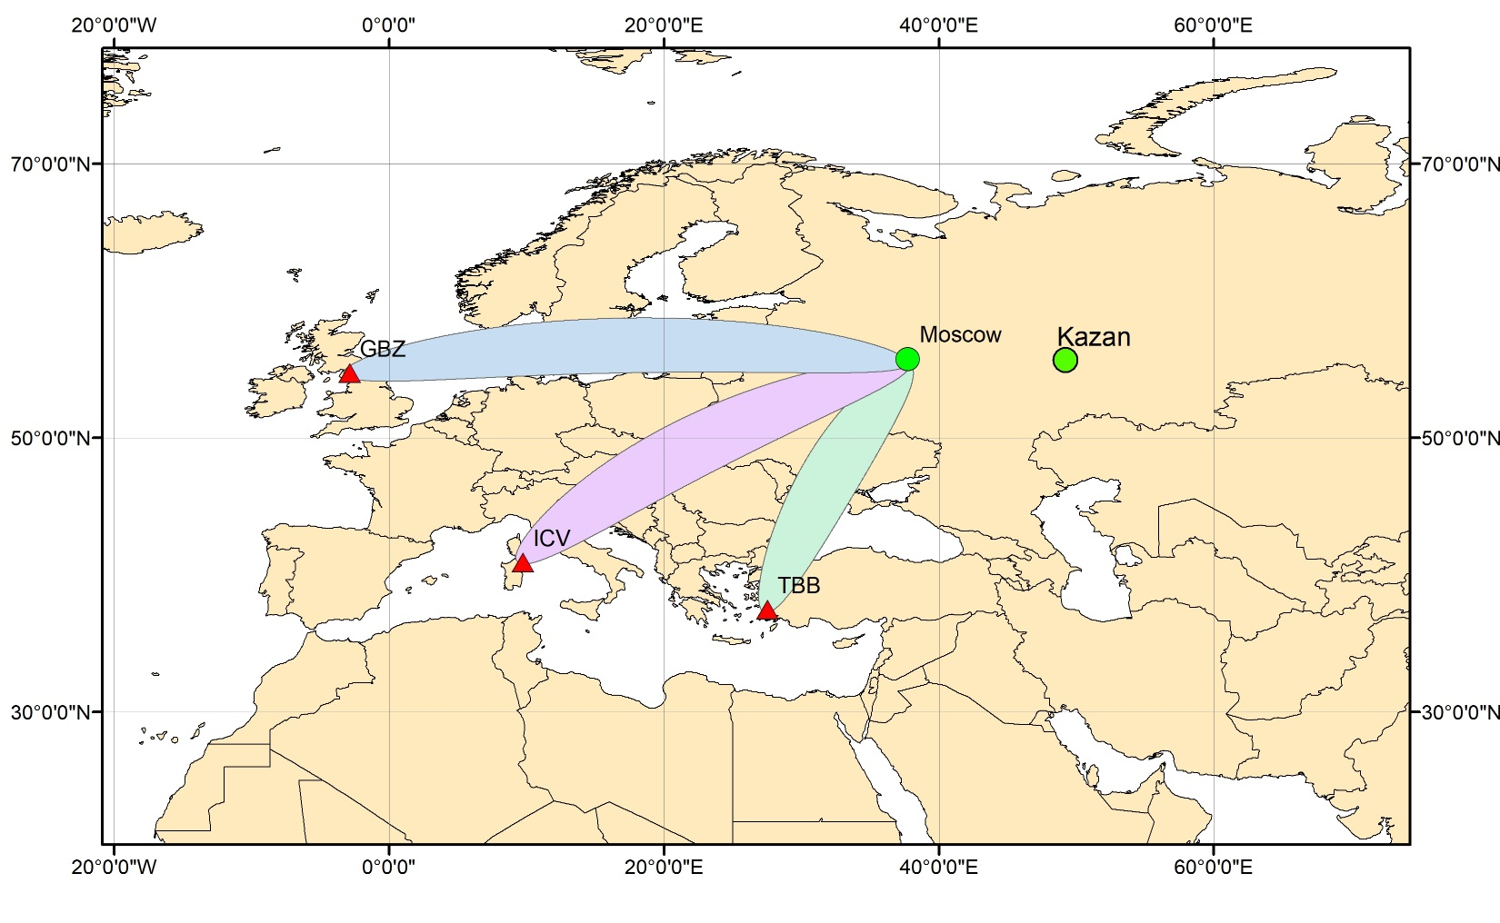
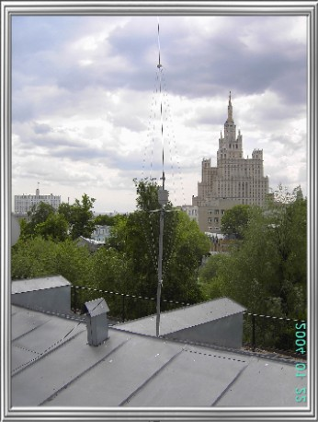
Equipment and research objectives
VLF-network, Moscow station

Slide 4
Takashi Maruyama, Takuya Tsugawa, Hisao Kato, Akinori Saito, Yuichi Otsuka, and Michi Nishioka. Ionospheric multiple stratifications and irregularities induced by the 2011 off the Pacific coast of Tohoku Earthquake. // Earth Planets Space, 63, 869–873, 2011

Slide 5
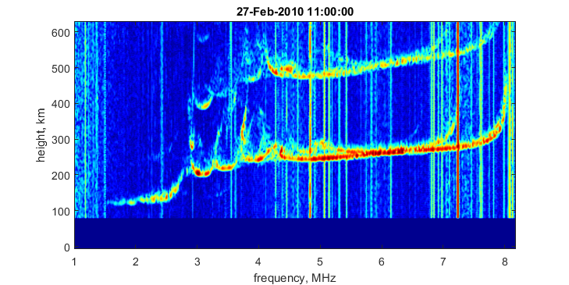
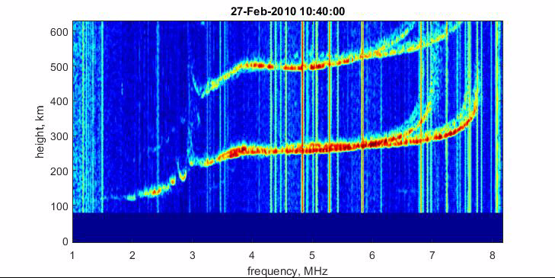
Ionogram examples with MCS

Slide 6
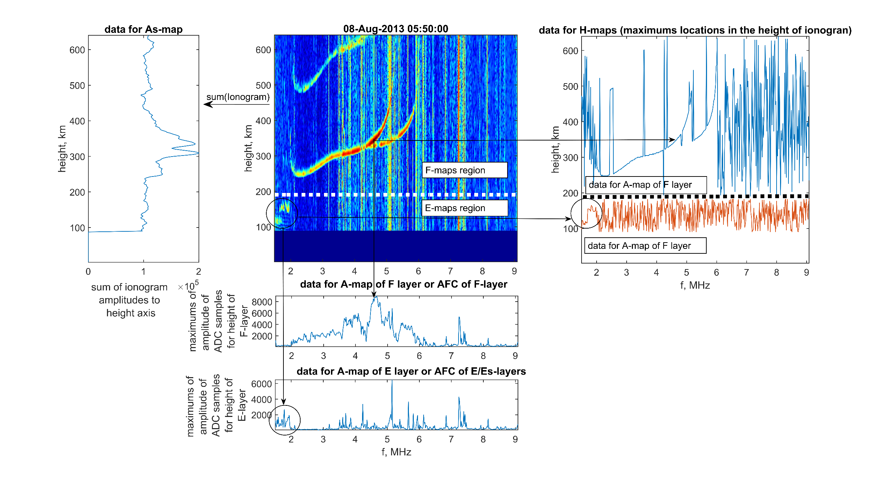
Ionogram data processing

Slide 7
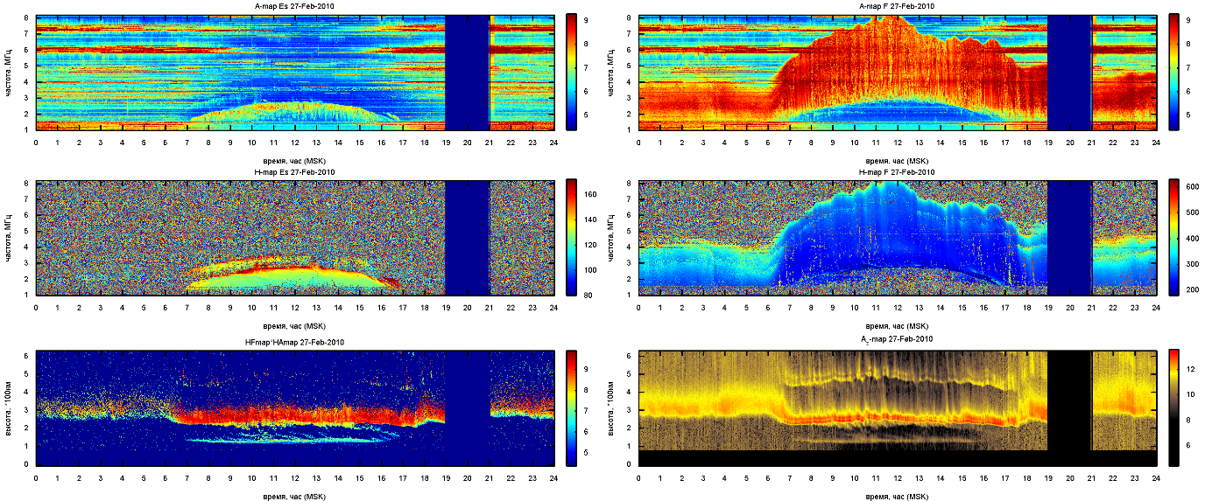
A-maps

Slide 8
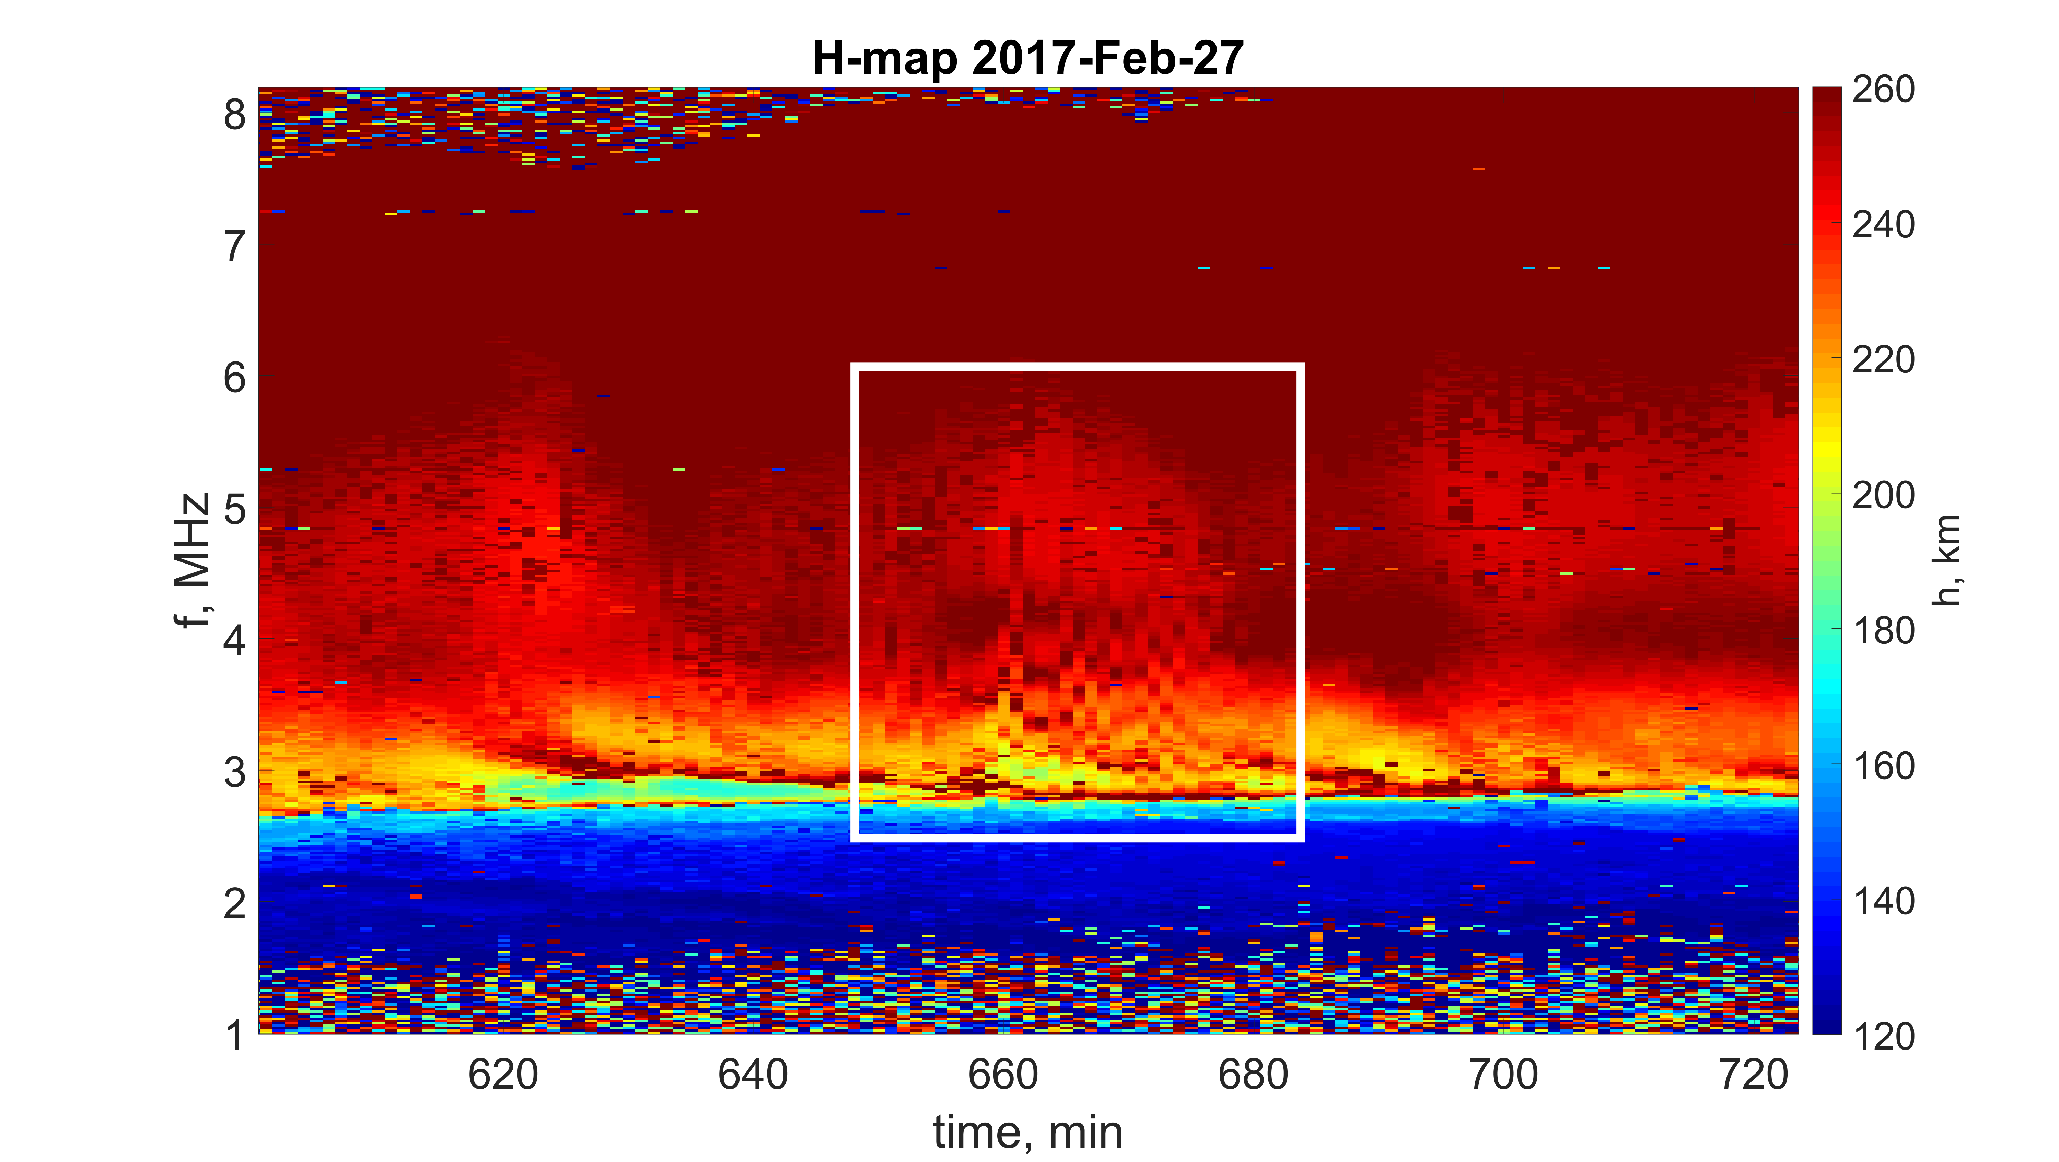
MCS in H-map

Slide 9
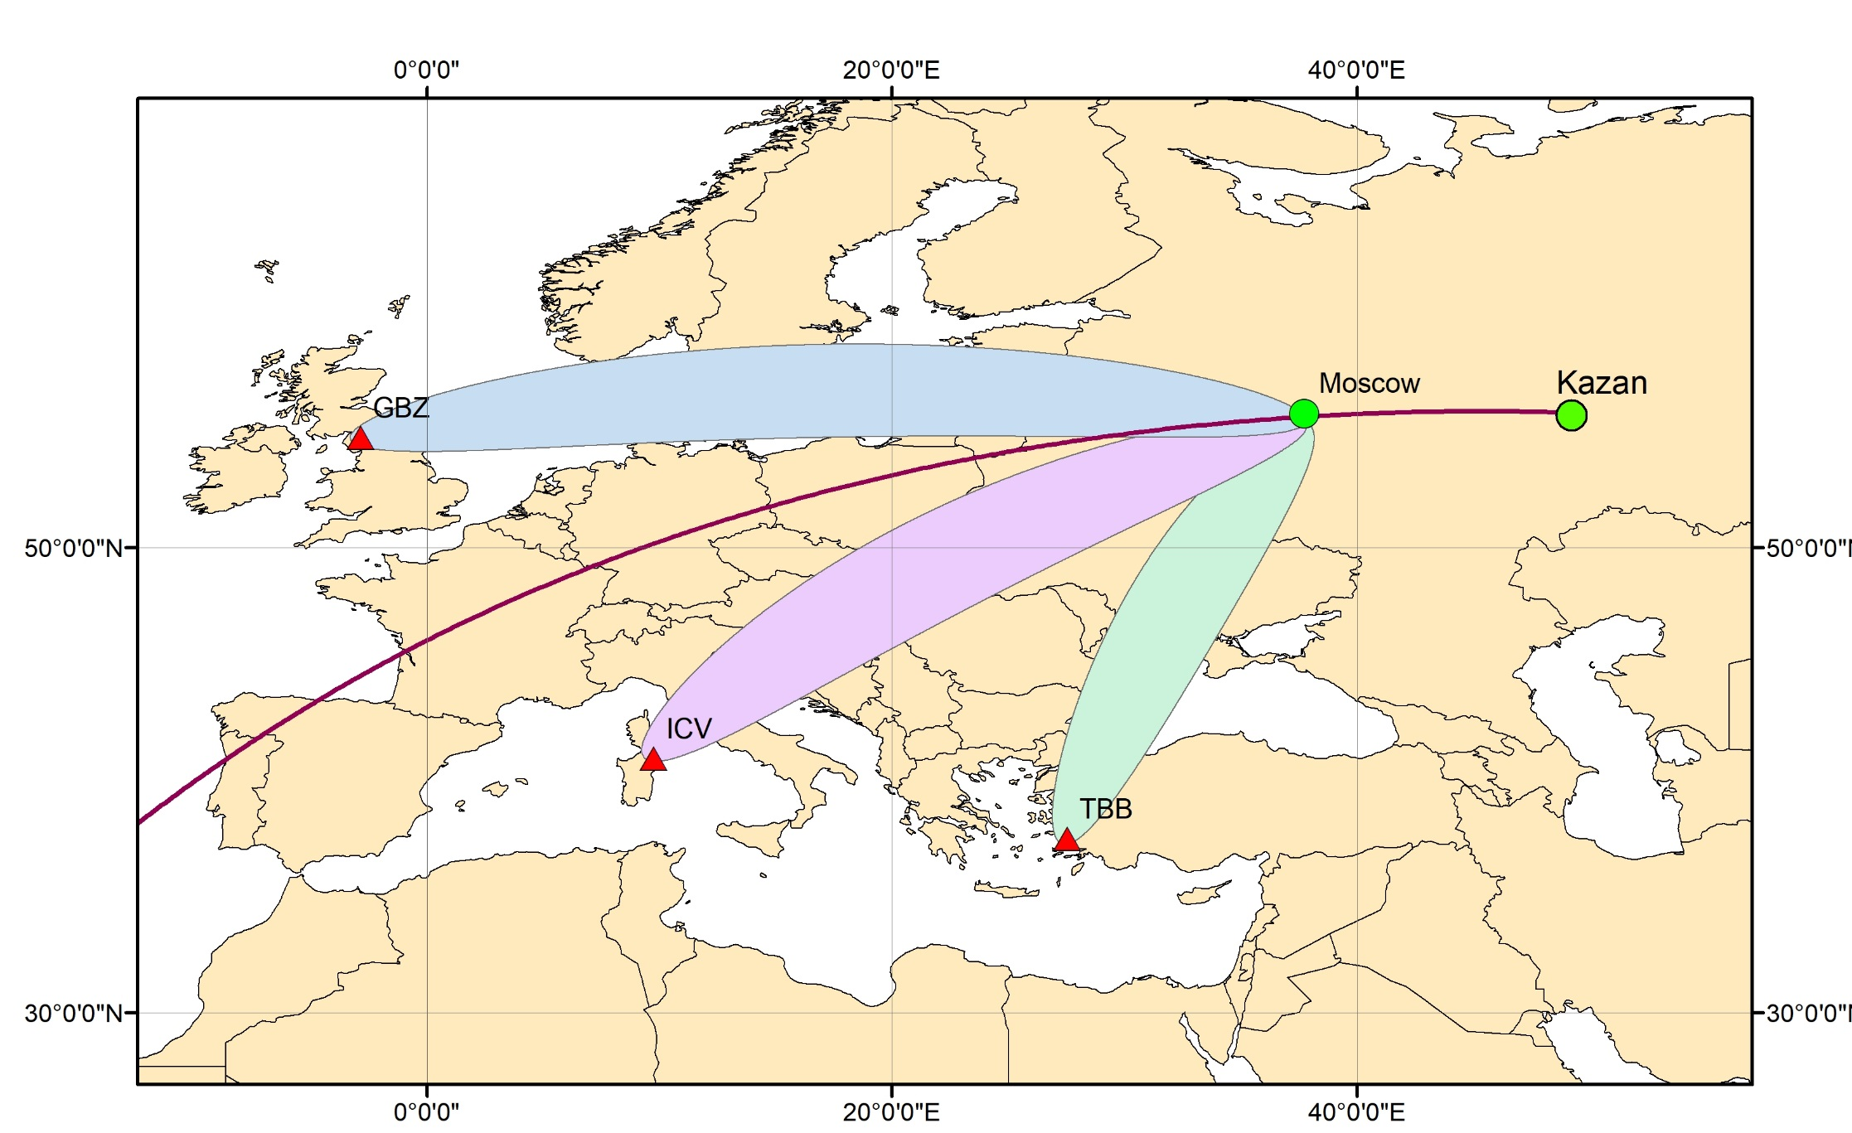
Rayleigh wave propagation

Slide 10
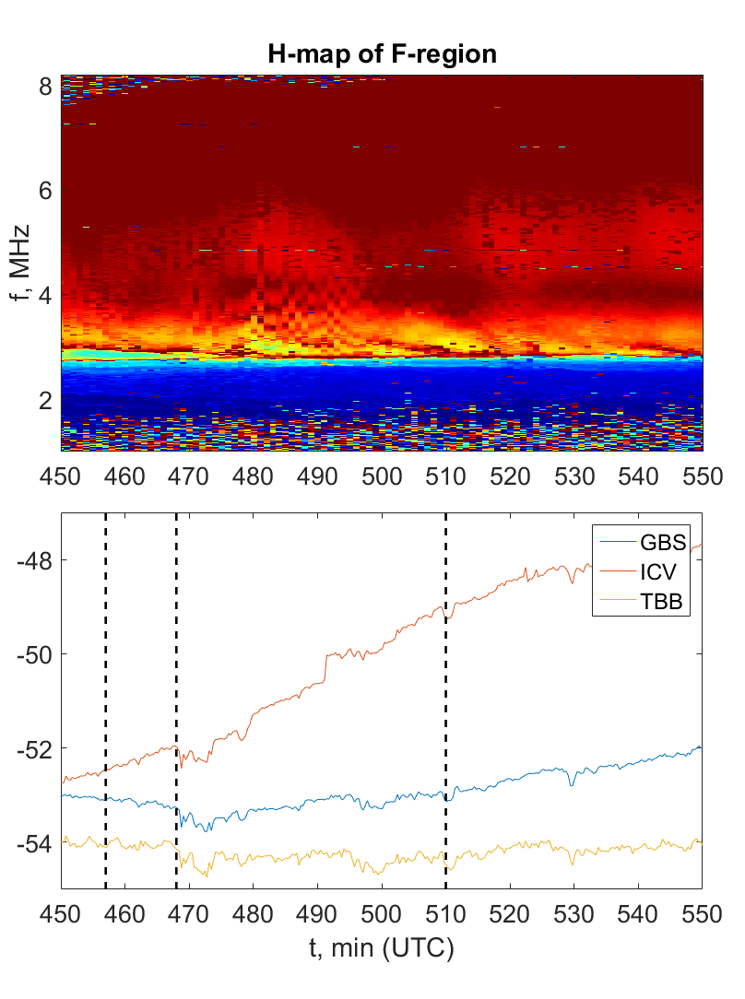
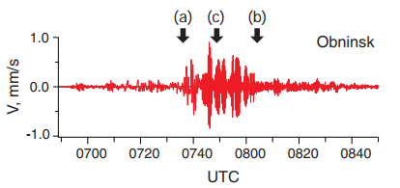
Ionogram MCS & VLF-data
Notes:
Скорость звука в воздухе (331м/с или 1191км/ч), до 100км-5мин,
Скорость волны 13680 км/ч
457 минута – начало регистрации Сейсмо волны
462 – маленький пик на данных ВЛФ, что соответствует 5 минутам – времени за которое акустическая волна достигает 100 км (высоты Е-области)

Slide 11
Conclusions
The MCS signatures in Ionograms was detected after an earthquake in Chile
H-map is clearly shows such events
During this event VLF-signals amplitude oscillations are shown
Thank you

