Slide 1
Driving mechanisms of sea-level variability in the U.S. mid-Atlantic during the last millennium
Jennifer Walker, Robert Kopp, Nicole Khan, Timothy Shaw, Niamh Cahill, Don Barber, Matt Brain, Jennifer Clear, Reide Corbett, Benjamin Horton
David and Arleen McGlade Foundation, Inc.

Slide 2
Last millennium relative sea-level (RSL) changes along the U.S. Atlantic coast are spatially variable
Glacial isostatic adjustment (GIA) has been a significant driving factor in RSL rise during the last millennium, producing maximum rates of vertical land motion in the mid-Atlantic region due to its proximity to the margin of the former Laurentide Ice Sheet
Engelhart and Horton (2012)
There is uncertainty surrounding the influence of other regional and local processes on RSL changes

Slide 3
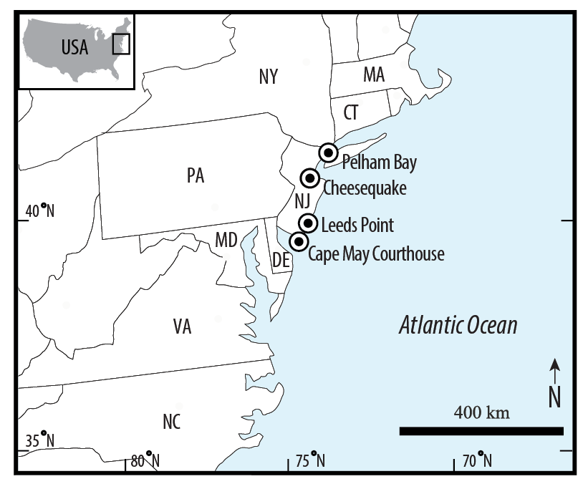
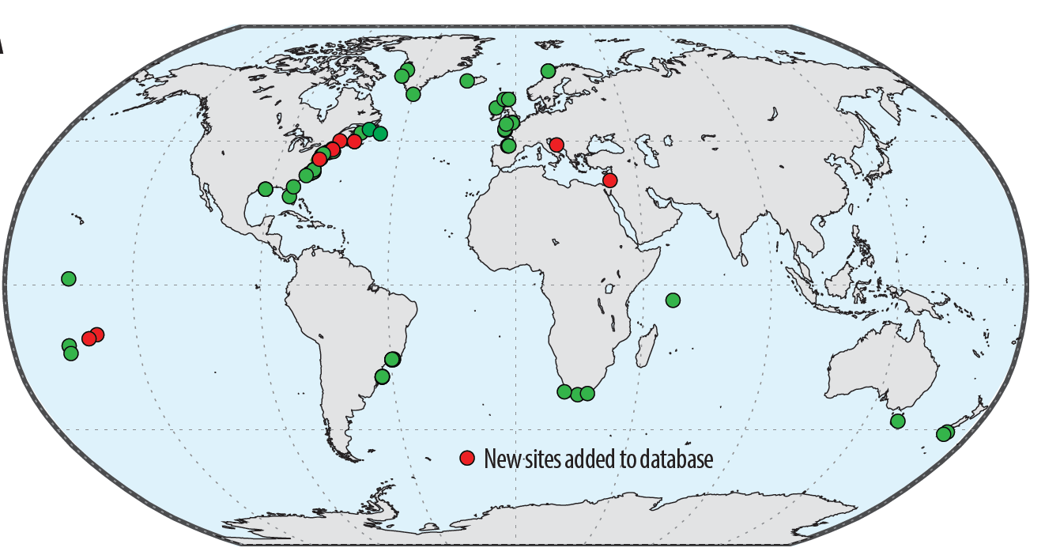
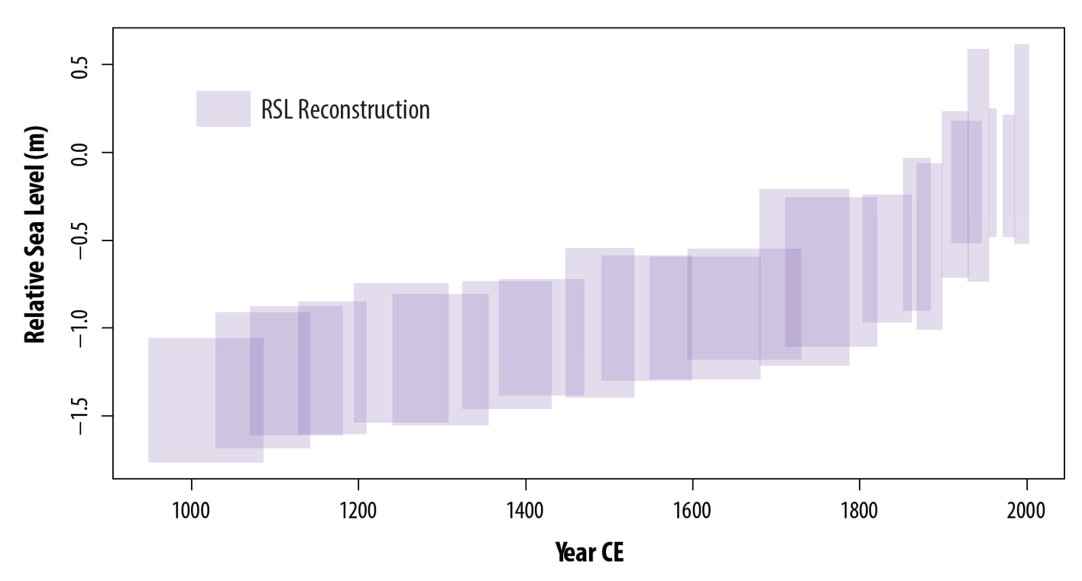
We examined the high spatial density of high-resolution RSL records along a ~200 km stretch of coastline from New York City to southern New Jersey to distinguish between local, regional, and global scale drivers
We produced a new high-resolution (decimeter vertical, decadal temporal) RSL record of the last millennium in northern New Jersey and integrated it into an updated global database of instrumental and proxy sea-level records of the Common Era.
We used a spatiotemporal empirical hierarchical model to estimate past RSL and rates of RSL change and their associated uncertainties in the context of broader regional changes by decomposing the records into global, regional linear, regional non-linear, and local components.
RSL in northern New Jersey continuously rose over the last 1000 years at a rate of 1.2 ± 0.2 mm/yr (2σ) from 1000 to 1700 CE before increasing to 1.3 ± 0.7 mm/yr from 1700-1800 CE to 1.8 ± 0.6 mm/yr from 1800-1900 CE to 3.0 ± 0.6 mm/yr from 1900-2000 CE.

Slide 4
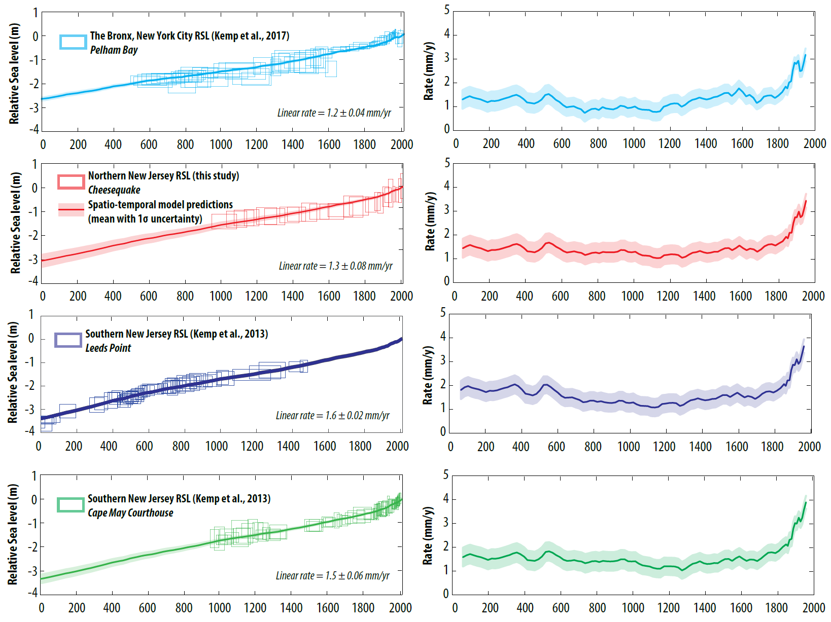
RSL Records and Linear Contribution
We used the spatiotemporal model to decompose the records into global, regional linear, regional non-linear, and local components
Most of the RSL rise during the past 1000 years is attributed to regional-scale linear processes that we interpret primarily as GIA. The linear component of the RSL records exhibits a north to south gradient, with a greater contribution of RSL rise in southern New Jersey and a smaller contribution in New York City.

Slide 5
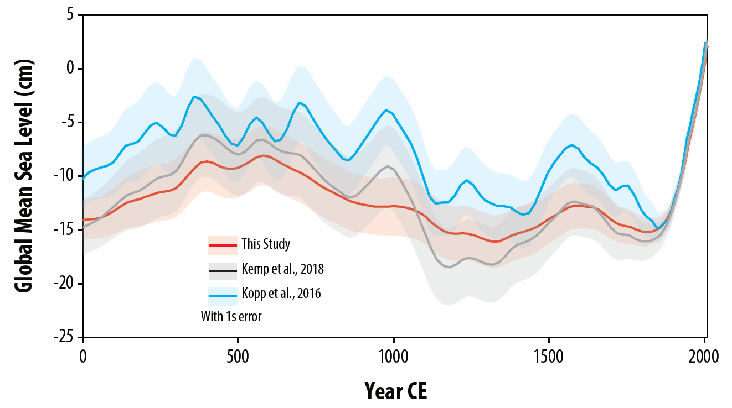
Global Contribution
Global sea-level gradually rose from 0 CE to 500 CE at a rate of 0.1 ± 0.2 mm/yr (1σ), but then gradually fell from 500 CE to 1300 to CE at a rate of -0.1 ± 0.2 mm/yr. GSL then rose from 1300 CE to 1600 CE at a rate of 0.1 ± 0.2 mm/yr and fell from 1600 CE to 1800 CE at a rate of -0.1 ± 0.2 mm/yr. GSL has continued to rise since 1800 CE, reaching a rate of 1.3 ± 0.1 mm/yr in the 20th century.

Slide 6
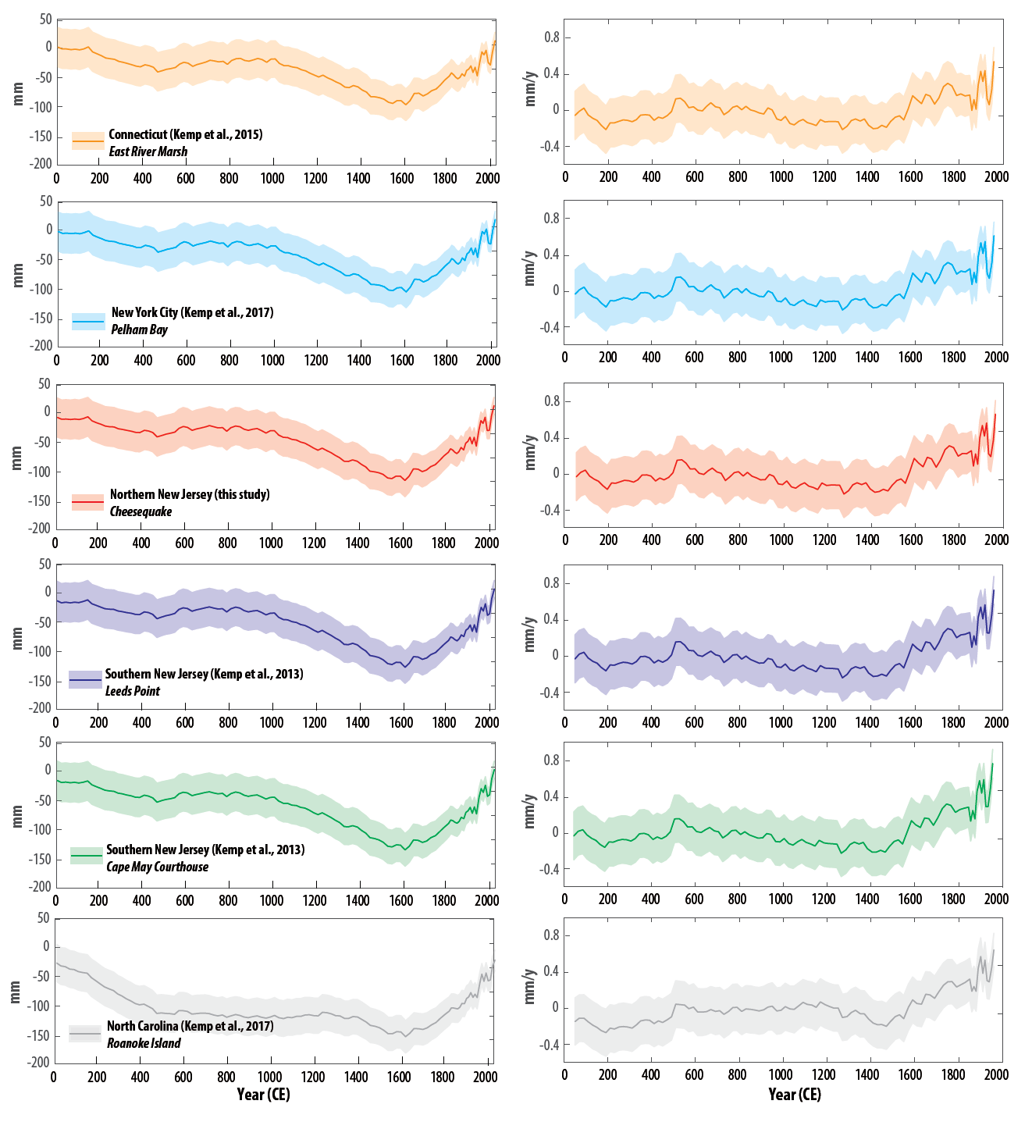
Regional Non-Linear Contribution
The regional-scale non-linear contribution from the records have a magnitude <15 cm and are spatially uniform because they fall within the same regional scale determined by the spatiotemporal model. The rate of the regional non-linear component fluctuated between -0.2 and 0.2 mm/yr until the late 19th century when it increased to a rate of 0.4 ± 0.2 mm/yr in the late 20th century. These trends are likely explained by a combination of physical processes, including the evolving mass of the Greenland Ice Sheet, steric effects, or ocean mass changes from atmospheric circulation and ocean currents.

Slide 7
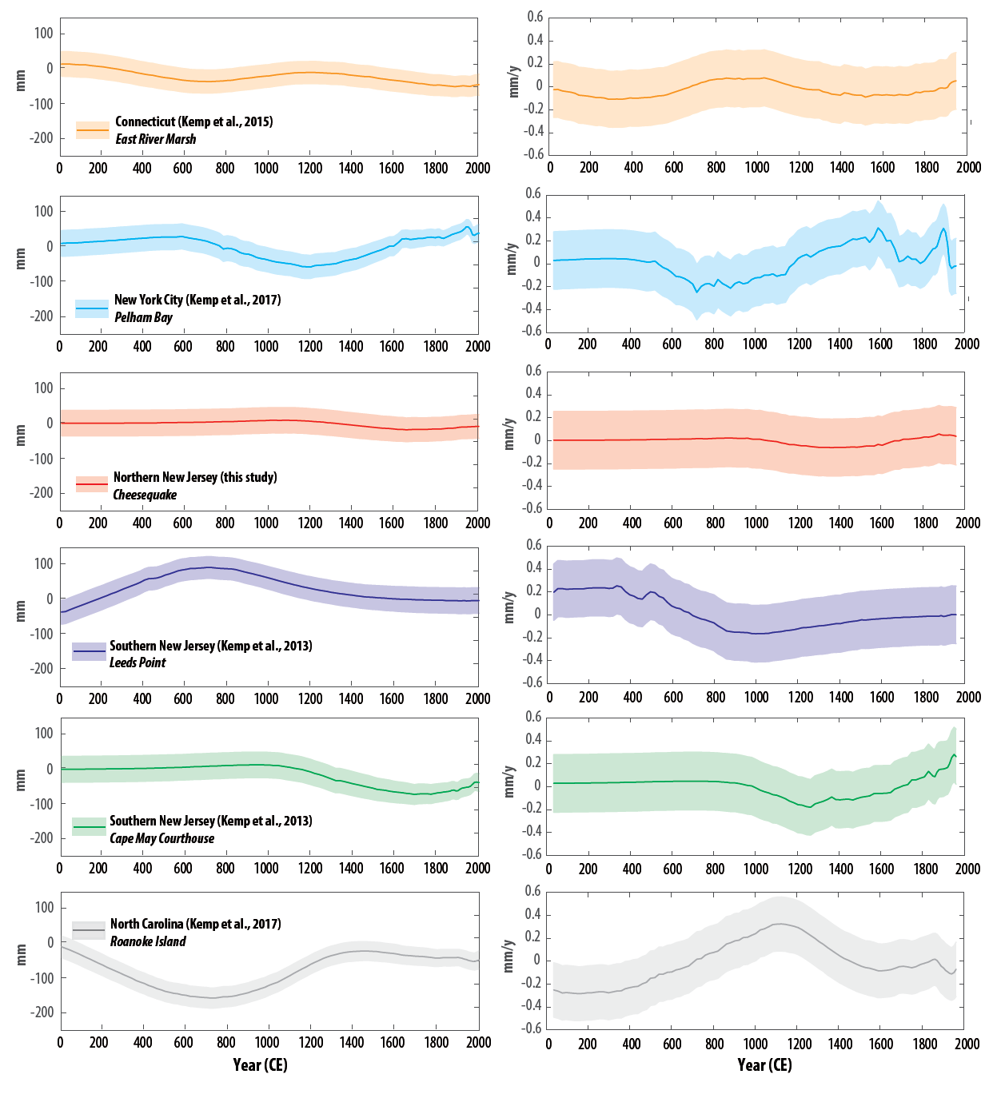
Local Contribution
The local-scale contribution is <10 cm at all sites, but varies in magnitudes and rates of change spatially and temporally among sites. Rates fluctuate between -0.3 and 0.3 mm/yr. These trends may be due to sediment compaction or tidal range change, as well as anthropogenic groundwater withdrawal in the last century.

Slide 8
Summary
We produced a new high-resolution RSL record from northern New Jersey, where RSL rose at a rate of 1.4 ± 0.2 mm/yr (2σ) over the Common Era
RSL records from New York City to southern New Jersey are dominated by regional-scale linear processes due to the effects of GIA, with the fastest rates of rise in southern New Jersey of 1.6 ± 0.02 mm/yr
Regional non-linear changes from atmosphere/ocean dynamics and gravitational/rotational/deformational effects of land-ice change are spatially uniform among the sites, contributing between -0.2 and 0.4 mm/yr at each site
The local signal, due to tidal range changes and anthropogenic groundwater withdrawal in the last century, vary spatially and temporally among sites between -0.3 and 0.3 mm/yr
This method could be applied to additional sites by utilizing the distinct spatial scales of driving processes to estimate the causes of sea-level change through time in further detail

