Slide 1
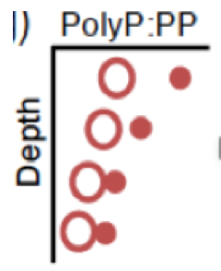
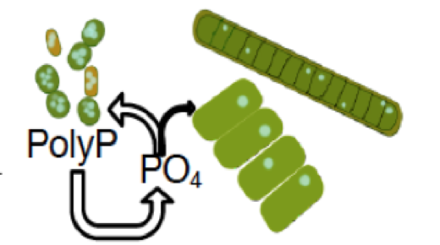
Recycling of polyphosphate (polyP) accumulated in picoplankton in coastal Lake Ontario
Maria Dittrich¹, Jiying Li^{1.2}, Diane Prouchart¹, Arthur Zastepa³
¹Department of Physical and Environmental Sciences, University of Toronto Scarborough ²University of Duluth, Minnesota, USA ³Canada Centre for Inland Waters, Environmental and Climate Change Canada
Summary
Low P
Intracellular polyP can contributes up to 50% to the total particular phosphorus (PP) in the water column
Picoplankton are dominant organisms for intracellular polyP storage
Deficiency response
PolyP recycling/accumulation/degradation
PolyP is recycled during settling of particles: up to 90% within the water column
Li, J., Plouchart, D., Zastepa, A., Dittrich, M., 2019. Polyphosphate dynamics in picoplankton enhance turnover of phosphorus in a eutrophic bay of Lake Ontario, Scientific Reports, 9, 19563
Notes:
This just an abstract or summary:
In a eutrophic bay of Lake Ontario, plankton accumulate and metabolize phosphorus polymers
polyphosphate to cope with phosphorus limitation. Planktonic cells accumulate polyP as storage under high
phosphorus conditions to overcome future phosphorus stresses.
PolyP enrichment also alleviates phosphorus limitation, because polyP is more readily recycled than other phosphorus compounds thus retain bioavailable phosphorus in the system.
Notably, small-size picoplankton, which are minor contributors to primary productivity, are responsible for the strategic polyP metabolisms. By storing and liberating polyP, picoplankton serve as phosphorus bank to support the primary productivity, predominantly that of the bloom-forming algae.
These findings advance our knowledge beyond previously observed polyP mechanisms. The diverse polyP mechanisms enable efficient P recycling and support P demands of various planktonic communities. The mechanisms may have strengthened the phosphorus-carbon coupling, and have implications for similar systems such as many freshwater inland lakes and coastal eutrophic systems experiencing strong dynamics in nutrient availability.

Slide 2
Recycling of polyphosphate accumulated in picoplankton in coastal
Lake Ontario
Maria Dittrich¹, Jiying Li^{1.2}, Diane Prouchart¹, Arthur Zastepa²
¹Department of Physical and Environmental Sciences, University of Toronto Scarborough
²University of Duluth, Minnesota, USA
³Canada Centre for Inland Waters, Environmental and Climate Change Canada
Acknowledgement
Environment and Climate Change Canada
Marianne Racine, Alex Morrissey at the CCIW
Dushara Ragavachari at the UTSC
Li, J., Plouchart, D., Zastepa, A., Dittrich, M., 2019. Polyphosphate dynamics in picoplankton enhance turnover of phosphorus in a eutrophic bay of Lake Ontario, Scientific Reports, 9, 19563
Notes:
Here talk starts:
I will be talking about some of the results that we got lately on one of the so-called phosphorus hidden biogeochemical cycle. Before I start I would like to thank Marianne Racine, and Alex Morrissey at the CCIW at Environment and Climate change Canada for help with sample collections, and our undergrad student Dushara for assistance in sample processing.

Slide 3
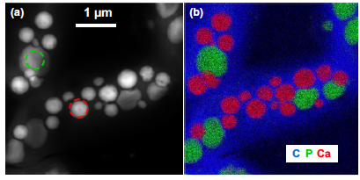
Polyphosphate (PolyP)
PolyP is a long chain polymer of 3 to thousands of phosphate units.
STEM- EDXS analyses of Gloeomargarita lithophora cells, Cam et al. 2017, Geobiology
PolyP accumulation under high P
Luxury uptake
Recycling of polyP during
cell decomposition
PolyP as P reserve under P stress
Deficiency response
Notes:
PolyP is a long chain polymer of 3 to thousands of phosphate units. It has been found in cells of many living organisms, including the primary producers in aquatic systems, like algae and cyanobacteria. It is typically found as electron dense material under transmission electron microscope. On the right are some examples of polyP found in cyanobacteria that we cultured in our lab.
One of the interesting microbial processes that involve polyP is the luxury uptake of phosphate under conditions with high P, which supports accumulations of polyP in the cells; These polyP serve as a storage. When the P concentrations are too low, the accumulated polyP serve as P reserve which can be broken down to provide phosphate that is needed to support other metabolism or to build biomass. Once the cell die, polyP could be decomposed and release PO4 into the surrounding waters.
Overplus uptake has been well documented, but the role of polyP in the response to P stress is not fully understood.

Slide 4
PolyP studies in marine environments
PolyP is a significant fraction of the total P, also in P-replete conditions
There are contradictory results about the biogeochemical fate of polyP
Besides recently, polyP has rarely been measured and almost no data in freshwater systems -> limited understanding
Martin et al., 2018, L&O
Diaz et al., 2016, L&O
Martin et al. 2014, PNAS
Notes:
Since very recent pP has been intensive studied in marine systems, where a so-called hidden cycle of PolyP has been discovered and PolyP has been shown to be important for the biogeochemical cycling of P. PolyP can contribute as much as 10% to the totalP, in oligotrophic conditions, However besides recent studies pP has been rarely measured in ocean. Intriguingly, previous studies reached apparently contradictory conclusions as to the biogeochemical fate of polyP.

Slide 5
Recent findings on PolyP in marine environments
Martin et al. PNAS, 2014
High SRP(soluble reactive P)
Low SRP
Low polyP:TPP
High polyP:TPP
Tropical Indian Ocean
High SRP
Low SRP
High SRP
Diaz et al., 2016, L&O
Martin et al 2018
Notes:
For example, the findings of the pioneer study by Martin et al 2014 are very suprising and quite opposite what we thought about polyP accumulation as a luxury uptake.
They found an opposite trend, a low polyP accumulation at high P level and an intensive accumulation of polyP under very low P conditions, which they called a P deficiency response.
However such trend was not found in the North Pacific ocean two years later by another study. They found was preferentially lost – or recycling – of polyP through the water column at the low P site but not at the high P site.
However, this can not explain what was found years later in the tropical Indian Ocean where P is relatively high (at least not the limiting nutrient) and preferentially recycling was observed. SO there are many inconsistences which trigger lots of discussions.

Slide 6
Most likely PolyP is important in freshwater, but…
no studies on a PolyP fate in lakes
So it is still unclear:
what is polyP accumulation mechanism in eutrophic freshwater systems
e.g., luxury uptake under high P levels or P deficiency responses under low P conditions
is there seasonal variability responding to environmental conditions
is any preference of polyP accumulation in different communities
Notes:
In addition to the inconsistences found in marine environments, there are many questions and knowledge gaps
For instance there is no such investigation in freshwater environments, which might have very different community structure and nutrients levels compared to oceans
It is also unclear
2) PolyP storage mechanisms in eutrophic systems are not known. The question is whether in eutrophic systems we expect to see P luxury as oppose to P deficiency responses in low P waters.
3) If the polyP is responding to P level, a nature question to ask is that in some highly dynamic systems, do we expect to see strong seasonal variability in the polyP,?
4) It is believed that the differences in polyP Conc. was not due to community shifts – but do we know if there is any variability among different species in terms of polyP accumulation

Slide 7
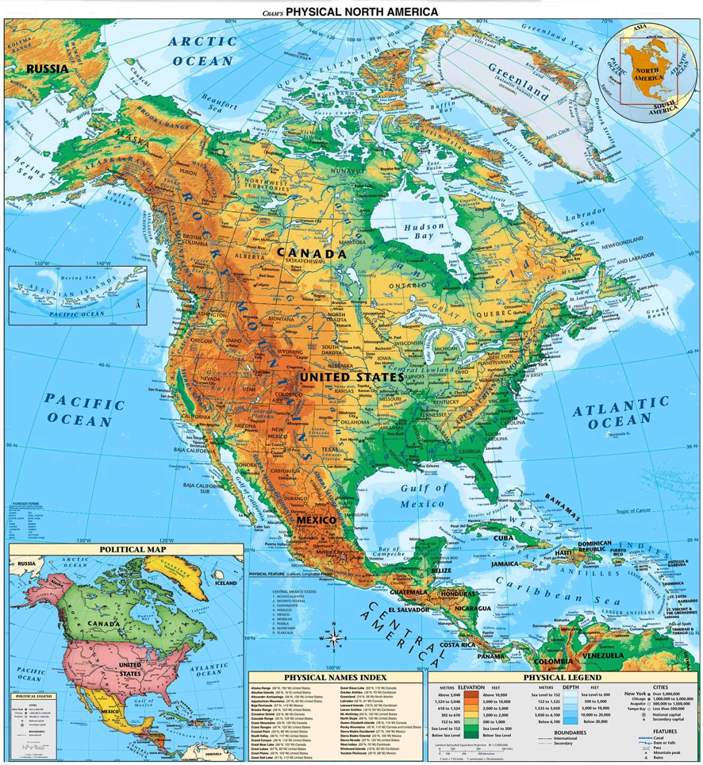
Lake Ontario: Hamilton Harbour
The Bay is 8 km long and 5 km wide, max. water depth is 24 m. Connection to Lake Ontario through the Burlington Canal 9.5 m deep
Great efforts on the reduction of external TP (50% from 1987 to 1997), but unchanged phytoplankton biomass (Hiriant-Baer et al., 2016)
Harmful cyanobacterial bloom occurs during late summer
Lake Ontario
Hamilton Harbour
Weekly/biweekly from July to November, 2017 Sites 9031 (nearshore) and 1001 (offshore) Water samples from 3-4 depths, including surface (1 m) and bottom
Notes:
Our study site is located in the Laurentian Great Lakes on Hamilton, Bay of Lake Ontario, which is one of the most polluted water body, On the southern shores, a deep-water port supports Canada’s iron and steel industries, in the past the loading to the bay was unregulated, while now days the bay received the treated loading from four waste water treatment plants.
Remedial Action Plans or Rap efforts for Hamilon Harbour have focused on lowering TP concentration in the water
column to <17 μg/L, including both particulate and inorganic/soluble forms of phosphorus.
However, the blooms occur still and we can not predict them.
We sampled two study sites, one on shore and one offshore biweekly from July to November

Slide 8
Study Site and Methods
Sampling
Weekly/biweekly from July to November, 2017
Sites 9031 (nearshore) and 1001 (offshore)
Water samples from 3-4 depths, including surface (1 m) and bottom (10 m at site 9031; 19 m at site 1001)
Sample processing:
Filtration of 250 mL to 1 L samples on 0.2 um (GTTP) and 2.0 um (TTTP) polycarbonate membrane filters
Filters stored frozen at -80 C prior to analyses
Analyses:
Total particular P (TPP), Soluble reactive phosphorus (SRP)
Chlorophyll-a: fluoremetry
Particulate polyP (PolyP): DAPI fluorescence method
DNA extractions
Laboratory experiments:
Three strains of picocyanobacteria,: P replete vs. P deplete, P upshift vs. P downshift
Monitoring cell growth, phosphate uptake, total cellular phosphorus, and alkaline phosphatase activity
Notes:
Water sample were collected at multiple depths from the surface to the bottom.
We used filters of difference sizes to distinguish larger sizes particles which are >2 um, from smaller 0.2 – 2um, which we think is mostly the picoplanktons. We analyzed the samples for total particular P(TPP), soluble reactive phosphorus (SRP) in the waters passed through the filters, chlorophyll-a, and polyP in the particles.
We also performed some laboratory experients with there strains of picoplankton under different conditions of P

Slide 9
Seasonal variability of polyP
Site 1001 (surface)
Low SRP in summer: P deficiency responses that are similar to the oligotrophic marine systems.
High SRP in winter: PolyP peak is indicative of P luxury uptake
Notes:
Here you see the seasonal changes in TTP, SRP, chla and Polyp.
To look at the seasonality, we plot the results from the surface water as functions of time.
The top panel is temperature in black and chl-a in green, which were high summer and decrease in winter. SRP, the blue markers, were low in summer, and increased in the winter because of the lost of stratification and the mixing of waters brings the nutrients from the deep water into the surface water.
2. TPP and polyP, which are shown in the middle panel, followed similar trend as chl-a.
3. But when normalized polyP to TPP, or to chl-a, we found some interesting pattern at the panel 3.
There is a peak of polyP in August, and another peak in winter. The peak in winter is indicative of P luxury uptake, because SRP concentrations were quit high in the winter. But this cannot explain the peak in summer. As SRP was very low in the summer, this might suggest P deficiency responses that are similar to the oligotrophic marine systems.

Slide 10
Recycling of polyP in water column
At site 1001, 17% - 72% of TPP and 50% - 90% of polyP recycled
PolyP was preferentially recycled
R=10%
T(C) O₂ (mg /L)
Chl-a (ug /L)
TTP(umol /L)
R=55%
PolyP(umol /L)
PolyP:TTP
1001
R=89%
R=68%
August 1, 2017
Notes:
What is also very interesting are the depths profiles.
Here I am showing you one snapshot of vertical profiles.
We have profiles for the whole seasons but this a typical one in late summer.
1 The thermocline at this time of the year was about 10 m, Chl-a decrease with depth, so as TPP and PolyP, which means that a portion of the polyP accumulated in the surface water is lost, or recycled into SRP in the water column.
We calculated how much of TPP is lost and how much of the polyP is recycled within the water column,
and we got 20-70% percent at the deep site and 10-60% percent at the shallow site;
And it looks like polyP was preferentially lost, which is suggest by the higher recycling efficiency, and decreasing ratios of polyP:TPP with depths.

Slide 11
Small-sized picoplankton responses
strongly to SRP variability
Picoplankton is playing a key role
Picoplancton is more sensitive to P levels for luxury uptake and deficiency responses than large cells.
Total including picoplankton (0.2 – 2 um)
Only larger size particles (>2 um)
Notes:
We had a question earlier what are the contributors of this polyP accumulations.
Are they the blooming algae? Or what kind of community?
We separated the particles into two size ranges and put them in the same plot.
It is quite exciting to see that the smaller size picoplanktons are playing a larger role;
they are more sensitive to P levels, in terms of luxury uptake and deficiency responses.

Slide 12
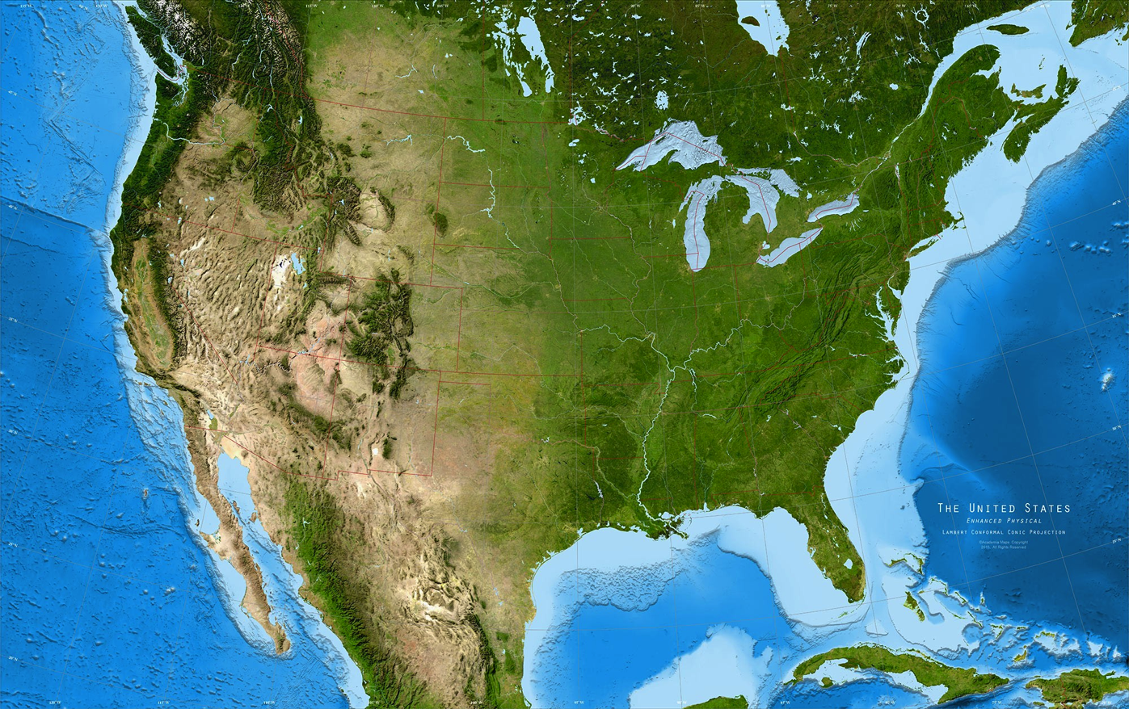
Summary
Polyphosphate contributes significantly to the total particular phosphorus pool in the water column of Hamilton Harbour (10% - 50%)
Polyphosphate is preferentially recycled during settling of particles:
25% - 70% (nearshore) and 50% - 90% (offshore) of polyP is recycled within the water column.
The strategic polyP metabolisms are predominately carried out by picoplankton. They support growth of blooming algae and cyanobacteria by rapid P turnover and recycling of polyP
Picoplankton is more sensitive to the P levels in terms of P deficiency responses and P luxury uptake
Notes:
To conclude: see the slide
Polyphosphate contributes significantly to the total particular phosphorus pool in the water column of Hamilton Harbour (10% - 50%)
Polyphosphate is preferentially recycled during settling of particles:
25% - 70% (nearshore) and 50% - 90% (offshore) of polyP is recycled within the water column.
The strategic polyP metabolisms are predominately carried out by picoplankton. They support growth of blooming algae and cyanobacteria by rapid P turnover and recycling of polyP
Picoplankton is more sensitive to the P levels in terms of P deficiency responses and P luxury uptake

Slide 13
Thank you
?

