Slide 1
Effect of stemflow on infiltration flux of rainwater and dissolved ¹³⁷Cs to forest soil
EGU2020 8 May 2020 Session GI2.8 D652
Hikaru IIDA^{1）}，Hiroaki KATO^{1）}，Tomoki SHINOZUKA^{1）}，
Satoru AKAIWA^{1）}，Tatsuya YOKOYAMA^{1）}，
Sean HUDSON^{1）}, Janice HUDSON^{1）}, Yuichi ONDA^{1）}
1）Center for Research in Isotopes and Environmental Dynamics, University of Tsukuba, JAPAN

Slide 2
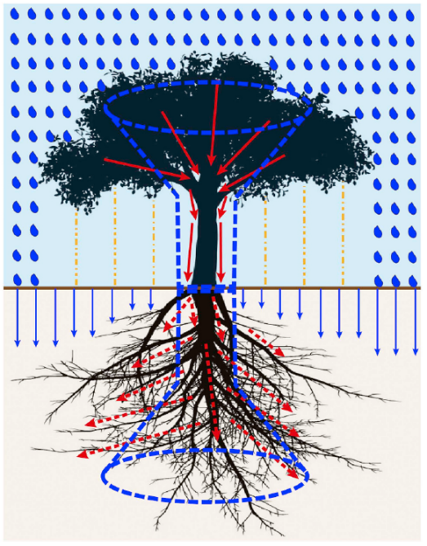
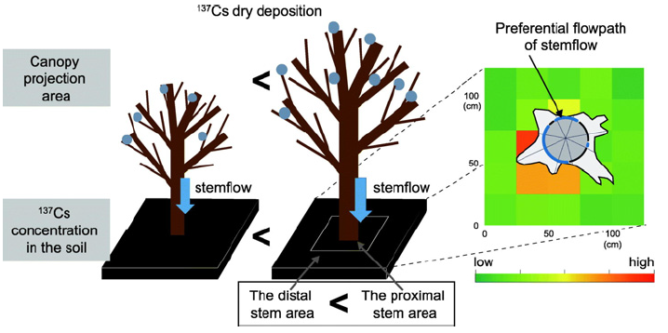
1．Introduction
Rainfall
○ Double-funneling (Johnson and Lehmann,2006, Guo et al.,2020)
・Aboveground ： rainfall partitioning by canopies (throughfall / stemflow)
・Belowground ： stemflow … Intensive infiltration in zones around trunk
( + preferential flow along tree root )
⇒ Generating heterogeneity of water and solute input
Stemflow
Throughfall
Infiltration
○ Radioactive cesium transfers to forest floor
・ ¹³⁷Cs concentration ： Stemflow ＞ Throughfall (Kato et al, 2019)
・Greater ¹³⁷Cs accumulation at proximal stem area
(1.2 – 2.3 times greater than the distal stem area, Imamura et al., 2017)
⇒ Infiltration water also needs to be analyzed
(Guo et al., 2020)
Question and Objective
Stemflow can cause further tree
contamination by root uptake for
long term?
: Elucidating influences of stemflow on
1) ¹³⁷Cs input flux by infiltration water
2) Preferential deeper penetration to root zone
(Imamura et al., 2017)
0 2 4 6 8
(kBq/kg)

Slide 3
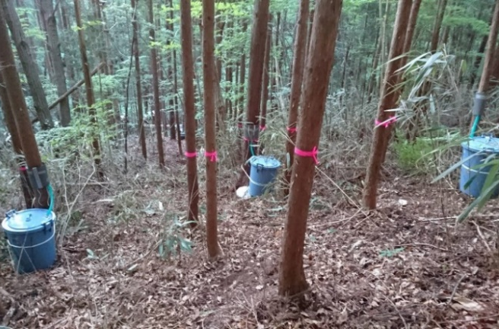
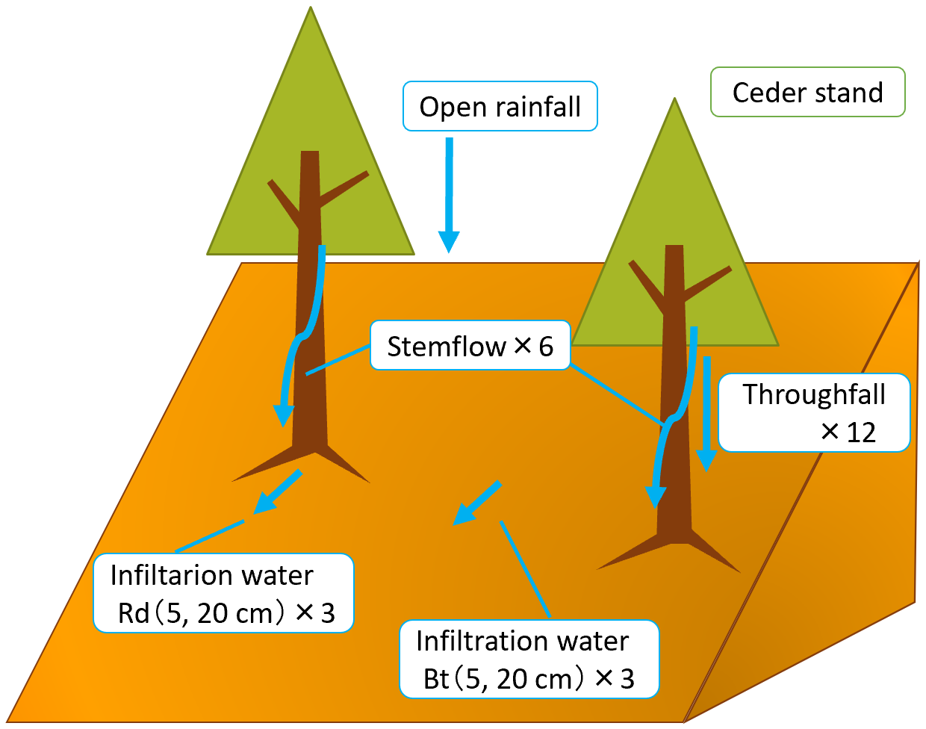
2．Method - Study site and Sampling
¹³⁷Cs initial deposition
< 10 kBq/m²
10 – 100 kBq/m²
100 – 300 kBq/m²
300 – 600 kBq/m²
> 600 kBq/m²
Namie ceder forest
○ Study site
Namie town, Fukushima prefecture (partially
selected as exclusion zone)
・23 km northwest of FDNPP
・Initial deposition
： 4,727 kBq/m²
→ Severely contaminated area
・Japanese Ceder stand (popular evergreen conifer in Japan)
○ Sampling and observation
Monitoring period：2019/6/24 – 12/11 (6 times)
・open rainfall ・stemflow ・throughfall
・infiltration water (5, 20 cm depth zero-tension lysimeter)
Rd (Root downslope) : the base of tree
Bt (Between trees) : the area far from tree
・soil water content (EC-5)
: temporal changes of volume water content
at same places that lysimeter located

Slide 4
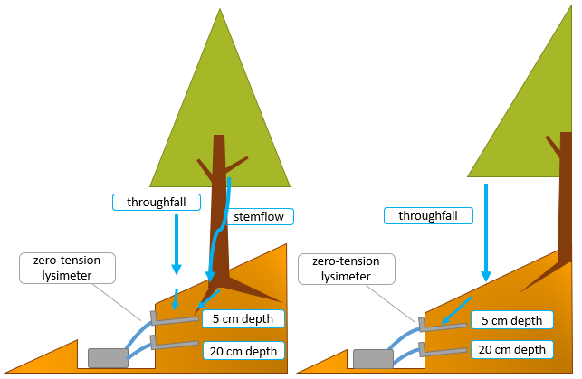
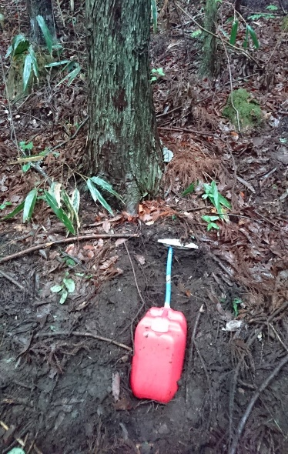
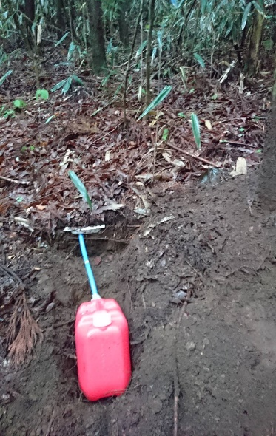
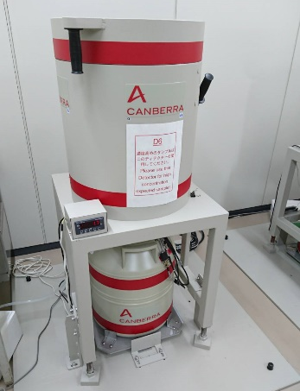
2．Method - Zero-tension lysimeter and Analysis
○ Zero-tension lysimeter
・For sampling infiltration water
(Marques et al.,1996, Weihermüller et al.,2007)
・Sampling depth : 5 and 20 cm depth
・Installation pattern
・Rd (Root downslope) : the base of tree
→ sampling water derived from
stemflow and throughfall
・Bt (Between trees) : the area far from tree
→ only throughfall
⇒ elucidate the effect of stemflow
Sampling Bt
Sampling Rd
Sampling Rd
Sampling Bt
○ Analysis
・water volume / depth
・¹³⁷Cs activity (Gamma spectrometry)
: separate dissolved / particulate
by ¹³⁷Cs 0.45 µm filter

Slide 5
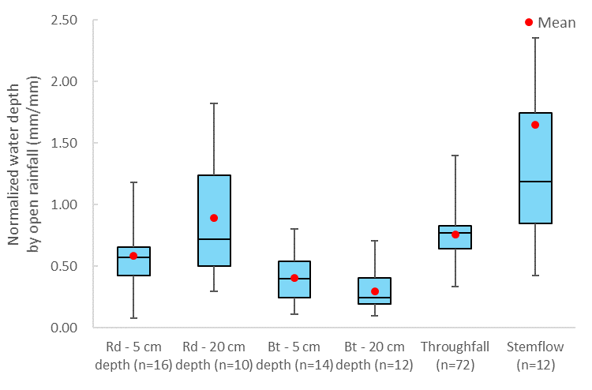
3．Result and Discussion
a) Water depth normalized by open rainfall * Stemflow : depth per unit infiltration area
The area far
from tree
Rainfall
The base of tree
3.0 times
1.4 times
○ Comparison of water depth
・Stemflow depth per unit infiltration area
: larger than throughfall and infiltration water clearly
・Rd (near) ＞ Bt (far) : same soil depth : 5 cm - 1.4 times 20 cm – 3.0 times
・Infiltration water Rｄ-20 cm
: larger than throughfall and Rd-5 cm ⇔ Bt : 5 cm ＞ 20 cm
⇒ Stemflow with a large amount of water into the base of tree and deeper soil

Slide 6
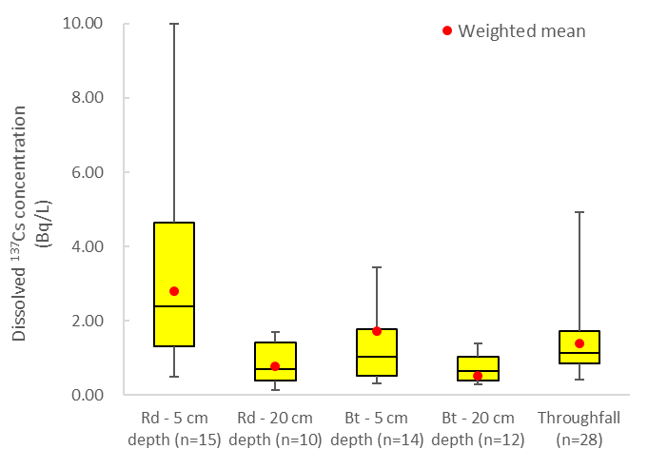
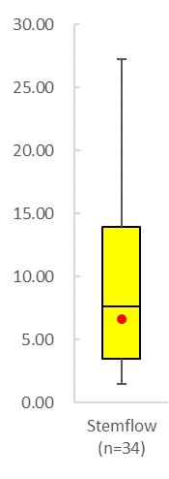
3．Result and Discussion
c) Dissolved ¹³⁷Cs concentration
The area far
from tree
Rainfall
The base of tree
1.6 times
1.5 times
○ Comparison of ¹³⁷Cs concentration
・Stemflow of dissolved ¹³⁷Cs concentration: larger than throughfall and infiltration water clearly
・Rd (near) ＞ Bt (far) : same soil depth : 5 cm - 1.6 times 20 cm – 1.5 times
but there is significant difference between 20cm Rd and Bt concentration
・Comparison of same area : shallow depth ＞deep depth
・Infiltration water Rｄ-5 cm ¹³⁷Cs concentration : larger than throughfall

Slide 7
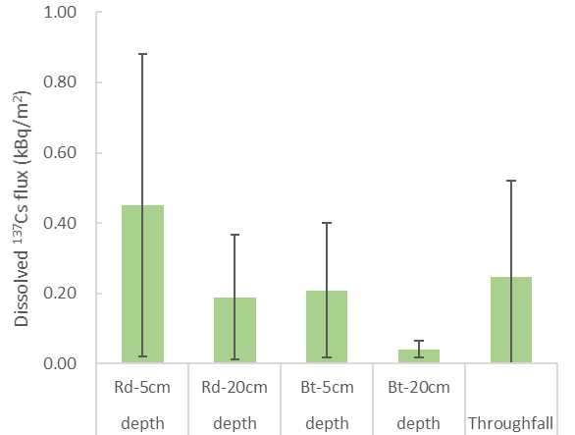
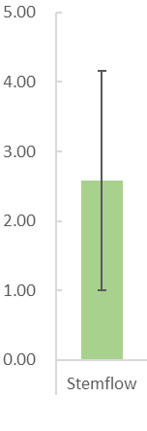
3．Result and Discussion
d) Mean dissolved ¹³⁷Cs flux during the sampling period *Stemflow : depth per unit infiltration area
**Error bar : SD
The base of tree
The area far from tree
Rainfall
1.6 times
4.6 times
○ Comparison of ¹³⁷Cs flux (calculating based on water depth and concentration)
・Stemflow of dissolved ¹³⁷Cs flux : larger than throughfall and infiltration water clearly
・Rd (near) ＞ Bt (far) : same soil depth : 5 cm - 1.6 times 20 cm – 4.6 times
・¹³⁷Cs flux of Rd-20 cm is as large as Bt-5 cm flux.
→ Generally, most ¹³⁷Cs in the soils exist within 5 cm depth (Matsuda et al., 2015) ,
and absorb to soil particles (Brouwer et al., 1983) .
⇒ Stemflow with a large amount of ¹³⁷Cs into the base of tree and deeper soil
; especially, 20 cm depth is supplied with ¹³⁷Cs by infiltration unlike previous studies.

Slide 8
4．Conclusion
○ Conclusion
・Rainwater infiltrates more at the base of tree than the area far from tree.
・¹³⁷Cs concentration of infiltration water is also larger at the base of tree than the area far from tree.
・Unlike previous studies about depth distribution of ¹³⁷Cs, actually, the amount infiltration water at
Rd-20 cm depth is large, and ¹³⁷Cs flux is about the same as at Bt-5 cm depth.
At the vicinity area of tree
: ¹³⁷Cs included in infiltration water and soil are affected by stemflow and ¹³⁷Cs moves to deep soil
layer preferentially due to the intensive input of stemflow.
○ Future direction
・Contribution rates of stemflow to infiltration water
⇒ In this study, although there was a difference between the base of tree and the area far from tree,
infiltration water at the base of tree seems to be contributed by both stemflow and throughfall.
Therefore, it is important to estimate the contribution rates by using a water stable isotopes.
・Infiltration mechanism of stemflow along the root
⇒ It is necessary to collect flow along the root and elucidate more detailed stemflow effect.
Thank you very much for your attention !

