Slide 1
EGU2020-12477
Plot-scale wash-off of Cesium-137 and Strontium-90
after three decades since the Chernobyl accident
Yoshifumi Wakiyama^{1*} (wakiyama@ipc.fukushima-u.ac.jp), Yasunori Igarashi¹, Yuichi Onda², Dmitry Samoilov³, Hlib Lisovy⁴, Volodymyr Demianovych ³, Gennady Laptev⁴, Alexei Konoplev¹, Kenji Nanba^{1,5}, Serhii Kirieiev³
1 Institute of Environmental Radioactivity, Fukushima University, Japan
2 Center for Research in Isotopes and Environmental Dynamics, University of Tsukuba, Japan
3 Chernobyl Ecocentre, State Agency of Ukraine on Exclusion Zone Management, Ukraine
4 Ukrainian Hydrometeorological Institute, Ukraine
5 Faculty of Symbiotic Systems Science, Fukushima University, Japan
This work was supported by JICA-JST SATREPS program in Japan through a project titled “The Project for Strengthening of the Environmental Radiation Control and Legislative Basis for the Environmental Remediation of Radioactively Contaminated Sites”.

Slide 2
Brief summary
✓Runoff plot observations quantified ¹³⁷Cs and ⁹⁰Sr wash-offs in Chernobyl area.
✓ Surface runoff, sediment discharge and wash-off are larger in summer rain events than in winter snowmelt events.
✓ Normalized liquid ¹³⁷Cs coefficients are likely lower than those in 1980s’.
✓ Snowmelt runoff occurs on frozen soil based on coupled monitoring soil temperature.
✓ Severe water repellency on soil surface and the ash layer prevented water infiltration on the post wild-fire site and resulted in frequent runoff events.

Slide 3
Introduction
✓Radionuclide wash-off is a key issue for understanding its redistribution in the environments after nuclear disasters.
✓ Plot-scale radionuclide wash-off was evaluated by coupling runoff plots with artificial rainfall experiment and snowmelt runoff monitoring after the accident of Chernobyl nuclear power plant (e.g., Bulgakov et al. 1990, Konoplev et al., 1993).
✓ However, there is no continuous observation of plot-scale radionuclide wash-off in Chernobyl and therefore long-term dynamics of radionuclide and hydrological response to natural rainfall remained unclear.
✓ This study aim to elucidate plot-scale wash-off processes of ¹³⁷Cs and ⁹⁰Sr in the Chernobyl exclusion zone.

Slide 4
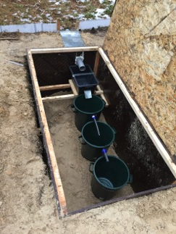
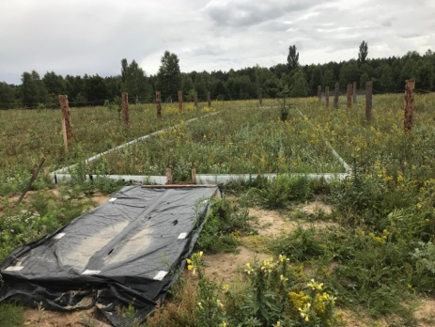
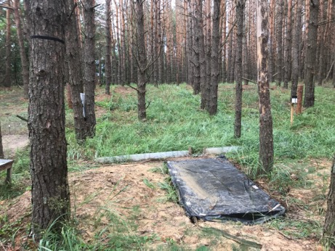
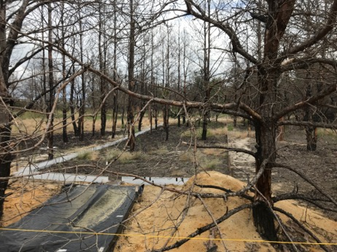
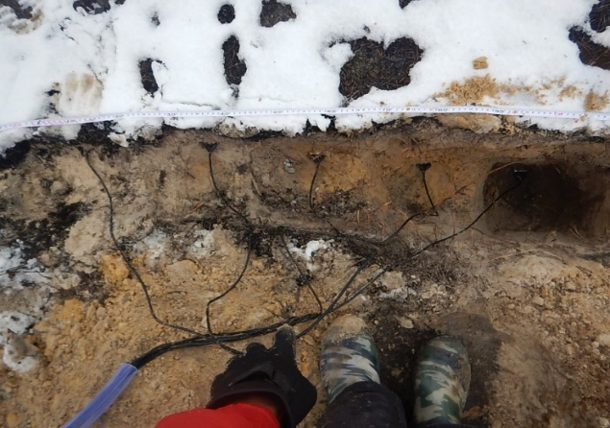
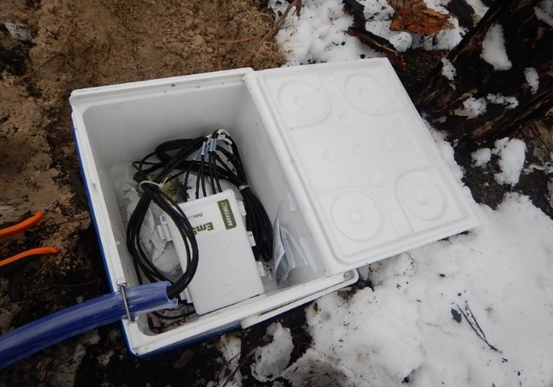
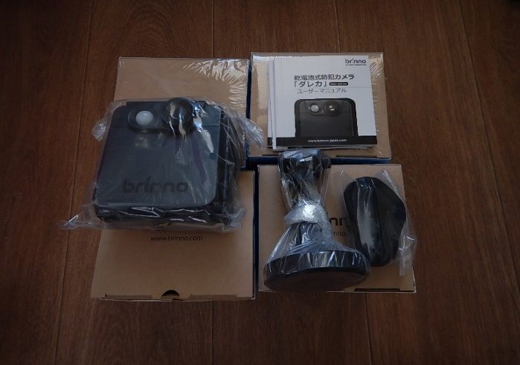
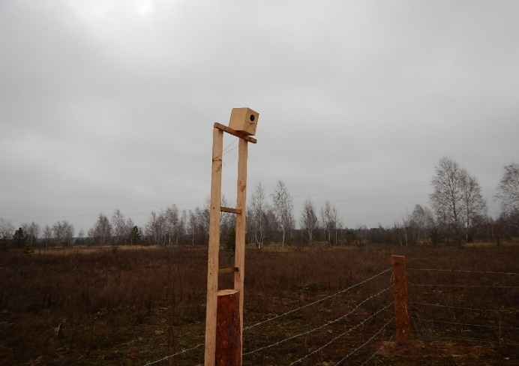
Materials and Method
Runoff plot of USLE standard
Korogod
(Abandoned farmland)
Kopachi
(Pine Forest)
Red forest
(Post wild-fire site)
Weir and water height sensor
Runoff water traps
¹³⁷Cs (30 cm) :
91 kBq m⁻²
¹³⁷Cs (30 cm) :
11000 kBq m⁻²
¹³⁷Cs (30 cm) :
3900 kBq m⁻²
A plot consists of boundary wall (22.13 m L, 5 m W), 30°nodge weir with water height sensor and sediment traps
Soil water/temperature sensors
Interval camera
Snow depth

Slide 5
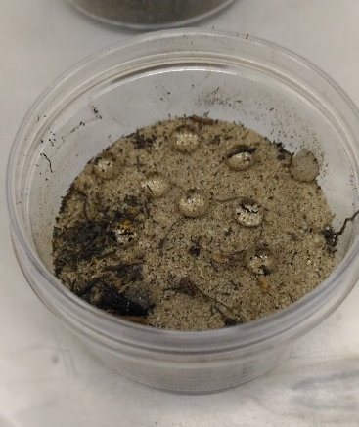
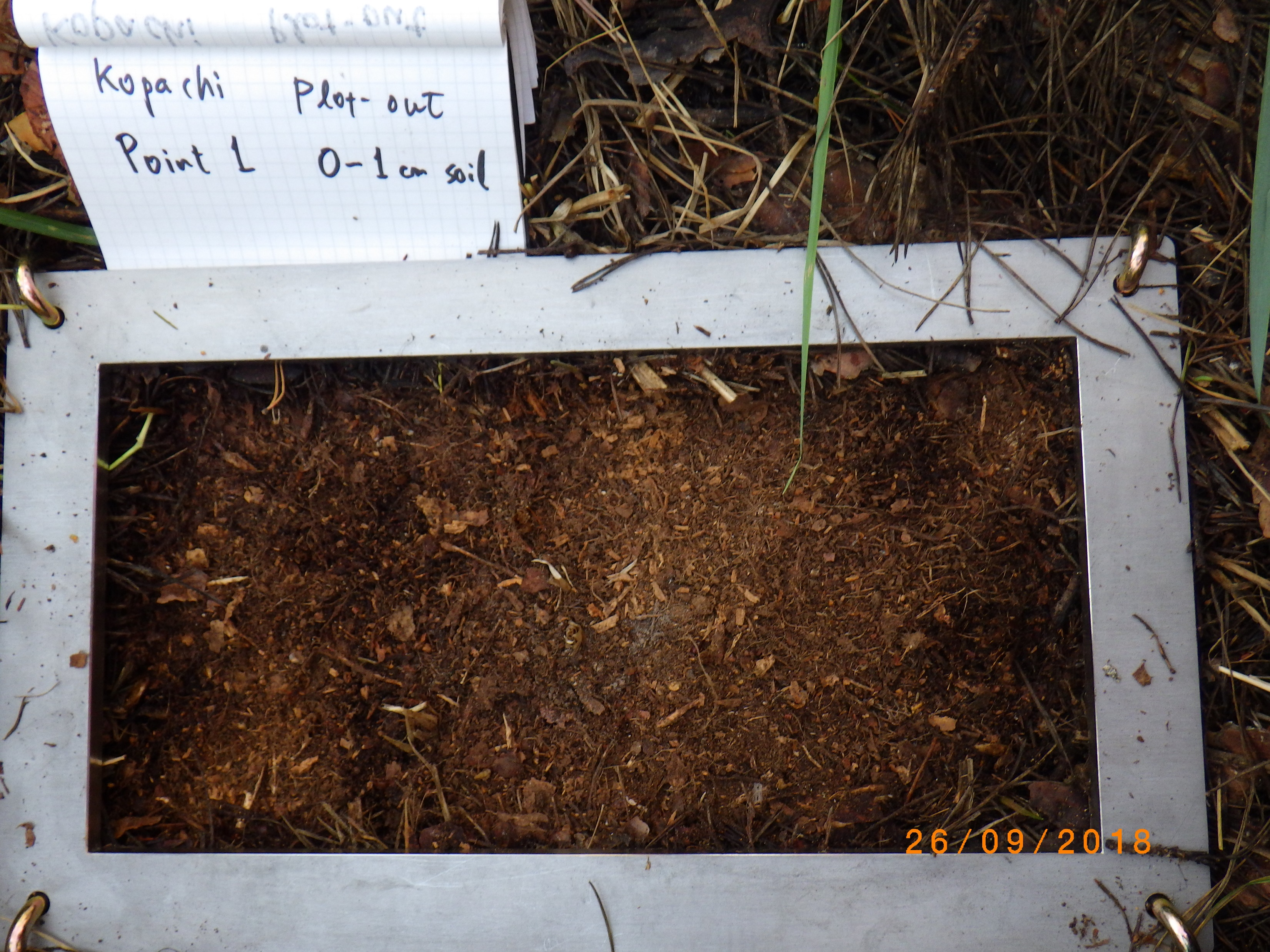
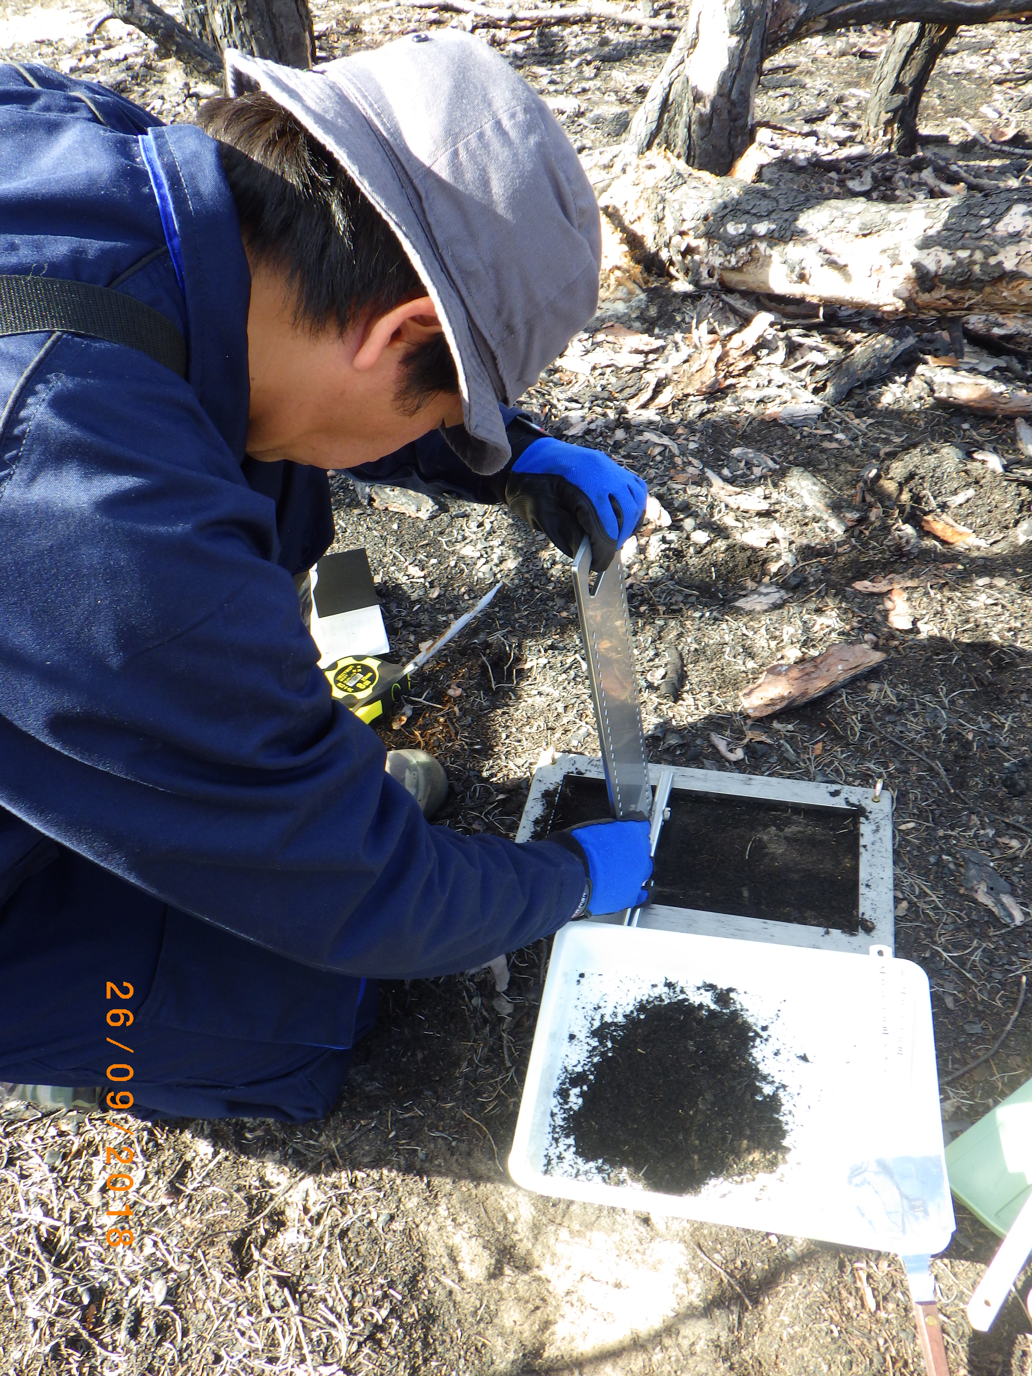
Materials and Method
Litter/Ash and surface soil sampling with scraper plat
Soil water repellency test
Litter/Ash and surface soil sampling
WDPT: Water Drop Penetration Time
EP test: Ethanol Percentage test
Site | Sample (n = 3) | Median time of penetration (second) | WDPT class | Ethanol percentage (%) | ¹³⁷Cs concentration (Bq kg⁻¹) | ⁹⁰Sr concentration (Bq kg⁻¹)
Kopachi | Litter | 290 | Slightly-Strongly | 15-20 | 210 | 33
 | 0-1cm | 3038 | Strongly-Extremely | 20 | 210 | 14
 | 1-2cm | 3290 | Severely - Extremely | 20-30 | 6300 | 3.7
 | 2-3cm | 3600 | Extremely | 20 | 9100 | 2.8
Red forest | Ash | 715 | Strong-Severely | 8-15 | 1800 | 800000
 | 0-1cm | 3292 | Severely-Extremely | 15 | 2900 | 180000
 | 1-2cm | 3600 | Extremely | 15 | 2100 | 57000
 | 2-3cm | 3600 | Extremely | 15-20 | 920 | 4000
Korogod | Litter | 608 | Strongly-Severely | 15 | 2.7 | 1300
 | 0-1cm | 2098 | Severely | 10-15 | 8.9 | 7.4
 | 1-2cm | 3052 | Severely-Extremely | 15-20 | 12 | 8.2
 | 2-3cm | 3057 | Severely-Extremely | 15-20 | 19 | 6.9

Slide 6
Results and Discussion
Table. Summary of observation results
Date of sample collection | Surface runoff | Sediment Discharge | Particulate ¹³⁷Cs wash-off | Dissolved ¹³⁷Cs wash-off | Dissolved ⁹⁰Sr wash-off | Apparent distribution coefficient ¹³⁷Cs | Solid ¹³⁷Cs wash-off coefficient | Liquid ¹³⁷Cs wash-off coefficient | ⁹⁰Sr/ ¹³⁷Cs
 | mm | g m⁻² | Bq m⁻² | Bq m⁻² | Bq m⁻² | L kg⁻¹ | m² kg⁻¹ | m⁻¹
Korogod (Abandaned farmland)
Feb-1, 2018 | 0.015 | 0.0023 | 0.0054 | 0.0081 | 0.018 | 4.3 × 10³ | 0.026 | 0.0059 | 2.2
Mar-20, 2018 | 0.29 | 0.0055 | 0.021 | 0.009 | 0.16 | 1.2 × 10⁵ | 0.042 | 0.00034 | 18
Mar-27, 2018 | 0.15 | 0.0017 | 0.0034 | 0.0027 | 0.054 | 1.1 × 10⁵ | 0.022 | 0.00020 | 20
Apr-1, 2018 | 0.28 | 0.0052 | 0.054 | 0.0036 | 0.081 | 8.1 × 10⁵ | 0.11 | 0.00014 | 23
Kopachi (Pine forest)
Feb-1, 2018 | 0.29 | 0.0042 | 1.4 | 1.3 | 6.0 | 7.4 × 10⁴ | 0.031 | 0.00042 | 4.6
Jul-2, 2018 | 0.67 | 0.40 | 50 | 6.2 | 50 | 1.4 × 10⁴ | 0.012 | 0.00086 | 8.0
Red forest (Post wild-fire site)
Jul-2, 2018 | 1.1 | 0.19 | 60 | 2.6 | 78 | 1.3 × 10⁵ | 0.081 | 0.00061 | 30
Jul-30, 2018 | 1.7 | 0.40 | 100 | 2.3 | 135 | 1.8 × 10⁵ | 0.064 | 0.00035 | 59
Jun-5, 2019 | 0.39 | 1.1 | 110 | 4.9 | 17 | 8.0 × 10³ | 0.026 | 0.0032 | 3.5
Reference
Konoplev et al (1998) | - | - | - |  |  | 0.39-1.3×10⁴ | 1.7-52×10⁻² | 0.9-57×10⁻³
*Blue and red characters mean winter-spring events and summer events, respectively.
Surface runoff, sediment discharge and wash-off are larger in summer rain events than in winter events.
Liquid ¹³⁷Cs wash-off coefficient and distribution coefficient for ¹³⁷Cs were likely lower than those in 1987 (by Konoplev, 1998).

Slide 7
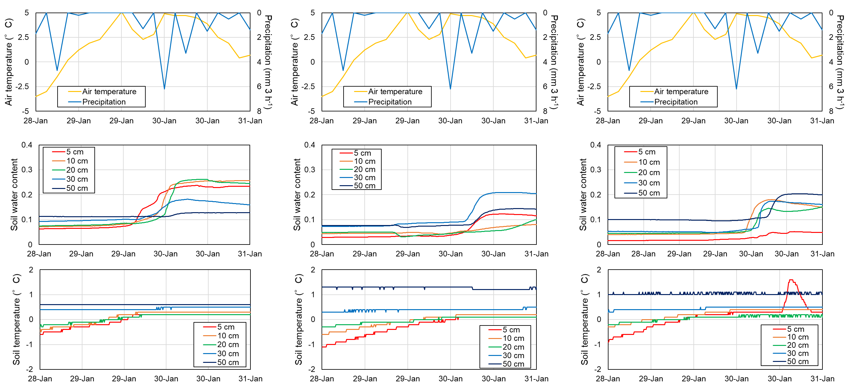
Results and Discussion
Case: Winter event 1: 28-31 JAN 2018.
Korogod
(Abandoned farmland)
Kopachi
(Pine Forest)
Red forest
(Post wild fire site)
Runoff 0.02 mm
Runoff 0.29 mm
No runoff
During mid-winter, soil temperature of 5 cm depth was below 0°C during precipitation at the Kopachi and surface runoff was observed. It was suggested that rain and snowmelt water on frozen soil resulted in greater surface runoff.

Slide 8
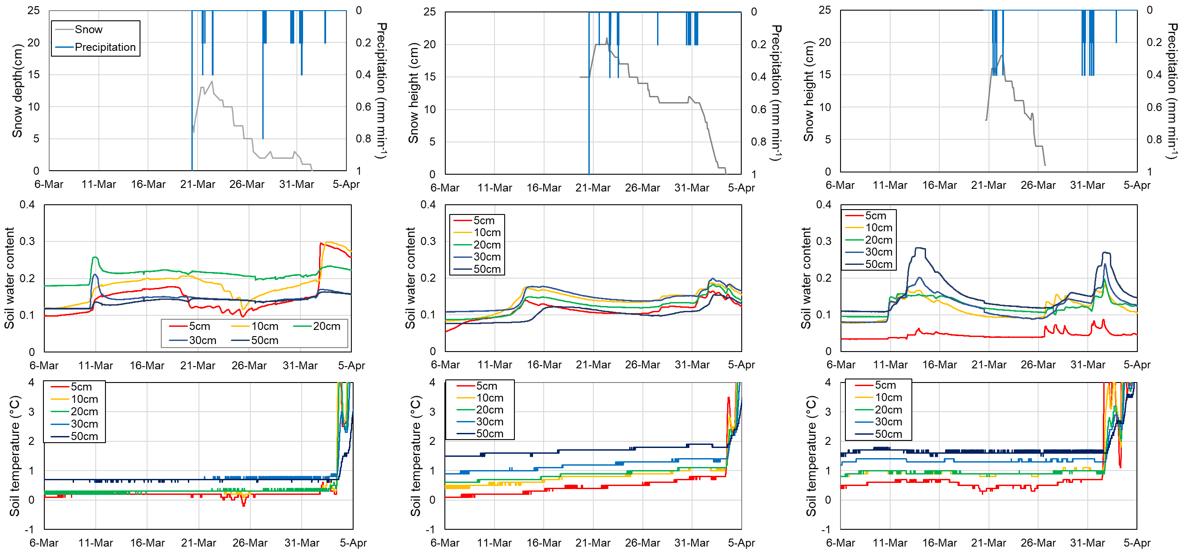
Results and Discussion
Case: Winter event 2: 6 Mar. - 5 Apr. 2018.
Korogod
(Abandoned farmland)
Kopachi
(Pine Forest)
Red forest
(Post wild fire site)
Runoff 0.29 mm
No runoff
No runoff
Runoff 0.15 mm
During snowmelt season, soil temperature was stable on the Korogod compared to other plots. It was suggested that both rain and snowmelt water on frozen soil resulted in greater surface runoff.
Runoff 0.28 mm

Slide 9
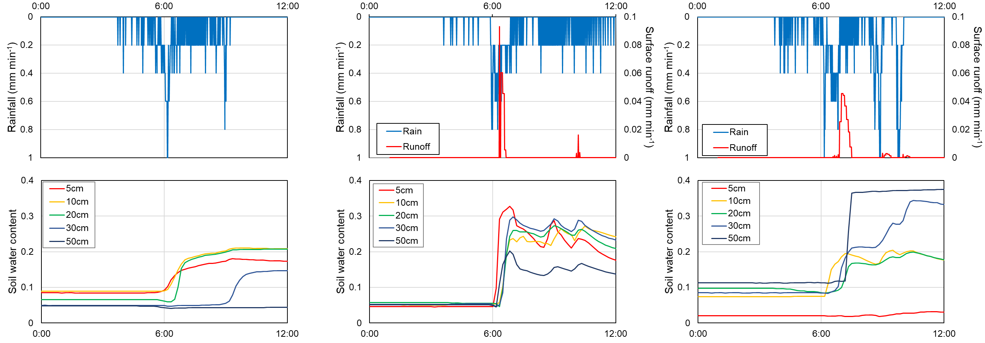
Results and Discussion
Case: Summer event 1: 30 Jun. 2018
Korogod
(Abandoned farmland)
Kopachi
(Pine Forest)
Red forest
(Post wild fire site)
No runoff
Runoff: 0.67 mm
(Runoff coeff. 0.016)
Runoff 1.1 mm
(Runoff coeff.: 0.027)
Intensive rainfall resulted in surface runoff on Kopachi and Red forest plots. Surface runoff was larger from the Red forest than from the Kopachi. Soil water content of surface soil did not increase on Red forest. These results suggest that severely water repellency on soil surface and the effect of ash layer prevented water infiltration on the post wild-fire site.

