Slide 1
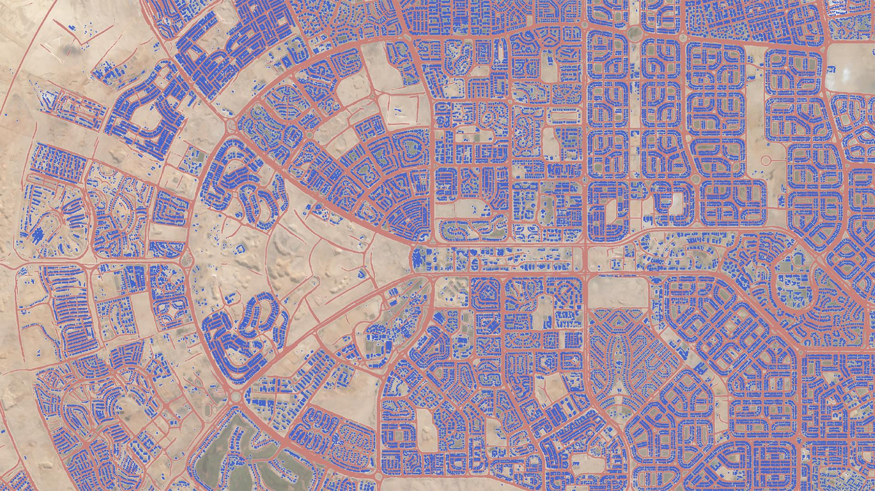
Modeling and Capturing New Phenomena from Very High Cadence Earth Observations
Click on Link to View
© 2020 Planet Labs, Inc. PROPRIETARY

