Slide 1





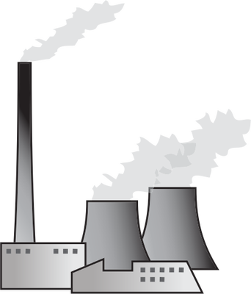

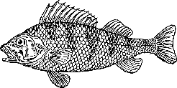

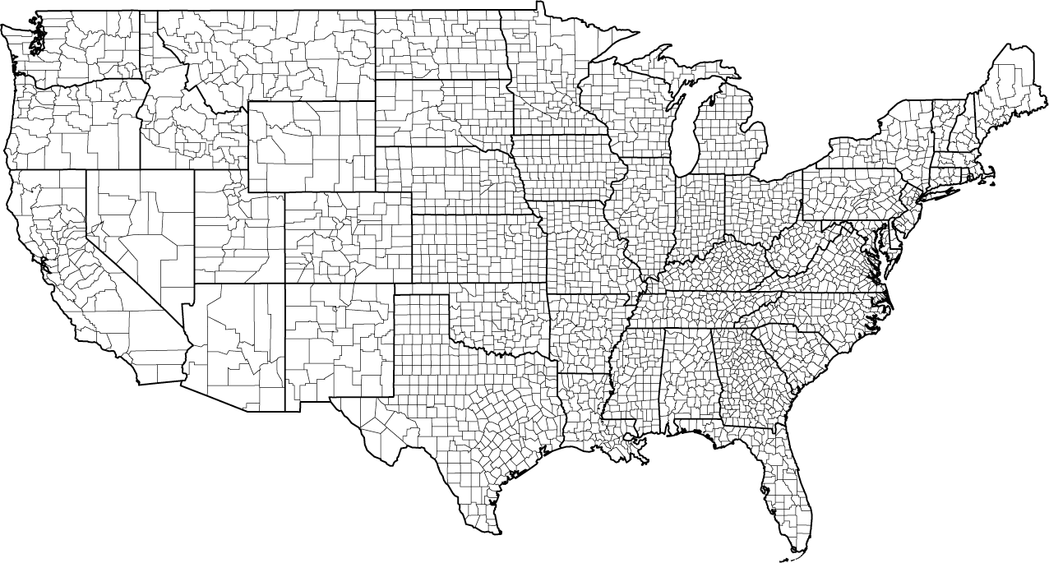
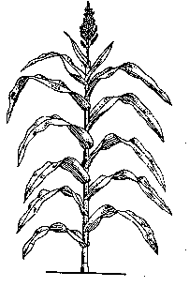
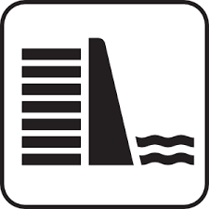




Reducing Water Scarcity by Improving Water Productivity
Abstract ID: EGU2020-12550
Landon Marston, Ph.D., P.E.
Assistant Professor
Kansas State University, Civil Engineering
Co-Authors: Gambhir Lamsal, Zach Ancona, Peter Caldwell, Brian Richter, Richard Rushforth, Ben Ruddell, & Kyle Davis
May 5, 2020
Notes:
https://cmgajcbuzz.files.wordpress.com/2015/07/droughtfi.jpg (drought sign)

Slide 2
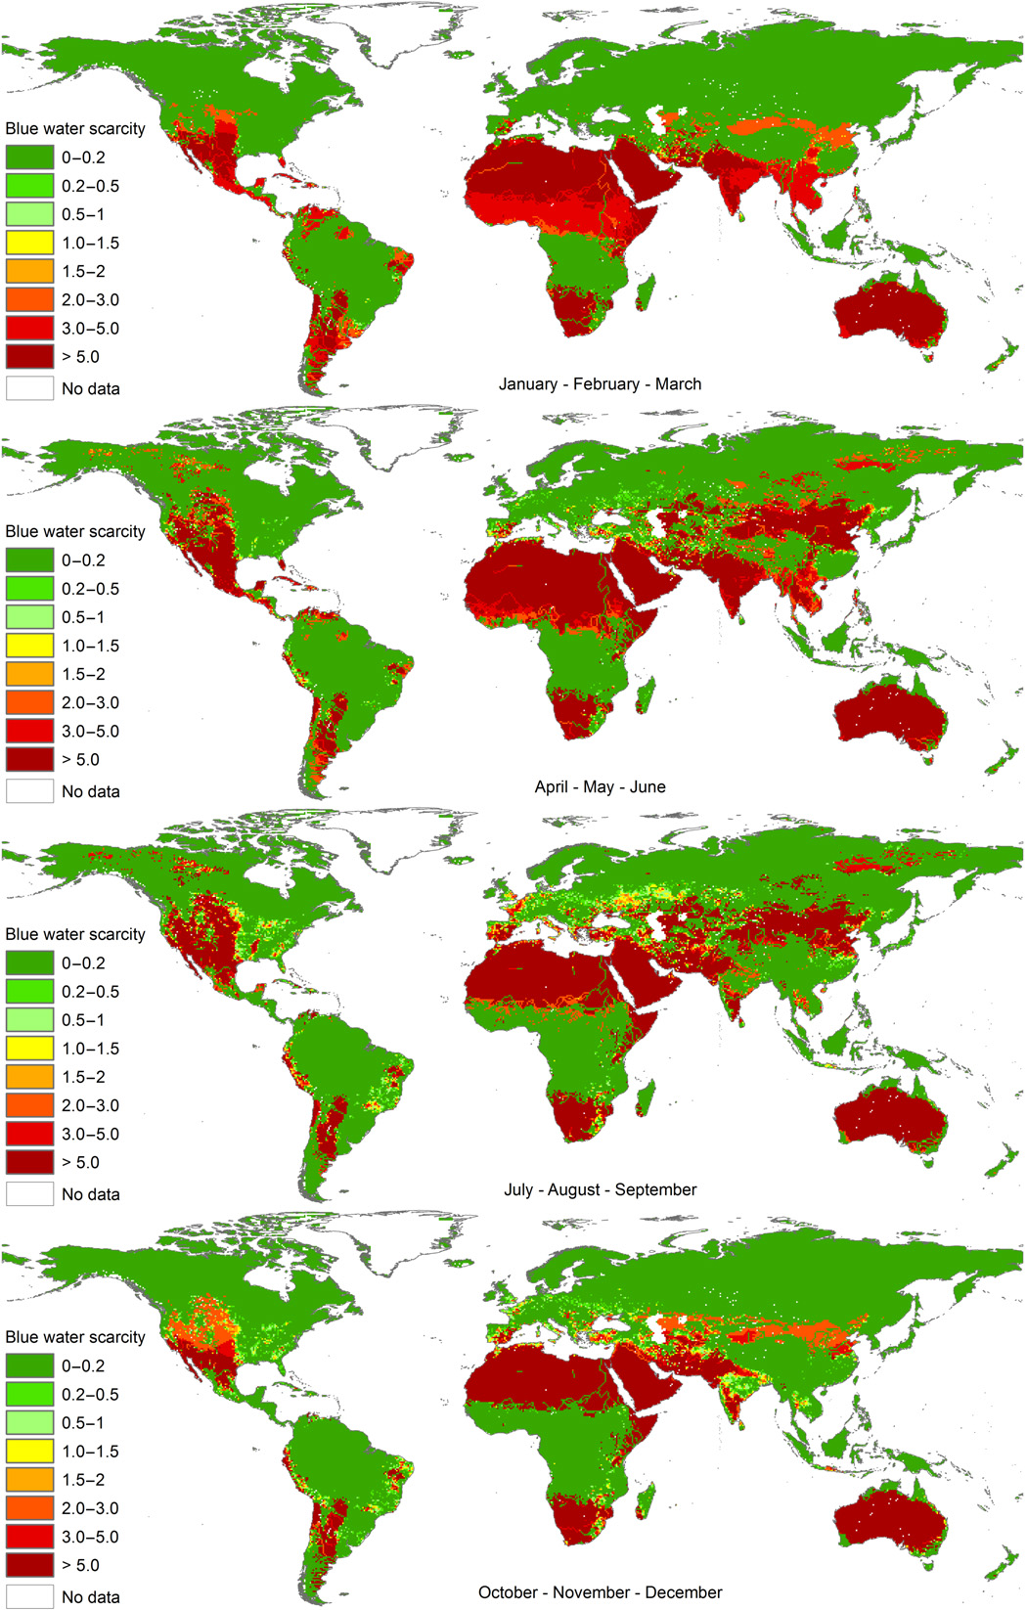
Water managers in 4 out of 5 states expect water shortages within their state by 2023.
Mekonnen & Hoekstra, 2016

Slide 3
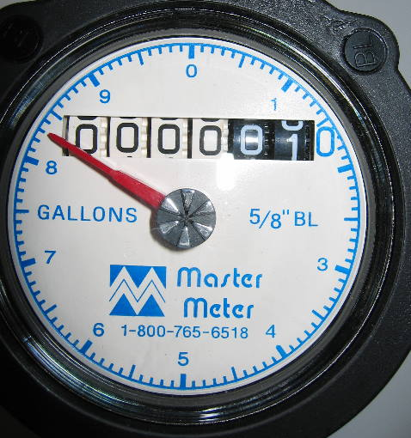
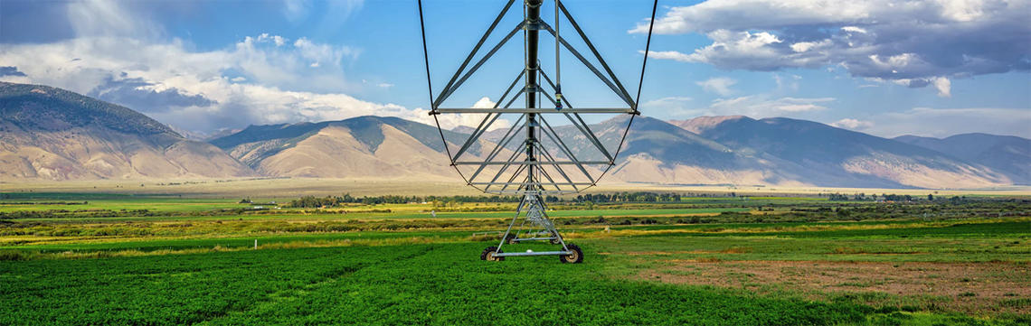
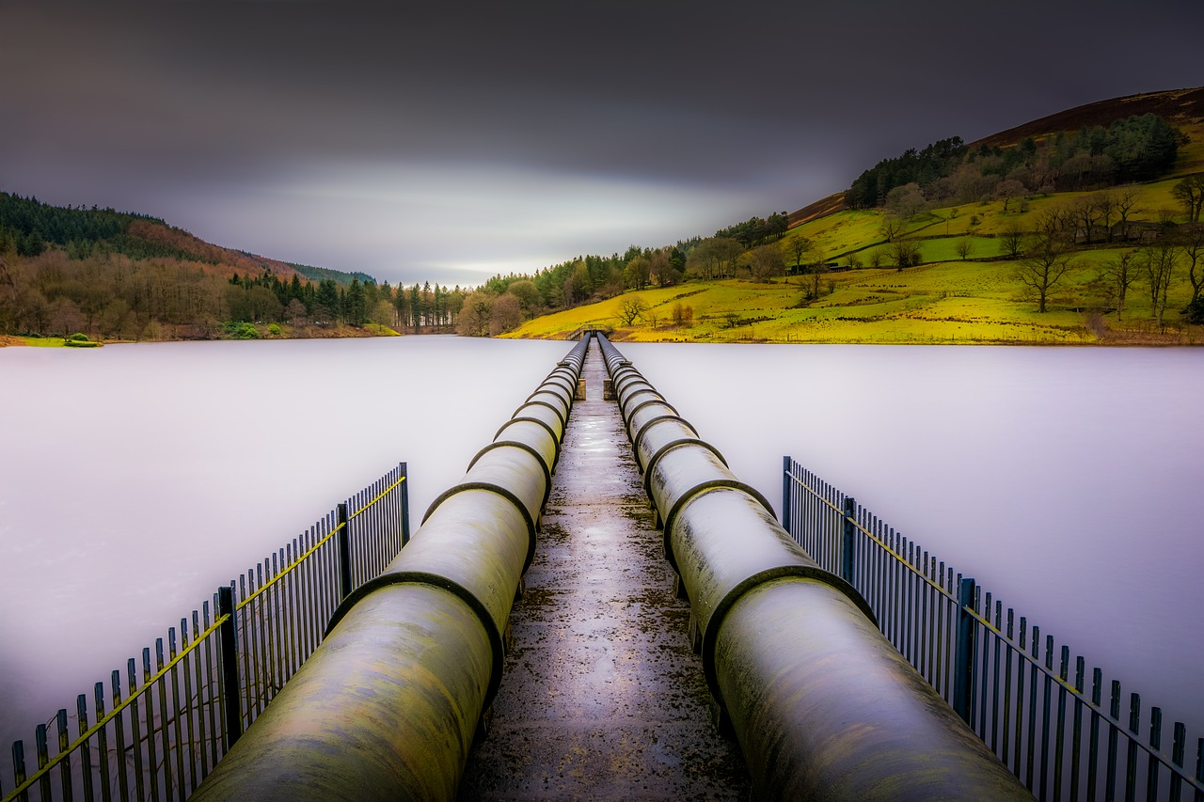
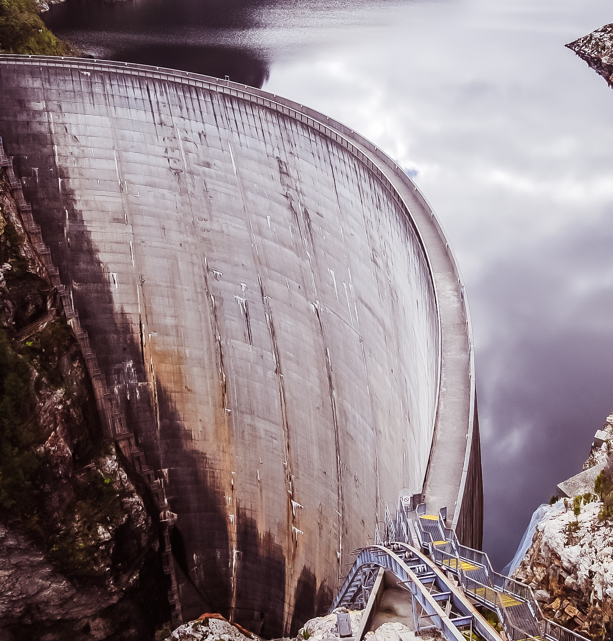
How can water scarcity be addressed?
demand management
supply augmentation
Notes:
Increasing water supplies through large infrastructure projects (e.g., dams and canals) has been the primary way society has dealt with an inability to meet all water demands.

Slide 4
How can water scarcity be addressed?
supply augmentation
demand management
Notes:
However, as these large infrastructure projects become more physically, economically, or socially intractable, the scales are beginning to tip in favor of demand management strategies to ensure available water supplies can meet all water demands.

Slide 5


What if all water users adjusted their water use to match their industry benchmark level?
BENCHMARK
$
$
$
Water savings
How much water could be saved and where?
Notes:
Benchmarking: If all industries and crop production improved their water use efficiency to that of the X% most efficient within their sector (and in their region!), how much water could be saved across the US economy (and in each region)? What industries and locations offer the greatest water savings, and the greatest savings in proportion to reducing water stress?

Slide 6

This work relies on a rich and high-resolution dataset of human water use in the U.S.
Useful resource for
  water management and modeling
  environmental LCA
  WF assessments
  benchmarking
Publication
Marston, L., Ao, Y., Konar, M., Mekonnen, M. M., & Hoekstra, A. Y. (2018). High-Resolution Water Footprints of Production of the United States. Water Resources Research, 1–29. https://doi.org/10.1002/2017WR021923
Dataset
Data available at:
http://waterfootprint.org
Landon Marston ltmarston@ksu.edu

Slide 7
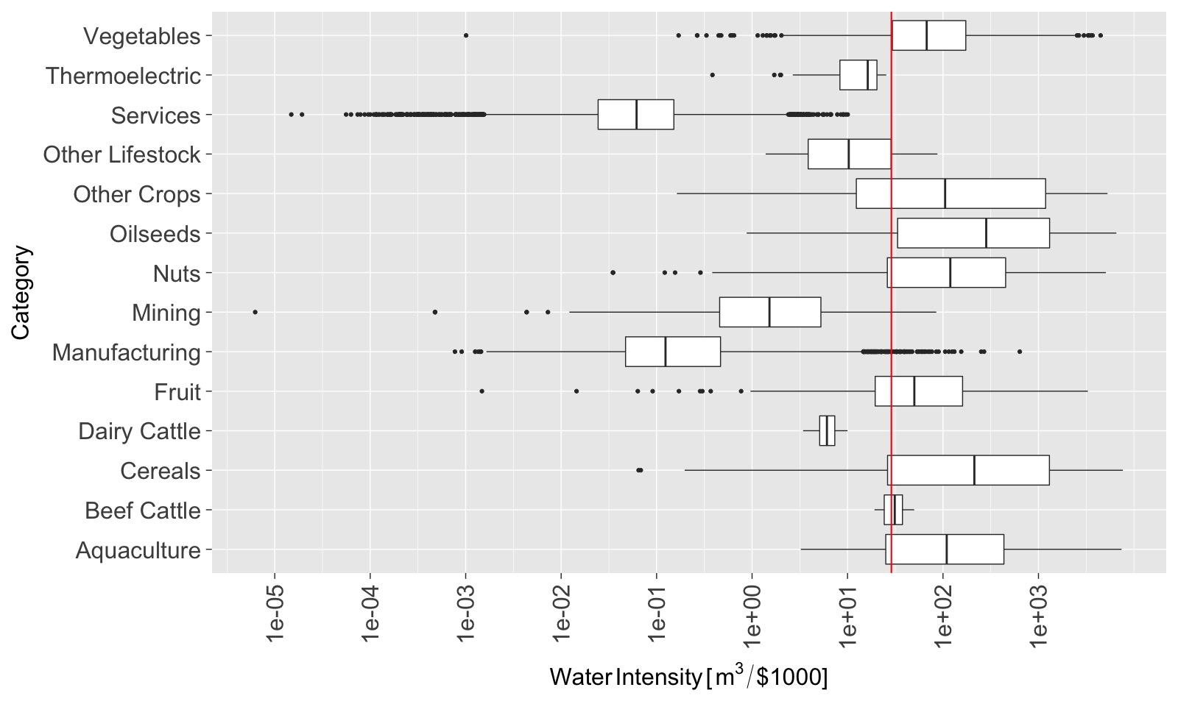
Water productivity varies significantly between and within economic sectors.
National average water intensity
Water Intensity [m³/$1000]
Marston et al, 2018 WRR
Notes:
Crop sectors require much more water to produce a $1 worth of goods than other economic sectors.

Slide 8
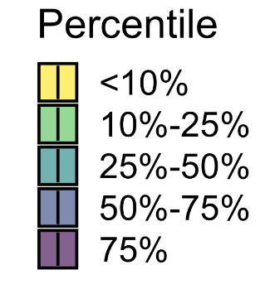

Expectations of reasonable water consumption were constrained based on current water utilization rates.
# of Water Users
BM₂₅ Scenario
BM₅₀ Scenario
BM₁₀ Scenario
Water Productivity
Based on similar production processes and comparable conditions.
Notes:
Other factors, such as technology, water pricing, water rights, infrastructure, and policy, have all been demonstrated to influence water use and productivity.
Unlike climate and other environmental conditions, these are all human decision points impacting water use.
We identify instances of when these human interventions influencing water consumption have led to more efficient water utilization.
Within each climate region and for each industry, we determine the production areas that use water most efficiently. We determine the median blue water consumption per unit of production, as well as the most efficient quartile and most efficient decile for each industry. These are set as water productivity benchmarks and denoted as BM₅₀, BM₂₅, and BM₁₀, respectively.
Potential Water Savings
Within each climatic region, an industry’s blue water footprint was set at the benchmark level for any area utilizing water less efficiently than it’s industrial benchmark.
Potential water savings is the difference between current water consumption and water consumption when all users productivity is equal to or better than their benchmark.

Slide 9
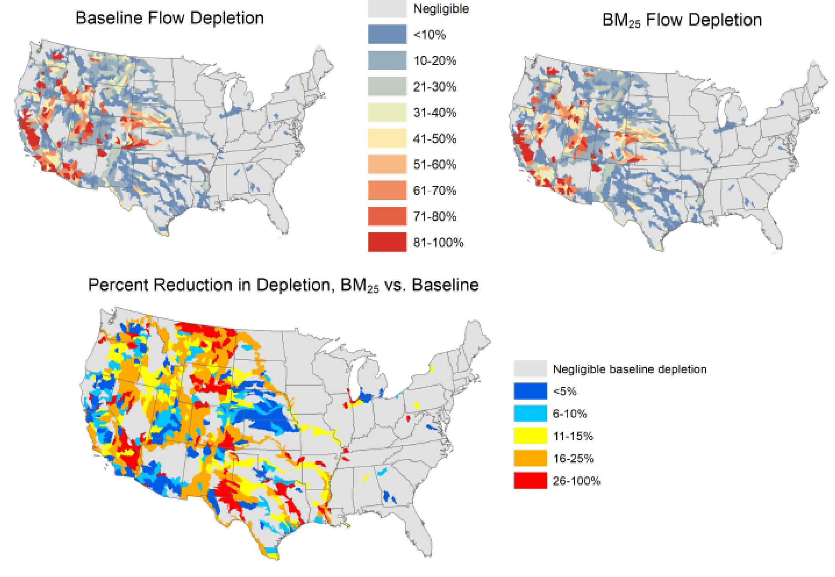
Where and how much water would be made available for other uses?
Notes:
The greatest water saving potential is in watersheds experiencing some of the greatest water scarcity.

Slide 10
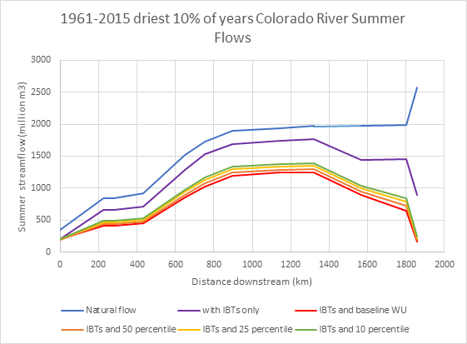
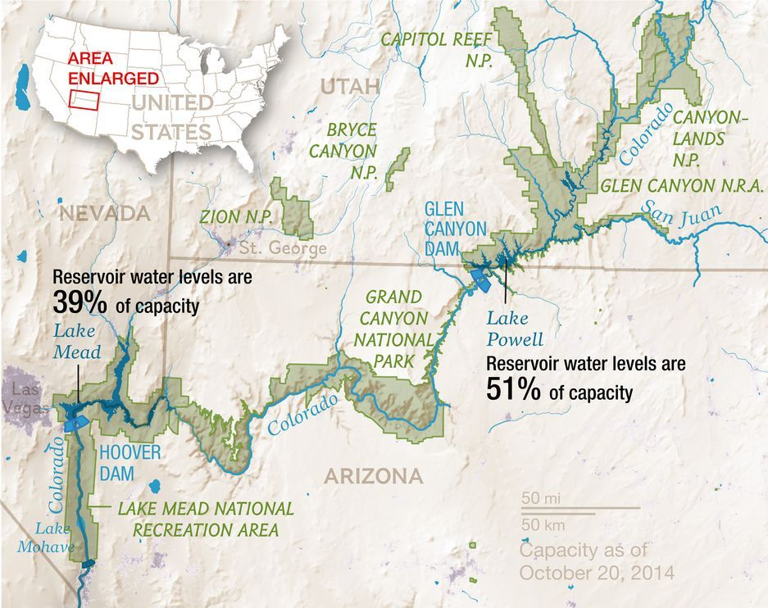
Water savings can have significant impacts on surface water availability in the over-appropriated Colorado Basin.
Lake Powell
Lake Mead
Powell
Mead
BM₅₀ Scenario
4.8%
4.1%
BM₂₅ Scenario
10.0%
8.6%
BM₁₀ Scenario
13.9%
11.9%
Notes:
Lake Mead and Lake Powell are critical for many cities and farms throughout the region that depend on these reservoirs to meet their water supply. These reservoirs have experienced record lows as historic droughts, coupled with increasing demands, have pushed them to their limits. Any additional water can be extremely valuable.

Slide 11
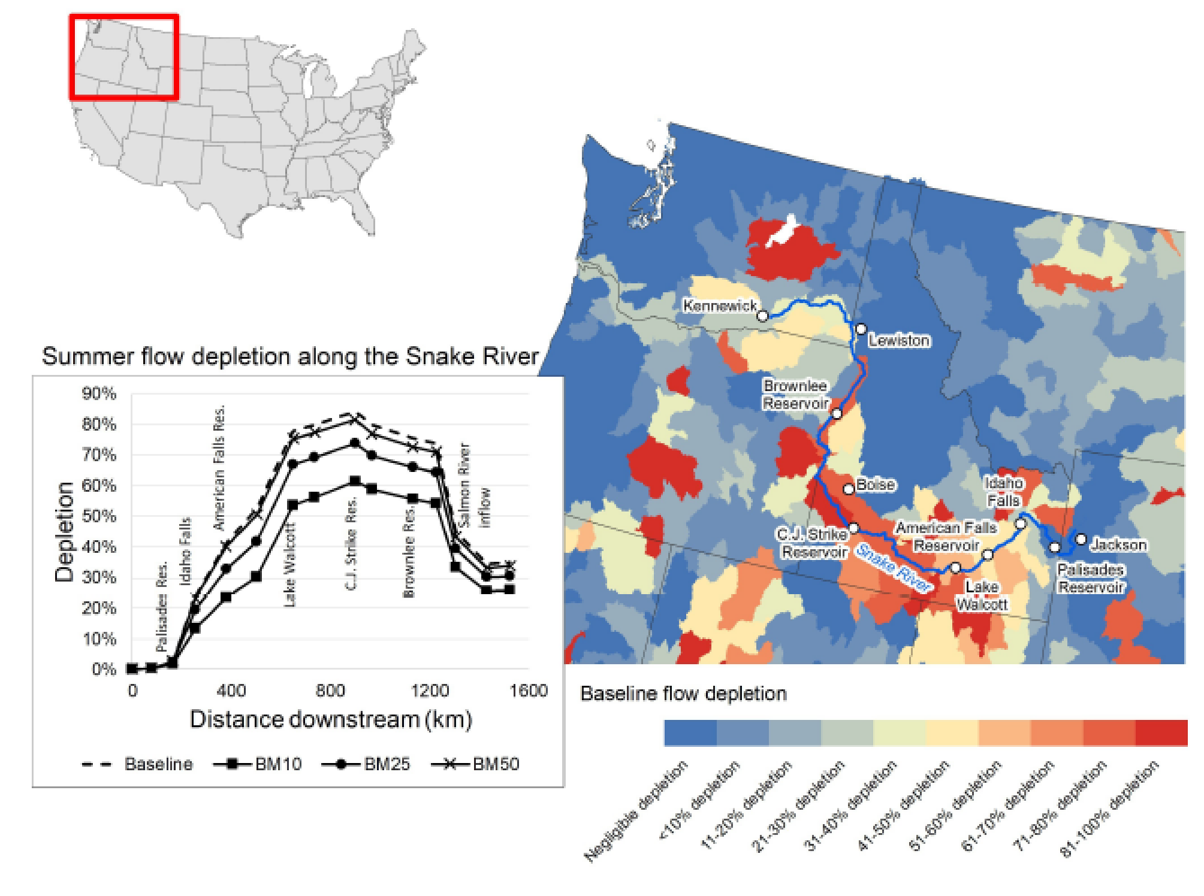
In the Snake River, reasonable improvements in water productivity can augment summer streamflow by as much as 25%.

Slide 12
The greatest water savings can be achieved in the agriculture sector.
BM₁₀
7
6
BM₂₅
5
4
Water Savings (km³/yr)
BM₂₅
3
BM₅₀
2
1
0
West
South
Central
Northwest
Southwest
East North Central
Southeast
Northeast
West North Central
Notes:
Potential crop water savings for BM₁₀, BM₂₅, and BM₅₀ are aggregated to NOAA climatic regions. A 31% reduction in blue water consumption can be achieved if all farmers utilize water as efficiently as the top decile (BM₁₀) of irrigators and 9% savings is obtainable at BM₅₀. The greatest savings occur in the South. Nearly half of potential crop water savings are from just two crops: corn and alfalfa, which are primarily used for animal feed and biofuel.

Slide 13
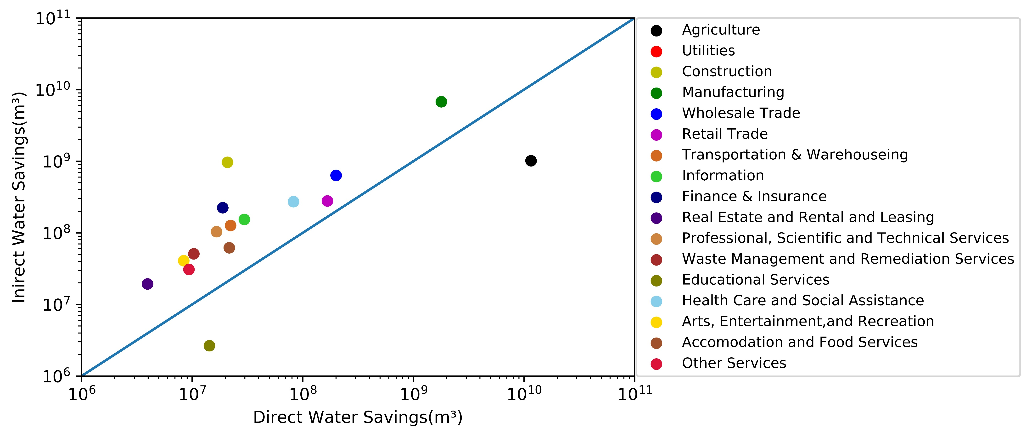
93% of sectors use more water through their supply chains than they consume directly.
BM₂₅ Scenario
Notes:
The total direct and indirect water requirements throughout a product’s supply chain were calculated using an environmentally extended version of the Leontief Input-Output model. The agricultural sector can achieve greater water savings than all other sectors combined. The manufacturing sector has the greatest indirect water savings due to its reliance on water intensive commodities as inputs to production.

Slide 14
In summary, there is still significant water savings to be achieved!
Areas facing water stress also show some of the greatest potential for water savings.
Most industries can save more water by working with their suppliers to reduce their water use than they can save directly by making their own operations more water efficient.
Future research is needed to explore the inherent tradeoffs involved in improved water utilization, such as potential increases in energy or fertilizer consumption which may lead to increased grey water and carbon footprints.
Notes:
We set water use benchmarks for each industry based on water-use efficiency levels achieved by others in the industry facing similar constraints. In doing so, we highlight specific industries and locations in the United States that could significantly reduce their water footprint by utilizing existing water management strategies and technologies.
Over 80% of all potential water savings occur in the crop sector, with half of those savings attributable to corn and alfalfa.

Slide 15




Marston Research Group
Exploring the interactions between water and society
ltmarston@ksu.edu
Questions?
@LandonMarston
http://marstonresearchgroup.com/

