Slide 1
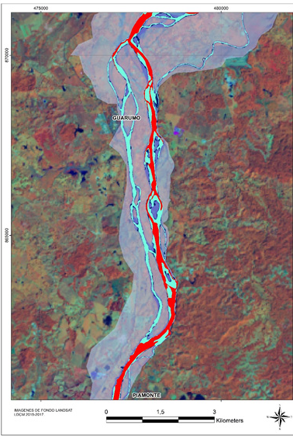
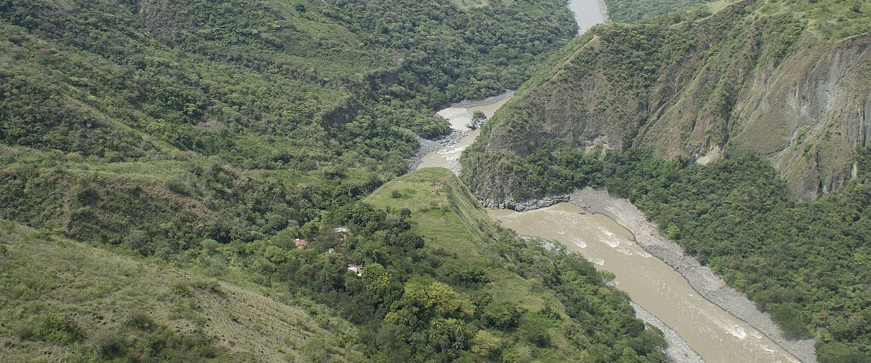
River are not only stream
EGU 2020 online
4 – 8 Mayo 2020
Sustainability of tropical river systems in Colombia, Integrating geomorphology, hydrology and vegetation analysis in the context of global change
Masiel Melissa Pereira Prado
PhD student of Geography mpereira@unal.edu.co
https://orcid.org/0000-0003-1882-1491

Slide 2
How we understand the concept of river?
What is a river?
Place or channel where the water runs
the river concept depends on cultural perspectives and geographical aspects
the river includes water and the dependency that humans and other organisms have on it
Stream of water that has a defined course
watercourse where water flow occurs within a well-defined channel
the river ecosystem, the whole of the river basin, taking into account that the channels depend on the exchange of matter and energy such as water, nutrients and food present in the basin Elosegi (2011) .
Open, complex and dynamic system, its biotic and abiotic elements are organized hierarchically, it has a structure and function, they are highly interrelated both in time and space, involving all subsystems of the natural system, the geosphere, atmosphere, hydrosphere , biosphere, and in turn with the anthroposphere.
Fundamental elements of the hydrosphere, the hydrological cycle, the natural system and social system of our planet.
Tropical rivers are an important component of continental drainage system
Why is this important?
Key components in the landscape that provide a wide variety of ecosystem services and human well-being
Tropical rivers are the most important source of fresh water
Energy generation
Hotspots of biodiverstiy and strategic elements for adaptation to Climate Change (Catford et al., 2013; Pettit et al., 2017)
Territorial planning and organization of territory
Carbon cycle

Slide 3
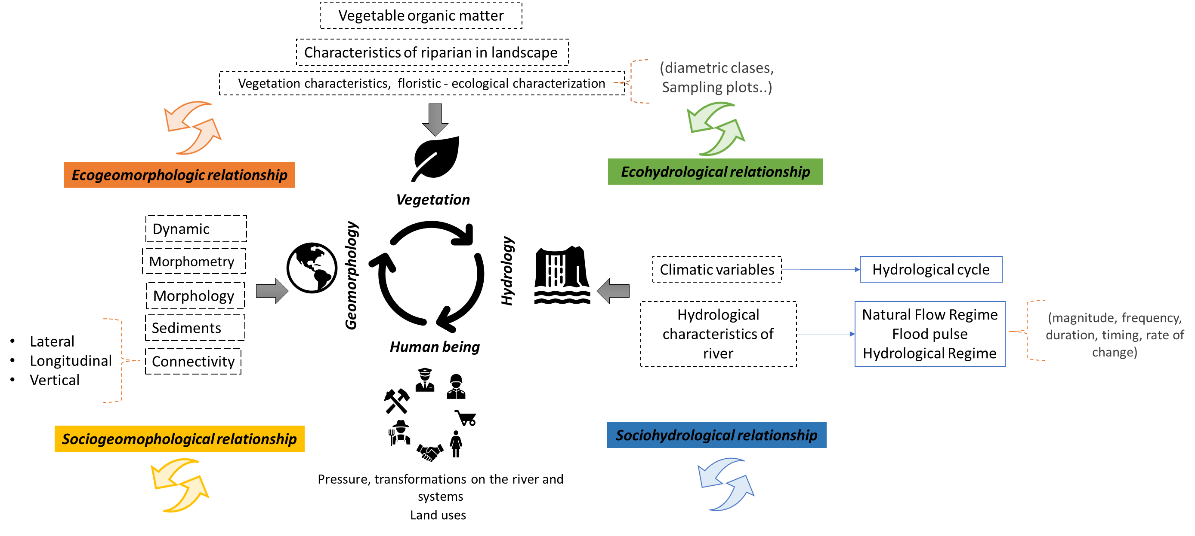
Aims and methodology
Relationsship that occur between geomorphology, hydrology and vegetation, in middle basins and floodplains of four main river in Colombia: Meta, Sinu, Magdalena, Cauca.
To evaluate the vulnerability of tropical fluvial system in Colombia, having into a count the historical relationship between human being and river (History of river)
Management and sustainability of water resources in Colombia, in a context of global change, based on scientific knowledge, that allow take desitions to manage, use river conservation.

Slide 4
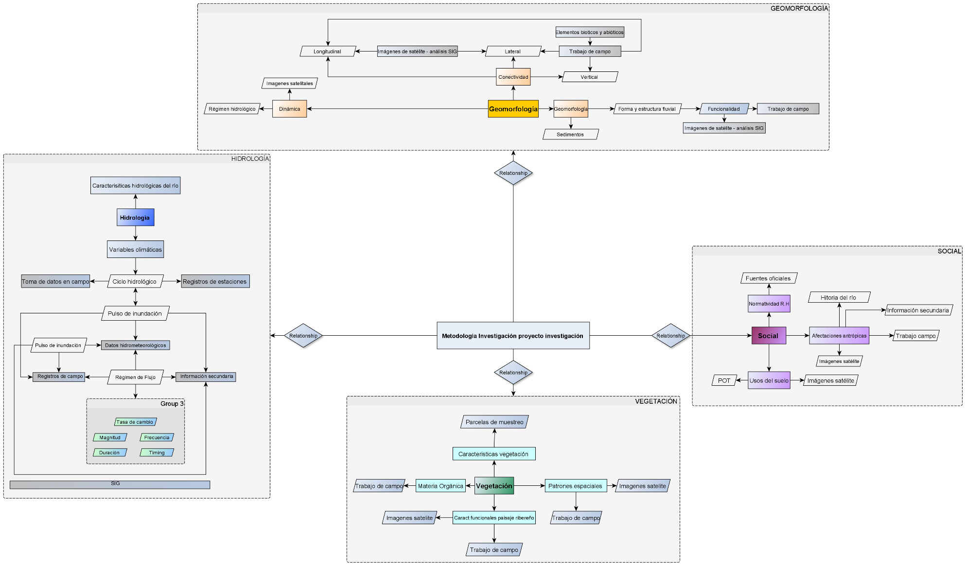
Components detalled of the methodology

Slide 5
Bibliography
Brierley, G., & Hooke, J. (2015). Emerging geomorphic approaches to guide river management practices. Geomorphology, 251, 1–5. https://doi.org/10.1016/j.geomorph.2015.08.019
Catford, J. A., Naiman, R. J., Chambers, L. E., Roberts, J., Douglas, M., & Davies, P. (2013). Predicting Novel Riparian Ecosystems in a Changing Climate. Ecosystems, 16(3), 382–400. https://doi.org/10.1007/s10021-012-9566-7
Elosegi, A., & Sergi, S. (2011). Conceptos y tècnicas en ecologìa fluvial. Uma ética para quantos? (Vol. XXXIII). https://doi.org/10.1007/s13398-014-0173-7.2
Latrubesse, E. M., Stevaux, J. C., & Sinha, R. (2005). Tropical rivers. Geomorphology, 70(3-4 SPEC. ISS.), 187–206. https://doi.org/10.1016/j.geomorph.2005.02.005
Pettit, N. E., Naiman, R. J., Warfe, D. M., Jardine, T. D., Douglas, M. M., Bunn, S. E., & Davies, P. M. (2017). Productivity and Connectivity in Tropical Riverscapes of Northern Australia: Ecological Insights for Management. Ecosystems, 20(3), 492–514. https://doi.org/10.1007/s10021-016-0037-4
Poff, N. L. R., Allan, J. D., Bain, M. B., Karr, J. R., Prestegaard, K. L., Richter, B. D., … Stromberg, J. C. (1997). The natural flow regime: A paradigm for river conservation and restoration. BioScience, 47(11), 769–784. https://doi.org/10.2307/1313099
Wohl, E. (2014). Chapter 1 Introductions. In Rivers in the Landscape (pp. 1–21).
Wohl, E. (2019). Forgotten Legacies: Understanding and Mitigating Historical Human Alterations of River Corridors. Water Resources Research. https://doi.org/10.1029/2018wr024433

