Slide 1
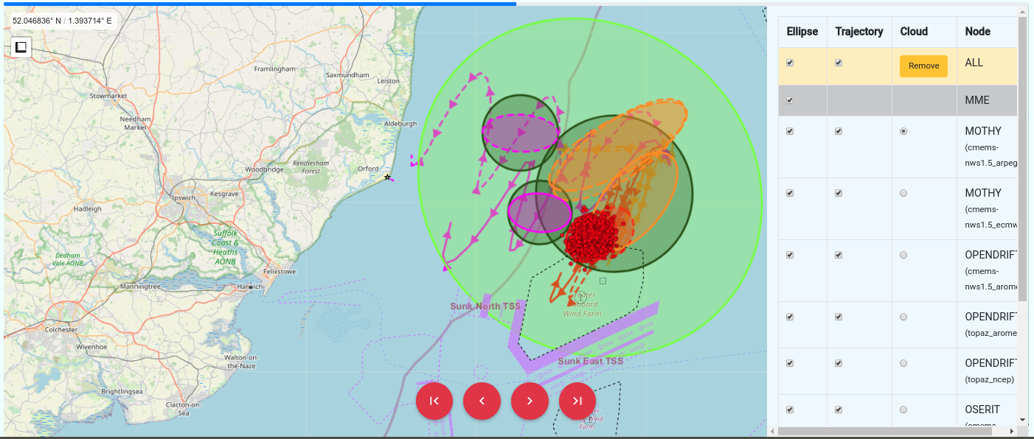
NOOS-Drift An innovative operational transnational multi-model ensemble system to assess ocean drift forecast accuracy
S. Legrand¹, K.F. Dagestad², P. Daniel³, M. Kapel¹ and S. Orsi¹

Slide 2
Outline
Introduction
How does it work? General principles
Multi-Model Ensemble analysis strategy
Conclusion

Slide 3
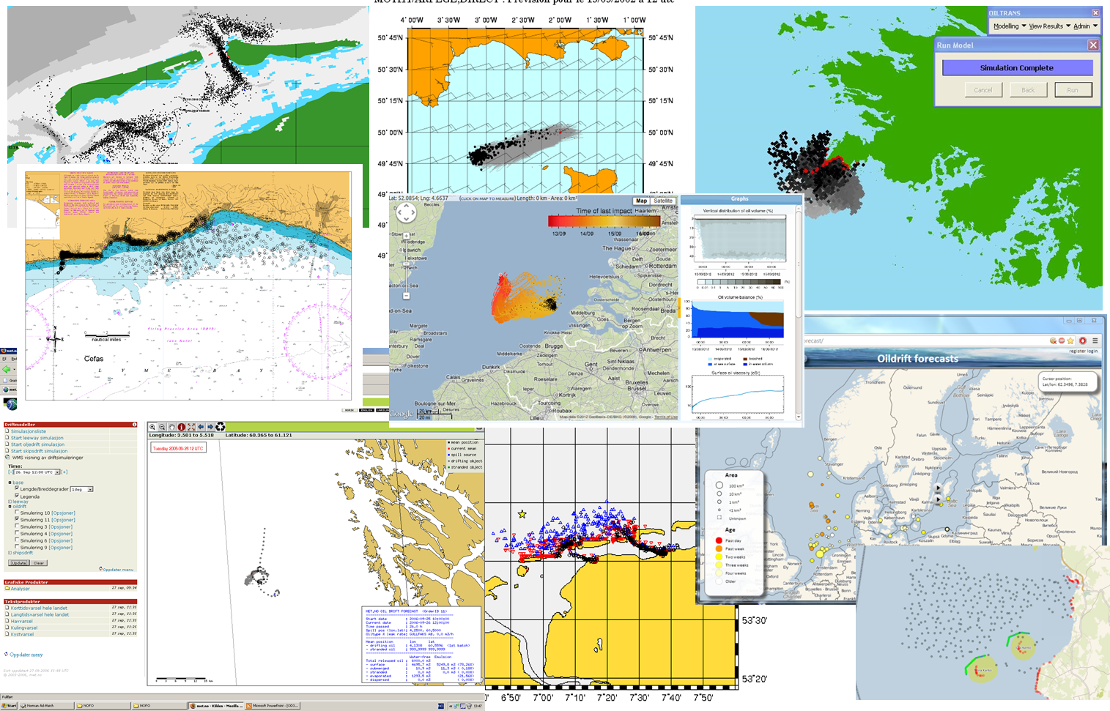
Drift models, key tools in the daily management of marine activities at national levels
1. Introduction | 2. General principle | 3. MME strategy | 4. Conclusions
Drift models provide key information in support of maritime safety, coastal and marine environment monitoring or marine resources management
Every country surrounding the North West European Continental Shelf operates at least one national drift trajectory forecast service.
These services run their state-of-the-art modelling system, often developed in-house.
As a consequence, all these services are similar but different
=> So far lack of collaboration and integration between countries

Slide 4
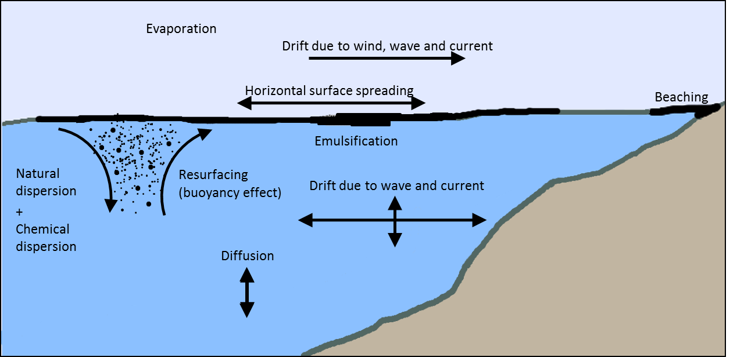
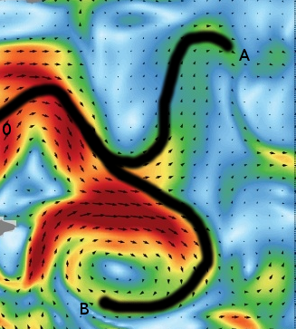
Similar but different models may lead to significantly different forecast results
1. Introduction | 2. General principle | 3. MME strategy | 4. Conclusions
Differences/uncertainties can be sorted in 3 classes:
Differences /uncertainties in drift models implementation such as ≠ resolved processes, ≠ parametrizations choices or ≠ calibration coefficients
Differences/uncertainties in met-ocean forcing such as ≠ in time-space resolution ≠ resolved dynamical processes (e.g. tide) errors in dynamical features location and intensity
Uncertainties inherent to dynamical systems theory such as branching effects

Slide 5
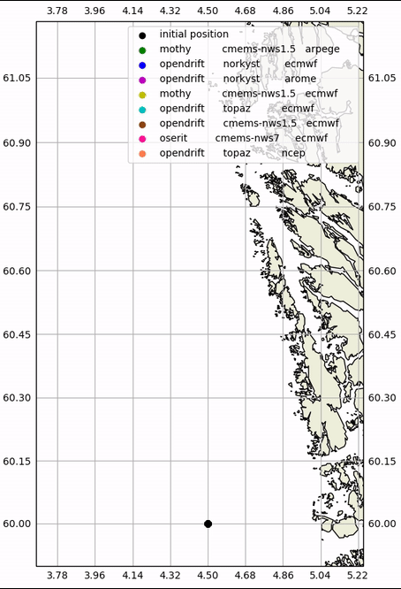
Similar but different models may lead to significantly different forecast results
1. Introduction | 2. General principle | 3. MME strategy | 4. Conclusions

Slide 6
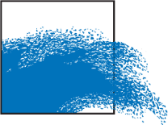
1. Introduction | 2. General principle | 3. MME strategy | 4. Conclusions
Although, over the years, national users gained trust in their national drift model predictions, they keep challenging modelers, continuously asking:
« How accurate and reliable are your drift trajectory forecast? »
Shipping Assistance Division

Slide 7
1. Introduction | 2. General principle | 3. MME strategy | 4. Conclusions
« How accurate and reliable are your drift trajectory forecast? »
Analysing the spread of a multi-model ensemble forecast system should answer this challenge.
Several NOOS members operate national drift services.
Let’s federate them and develop a transnational multi-model ensemble system for drift trajectory and call it NOOS-Drift!
NOOS members from Belgium, France and Norway are volunteer to develop the prototype. #StrongerTogether
> http://noos.eurogoos.eu/ > Community Products > NOOS-Drift

Slide 8
Key specifications of the NOOS-Drift service:
1. Introduction | 2. General principle | 3. MME strategy | 4. Conclusions
Running on demand the same drift simulation request in different national centres; results must be available within 15’-30’ after submission
Thanks to the ensemble spread, providing quick and easy way to intercompare different model trajectories results and identify possible outliers
Providing a straightforward visualization of the forecast uncertainty
Providing a straightforward identification of areas at risk
Making possible the integration of NOOS-Drift results in users’ systems.
Making the system as automated and robust as possible
NOOS-Drift is in essence a back-office service:
It is not intended to replace or shortcut national services: National services remain the primary point of contact for their national users
A fine analysis of NOOS-Drift ensemble spread requires advanced knowledge about the drift models and their met-ocean forcing

Slide 9
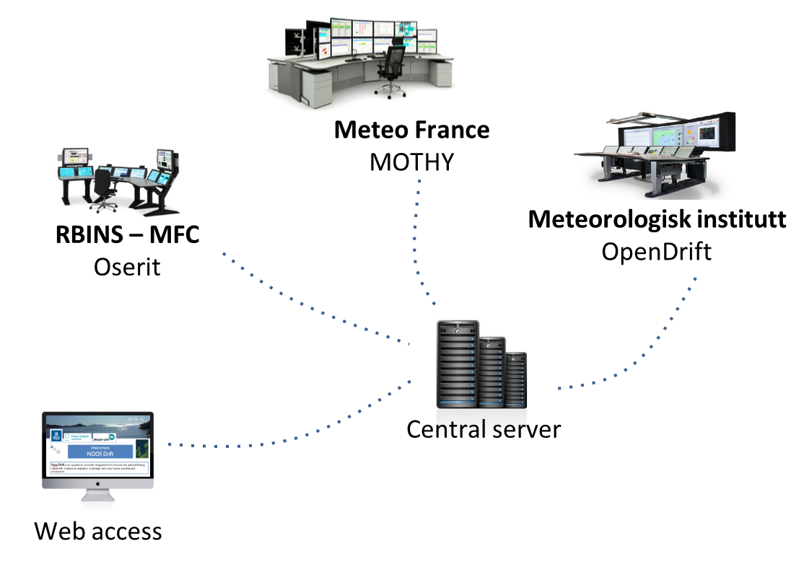
1. Introduction | 2. General principle | 3. MME strategy | 4. Conclusions
How does it work?
NOOS-Drift system is based on a distributed system made of
A web application allowing users to request a simulation, visualize or download results;
A series of computational nodes hosted by the participating national centers;
A central server managing the execution of a simulation request, hosting the simulation results and runs the multi-models ensemble analysis
A fit-for-purpose secure communication system based on python/Django enforces a smooth dialog between the different components of the service.
https://github.com/rbins-swap-team/NoosDrift

Slide 10
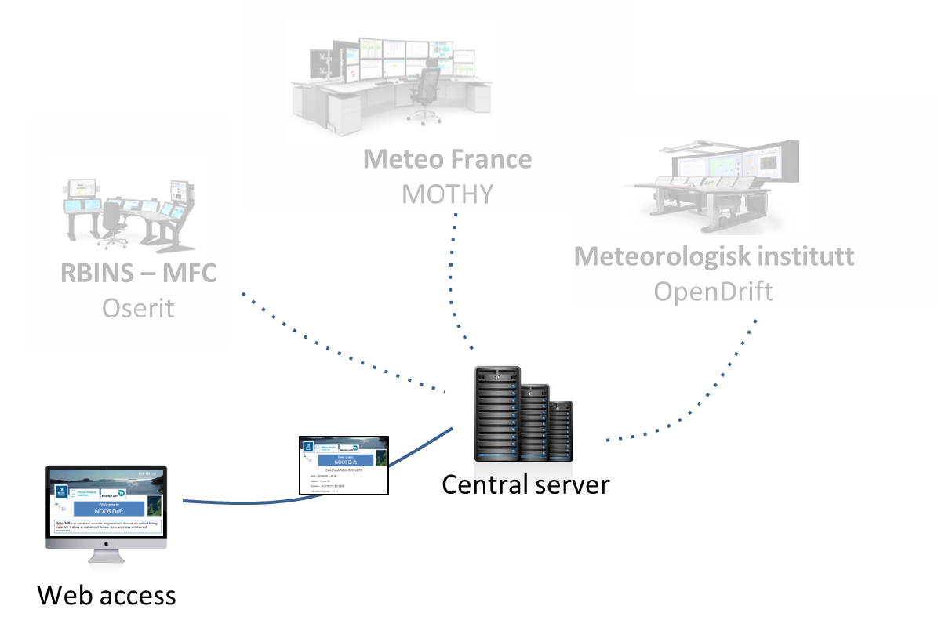
1. Introduction | 2. General principle | 3. MME strategy | 4. Conclusions
1. Service request
The central server collects the incoming service request.
Users can request a new simulation by filling in a web form with
General description of the simulation (start time, duration, forward or backward in time)
Drifter characteristics (oil or objects adrift)
Release scenario / initial conditions
Model set-up
Data of the web form are converted into a JSON object
and then sent to the central server
In order to automate simulations, connected systems may also directly submit a JSON object to the central server

Slide 11
1. Introduction | 2. General principle | 3. MME strategy | 4. Conclusions
2. Service request dispatched
The central server validates the JSON object
and dispatches it towards the calculation centers.
Meteo France
MOTHY
RBINS – MFC
Oserit
Meteorologisk institutt
OpenDrift
Central server
Web access

Slide 12
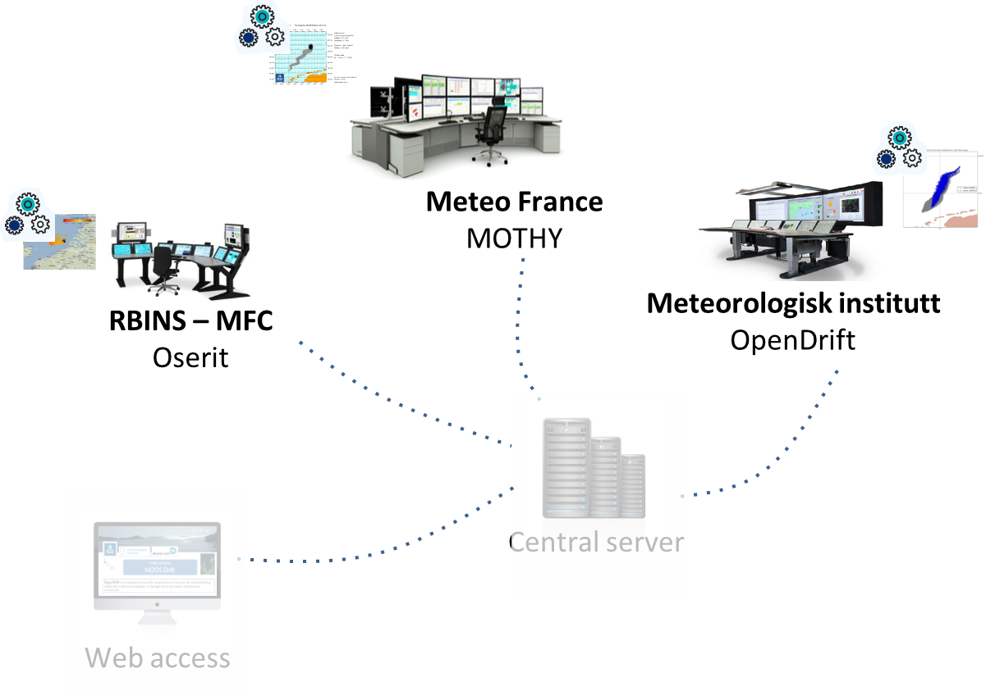
1. Introduction | 2. General principle | 3. MME strategy | 4. Conclusions
3. Distributed computation
Each model computes its drift forecast and formats its results into a netCDF-CF file
Each center must run simulations for at least two met-ocean forcing sets:
The met-ocean forcing made of ECMWF wind forecast and CMEMS NWS ocean physics forecast. This first set of forcing covers the whole NWS area.
The met-ocean forcing they would use for their national users. In general, this second set of forcing has a higher spatial resolution and better resolves geographical features locally influencing hydrodynamics (estuary, fjords, small islands, sandbanks, dredged channels…). However, these forcing does not always cover the whole NWS area.

Slide 13
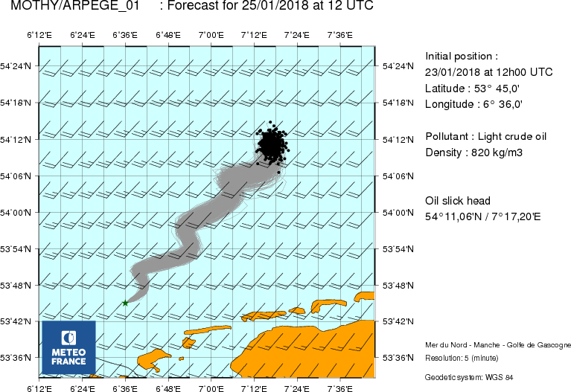
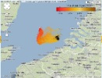
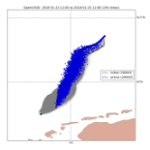
1. Introduction | 2. General principle | 3. MME strategy | 4. Conclusions
4. Forecasts collection
The central server collects the forecasts of the drift models.
Meteo France
MOTHY
RBINS – MFC
Oserit
Meteorologisk institutt
OpenDrift
Central server
Web access

Slide 14
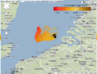
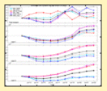
1. Introduction | 2. General principle | 3. MME strategy | 4. Conclusions
5. Ensemble Analysis
The central server performs the MME analysis of the forecasts. This step also prepares the GeoJSON objects to be displayed on the web applications
https://github.com/knutfrode/noosdrift
Meteo France
MOTHY
RBINS – MFC
Oserit
Meteorologisk institutt
OpenDrift
Central server
Web access

Slide 15
1. Introduction | 2. General principle | 3. MME strategy | 4. Conclusions
6. Results distribution
All users can visualize and download simulations results.

Slide 16
Multi-model ensemble analysis
1. Introduction | 2. General principle | 3. MME strategy | 4. Conclusions
Let’s assume we have an ensemble of N drift simulations of the same event.
The objectives of the MME analysis is
to intercompare different model trajectories;
to identify possible outliers or equivalently identify simulations with similar behaviour;
to quantify forecast uncertainty;
to identify areas at risk

Slide 17
1. Introduction | 2. General principle | 3. MME strategy | 4. Conclusions
Good case
Release location
Center of mass / member
Center of mass of all members
At each time step, each particles cloud is projected onto an ellipse.
Intuitively, the drift forecast uncertainty is related to the spread of the ellipses.
A good candidate metric is the area of the smallest disk that encompasses all these ellipses (in red).

Slide 18
1. Introduction | 2. General principle | 3. MME strategy | 4. Conclusions
Outlier
However this disk can quickly become very large, especially in case of outliers or branching trajectories.

Slide 19
1. Introduction | 2. General principle | 3. MME strategy | 4. Conclusions
Outlier
In that case, one would like to subdivide the ensemble into 2 clusters.

Slide 20
1. Introduction | 2. General principle | 3. MME strategy | 4. Conclusions
Outlier
The clustering is made from a decision tree that minimizes the number of clusters under constraints on the distance between ellipses and angles with respect to the release location.

Slide 21
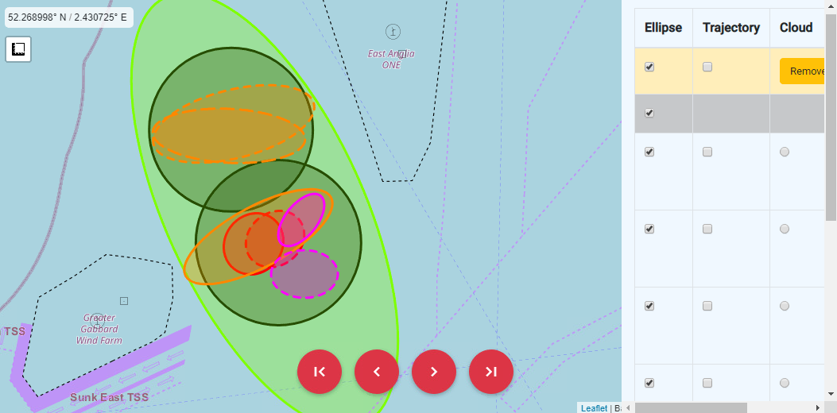
NOOS-Drift MME analyses implements this intuitive strategy
1. Introduction | 2. General principle | 3. MME strategy | 4. Conclusions
Clustering “Identifying potential outliers”
Likely impacted areas per cluster (mass centers and radius)
Risk map (weighted sums of the impacted areas)
https://github.com/knutfrode/noosdrift

Slide 22
Conclusion NOOS-Drift = A transnational multi-models ensemble system to assess drift forecast accuracy in the NWS area
A MME-analysis tool, prototype allowing many future developments & improvements
Standardisation of model outputs based on netCDF-CF, JSON (metadata) and GeoJSON (MME analysis)
Secure and efficient communication system minimizing latency inherent to distributed system (python-Django framework)
Ready to welcome new users and model service providers!

